Slide 1
SDP22 Team 22:
Piano Trainer
Alexander Charpentier, William Farland, Brendan Gentile, Allison Rizoli

Slide 2
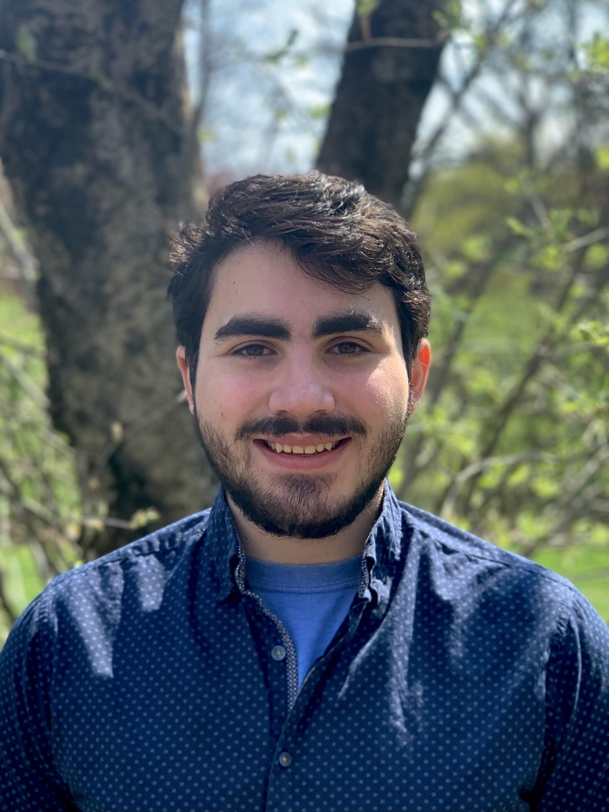
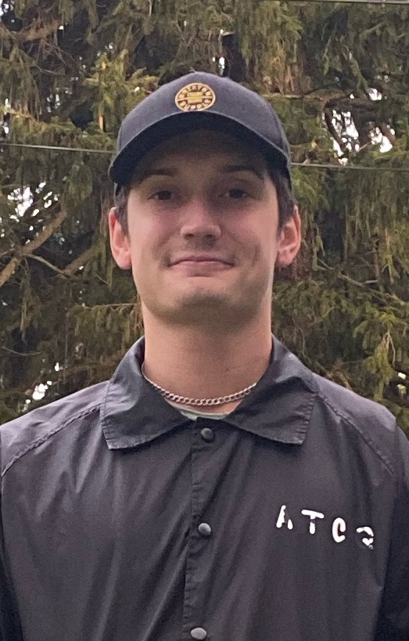
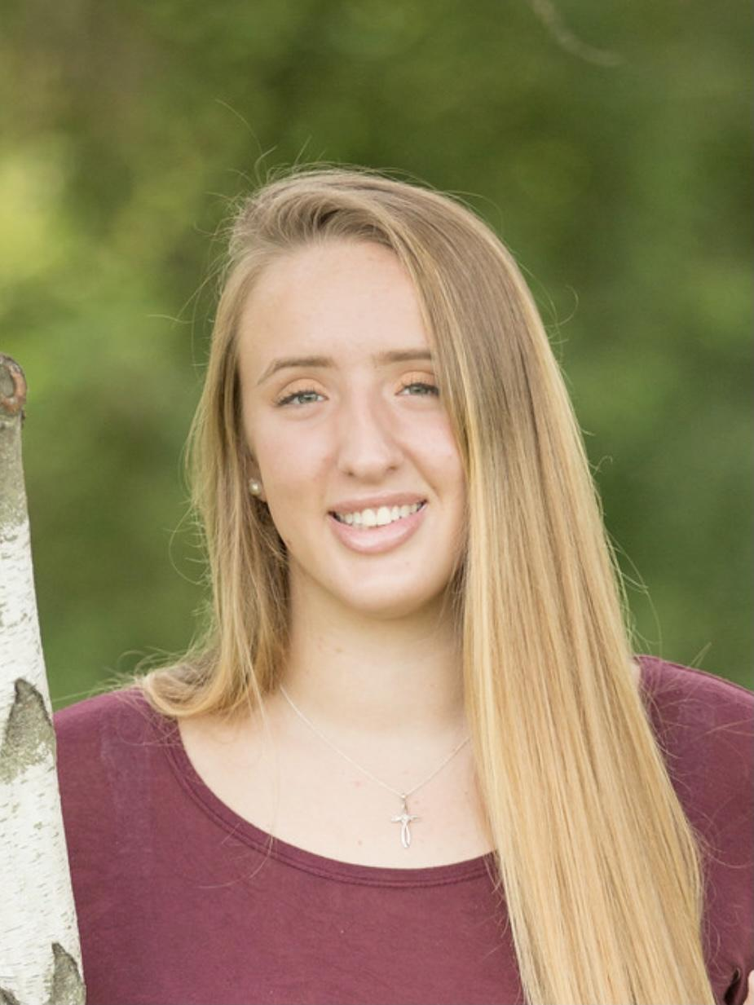
Introduction
Software Lead, Sensor Subsystem, Backend Development
Team Lead, Front & Backend Development
Music Lead, Front End Development
Altium & Budget Lead, Glove Subsystem
Notes:
Speaker: Everyone
Just list your name and major.

Slide 3
Some Background
-Currently piano lessons can cost anywhere from $20 to over $100 for an hour. The student also has to put in practice time while away from their teacher.
-This price can scare away a lot of people who are interested in learning piano.
-Piano’s are expensive. Digital and/or MIDI enabled pianos come at a decreased cost and have seen a rise in sales in the past decade.
-They are very accessible even when on a tight budget.
Notes:
Speaker: Alex
How are current piano students being taught, what is their opinion in it.
It it costly?
Can we make it cheap?
Do people have MIDI keyboards
Sell this idea

Slide 4
Some Background
-How can beginning students learn to play the piano in a cost effective way with multiple levels of feedback?
-How can we keep these students engaged when there is no teacher?
-How can we make this accessible to a large number of piano students?
Notes:
Speaker: Alex
An Idea always starts with a question… Need Title

Slide 5
Problem Statement
Prospective students trying to learn piano face many challenges. The upfront cost of a piano and a piano teacher can be too much for incoming students. They also must be prepared to practice and rehearse without any feedback on their own time. This task can lead many to be disengaged and uninterested in learning to play the piano. Because of this, many students stop paying for their lessons and discard their piano. Our solution to this will act as a at home trainer that will use an existing digital piano to reduce the learning curve and cost of a personal piano tutor.
Notes:
Speaker: Gents

Slide 6
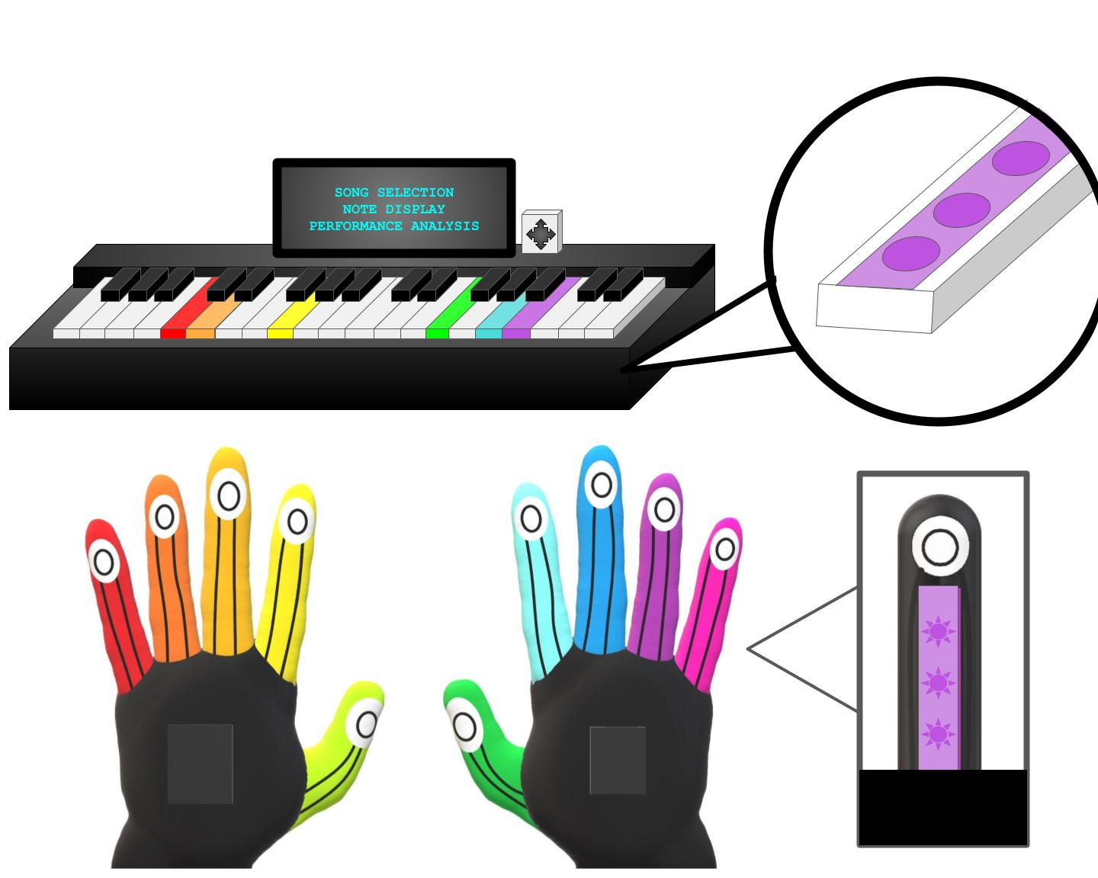
Our Solution
The Piano Teacher will feature an LED harness for the keys that fits most digital pianos and two haptic gloves. There will also be a display with button controls.
The user will be able to select a song of their choice and play that song on the piano with different levels of assistance
At the end of the song the system will display a report providing feedback for the user’s accuracy and tempo. The system will also suggest more practice or removing a level of assistance.
Our Piano Teacher system includes two types of real time feedback:
Two gloves that provide haptic feedback when a key is pressed incorrectly and a different LED light on each finger.
LED lights for each piano key that tells the user to press a key with a certain finger and will flash when the wrong key is pressed.
Notes:
Speaker: Gents

Slide 7
Main System Specifications (Keyboard / Mainboard)
System is applicable to any MIDI keyboard
System will play the correct note through speaker/headphones
System will present song library and data analytics to the user via a screen
Analytics include accuracy, tempo, and recommendations
Song library can be easily expanded
User will be able to change the level of training needed
User input will be done with multiple buttons and be responsive within 10ms
System will light individual LEDs to instruct the user to press those piano keys
The LED harness will have an RGB LED strip for each key
The LED will light up within 5ms of an instruction being sent
The LEDs on each key will light up a different color that corresponds to each finger
The LEDs will light up at a specific tempo dependent on the song choice and difficulty settings
System will use MIDI data to determine if the correct keys were pressed
MIDI Data must be interpreted quickly, within 10ms
Notes:
Speaker: Ali
Bullet Points
Animation of visual, to give our solution.
Animations to bring in each specification
Battery Life mentioned
Quantitative Value
MIDI Keyboard (Musical Instrument Digital Interface)
-

Slide 8
Sub System Specifications (Gloves)
System will vibrate individual fingers if the corresponding colored piano key was not pressed
The user will feel the vibration within 50ms of missing a key
System will vibrate all fingers if a piano key that was not indicated was pressed
The user will feel the vibration on all fingers within 50ms of pressing the wrong key
System will have a different color LED on each finger
System will not restrict the ability to play the piano by the user
The battery life of each glove will exceed two hours and be rechargeable
The Gloves will be able to communicate to the main board via bluetooth
Communication will be possible from within 15 feet from keyboard
Notes:
Speaker: Alex
Bullet Points
Animation of visual, to give our solution.
Animations to bring in each specification
Battery Life mentioned
Quantitative Value
MIDI Keyboard (Musical Instrument Digital Interface)
-

Slide 9
Testing Plan for the Main System (Keyboard)
Plug in the system to any other MIDI enabled piano and see if it interfaces
Press a key on the keyboard and listen to the note played through speakers/headphones
Visually confirm the screen presents song library and data analytics after the song is played
Visually confirm the screen presents accuracy and tempo data
Go through the process of adding a song
Change the training level and view the change when a song is played
Press each button and confirm their actions.
Measure the time the system is able to update the screen once a button has been pressed using timestamps within code
Visually confirm the LEDs light up the correct notes on the keyboard when the song is being played
Visually confirm that each key has its own RGB LED
Measure the time the system is able to update the RGB LED of a key using timestamps within the code
Visually confirm that the colors of the LEDs on the keys are of the same color of the finger needed to play it
Measure the tempo of the notes being illuminated on the keyboard using timestamps and then compare to the tempo of the song
Set up a test program that shows the note being pressed by the user on the MIDI keyboard
Measure the time between pressing the key and the system interpreting the note within the code
Notes:
Speaker: Will
Three major systems to test (Keyboard, Gloves, and speaker system)
Incorporating a testing plan for each subsystem and each requirement for the subsystems.
Major testing plan for keyboard:
Test that the system is universal by using another MIDI keyboard and making sure our system can understand the outputted data.
On the separate keyboard we will test the speaker subsystem by picking a note and playing it
Visual confirmation of the display working properly after a note is picked on keyboard
This will include monitoring of several factors including: correct tempo, adding a new song choice, buttons work correctly when pressed
We will also measure the time delay to make sure the system is up to spec when pressing a key using time stamps in the code
Visual confirmation of the LEDs on the keyboard
Measure the time delay between the RGB update using time stamps in code
Confirmation the correct finger is being addressed for the correct note
Measure the correct temp of notes being illuminated on the keyboard
Test program for MIDI displaying correct note after a note is pressed by user

Slide 10
Testing Plan for the Sub System (Gloves)
User will not press a key presented on the keyboard and feel the resulting vibration on the finger
Measure the time between missing a note and the analog signal being sent to the motor using timestamps within the code and confirm they are under 50ms
User will press an incorrect key on the keyboard and feel the resulting vibration on all of their fingers
Measure the time between pressing a wrong key and the analog signal being sent to the all the motors using timestamps within the code and confirm it is under 50ms
Visually confirm a different color LED on each of the 10 fingers
Place the gloves on a user and confirm they are able to move their fingers without restriction and have no issue playing individual keys on the keyboard
Use the gloves for an extended period of time under an average load of use and confirm they function for at least two hours
Set up a test program on the main board that communicates with the gloves over Bluetooth that illuminates certain LEDs on the gloves fingers
User will stand 15 feet away from the main board and confirm that the system is able to communicate with the gloves by feeling the vibration of the motors.
Notes:
Speaker: Gents
Two separate systems to test, gloves and keyboard
Testing plan for each specification

Slide 11
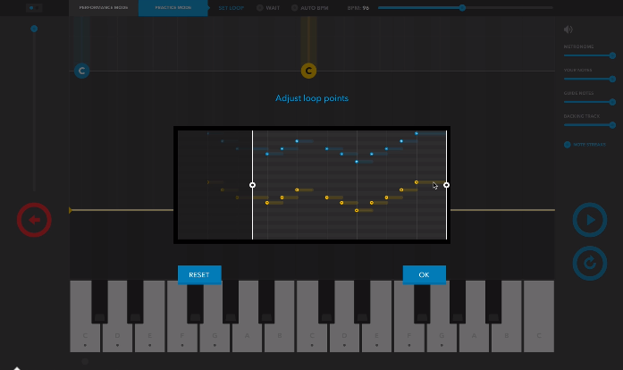
Similar Existing Solution (Melodics)
A complete software solution to a piano tutor
Compatible with any MIDI enabled piano
Needs connection to a modern PC
Subscription based service ($30/month)
Notes:
Speaker: Ali

Slide 12
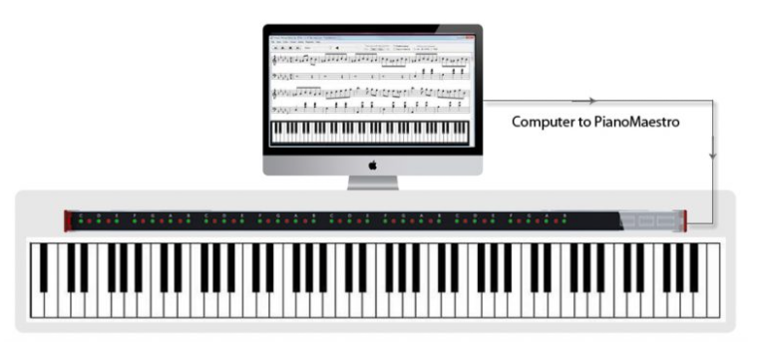
Similar Existing Solution (Piano Maestro)
A portable electronic USB device for learning to play piano.
Compatible with any MIDI enabled piano.
Uses an “LED Bar” to highlight notes needed to play.
Plugs into a modern PC
Paid subscription to the software
Notes:
Speaker: Ali

Slide 13
Comparison of Existing Similar Solutions
 | Used with any MIDI Enabled Piano | Visual Guide for Key Presses | Portability | Haptic feedback for errors
Melodics |  | No visual guide next to keys | Needs PC connection
Piano Maestro |  |  | Needs PC connection
Our Solution
Notes:
Speaker: Gents

Slide 14
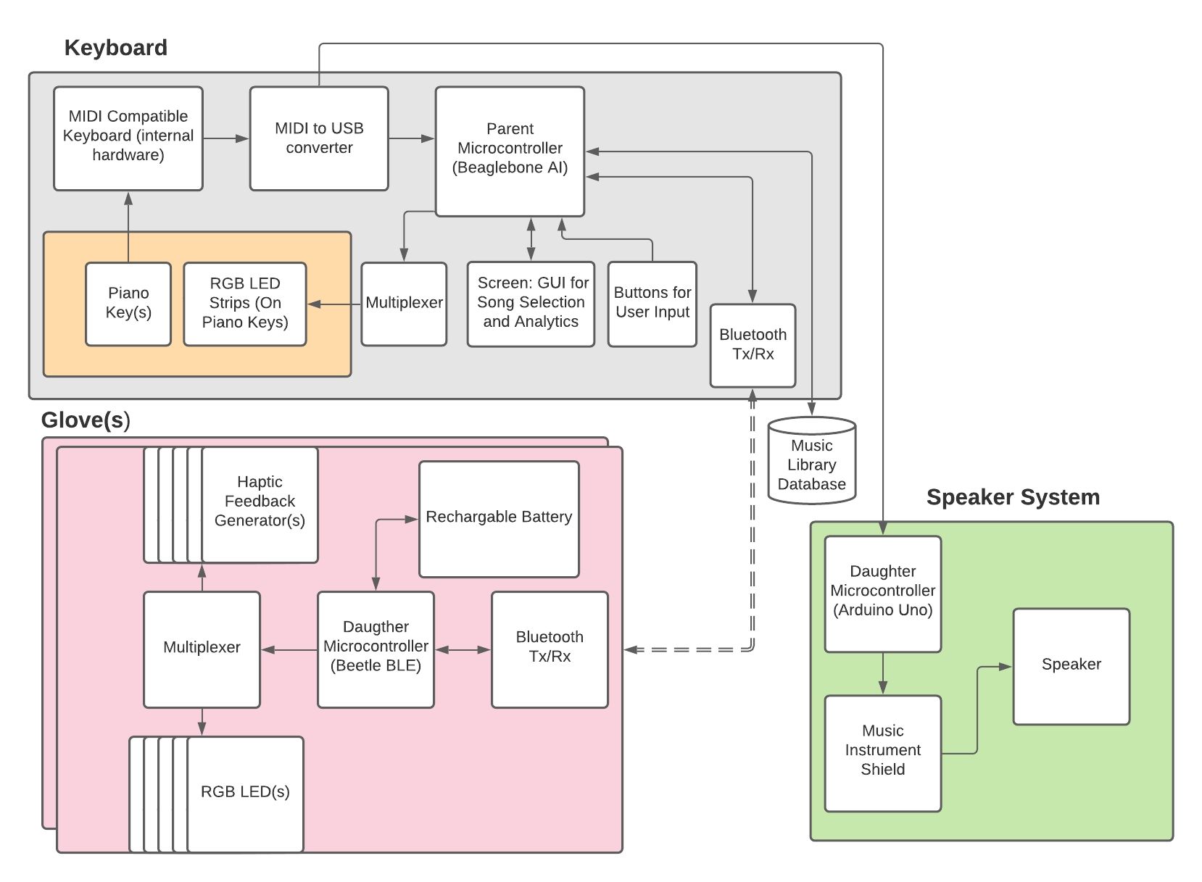
Preliminary
Design
(Hardware)
Notes:
Speaker: Will
Three main subsystems:
Keyboard, Glove, Speaker system
Keyboard:
Piano key is pressed, signal is internalized by MIDI keyboard, data is sent to microcontroller, logic is processed for RGBs on keyboard, data is sent wirelessly to Glove. Note is displayed on screen
Glove:
Receives information from parent microcontroller and outputs corresponding logic to haptic feedback generators and LEDs on glove.
Speaker:
Receives MIDI information and outputs notes to speaker
Mention different levels of difficulty, ability to choose through screen
Notes feedback and performance feedback

Slide 15
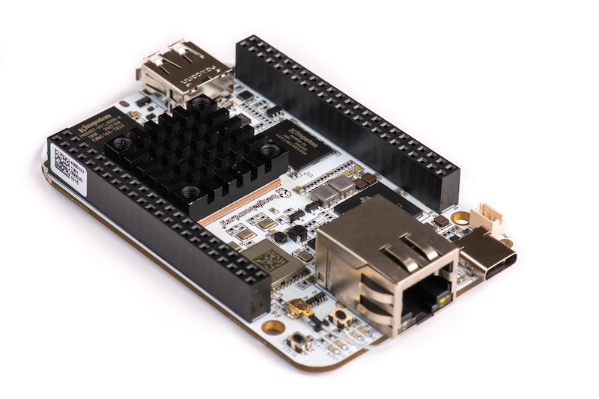
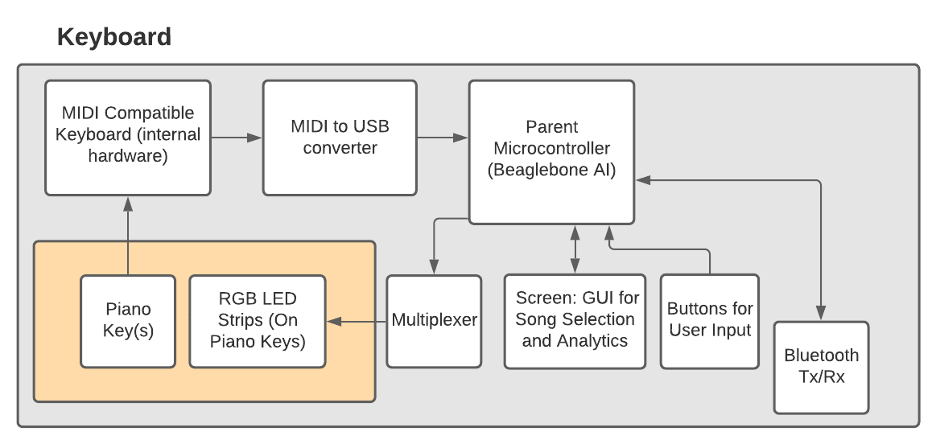
Preliminary Design (Main Board)
Beaglebone Black
2x 46 pin headers
Arm Cortex A8 microprocessor subsystem
HDMI mini out
MIDI to USB
Easily translate almost any modern keyboard’s signal
Notes:
Speaker: Will

Slide 16
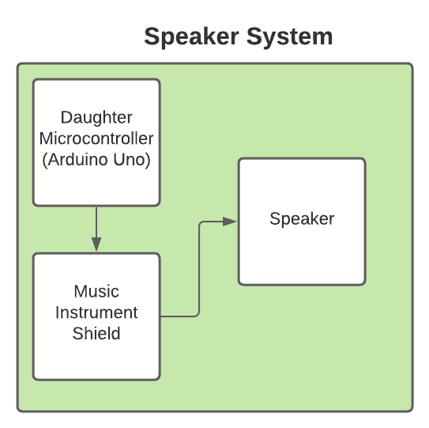
Preliminary Design (Speaker Sub System)
Arduino Uno
Interprets signal sent from MIDI to USB converter
Sends interpretation to Musical Instrument Shield
Musical Instrument Shield
Translates interpretation from the Arduino Uno to Audio Jack Out
Sends signal to external speaker
Speaker
Plays the note pressed by the user
Notes:
Speaker: Alex

Slide 17
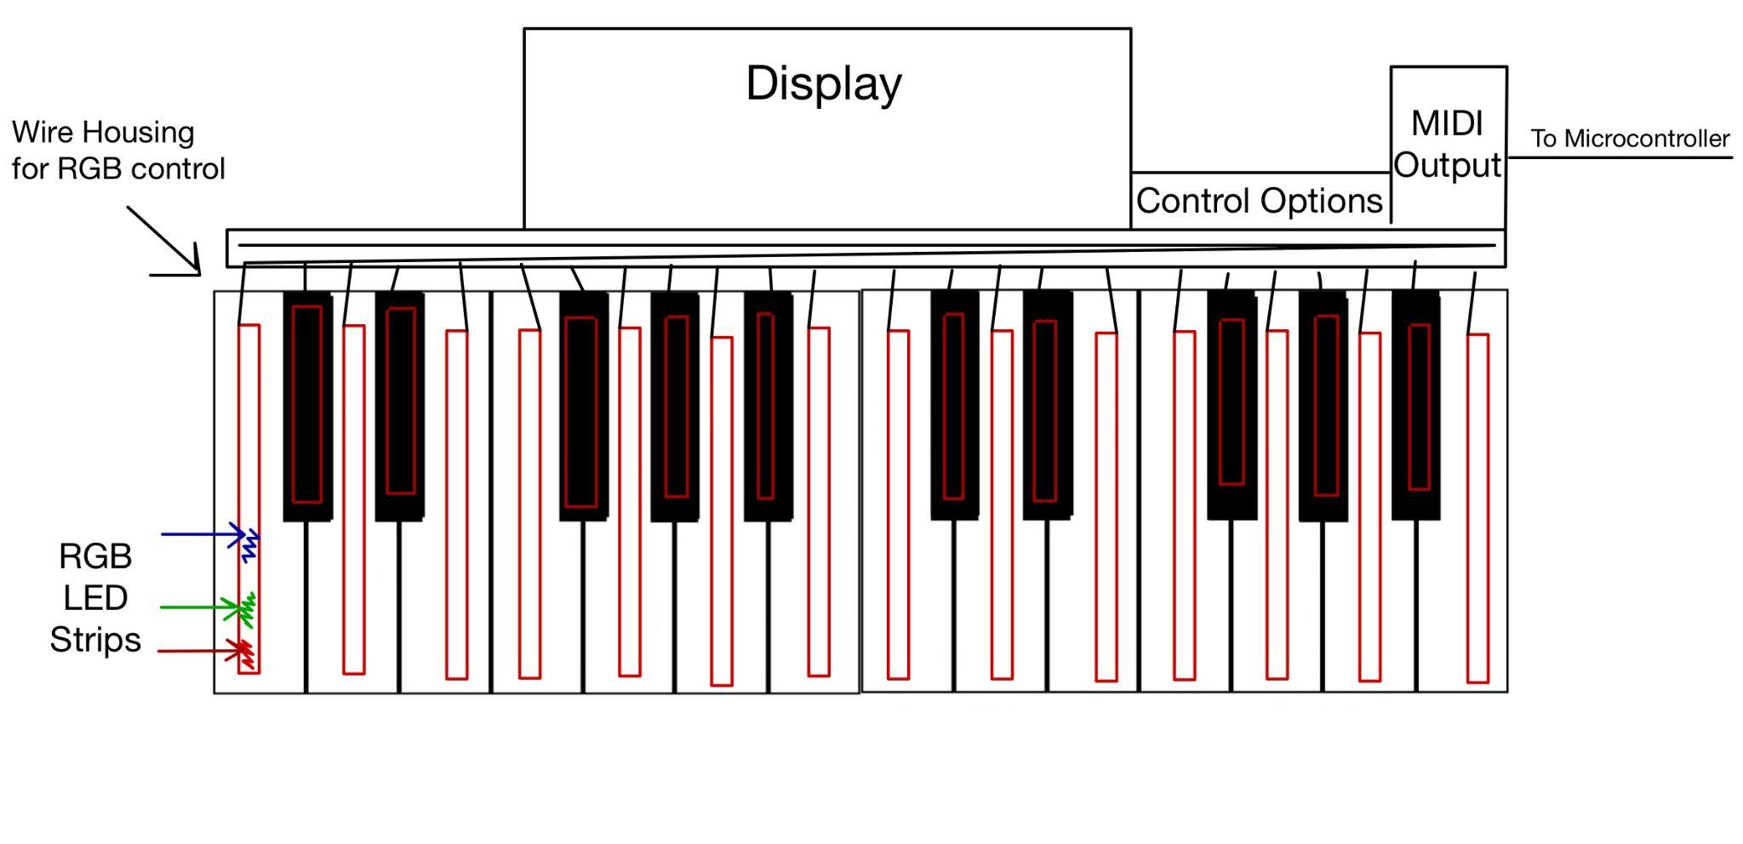
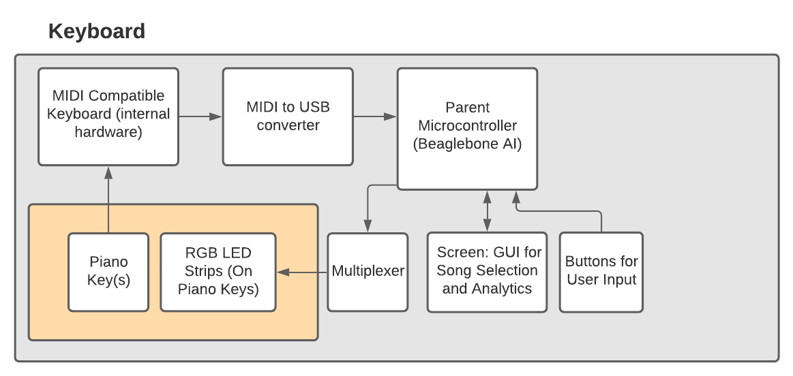
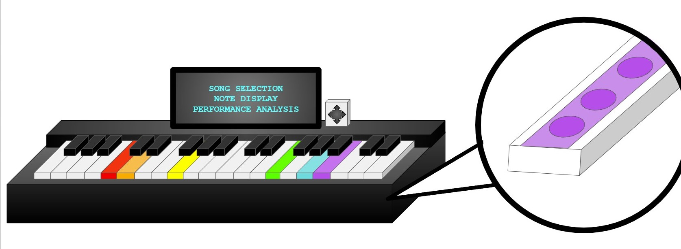
Preliminary Design (Keyboard Attachment)
Notes:
Speaker: Will

Slide 18
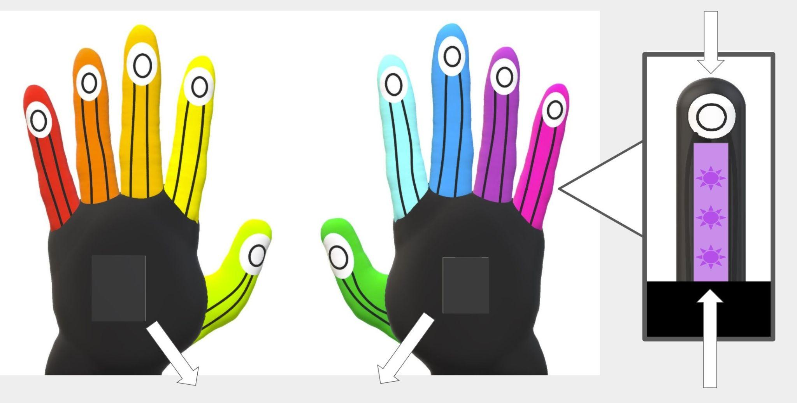
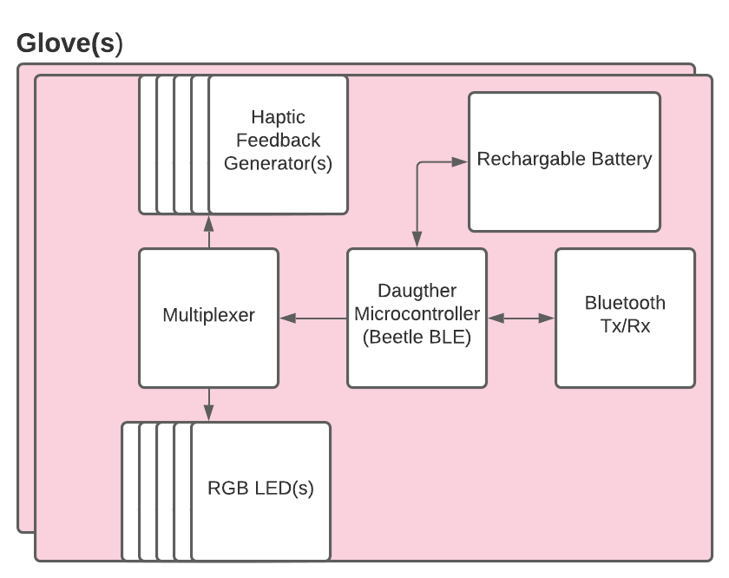
Preliminary Design (Glove)
Haptic Feedback
Generator(s)
Daughter Microcontrollers
(Beetle BLE)
&
Power Bank
RGB
LED Strip(s)
Notes:
Speaker: Alli
Power Budget Chart
LED and Motor consumption

Slide 19
Glove Power Requirement
The gloves will be powered by a battery that is secured each one
What will require power for each glove:
Beetle BLE with Bluetooth Capabilities
5x Vibration Motors (LRA Coin Vibration Motor)
5x RGB LEDs
 | Beetle BLE | Vibration Motors x5 | RGB LEDs x5 | Total
Max Power Draw | 10mA | 80mA * 5 = 400 mA | 20mA * 5 = 100 mA | 510mA
Notes:
Speaker: Alex

Slide 20
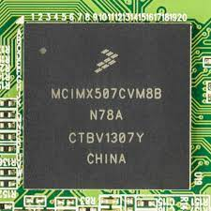
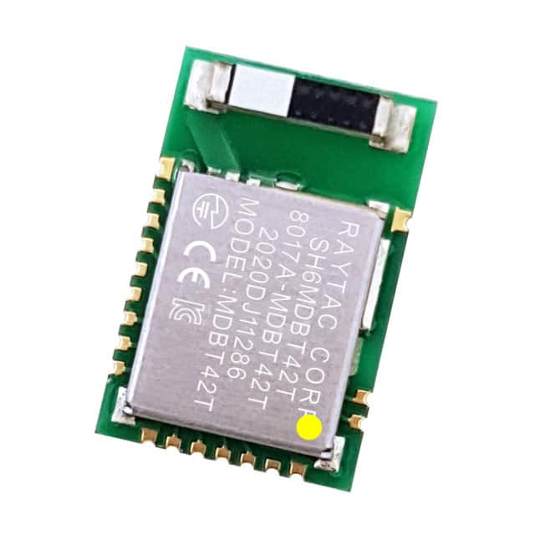
Proposed Custom PCB
PCB for the Main System - Needs to accommodate Bluetooth, 44-64 LEDs, display and control buttons, with Synthesizer Capabilities)
Use an ARM Cortex-A8 (Same processor as Beaglebone Black)
Easy to port code with same architecture
Bluetooth enabled
MDBT42T-AT → Capable of high speed bluetooth
Incorporate enough digital outputs to accommodate the 44-64 LEDs
Video control to the screen
Accomodations for the control buttons to navigate screen
Audio Jack Out for speaker connection
Video Output for the screen
PCB for the Gloves - Needs to accommodate Bluetooth, 5 LEDs, and 5 haptic feedback motors
Use an ATMega328p
Bluetooth enabled
Incorporate enough digital and analog outputs to accommodate the 5 haptic feedback motors and the 5 LEDs
Notes:
Speaker: Will
Power Budget Chart
LED and Motor consumption

Slide 21
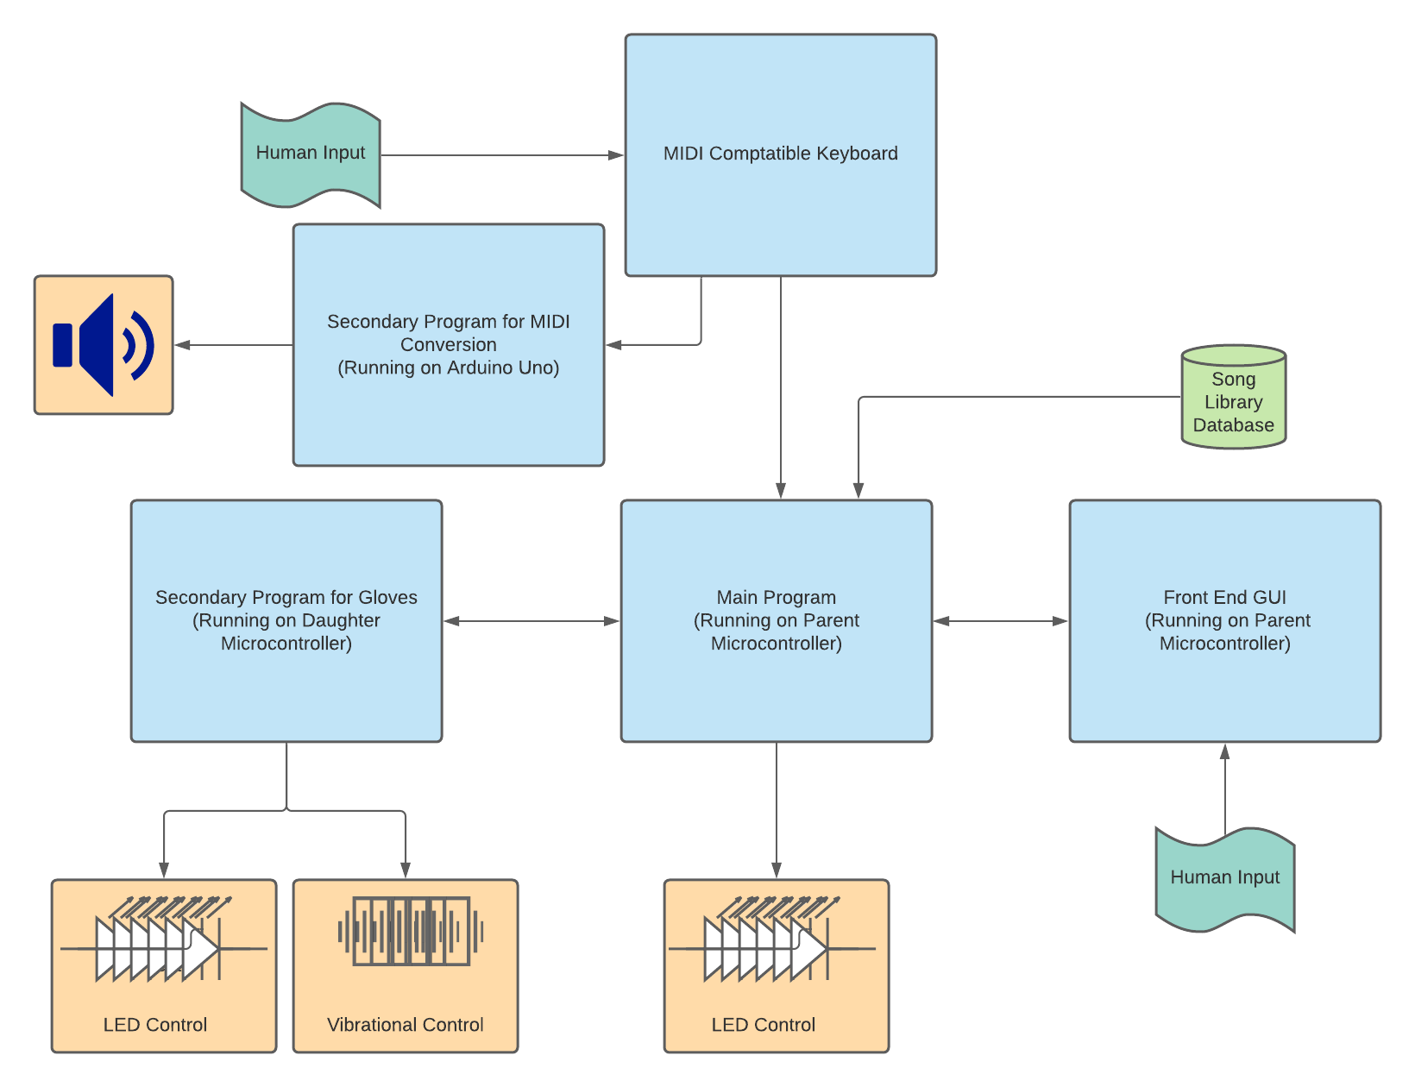
Preliminary
Design
(Software)
Notes:
Speaker: Will
Rough Diagram
Label connections and arrows
Mention backup plans
Show how the data is delivered

Slide 22
MDR Deliverables
Given a MIDI keyboard, our design will include:
A LCD screen and buttons for song selection and traversal through the GUI
RGB LED lights for each key on the keyboard
Two Gloves that provide feedback haptic feedback for the user if the song is played and a unique LED light for each finger.
LED lights between keys and fingers will correlate so the correct hand placement is used
Performance feedback on the interface after each song is played
User note accuracy and tempo displayed on the LCD screen
Prominent audio so the user can easily distinguish songs and learn alongside them

Slide 23
MDR Demonstration
Demonstrator will sit down at the Digital Piano and place on gloves
Demonstrator will select song and training level
Demonstrator will play the song following the LEDs on the keys and with the Gloves
The notes will be heard through our external speakers
Demonstrator will be given analytics at the end of the song
Demonstrator will show that the correct finger will vibrate when a key is missed
Demonstrator will show that when an incorrect key is pressed all fingers will vibrate

Slide 24
Project
Expenditures
Item | Predicted Cost
Keyboard (M5 MIDI Keyboard) | $ 0
MIDI to USB Converter | $ 10
Parent Controller (Beaglebone Black) | $ 0
Screen | $ 40
Push Buttons | $ 0
RGB LEDs | $ 20
Gloves | $ 0
Daughter Controller (Beetle BLE for Gloves) | $ 30
Haptic Sensors | $ 40
Rechargeable Battery | $ 0
Daughter Controller (Arduino Uno for Speaker) | $ 0
Musical Instrument Shield | $ 20
Speaker | $ 0
Early PCB Revisions | $ 100
Final PCB Revisions | $ 150
Totals: | $ 410
Notes:
Slide Notes:

Slide 25
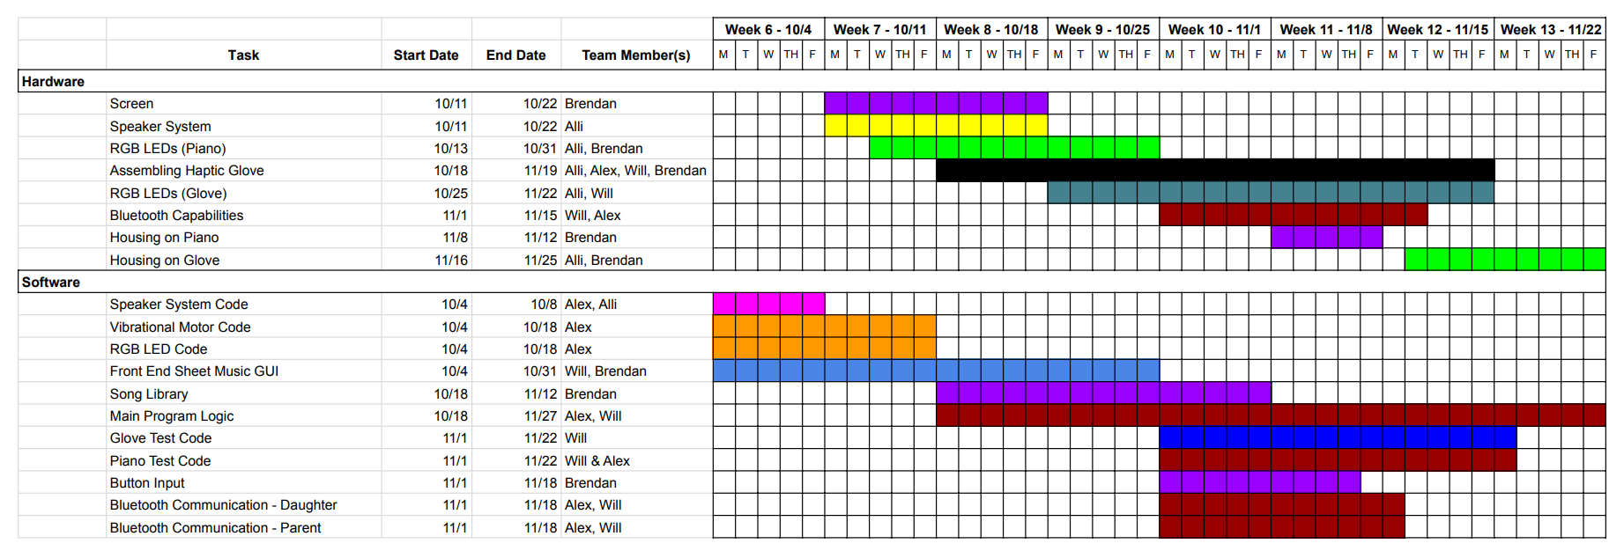
Project Management
Gaant Chart
Include Gantt Chart, Highlight individual responsibilities

Slide 26
Individual Responsibilities
For the most part everyone will be assisting one another in this project
Will Farland will be our Project Coordinator
Will Farland: Main System Software (controller for LEDs and Screen)
Allison Rizoli: Microcontrollers, PCB design, and Speaker Subsystem
Alexander Charpentier: Sub System Software (controller for haptic, LEDS, and Speaker)
Brendan Gentile: Interfacing for the screen, gloves, and LED strip

Slide 27
Questions

