Slide 1
SDP22 Team 22:
Piano Trainer MDR
Alexander Charpentier, William Farland, Brendan Gentile, Allison Rizoli

Slide 2
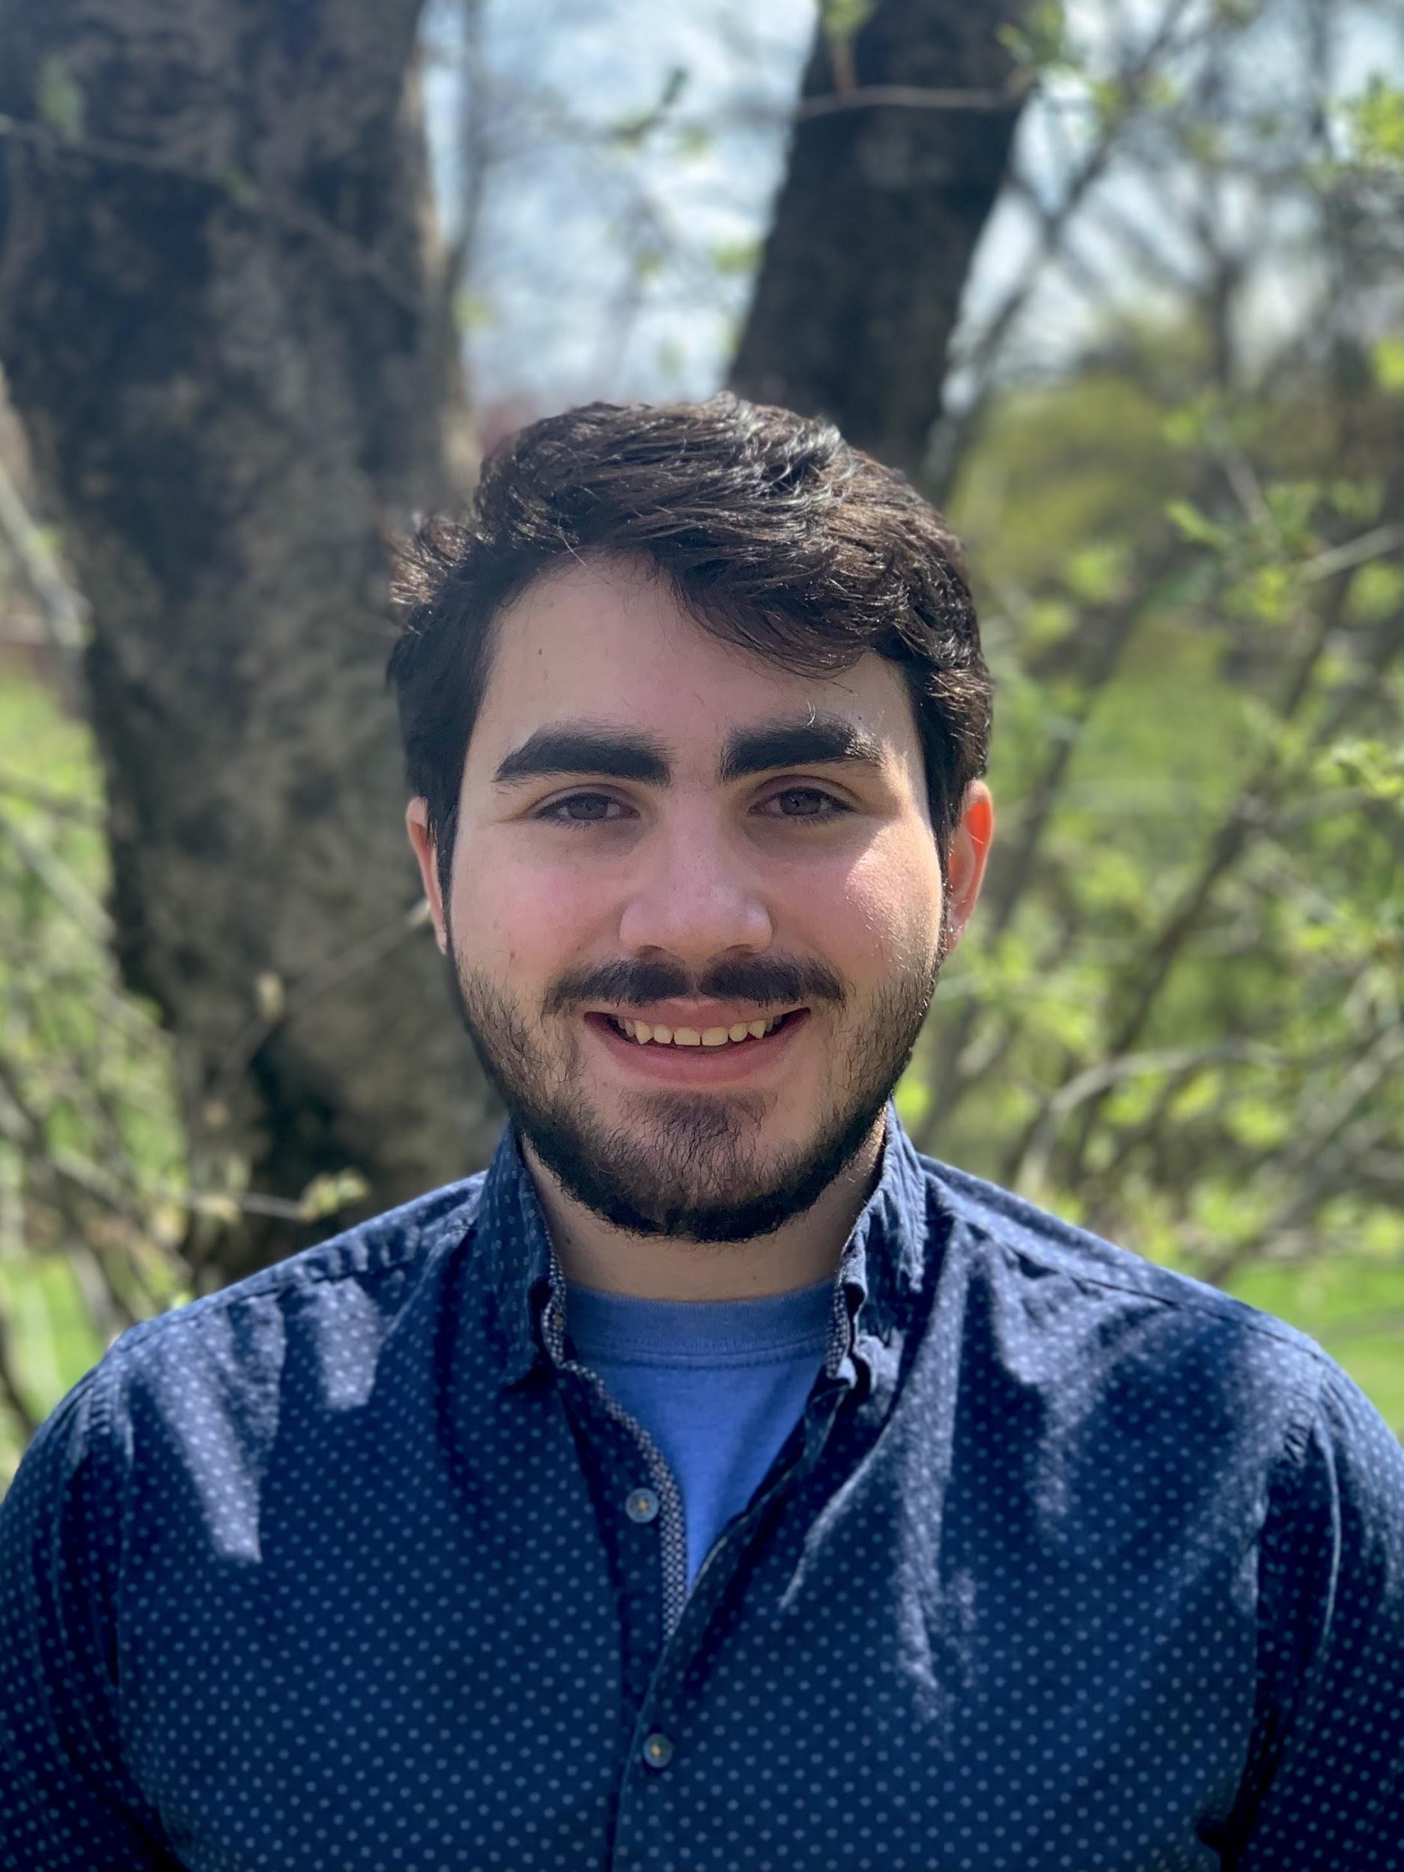
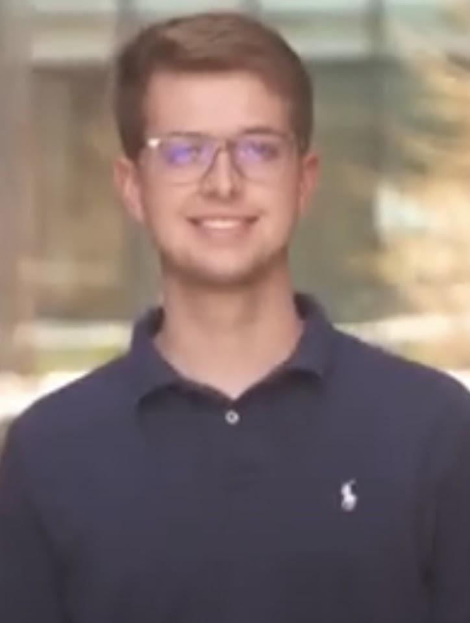
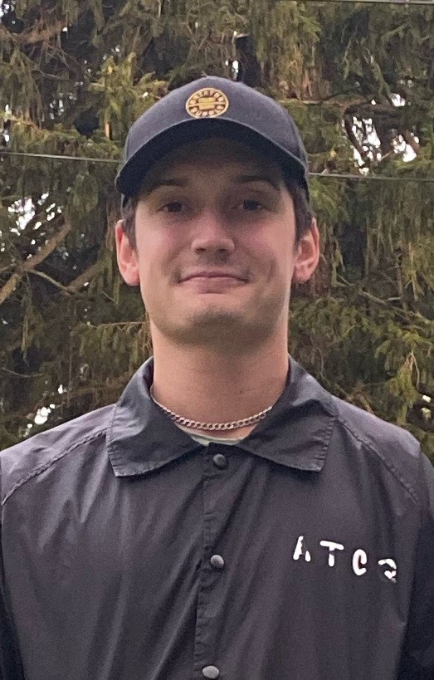
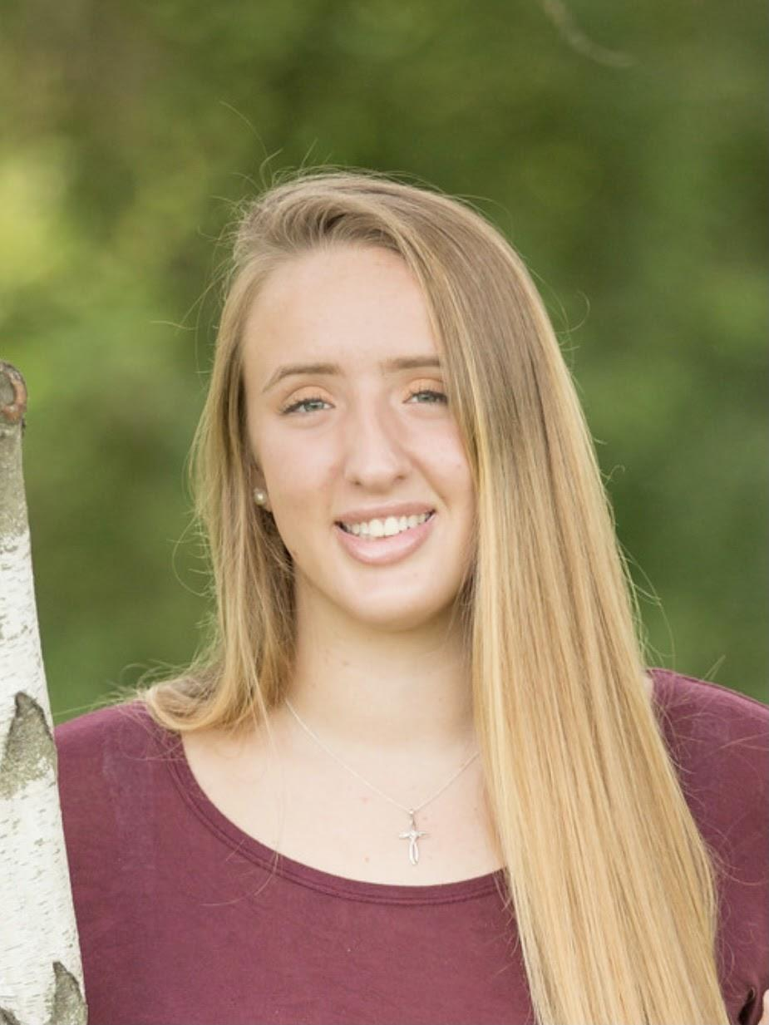
Introduction
Software Lead, Sensor Subsystem, Backend Development
Team Lead, Front & Backend Development
Music Lead, Front End Development
Altium & Budget Lead, Glove Subsystem
Notes:
Speaker: Everyone
Just list your name and major.

Slide 3
Problem Statement
Prospective students trying to learn piano face many challenges. The upfront cost of a piano and a piano teacher can be too much for incoming students. They also must be prepared to practice and rehearse without any feedback on their own time. This task can lead many to be disengaged and uninterested in learning to play the piano. Because of this, many students stop paying for their lessons and discard their piano. Our solution to this will act as a at home trainer that will use an existing digital piano to reduce the learning curve and cost of a personal piano tutor.
Notes:
Brendan

Slide 4
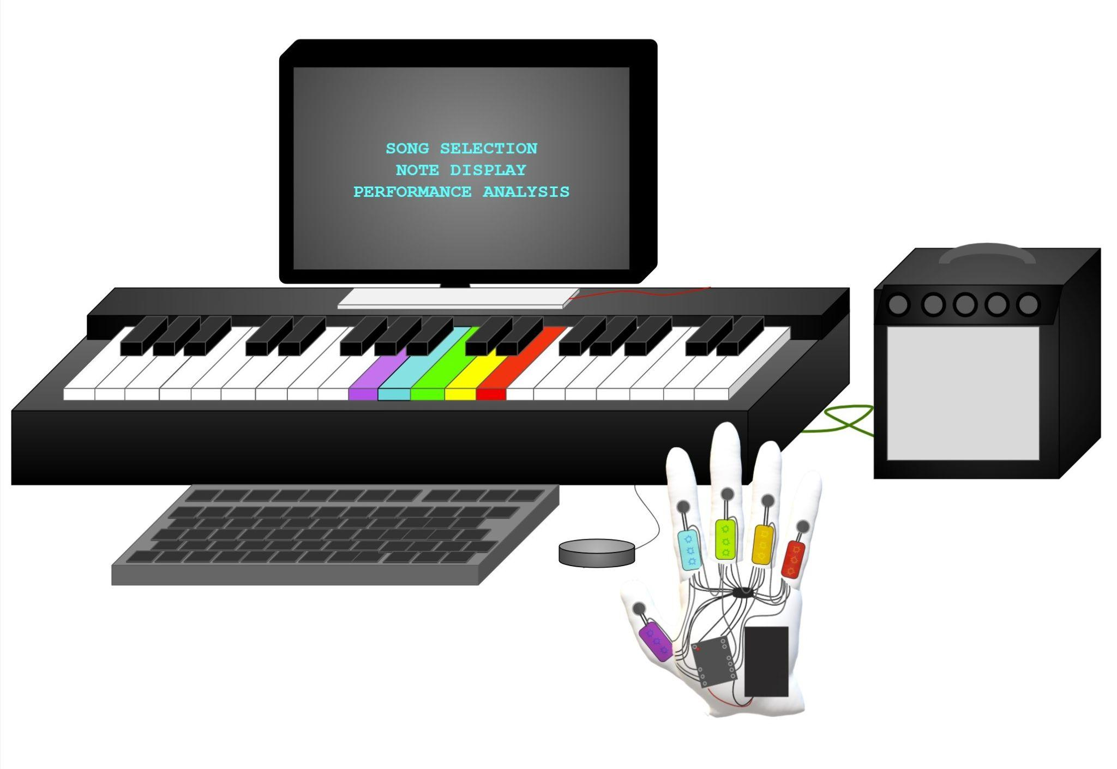
Our Solution
The Piano Teacher will feature an LED harness for the keys that fits most digital pianos and two haptic gloves. There will also be a display with button controls.
The user will be able to select a song of their choice and play that song on the piano with different levels of assistance
At the end of the song the system will display a report providing feedback for the user’s accuracy and tempo. The system will also suggest more practice or removing a level of assistance.
Our Piano Teacher system includes two types of real time feedback:
Two gloves that provide haptic feedback when a key is pressed incorrectly and a different LED light on each finger.
LED lights for each piano key that tells the user to press a key with a certain finger and will flash when the wrong key is pressed.
Notes:
Will

Slide 5
Main System Specifications (Keyboard / Mainboard)
System is applicable to any MIDI keyboard
System will present song library and data analytics to the user via an LCD Screen
Analytics include accuracy, tempo, and recommendations
Song library can be easily expanded
User will be able to change the level of training needed
User input will be done with multiple buttons and be responsive within 10ms
System will light individual LEDs to instruct the user to press those piano keys
The LED harness will have an RGB LED strip for each key
The LED will light up within 30ms of an instruction being sent
We expect the Piano Trainer to be able to accurately teach 16th notes at 120 BPM
The LEDs on each key will light up a different color that corresponds to each finger
The LEDs will light up at a specific tempo dependent on the song choice and difficulty settings
System will use MIDI data to determine if the correct keys were pressed
MIDI Data must be interpreted quickly, within 10ms
System will have advanced error reporting methods
There will be a reported error if the user presses correct note, but for an incorrect amount of time (i.e. presses for a half note, when it should be whole note)
There will be a reported error if user completely misses a note altogether, vibration of all fingers, and finger that was supposed to be pressing another key vibrates longer
Notes:
Alex

Slide 6
Sub System Specifications (Gloves)
System will vibrate individual fingers if the corresponding colored piano key was not pressed
The user will feel the vibration within 30ms of missing a key
System will vibrate all fingers if a piano key that was not indicated was pressed
The user will feel the vibration on all fingers within 50ms of pressing the wrong key
System will have a different color LED on each finger
The LEDs for each finger will light up corresponding to the note(s) that need to be played.
The LEDs will light up within 30ms from the instruction being sent from the main controller.
System will not restrict the ability to play the piano by the user
The battery life of each glove will exceed two hours and be rechargeable
The Gloves will be able to communicate to the main board via bluetooth
Communication will be possible from within 15 feet from keyboard
Notes:
Alli

Slide 7
Testing Plan for Keyboard
Plug in the system to any other MIDI enabled piano and see if it interfaces
Press a key on the keyboard and listen to the note played through speakers/headphones
Visually confirm the screen presents song library and data analytics after the song is played
Visually confirm the screen presents accuracy and tempo data
Go through the process of adding a song
Change the training level and view the change when a song is played
Press each button and confirm their actions.
Measure the time the system is able to update the screen once a button has been pressed using timestamps within code to confirm they match our system specifications of 10ms
Visually confirm the LEDs light up the correct notes on the keyboard when the song is being played
Visually confirm that each key has its own RGB LED
Measure the time the system is able to update the RGB LED of a key using timestamps within the code to confirm they match our system specifications of 30ms
Visually confirm that the colors of the LEDs on the keys are of the same color of the finger needed to play it
Measure the tempo of the notes being illuminated on the keyboard using timestamps and then compare to the tempo of the song
Set up a test program that shows the note being pressed by the user on the MIDI keyboard
Measure the time between pressing the key and the system interpreting the note within the code to confirm they match our system specification of 10ms
Program also outputs an error if user presses note for incorrect amount of time, visual confirmation.
Notes:
Alex

Slide 8
Testing Plan for Gloves
Place the gloves on a user and confirm they are able to move their fingers without restriction and have no issue playing individual keys on the keyboard
Visually confirm a different color LED on each of the 10 fingers
User will miss a note presented on the keyboard and feel the resulting vibration on the finger
Measure the time between missing a note and the analog signal being sent to the motor using timestamps within the code and confirm they are under 30ms
User will press an incorrect key on the keyboard and feel the resulting vibration on all of their fingers
Measure the time between pressing a wrong key and the analog signal being sent to the all the motors using timestamps within the code and confirm it is under 30ms
Use the gloves for an extended period of time under an average load of use and confirm they function for at least two hours
Set up a test program on the main board that communicates with the gloves over Bluetooth that illuminates certain LEDs on the gloves fingers
User will stand 15 feet away from the main board and confirm that the system is able to communicate with the gloves by visually confirming that fingers are still illuminated.
Notes:
Ali

Slide 9
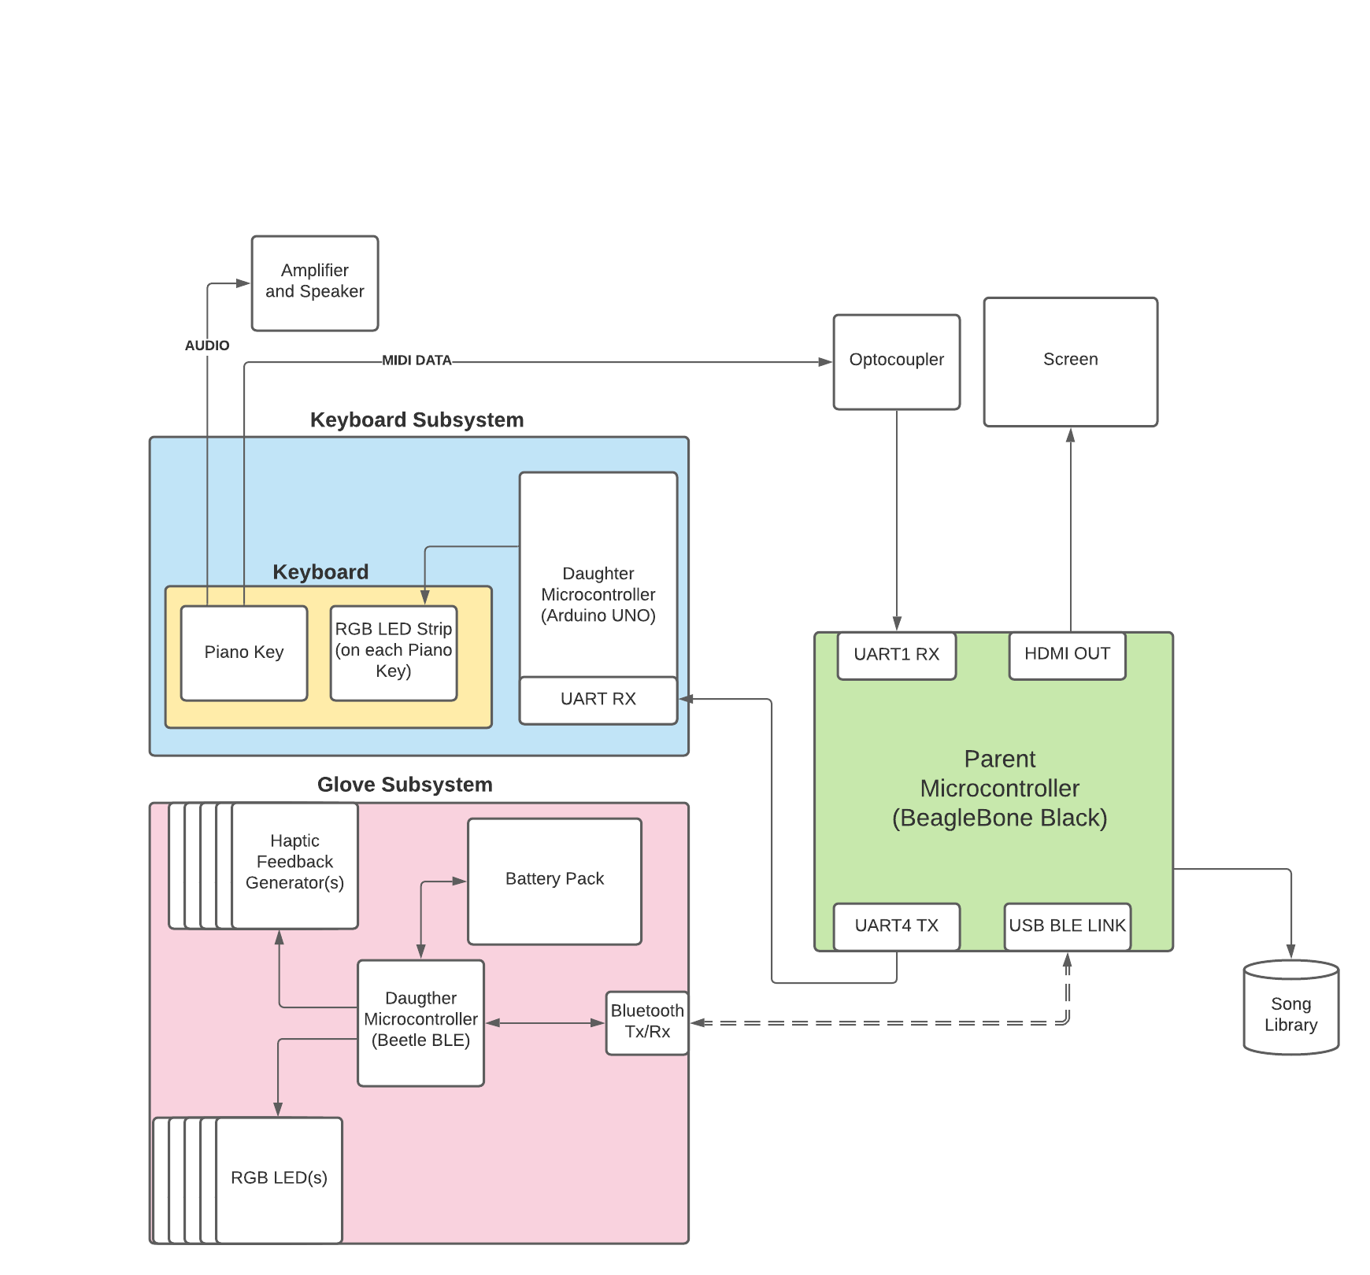
Hardware Design
(Block Diagram)
Notes:
Alex

Slide 10
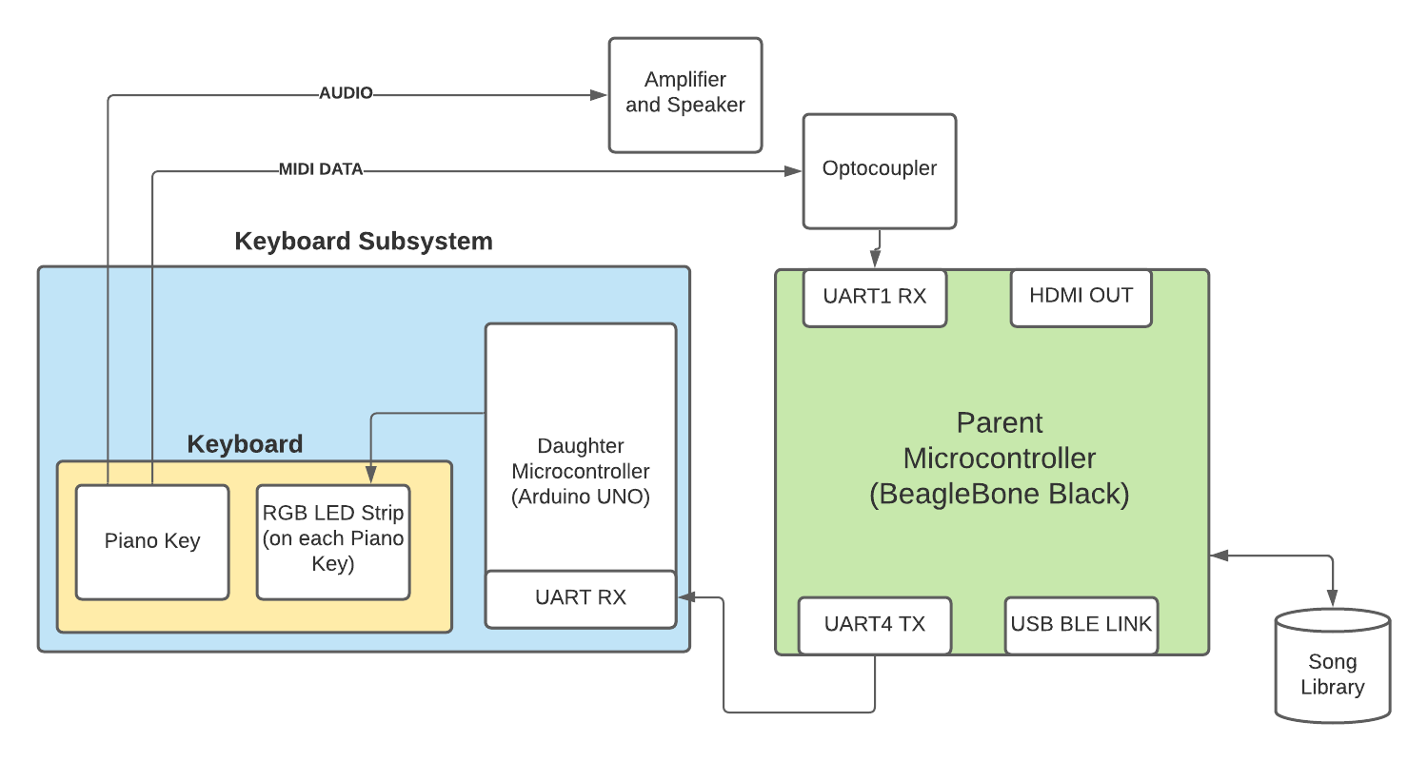
Hardware Design (Keyboard)
BeagleBone Black (Main Controller)
Communication with the Arduino controller for the LEDs
Reads MIDI input from the Piano
Communication with the Glove over Bluetooth
Accesses a Library of Songs
Arduino UNO
Interprets message from BBB through its UART
Turns on key LEDs on the piano
M1 Korg Digital Piano
Sends MIDI data out through an optocoupler to the BBBs UART1
Notes:
Brendan

Slide 11
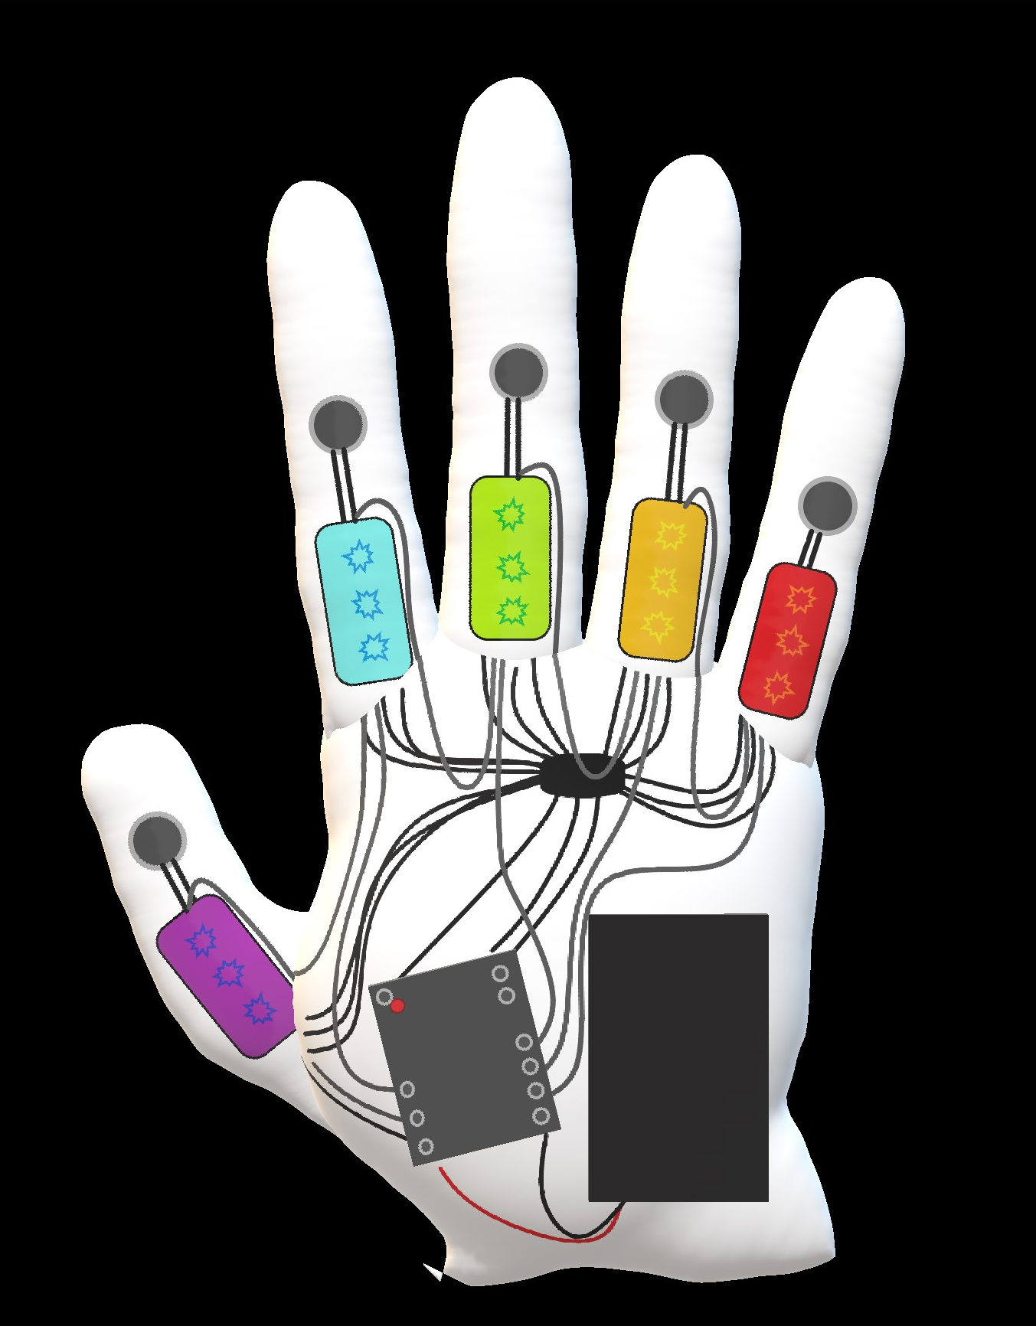
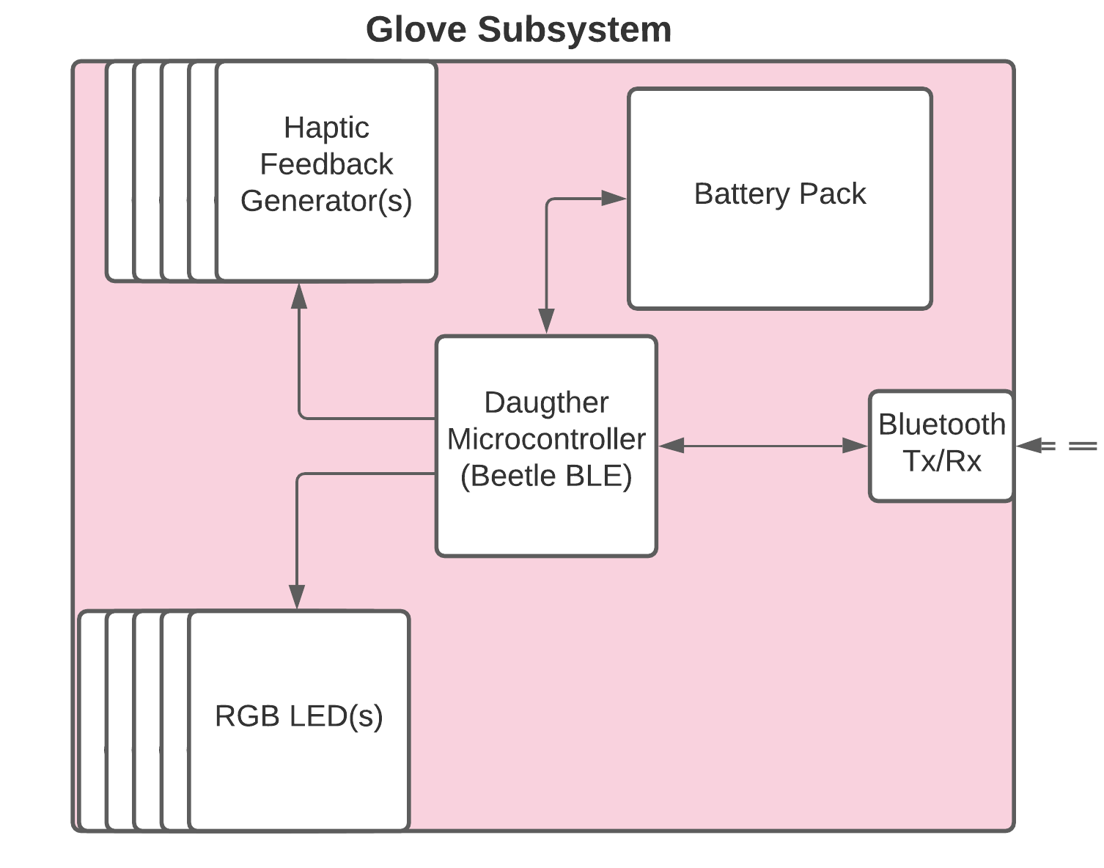
Vibration Motors
Hardware Design (Glove)
RGB LEDs
Beetle BLE
Power Bank
Notes:
Ali

Slide 12
Hardware Components (with Justification)
Main Controller
BeagleBone Black
Running GUI through HDMI
Communication to two subsystems as well as receiving MIDI data
Keyboard Control Subsystem
Arduino UNO
Faster control of the key LEDs such that timing requirements are met
11 DotStar LED Strips of three LEDs each
Korg M1 Piano
There is a MIDI cable coming from MIDI Out of the Piano.
The MIDI cable connects to an optocoupler circuit to separate the two individual systems
The BeagleBone Black then receives this data
Notes:
Alex

Slide 13
Hardware Components (with Justification)
Glove Subsystem
Beetle BLE
Built in bluetooth for simplicity
Controlling 5 light strips and 5 vibration motors
Battery Pack
5 DotStar LED Strips of three LEDs each
5 Coin Vibration Motors
Speaker Subsystem
Audio cable for connection to the amplifier
Amplifier
Allows for polyphony (Sound generated from multiple keys, i.e. Chords)
A simple arduino would be unable to make these chords (This would be a whole project on itself)
Notes:
Alex

Slide 14
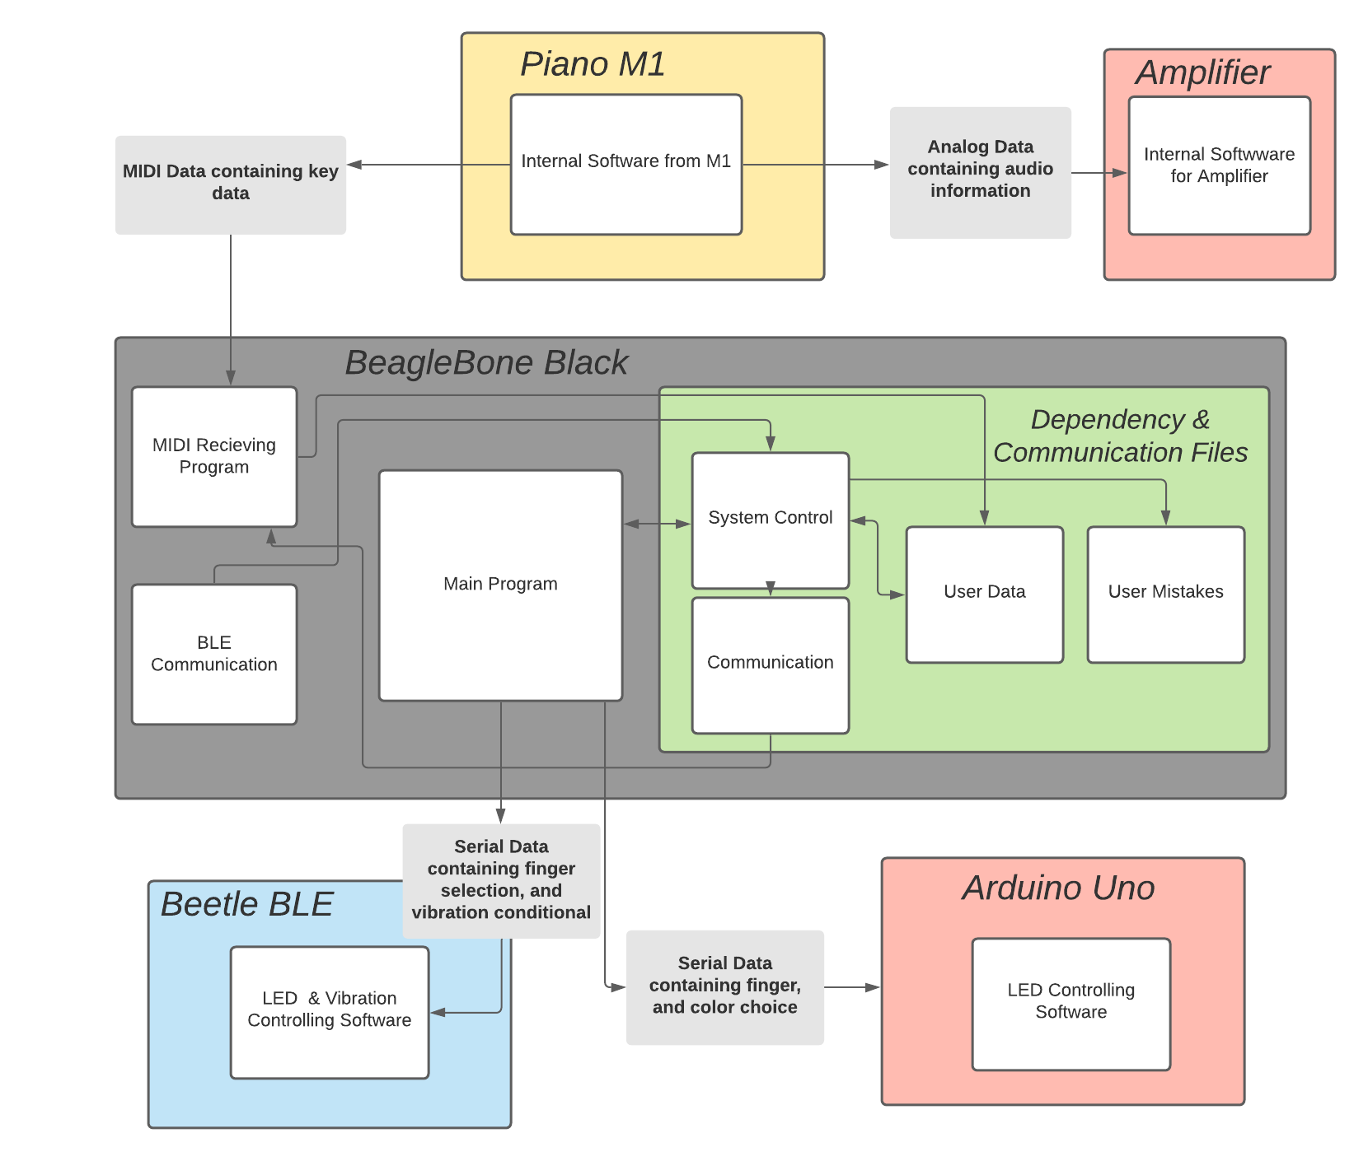
Software Design (Block Diagram)
Notes:
Will

Slide 15
Software Modules
Adafruit Dotstar Library
Both arduino boards use this library to control the Adafruit Dotstar LEDs that are used in the gloves and the key elements
Arduino Serial Library
Used for serial communication between the BeagleBone and the Arduino Red Board
PySerial
Used for all serial communications between UART
Python Time Library
Keeps track of time in order to effectively distinguish between a good press and a bad press
Adafruit_BBIO
Used to interact with the I/O on the beaglebone
Notes:
Will

Slide 16
Commitment to PCB
PCB For LED Key Control and MIDI optocoupler circuit - Accommodates ~64 Keys
This PCB will take over the current arduino and optocoupler circuit
It will be the main control for the LED Key Control
It will be able to communicate with the BeagleBone Black
This will be possible using an ATMega328p
PCB For the Gloves - Accommodates Bluetooth, 5 LED Strips, and 5 Haptic Motors
This PCB will take over for the BeetleBle
This will use an ATMega328p
Bluetooth Enabled through UART
Notes:
Will

Slide 17
MDR Deliverables
Our MDR Includes:
A screen with controls for song selection and traversal through the GUI
RGB LED lights for 11 keys on the keyboard (3 LEDs per key, 33 LEDs total)
One Glove that provides haptic feedback for the user and a unique LED light for each finger. (3 LEDs per finger, total of 15 LEDs)
LED lights between keys and fingers correlate so the correct hand placement is used
Performance feedback on the interface after each song is played
User’s note accuracy and tempo displayed on the screen after the song is finished
Prominent audio through an AMP such that the user can easily distinguish songs and learn alongside them
Notes:
Ali

Slide 18
Demonstration
Notes:
Will

Slide 19
Current Project
Expenditures
Item | Predicted Cost
Keyboard (M5 MIDI Keyboard) | $ 0
Parent Controller (Beaglebone Black) | $0
Monitor for Testing | $ 0
Gloves | $ 0
External AMP with Cables | $0
Beetle BLE (1) | $15
Vibration Mini Motor Disc (5) | $9.75
Battery Holder (for glove assembly) | $1.95
USB BLE Link (for Bluetooth) | $9.90
Optocuplor (for MIDI Input) | $1.60
MIDI Jack (for MIDI input) | $1.75
Adafruit LED Digital Strip | $99.85
5V 10A Power Supply | $29.95
Testing Components Not Used in MDR | $29.24
Totals: | $ 198.99
Notes:
Brendan

Slide 20
Projected Future Project
Expenditures
Item | Predicted Cost
Current Expenditures | $ 198.95
Screen | $ 40
Bluetooth Receiver Modules (for Gloves) | $ 30
Haptic Sensors (5) | $ 9.75
Rechargeable Battery (2) | $ 20
Early PCB Revisions | $ 100
Final PCB Revisions | $ 100
Totals: | $ 498.70
Notes:
Brendan

Slide 21
Software:
GUI
Finish a GUI, so that feedback is presented in a visually pleasing way including sheet music
Song Database
Pull a large library of song data, so user has choice of many songs (hopefully in order of magnitude of ~100s)
Write script to convert usable database to our music formatting system
Error Detection
Current error detection and timing can be improved, some edge cases are not detected
Goals
Keys:
Design housing for sharp keys
Encase LED wires in wire housing
Finish rest of the keys on the keyboard (~40 more)
Gloves:
Finish outer layer of glove for housing
Improve on wiring
Lithium Rechargeable Battery
Build another glove
PCB:
PCB for gloves
PCB for arduino, including MIDI subsystem
Notes:
Goals

Slide 22
Project Management
New gantt chart
https://docs.google.com/spreadsheets/d/1Dq7XoUNnZf1wwEn2wBI9Xhlfh-EZjeMk007MQlQoOgY/edit?usp=sharing
Notes:
Brendan

Slide 23
Individual Responsibilities
Will Farland (Project Coordinator)
Main system software (Controller for main keyboard system, Main program logic)
Alex Charpentier
Sub system software (Controller for glove subsystem, bluetooth connections, MIDI data interpretation)
Brendan Gentile
Hardware for keyboard system and LED strip design
Allison Rizoli
Hardware for haptic glove design and Power requirements
Notes:
Brendan

Slide 24
Questions

