Slide 1
SDP22 Team 22:
Piano Trainer CDR
Alexander Charpentier, William Farland, Allison Rizoli, Brendan Gentile

Slide 2
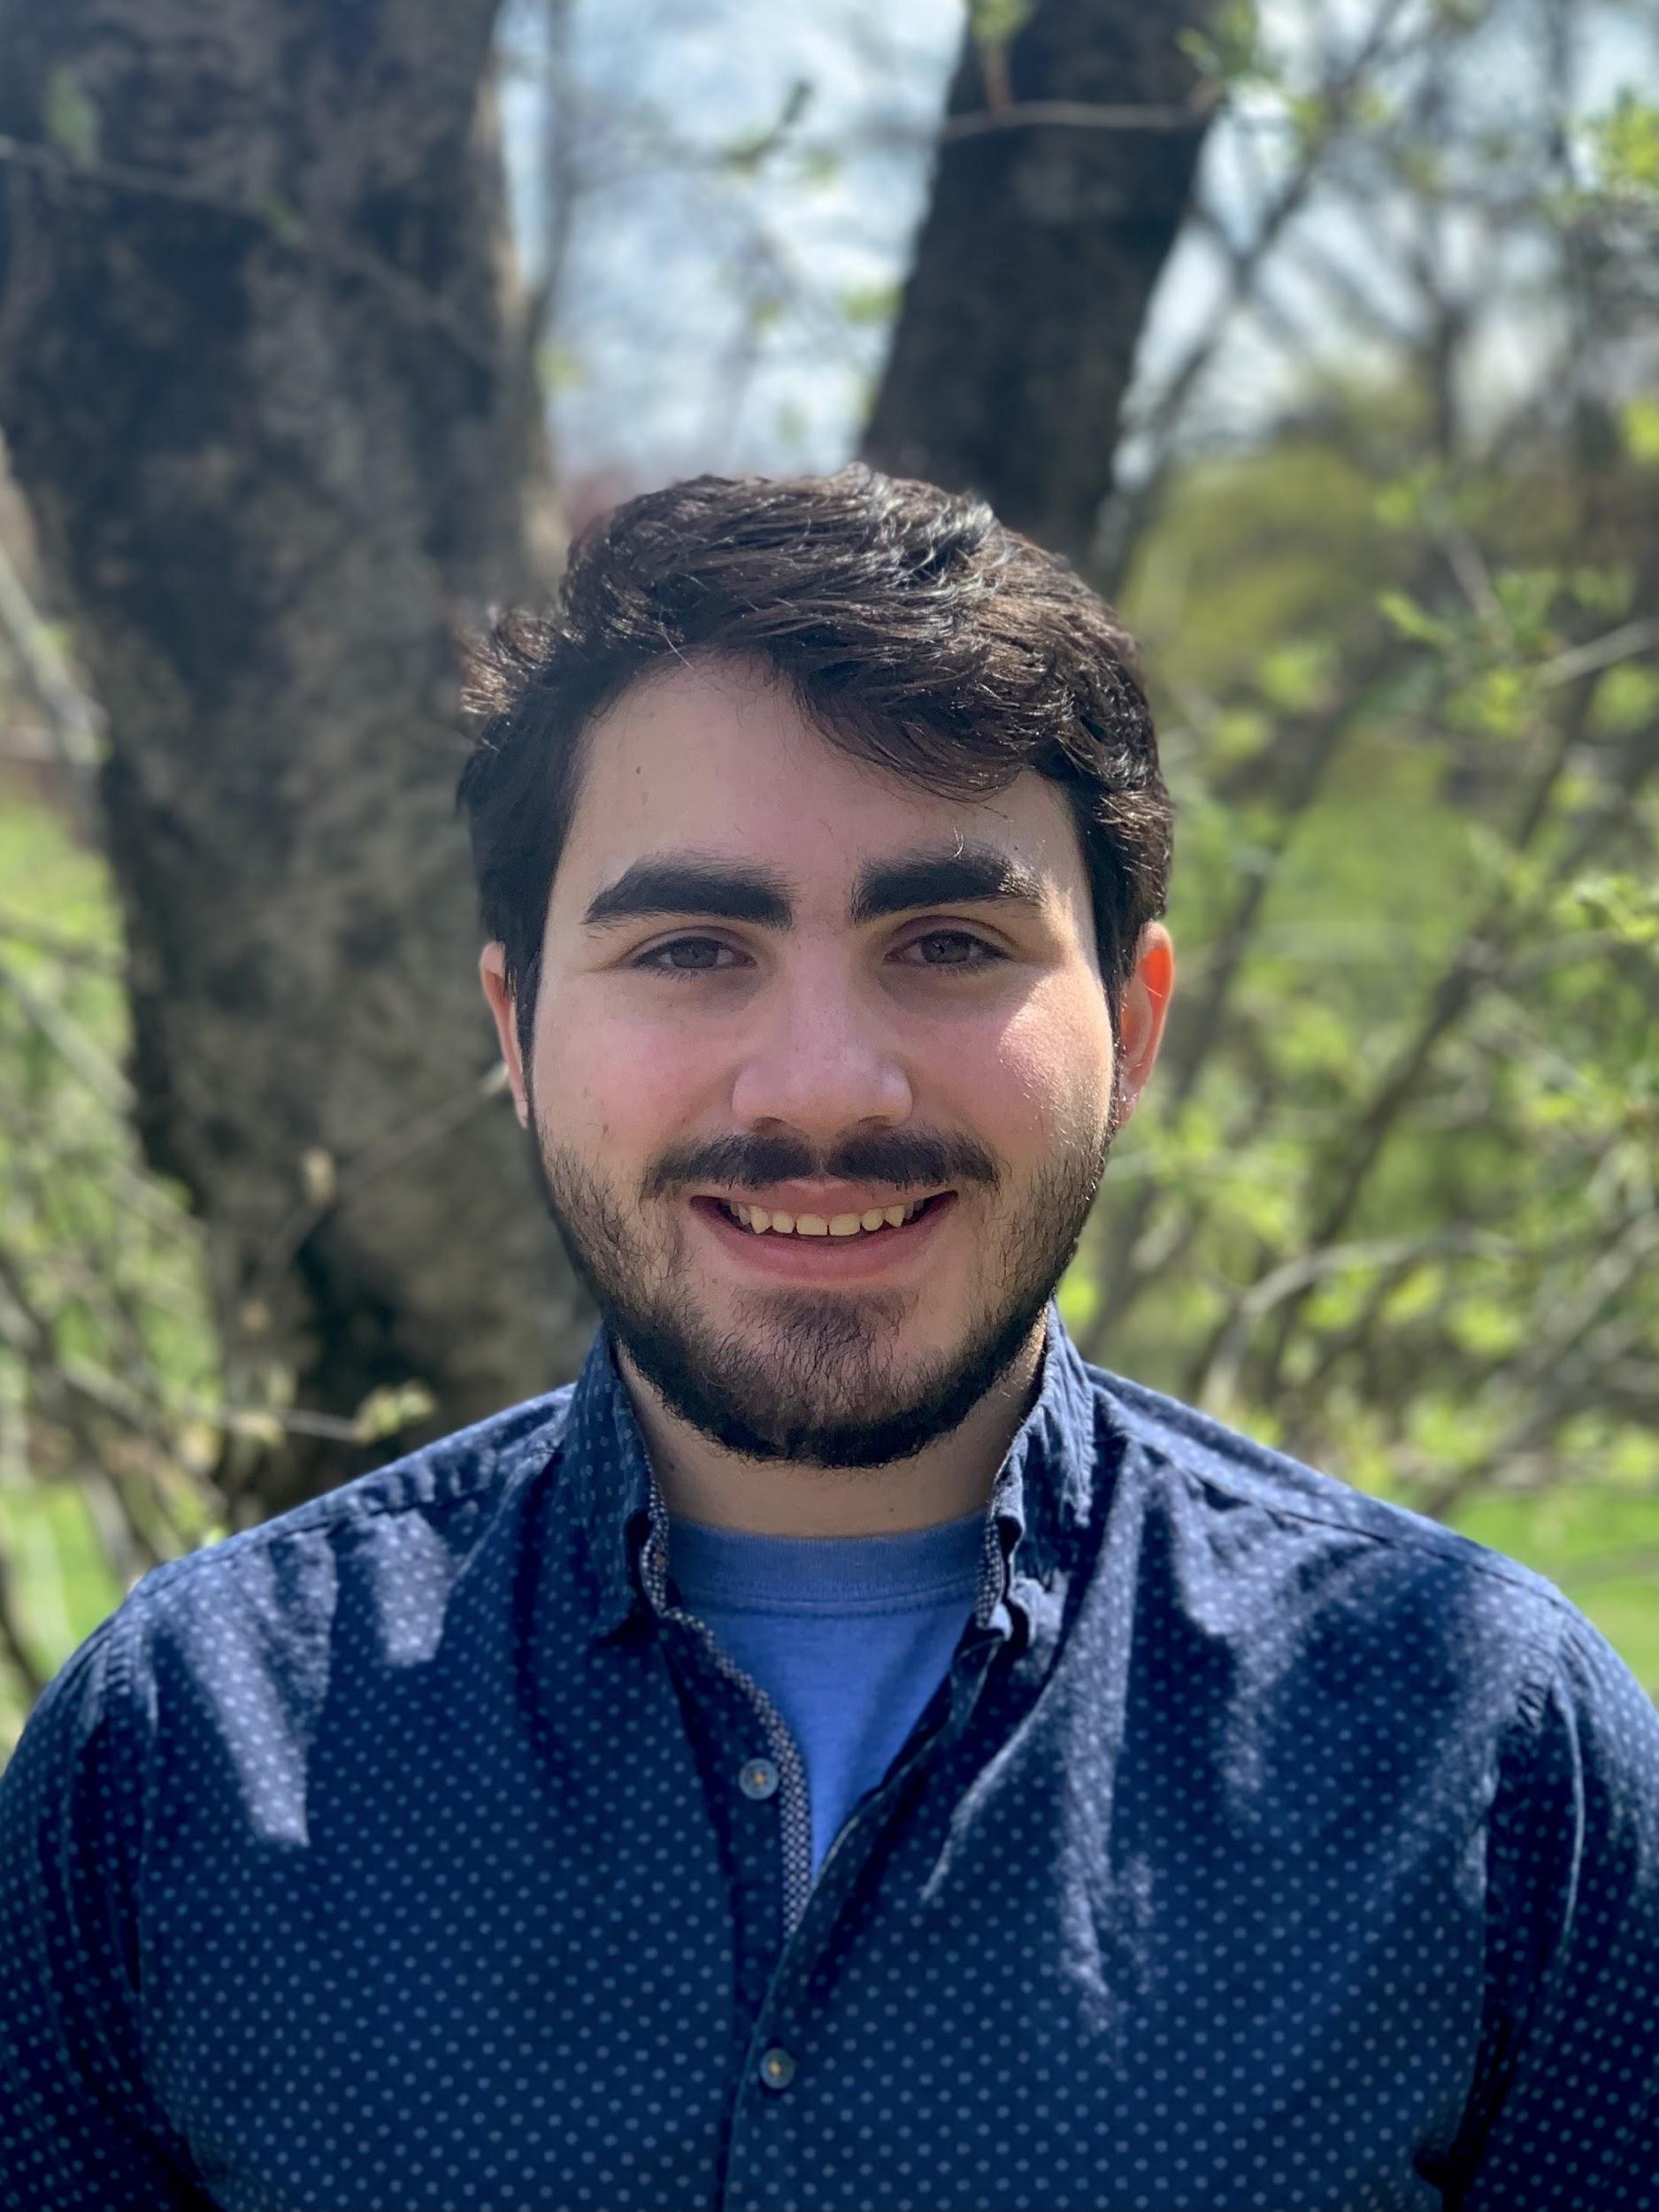
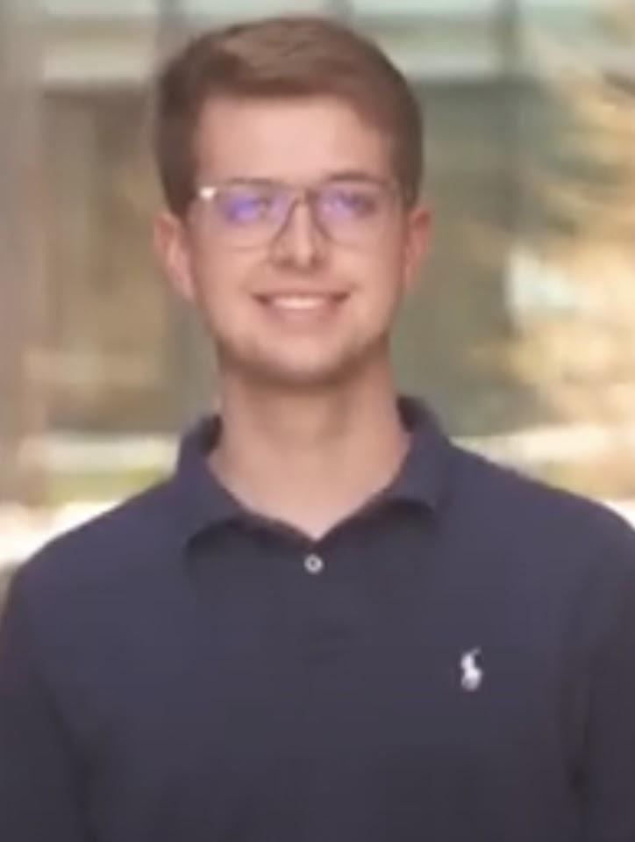
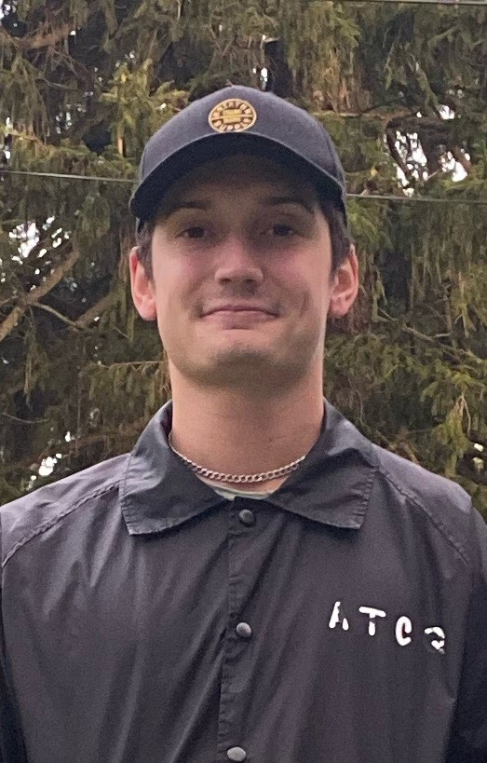
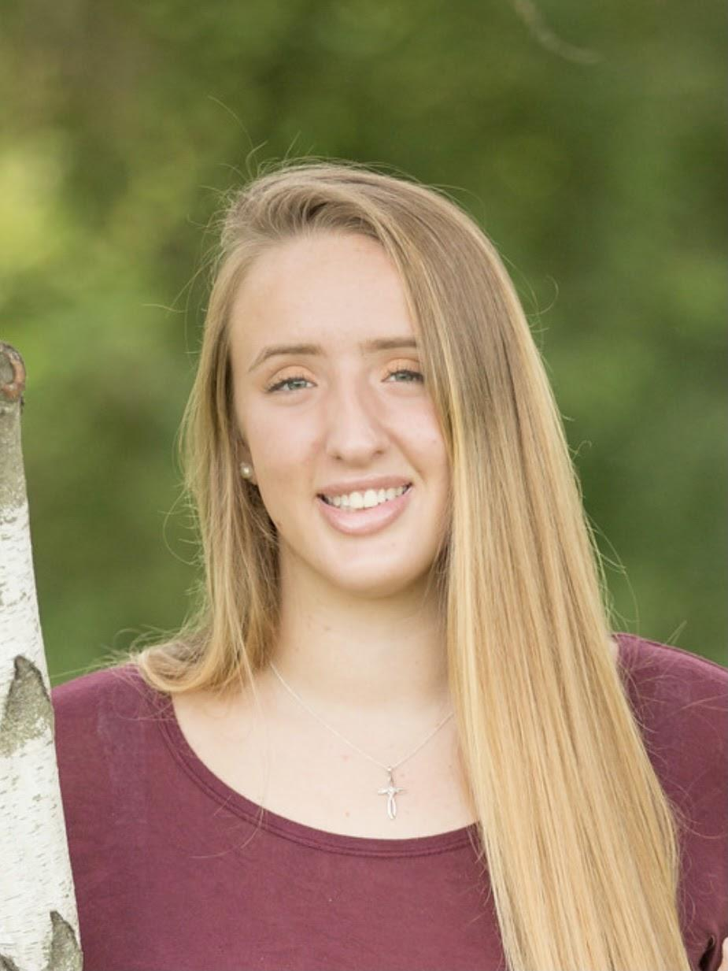
Introduction
Software Lead, Sensor Subsystem, Backend Development
Team Lead, Front & Backend Development
Music Lead, Front End Development
Altium & Budget Lead, Glove Subsystem
Notes:
Speaker: Everyone
Just list your name and major.

Slide 3
Problem Statement
Prospective students trying to learn piano face many challenges. The upfront cost of a piano and a piano teacher can be too much for incoming students. They also must be prepared to practice and rehearse without any feedback on their own time. This task can lead many to be disengaged and uninterested in learning to play the piano. Because of this, many students stop paying for their lessons and discard their piano. Our solution to this will act as a at home trainer that will use an existing digital piano to reduce the learning curve and cost of a personal piano tutor.
Notes:
Brendan

Slide 4
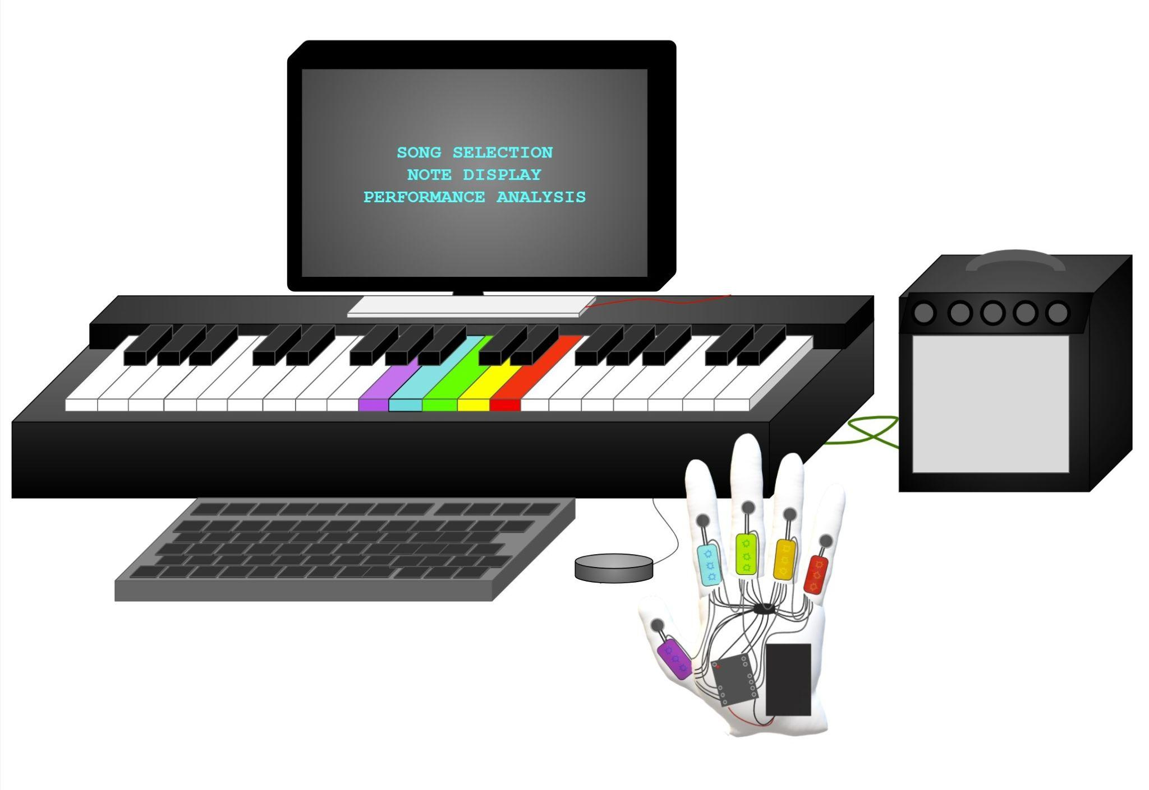
Our Solution
The Piano Teacher will feature an LED harness for the keys that fits most digital pianos and two haptic gloves. There will also be an interface for song selection and difficulty settings.
The user will be able to select a song of their choice and play that song on the piano with different levels of assistance
At the end of the song the system will display a report providing feedback for the user’s accuracy and tempo. The system will also suggest more practice or removing a level of assistance.
Our Piano Teacher system includes two types of real time feedback:
Two gloves that provide haptic feedback when a key is pressed incorrectly and a different LED light on each finger.
LED lights for each piano key that tells the user to press a key with a certain finger and will flash when the wrong key is pressed.
Notes:
Will

Slide 5
Main System Specifications (Keyboard / Mainboard)
System is applicable to any MIDI keyboard ✓
System will present song library and data analytics to the user via a monitor Screen ✓
Analytics include accuracy, ✓ tempo ✓ , and recommendations
Song library can be easily expanded ✓
User will be able to change the level of training needed ✓
User input will be done with a mouse and be responsive within 10ms ✓
System will light individual LEDs to instruct the user to press those piano keys ✓
The LED harness will have an RGB LED strip for each key ✓
The LED will light up within 20ms of an instruction being sent ✓
We expect the Piano Trainer to be able to accurately teach 16th notes at 120 BPM ✓
The LEDs on each key will light up a different color that corresponds to each finger ✓
The LEDs will light up at a specific tempo dependent on the song choice and difficulty settings ✓
System will use MIDI data to determine if the correct keys were pressed ✓
MIDI Data must be interpreted quickly, within 10ms ✓
System will have advanced error reporting methods ✓
There will be a reported error if the user presses correct note, but for an incorrect amount of time (i.e. presses for a half note, when it should be whole note) ✓
There will be a reported error if user completely misses a note altogether or an incorrect not was pressed ✓
Notes:
Alex

Slide 6
Sub System Specifications (Gloves)
System will vibrate individual fingers if the corresponding colored piano key was not pressed
The user will feel the vibration within 30ms of missing a key ✓
System will have a different color LED on each finger ✓
The LEDs for each finger will light up corresponding to the note(s) that need to be played. ✓
The LEDs will light up within 30ms from the instruction being sent from the main controller.✓
System will not restrict the ability to play the piano by the user
The battery life of each glove will exceed two hours and be rechargeable ✓
The Gloves will be able to communicate to the main board via bluetooth ✓
Communication will be possible from within 15 feet from keyboard
Notes:
Alli

Slide 7
Testing Plan for Keyboard
Plug in the system to any other MIDI enabled piano and see if it interfaces
Press a key on the keyboard and listen to the note played through speakers/headphones
Visually confirm the screen presents song library and data analytics after the song is played
Visually confirm the screen presents accuracy and tempo data
Go through the process of adding a song
Change the training level and view the change when a song is played
Confirm the input to the GUI works by accessing the song library
Measure the time the system is able to update the screen once a button has been pressed using timestamps within code to confirm they match our system specifications of 10ms
Visually confirm the LEDs light up the correct notes on the keyboard when the song is being played
Visually confirm that each key has its own RGB LED
Measure the time the system is able to update the RGB LED of a key using timestamps within the code to confirm they match our system specifications of 30ms
Visually confirm that the colors of the LEDs on the keys are of the same color of the finger needed to play it
Measure the tempo of the notes being illuminated on the keyboard using timestamps and then compare to the tempo of the song
Set up a test program that shows the note being pressed by the user on the MIDI keyboard
Measure the time between pressing the key and the system interpreting the note within the code to confirm they match our system specification of 10ms
Program also outputs an error if user presses note for incorrect amount of time, visual confirmation.
Notes:
Alex

Slide 8
Testing Plan for Gloves
Place the gloves on a user and confirm they are able to move their fingers without restriction and have no issue playing individual keys on the keyboard
Visually confirm a different color LED on each of the 10 fingers
User will miss a note presented on the keyboard and feel the resulting vibration on the finger
Measure the time between missing a note and the analog signal being sent to the motor using timestamps within the code and confirm they are under 30ms
Use the gloves for an extended period of time under an average load of use and confirm they function for at least two hours
Set up a test program on the main board that communicates with the gloves over Bluetooth that illuminates certain LEDs on the gloves fingers
User will stand 15 feet away from the main board and confirm that the system is able to communicate with the gloves by visually confirming that fingers are still illuminated.
Notes:
Ali

Slide 9
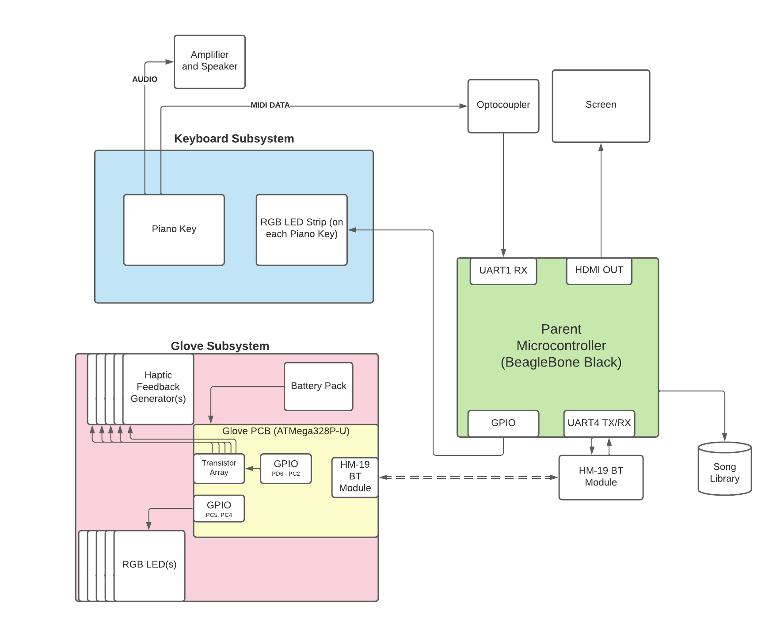
Hardware Design
(Block Diagram)
Notes:
Alex

Slide 10
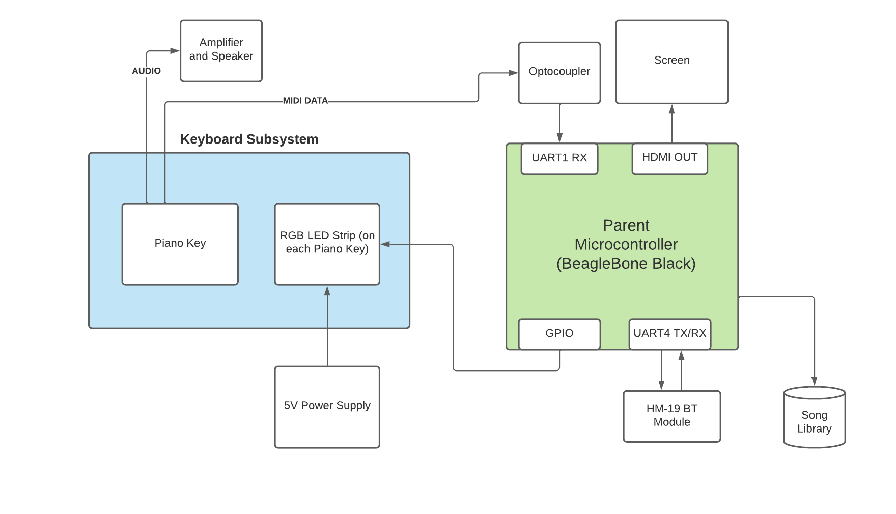
Hardware Design (Keyboard)
Notes:
Brendan

Slide 11
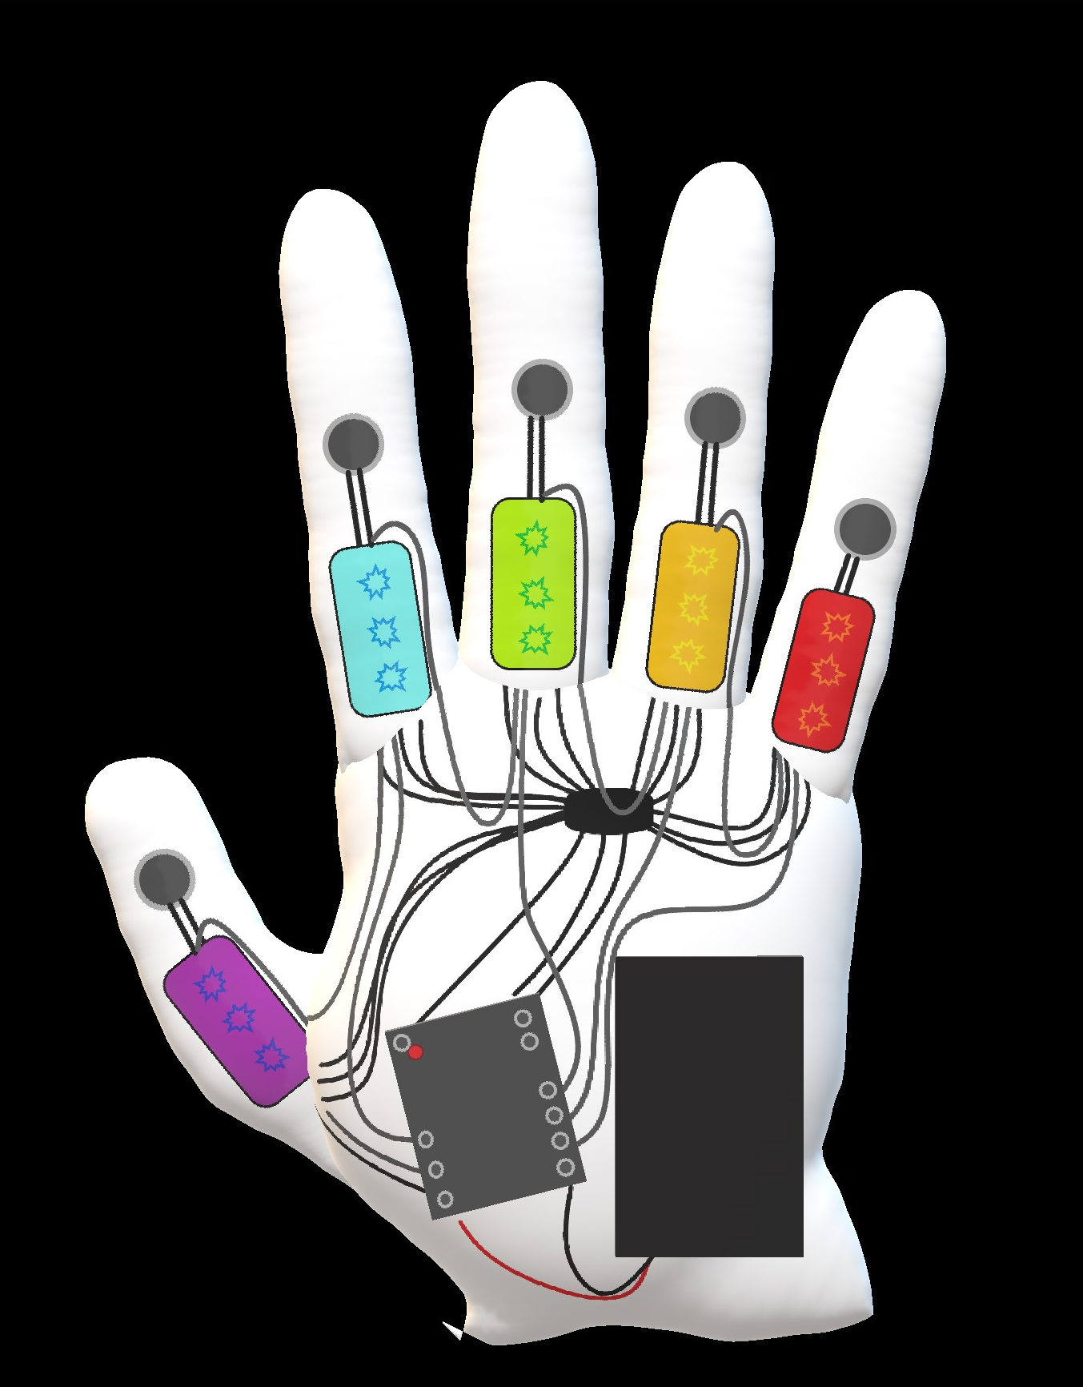
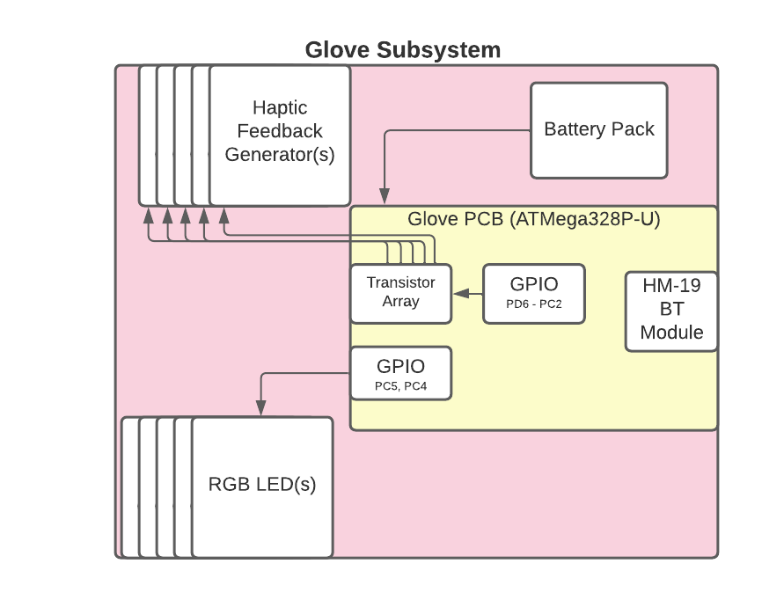
Vibration Motors
Hardware Design (Glove)
RGB LEDs
PCB
Power Bank
Notes:
Ali

Slide 12
Hardware Components for Keyboard (with Justification)
Beaglebone Black
Controls three different serial communication
Two Bluetooth Modules (HM-19) for Glove Control
Midi Input signal
Provides a video output for our GUI
Supports high-refresh rate
Supports many different input controls
Controls 108 individual LED pixels
DotStar LEDs
Allows for simple LED control
Only requires four wires from the Beaglebone
Reduces the amount of wire needed in this project
Optocoupler Circuit
Separates and protects the Beaglebone Black from the Keyboard
HM-19 Bluetooth Module
Communication with the Glove Subsystem
Low-Power and High Speed data transmission to reach our specifications
Notes:
Alex

Slide 13
Hardware Components Glove (with Justification)
ATMega328P-U
Low-Power MicroController
Supports fast GPIO control and UART support
HM-19 Bluetooth Module
Communication with the Glove Subsystem
Low-Power and High Speed data transmission to reach our specifications
Transistor Array
Powers the 5 separate coin motors for user feedback
The ATMega328P-U’s GPIO is unable to provide enough current to toggle these motors effectively
DotStar LED’s
Allows for simple LED control
Only requires four wires (simplifies the glove subsystem)
Battery Pack
Powers the Glove Subsystem
Allows us to reach our time specification
Notes:
Alex

Slide 14
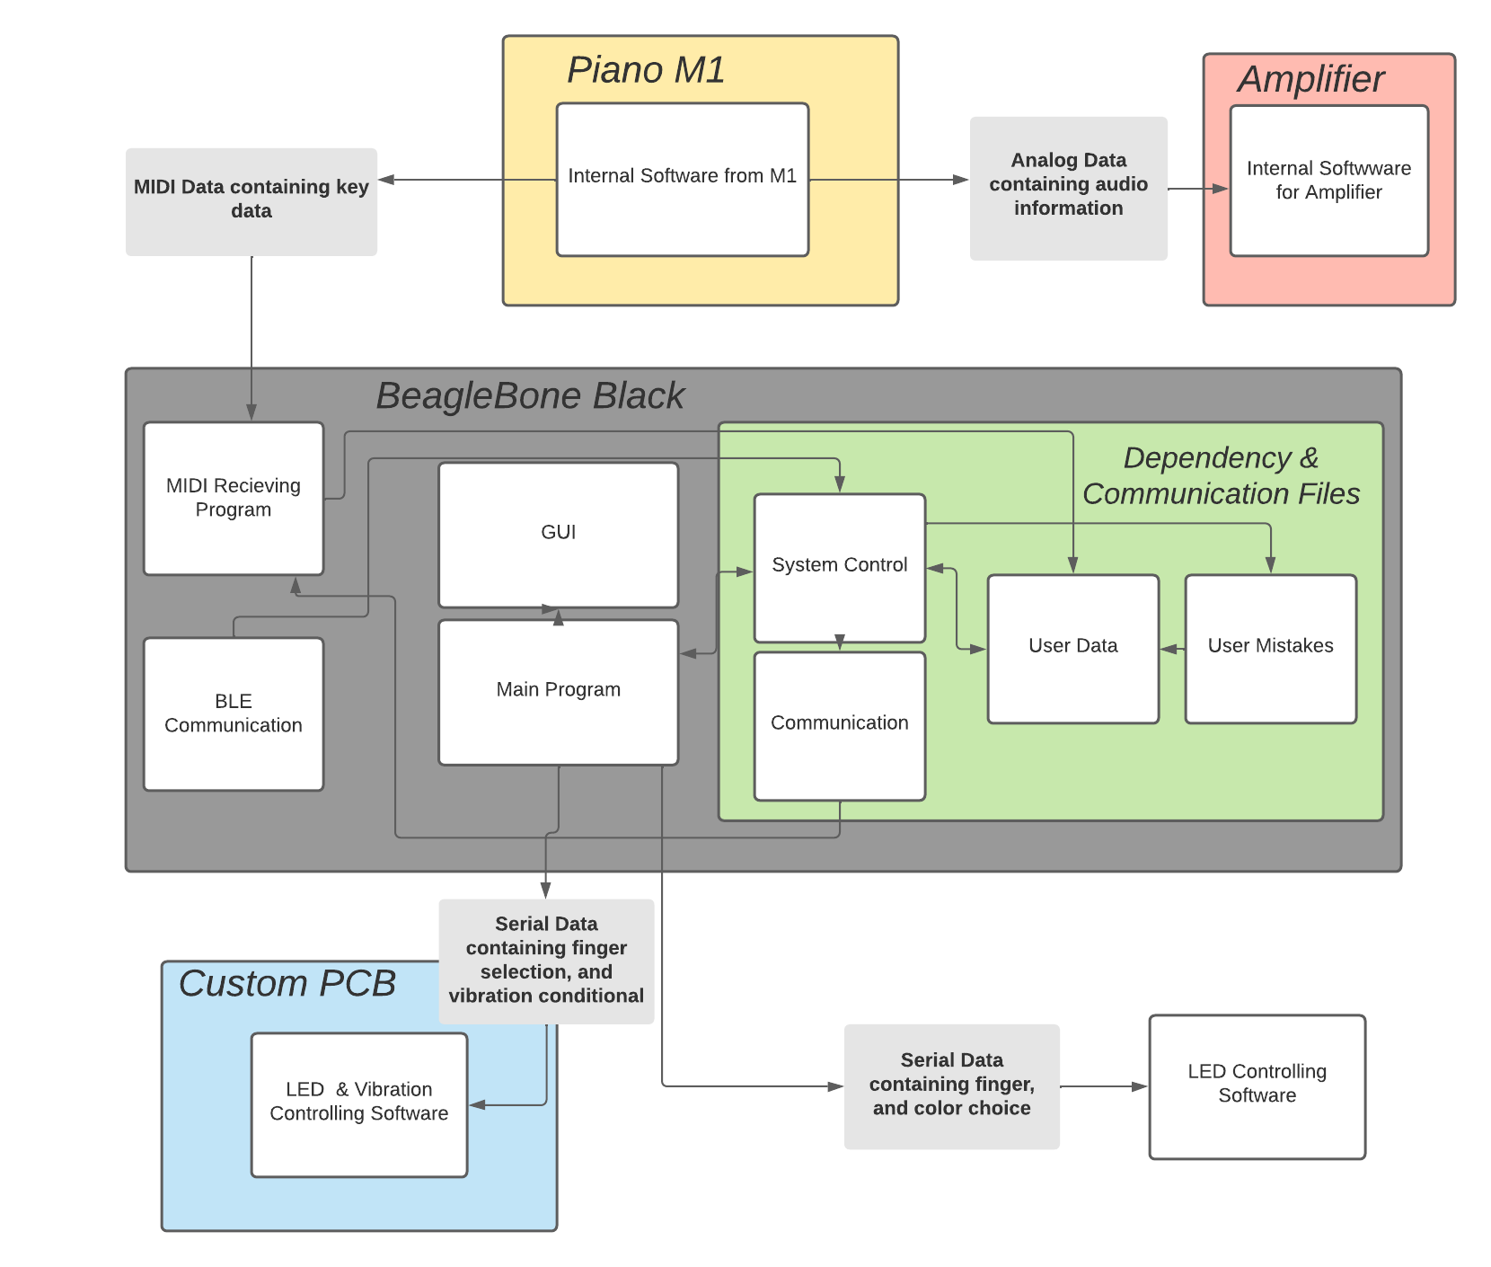
Software Design (Block Diagram)
Notes:
Will

Slide 15
Software Modules
GUI Functions Library
Custom built to support application
Includes two separate modules that control sheet music and virtual keyboard
Music Extraction Library
Custom built library to extract note information from MIDI file, tempo information and translate this information to be readable by LEDs and Sheet Music
Custom Python Library to support LED control
This is required to control the DotStar LED’s at high speed
Beaglebone Black’s GPIO pins only runs at 3.5KHz without this custom library
With this addition the BeagleBone is able to reach 3.5MHz on it’s GPIOs
PySerial
Used for all serial communications between UART
Python Time Library
Keeps track of time in order to effectively distinguish between a good press and a bad press
Notes:
Will

Slide 16
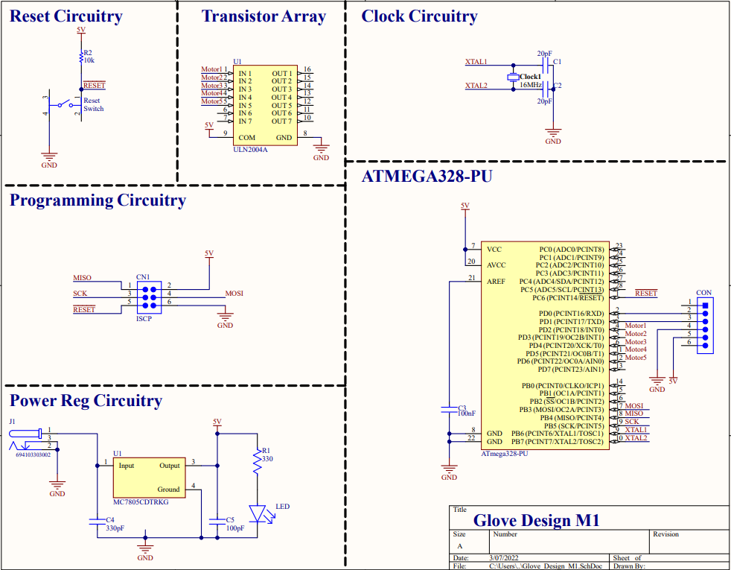
PCB Design
(Schematic)
Notes:
Will

Slide 17
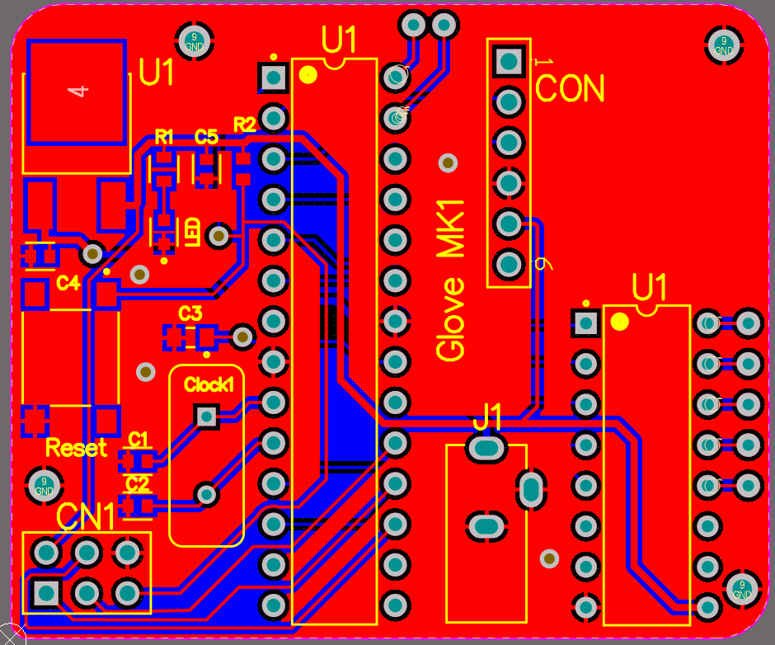
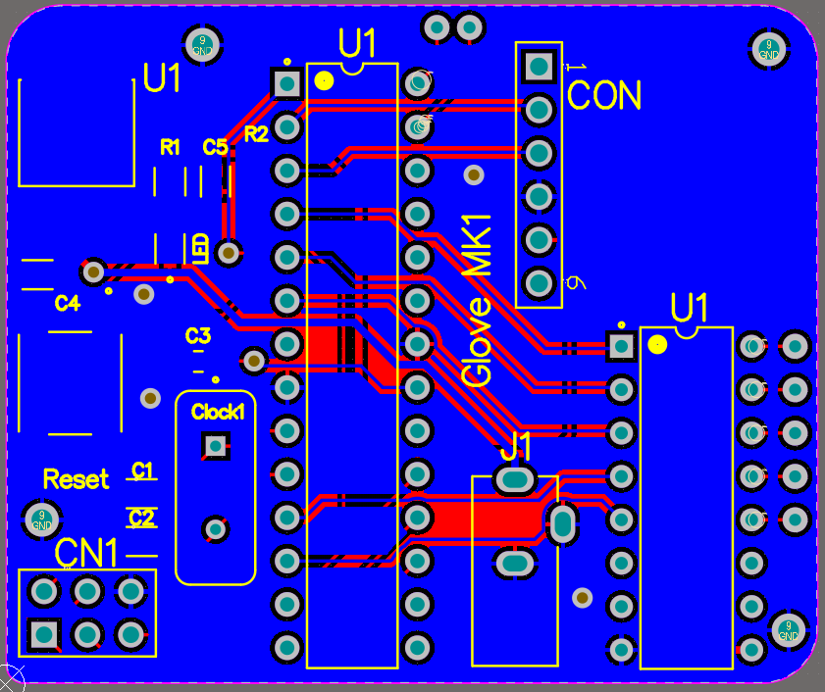
PCB Design (Layout)
Notes:
Will

Slide 18
Demonstration
Notes:
Will

Slide 19
Planned FDR System with Changes
Complete Keyboard
All of the keys including the sharps will have LED’s and a housing
The Bluetooth, LED power, and MIDI circuitry will be made into a PCB
All the Hardware will be built into a final enclosure
All circuitry will be hidden from the user’s view
Complete Glove System
Both gloves will be assembled with a completed and populated PCB
All circuitry will be hidden from the user’s view
Build better music functions
Need a better finger placement algorithm that can comprehensively find shortest cost for all fingers in play
Support for more notes
Complete GUI
A more clean and tested GUI will be present
The user will be able to control the tempo and difficulty setting
User will get suggestions and feedback based on their performance
Notes:
Ali

Slide 20
FDR Improvements
The FDR system will be tested using the already discussed testing plan
The prototype will be hardened through multiple tests and reworks:
MIDI song database is large and we can gather much information from running multiple songs
The Keyboard LED’s need to be improved with a line driver to support the additional sharp keys.
The Glove’s error feedback might be reworked depending on how distracting the vibrations are.
Notes:
Brendan

Slide 21
FDR Demonstration
User will place on the gloves and interact with the GUI
User will be able to select a song from large song library
User can select a difficulty and temp speed depending on their preference
User will be begin playing and will be able to see the sheet music as well as their correct finger placement on the keyboard
User will receive feedback and suggestions based on their performance
Notes:
Brendan

Slide 22
Goals
Keys:
Design housing for sharp keys
Encase LED wires in wire housing
Finish the sharp keys
Gloves:
Finish outer layer of glove for housing
Build another glove
PCB:
PCB for the MIDI subsystem and driver for the Keyboard’s LED control
Software:
GUI
Clean up the GUI, so that feedback is presented in a more visually pleasing way including sheet music
Song Database
Pull a large library of song data, so user has choice of many songs (hopefully in order of magnitude of ~100s)
Error Detection
Improve on the error detection
Notes:
Goals

Slide 23
Item | Cost
Keyboard (M5 MIDI Keyboard) | $ 0
Parent Controller (Beaglebone Black) | $0
Monitor for Testing | $ 0
Gloves | $ 0
External AMP with Cables | $0
Beetle BLE (1) | $15
Vibration Mini Motor Disc (10) | $19.90
Glove PCB First Revision | $17.50
PCB Components | $30.00
Item | Cost
Battery Holder (2) (for glove assembly) | $3.90
USB BLE Link (for Bluetooth) | $9.90
Optocuplor (for MIDI Input) | $1.60
MIDI Jack (for MIDI input) | $1.75
Adafruit LED Digital Strip | $99.85
5V 10A Power Supply | $29.95
Testing Components Not Used | $29.24
HM-19 Bluetooth Modules (2) | $20.00
PCB Prototyping (Provided by M5) | $0
Total | $269.59
Notes:
Brendan

Slide 24
Projected Future Project
Expenditures
Item | Predicted Cost
Current Expenditures | $ 269.59
HM-19 Bluetooth Module (2) | $20.00
Adafruit LED Digital Strip | $99.85
Final Glove PCB Revisions | $ 20.00
Final Keyboard PCB | $20.00
Equipment Needed to Polish the System | $60.00
Screen | $0
Totals: | $489.44
Notes:
Brendan

Slide 25
Project Management
New gantt chart
https://docs.google.com/spreadsheets/d/1Dq7XoUNnZf1wwEn2wBI9Xhlfh-EZjeMk007MQlQoOgY/edit?usp=sharing
Notes:
Brendan

Slide 26
Individual Responsibilities
Will Farland (Project Coordinator)
Main system software (Controller for main keyboard system, Main program logic)
Alex Charpentier
Sub system software (Controller for glove subsystem, bluetooth connections, MIDI data interpretation), PCB Design
Allison Rizoli
Hardware for haptic glove design and Keyboard System
Brendan Gentile
Main system software, and power requirements
Notes:
Brendan

Slide 27
Questions

