Slide 1
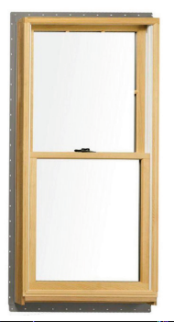
Active Window Control Module
Preliminary Design Review
By Maxwell Rapier, Andrew Hartnett, Jonathan Townsend, and Damian Gunadasa

Slide 2
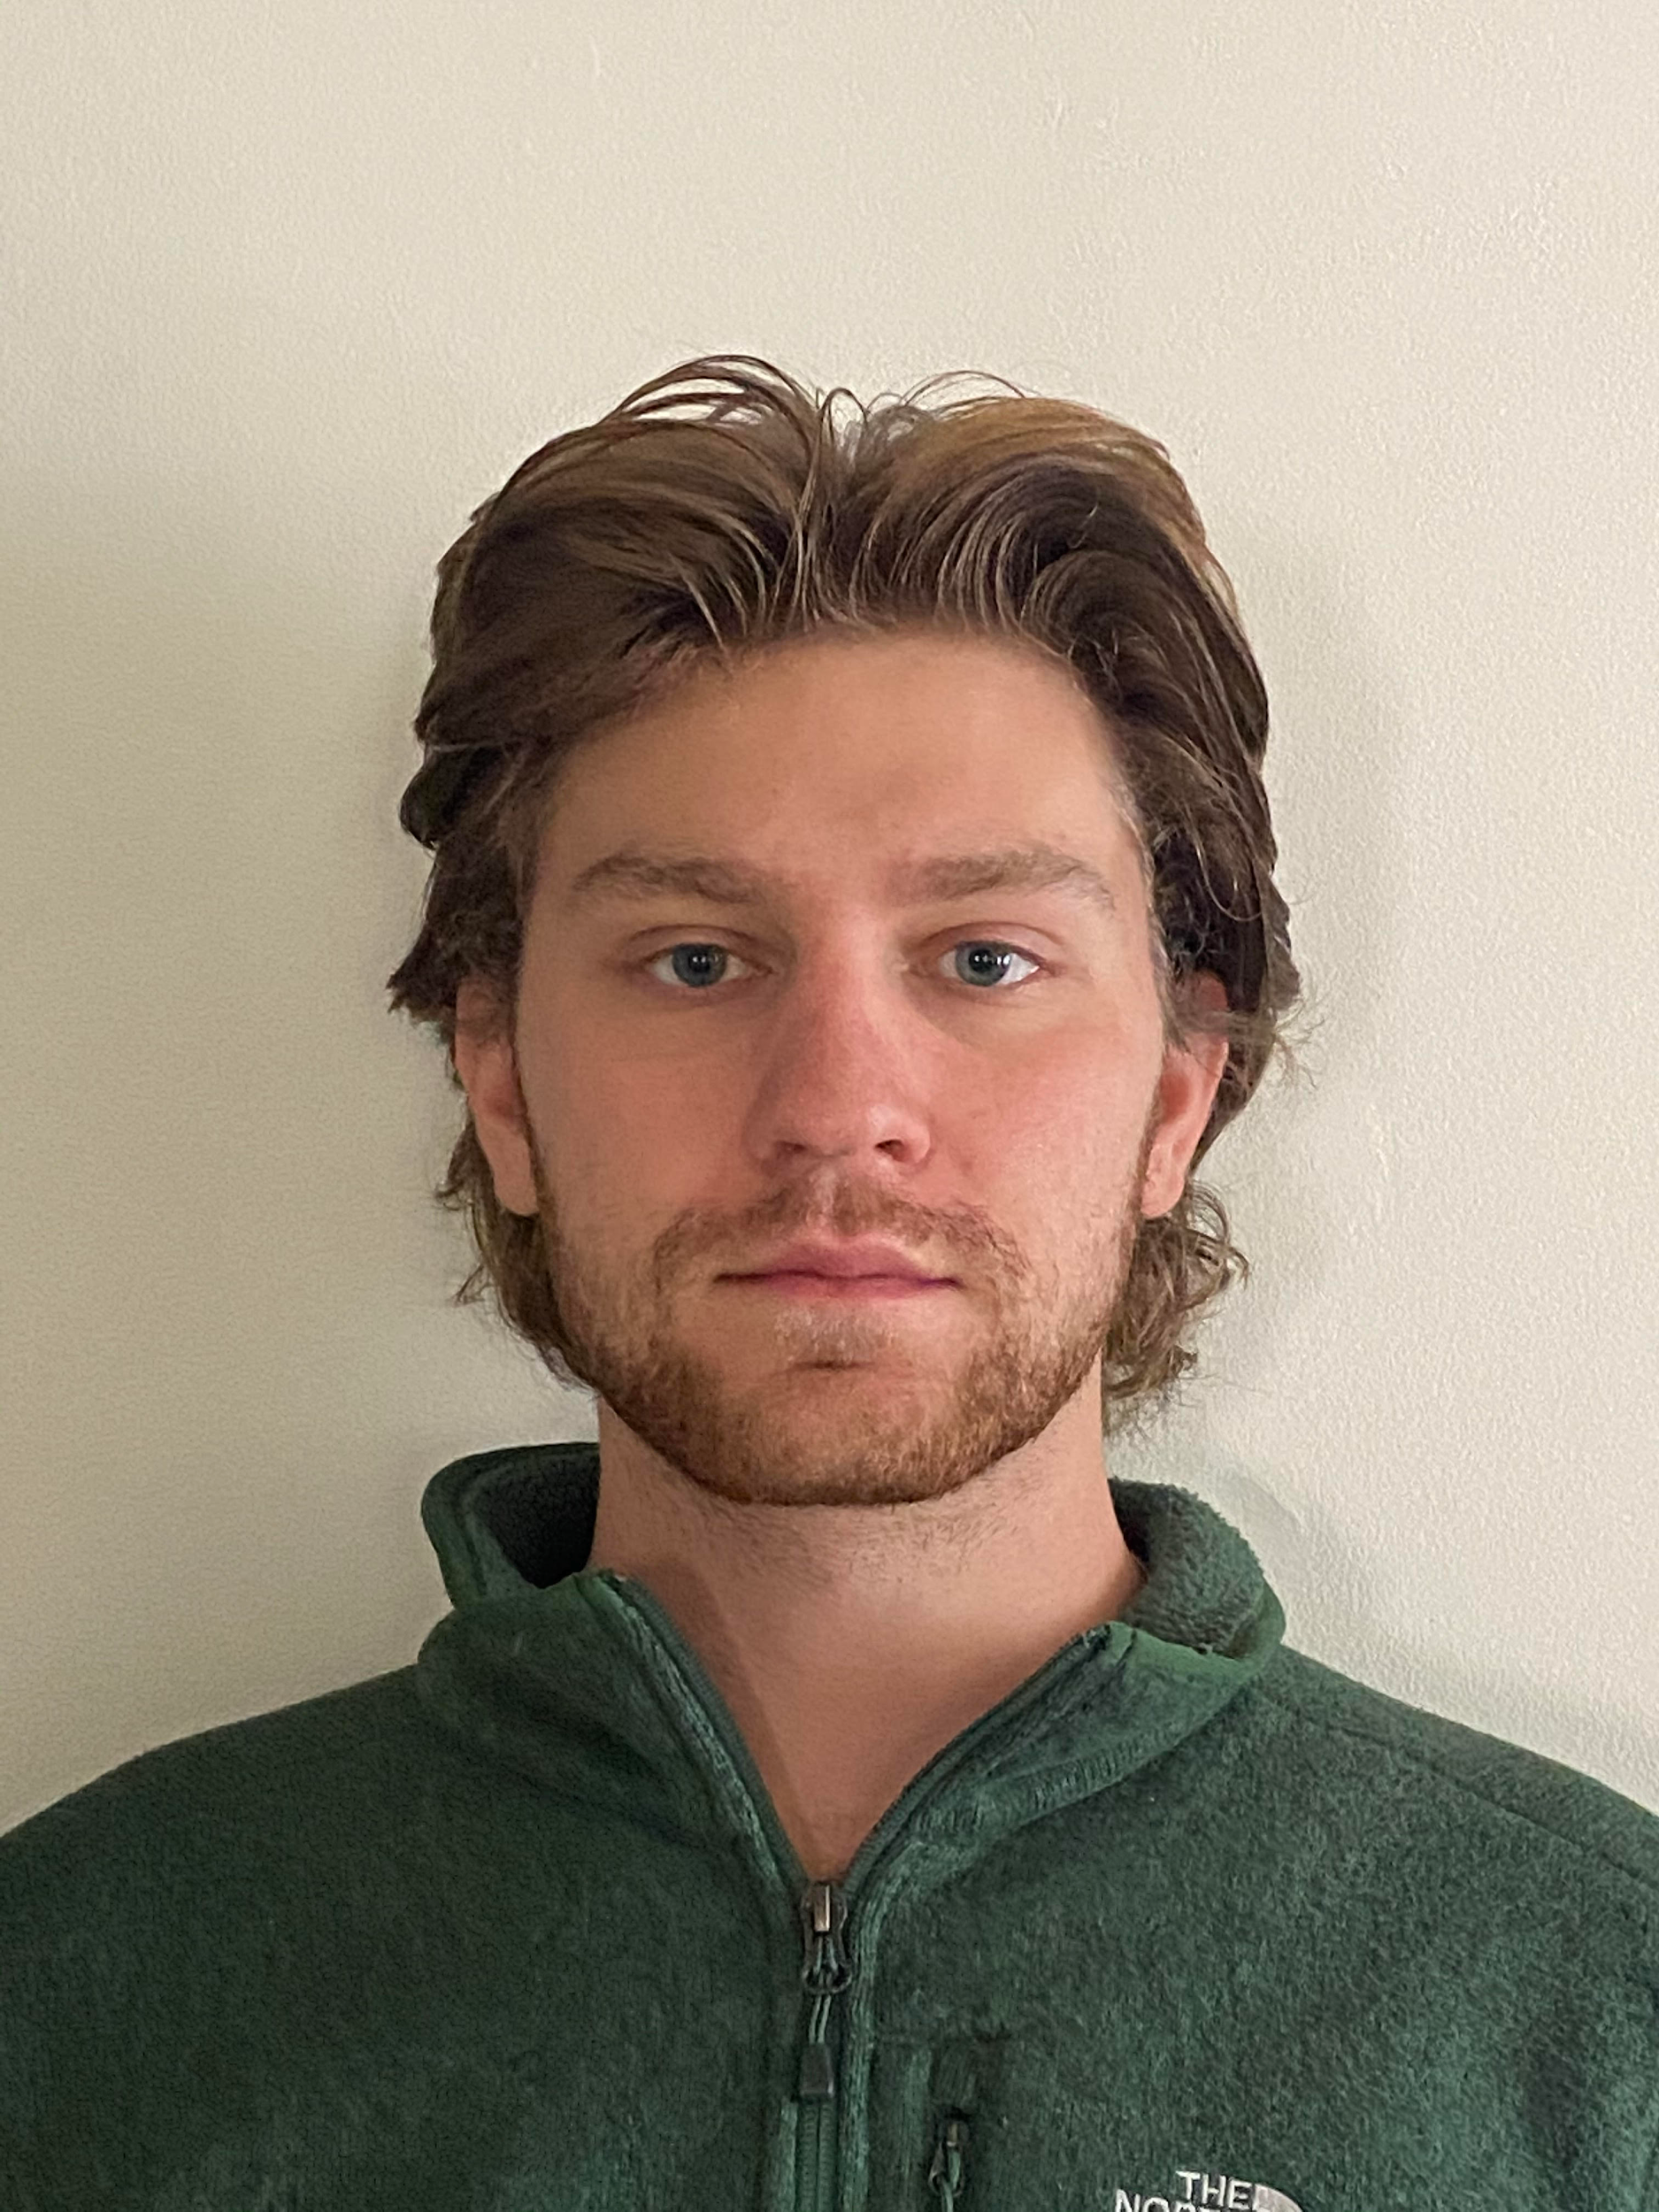
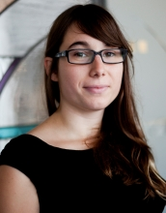
HELLO!
Maxwell Rapier
Electrical Engineer
Andrew Hartnett
Computer Engineer
Jonathan Townsend
Electrical Engineer
Damian Gunadasa
Computer Engineer
Shira Epstein
Faculty Advisor

Slide 3
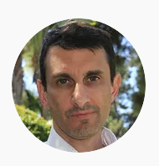
Manhattan 2
Glenn Weinreb - CTO of Manhattan 2
Glenn is the founder and CEO of GW Instruments a manufacturer of data acquisition hardware and software. He has designed approximately 30 commercial systems that connect processors to gadgets within a building. He founded this company in 1985 while an electrical engineering student at MIT. Glenn is experienced with designing analog and digital electronics, writing software, web design, doing mechanical design, raising venture capital (from Sigma Partners), sales/marketing, and manufacturing.
Manhattan 2 - Company looking to develop Active Window
Manhattan 2 is a 501c3 non-profit corporation that mobilizes top scientists to solve large problems that threaten our society. They develop electrical, mechanical, and communications standards that define how low CO2 devices interconnect within the building of the future.

Slide 4
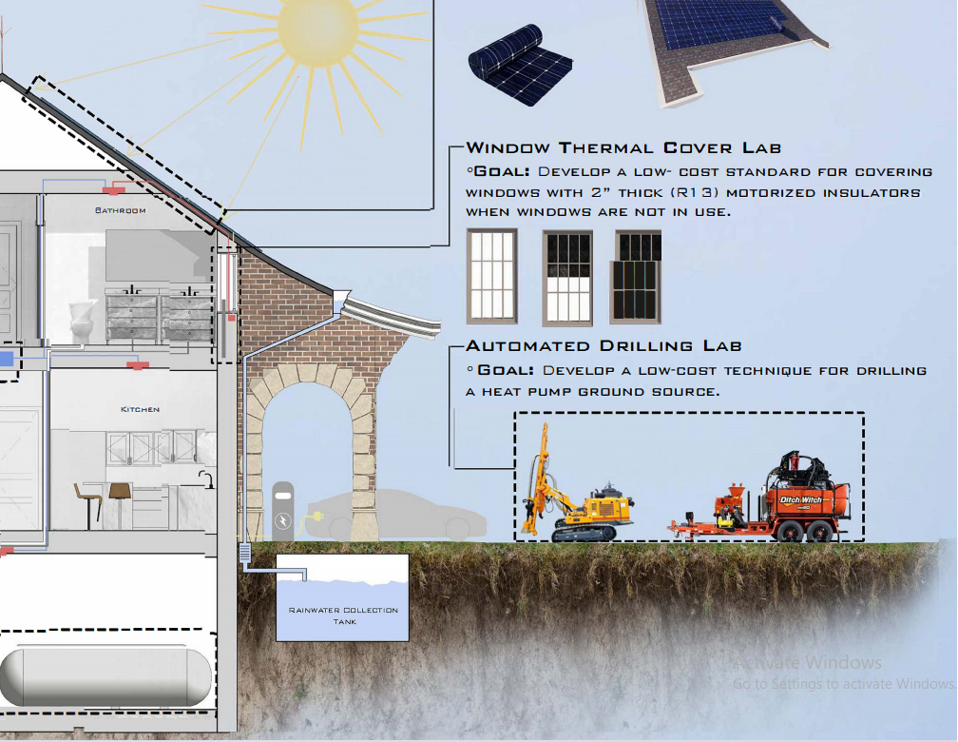
Problem Statement
Background: Smart home technology greatly improves home efficiency. Smart window technology stands to further increase efficiency in terms of power consumption by incorporating sensors that track real time environmental data and by networking sensor data between windows. This allows users to set automated preferences relating to temperature, pressure, humidity and sunlight to create a suitable, personal environment within the home bypassing traditional HVAC solutions
Goal: Design a user interface that controls a system of motors based on environmental data from sensors to regulate indoor environments robustly between windows.

Slide 5
Preliminary System Specifications
The Active Window - Window Primary Control Module will meet or exceed the following system specifications:
1. Supports communication with network via WallBus (CAN Bus) 2. Supports communication with inter-window motors via WindowBus (CAN Bus) 3. Allow the user to set the height at which the window, thermal cover, and blinds are opened/drawn 4. Allow the user to create a time schedule to open/close parts of the window 5. Allow the user to stop smart capabilities of the window, returning it to a simple mechanical device 6. Measure temperature, humidity, air pressure, and light inside and outside the room 7. Display the height at which the window, thermal cover, and blinds are opened/drawn 8. Ability to enter Sleep mode when not being used, can enter Active mode upon user touching screen 9. Volume (LxWxH): 1,536 cubic cm. (12 x 16 x 8 cm) (93.7 cubic in. (4.72 x 6.30 x 3.15 in)) 10. Last more than 50 years before needing replacement

Slide 6
Prototype Cost Estimates:
Component Overview

Slide 7
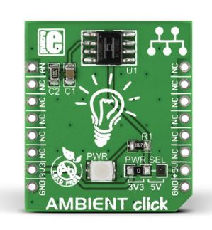
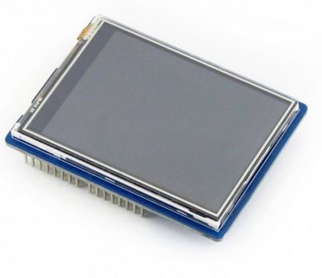
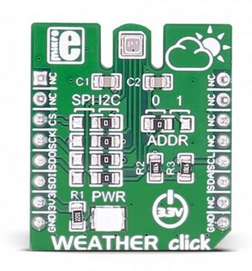
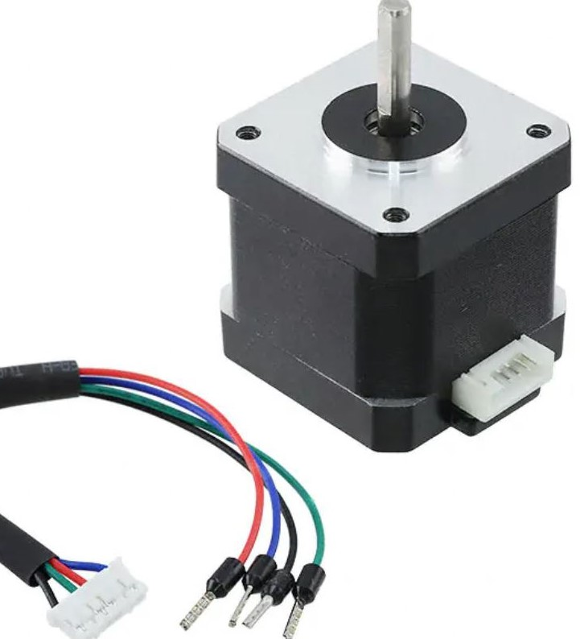
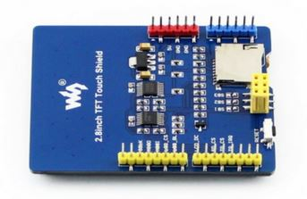
Prototype Components
Light Sensor
Touch Interface- Front
Weather Sensor
Stepper Motor
Touch Interface- Rear

Slide 8
Competing Solutions-Fenestra Smart Window Technology
Manufacturer: Fenestra
Product Overview: By automatically opening and closing the windows in your home at precisely the right time, fresh air from the outdoors can circulate seamlessly through your home, flushing out stale and dirty air in the process. During summer, temperatures rise, A/C use increases considerably, as does electricity consumption. fenestra helps cool your home easily and conveniently with fresh morning air. As the day goes by and temperatures begins to rise, fenestra conveniently responds by closing windows.
System Specs: - Motor: 6 volt electric motor mechanism. - Security: Temperature and movement sensors onboard. - Chipset: ATMEL® Microcontroller + ZigBee® Radio. - Connectivity: Samsung SmartThings®. - Power: High capacity LiO battery charged by a 6 Watt solar panel. - Operation: Controlled using any smartphone/tablet via the SmartThings® app. - Control Range (May Vary): 325 feet (100 meters).
http://www.smartfenestra.com/products

Slide 9
Competing Technology Companies
HDH Technology - “Create and build custom automation systems to fit your needs”
Motorized Shades and Drapes
Services include residential and commercial infrastructure
Hogar Controls - “Smart Home Controllers for A Smarter Everything”
Motorized Curtains
Automatic Temperature Control
Residential, Hospitality and Commercial market
SmartThings - “Easily control, monitor, and secure your home”
Smart Thermostats
Motorized, controllable smart shades, solar covers, blinds
Primarily residential, customizable application

Slide 10
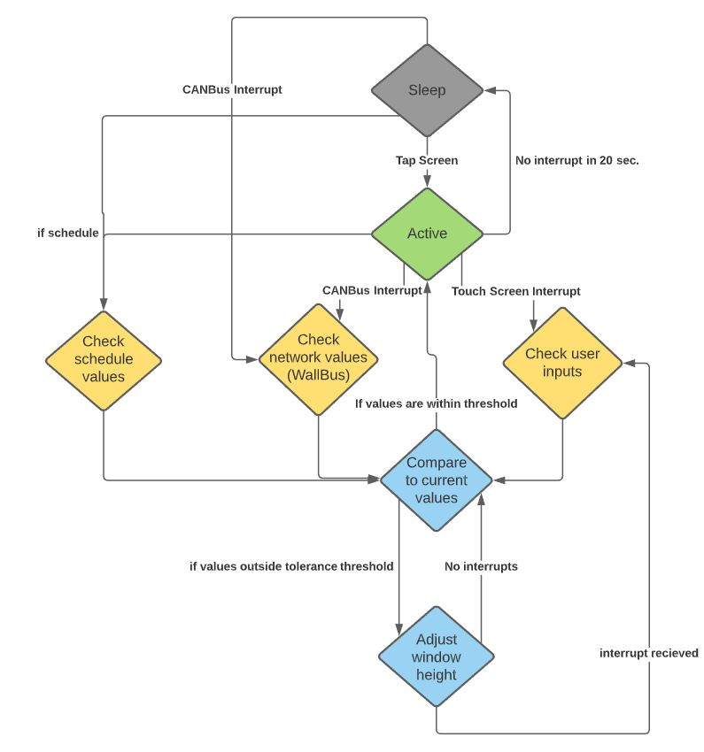
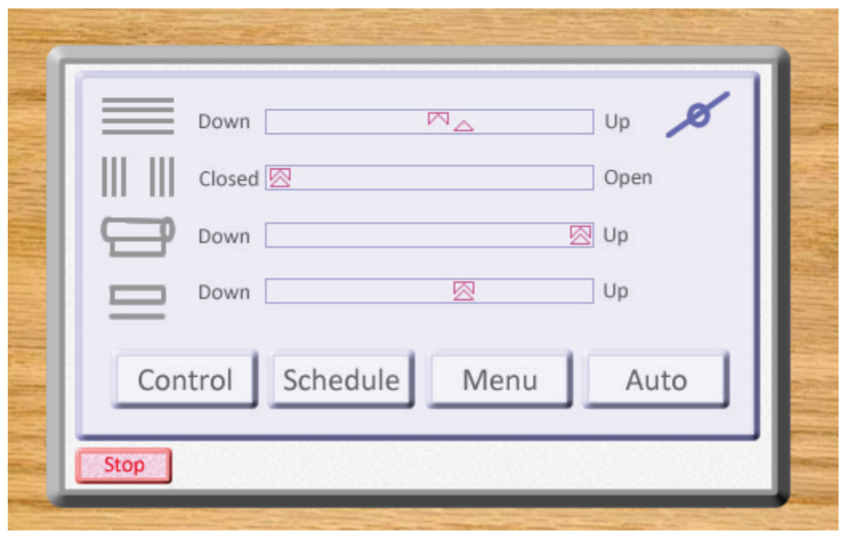
System Software Block Diagram
Source: Manhattan2 Active Window Development Initiative

Slide 11
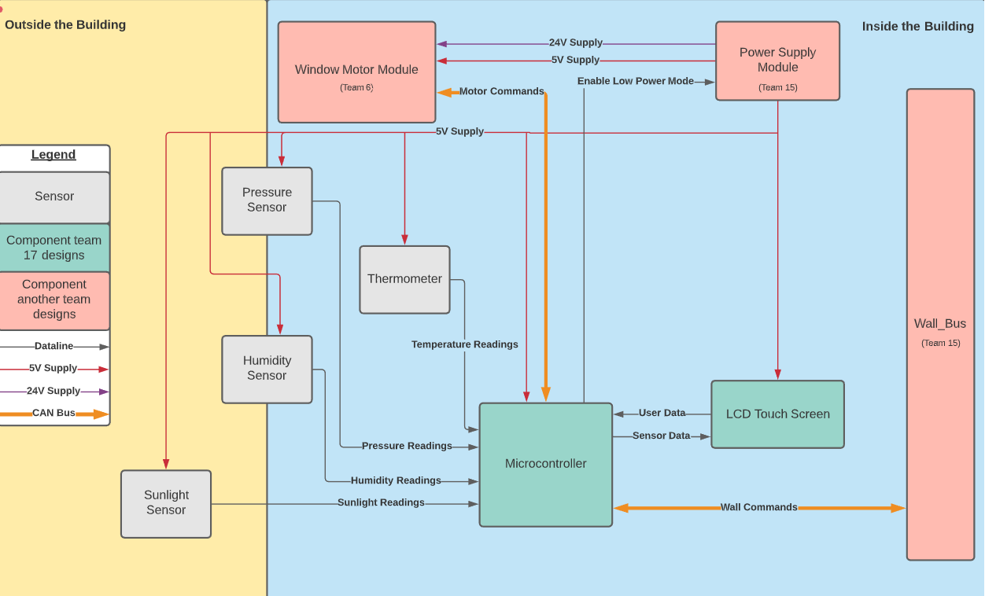

Slide 12
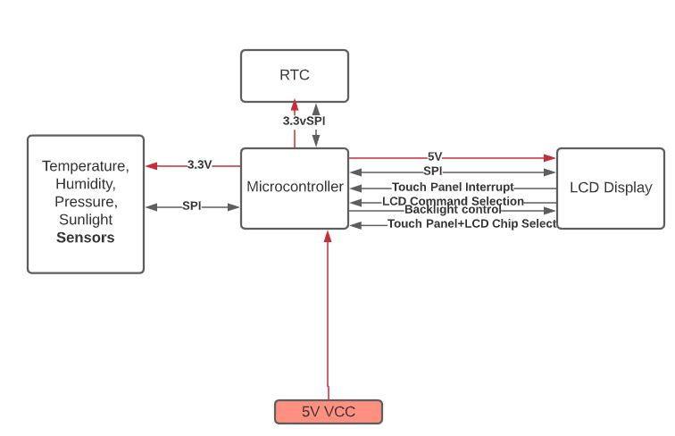
Significant Custom Hardware
Microcontroller
Peripherals
Supports SPI, I2C, and UART
Click boards (Sensors)
Weather click, Ambient click
SPI Interface
LCD Display Shield
SPI Interface
Interrupts
Real time clock
CANBus click boards
Interface WindowBus and WallBus

Slide 13
MDR Deliverables
Send a message via CAN bus
Demonstrate data to and from the LCD touch screen
Demonstrate we can get readings from each of our sensors
Control Stepper Motor
Finalize parts list and assure system will last 50 years

Slide 14
Technical Responsibilities
Maxwell Rapier
Team Coordinator
CANBus
Andrew Hartnett
Technical Lead
LCD Display
Jonathan Townsend
Budget Manager
Motor Driver
Damian Gunadasa
Altium Lead
Weather click

Slide 15
Overarching Category | Task | Team Member | Week 1 | Week 2 | Week 3 | Week 4 | Week 5 | Week 6 | Week 7 | Week 8
CANBus | Arduino UNO “Hello World” | Max
CANBus | CANBus Testing | Max
Motor | Arduino UNO “Hello World” | Jon
Motor | Stepper Motor Testing | Jon
LCD | Arduino Uno “Hello World” | Andrew
LCD | LCD Testing | Andrew
Sensors | Arduino UNO “Hello World” | Damian
Sensors | Sensor Testing | Damian
50 Years | Checking 50 Year Requirement | All
MDR | Presentation | All

Slide 16
Thank You!

