Slide 1
Active Windows
MDR - Presentation
By Maxwell Rapier, Andrew Hartnett, Jonathan Townsend and Damian Gunadasa

Slide 2
HELLO AGAIN!
Maxwell Rapier
Electrical Engineer
CAN Bus
Team Coordinator
Andrew Hartnett
Computer Engineer
User Interface
Website Czar
Jonathan Townsend
Electrical Engineer
Motor Control
Budget Manager
Damian Gunadasa
Computer Engineer
Sensors
Altium Lead
Shira Epstein
Faculty Advisor & Enormous Help

Slide 3
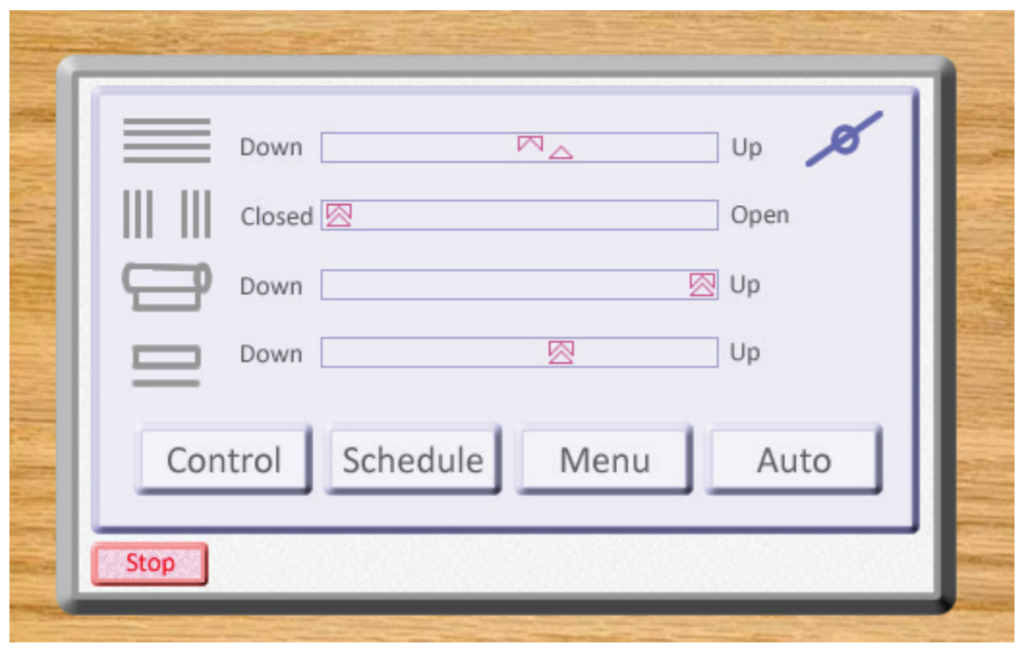
Our Problem Statement
Goal: Design a user interface that utilizes environmental data from sensors to allow a user to receive scheduling information that controls windows in their house.

Slide 4
Updated System Specifications
The Active Window - Window Primary Control Module will meet or exceed the following system specifications:
1. Supports communication with network via WallBus (CAN Bus) 2. Supports communication with inter-window motors via WindowBus (CAN Bus) 3. Allow the user to set the height at which the window, thermal cover, and blinds are opened/drawn 4. Allow the user to create a time schedule to open/close parts of the window 5. Allow the user to stop smart capabilities of the window, returning it to a simple mechanical device 6. Measure temperature, humidity, air pressure, and light inside and outside the room 7. Display the height at which the window, thermal cover, and blinds are opened/drawn 8. Ability to enter Sleep mode when not being used, can enter Active mode upon user touching screen 9. Volume (LxWxH): 1,536 cubic cm. (12 x 16 x 8 cm) (93.7 cubic in. (4.72 x 6.30 x 3.15 in)) 10. Last more than 50 years before needing replacement

Slide 5
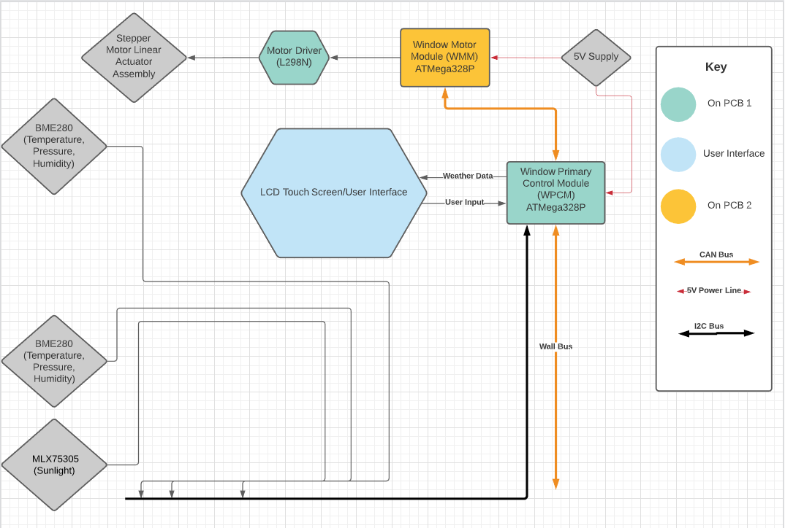

Slide 6
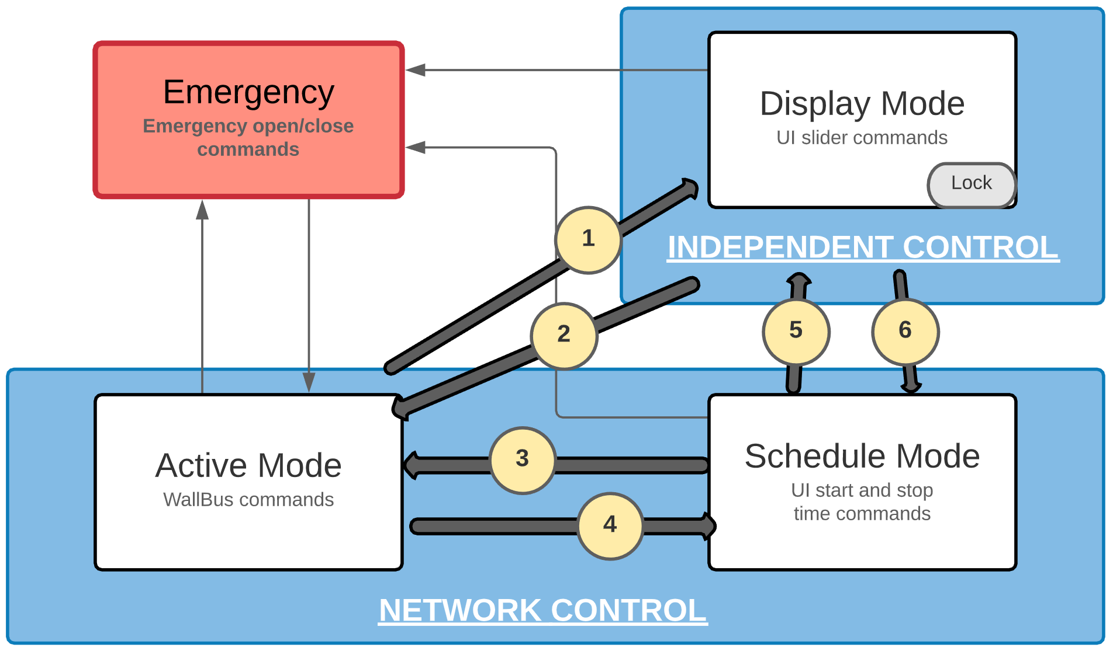
Active Window Command Hierarchy
4 Modes:
Active: WallBus commands determine window height
Display: User sets height via touch screen
Schedule: User sets schedule to open/close window to
Emergency: Activated via network, waits to receive “All clear”
Emergency commands will always have priority, while selected mode commands will come second:
1&2. User can switch between Active and Display mode at the touch screen at any time. Lock function will prevent anything (WallBus, sliders, or schedule) except Emergency commands from changing the window height. Lock can only be set/unset from the touch screen.
3&5. User can decide to switch into Active or Display mode once their schedule command finishes (or switch to Display by interrupting the schedule).
4&6. Schedule Mode will be automatically entered when a scheduled start time is reached.

Slide 7
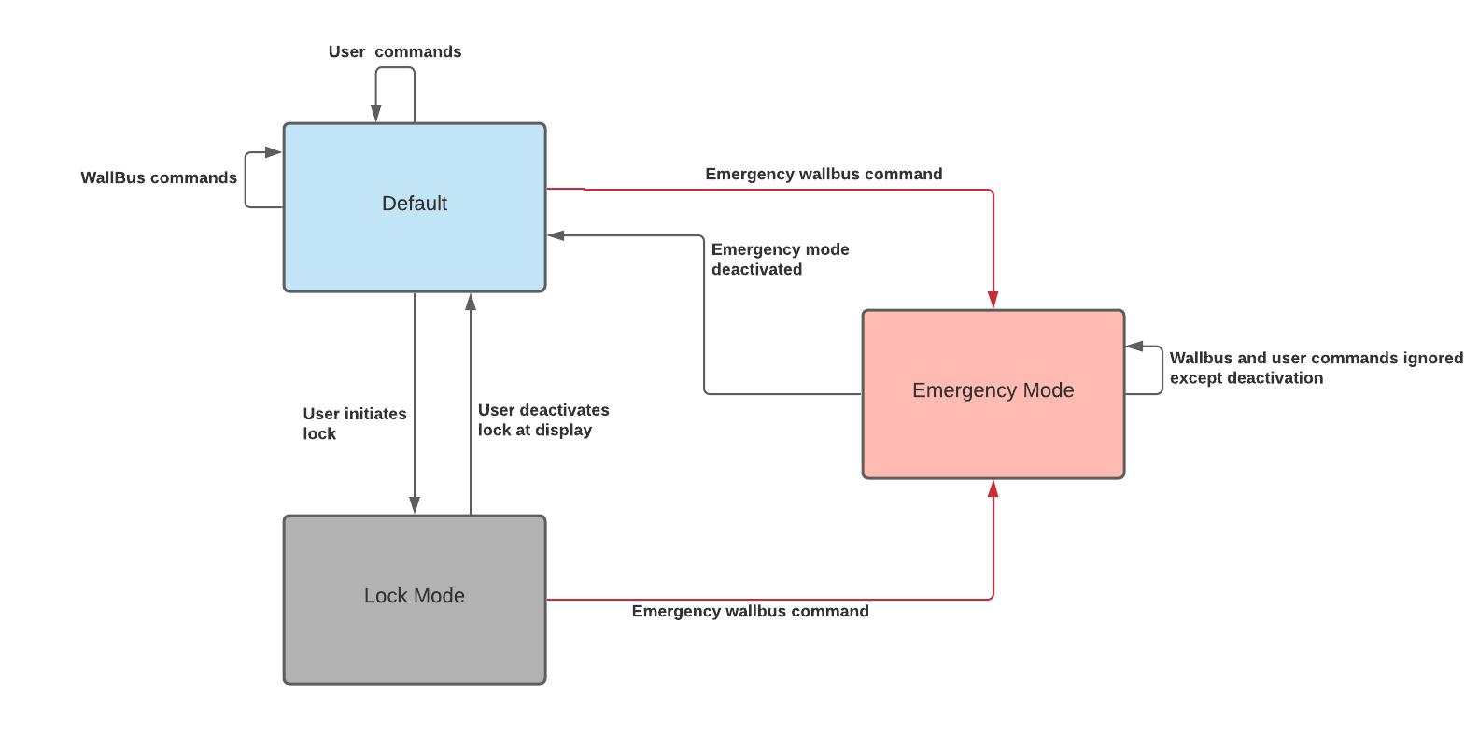
Updated Software Diagram (WPCM)

Slide 8
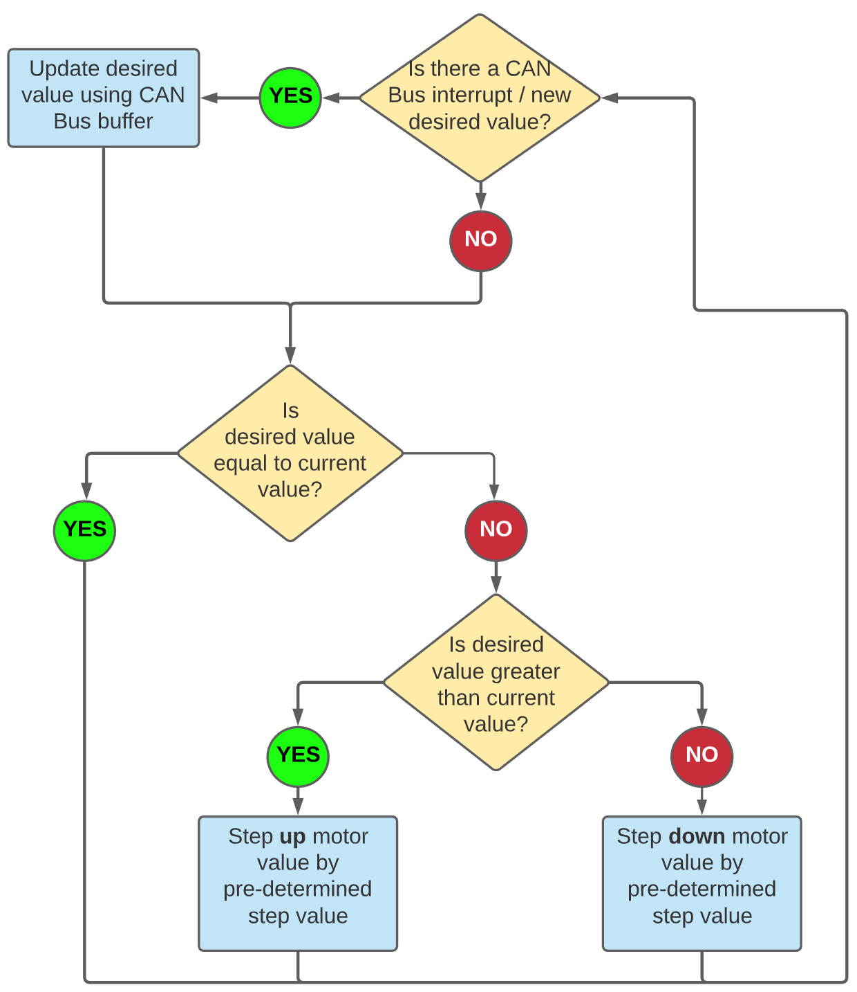
Updated Software Diagram (WMM)

Slide 9
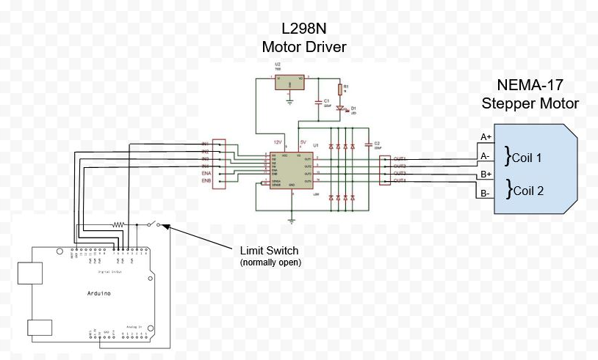
Deliverables - Motor Control
Installed Features
Homing position upon system initialization
Specific distance control via user input
Directional control via user input
Integration with CanBus: able to receive and execute CanBus communications
Directional Control
Can Demo
https://www.arduino.cc/en/Tutorial/BuiltInExamples/Button
https://components101.com/modules/l293n-motor-driver-module

Slide 10
Deliverable - User Interface Display Demo
What We Have Done:
**Transferring data to / from Touch Screen (MDR GOAL)
Main Menu
Allows user access between different window toggles (Network and Manual)
Slider Menu
Allows user to set values for window height, thermal cover, and blinds
Displays slider percentage to user
What We Plan to Design:
A CAN bus communication line between the Touch Screen and motors
Communication between the sensors and display (to show current temperature in the room, override Manual mode)
Allow user to input automatic schedule through Schedule Menu

Slide 11
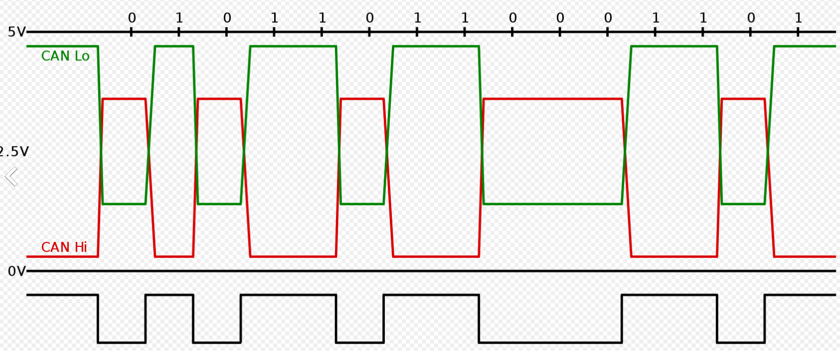
CAN Bus
2-Wire Interface - Uses only two wires to communicate
Asynchronous - There is no clock signal
Multi-Master - Any device in the network can be either a master or a target device
Bitwise Arbitration - Device that sends first zero gains control of the bus
Figure 1: Example of CAN Bus Network https://tekeye.uk/automotive/can-bus-cable-wiring
Figure 2: CAN Bus 2-Wire Output https://support.squarell.com/index.php?/Knowledgebase/Article/View/94/7/can-high--can-low

Slide 12
CAN Bus Message Structure
Figure 3: Example CAN Bus Message https://www.electronicsweekly.com/news/high-speed-can-fd-bus-is-coming-to-cars-says-microchip-2015-10/

Slide 13
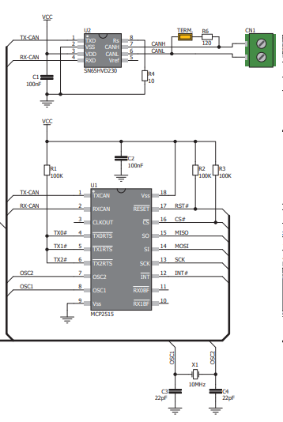
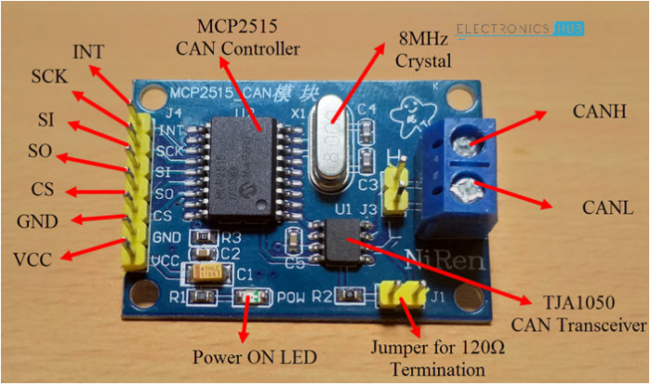
Our Current CAN Board
Made of two chips - Can controller (MCP 2515) and Can transceiver (TJA 1050)
Arduino communicates to controller via SPI
Controller controls what message transceiver outputs and interprets what the transceiver inputs
Transceiver delivers/receives actual Can bus message
CAN Bus Demo
Figure 4: CAN Board we are currently using, XSOURCE CAN Board https://www.electronicshub.org/arduino-mcp2515-can-bus-tutorial/
Figure 5: Example of board wiring https://www.mikroe.com/can-spi-33v-click

Slide 14
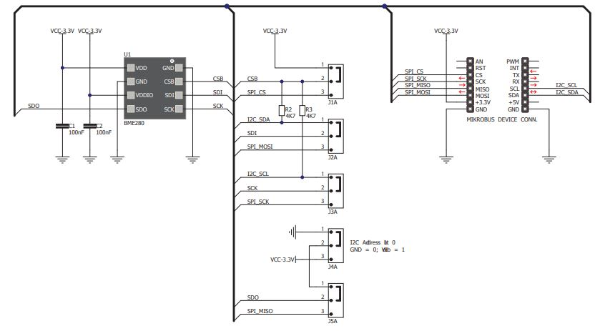
Deliverable - Weather Data (Damian)
What We Have Done
Enabled communication via I2C with the Weather Click and Microcontroller
Obtained readings for humidity (%), temperature(C), and pressure (hPa)
Collected ambient light readings via analog connection
Readings obtained as illuminance (lux)
All data is logged into a spreadsheet where we can take averages and plot data
Researched usage of filtering modes, resolution of data, and active/sleep modes of the sensors
https://www.mikroe.com/weather-click
What We Plan to Design
Design system (sensors) without click boards using chips on the boards
Full integration of weather sensors and data so data can be read by microcontroller and create responses via motor
Send sensor data to Display

Slide 15
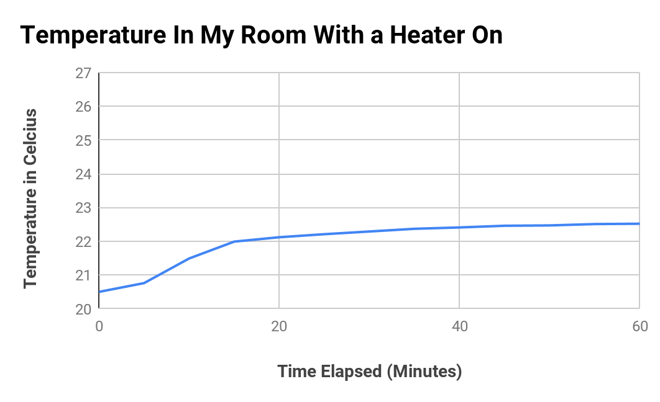
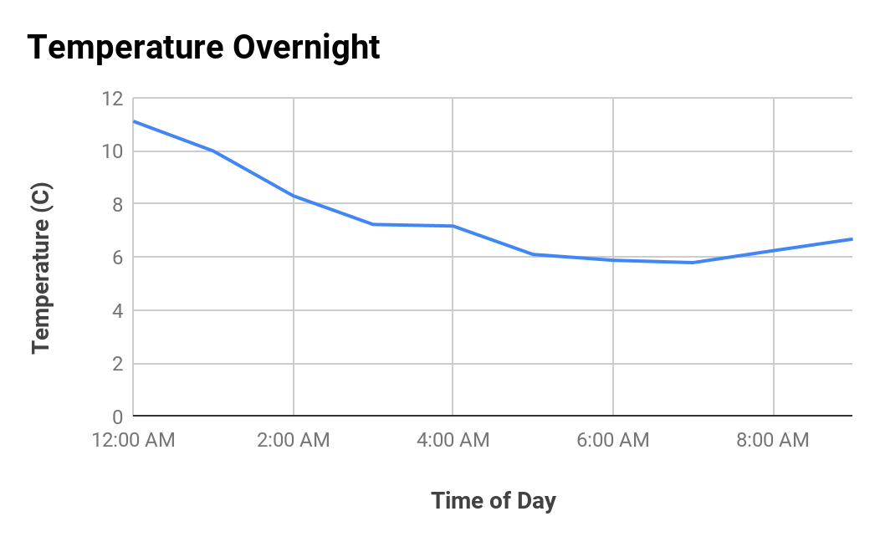
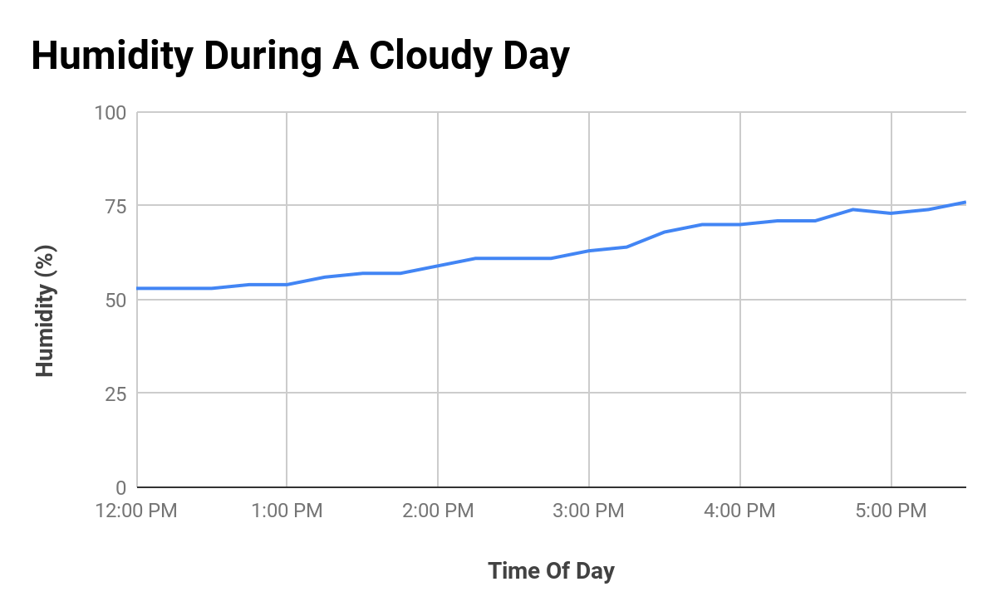
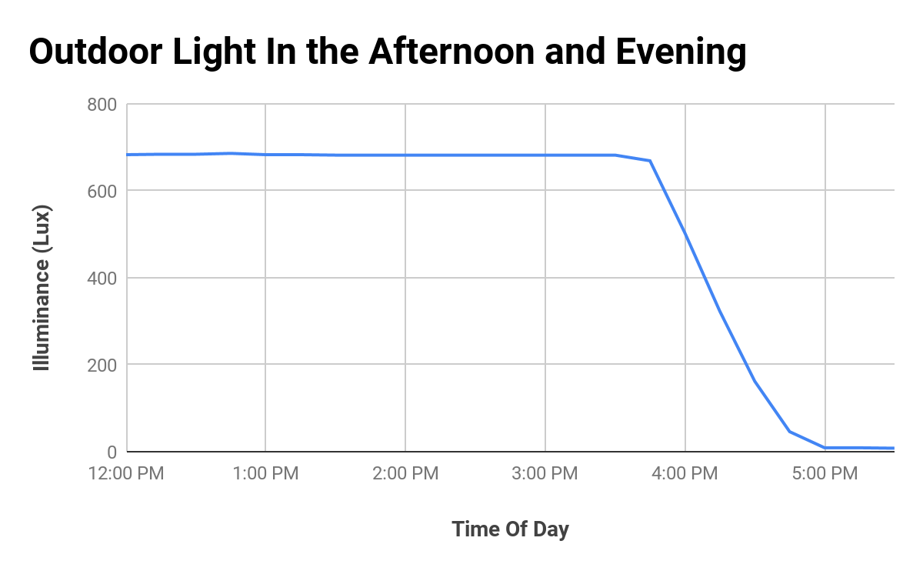
Weather Data

Slide 16
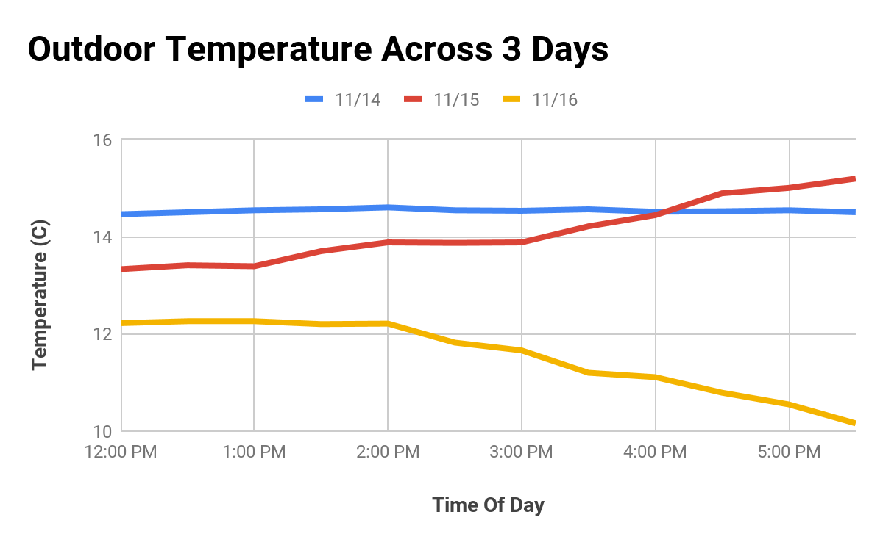
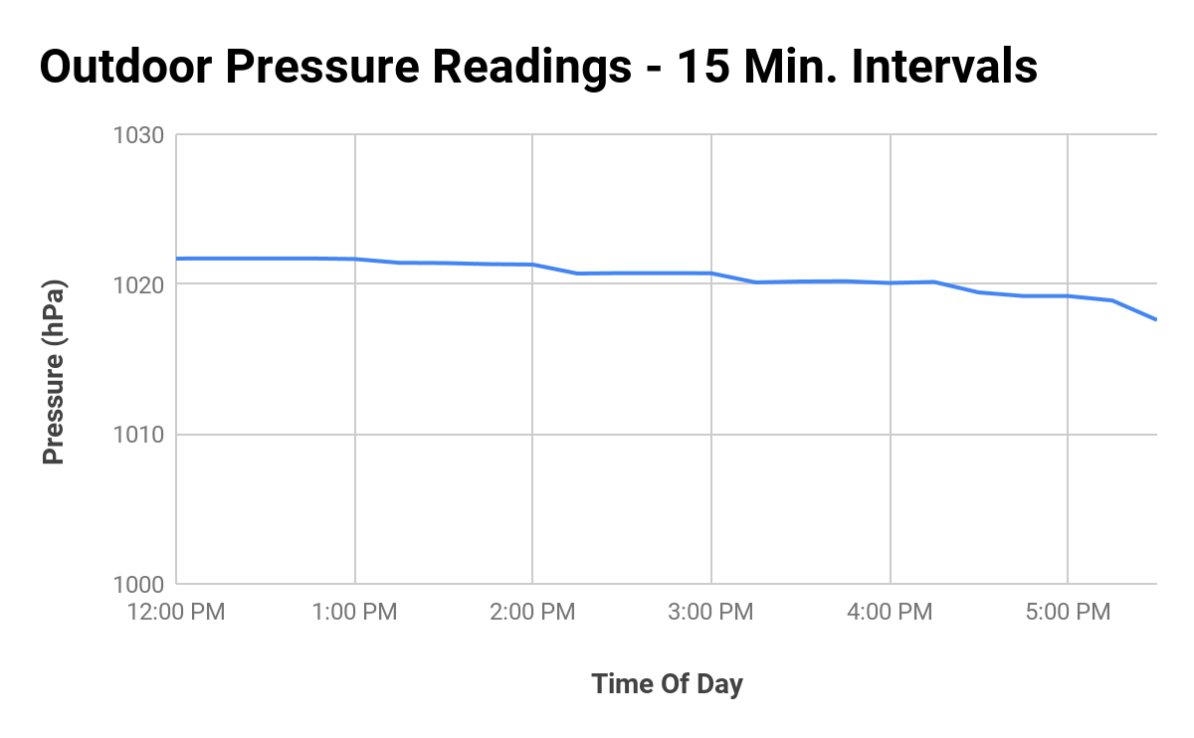
More Weather Data

Slide 17
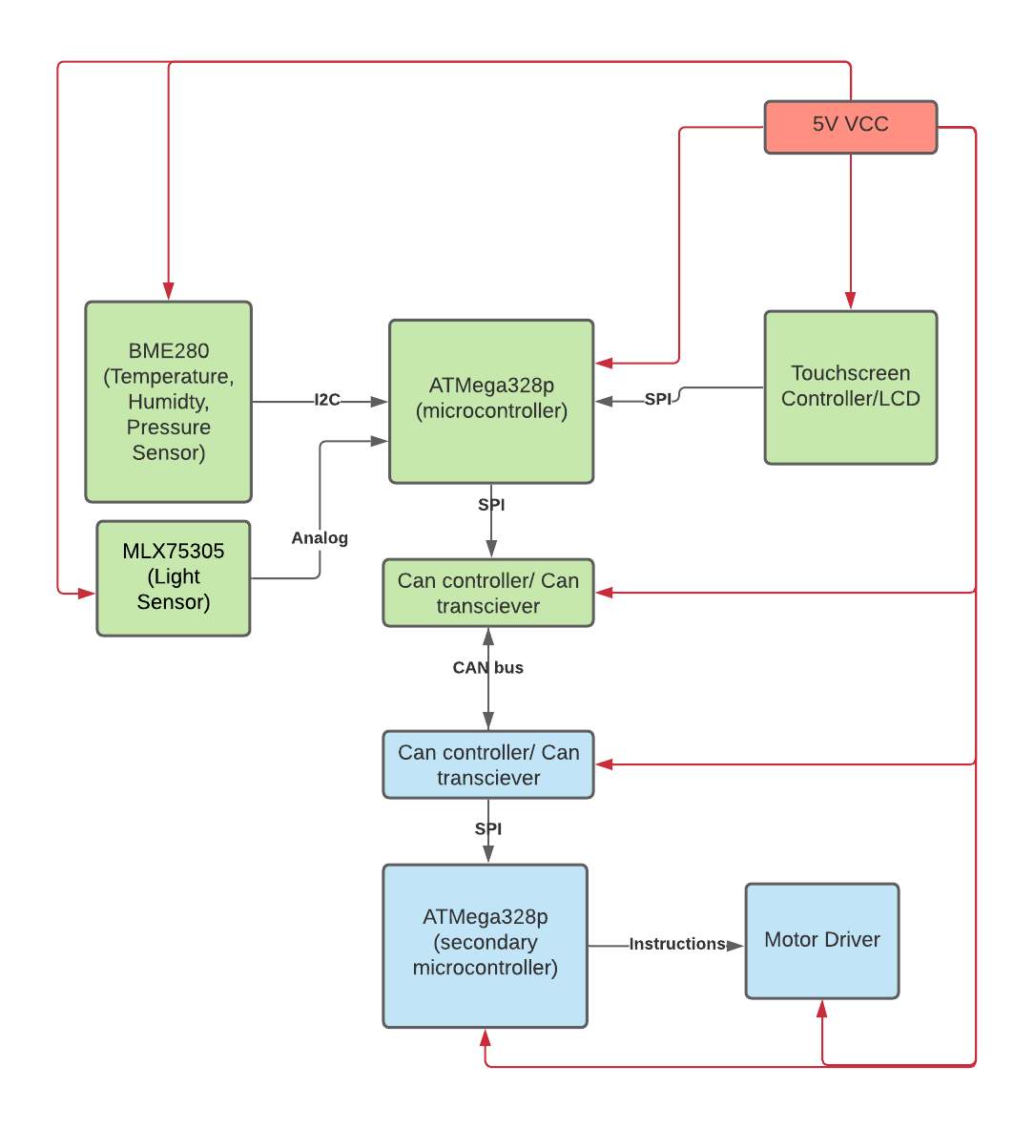
Custom Hardware Plan
Microcontroller x2
ATMega328p
Chips from the Click Boards
Weather Click- BME280
Ambient Click- MLX75305
CAN SPI Click - MCP2515 and TJA1050
Motor Driver and Motor
RTC
Will keep the breakout board for LCD
3.5" TFT 320x480 + Touchscreen
Will test and use Altium

Slide 18
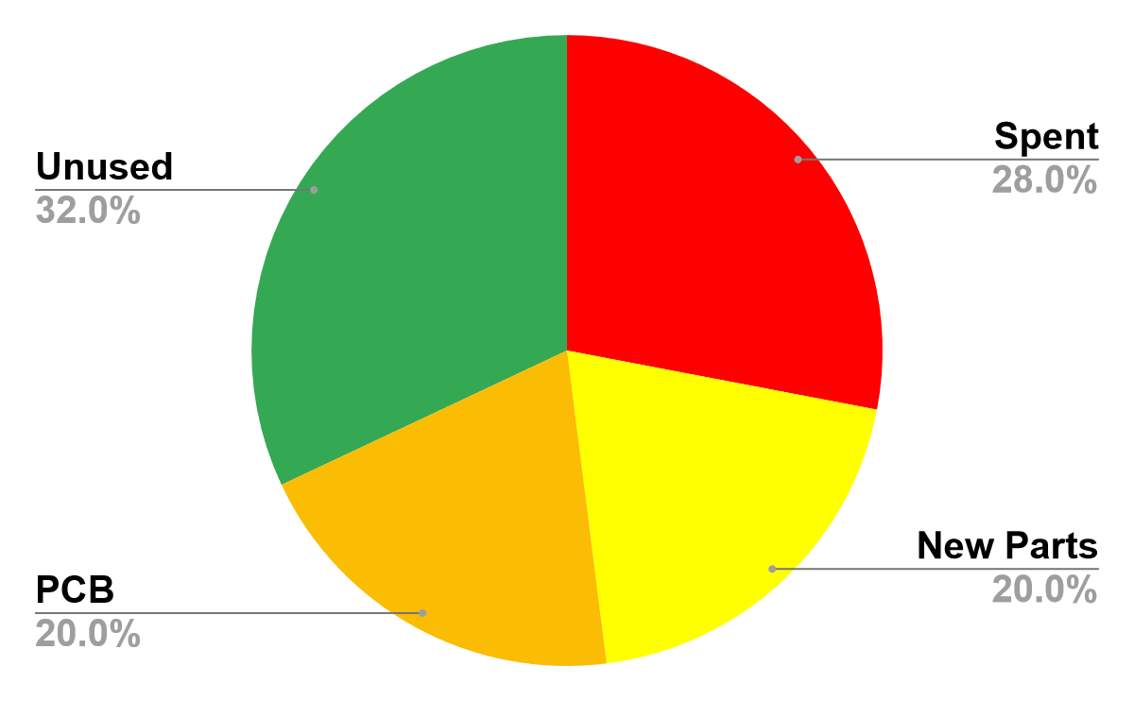
Budget Update
Fall Parts Purchase
Part | Part Number | Quantity | Cost | Totals
2.8" Touch LCD Display Shield | 1528-1027-ND | 1 | $34.95 | $34.95
Weather click by Mikroe | MIKROE-1978 | 1 | $22.88 | $22.88
Ambient Click by Mikroe | MIKROE-1890 | 1 | $9.36 | $9.36
Arduino UNO Click Shield | MIKROE-1581 | 2 | $7.80 | $15.60
Can SPI Click | MIKROE-986 | 2 | $21.84 | $43.68
IC MCU | ATMEGA328P-PU-ND | 1 | $2.08 | $2.08
 |  |  |  | $128.55
Spent = $140 Spring Cost Estimate = $200 Unused = $160

Slide 19
Budget Update: Proposed Parts Purchase (SP21)
Part | Part Number | Segment of Project | Quantity | Cost | Totals
Can Controller | MCP 2515 | Can Bus | 3 | $2.52 | $7.56
Receiver | TJA1050 | Can Bus | 3 | $1.09 | $3.27
Microcontroller | ATMega 328P | Can Bus, Sensing, Motor, Display | 3 | $1.72 | $5.16
IC Bridge Driver | L298N | Motor Control | 1 | $4.86 | $4.86
Voltage Regulator | 78M05 | Motor Control | 1 | $0.48 | $0.48
Temp/Humidity/Pressure Sensor | BME280 | Sensing | 1 | $5.95 | $5.95
Optical Light Sensor | MLX75305 | Sensing | 1 | $2.33 | $2.33
3.5" TFT 320x480 + Touchscreen | HXD8357D | User Interface | 1 | $39.95 | $39.95
Resistive Touch Screen Controller | STMPE610 | User Interface | 1 | $9.95 | $9.95
 |  |  |  |  | $79.51

Slide 20
List of Software and Hardware
Component | Software/Hardware | Part Number
Dual H-Bridge Motor Driver | Hardware | L298N
Bipolar Stepper-Motor | Hardware | Nema-17
mcp2515 Library | Software
Arduino Uno | Hardware | A000066
Stepper Motor | Hardware | 28BYJ-48
Motor Driver | Hardware | ULN2003
XSOURCE CAN Board | Hardware | MCP2515
2.8" TFT Touch Shield for Arduino with Resistive Touch Screen | Hardware | 1651
Adafruit GFX Library | Software
Adafruit ILI9341 Arduino Library | Software
SPI Library | Software
Weather Click | Hardware | BME280
Ambient Click | Hardware | MLX75305
SparkFun_BME280_Arduino_Library | Software

Slide 21
Task | Team Member | Week 1 | Week 2 | Week 3 | Week 4 | Week 5 | Week 6 | Week 7 | Week 8 | Week 9 | Week 10 | Week 11 | Week 12 | Week 13
Motor Behavior | Jon |  |  |  |  |  |  |  |  |  | Debug / Integration
Simulating WallBus Setup | Max |  |  |  |  |  |  |  |  |  | Debug / Integration
Improving User Interface | Andrew |  |  |  |  |  |  |  |  |  | Debug / Integration
Altium | Damian |  |  |  |  |  | Test PCB | Test PCB |  | Test PCB | Debug / Integration
PCB | All |  |  | Design PCB | Order PCB |  | PCB Arrives | Possibly Re-Order PCB |  | New PCB Arrives
CDR | All
FPR | All
Demo Day | All

Slide 22
Thanks!

Slide 23
Q&A

