Slide 1
Active Windows FPR
By Maxwell Rapier, Andrew Hartnett, Damian Gunadasa, Jonathan Townsend
Notes:
Max

Slide 2
Good afternoon!
Maxwell Rapier
Electrical Engineer
CAN Bus
Team Coordinator
Andrew Hartnett
Computer Engineer
User Interface
Website Czar
Jonathan Townsend
Electrical Engineer
Motor Control
Budget Manager
Damian Gunadasa
Computer Engineer
Sensors
Altium Lead
Shira Epstein
Faculty Advisor & Enormous Help
Notes:
Max - Short intros, they know us by now

Slide 3
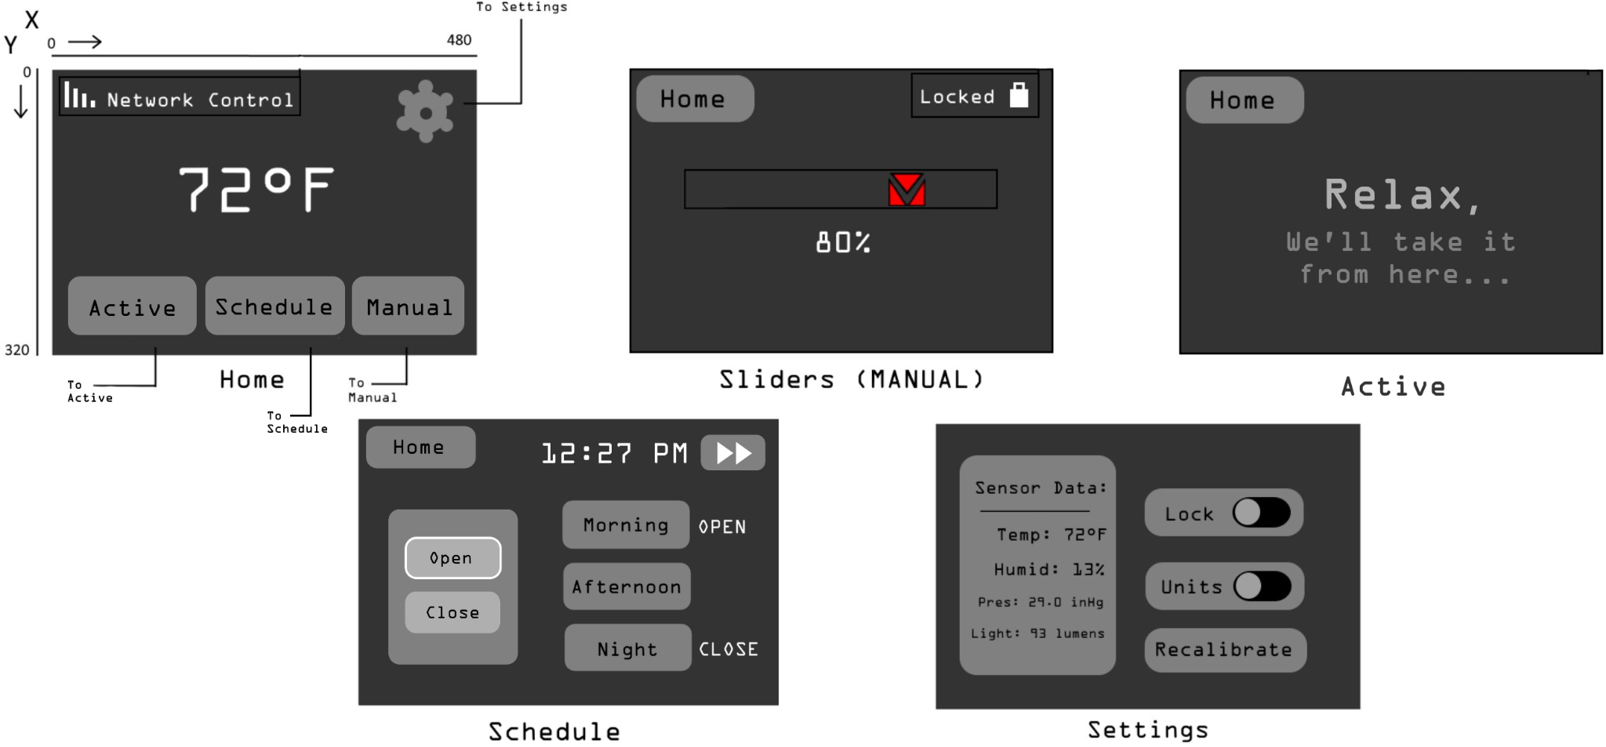
Our Problem Statement
Goal: Design a user interface that forwards environmental data from sensors to a server and allows a user to input scheduling information that controls windows in their house.
Notes:
Andrew - Contextualize the problem statement. They know this already. Both Active and Schedule are new UIs.
While we demonstrated Active mode during CDR we have since given it its own menu off the homepage. You may also notice the bottom left UI, this is brand new.

Slide 4
Updated System Specifications
1. Supports communication with network via WallBus (CAN Bus) 2. Supports communication with inter-window motors via WindowBus (CAN Bus) 3. Allow the user to set the height of the window 4. Allow the user to create a time schedule to open/close parts of the window 5. Allow the user to stop smart capabilities of the window, returning it to a simple mechanical device 6. Measure temperature, humidity, air pressure, and light inside and outside the room 7. Display the position of the window 8. Ability to enter Sleep mode when not being used, can enter Active mode upon user touching screen 9. Volume (LxWxH): 1,536 cubic cm. (12 x 16 x 8 cm) (93.7 cubic in. (4.72 x 6.30 x 3.15 in))
The Active Window - Window Primary Control Module will meet or exceed the following system specifications:
Notes:
#6: “We originally intended to measure temperature, humidity, and air pressure with a singular sensor, but that sensor has been out of stock for the entire semester so we moved forward with an analog temperature sensor”
#8: “we were unable to achieve sleep mode for this presentation, but as we will show later, with more time we believe we could implement it”

Slide 5
Decision to not use Custom PCB
Custom PCB Testing/Debugging Issues
PCB did not power Up
Trace continuity checks
Resoldering of parts sequentially
Improper Outputs from Voltage Regulators
Debugged 5V regulator and 3.3V regulators
Power to LCD
Time constraints with further testing and reordering of PCB
Certain parts like the BME280 were out of stock
Used soldered protoboards
All chips are properly soldered and connected using schematics
System functions as intended
User can interact with the LCD to control the motor
Motor responds effectively to CAN commands
Sensors read accurate data
Notes:
Damian - Compare pros and cons of sticking with PCBs and switching to protoboards (can be its own slide). What did we learn in this process? What caused the PCB to not work? What we tested: 5V regulator, getting 5V out and getting the correct voltage drop across the capacitors at either end. Getting power to the LCD screen
Began working on adding parts sequentially until finding the problem. Did not find the problem

Slide 6
Final Demo
Notes:
Max - Should network topology in the meantime, fill dead air with explaining the routing of data

Slide 7
Populated PCBs
4 separate PCBs
WPCM
WMM
Indoor Sensor
Outdoor Sensor
Main Components
Atmega328p in each board
Canbus modules in each board
3 in the WPCM board
1 in the other boards
RTC in WPCM
BME280 in indoor sensor board
BME280+Light sensor in outdoor sensor board
Motor module in the WMM board
Power Supply
9V supply for each board
3.3V and 5V voltage regulator on each board
Notes:
Damian - don’t speak in past tense, this is an ongoing project. “Our project is currently broke”

Slide 8
Summary of System
System uses three MCP2515 CAN controllers to receive and send information about motor position and sensor data across the network
LCD screen allows user to switch between modes, adjust the motor’s position via a slider, and displays the temperature
Communication to the CAN controllers occurs over a prototyping board.
Notes:
Jon

Slide 9
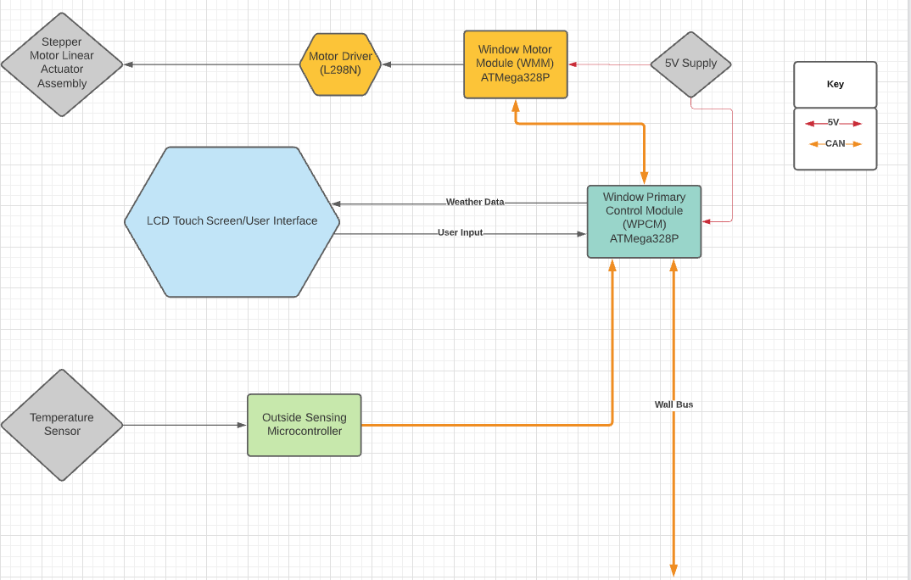
Hardware Overview
Notes:
Max - Indoor and outdoor sensor? Add the outdoor sensor

Slide 10
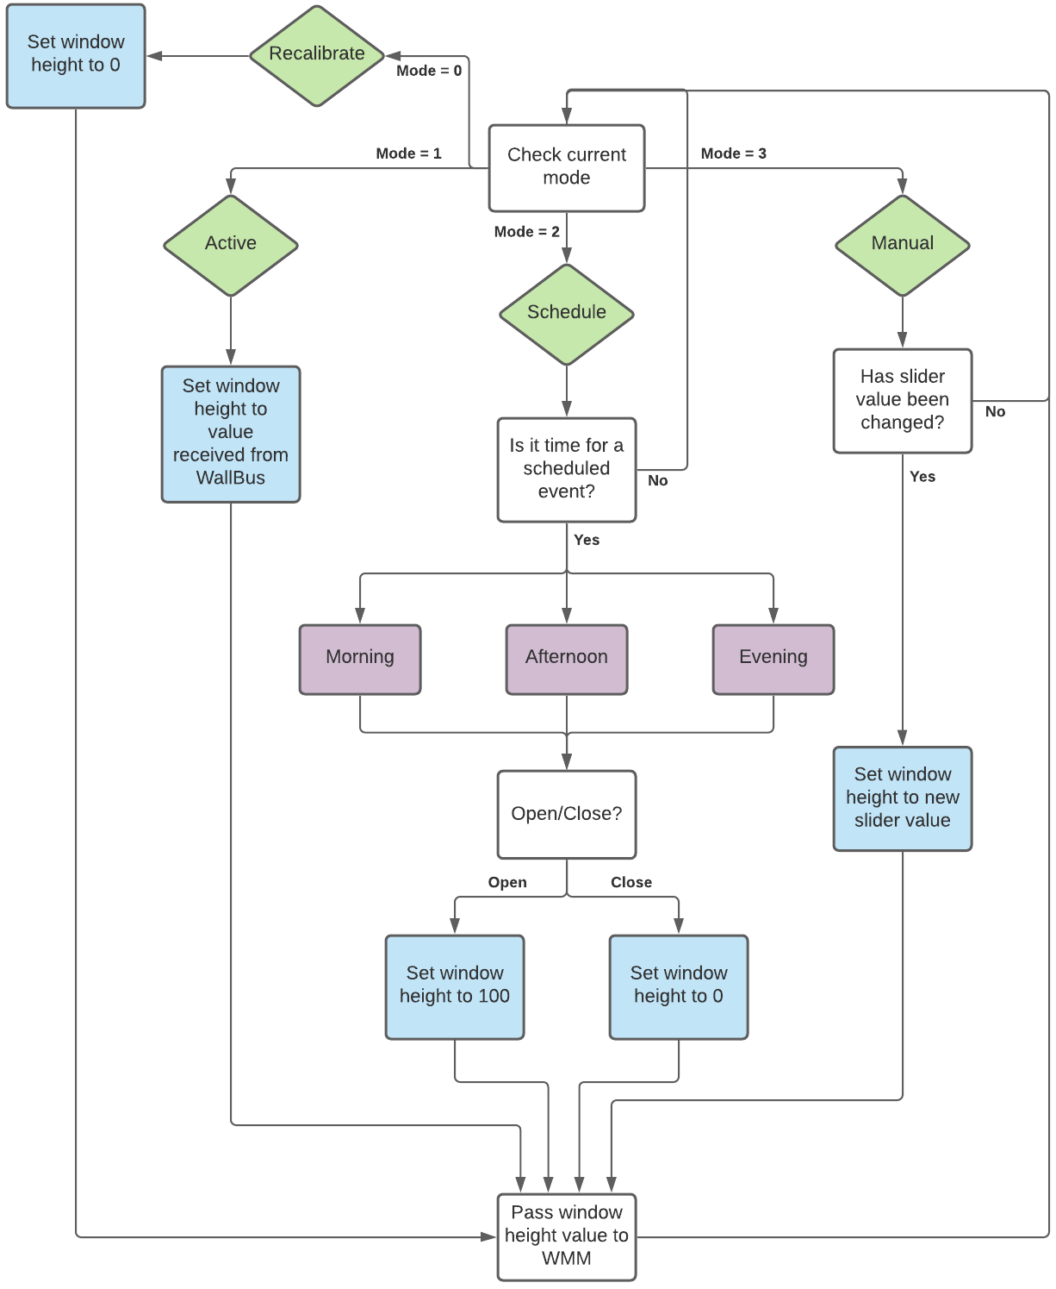
Software Overview
Window works in 3 modes (and 1 function):
Active Mode - WPCM forwards sensor data from MCP2515 to WallBus, which then returns the desired height of the window
Schedule Mode - User enters preset commands based on 3 popular times of the day. When time of day is reached, the height command is set for the window
Manual Mode - User adjusts the window height in real-time via a slider on the LCD display
Recalibrate - Forces the window to close until limit switch is hit. Useful due to drift in our linear actuator
Notes:
Andrew - Explain what it would look like to have a hierarchy between Modes, evaluators will ask. How could it be implemented in the future? Don’t necessarily need to go to in depth about having to shelf it Needed to shelf the hierarchy due to time constraints. Instead, the user can switch between Modes by selecting it from the homepage. Implementing hierarchy would look like using the real time clock on the board, which we have demonstrated in schedule mode. We planned to have a “timeout” where if the user was in manual mode then it would remain there for

Slide 11
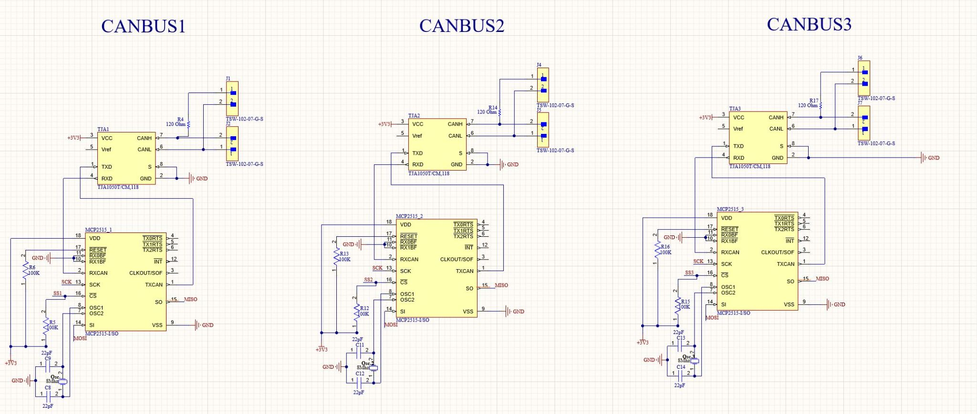
WPCM Schematics
Notes:
Damian - Bigger schematic things that we can see

Slide 12
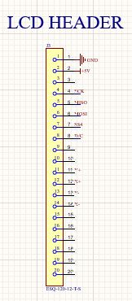

Slide 13
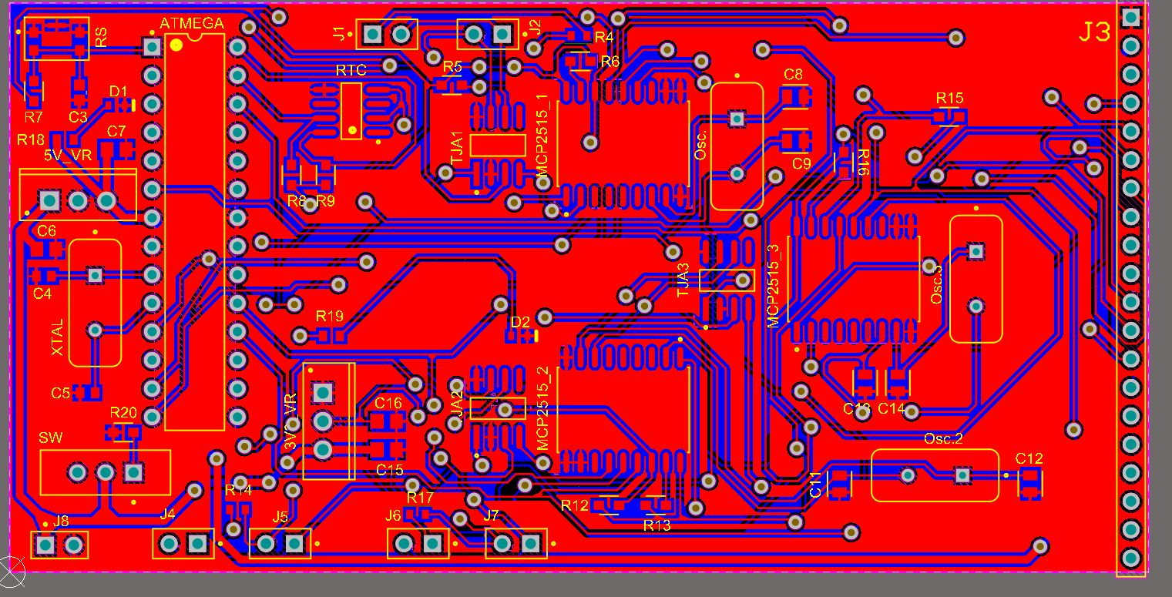
WPCM Layout
Notes:
Damian

Slide 14
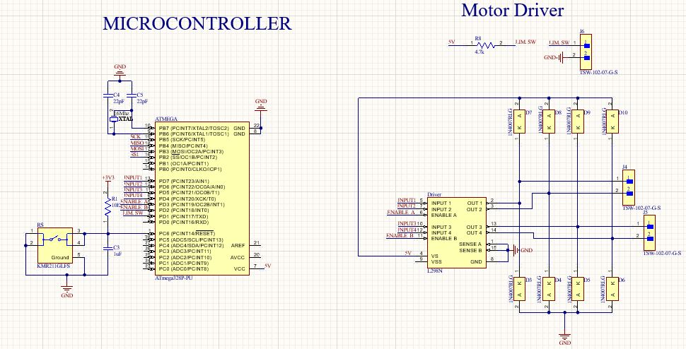
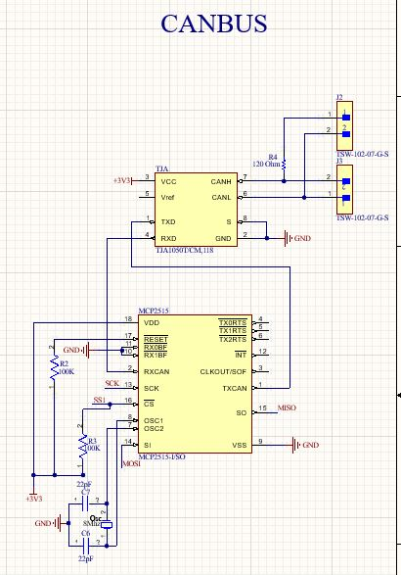
WMM Schematics
Notes:
Damian

Slide 15
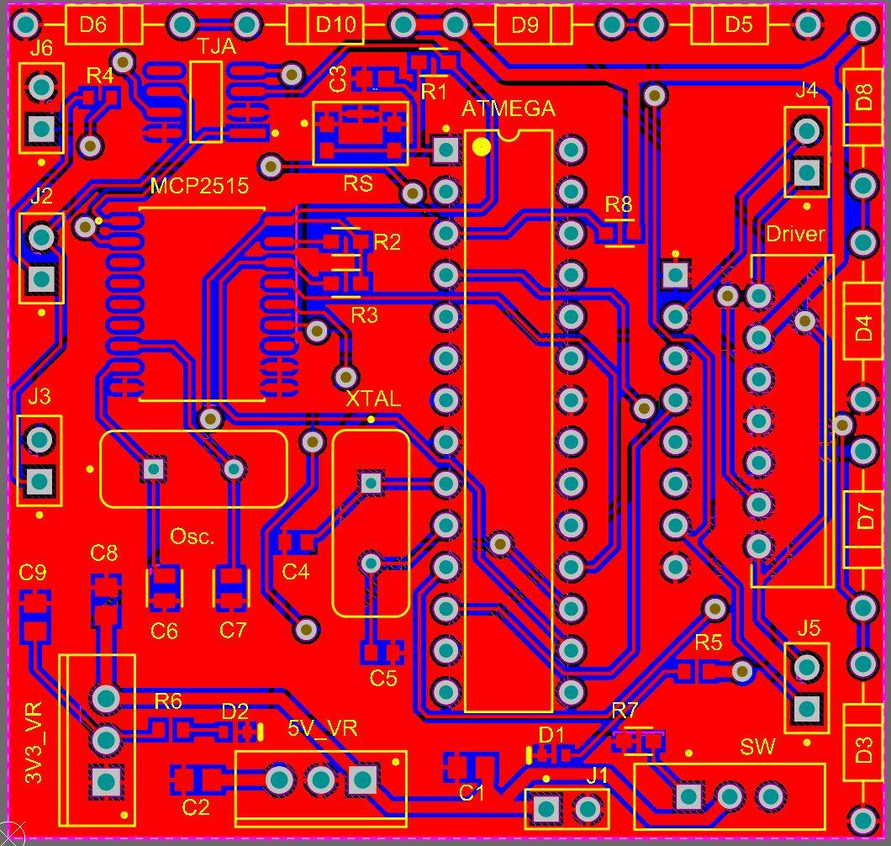
WMM Layout
Notes:
Damian

Slide 16
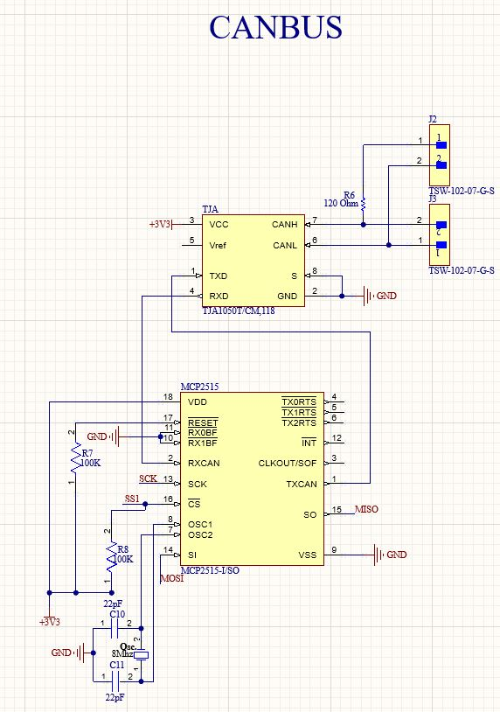
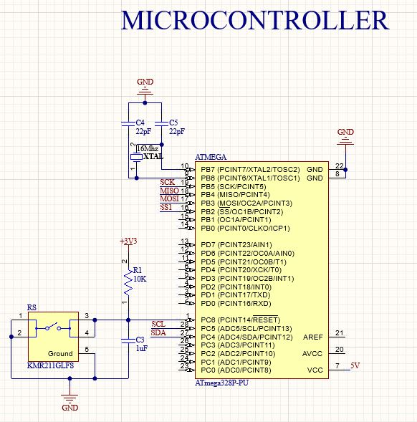
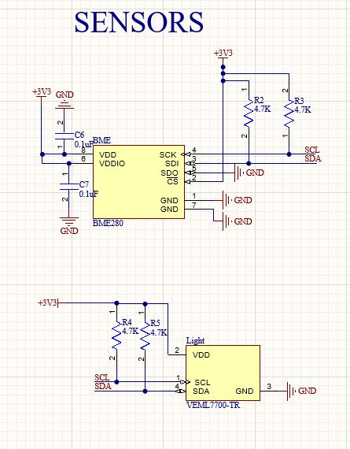
Sensor Board Schematics
Notes:
Damian

Slide 17
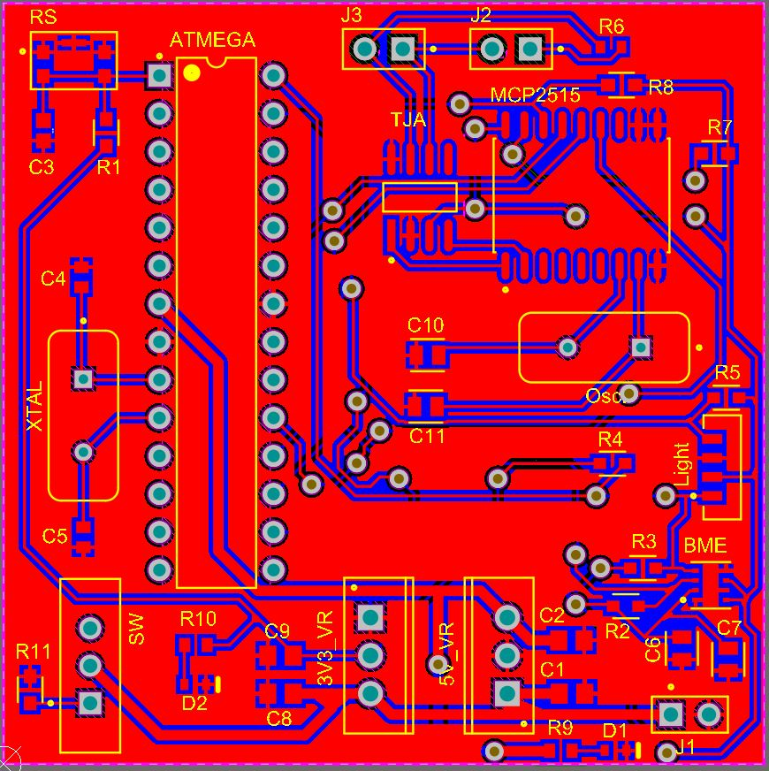
Sensor Board Layout
Notes:
Damian

Slide 18
Thank You!
Notes:
Max

