Slide 1
Active Windows CDR
By Maxwell Rapier, Andrew Hartnett, Damian Gunadasa, Jonathan Townsend

Slide 2
Good afternoon!
Maxwell Rapier
Electrical Engineer
CAN Bus
Team Coordinator
Andrew Hartnett
Computer Engineer
User Interface
Website Czar
Jonathan Townsend
Electrical Engineer
Motor Control
Budget Manager
Damian Gunadasa
Computer Engineer
Sensors
Altium Lead
Shira Epstein
Faculty Advisor & Enormous Help

Slide 3
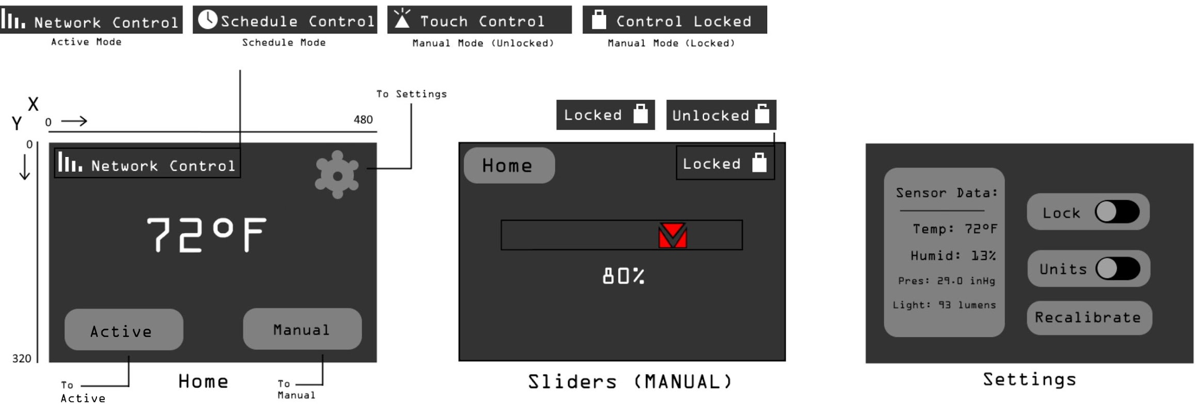
Our Problem Statement
Goal: Design a user interface that forwards environmental data from sensors to a server and allows a user to input scheduling information that controls windows in their house.
Notes:
Andrew

Slide 4
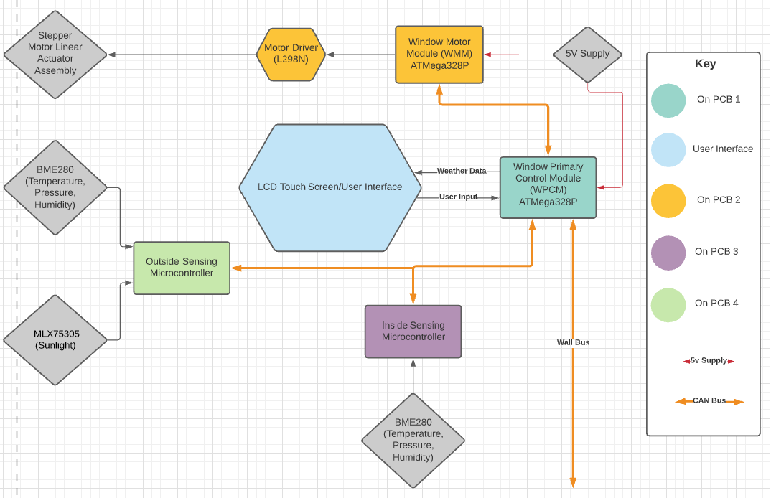
Notes:
Would be good to show what data is being sent over each CAN Bus line

Slide 5
Updated System Specifications
The Active Window - Window Primary Control Module will meet or exceed the following system specifications:
1. Supports communication with network via WallBus (CAN Bus) 2. Supports communication with inter-window motors via WindowBus (CAN Bus) 3. Allow the user to set the height of the window 4. Allow the user to create a time schedule to open/close parts of the window 5. Allow the user to stop smart capabilities of the window, returning it to a simple mechanical device 6. Measure temperature, humidity, air pressure, and light inside and outside the room 7. Display the position of the window 8. Ability to enter Sleep mode when not being used, can enter Active mode upon user touching screen 9. Volume (LxWxH): 1,536 cubic cm. (12 x 16 x 8 cm) (93.7 cubic in. (4.72 x 6.30 x 3.15 in)) (FPR DESIGN)

Slide 6
Prototype Overview
We are able to control where the window is with the LCD and we can switch the window into Active Mode or Manual Mode with the LCD. In active mode a temperature sensor can control whether the window is open or closed. After we design the user interface for Schedule Mode we will be able to implement that as well without changing any hardware.

Slide 7
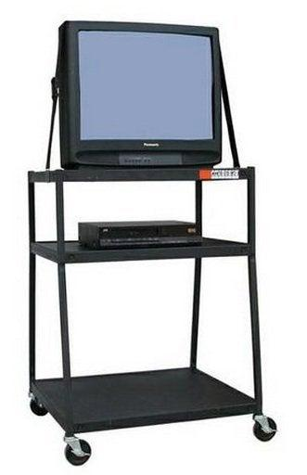
Live Demo
Please Direct your attention to the nearby Zoom video.

Slide 8
Proposed vs. Actual - CDR Deliverables
Proposed | Actual
UI touch input changing the motor height | UI touch input changing the motor height
Sensor data being transmitted via CAN Bus through Primary Control Module | Sensor data being transmitted via CAN Bus through Primary Control Module, as well as demonstration of motor control from WallBus
First attempt at PCB | All 4 PCBs in-hand, unsoldered
Notes:
Andrew

Slide 9
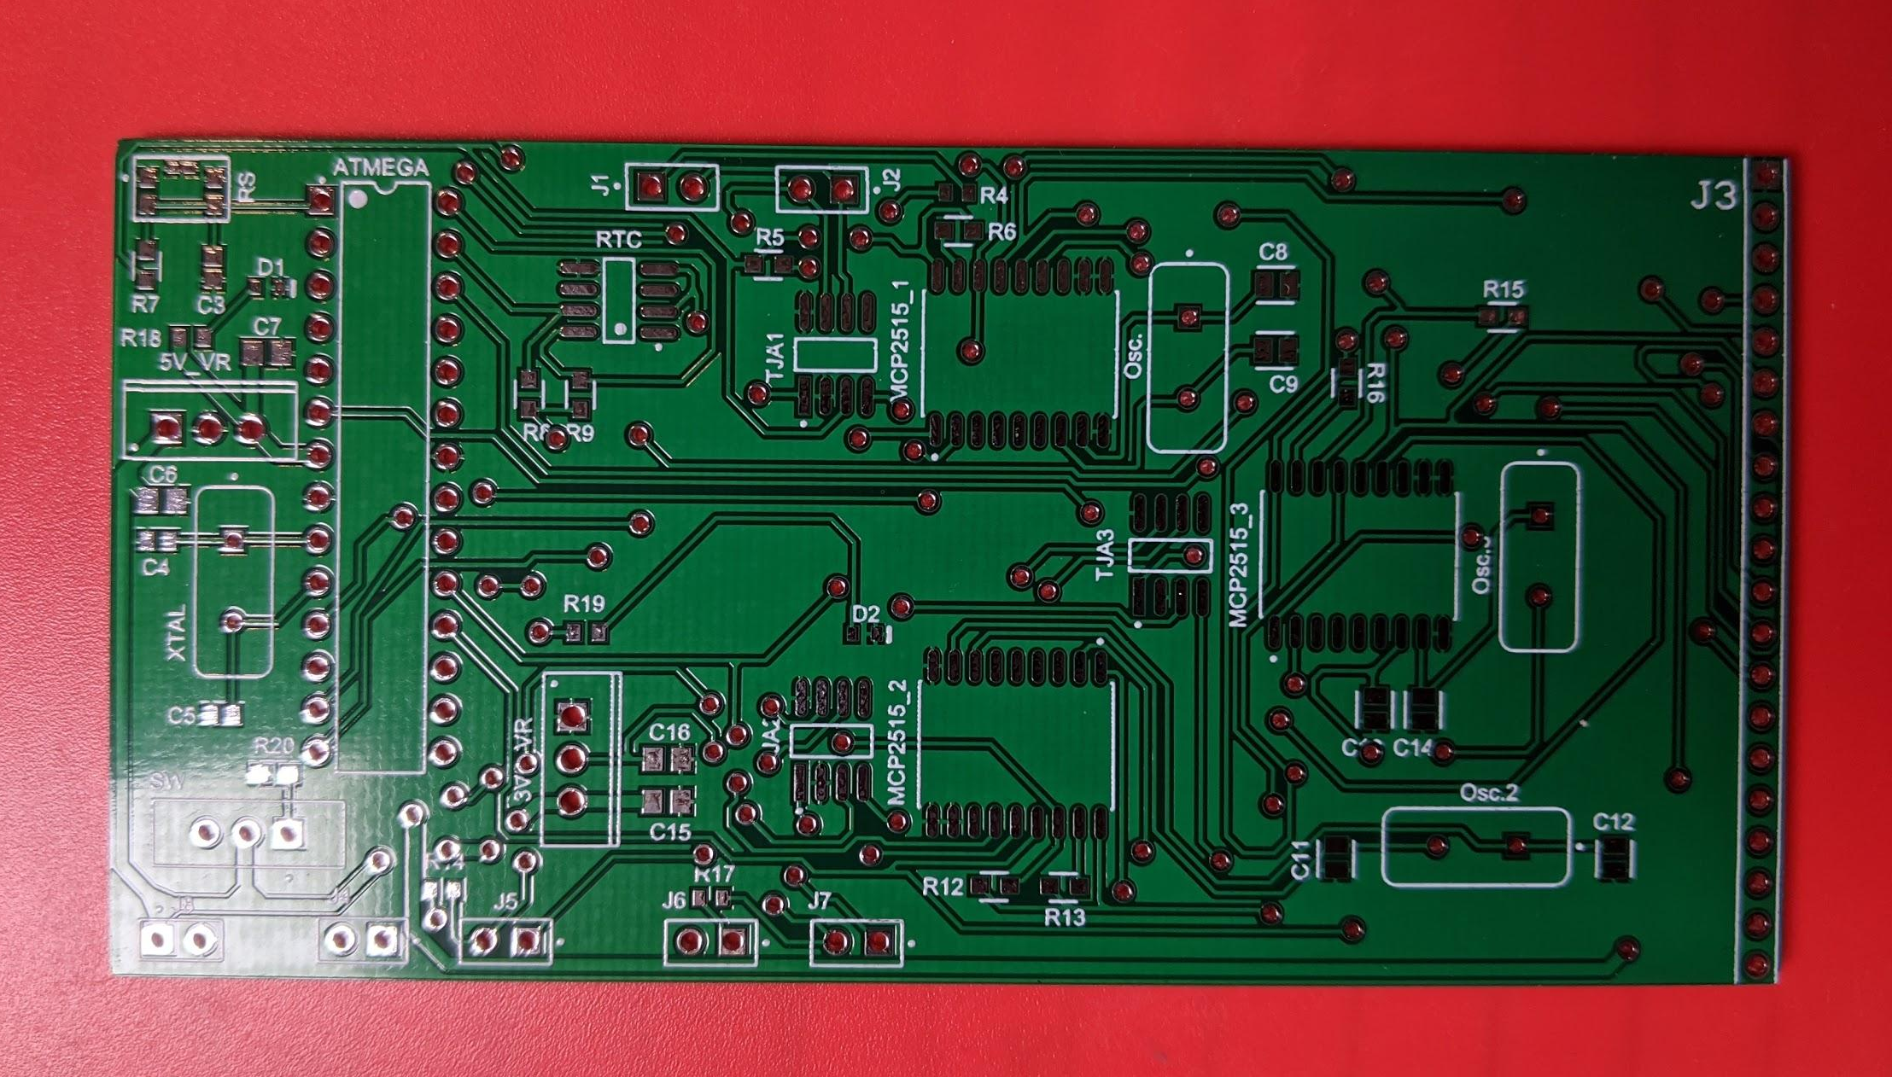
Window Primary Control Module PCB

Slide 10
Prototype Component Overview
WMM
1 x Arduino Uno
L298N Motor Driver
Stepper Motor
Threaded rod
Normally open limit switch
1 x MCP2515 CAN controller
WPCM
1 x Arduino Uno
1 x 3.5” TFT LCD Touchscreen
3 x MCP2515 CAN controller
Peripherals
2 x Arduino Uno
2 x MCP2515 CAN controller
1 x temperature sensor

Slide 11
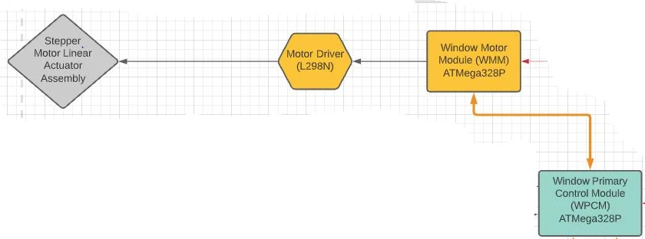
Window Motor Module
WMM executes positional commands from the WPCM
WMM’s CAN transceiver constantly receives an integer value from the WPCM that is updated based on user requests
WMM completes a parity check on the data received from the WPCM to ensure accuracy before executing moves
WMM can be re-calibrated at any time with a button, which will clear the positional data and return the window to the closed position.
WMM stores absolute positional data and updates WPCM
YOU ARE HERE!

Slide 12
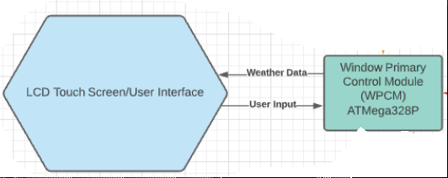
Display and WPCM
The LCD Display is on a breakout board with SPI connection to the WPCM
The communication between Display and WPCM is done via SPI and handled with graphics and touch libraries
Via CAN, WPCM tells the WMM what height to set the window
If in Manual Mode, the height value can be from 1-102 (0%-100% plus a recalibrate)
If in Active Mode, the height value can be 2 or 102 (Closed or open, respectively)
Via CAN, WPCM forwards sensor data to WallBus, as well as forwards the window height response from WallBus to the WMM
Notes:
Andrew

Slide 13
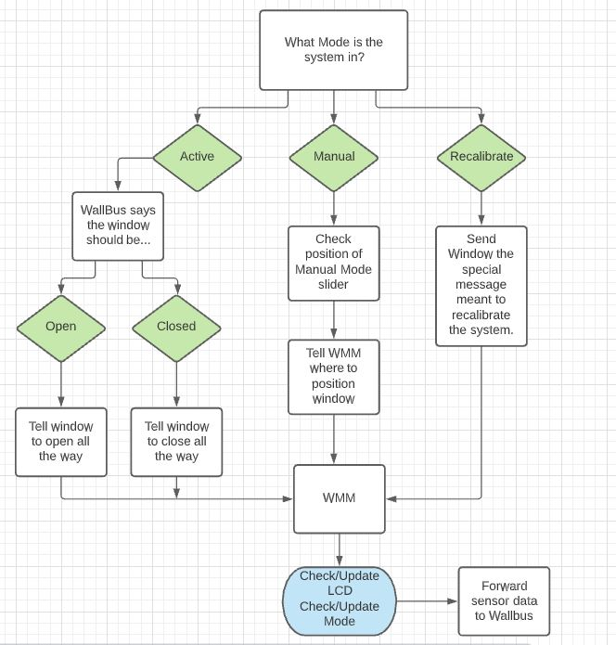
Prototype
Integration
Notes:
Andrew

Slide 14
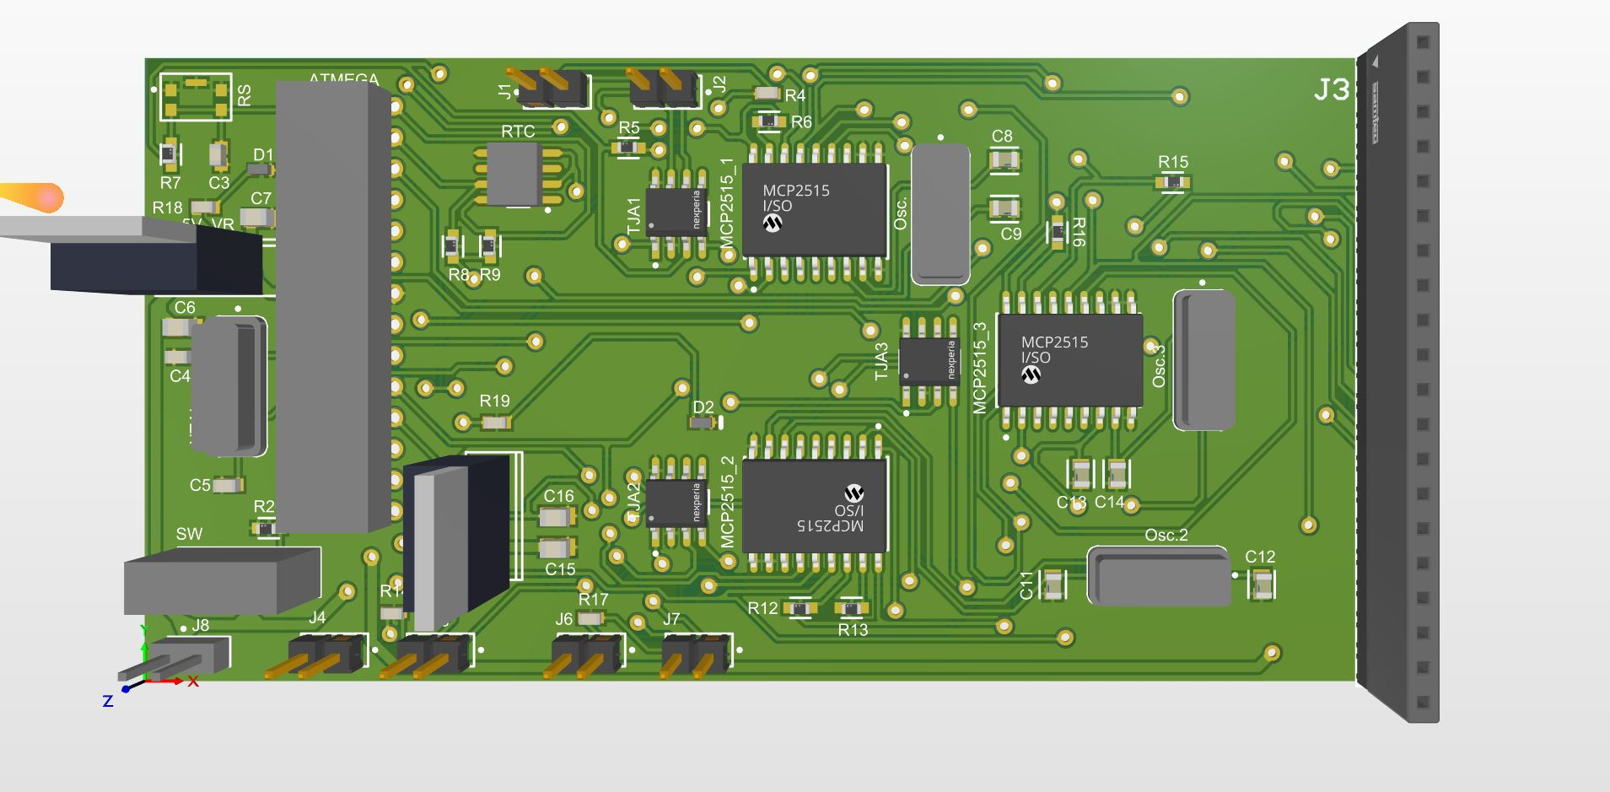
Custom PCB
4 separate PCBs
WPCM
WMM
Indoor Sensor
Outdoor Sensor
Main Components
Atmega328p in each board
Canbus modules in each board
3 in the WPCM board
1 in the other boards
RTC in WPCM
BME280 in indoor sensor board
BME280+Light sensor in outdoor sensor board
Motor module in the WMM board
Power Supply
12V supply for each board
3.3V and 5V voltage regulator on each board
Layout of WPCM

Slide 15
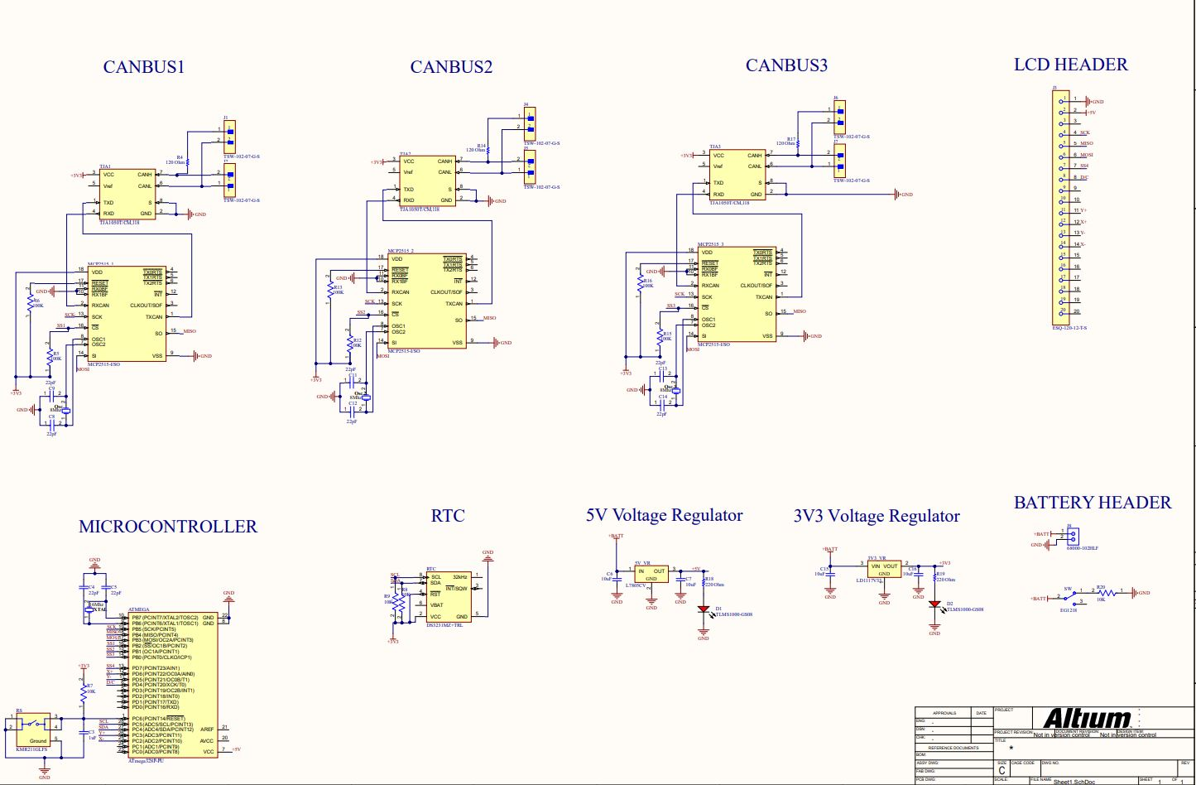
Schematic of WPCM

Slide 16
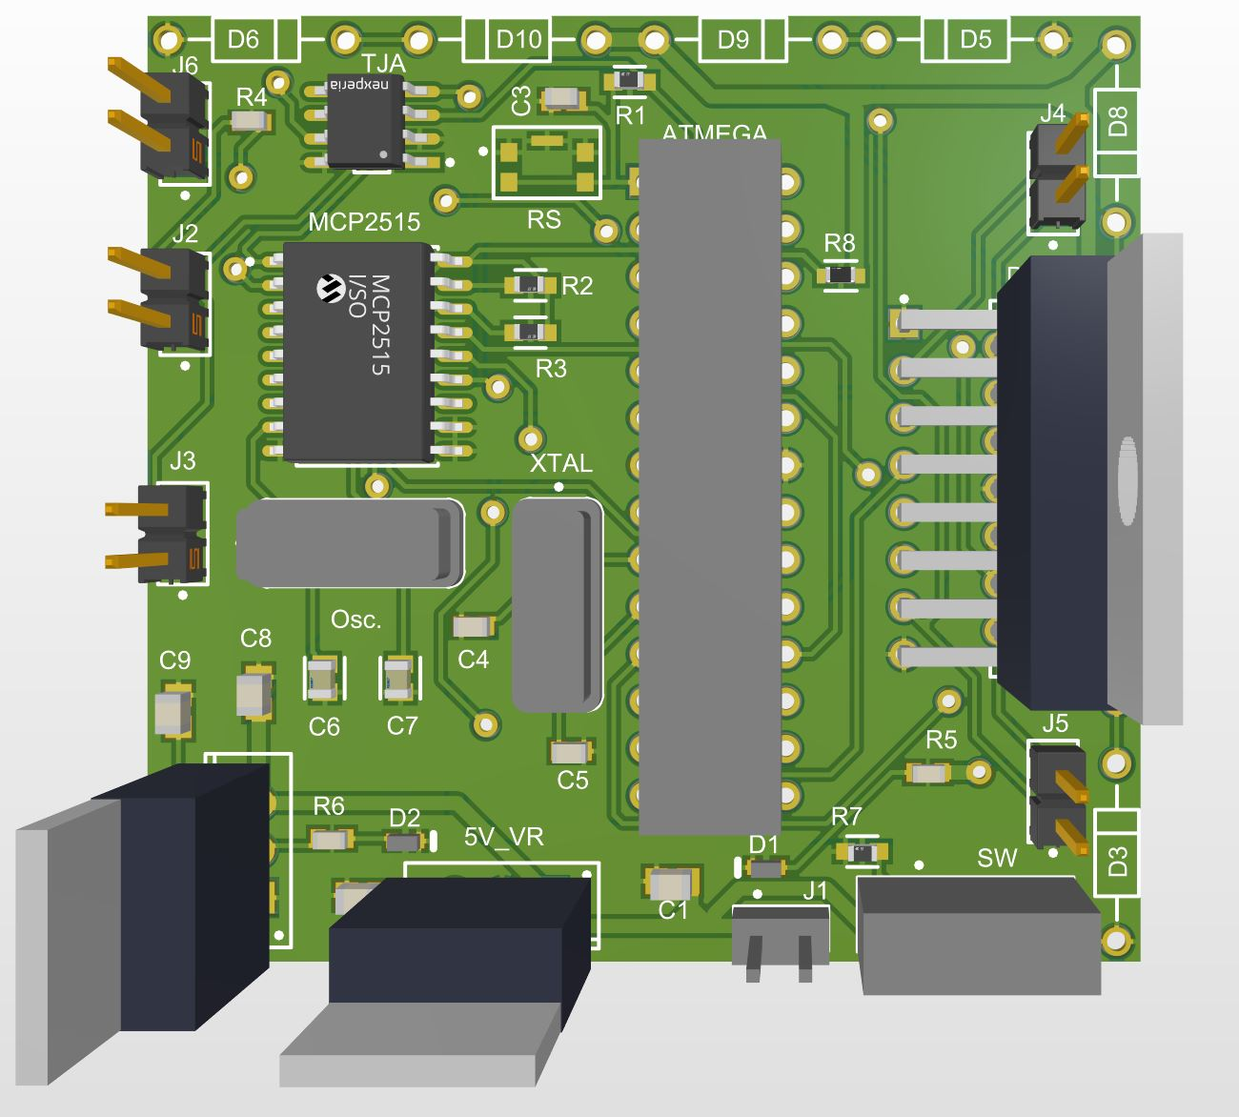
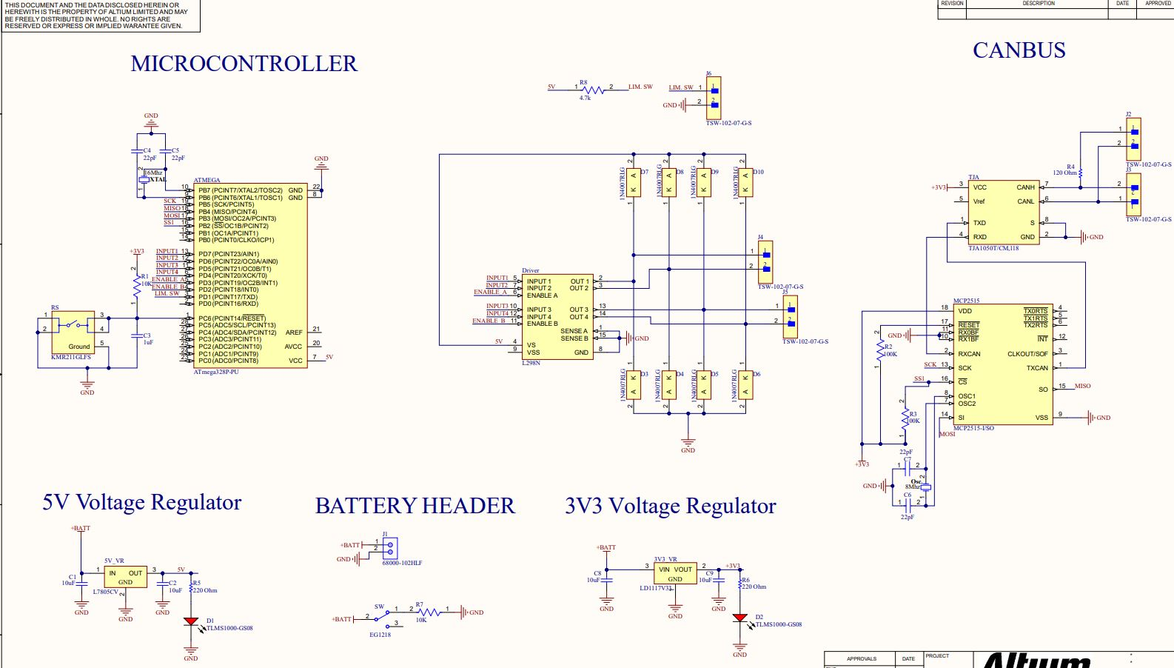
WMM

Slide 17
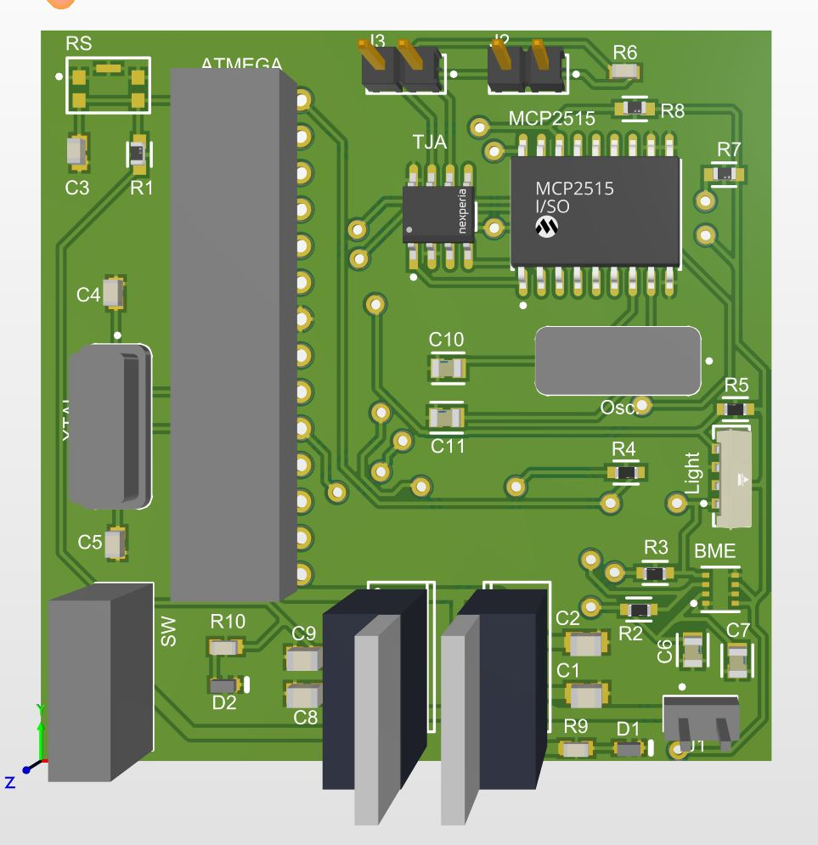
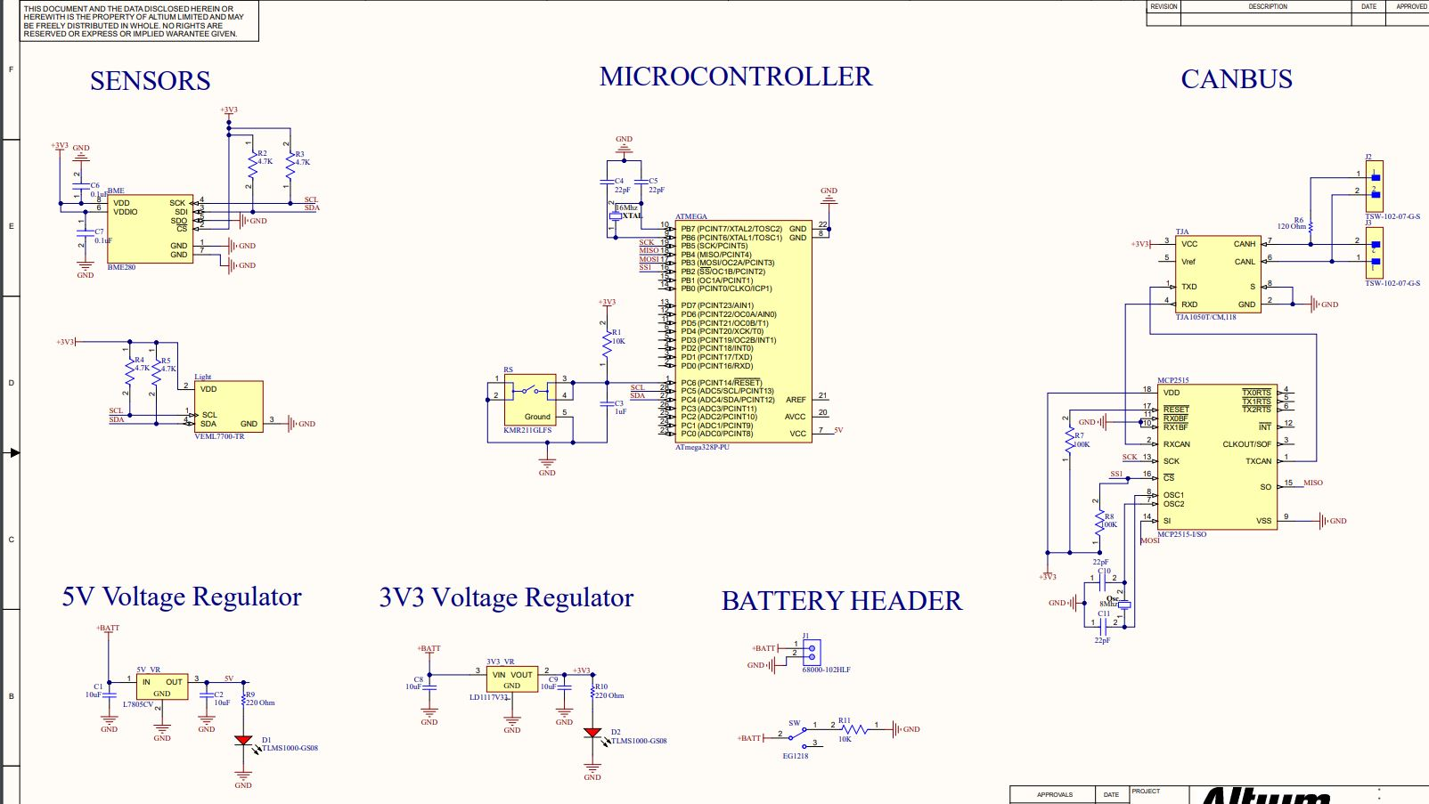
Outdoor Sensor Board

Slide 18
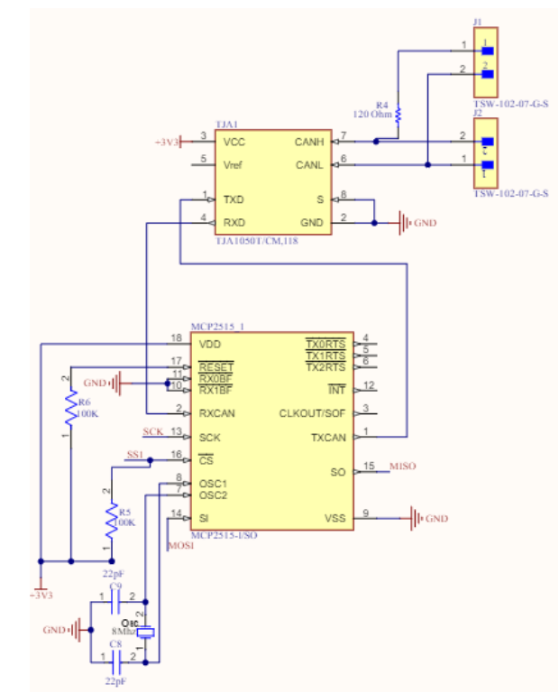
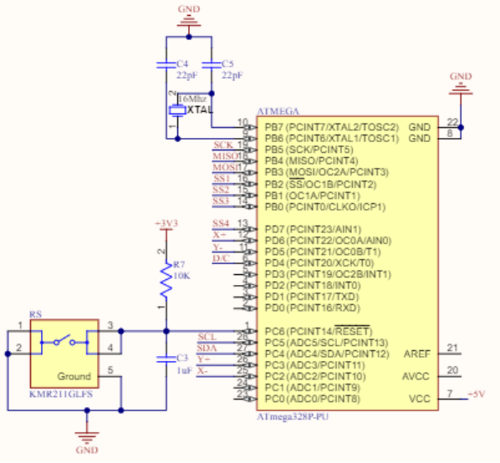
Prototype Schematics
CAN Controller
Microcontroller

Slide 19
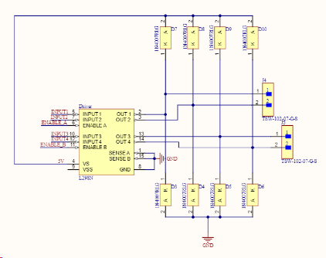
Prototype Schematics (cont.)
Motor Driver

Slide 20
Demo Takeaways (M)
We can…
Open the window to a specific position.
Calibrate the window.
Set the window to move according to feedback from a sensor.

Slide 21
FPR Plan
Test/Implement PCBs (This week and the week after)
Implement schedule mode (Any time left over)

Slide 22
FPR Testing
WMM - Assure proper calibration, make sure motor can send out errors, make sure motor is in appropriate position for slider mode.
WPCM - Make sure motor moves with slider. Make sure schedule properly opens the window when it needs to.
Sensors - Properly measures the environment. Read at consistent intervals.
WallBus - Manually reach each conditional.

Slide 23
Thank You!

