Slide 1
SDP ‘21 Preliminary Design Review: Active Window - IoT, Network Controller, and Motor Module
Team 6
Jonathan Clifford, Frank Cremonini, Griffin Manns, Connor Moore
Advisor: Professor Arman Pouraghily
Manhattan2 CTO & Contact: Mr. Glenn Weinreb
Notes:
Jonathan

Slide 2
Overview
Motivation
Problem Statement
System Specifications
Related Solutions
Block Diagrams
Custom Hardware Solution
MDR Deliverables
Cost Estimate
Project Management
Questions & Answers
Notes:
Jonathan

Slide 3
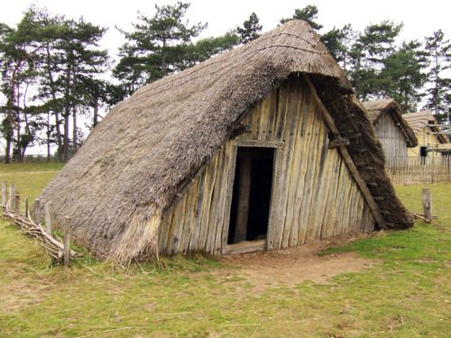
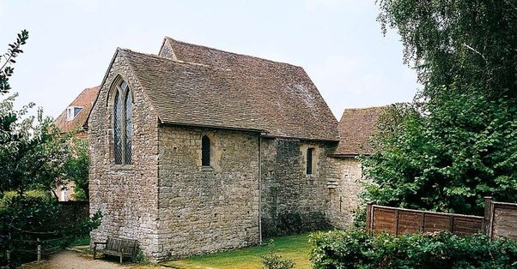
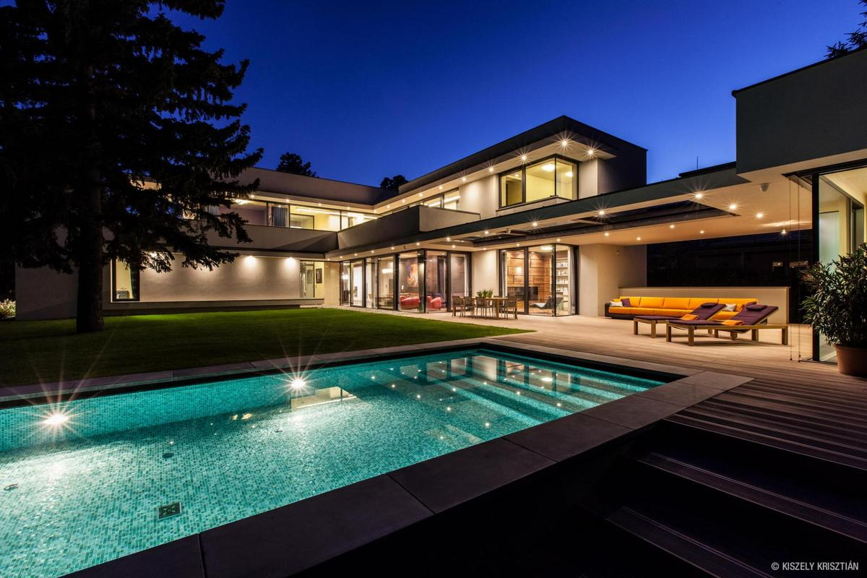
Motivation - The Home
The home has existed for thousands of years - it serves as the very foundation of our society.
As technology improved, so did the technology that was implemented in the home.
First it was through the addition of simple light bulbs, to complex appliances such as refrigerators and heaters.
However, there is one major problem with the average home in the 21st century:
https://paganroots.tumblr.com/
https://www.quora.com/What-was-a-knights-home-like-during-the-Middle-Ages
https://cdn.trendir.com/wp-content/uploads/old/house-design/assets_c/2015/02/modern-day-bauhaus-home-contemporary-masterpiece-1-thumb-1200xauto-51484.jpg
Notes:
Jonathan
A person does not know when it is the optimal time to open a window
windows are manual

Slide 4
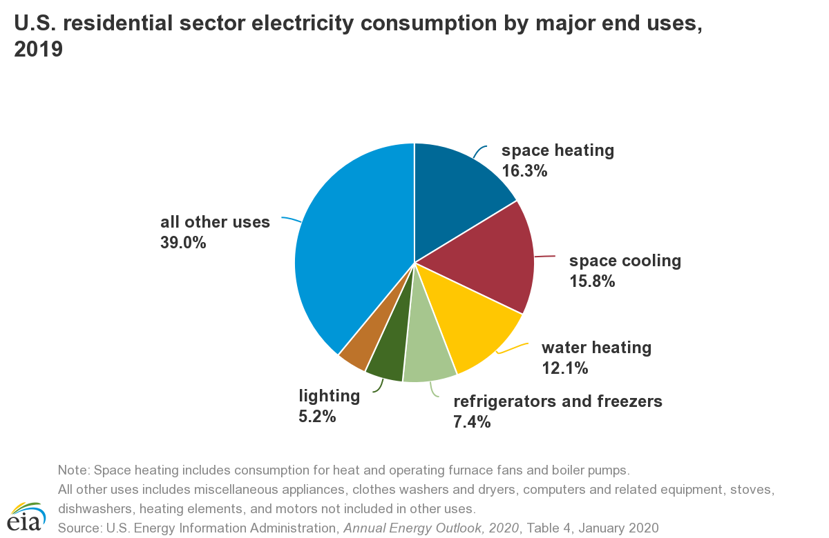
Motivation - Home Energy Efficiency
They’re Dumb!
Homes waste an unnecessary amount of energy by not properly responding to environmental changes.
Home Air Conditioning is not integrated with the windows
On average, Residential AC accounts for 50% of home energy usage and 32% of total US energy usage according to the U.S. Energy Information Administration.
But, why does this even matter?
Notes:
Jonathan
A person does not know when it is the optimal time to open a window
windows are manual

Slide 5
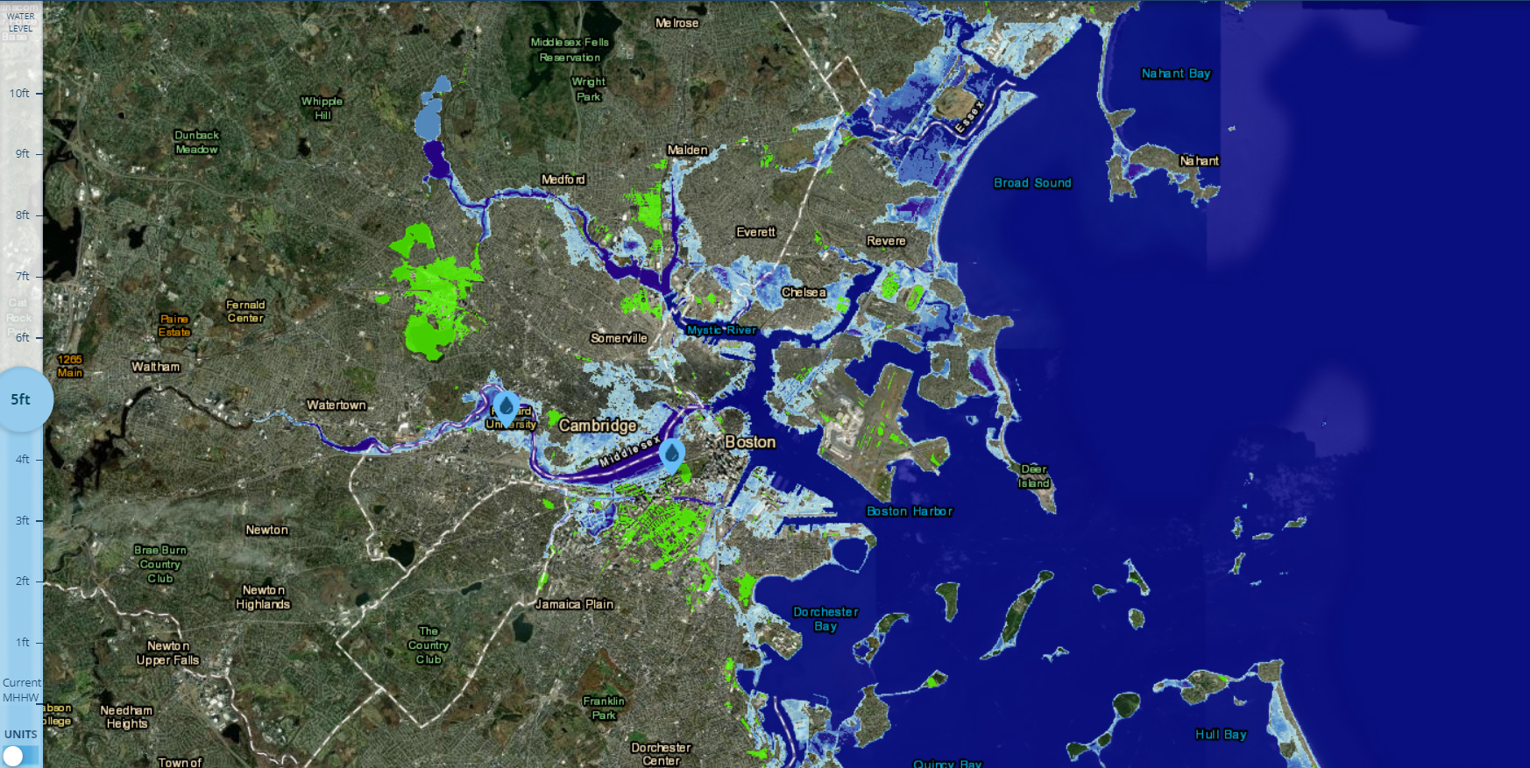
Motivation - Climate Change
Owing to the ever-increasing impacts of Climate Change, it falls on the next generation of engineers to combat it in whatever way possible.
By trying to optimize homes to consume less energy, we make homes more comfortable while being more energy efficient.
https://coast.noaa.gov/slr/
Notes:
Jonathan
Especially with the impact of the COVID-19 Pandemic, we have all been spending more time in our home! As a result, it’s possible that we are spending even more energy on our homes, contributing to Climate Change

Slide 6
Motivation - Manhattan 2 Initiative
Dedicated to develop standards for home automation technology
Make homes more active
utilize renewable energy sources
maximize energy efficiency
How?
Develop network of communication between home appliances, AC/heat systems, Washer/dryers, etc.
https://www.manhattan2.org/
Notes:
Jonathan

Slide 7
Problem Statement - Solution
We propose, with the assistance of the Manhattan2 Initiative, to begin to make the average home more “active.”
Windows capable of receiving data from the outside world and making adjustments to optimize energy efficiency of the average home.
Interface with users via an Android Application, and the motor module to adjust the window when needed.
Master controller that is able to understand this data and adjust accordingly and send commands while also acting as an interface with the outside world - ultimately the task of the master controller.
Master Network Controller will connect directly to the motor module in order to ensure that commands are able to be understood and properly carried out.
Notes:
Griff
We propose, with the assistance of the Manhattan2 Initiative, to begin to make the average home more “active.” For instance, if a home is hot on the inside, but it’s cold outside, the system could adjust such that the heating for the home is turned off, and the window cracks open to cool the house, without needing to turn on air conditioning. The first objective is to make the simplest part of the home active - the window. Along with two other groups we will endeavor to create an Active Window for the average home. The ultimate purpose of this project is to allow windows to be capable of receiving data from the outside world and making adjustments to optimize energy efficiency of the average home. This team will be focused on the Network Master Controller, which is capable of communicating with the outside world and the motor module, the Interface with users via an Android Application, and the motor module to adjust the window when needed. To endeavour to make the window more intelligent, we will need a large variety of transducers and sensors in order to take measurements of the surrounding environment, more importantly, we need a master controller that is able to understand this data and adjust accordingly and send commands while also acting as an interface with the outside world - this is ultimately the task of the master controller. For rapid prototyping purposes, the Master Network Controller will connect directly to the motor module in order to ensure that commands are able to be understood and properly carried out.

Slide 8
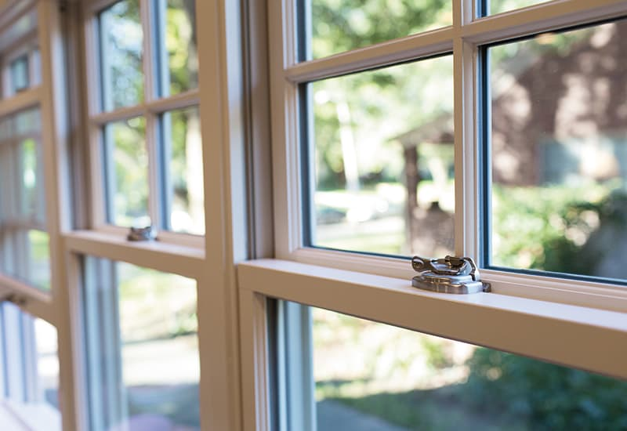
Motivation - The Window
The function of a window is incredibly simple:
They let light and air into the home
But, a significant portion of energy loss in a typical home occurs through the windows as they are not properly insulated.
Windows must be operated manually making it nearly impossible to optimize their use.
https://www.pellabranch.com/webres/Image/misc/2018-window-glass-option-header.jpg
Notes:
Jonathan

Slide 9
Problem Statement
As the impacts of Climate Change become ever more apparent, it falls on the next generation of Engineers to combat the issue in whatever way possible. The average home is almost completely unoptimized to combat Climate Change in its current state - nearly every aspect of the home is “dumb”. For instance, everything in the home needs to be manually adjusted to account for temperature variances, and the system cannot adjust on its own in order to not waste power.
Notes:
Griff

Slide 10
System Specifications
The Active Window Subsystems consisting of the Network Master Controller, IoT/Phone Application, and the Motor Module will meet or exceed the following specifications:
Capable of receiving signals from Amazon Web Services (AWS) for direct communication between the user and the rest of the system.
Capable of transmitting commands from the Android Application through AWS to the Network Master Controller that drives a stepper motor driver, which in turn adjusts a window.
User interaction via an Android Phone Application that transmits data via AWS to the controllers. This Application will include a user interface to control and monitor window status.
The Network Master Controller’s size is as small as possible in order to maximize installation in a home (i.g., fit within a wall in a home).
DC Stepper Motor and Driver, will utilize a 24V power supply and use a pulley system solution that can adjust the window via commands. This pulley system will physically lower and raise the test window once it receives the proper command.
In addition, there will also be a manual override switch for the test window that is capable of bypassing the Android Application and will raise or lower the window when it is flipped.
In the event of external network failure, the Android Application is capable of sending commands to the Network Master Controller via a Peer to Peer connection.
Notes:
Griff

Slide 11
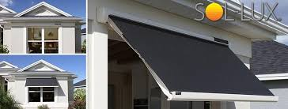
Related Solutions
Sol-Lux
Sol-Lux is an automatic Solar-Powered window blind system that automatically adjusts itself to variations in sunlight throughout the day.
Pros: Shade automatically blocks sunlight when it detects sunlight, and generates its own power to open and close shade
Cons: The shades are independent devices and have no system for data monitoring or components for user control.
https://www.sol-lux.com/
Notes:
Connor
One of the related solutions that we found was developed by Sol-lux
so solux offers a simple solution for blocking sunlight
Pro operates auto and requires no power
con offers no data gathering or option for scalability

Slide 12
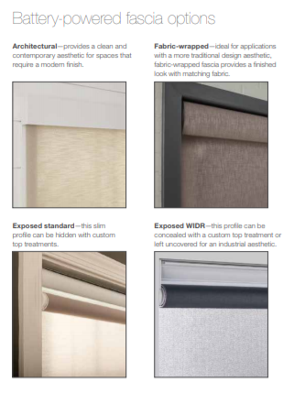
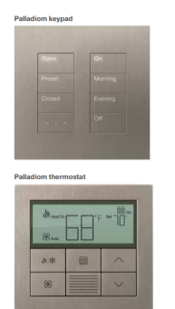
Related Solutions (cont.)
Lutron Shades
Lutron is the leading company in home lighting automation and also has a automated shading product for home and commercial use.
Pros: their network is able to integrate with alexa, google home, and apple homekit to open and close shades including locally placed switches
Cons: their product is focused on opening and closing decorative shades not opening and closing windows.
https://www.lutron.com/TechnicalDocumentLibrary/3671319_Resi_Consumer_Brochure_lr_sg.pdf
Notes:
Connor
Another related solution was developed by Lutron
Lutron has had many year of experience developing a network for home automation
- some of the products they include lighting controllers, thermostats and most
-and most relating to our project a shade automation device
Pros: complex network and IOT connectivity
Cons: Their shades are decorative and not very insulated, aswell they don’t operate the windows

Slide 13
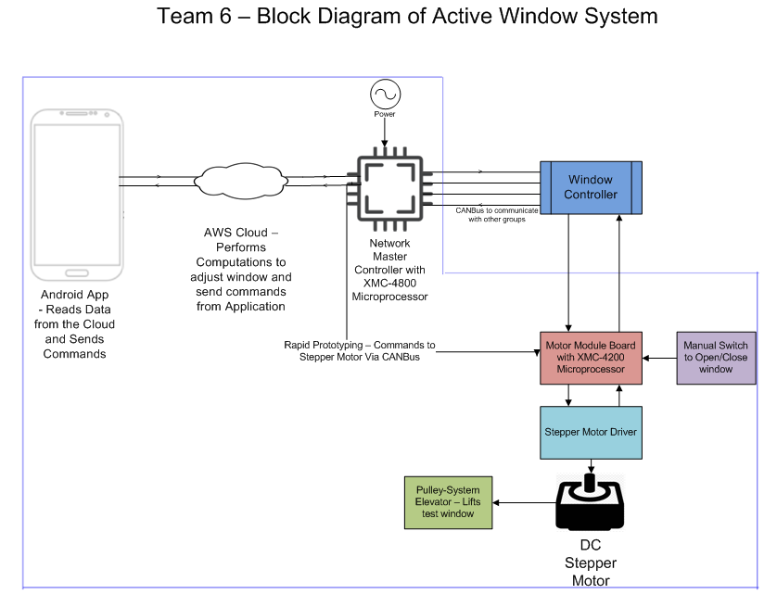
Preliminary Hardware Design
Notes:
Connor
So the best way to explain this would be from right to left so starting off we have the….
App → AWS → NMC w/ can connectivity → rapid prototyping → motor modules -- manual switch operates motor
mention the windows controller being dev by other group
for rapid production we will interface directly
manual switch
pulley system elevator to open and close window

Slide 14
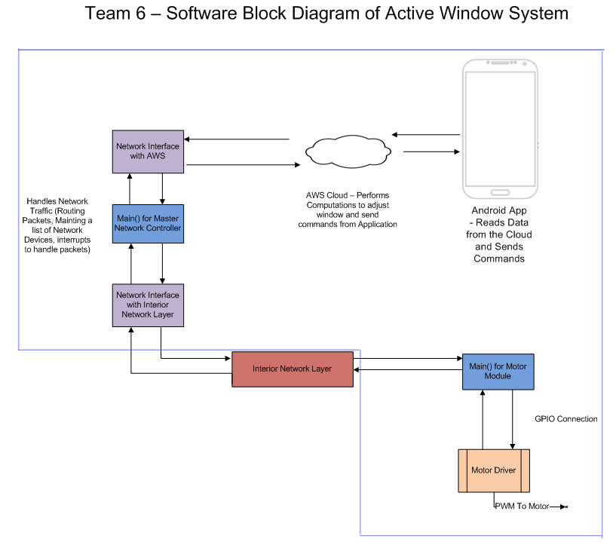
Preliminary Software Design
Notes:
Connor
So now the software diagram start at the APP
-again the app will have a connection to aws for remote access to the device
-Network controller will be used to route commands from app to control window
For this controller there will be an interface
to connect to the aws
- another interface to rout command to the motor.
- the interior network layer is being dev by other group is a component that will be part of the windows master controller
- our NMC will have ability to interface to this network but for us we will interface directly
-and direct connection from the network controller to the motor

Slide 15
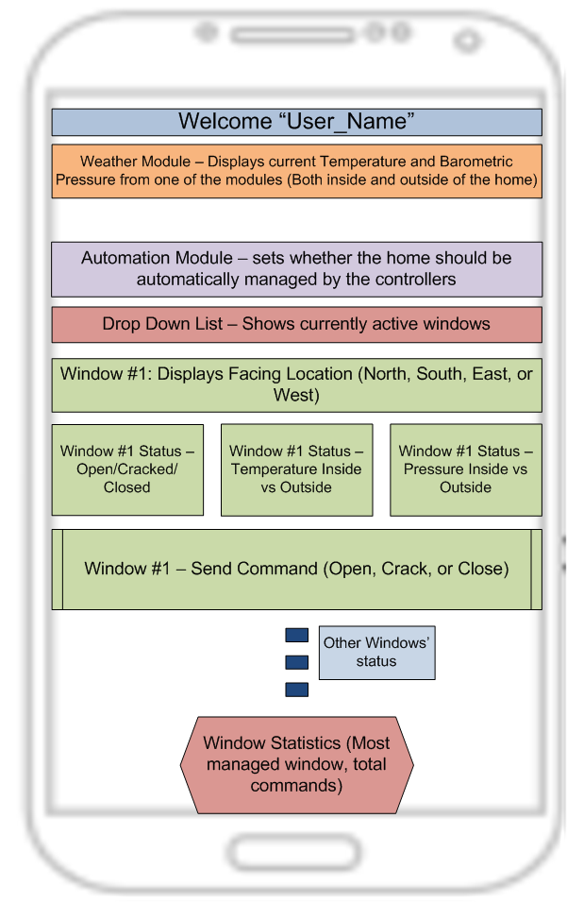
Preliminary Software Design - App
Notes:
Connor
This diagram is a good mock up of what we see the app to look like…
this app will be use for monitoring and user control of window operation
it will include data that is collected from the window
-Such as pressure, temp, status
as well as some calculations based on the data to help the user understand when and why windows automatically open or close
-

Slide 16
Custom Hardware Solution
Specifics:
XMC-4800, KITXMC48IOTAWSWIFITOBO1, Evaluation board for the main microprocessor on the Network Controller.
The Network Master Controller will have 1 Ethernet Port Protocol for communication with the outside world, and a CANBus data connector for interface with the rest of the system.
XMC-4200, KITXMCPLT2GOXMC4200TOBO1, microprocessor for the Motor Module, this will listen via CANBus for commands and send instructions to the Stepper Motor. For direct interfacing with the Stepper Motor, the GPIO will be utilized for testing purposes.
24V 23KM-K066-00V Stepper Motor and A4988 Stepper Driver driving an pulley system for the test window.
PCB created with only the necessary interfaces for the Network Controller to function properly.
A second PCB will be created for the XMC-4200 Microprocessor for the Motor Module, it will also only need the necessary interfaces for it to function properly.
Notes:
Frank
For the initial prototype, we will be using two evaluation boards, and will eventually move on to PCB designs for the project, starting next semester
Ethernet connection over Wifi because ethernet is more stable and reliable. Also ethernet will have minimal power loss due to calculating parity bits.

Slide 17
MDR Deliverables
For this group’s MDR, we propose that the following are delivered:
A fully functioning connection between AWS and the Android Application.
The Network Master Controller is capable of direct connection and sending commands to the Motor Module via CANBus.
The Network Master Controller is capable of connection to AWS and can transfer data.
Motor Module can respond to a command sent from the Network Master Controller.
Notes:
Frank

Slide 18
Cost Estimate & Budgetary Impact
Costs will be incurred throughout the process of development
Part | Cost ($)
XMC4800 Evaluation Board | $95.93
XMC4200 Evaluation Board | $57.85
24V 23KM-K066-00V Stepper Motor | $66.15
A4988 Stepper Driver | $7.45
XMC4800 Processor | $23.65 (per processor)
XMC4200 Processor | $6.31 (per processor)
Estimated PCB Costs | ~$20.00
Pulley Parts (wood, hardware, etc.) | $33.00
Model Window Parts (wood, hardware, etc.) | $20.00 (sans glass)
Notes:
Frank

Slide 19
Cost Estimate & Budgetary Impact
Total: $330.34
This total leaves us with approximately $170
Allows room for:
Part Failure
Accidental, DOA, etc.
Expansion
Potential changes in hardware design
Redundant purchases
Notes:
Frank

Slide 20
Project Management
Jonathan Clifford
Team Coordinator & AWS, Android Application Developer
Griffin Manns
Stepper Motor Module & PCB Designer
Professor Arman Pouraghily
Advisor
Frank Cremonini
Network Master Controller & Motor Module Code
Connor Moore
Network Master Controller & Budget
Mr. Glenn Weinreb
Manhattan2 CTO & Contact
Notes:
Frank

Slide 21
Project Management - Gantt Chart
Notes:
Frank

Slide 22
Questions & Answers
Notes:
End

