Slide 1
SDP ‘21 - Midway Design Review - Active Windows
Team 6
Jonathan Clifford, Frank Cremonini, Griffin Manns, Connor Moore
Advisor: Professor Arman Pouraghily
Manhattan2 CTO & Contact: Mr. Glenn Weinreb
Notes:
Jonathan

Slide 2
Overview
Problem Statement
Project Overview
Our Solution
Project Specifications
Updated System Design
MDR Accomplishments & Prototypes
Hardware Plan For FPR
Project Management
Gantt Chart
Project Expenditures
Notes:
Jonathan

Slide 3
Problem Statement
“With climate change becoming ever more relevant, engineers from every discipline are scrambling to combat the issue. Through methods such as green energy technologies and reducing reliance on fossil fuels, our society has made significant progress. However, there is still much work to be done. The average home presents opportunities for countless improvements in energy conservation. In particular, heating and cooling of homes present the opportunity for many inefficiencies to be addressed, including the lack of automation of residential climate control. For instance, to account for temperature variances, an individual may choose to run power-hungry central air systems as opposed to using manually adjusted power-saving alternatives. However, a sufficiently smart home automation system could replace human negligence and laziness and utilize alternative energy saving options that take advantage of the existing features of homes.”
Notes:
Jonathan
With climate change becoming ever more relevant, engineers from every discipline are scrambling to combat the issue. Through methods such as green energy technologies and reducing reliance on fossil fuels, our society has made significant progress. However, there is still much work to be done. The average home presents opportunities for countless improvements in energy conservation. In particular, heating and cooling of homes present the opportunity for many inefficiencies to be addressed, including the lack of automation of residential climate control. For instance, to account for temperature variances, an individual may choose to run power-hungry central air systems as opposed to using manually adjusted power-saving alternatives. However, a sufficiently smart home automation system could replace human negligence and laziness and utilize alternative energy saving options that take advantage of the existing features of homes.

Slide 4
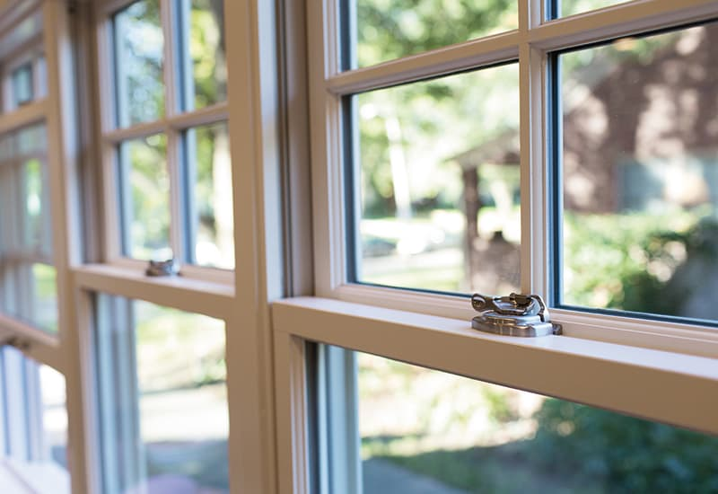
Project Overview
Window Operation
We are focused on contributing to window automation in order to try and combat climate change.
To do so, our team is focused on developing the end to end communications that this proposed system will utilize to communicate internally and externally.
This is done via CAN internally and Amazon Web Services (AWS) externally, both to forward system status as well as User commands to control and monitor the window.
https://www.pellabranch.com/webres/Image/misc/2018-window-glass-option-header.jpg
Notes:
Jonathan
So we are focusing on the window component of this home automation initiative
now talk about where we fall in with the window as a components of this total home automation
on this component we are focusing on the communication underlying system

Slide 5
Our Solution
Windows are “Dumb”, we will attempt to make them more “Active” by allowing automated remote operation of the window.
To achieve this we have the following components:
Android App for the user to interface with the system and operate the window.
Cloud Connection → Monitor and Control from anywhere.
If Cloud is down, locally we have:
a manual override switch.
direct connection between the Android App & the system.
Network Master Controller to control the local network and interface with Cloud services
Motor Module to operate window.
https://backtest-rookies.com/2018/10/26/tradingview-opening-a-window/
Notes:
Jonathan
Since windows are “dumb” we will attempt to make them more “active”, and consequently smarter, by allowing for remote operation of the window.
In this system a phone application will allow for the user to interface with the system and operate the window.
In order to be able to control the window from anywhere, we can make use of the Cloud in order to facilitate communication.
By using the Cloud, we can ensure that future Engineers can add additional features such as Machine Learning algorithms to adjust the home automatically.
In the event that you cannot connect to the Cloud, we allow for the user to bypass the Cloud by two methods:
A manual override switch that opens the window.
A local connection between the phone and the window that still allows for you to adjust it.
In order to interface with the Cloud, we also need a Network Master Controller to provide the interface between the interior network and exterior cloud infrastructure, as well as a Motor Module to actually perform the requested user commands.

Slide 6
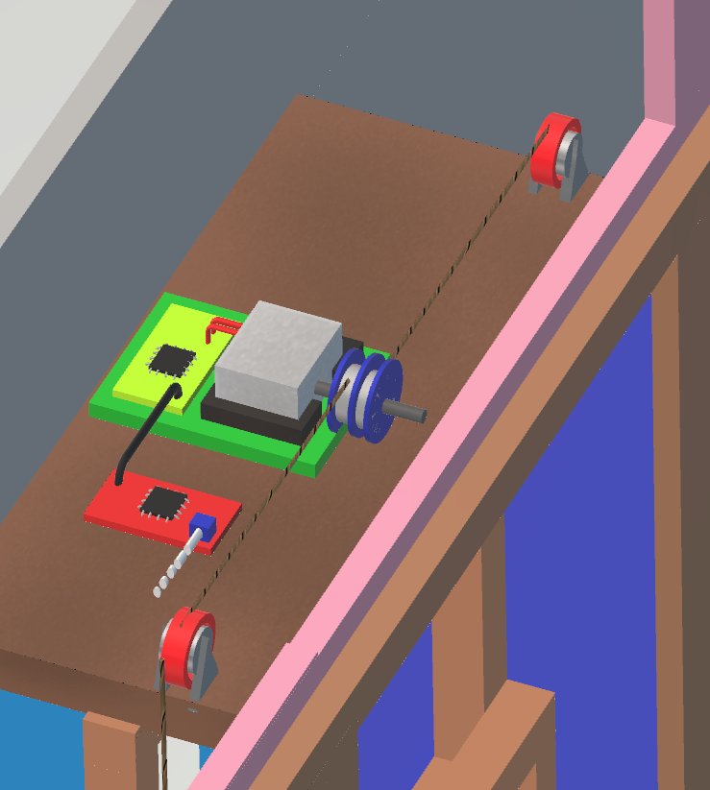
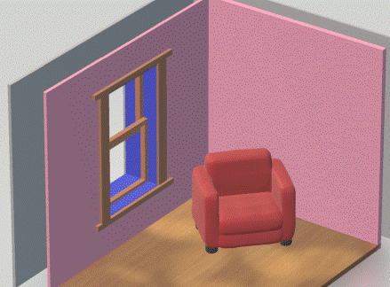
Our Solution in The Field
Notes:
Connor
So before we get into specifics to get a better idea of what these components will look like, here is a mockup of the Physical system
On the left there is an example of our system installed in a home with all the components located within the wall and a seamless installation to appear as a regular window
And on the right is a zoomed in picture of the system located on the top of the window
To present this project however we are planning on building a model window that will be operated by our platform.

Slide 7
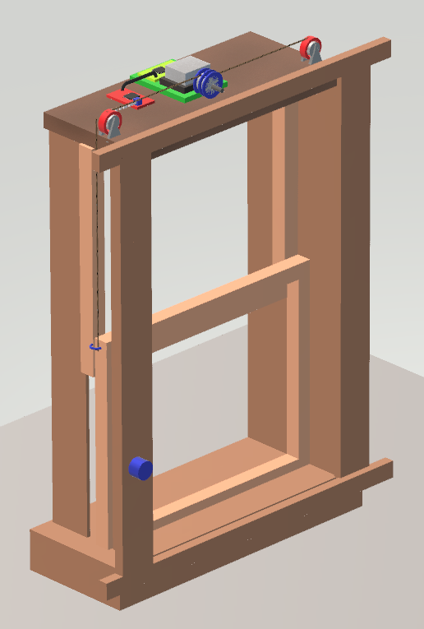
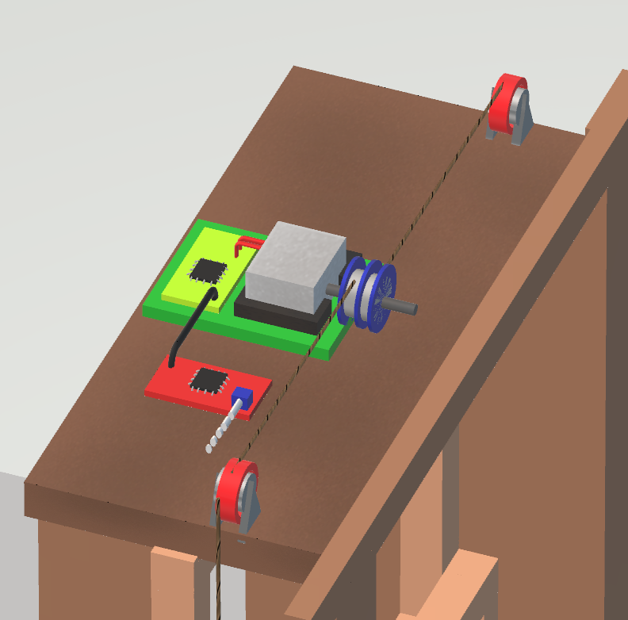
Model Window:
Notes:
So here we have the model window which we plan to build to demonstrate our project
For hardware
there will be 2 pulleys, 2 hooks on the window that is being operated, and a wire to pull up and down the window
the window frame will be constructed with wood and assembled with screws
On the right picture you can see the stepper motor attached to the pulleys and wire. The light green block behind the motor is the Motor Module which connects to the red block being the NMC. Going back to the left picture the blue object in the bottom left corner of the window represents an example manual switch location.

Slide 8
System Specifications
The Active Window Subsystems consisting of the Network Master Controller, IoT/Phone Application, and the Motor Module will meet or exceed the following specifications:
Capable of receiving signals from Amazon Web Services (AWS) for direct communication between the user and the rest of the system.
Capable of transmitting commands from the Android Application through AWS to the Network Master Controller that drives a stepper motor driver, which in turn adjusts a window.
User interaction via an Android Phone Application that transmits data via AWS to the controllers. This Application will include a user interface to control and monitor window status.
The Motor Module’s size is at least 14cm x 8cm in order to maximize installation in a home.
DC Stepper Motor and Driver, will utilize a 24V power supply and use a pulley system solution that can adjust the window via commands. This pulley system will physically lower and raise the test window once it receives the proper command.
In addition, there will also be a manual override switch for the test window that is capable of bypassing the Android Application and will raise or lower the window when it is flipped.
In the event of external network failure, the Android Application is capable of sending commands to the Network Master Controller if they are on the same network.
Notes:
Jonathan
4 - NMC is too complicated & will be a budget hinderance, changed to motor module (XMC-4200)
7 - No longer peer to peer

Slide 9
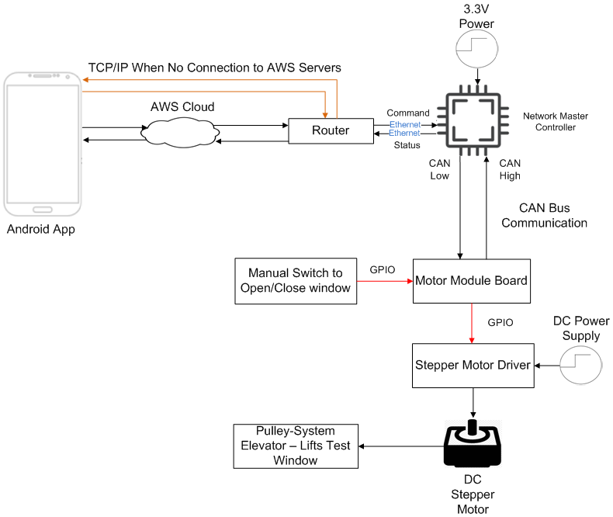
Updated Hardware Block Diagram
Notes:
Connor
-So starting from left to right we have the Android app that is used to monitor and send commands to the system
through AWS
AWS cloud is used to forward these commands
in the event of a lost of connection direct connection to the NMC through the router is also possible
-Then on the right we have the xmc4800 that is able to connect and receive the commands through an internet connection via router and ethernet
-Continuing down there is the MotorModule which is an XMC4200 and communicates via CAN with the NetworkMasterController
-Connected to this via GPIO we have a localized switch used to operate the window manually as well as the MotorDriver which is used to translate commands into actuation of the Stepper motor

Slide 10
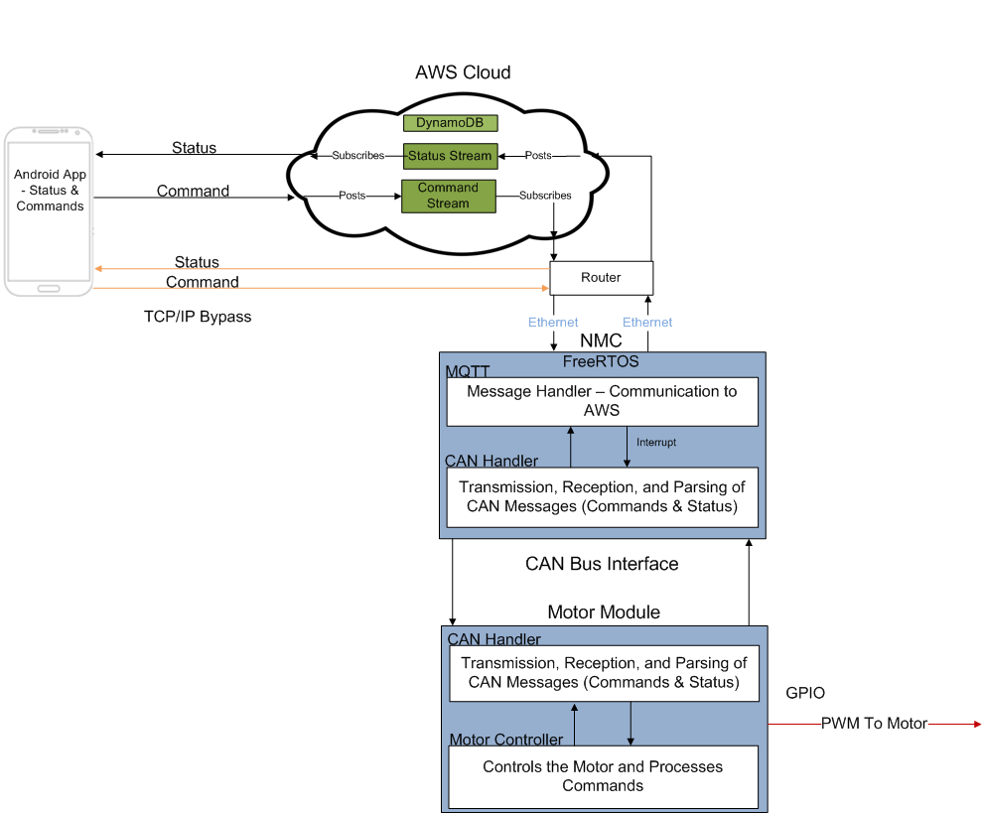
Updated Software Block Diagram
Notes:
Connor
So again starting at the App on the left, it can communicate with AWS cloud via Wifi
and as mentioned before can also directly connect
Moving on to the AWS cloud
inside this we take advantage of a Publish&Subscribe message stream
Publishers send messages
Subscribers get messages
On the NMC we are running a open Source version of FreeRTOS which is a real time operating system
inside of this system there are two main components
AWS Message Handler, which is used to receive and transmit messages to AWS
below that we have a software component for handling transmission and reception of CAN messaging from the motor Module
And finally on the Motor Module
There is a similar software component the handle CAN messages
As well as a component used to operate the Stepper Motor

Slide 11
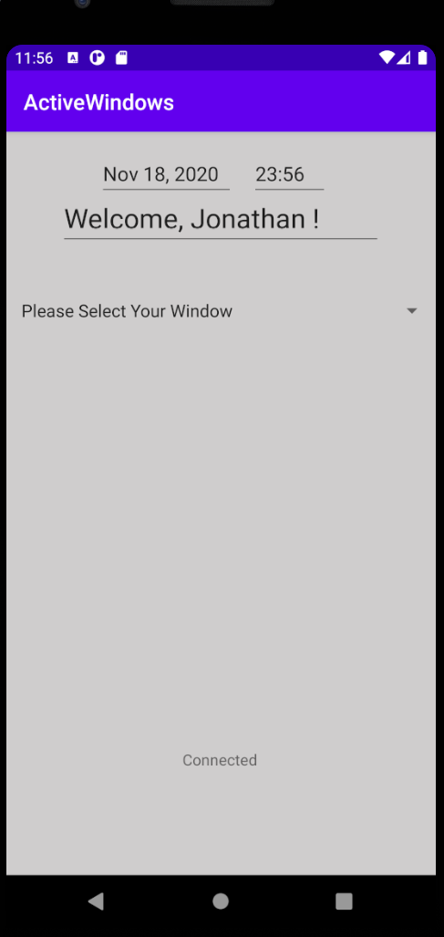
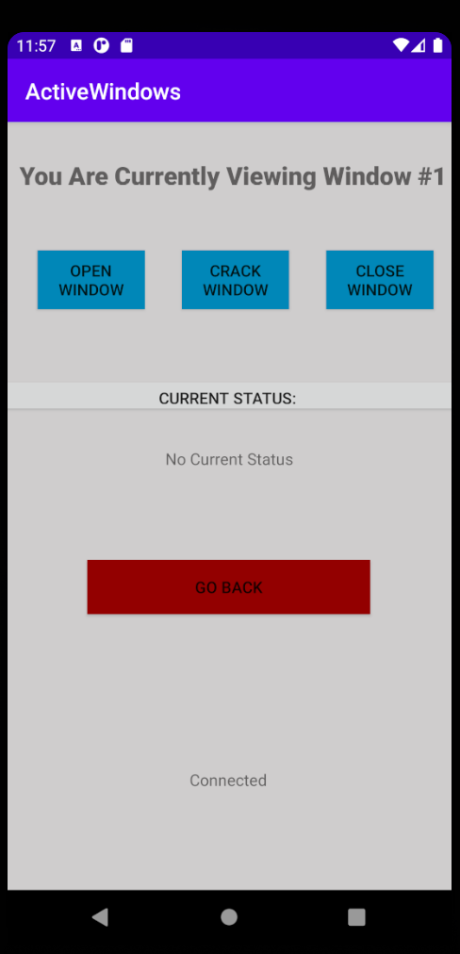
Updated Application Interface
Notes:
Connor
These are picture of the app we are currently developing.
this app will be use for monitoring and user control of window operation

Slide 12
MDR Deliverables
As promised, this is what we will be delivering for this MDR:
Deliverable Number | Deliverable | Engineer Responsible
1 | A fully functioning connection between AWS and the Android Application. | Jonathan
2 | The Network Master Controller is capable of connection to AWS and can transfer data. | Connor
3 | The Network Master Controller is capable of direct connection and sending commands to the Motor Module via CAN Bus. | Frank
4 | Motor Module can respond to a command sent from the Network Master Controller | Frank
5 | The Motor Module can drive and control the Stepper Motor | Griff
Notes:
Frank

Slide 13
MDR Demo - App & AWS
Focused primarily on being able to establish communication between a simple Android App and AWS.
Use of IoT Core & Amazon Cognito to properly communicate from the App to AWS.
Amazon Cognito establishes “Roles” to communicate between the two - support for Authentication.
App reads the most recent message from AWS, and upon user input sends a command for selected window.
Issues: A noticeable delay & will only send a message after hitting the buttons once.
Notes:
Jonathan
What is IoT Core? It is used to interface with any sort of “Internet of Things” Device. It allows for “Topics” (Message Streams) to be relayed between two seperate devices.
These “Topics” can be subscribed to or have data published to them. Any device that is “Subscribed” to a “Topic” will receive any data that something else “Publishes” to that topic.
Specifically, these “Topics” use the MQTT Protocol to relay these messages/Topics between devices.
Amazon Cognito is a service that establishes well-defined “Roles” for connections - configured by the user. These “Roles” ensure that a device does not access data that it isn’t allowed to receive. More importantly, Cognito allows for Authentication to the connection to AWS, ensuring security protocols to be in place.
In this demo, the application reads the most recent message that AWS publishes to it, and upon clicking a button, the user is able to send a command to AWS.

Slide 14
MDR Demo - NMC & AWS
Focus was to establishing Connection between NMC and AWS Iot Core
Simulated response from Motor Module command from AWS is printed to debug console and then published to windowStatusTopic
Kept track of state variable on the NMC on the status of the LED
State table will be held in AWS in future production
Notes:
Connor
The focus of this component was to demonstrate the communication between AWS IoT core which previous received commands from the APP. So Jonathan u can now open the video and quickly pause it. Ok so here on the screen there are two instances of the Iot Console on the right. The top is subscribed to the windowStatusTOPIC and the lower one is where i will publish commands to the windowCommandTOPIC. On the left is the DAVE debugger which is plugged into the board. And for the ease of presenting I used wifi instead of ethernet.[ Ok now press play and pause at 15 sec]. So I start the video by flashing on the program and when the program starts to run it 1st Establishes a connection to the internet Access Point. Then it connects to the AWS endpoint in order to subscribe to the windowCommandTOPIC. After this point the Board is done with its initial setup and is waiting for a command from AWS. At this point I go into the AWS console to publish a command. The two commands that I use are simply 1 and 0. 0 will turn on the LED. 1 will turn off the LED. The LED that I will be operating is red and located to the left of the top green LED. So initially I enter in “0” to turn on the LED [PlayVideo]. [pause when i press publish]. So now looking at the board the LED turns on. Now looking at the Dave Console. The message is received on the NMC and the command is printed out. And finally the acknowledgement of the message is published back to AWS on the WindowStatusTOPIC in the top right window. [play video pause when i press publish]. Next I enter in “0” again. The NMC receives this command and outputs it to the Dave console again. But since the LED is already on. The NMC sends back that it is already on.
The program that I implemented keeps track of the state of the LED locally on the NMC however in future development this state will kept track of on AWS
so instead of propagating a redundant command to the system AWS will check its state table first and respond
So moving on I now enter a “1”. which tells the NMC to turn off the LED.[Play video pause when I press publish] so the command is output to the console. the LED turns off and the acknowledgement is sent back to the windowStatusTOPIC in the top right. {Play Video} Similar to the previous case I enter a “1” again which tells the nmc to turn off the LED. NMC gets this command and it publishes that the LED is already off
So the Operation of the LED is used to demonstrate actuation different commands sent from AWS
in future development these messages will be translated into a CAN message and sent to the 4200
however we can’t relay these messages through CAN until we understand how it works…..which is what frank will now explain

Slide 15
MDR Demo - CAN Bus Overview
DAVE Graphical Programming
Built on CAN Example, basic button functionality
Sent continuous messages based on button → Changed to toggle on button, acknowledge messages, print CAN message information
Notes:
Frank

Slide 16
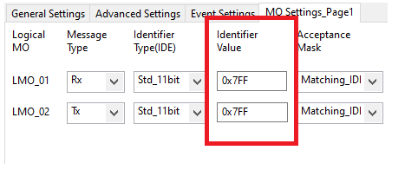
MDR Demo - CAN Bus Detail
Receipt of CAN message triggers hardware interrupt, handled in code.
Message IDs
Notes:
Frank

Slide 17
MDR Demo - CAN Bus
Notes:
Frank

Slide 18
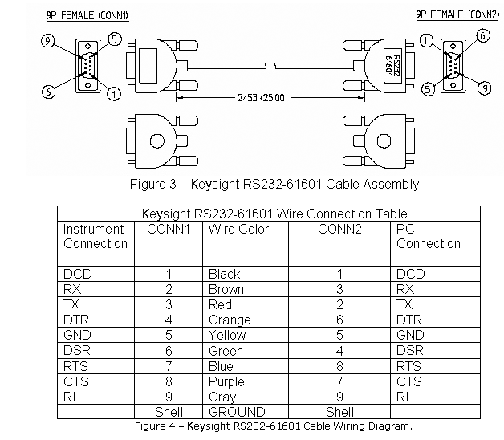
MDR Demo - CAN Bus Challenges
Challenges
Wrong Cable
Wrong Data Sheet
Limited Support
Solutions
Oscilloscope and Jumper Wires
Trial and Error
Lots of time and effort
Notes:
Frank

Slide 19
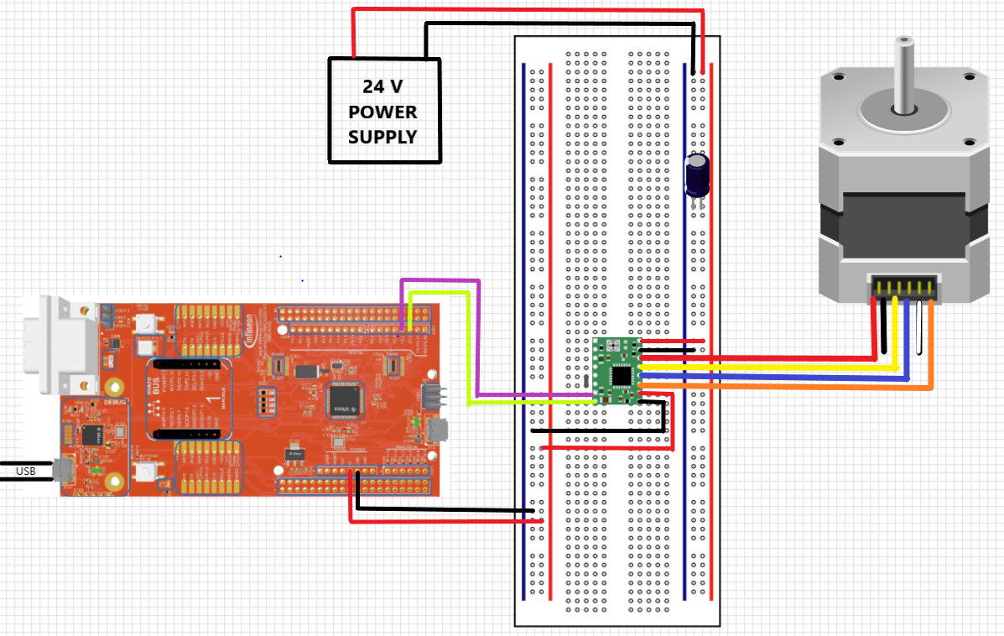
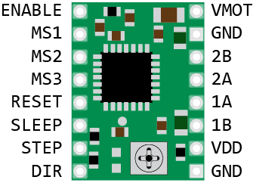
MDR Demo - Motor Module
A4988 Driver
Notes:
Griff
Schematic:
Say:
I was responsible for creating the Motor Module that can drive and control the Stepper Motor
The Hardware used for Motor Module: XMC4200 board, 24V stepper motor, stepper motor driver, and a 24 V power supply
- Unipolar Stepper motors have windings consisting of reversible magnetic poles that follow a magnetic field in each direction ( can move in both directions without reversing current)
- Stepper Motor’s do not simply rotate, instead they step, making repeated movements of small increments, which appears as continuous motor rotation
- The purpose of the stepper motor driver is to convert the wave pulses generated by a Pulse Width Modulation sent from the microcontroller into motor driving steps
- Basically the driver provides sufficient and controlled energy to operate the motor
The Hardware and wiring setup for the Motor Module system is shown in the following schematic:
A 24 Volt Power supply connects to the A4988 driver to power the 24V Stepper motor, which is also connected to the driver in order to fully step and drive the motor
The driver also connects to the XMC4200 board in order to respond to operations and pulses that the driver can convert into steps and rotate the motor at specific speeds and directions
A 100 microFarad Capacitor is used to filter out noise and prevent voltage spikes in the driver by connecting between the Power supply and the driver. ( + positive end to power)

Slide 20
MDR Demo - Motor Module
Phase 1: DIRECTION pin is set high to rotate the motor clockwise (opening the window)
Phase 2: The PWM sent to the STEP pin is shut off to stop the motor
Phase 3: The PWM sent to the STEP pin starts and the DIRECTION pin is set low to rotate the motor counterclockwise (closing the window)
Phase 4: The PWM is stopped again, shutting off the motor
Notes:
Griff
Say:
Software used: DAVE IDE
The Motor Module responds to operations sent from DAVE IDE that are debugged on XMC4200 board:
APPS:
On DAVE IDE I was able to make the driver’s DIRECTION connected to the XMC4200 a digital input/output that can either be set high or low to change directions of the motor
I was also able to generate a Pulse Width Modulation on DAVE in order to send square-wave pulses at specific frequencies to the driver in order to STEP and move the motor at specific speeds
Lastly I Implemented an RTC or Real Time Clock on DAVE, to create a variable to track the runtime of the program and the motor in seconds
I Used the the Real Time Clock to create time intervals in which the motor will change its phases or the controls being sent to the motor will change
The Phases: clockwise, counterclockwise, and stop
Phase 1: DIRECTION pin is set high to rotate the motor clockwise (opening the window)
Phase 2: The PWM sent to the STEP pin is shut off to stop the motor
Phase 3: The PWM sent to the STEP pin starts and the DIRECTION pin is set low to rotate the motor counterclockwise (closing the window)
Phase 4: The PWM is stopped again, shutting off the motor
Demo video:
The string being rolled up represents the window being opened and then stopped once it is all the way open or the string is all the way rolled up. Then the string is unrolled to represent the window being closed until it is all the way shut or the string is all the way unrolled.

Slide 21
Hardware Plan For FPR
Plan to create one PCB for the XMC 4200 (Motor Module)
CAN
GPIO
Debugger
Plan to use XMC 4800 Evaluation Board
XMC 4800 PCB → Lots of overhead
Need approval from Course Coordinators
Notes:
Frank

Slide 22
Hardware & Software Used
Software | Hardware
DAVE IDE Android Studio AWS MQTT Library Amazon Web Services (AWS) IoT Core (Message Streams) Cognito | XMC-4800 Microcontroller XMC-4200 Microcontroller A4988 Motor Driver 24V DC Stepper Motor TP-3005D-3 Power Supply CAN Bus Wires
Notes:
Frank

Slide 23
Project Management
Jonathan Clifford
Team Coordinator & AWS, Android Application Developer
Griffin Manns
Stepper Motor Module & Altium Lead
Professor Arman Pouraghily
Advisor
Frank Cremonini
CAN Bus Communication
Connor Moore
Network Master Controller & Budget
Mr. Glenn Weinreb
Manhattan2 CTO & Contact
Notes:
Griff

Slide 24
Gantt Chart - Spring 2021 - CDR
Notes:
Griff:
We Plan to get some things Done Over Break: consisting of
Window design build, start working with DynamoDB, and the team website
CDR:
My Responsibilities
Will be to design the PCB and order parts as well as to design The Manual Override Switch design for the Motor Module
Jonathan & Connor
Will set up the Transmission Control Protocol/Internet Protocol On the Network Master Controller & Android App
Frank
Will be making Final Revisements to CAN Protocol
ALL
Will be working on the Full end to end Communication Established
Each task should take from 2-4 weeks, leaving a free week before CDR week in case anything takes longer than expected

Slide 25
Gantt Chart - Spring 2021 - FPR
Notes:
Griff:
FPR:
My Responsibilities:
I will be installing Components & Debugging for the PCB
All:
Will be designing and updating the overall Window model and system and also confirming that end to end Communication is working on the PCB for
Each task should take from 2-4 weeks, leaving a free week before CDR week in case anything takes longer than expected

Slide 26
Project Expenditures
Current Expenses:
Estimated Future Expenses:
Part | Cost ($)
XMC4800 Evaluation Board | $95.93
XMC4200 Evaluation Board | $57.85
24V 23KM-K066-00V Stepper Motor | $66.15
A4988 Stepper Driver | $7.45
Total | $227.38
Part | Cost ($)
XMC4800 Processor | $23.65 (per processor)
XMC4200 Processor | $6.31 (per processor)
Estimated PCB Costs | ~$20.00
Pulley Parts ( hardware, etc.) | ~$30.00
CAN cable | $5.00
Model Window Parts (wood, hardware, etc.) | ~$20.00 (sans glass)
Manual Override Switch(s) | $0.20 / Switch
Total | ~$105.96
Overall Expenses (Current + Future) | ~$336.34
Notes:
Griff:
We have already purchased and have used the XMC4800 board, the XMC4200 board, the 24 V Stepper Motor, and the A4988 Driver.
=> The total we have already spent is $227.38
Our future expenses consist of the XMC4800 Processor, the XMC4200 Processor, the PCB, the Pulley System Parts (pulleys, metal belt, etc.) , a CAN cable, a Manual Override Switch, and the Model window parts (wood, hardware, etc.)
=> The estimated total we plan to spend is $

Slide 27
Questions & Answers
Notes:
Griff
End

