Slide 1
SDP ‘21 - Final Project Review - Active Windows
Team 6
Jonathan Clifford, Frank Cremonini, Griffin Manns, Connor Moore
Advisor: Professor Arman Pouraghily
Manhattan2 CTO & Contact: Mr. Glenn Weinreb
Notes:
Jonathan

Slide 2
Overview
Problem Statement
Introduction
System Specifications
System Documentation
Our System & Block Diagrams
Custom PCB - Overview & Status
Demonstration
Notes:
Jonathan

Slide 3
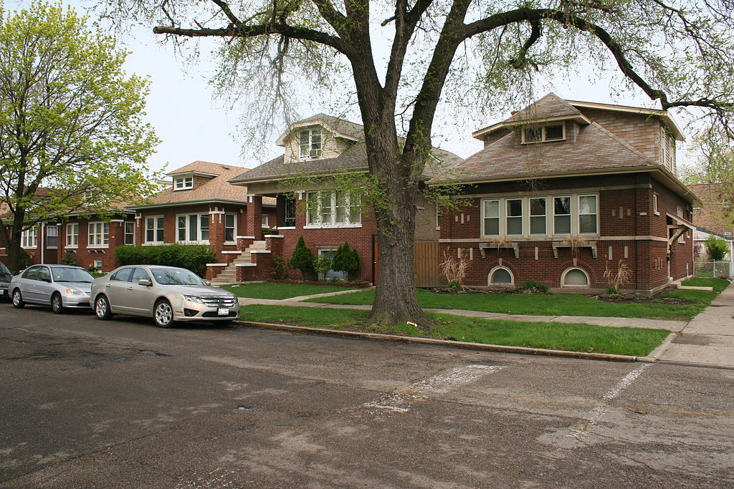
Problem Statement
Climate change is becoming ever more apparent in our daily lives.
We’ve made great strides, but there is still more to be done.
We can focus on the average home in order to reduce the amount of greenhouse gasses produced.
Without a smart home automation system in place, more power hungry alternatives are used.
Making the home smart is the next step to replace negligence and reducing carbon emissions.
https://images.adsttc.com/media/images/5b4b/8056/f197/ccbd/3200/0276/large_jpg/1024px-Falconer_Bungalow_Historic_District_2.jpg?1531674705
Notes:
Jonathan
With climate change becoming ever more relevant, engineers from every discipline are scrambling to combat the issue. Through methods such as green energy technologies and reducing reliance on fossil fuels, our society has made significant progress. However, there is still much work to be done. The average home presents opportunities for countless improvements in energy conservation. In particular, heating and cooling of homes present the opportunity for many inefficiencies to be addressed, including the lack of automation of residential climate control. For instance, to account for temperature variances, an individual may choose to run power-hungry central air systems as opposed to simply making use of natural resources like opening a window to cool a home. However, a sufficiently smart home automation system could replace human negligence and laziness and utilize alternative energy saving options that take advantage of the existing features of homes.

Slide 4
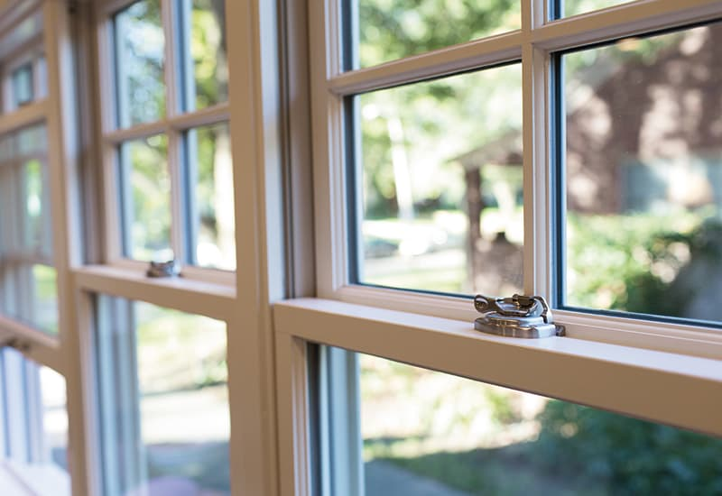
Project Overview
Window operation
We are focused on contributing to window automation in order to try and combat climate change.
To do so, our team is focused on developing the end to end communications that this proposed system will utilize to communicate internally and externally.
This is done via CAN internally and Amazon Web Services (AWS) externally, both to forward system status as well as user commands to control and monitor the window.
https://www.pellabranch.com/webres/Image/misc/2018-window-glass-option-header.jpg
Notes:
Jonathan
So we are focusing on the first step of creating these Smart Window systems, an end to end system.
Specifically we have allowed users to interact with a window automation system
now talk about where we fall in with the window as a components of this total home automation
on this component we are focusing on the communication underlying system

Slide 5
Our Solution
Windows are “Passive”, we will attempt to make them more “Active” by allowing automated remote operation of the window.
To achieve this we have the following components:
Android App for the user to interface with the system and operate the window.
Cloud Connection → Monitor and Control from anywhere.
If Cloud is down, locally we have:
A manual override switch.
Direct connection between the Android App & the system.
Network Master Controller to control the local network and interface with Cloud services .
Motor Module to operate window.
https://backtest-rookies.com/2018/10/26/tradingview-opening-a-window/
Notes:
Jonathan
Since windows are “dumb” we will attempt to make them more “active”, and consequently smarter, by allowing for remote operation of the window.
In this system a phone application will allow for the user to interface with the system and operate the window.
In order to be able to control the window from anywhere, we can make use of the Cloud in order to facilitate communication.
By using the Cloud, we can ensure that future Engineers can add additional features such as Machine Learning algorithms to adjust the home automatically.
In the event that you cannot connect to the Cloud, we allow for the user to bypass the Cloud by two methods:
A manual override switch that opens the window.
A local connection between the phone and the window that still allows for you to adjust it.
In order to interface with the Cloud, we also need a Network Master Controller to provide the interface between the interior network and exterior cloud infrastructure, as well as a Motor Module to actually perform the requested user commands.

Slide 6
System Specifications
The Active Window Subsystems consisting of the Network Master Controller, IoT/Phone Application, and the Motor Module will meet or exceed the following specifications:
Capable of receiving signals from Amazon Web Services (AWS).
Capable of transmitting commands from the Android Application through to the Network Master Controller.
User interaction via an Android Phone Application
Motor Module size is at least 14cm x 8cm.
DC Stepper Motor and Driver, 24V power supply, pulley system solution that can adjust the window
Manual override switch
Android Application is capable of sending commands to the NMC if they are on the same network.
Notes:
Jonathan
These haven’t changed since CDR, but very quickly:
The Active Window Subsystems consisting of the Network Master Controller, IoT/Phone Application, and the Motor Module will meet or exceed the following specifications:
Capable of receiving signals from Amazon Web Services (AWS) for direct communication between the user and the rest of the system.
Capable of transmitting commands from the Android Application through AWS to the Network Master Controller that drives a stepper motor driver, which in turn adjusts a window.
User interaction via an Android Phone Application that transmits data via AWS to the controllers. This Application will include a user interface to control and monitor window status.
The Motor Module’s size is at least 14cm x 8cm in order to maximize installation in a home.
DC Stepper Motor and Driver, will utilize a 24V power supply and use a pulley system solution that can adjust the window via commands. This pulley system will physically lower and raise the test window once it receives the proper command.
In addition, there will also be a manual override switch for the test window that is capable of bypassing the Android Application and will raise or lower the window when it is flipped.
In the event of external network failure, the Android Application is capable of sending commands to the Network Master Controller if they are on the same network.

Slide 7
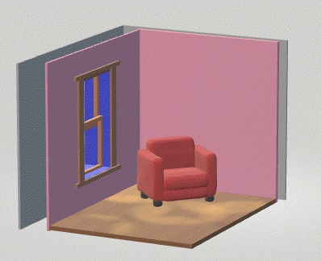
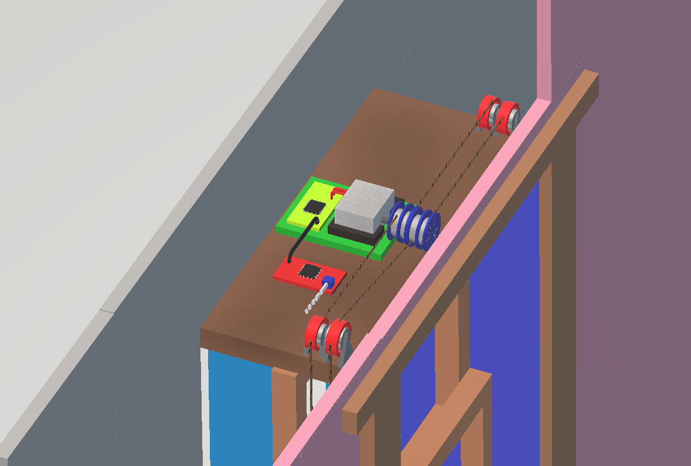
Our Solution in The Field
Notes:
Connor
So before we get into specifics to get a better idea of what these components will look like, here is a mockup of the Physical system
On the left there is an example of our system installed in a home with all the components located within the wall and a seamless installation to appear as a regular window
And on the right is a zoomed in picture of the system located on the top of the window with some updates that I will explain on the next slide

Slide 8
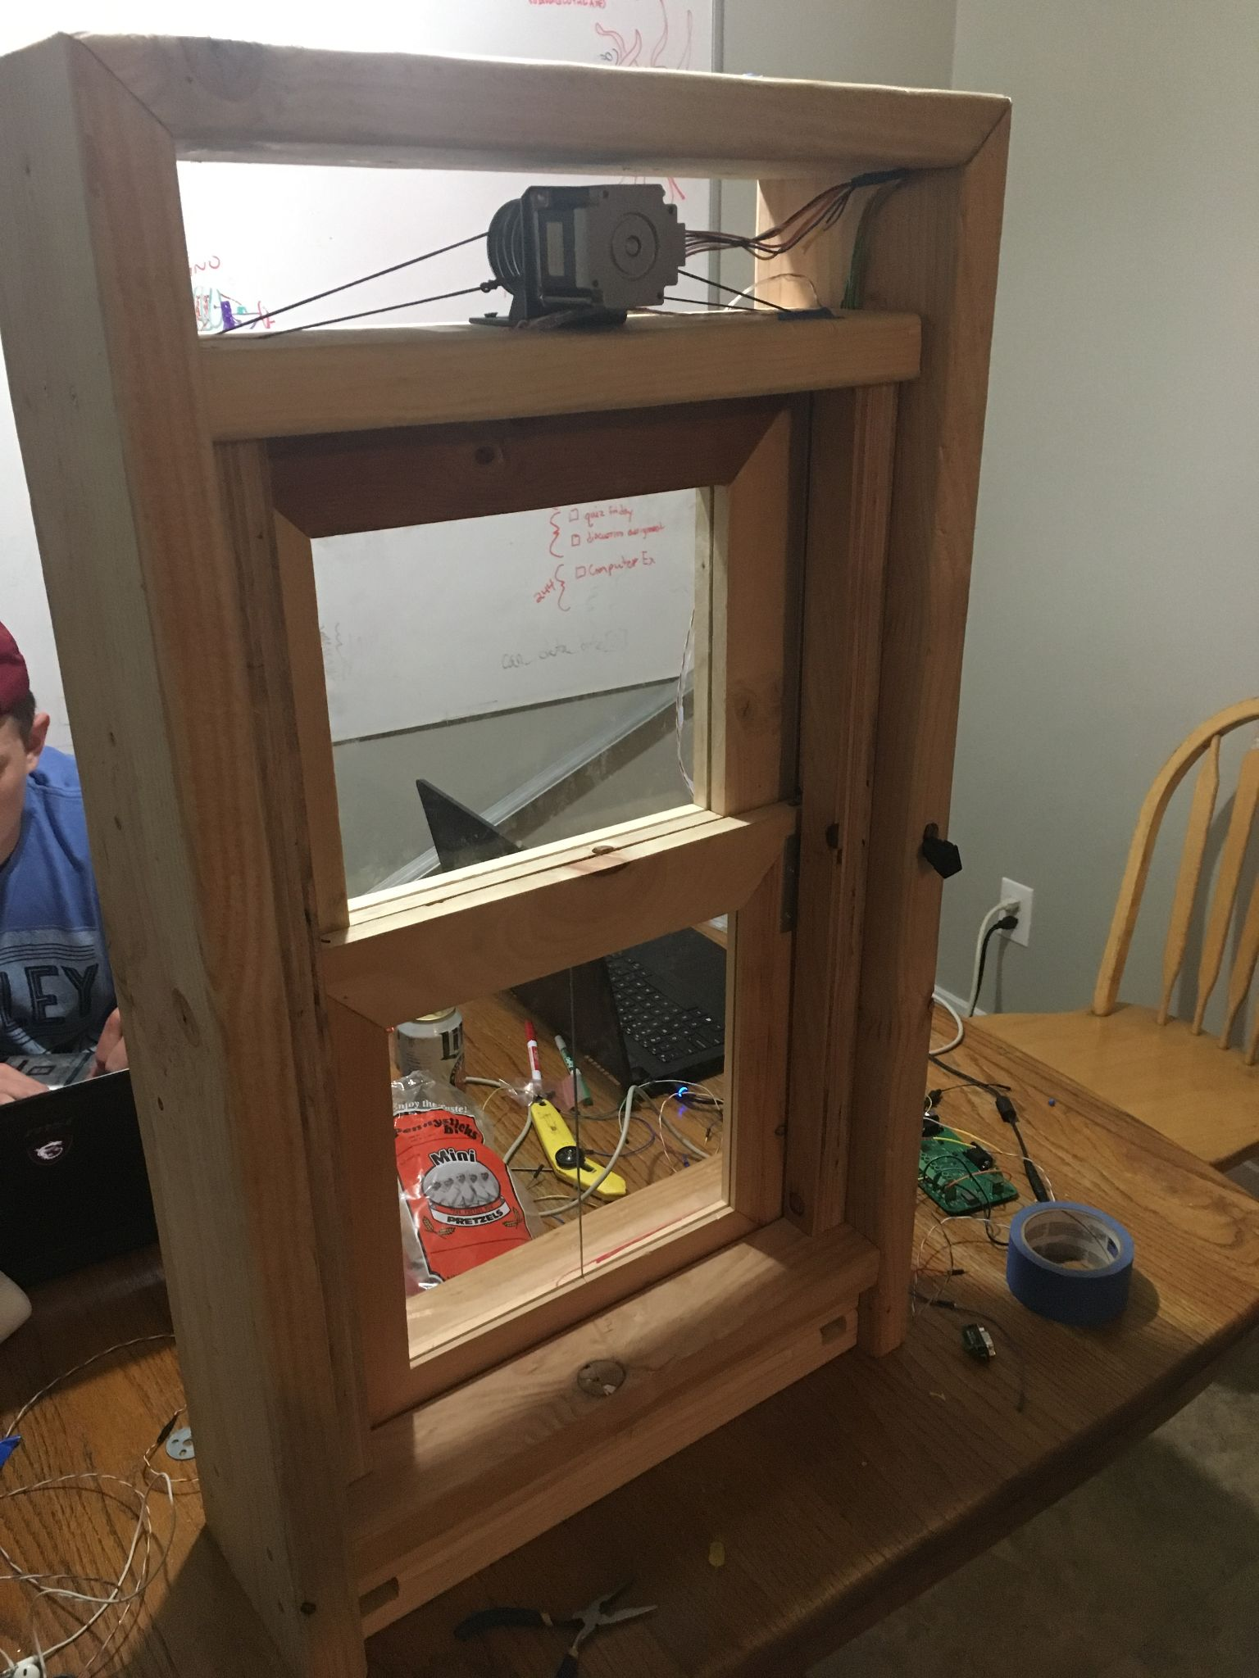
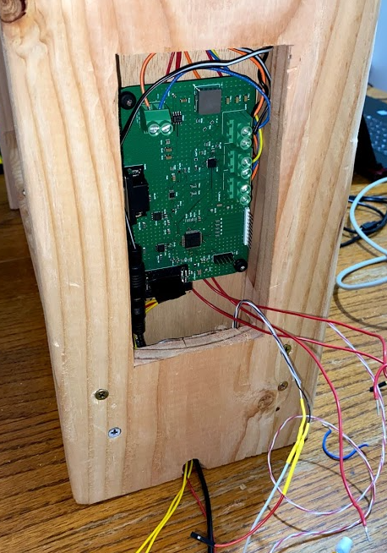
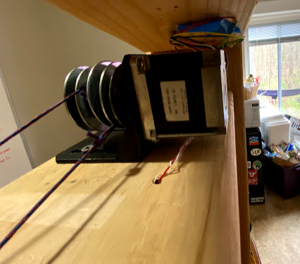
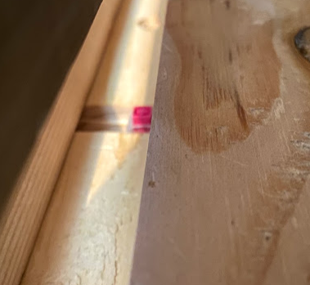
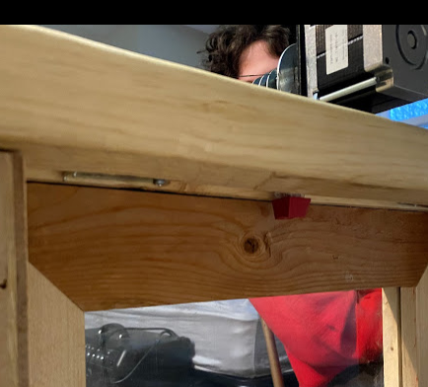
Final Model Window:
21”
36”
7”
Notes:
Connor
So here we have the model window we made
The dimensions of the window are 18” wide 36” tall and 7” deep. The increase in dimensions was to encase the perimeter of the window with would to increase its structural strength
The depth of the window I decided to use was based off the window in my room which is about 7” from the screen to the outside lip. The height and width of window were all based off the two pieces of plexiglass that I had In my garage and just built the frame off of that.
For hardware
There are 6 pulleys in total, with one set of string attached to the top of the window and the other set attached to the bottom of the window.
The second set of pulleys was to add downward force to the window aside from just gravity pulling it down.
The motor which is placed on the top of the window fits just within the dimensions of the window as shown on the right two images
Limit switches placed at the start and end of the moving window path which I will explain later
And finally in the middle is our pcb placed within the window frame to conceal the pcb along with most of the wires aside from the necessary ones that need to exit the window

Slide 9
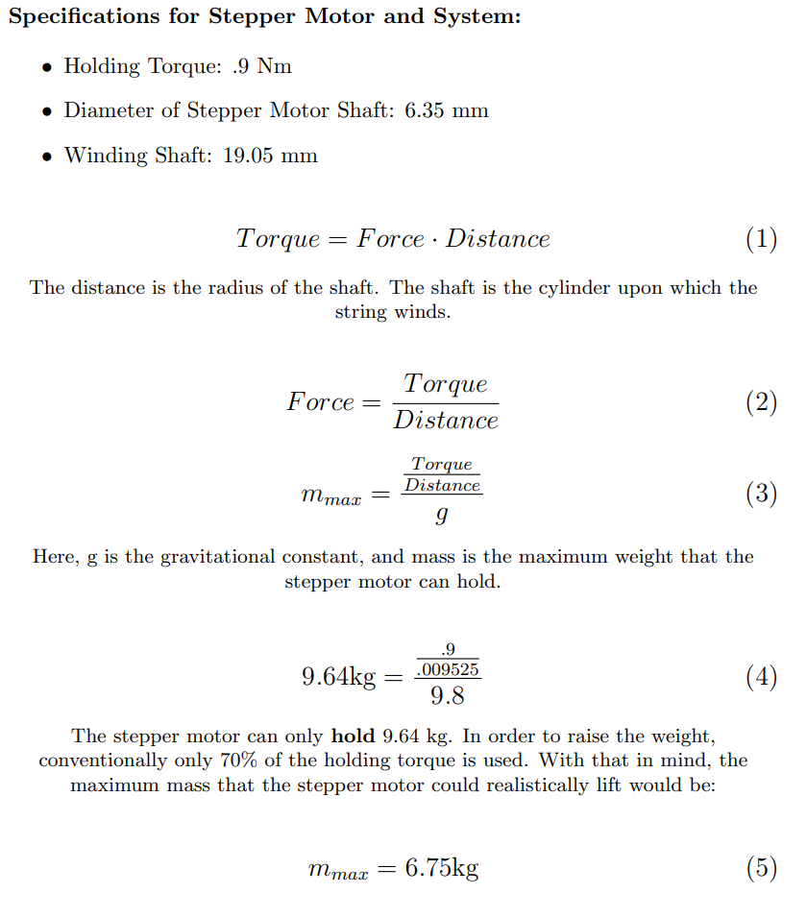
Maximum Weight Calculation
Notes:
Connor
We also calculated some of the specifications of the motor we used in our system to get a better understanding of how much this motor can support given our pulley design.
The motor with the custom designed axcel we made can hold up to 9.46kg, however conventionally only 70% of this value is marked as the comfortable limit to not risk burning out the motor. The dynamic window pane in our design weighed in at less than 1kg so the motor was more than enough to support our model.

Slide 10
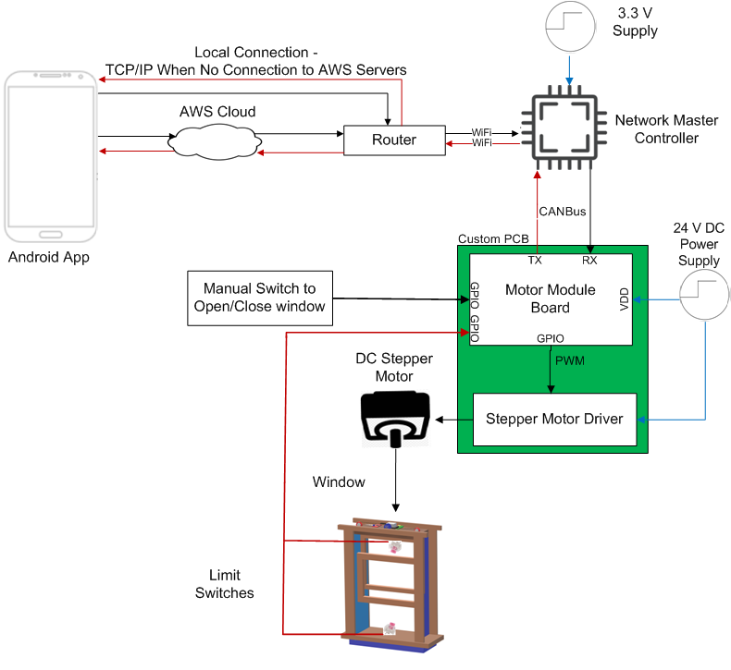
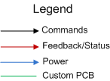
Final Hardware Block Diagram
Notes:
Connor
-So starting from left to right we have the Android app that is used as the user interface with the system and is able to control the system by either
AWS cloud which allows for world wide control and monitoring of the window
Or if internet connection fails the app is still able to control the window locally through a wireless TCP/IP connection.
-Moving to the right we have the NMC which is the xmc4800 that is able to connect and receive the commands through wifi.
-Continuing down there is the MotorModule which is the PCB we designed and this communicates via CAN with the NetworkMasterController
-Connected to this via GPIO we have a localized switch used to operate the window manually, limit switches located on the top and bottom of the window used for a homing algorithm. Then finally the motor driver with is used to drive the motor.

Slide 11
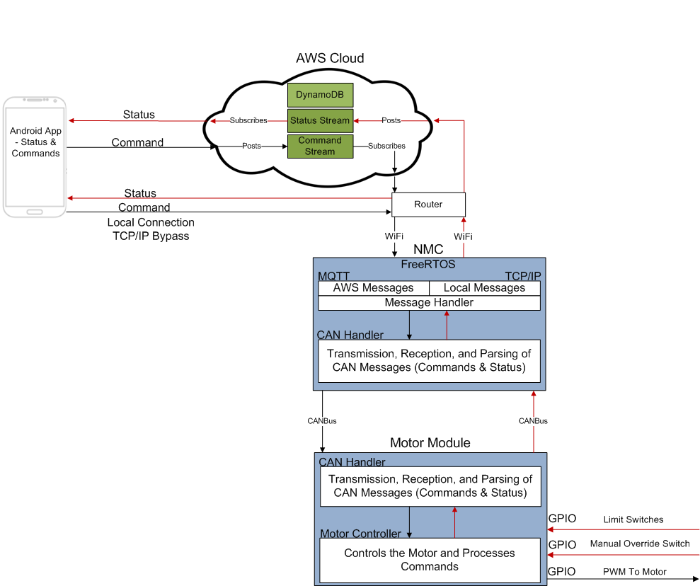
Final Software Block Diagram
Notes:
Connor
So again starting at the App on the left, it can communicate with AWS cloud via Wifi
and as mentioned before can also directly connect
Moving on to the AWS cloud
inside this we take advantage of a Publish&Subscribe message stream
Publishers send messages
Subscribers get messages
On the NMC we are running a open Source version of FreeRTOS which is a real time operating system
inside of this system there are two main components
AWS Message Handler, which is used to receive and transmit messages to AWS
As well as a TCP/IP message handler which transmits messages through Sockets
below that we have a software component for handling transmission and reception of CAN messaging from the motor Module
And finally on the Motor Module
There is a similar software component the handle CAN messages
As well as a component used to operate the Stepper Motor

Slide 12
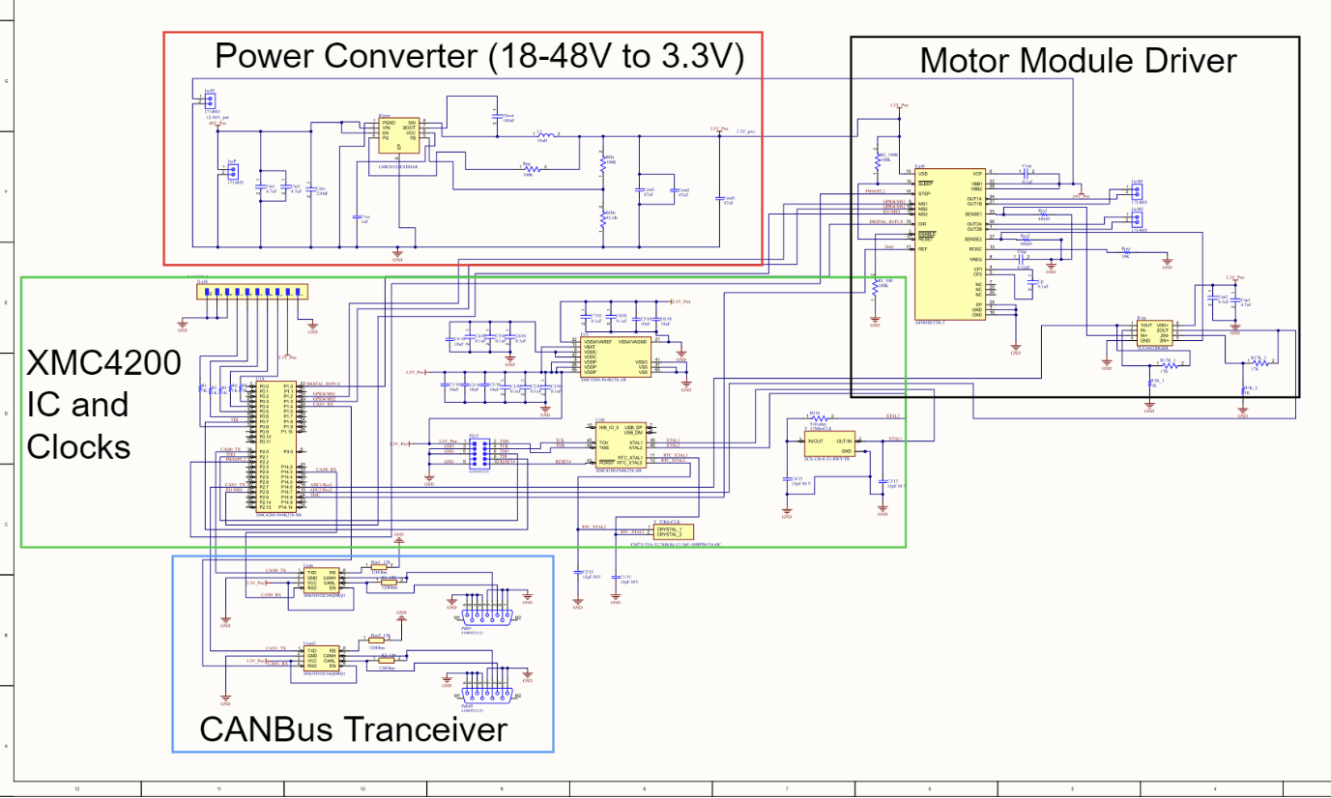
PCB Status & Overview
Notes:
Griff
Schematic:
Now for our teams PCB schematic design created on Altium Designer
Our schematic is broken down into four different parts that wire together to create a PCB board with the functionalities needed of an XMC4200 microcontroller, as well as an A4988 Stepper motor driver.
The part of the schematic shown within the green outline, is the XMC4200’s integrated circuit chip and two Crystal oscillators, that act as clocks for the chip.
XMC4200 IC:
The XMC4200 IC chip is the main part of the PCB, that provides the needed functionalities to connect each of the other parts together through its CAN, GPIO, power, and other valuable pinouts.
Within this part of the PCB there also is a pin header connected to the GPIO pins on the XMC4200 chip, in order to provide input/output communication for the sensing buttons, which track the exact location of the window, as well as the manual override switch
Crystal Oscillators
The two Crystal oscillators provide the clock signals that are needed for synchronization of the internal operations on the board, such as governing the speed at which the processor executes instructions and other necessary functions for the board
The part of the schematic shown within the blue outline, is the CANBus Transceivers
These transceivers connect to the CAN communication pinouts on the XMC4200 IC, which allows for the XMC4200 and PCB to receive and interpret commands from the Network Master controller via CANBus communication
The part of the schematic shown within the black is the A4988 Motor Driver integrated circuit chip, which has the same functionalities as the A4988 Driver we purchased on our breakout board
This Driver IC connects to the GPIO, input/output pinouts, as well as the Post Width Modulation (PWM) pinouts on the XMC4200 IC, in order to receive the interpreted commands sent through the CANBus transceivers.
This Stepper Motor Driver Module then drives the Stepper motor connected to the PCB to follow these commands, which moves the window to the desired location.
The part of the schematic shown within the red outline is the Power Converter, which allows the PCB to take in up to 56 Volts of power via a power supply, and can convert that supplied power down to 3.3 Volts.
This power converter is initially supplied with a 24 Volt power supply in our project, and the 24 Volt power line then connects to the A4988 Motor Driver IC in order to power the 24 Volt Stepper Motor
At the same time the power converter, converts this 24 V power line down to exactly 3.3 volts, in order to power pretty much the rest of the PCB, including the 3 other sub parts mentioned: XMC4200 IC, the A4988 Driver IC, and the CANBus Transceivers

Slide 13
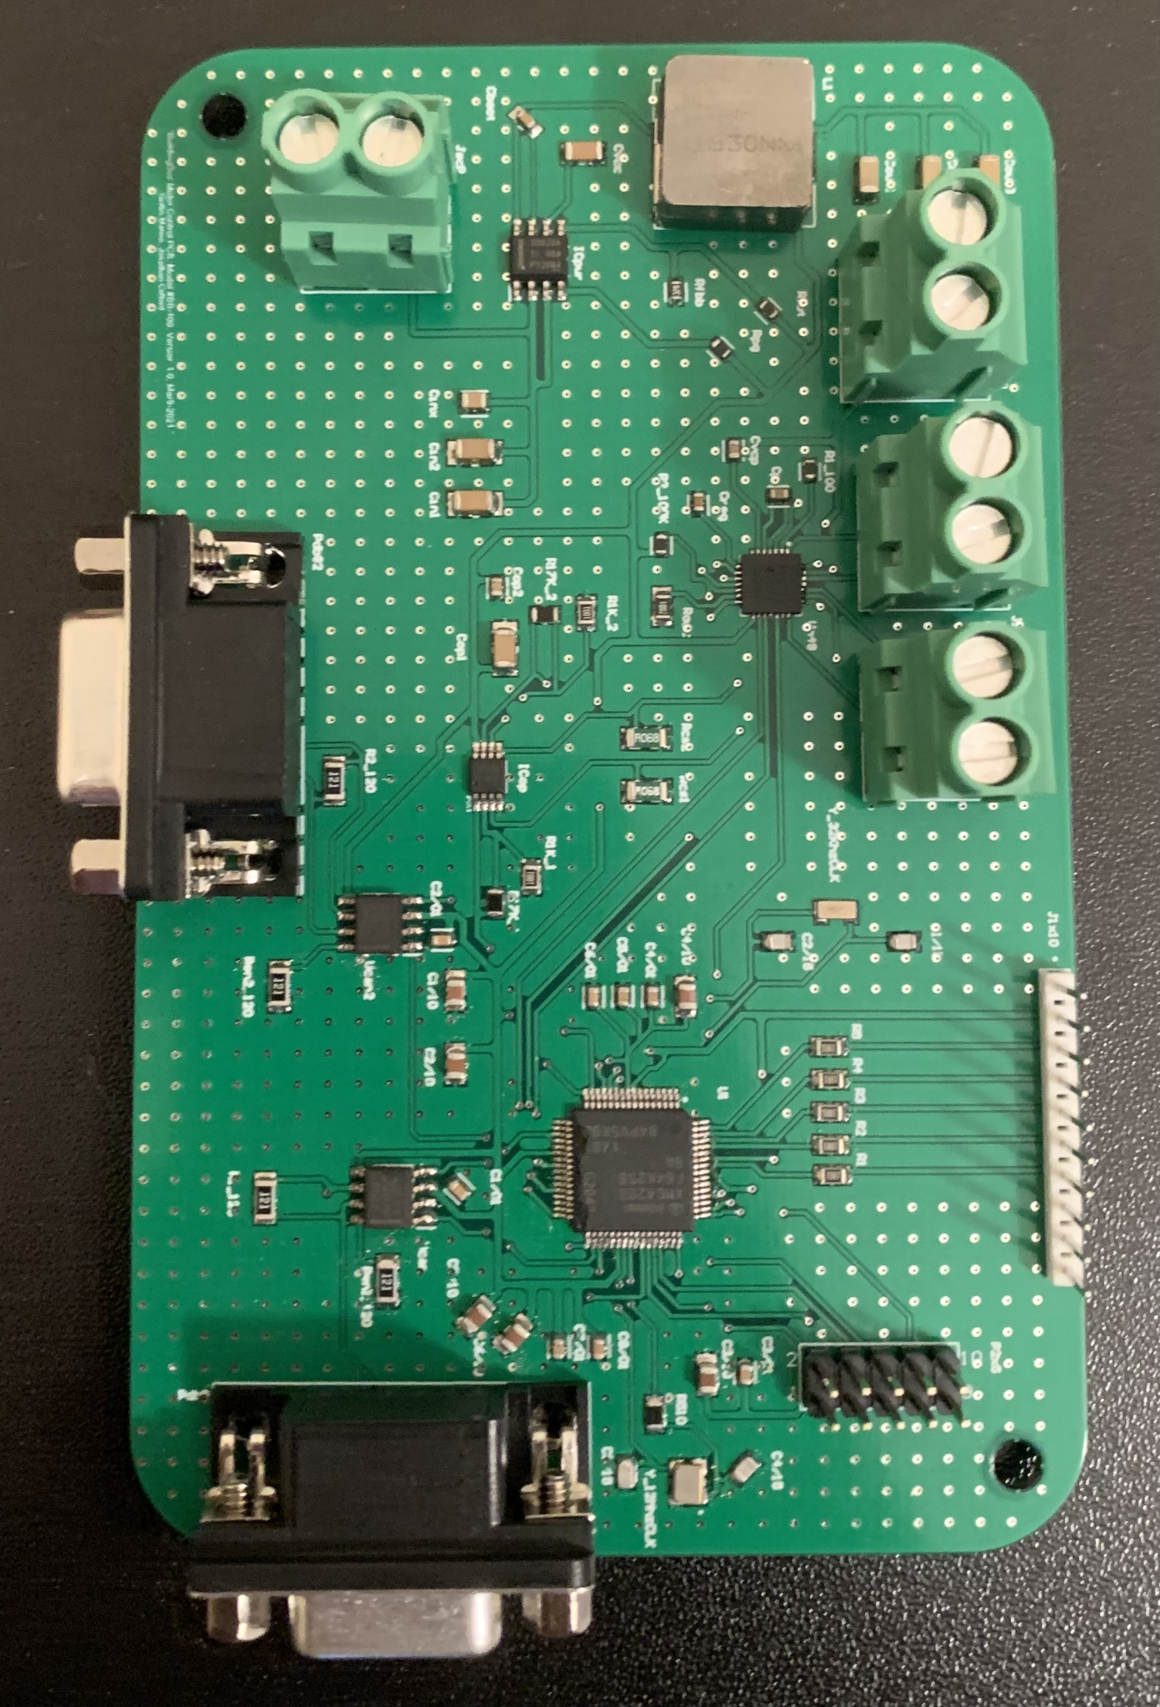
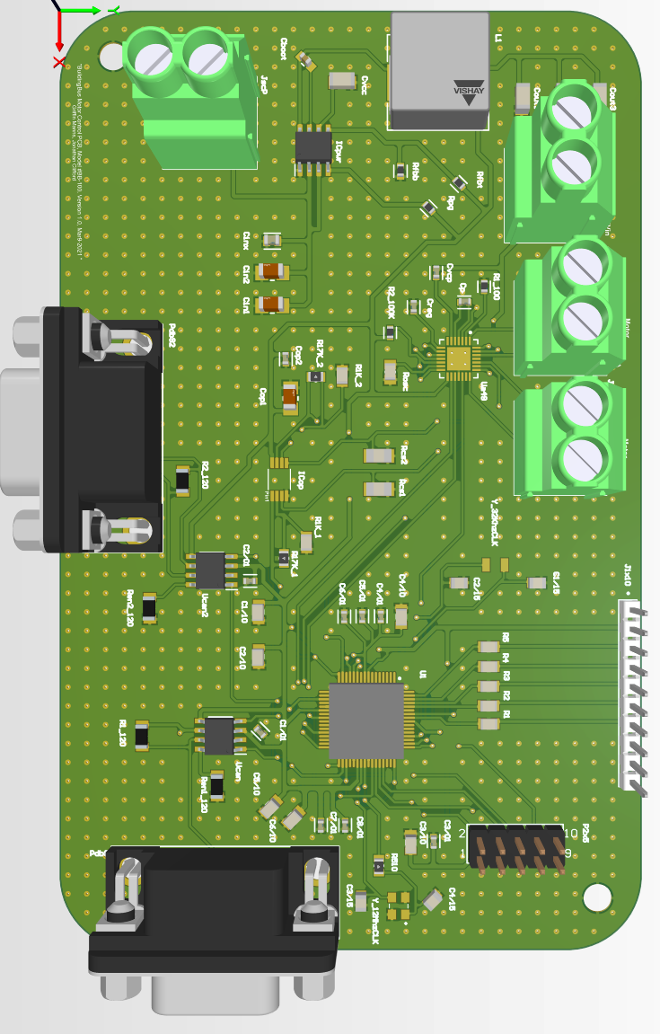
PCB Status & Overview
Notes:
Griff
3D PCB Design:
Once the schematic was finalized, I then imported the design over to the PCB board layout tool on Altium, where I organized the part positions and routed the connections between parts.
The finalized board design is a two-layer Board that is about 13 cm by 8 cm, and will fit easily above our window design
We have the blank PCB physically in hand as well as a Stencil that will make soldering the parts in their exact positions on the PCB easy.

Slide 14
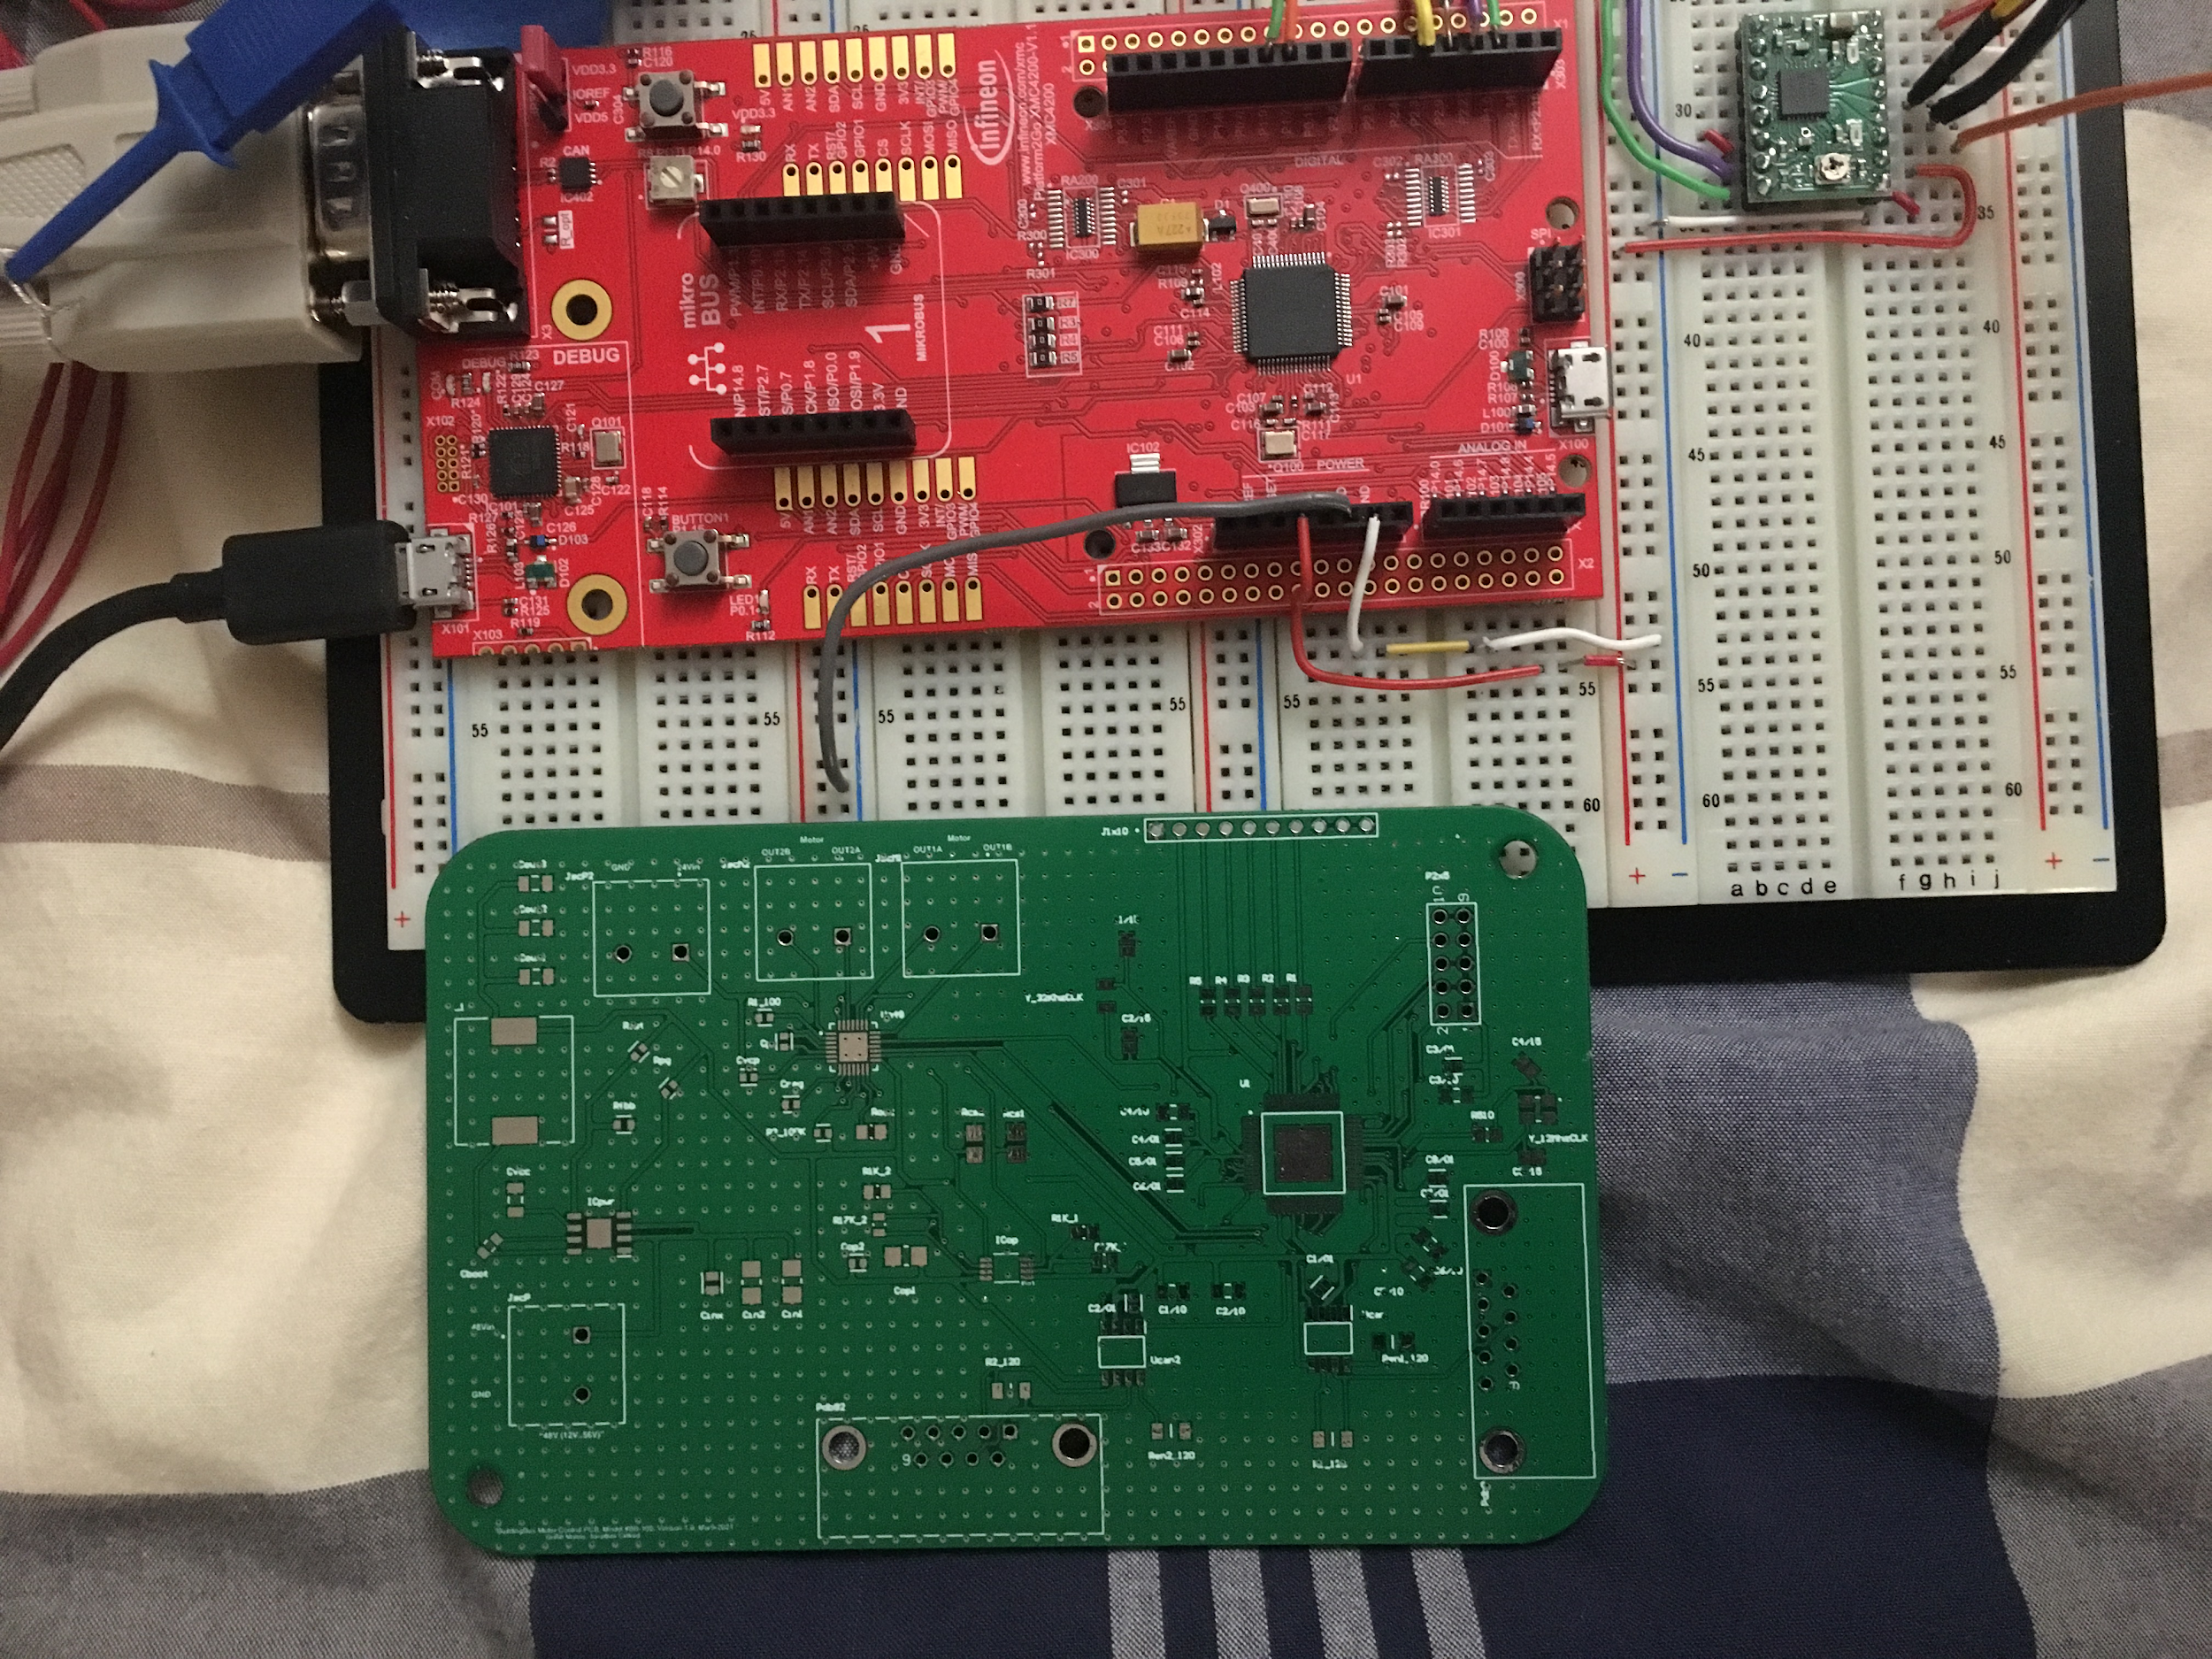
PCB Status & Overview
Notes:
Griff
Our PCB Compared to the Evaluation Board

Slide 15
Hardware & Software Used
Software | Hardware
DAVE IDE DAVE APPs Android Studio AWS MQTT Library Java Sockets Amazon Web Services (AWS) IoT Core (Message Streams) Cognito Altium Designer Texas Instruments WEBENCH | PCB XMC-4200 MCU A4988 Motor Driver Various Components (Resistors, Capacitors, ICs) XMC-4800 Microcontroller 24V DC Stepper Motor Power Supply CANBus Cable Window Hardware (wood, pulleys, switches, etc.)
Notes:
Frank

Slide 16
Final Project Expenditures
Part | Price
XMC4800 Eval Board | 95.93
XMC4200 Eval Board | 55.47
Stepper Motor | 50.00
24v Shield (motor driver) | 25.97
Motor Driver | 8.00
XMC4800 Processor | 23.65
XMC4200 Processor | 14.62
XMC 4000 debugger | 95.00
PCB components | 22.89
Custom board version 1 | 58.15
Custom board version 2 | 35.11
Mouser order for crystal oscillator | 14.79
DigiKey order | 49.37
TOTAL | $548.95
Notes:
Frank:
The purchases we have made so far are:
Our total expenses add up to $548.95, which still remain below our budget because we were granted a $50 increase in our budget
We do not plan to have any future expenses at this point.

Slide 17
FPR Demo - Documentation
Full end to end system is functioning
A user will boot up the Android Phone Application and connect to the system via AWS
The user will command the window to move up/down based on preference, and receive statuses back from the NMC once the window is done actuating.
Another user will then actuate the window with the manual override switch, the user over AWS will receive a status update when it is complete.
A user will boot up the Android Phone Application and connect to the system via Local Connection (TCP/IP)
The user will perform the same steps as above.
Audience Participation: Commanding the window via a website (http://www.ecs.umass.edu/sdp/sdp21/team06/WebDemo.html)
Notes:
Frank

Slide 18
FPR Demo
Notes:
Backup video

Slide 19
Questions & Answers
Notes:
Griff
End

Slide 20
FPR Demo - Backup Video
Notes:
Backup video

