Slide 1
Shiver-Ring
PDR Presentation for Team 2
Michael Burton, Connor Loughman,
Adam Maciazek, John Murray
Notes:
Team 2 PDR presentation
Starting Speaker - John
Basic Intro
Say “Hello, welcome to the preliminary design review for group 2
Each member introduces themselves, John, Adam, Connor, Mike
John - “The name of our project is Shiver-Ring” (TRANSITION after 1 second of hearing this)

Slide 2
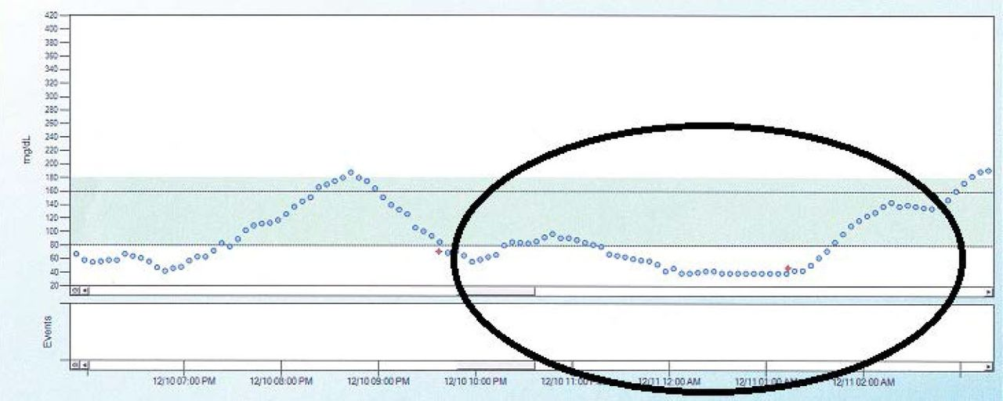
Problem Statement
When diabetic patients sleep their blood sugar levels can drop and result in hypoglycemic events, if the patient is unable to wake these events can go untreated and result in coma and even death.
(Source: Unger J: Diabetes Management in Primary Care. 2nd ed. Philadelphia, Pa., Lippincott, Williams, and Wilkins, 2012.)
Blood Sugar levels in a Type 1 Diabetes Patient Over Time
Notes:
Mike reads problem statement
Our goal is to create an alarm system that can alert a 3rd party via SMS messaging to aid when in a hypoglycemic episode. Using an EMG to measure the movements in the muscles in the hand, you can detect the frequency of movement that can indicate shivering which is a symptom of hypoglycemia. As of 2020, the technology to detect hypoglycemia is both expensive and not very reliable, or it is invasive. Our system intends to be a non-invasive, alternative to the current commercially available products. The currently available solutions use sensors based off of temperature and moisture, however we want to use the patients shivering as our trigger.
After finished reading wait 1 sec and next slide
Info for the graphic:
https://clinical.diabetesjournals.org/content/31/4/179.figures-only from the American Diabetes Association

Slide 3
Preliminary System Specifications
Sense in range 8-12 Hz
Have an alarm go off when threshold met for 5 seconds
Send a message to someone if the event is occurring and alarm has not been disabled within 10 seconds
Wearable and comfortable wrist strap
Our SDP budget is the limit to the price of our solution ($500)
12 Hour battery life
Notes:
Connor reads slide ( each bullet, a bit of what each means/why it is a spec)
TRANSITION READ THIS FIRST - In order to properly sense the patients shivering we have found that these specifications must be followed.
Reasons why
From multiple research papers on post-operation shivering and cold temperature based shivering
Similar to diabeties sentry
This allows for a secondary level of assurance that the patient is saved
If the device isn’t comfortable the patient won’t wear it
As shown in later slides we are sitting well under budget
As to last the night for continuous monitoring
wait 1 sec before transitioning to the next slide after stating that the battery is planned to last for 12 hours so that it will last for the duration of the users sleep

Slide 4
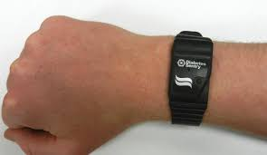
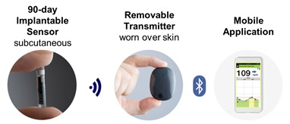
Survey of Competing Solutions in Marketplace
Advantages:
FDA Approved Class 3 medical device
Non-Invasive
No calibration required
Disadvantages:
Expensive
10% failure rate
Only alerts nearby users using a buzzer, no secondary alert system
Advantages:
96% success rate
user monitoring app
data shared to family and health professionals
Disadvantages:
Invasive
Has to be replaced every 90 days
Sends data every 5 minutes
Notes:
Mike slide
In conclusion, we will aim to be competitive with these systems.

Slide 5
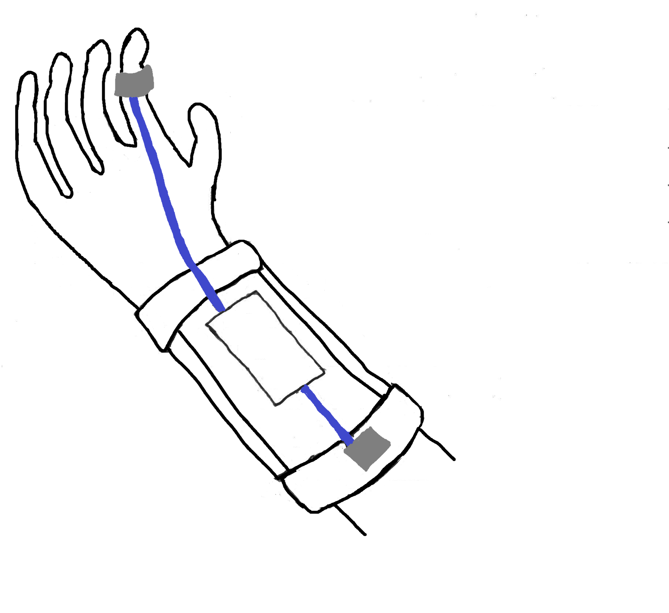
Design Alternatives/Ideas
Flex PCB to accelerometer
Cloth covering
Battery, Microcontroller, and Bluetooth (EMG, if used)
sweatshirt sleeve like elastic
Flex PCB to EMG Electrode
Notes:
John talks
This image of our systems show the two sensors currently in the running for our design.
The final design will include the sensor or sensors that most reliably give us shiver events.
Our overall device goal is focused on reliability of event reporting and comfort of the user.
Wait 1 sec then next

Slide 6
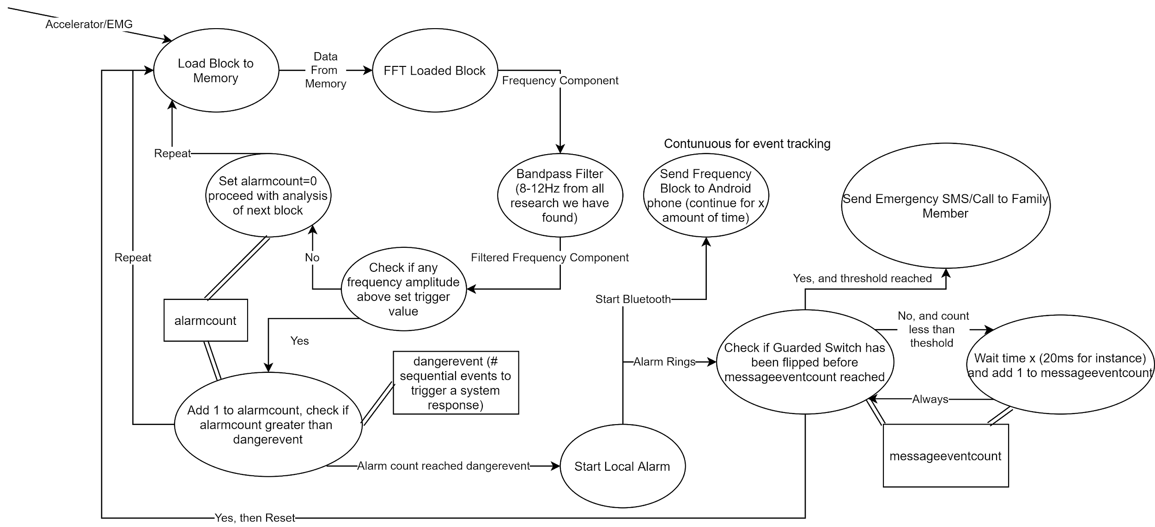
Preliminary Design
Overall Design:
Notes:
Adam -
1 The signal is taken in processed and the shivering events count increments, until threshold reached
2 The local alarm is set off and 10 seconds of time
3 if the alarm has not been shut off them the bluetooth connects send the data to android phone connected
4 the custom app on the phone send an sms to preset person to aid them
trans after The sms is sent

Slide 7
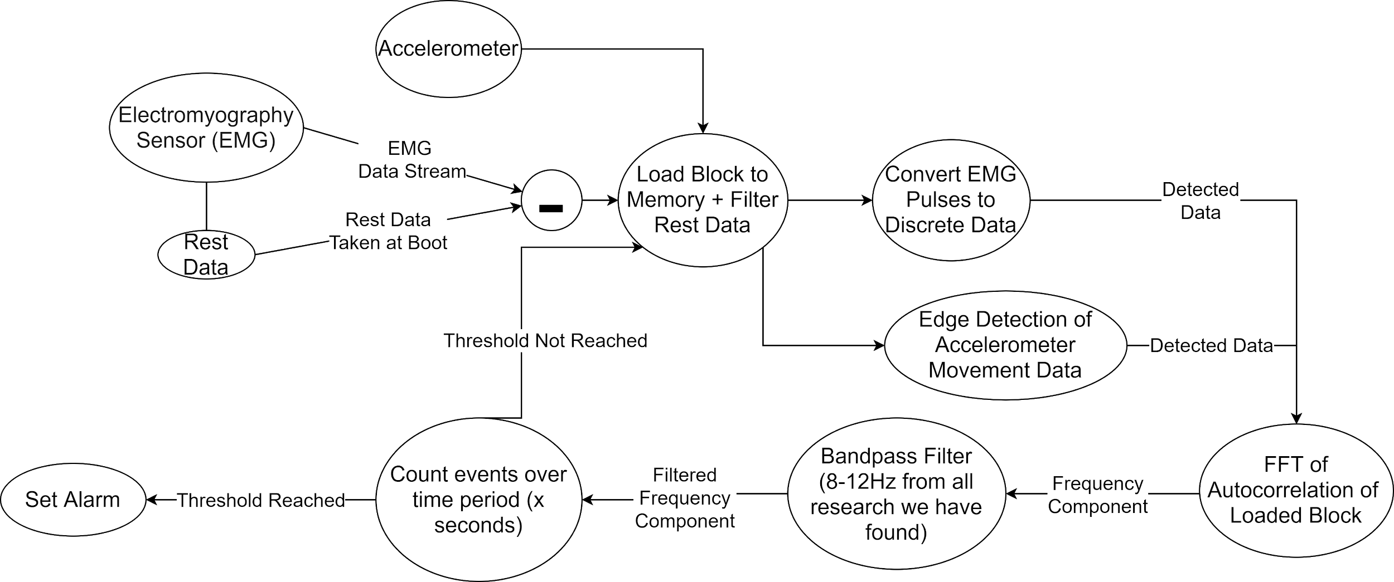
Signal Processing
Notes:
Adam talks
Signal Processing of both Options
(1) The emg sensor will collect rest electrical data, and the accelerator will be calibrated on the x y plane
(2) The sensors, for now run at 1khz, much higher than nyquist to prevent aliasing, 5 seconds of data into the block take up less than 5% of non bootloader memory
(3) The block of data then filters out the rest data. Then convert the data into events, pulses for emg and and change in direction for accelerometer
(4) The perform a fft of the autocorrelation of the signal. Then filter out non shivering frequencies. Count number of events
transition after “alarm state is triggered”

Slide 8
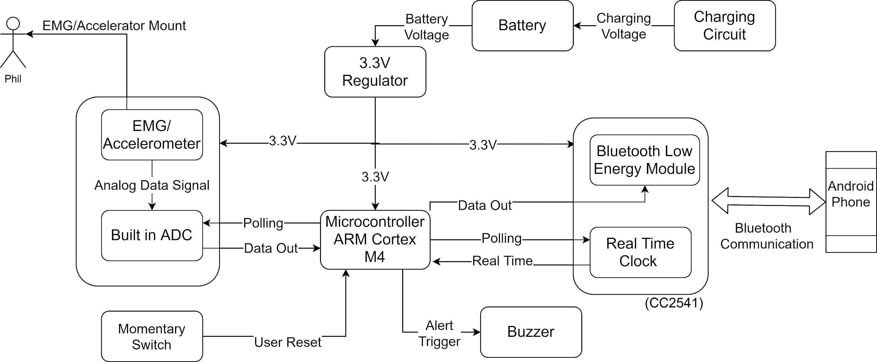
Significant Custom Hardware Design
Notes:
Connor talks
Just go through components and connections
as for why the m4? mention designed for digital signal processing and is low energy
Go in depth about purpose of momentary switch
Talk a bit about android app how it receive bluetooth alert and send SMS
Transition after “If the alert is not disabled, there is a bluetooth module that communicates with an android app that is responsible for communicating with an emergency contact via sms”

Slide 9
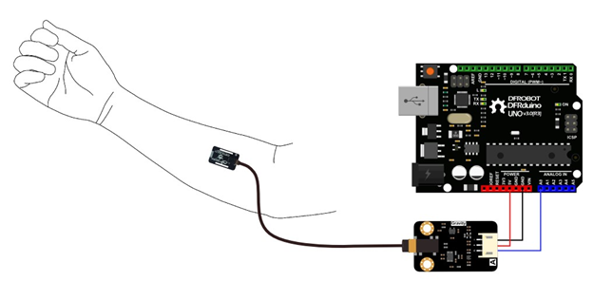
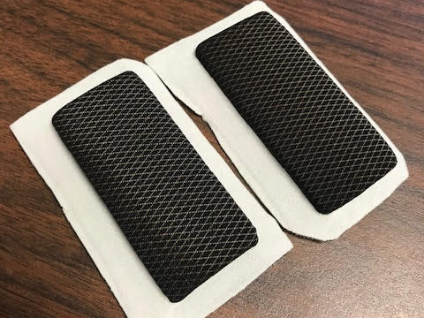
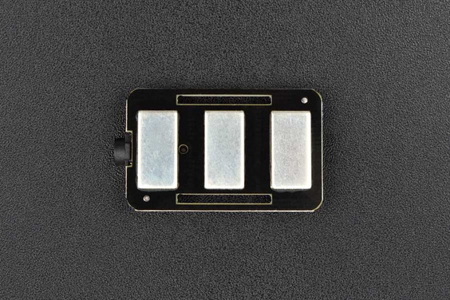
Proposed MDR Deliverables
A survey of sensors:
Oymotion Analog EMG
needs electrodes
wet and dry electrodes
conductive textile electrode
Triple Axis Accelerometer MPU6050
Tests to report back on:
determine the better sensor
location tests to get the best signal for EMG
signal processing in MATLAB or similar
Android app (only calling functionality, no connectivity with the rest of the project yet)
Breadboard prototype
Notes:
Connor talks
transition after “Lastly we will have a breadboard prototype come MDR”

Slide 10
Cost Break Down
Part | Number | Price Each | Price | Link to Part
Oymotion Analog EMG | 1 | $38 | $38 | link
Triple Axis Accelerometer MPU6050 | 3 | $10 | $30 | link
Arm Cortex M4 | 2 | $14 | $28 | link
M4 development Board | 2 | $28 | $56 | link
Flexible Custom Board | 1 | $40 | $40 | link
Bluetooth Low Energy 4.0 TI CC2540 | 2 | $9 | $18 | link
3,600mah Li-on Battery | 1 | $14 | $14
Alarm & Switch | 1 | $5 | $5
Housing and Band Material |  | $40 | $40
Shipping Costs |  | $30 | $30
Total |  |  | $299
Notes:
Adam talks
After total is stated wait 1 sec and transition
List parts explain

Slide 11
Project Management - Administrative and Technical
Connor Loughman - PCB design, App Dev, Web Service
Adam Maciaszek - Budget Management, Algorithm/Embedded, Web Service
Michael Burton - Embedded + Security, Project Co-Manager (Short-Term), Web Service
John Murray - Communication Networking, App Dev, Project Co-Manager (Long-Term)
Notes:
Mike talks
Read the slide
Clear explanation of what is short term( and what is long term management
Short-Term: Scheduling meetings, including team and advisor meetings, and all external communications.
Long-term: Updates the Gantt chart based on estimates from the co-manager that covers short term needs.
John will now explain our long-term plans in our Gantt Chart.

Slide 12
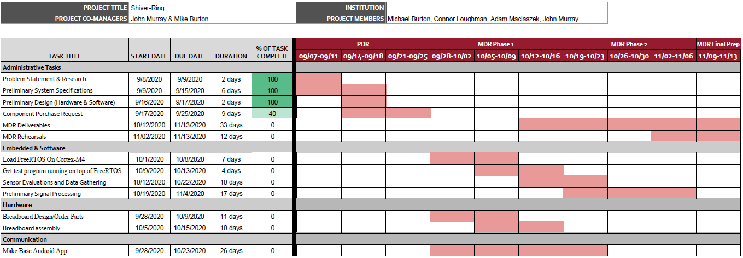
Project Management - Gantt Chart
Notes:
John
End - Thank you for listening.

