Slide 1
Shiver-Ring
MDR Presentation for Team 2
Michael Burton, Connor Loughman,
Adam Maciaszek, John Murray
Notes:
Team 2 PDR presentation
Starting Speaker - John
Basic Intro
Say “Hello, welcome to the preliminary design review for group 2
Each member introduces themselves, John, Adam, Connor, Mike
John - “The name of our project is Shiver-Ring” (TRANSITION after 1 second of hearing this)

Slide 2
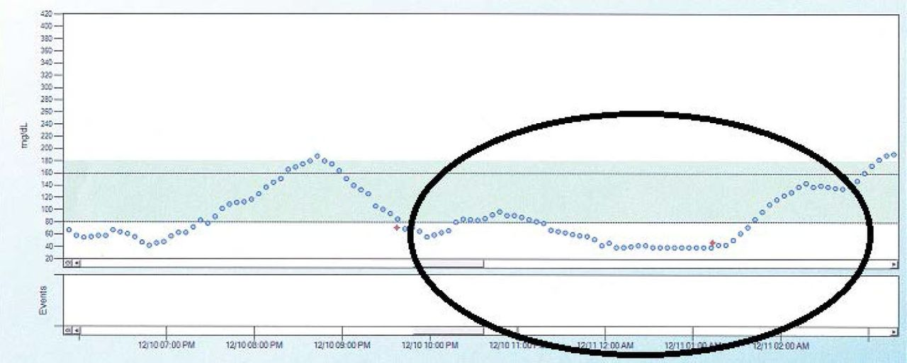
Updated Problem Statement
When diabetic patients sleep their blood sugar levels can drop and result in hypoglycemic events, if the patient is unable to wake these events can go untreated and result in coma and even death. IMPORTANT CHANGE: No EMG
(Source: Unger J: Diabetes Management in Primary Care. 2nd ed. Philadelphia, Pa., Lippincott, Williams, and Wilkins, 2012.)
Blood Sugar levels in a Type 1 Diabetes Patient Over Time
Notes:
Mike reads problem statement
Our goal is to create an alarm system that can alert a 3rd party via SMS messaging to aid when in a hypoglycemic episode. Using an accelerometer to measure the movements in the muscles in the hand, you can detect the frequency of movement that can indicate shivering which is a symptom of hypoglycemia. As of 2020, the technology to detect hypoglycemia is both expensive and not very reliable, or it is invasive. Our system intends to be a non-invasive, alternative to the current commercially available products. The currently available solutions use sensors based off of temperature and moisture, however we want to use the patients shivering as our trigger.
After finished reading wait 1 sec and next slide
Info for the graphic:
https://clinical.diabetesjournals.org/content/31/4/179.figures-only from the American Diabetes Association

Slide 3
Updated System Specifications
Sense in range 8-12 Hz
Have an alarm go off when threshold met for 12 seconds
Send a message to someone if the event is occurring and alarm has not been disabled within 24 seconds
Wearable and comfortable wrist strap
Our SDP budget is the limit to the price of our solution ($500)
Multiple day battery life
Notes:
Connor reads slide ( each bullet, a bit of what each means/why it is a spec)
TRANSITION READ THIS FIRST - In order to properly sense the patients shivering we have found that these specifications must be followed.
Reasons why
From multiple research papers on post-operation shivering and cold temperature based shivering
Similar to diabetes sentry
This allows for a secondary level of assurance that the patient is saved
If the device isn’t comfortable the patient won’t wear it
As shown in later slides we are sitting well under budget
As to last past the night for continuous monitoring
wait 1 sec before transitioning to the next slide after stating that the battery is planned to last for 12 hours so that it will last for the duration of the users sleep

Slide 4
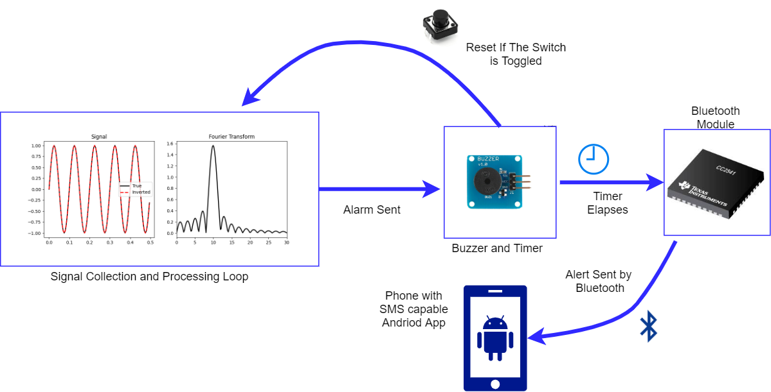
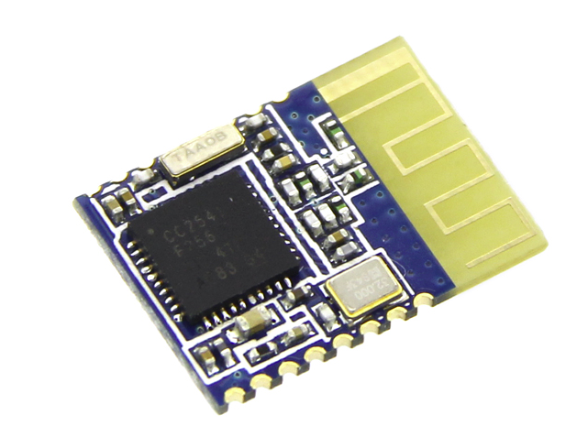
Updated Overall Design
Notes:
John-
1 The signal is taken in processed and the shivering events count increments, until threshold reached
2 The local alarm is set off and 10 seconds of time
3 if the alarm has not been shut off them the bluetooth connects send the data to android phone connected
4 the custom app on the phone send an sms to preset person to aid them
trans after The sms is sent

Slide 5
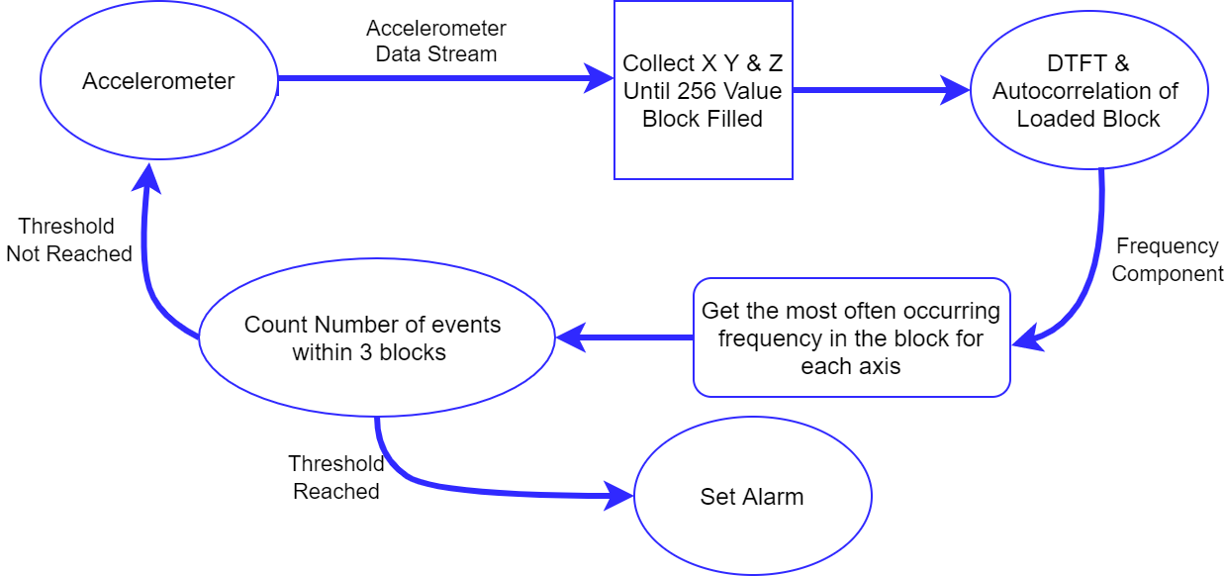
Updated Signal Processing
Notes:
Adam talks
Gathering data takes 2.37 seconds
calculating the data takes 1.49 seconds
total time between outputs 3.86 seconds
data sampled at 108 Hz
which is much lower than previously thought

Slide 6
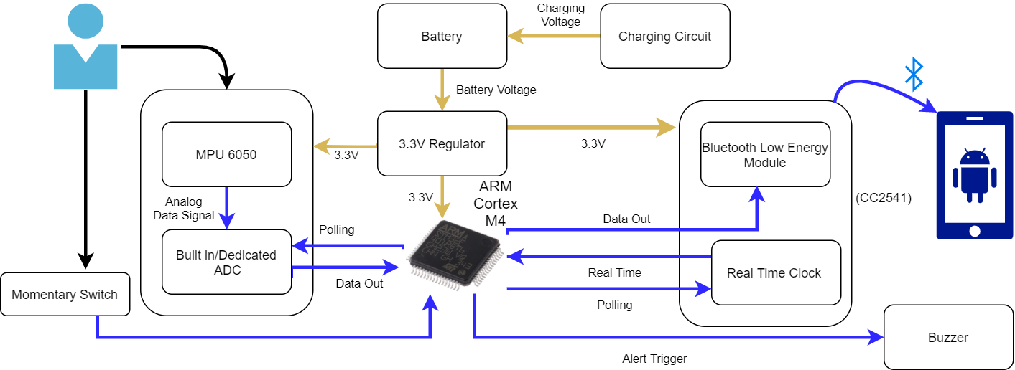
Updated Hardware Design
(HM-11)
Notes:
Connor talks
Just go through components and connections
as for why the m4? mention designed for digital signal processing and is low energy
Go in depth about purpose of momentary switch
Talk a bit about android app how it receive bluetooth alert and send SMS
Transition after “If the alert is not disabled, there is a bluetooth module that communicates with an android app that is responsible for communicating with an emergency contact via sms”

Slide 7
Addressing PDR Questions
FDA Approved Class 3 medical device
Find out if big manufacturers (Apple, Fitbit, etc.) have already looked into this problem.
The shivering threshold is now 12 seconds instead of 5 seconds
Notes:
Mike talks
Now I will answer questions from the PDR evaluation. The first question was about FDA-approved class 3 medical devices. The definition of this from the FDA website is as follows: “These devices usually sustain or support life, are implanted, or present potential unreasonable risk of illness or injury. Examples of Class III devices include implantable pacemakers and breast implants. 10% of medical devices fall under this category.”
https://www.fda.gov/medical-devices/consumers-medical-devices/learn-if-medical-device-has-been-cleared-fda-marketing
Big manufacturers have looked into the problem of detecting nighttime glucose levels to determine low-blood sugar, but a non-invasive accelerometer based approach has not been put to market by any major manufacturer. The main health functionality that is advertised is an integrated electrocardiogram, or ECG.
The second question about big manufacturers is that no not specifically for this application. There is a library available to apple watch developers for tremor detection using the watch’s accelerometer, though no shiver implementation has been used as far as we know. No fitbit is currently able to detect shivering either.
The third question was why the shivering threshold was 5 seconds and why it was set at this. It was mainly due to our initial signal processing outline, btu this has changed. Now we are monitoring all 3 axis of motion and looking for 5-9 alarms over a period of 3 sample cycles. Each sample cycle is 4 seconds long, with each cycle giving 3 frequency outputs. If 5/9 of these values are between 8 and 12 Hertz then the shiver event is triggered. This decision was made in consideration of what data we were able to gather from our group members, as there were rarely if any natural frequencies that occured over 5Hz. Also it is important to know that hypoglycemia induced hypothermia which would cause shivers, but in extreme cases of hypothermia when the person is about to die they will stop shivering. This is extremely dangerous, and one of the reasons why we try to detect the events as early as we can. This number is also not static, and will most likely continue to change as we gather more shivering data, but given what we have so far we believe this to be the best method.
Transition “We will now go over the MDR project management, including team responsibilities.

Slide 8
Project Management - Administrative and Technical
Connor Loughman - Altium Lead, App Dev (Android Calendar Integration)
Adam Maciaszek - Budget Management Lead, Algorithm/Embedded, Web Service
Michael Burton - Project Co-Manager (Short-Term), FreeRTOS, Web Service
John Murray - Communication Networking, App Dev (General&SMS), Project Co-Manager (Long-Term)
Notes:
Mike talks
Read the slide
Clear explanation of what is short term( and what is long term management
Short-Term: Scheduling meetings, including team and advisor meetings, and all external communications.
Long-term: Updates the Gantt chart based on estimates from the co-manager that covers short term needs.
Transition: Now we will talk about MDR tests.

Slide 9
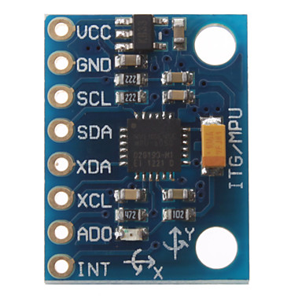
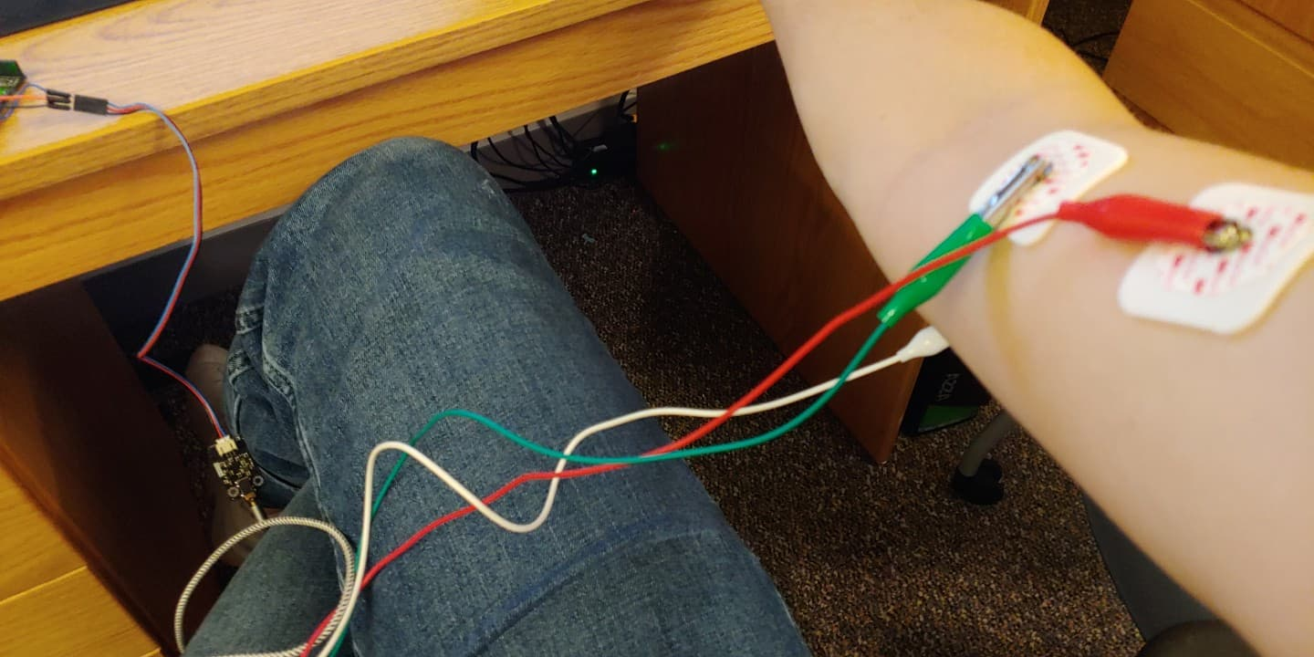
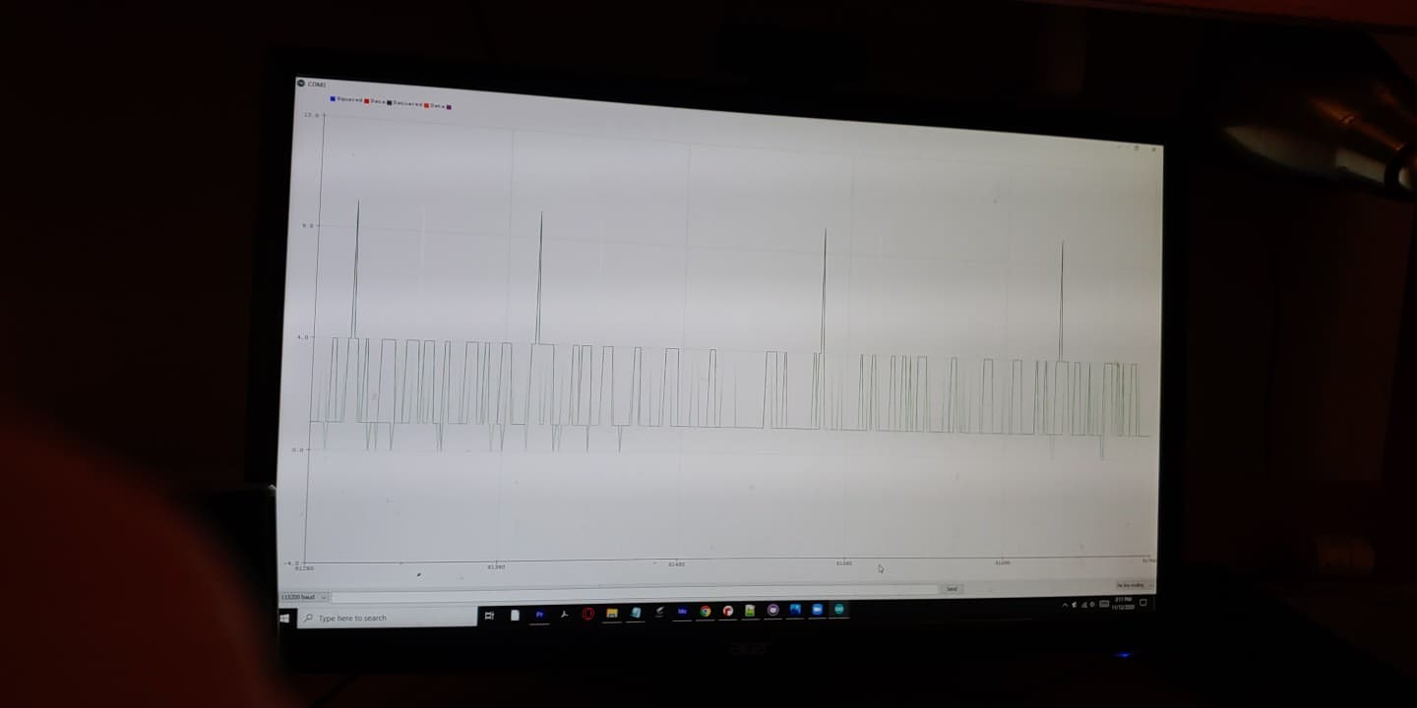
MDR Tests
A survey of sensors:
Oymotion Analog EMG
needs electrodes
wet and dry electrodes
conductive textile electrode
Triple Axis Accelerometer MPU6050
Tests to report back on:
determine the better sensor
location tests to get the best signal for EMG
signal processing
Android app
(only calling functionality, no connectivity with the rest of the project yet)
Breadboard prototype
Notes:
Adam talks
transition after “At the end we will demonstrate the accelerometer at work”

Slide 10
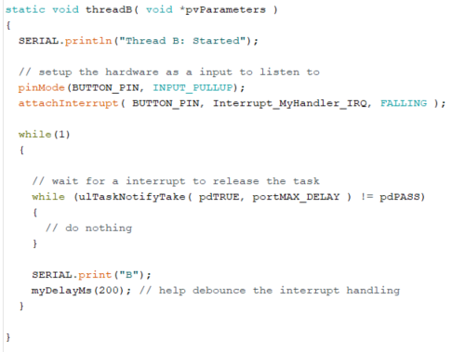
Mike Deliverables-
FreeRTOS Implementation and Testing
Input-Driven interrupts
Scheduling
Additional Task:
Gathered Shivering data
Notes:
Mike
I will be demonstrating input-dri
Transition “And now we will discuss our Android app development.”

Slide 11
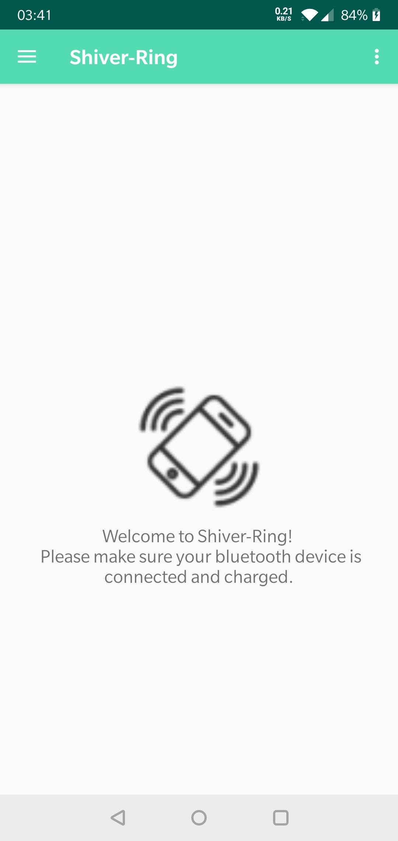
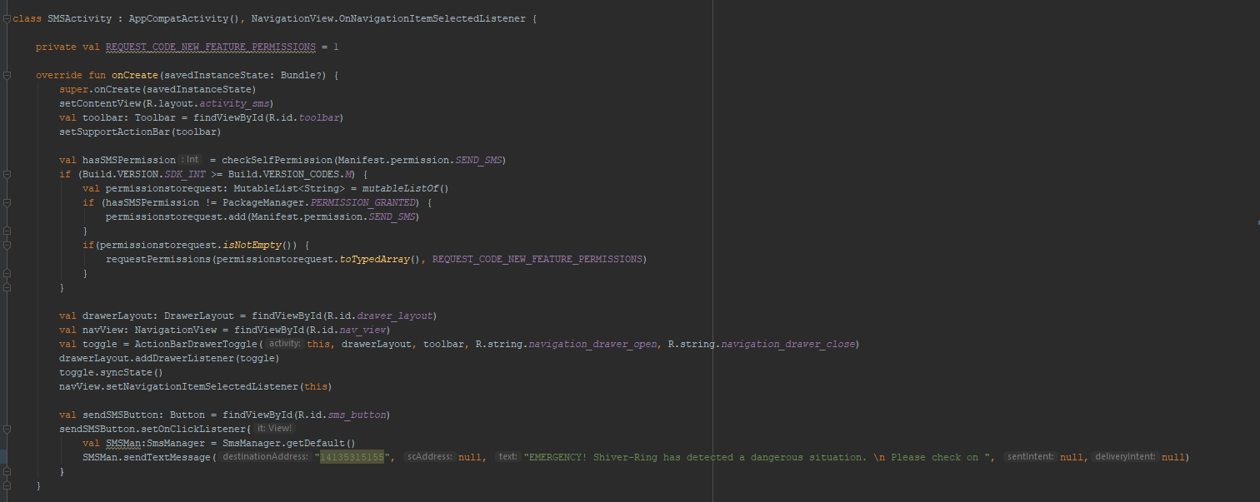
John Deliverables-
General Android App Creation & SMS Implementation
Main Deliverable - Android App with SMS functionality
Other Tasks
Helped with Embedded
Gathered Shivering Data
Notes:
John
Transition “ Now we will discuss our circuit and pcb progress”

Slide 12
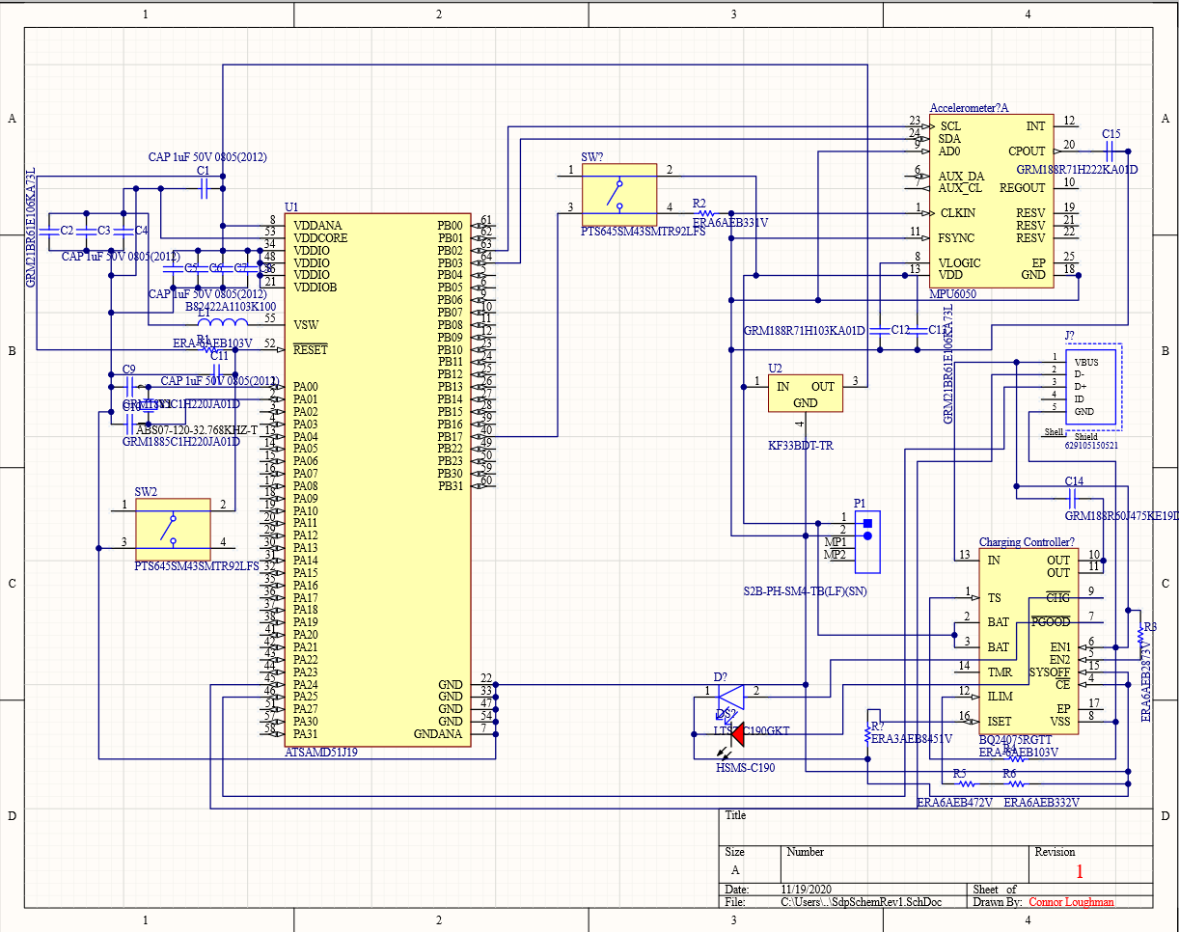
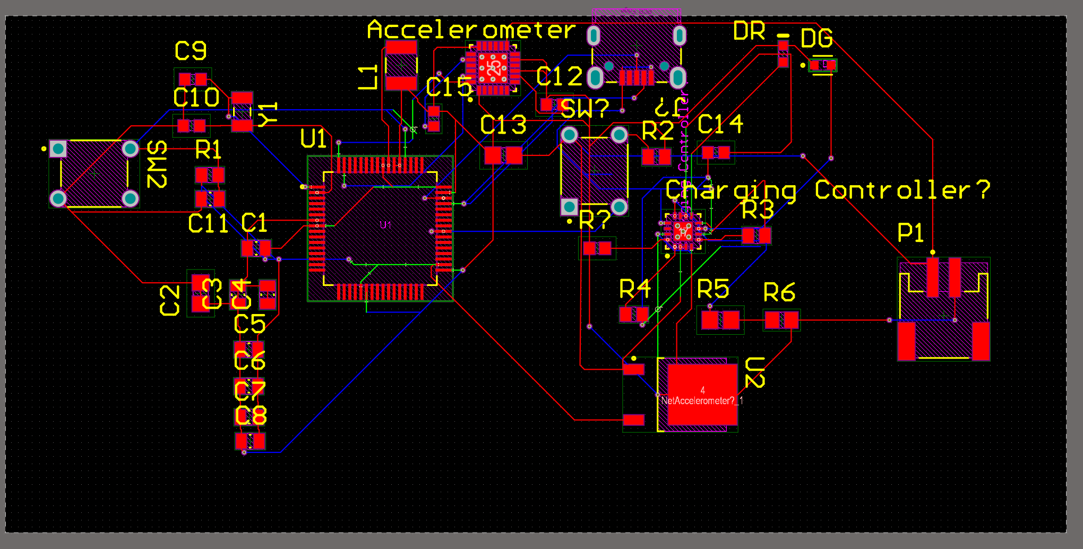
Connor - Deliverables
Main Deliverable - Custom Hardware Design
and Research
Research Flexible Circuit Boards
Pros/Cons
We chose to use flexible PCB
Design Schematic for circuit
Begin sourcing individual components
First version PCB design
Additional Deliverables
Assisted with beginning Calendar Integration into
Android App (still in progress)
Gathered Shiver Data
Notes:
Connor
I have assumed the role of Altium Lead and my main responsibility was to do research into the idea behind the use of flexible PCBs.
Flexible PCBs do offer notable benefits.
Flexible circuits are often more durable than their rigid counterparts
Since they are flexible they can conform to non-standard shapes such as the curve of someone’s wrist
They are often quite a bit thinner at ~0.1 mm vs 1.6 mm
However they do have some serious drawbacks
They are ~ twice as expensive ($10/in² vs $5/in²) (oshpark.com)
The number of layers is limited (oshpark will only print 2 layers)
Lastly, Flexible PCBs have a greater lead time (12-21 days vs 9-12 days) (oshpark)
Since we only require a two layer PCB and would benefit from the durability and slim form factor of a flexible PCB we will be going forward with that type.
Lastly, an additional deliverable that I have been assisting with is the integration of the calendar feature into the Android app and I assisted with gathering shivering data.

Slide 13
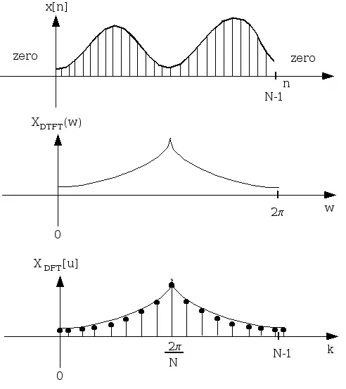
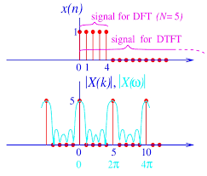
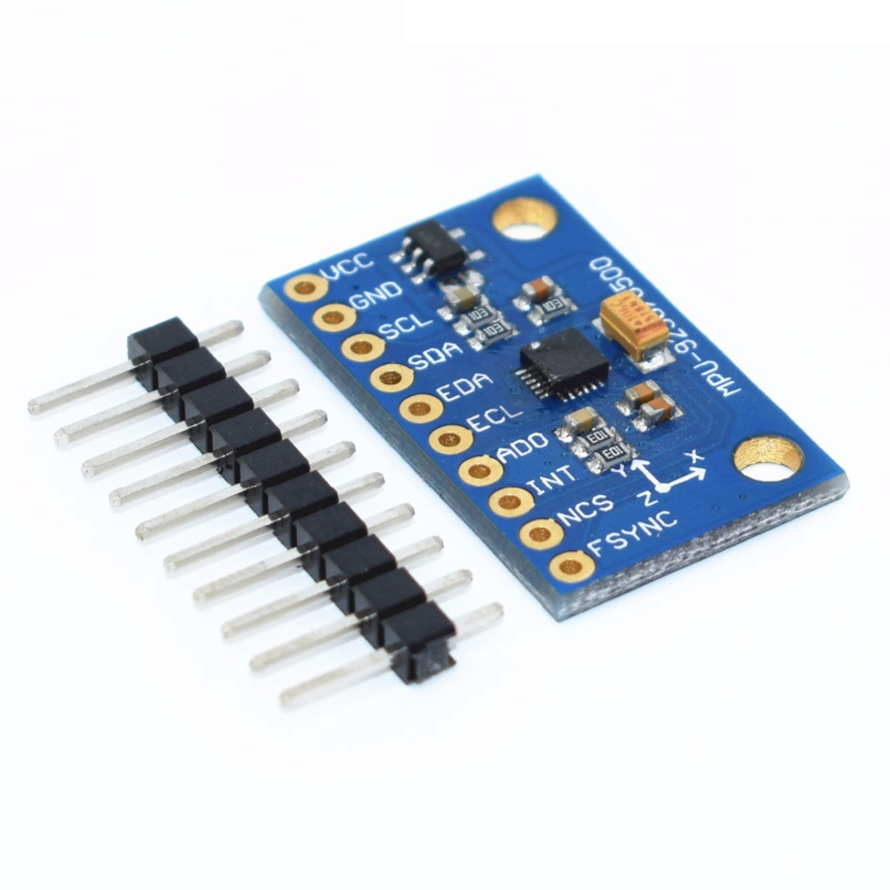
Adam Deliverables-
Signal Analysis of Accelerometer & EMG
Using publicly available compact DTFT library was able to facilitate frequency and magnitude referencing of accelerometer output
Configured parameters for what is a shiver
In charge of all embedded system activity
Was able to eliminate EMG through testing
Gathered Shivering data
Notes:
gathered shivering data

Slide 14
Project Management - Gantt Chart
Notes:
John
Finally we will state our project estimated cost for next semester into CDR & FPR

Slide 15
Cost Break Down
Part | Number | Price Each | Price | Link to Part
Oymotion Analog EMG | 1 | $0 | $0 | link
Triple Axis Accelerometer MPU6050 | 4 | $0 | $0 | link
Arm Cortex M4 | 3 | $14 | $42 | link
M4 development Board | 4 | $0 | $0 | link
Flexible Custom Board | 1 | $40 | $40 | link
Bluetooth Low Energy 4.0 TI CC2540 | 2 | $9 | $18 | link
2100 mah Li-Po Battery | 1 | $24 | $24
Alarm & Switch | 1 | $5 | $5
Housing and Band Material |  | $60 | $60
Shipping Costs |  | $30 | $30
Total |  |  | $210
Notes:
Adam
Transition :” our estimated total is 210 dollars”

Slide 16
Demo Time
Notes:
Demo order:
Adam
Mike
John

