Slide 1
Shiver-Ring
FPR Presentation for Team 2
Michael Burton, Connor Loughman,
Adam Maciaszek, John Murray
Notes:
Team 2 FPR presentation
Starting Speaker - John
Basic Intro
Say “Hello, welcome to the final project review for team 2
Each member introduces themselves, John, Adam, Connor, Mike
John - “The name of our project is Shiver-Ring” (TRANSITION after 1 second of hearing this)

Slide 2
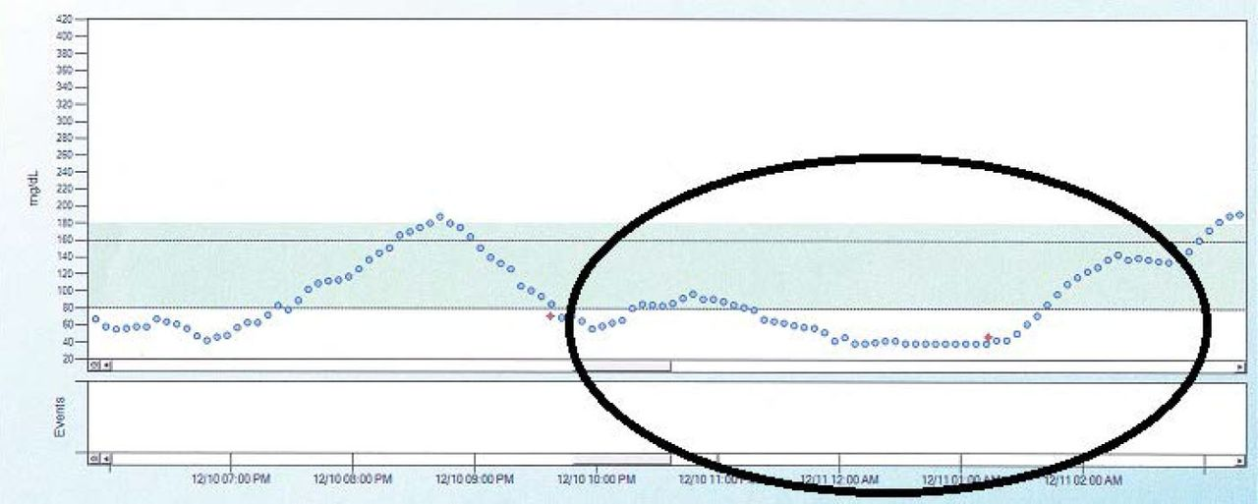
Problem Statement
When diabetic patients sleep their blood sugar levels can drop and result in hypoglycemic events, if the patient is unable to wake these events can go untreated and result in coma and even death.
(Source: Unger J: Diabetes Management in Primary Care. 2nd ed. Philadelphia, Pa., Lippincott, Williams, and Wilkins, 2012.)
Blood Sugar levels in a Type 1 Diabetes Patient Over Time
Notes:
Mike reads problem statement (Just read it)
“Our goal is to create an alarm system that can alert a 3rd party via SMS messaging when the user is in a hypoglycemic episode. Using an accelerometer to measure the movements in the muscles in the hand, you can detect the frequency of movement that can indicate shivering, which is a symptom of hypoglycemia. As of 2021, the technology to detect hypoglycemia is both expensive and not very reliable, or it is invasive. Our system intends to be a non-invasive alternative to the current commercially available products. The currently available solutions use sensors based off of temperature and moisture, however we want to use the patients shivering as our trigger.”
After finished reading wait 1 sec and next slide
Info for the graphic:
https://clinical.diabetesjournals.org/content/31/4/179.figures-only from the American Diabetes Association

Slide 3
System Specifications
Sense in range 8-12 Hz
Have an alarm go off when threshold met for 15 seconds
Send a message to someone if the event is occurring and alarm has not been disabled within 24 seconds
Wearable and comfortable wrist strap
Our SDP budget is the limit to the price of our solution ($500)
Multiple day battery life
Notes:
Mike reads slide ( each bullet, a bit of what each means/why it is a spec)
All of our specifications have been satisfied.
TRANSITION READ THIS FIRST - In order to properly sense the patients shivering we have found that these specifications must be followed.
Reasons why
From multiple research papers on post-operation shivering and cold temperature based shivering
Similar to diabetes sentry
This allows for a secondary level of assurance that the patient is saved
If the device isn’t comfortable the patient won’t wear it
As shown in later slides we are sitting well under budget
As to last past the night for continuous monitoring
wait 1 sec before transitioning to the next slide

Slide 4
Documentation of Final Design
Accelerometer
Speaker
BLE chip
Button to lower the alarm and reset system
SWD Programmer
Notes:
Mike Reads.
This is a picture our current design, courtesy of John. The buzzer and covered button are now part of our design. Our bootloader is loaded via the SWD connection, and the accelerometer is wired to our main PCB.
Transition: “Now, we will discuss the overall design.”

Slide 5
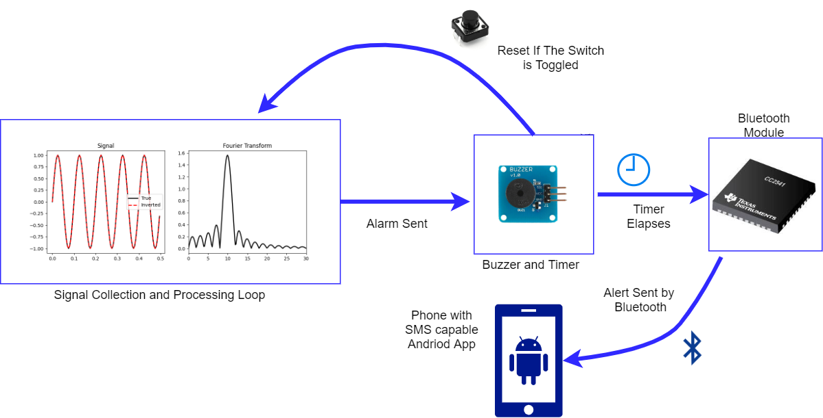
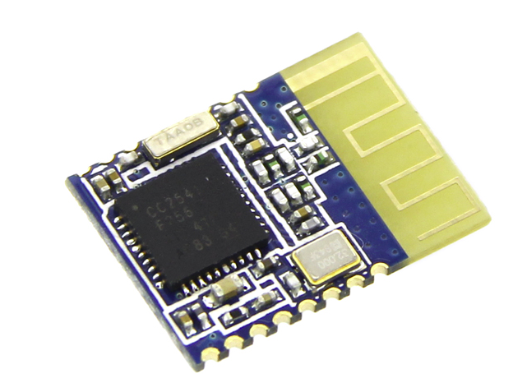
Updated Overall Design
Notes:
John-
1 The signal is taken in processed and the shivering events count increments, until threshold reached
2 The local alarm is set off and 9 seconds of time (to meet previous stated 24 seconds from initial event detected)
3 if the alarm has not been shut off them the bluetooth connects send the data to android phone connected
4 the custom app on the phone sends an sms to preset person to aid them
trans after The sms is sent

Slide 6
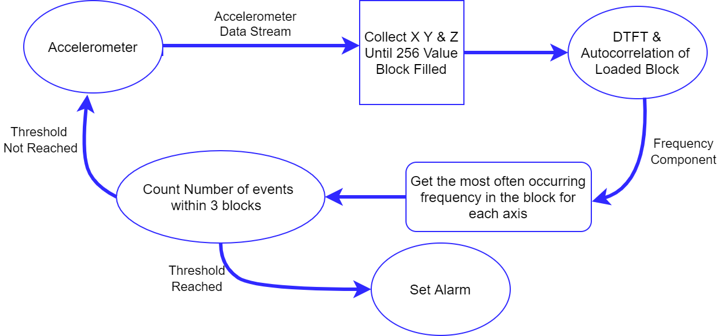
Updated Signal Processing
Collect X Y & Z Until 1024 Value Block FIlled
DTFT on each axis of the loaded box
Count events in a sliding window of 3 blocks
Notes:
Adam talks
Gathering data takes 4.096 seconds
calculating the data takes 0.78 seconds
total time between outputs 4.79 seconds
data sampled at 250 Hz
transition : emergency detection alarm is raised

Slide 7
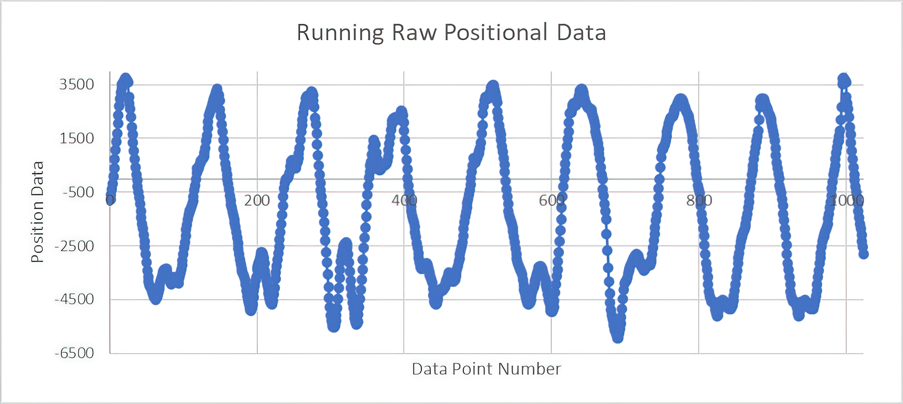
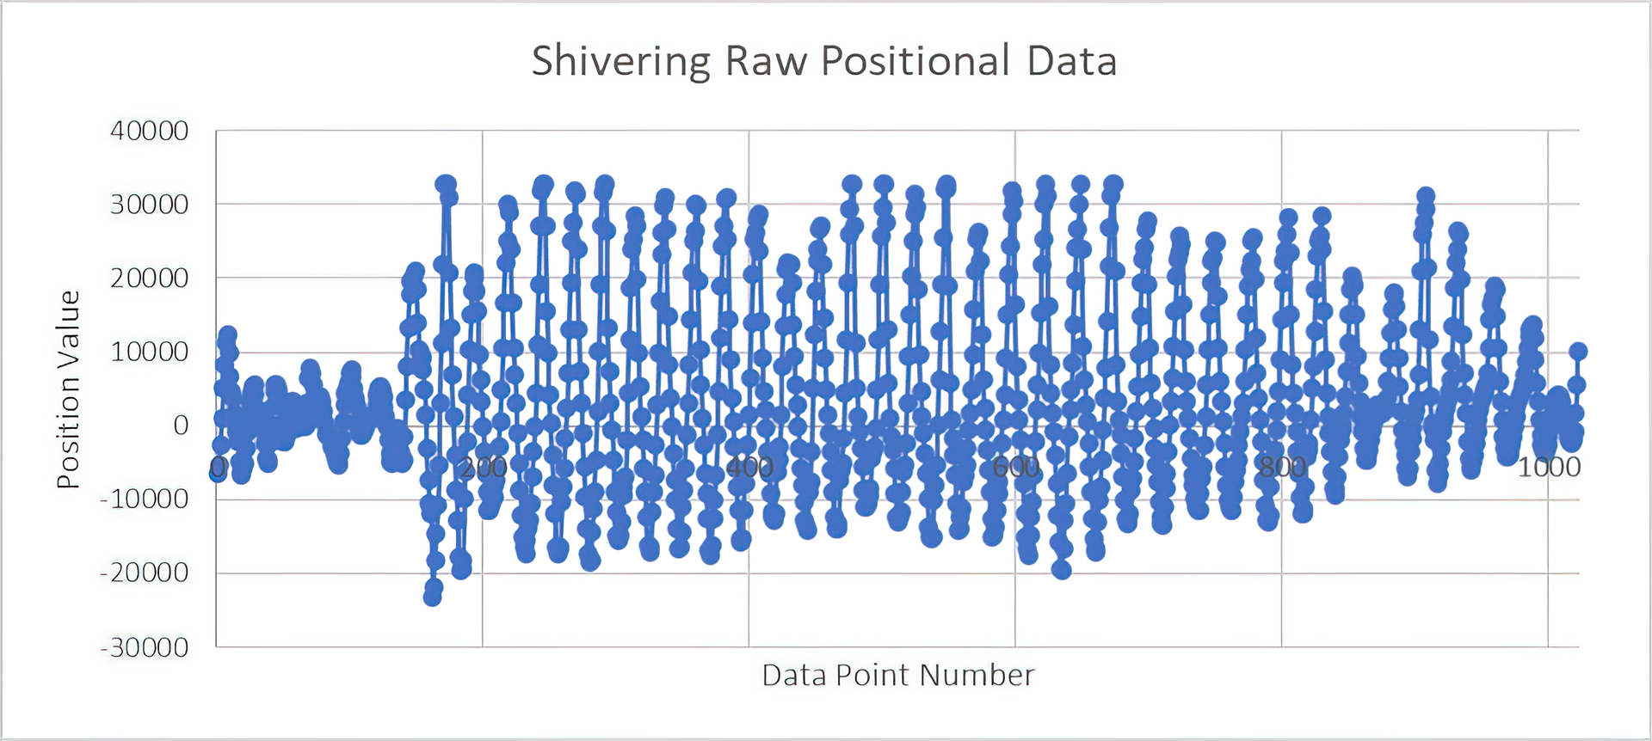
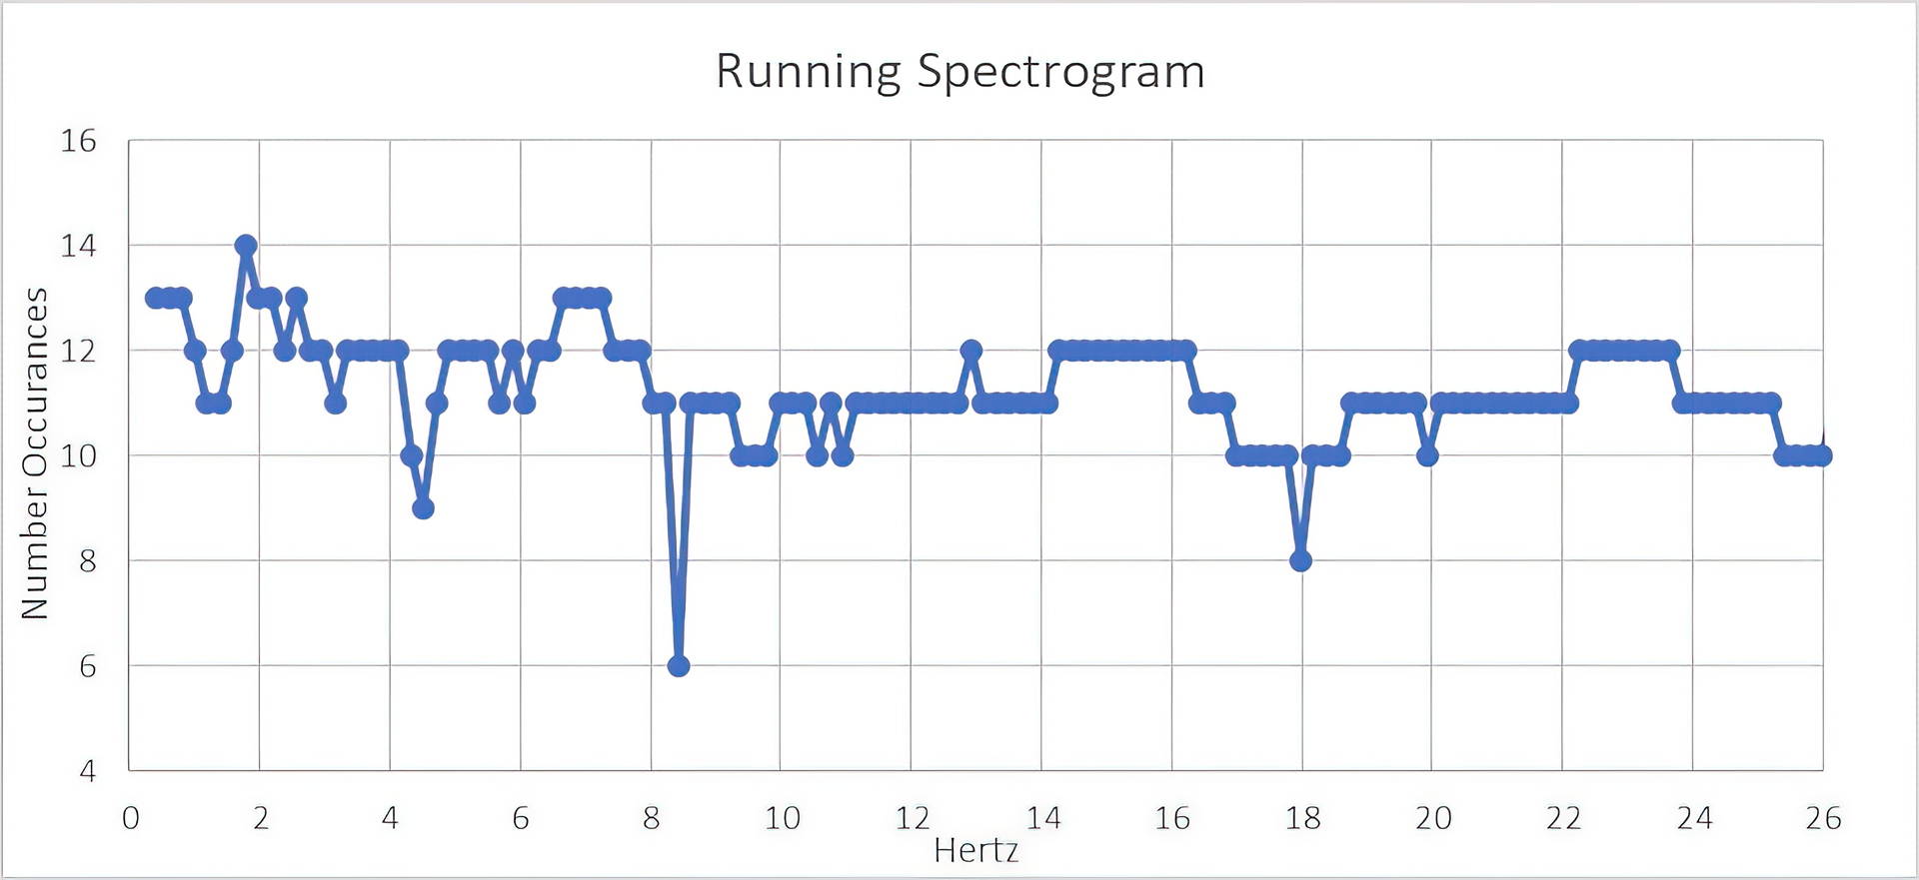
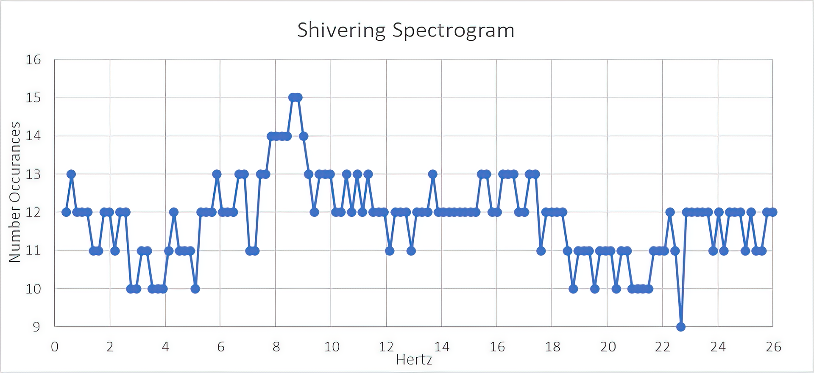
Notes:
Adam speaks. As you can see, our data processing pipeline takes in positional data collected from accelerometer.

Slide 8
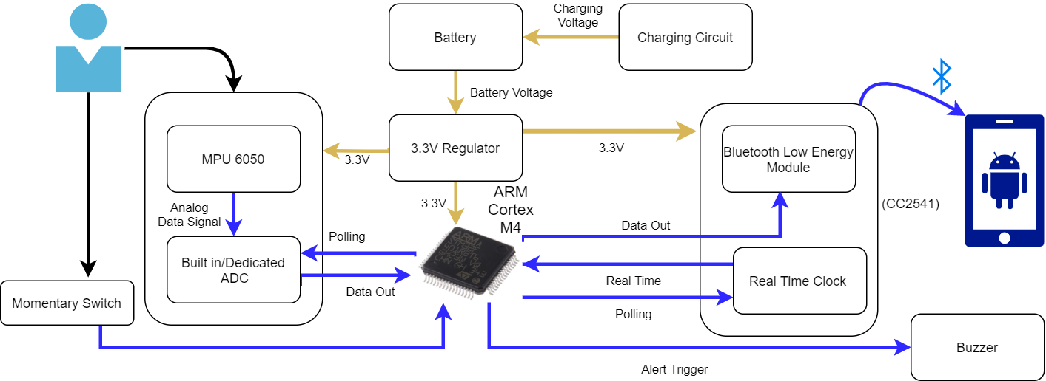
Updated Hardware Design
(HM-11)
Notes:
Connor talks
Just go through components and connections
as for why the m4? mention designed for digital signal processing and is low energy
Go in depth about purpose of momentary switch
Talk a bit about android app how it receive bluetooth alert and send SMS
Transition after “If the alert is not disabled, there is a bluetooth module that communicates with an android app that is responsible for communicating with an emergency contact via sms”

Slide 9
Custom PCB
Errors found during assembly
unable to find workarounds for a variety of issues in design
Had to redesign and order new boards
Rigid board to show functionality
Flex boards would not arrive in time

Slide 10
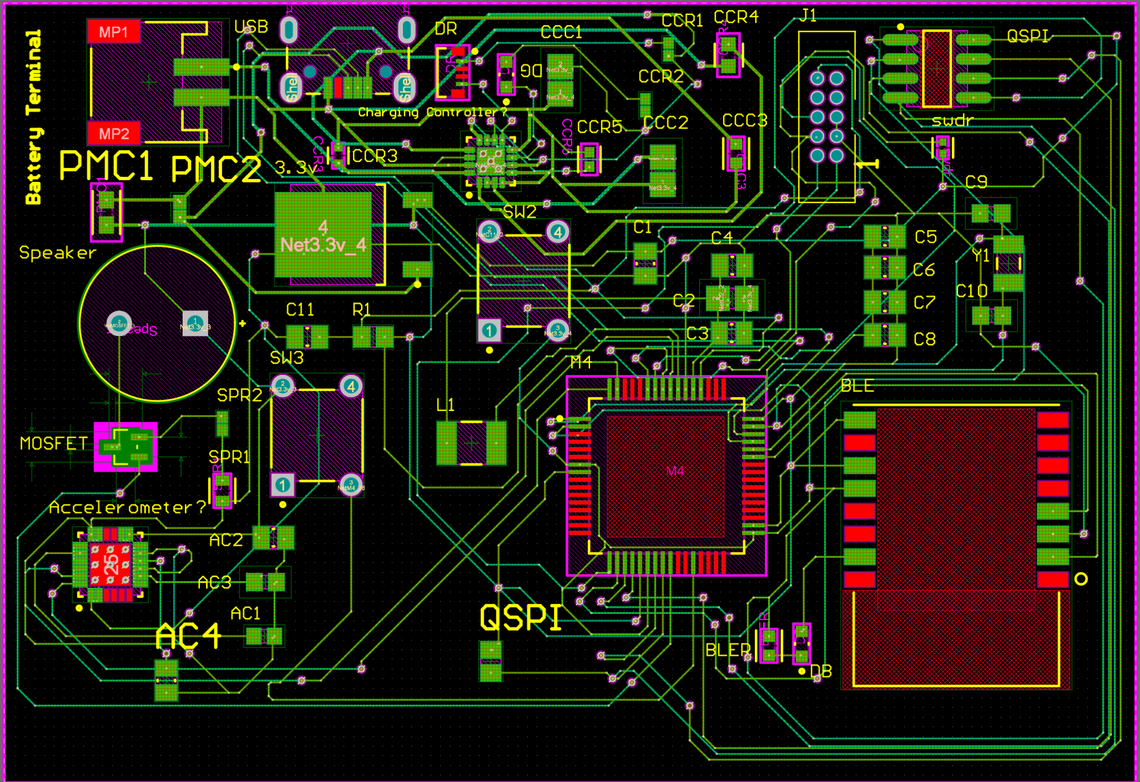
Board Layout
Notes:
We made a significant number of modifications to our PCB design since CDR. The most obvious changes are the removal of several unnecessary switches, and some components were switched out. In addition, we made several changes to the routing between components, which will be detailed in the next several slides.
Shown is M4 microcontroller
Bluetooth/ flash
USB and battery terminal

Slide 11
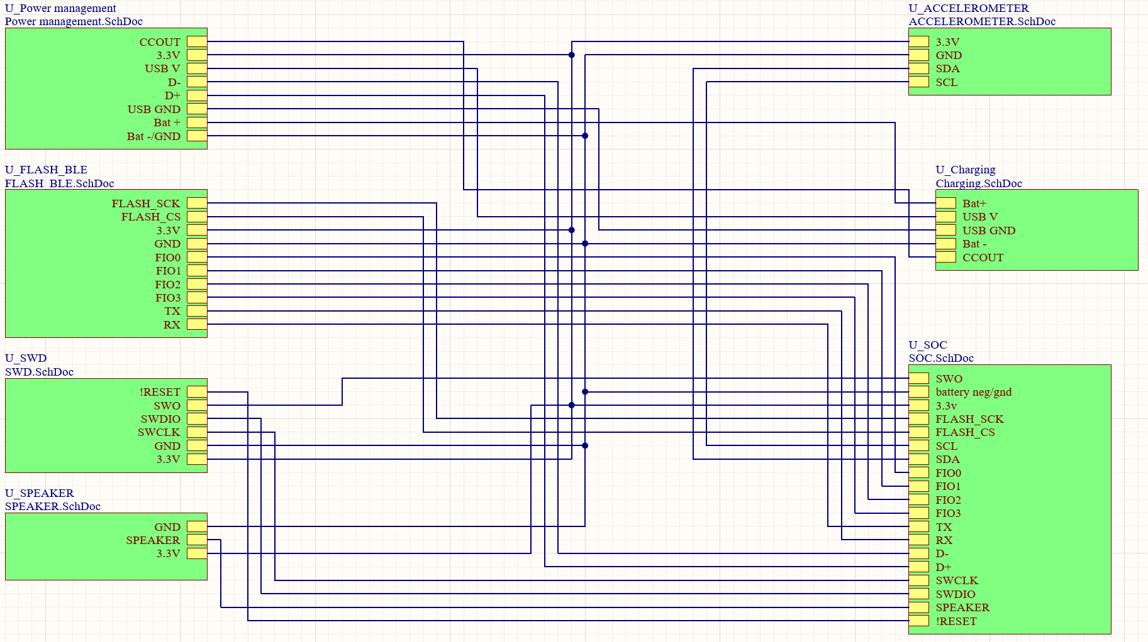
Main Schematic
Notes:
This schematic shows the interconnection between the individual sheets and their components. We will now discuss each component in greater detail.

Slide 12
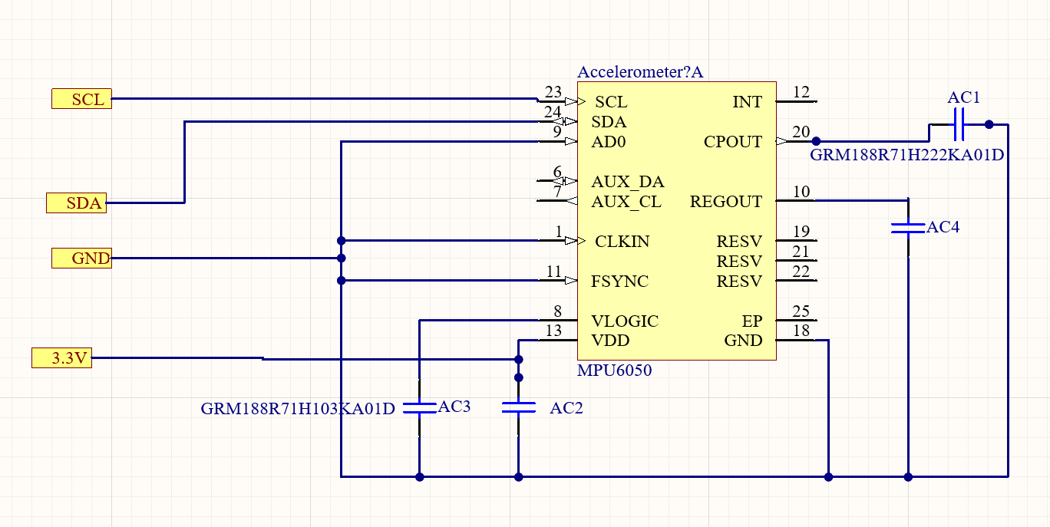
Accelerometer
Notes:
John - This is our accelerometer circuit, where we made some major revisions, which included some pins that were not connected correctly. Specifically, SDA and SDL were switched.

Slide 13
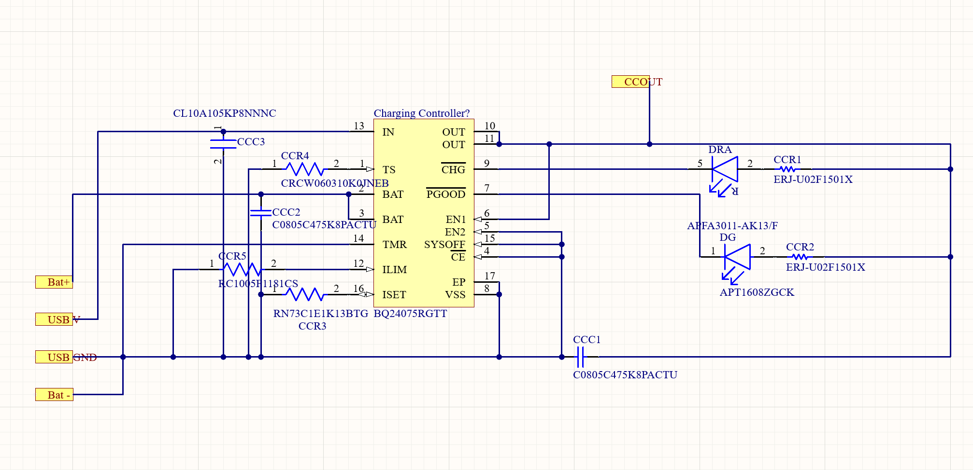
Charging Circuit
Notes:
The EP pin was shorted with VSS in this new revision.
Charging circuit

Slide 14
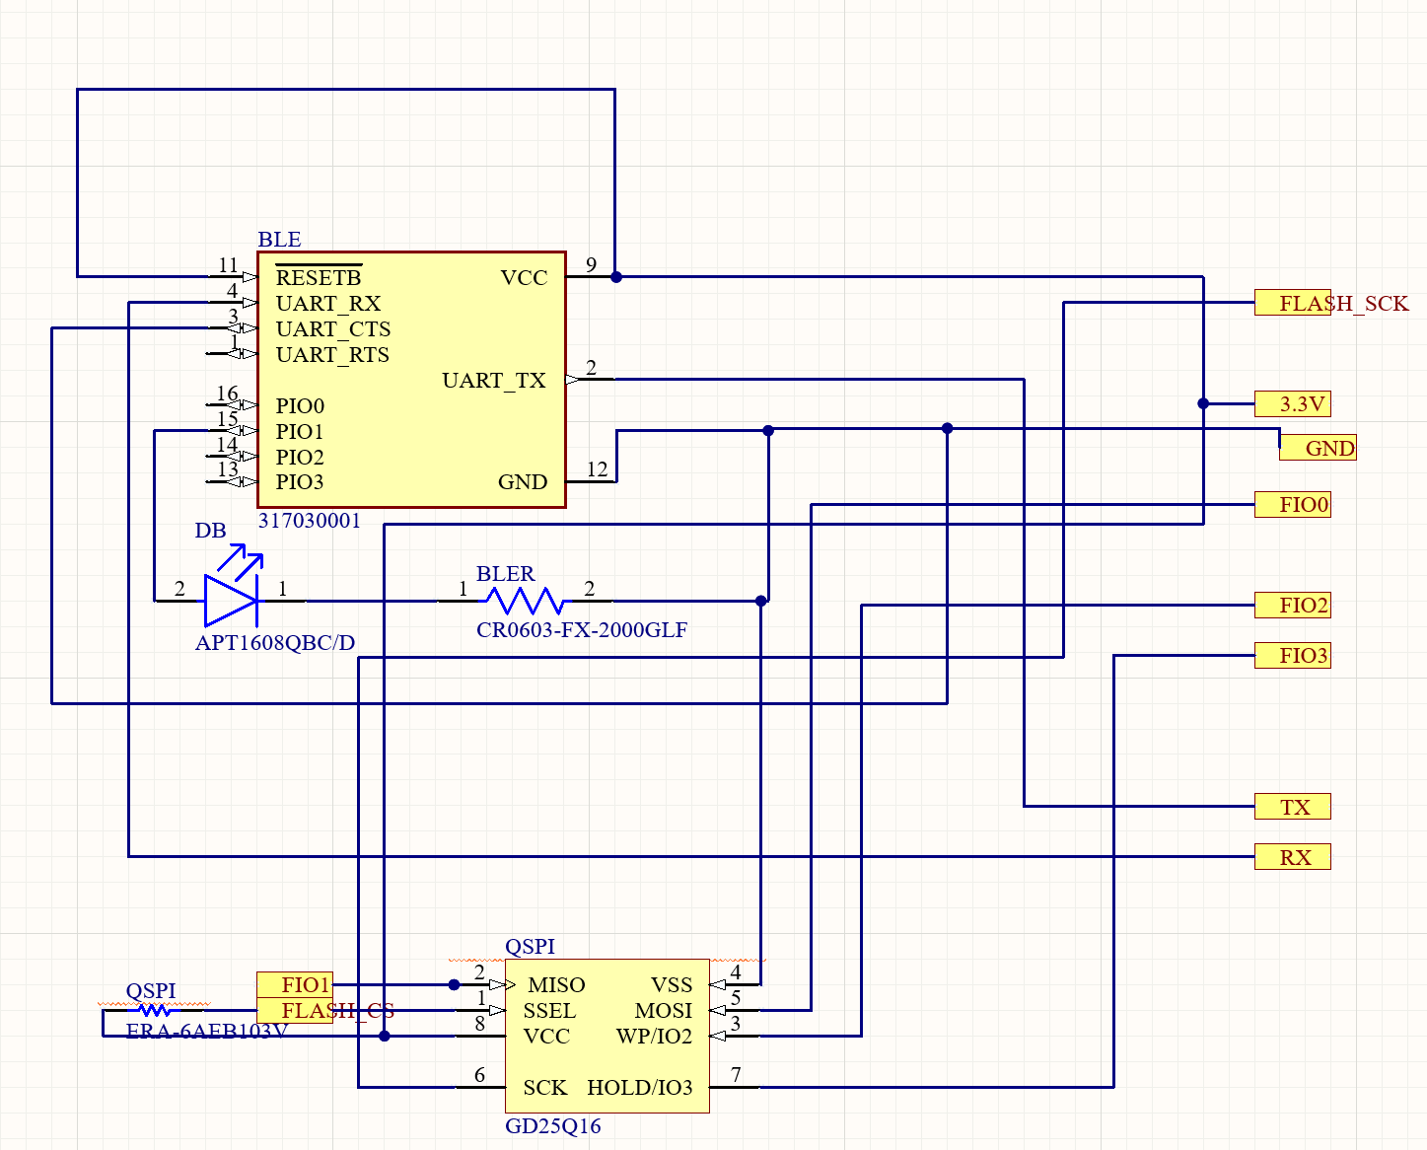
Flash and BLE Circuit
Notes:
The switches in this circuit were removed, RESETB was tied directly to VCC.

Slide 15
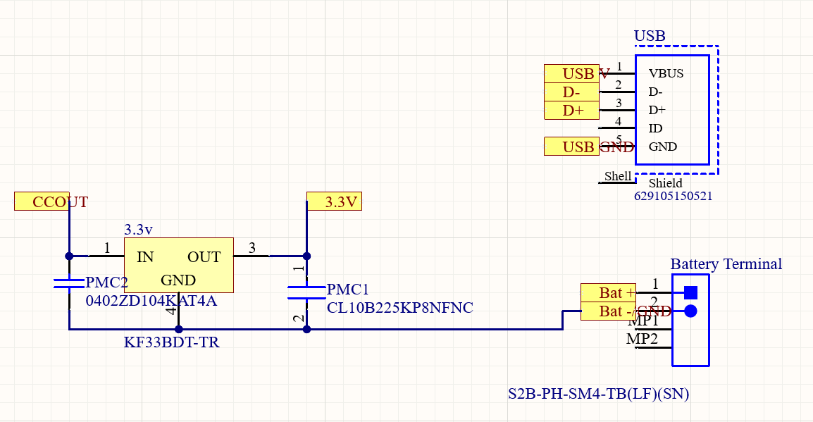
Power Management
Notes:
Important change was connecting the ccout to the ccout for the charging circuit.

Slide 16
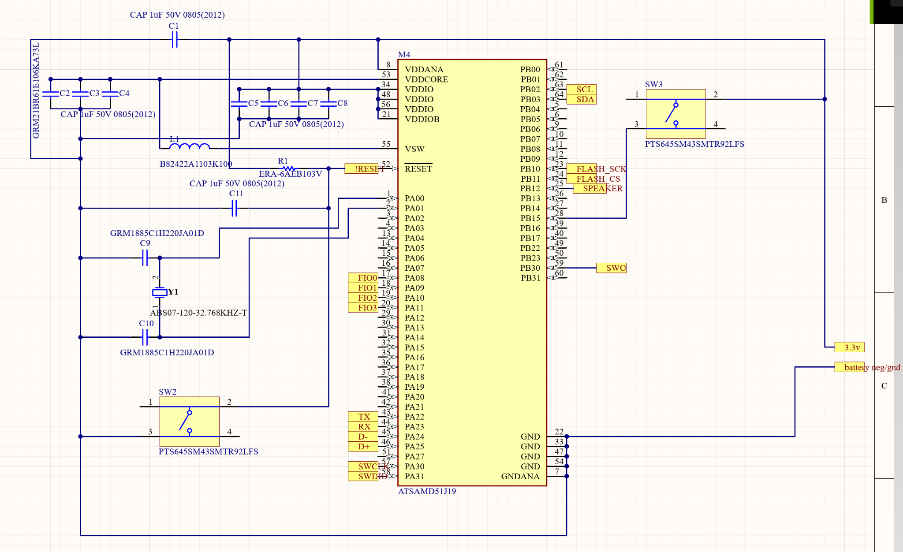
SoC

Slide 17
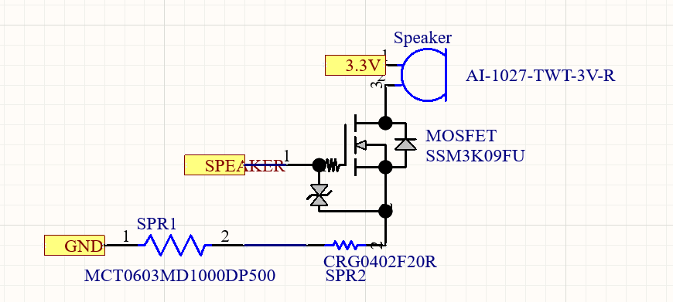
Speaker
Notes:
Our speaker circuit did not change from the previous design. Trans - However we did desolder the resistors to increase the speakers volume after experimentation.

Slide 18
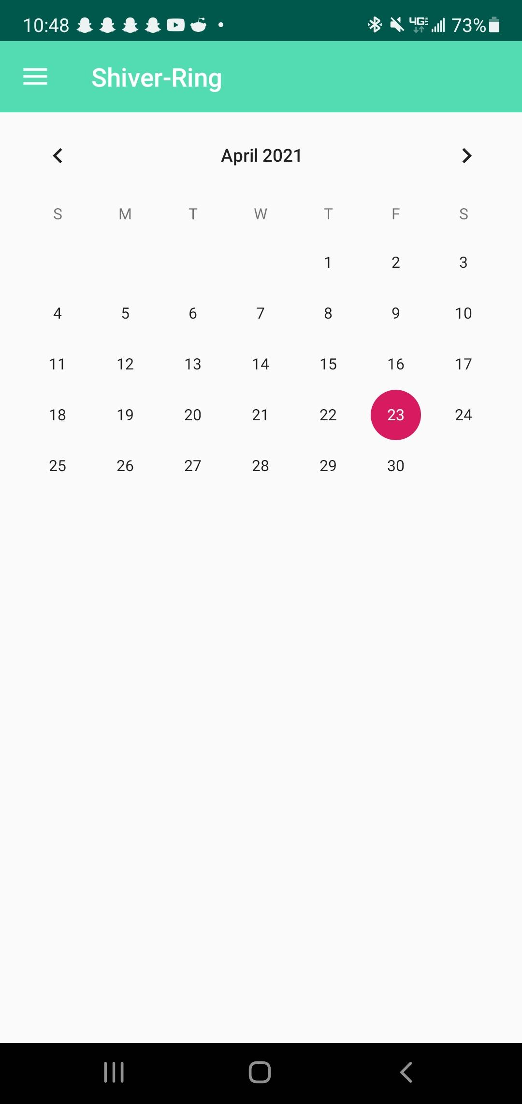
Calendar integration
Event triggers text
Time is recorded and written to a file for that date
Calendar reads data from date file
displays list of times of events for that day
Top half - Calendar plugin
Bottom half - listView

Slide 19
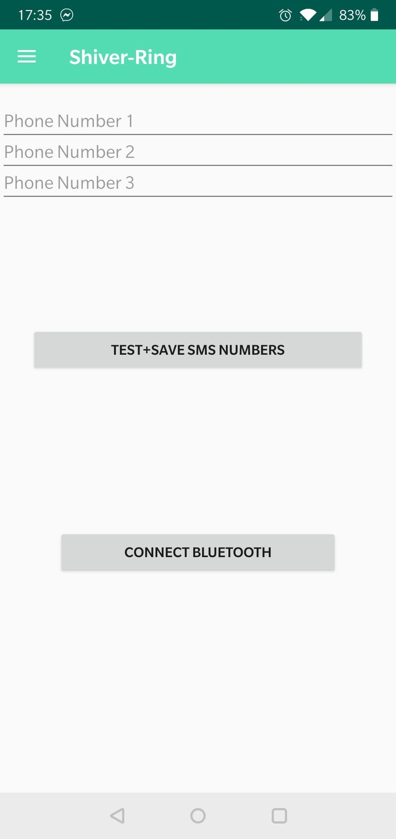
Multiple Phone Number Selection
Notes:
John

Slide 20
Demo Time
Notes:
Demo order:
Adam
Mike
John

