Slide 1
Shiver-Ring
CDR Presentation for Team 2
Michael Burton, Connor Loughman,
Adam Maciaszek, John Murray
Notes:
Team 2 CDR presentation
Starting Speaker - John
Basic Intro
Say “Hello, welcome to the comprehensive design review for team 2
Each member introduces themselves, John, Adam, Connor, Mike
John - “The name of our project is Shiver-Ring” (TRANSITION after 1 second of hearing this)

Slide 2
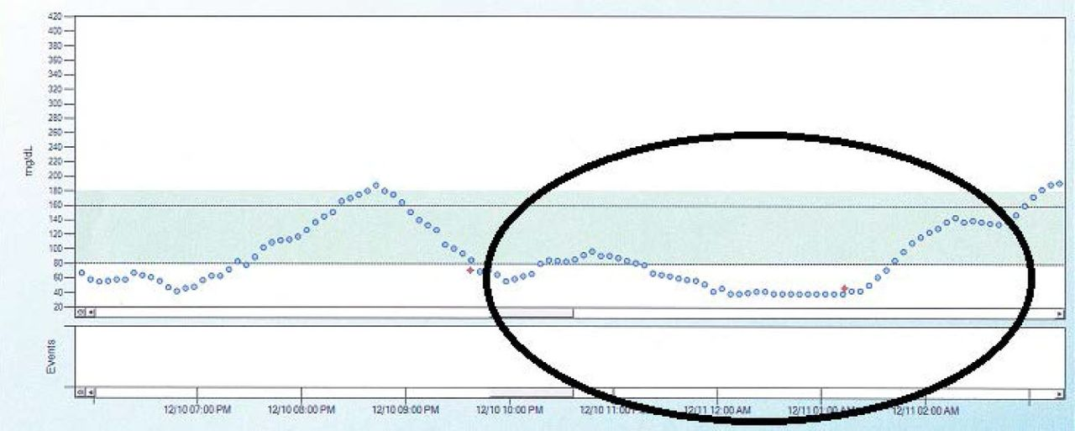
Updated Problem Statement
When diabetic patients sleep their blood sugar levels can drop and result in hypoglycemic events, if the patient is unable to wake these events can go untreated and result in coma and even death.
(Source: Unger J: Diabetes Management in Primary Care. 2nd ed. Philadelphia, Pa., Lippincott, Williams, and Wilkins, 2012.)
Blood Sugar levels in a Type 1 Diabetes Patient Over Time
Notes:
Mike reads problem statement (Just read it)
“Our goal is to create an alarm system that can alert a 3rd party via SMS messaging when the user is in a hypoglycemic episode. Using an accelerometer to measure the movements in the muscles in the hand, you can detect the frequency of movement that can indicate shivering, which is a symptom of hypoglycemia. As of 2021, the technology to detect hypoglycemia is both expensive and not very reliable, or it is invasive. Our system intends to be a non-invasive alternative to the current commercially available products. The currently available solutions use sensors based off of temperature and moisture, however we want to use the patients shivering as our trigger.”
After finished reading wait 1 sec and next slide
Info for the graphic:
https://clinical.diabetesjournals.org/content/31/4/179.figures-only from the American Diabetes Association

Slide 3
Updated System Specifications
Sense in range 8-12 Hz
Have an alarm go off when threshold met for 15 seconds
Send a message to someone if the event is occurring and alarm has not been disabled within 24 seconds
Wearable and comfortable wrist strap
Our SDP budget is the limit to the price of our solution ($500)
Multiple day battery life
Notes:
Connor reads slide ( each bullet, a bit of what each means/why it is a spec)
Green is currently satisfied
Yellow is satisfied by FPR
TRANSITION READ THIS FIRST - In order to properly sense the patients shivering we have found that these specifications must be followed.
Reasons why
From multiple research papers on post-operation shivering and cold temperature based shivering
Similar to diabetes sentry
This allows for a secondary level of assurance that the patient is saved
If the device isn’t comfortable the patient won’t wear it
As shown in later slides we are sitting well under budget
As to last past the night for continuous monitoring
wait 1 sec before transitioning to the next slide

Slide 4
CDR Deliverables
Fully functional prototype
Detecting shivers
Bluetooth Communication with app
Send SMS through app
Log in calendar
Alarm reset switch
Notes:
Mike reads.
We satisfied 4 out of 5 of our deliverables for CDR. For the period between MDR and CDR, we prioritized PCB design first and foremost, then microcontroller software, and then the app. We were previously able to detect shivers with our old prototype, and our new one does as well. Bluetooth connectivity between the microcontroller, bluetooth chip, and android app have been achieved. As previously demonstrated, the app can send SMS. The log in calendar is still a work in progress. The alarm reset button has been ordered, but our components have not all come in yet, so this is achieved through a button for this prototype.
Transition: “Now we will go over the current prototype.”

Slide 5
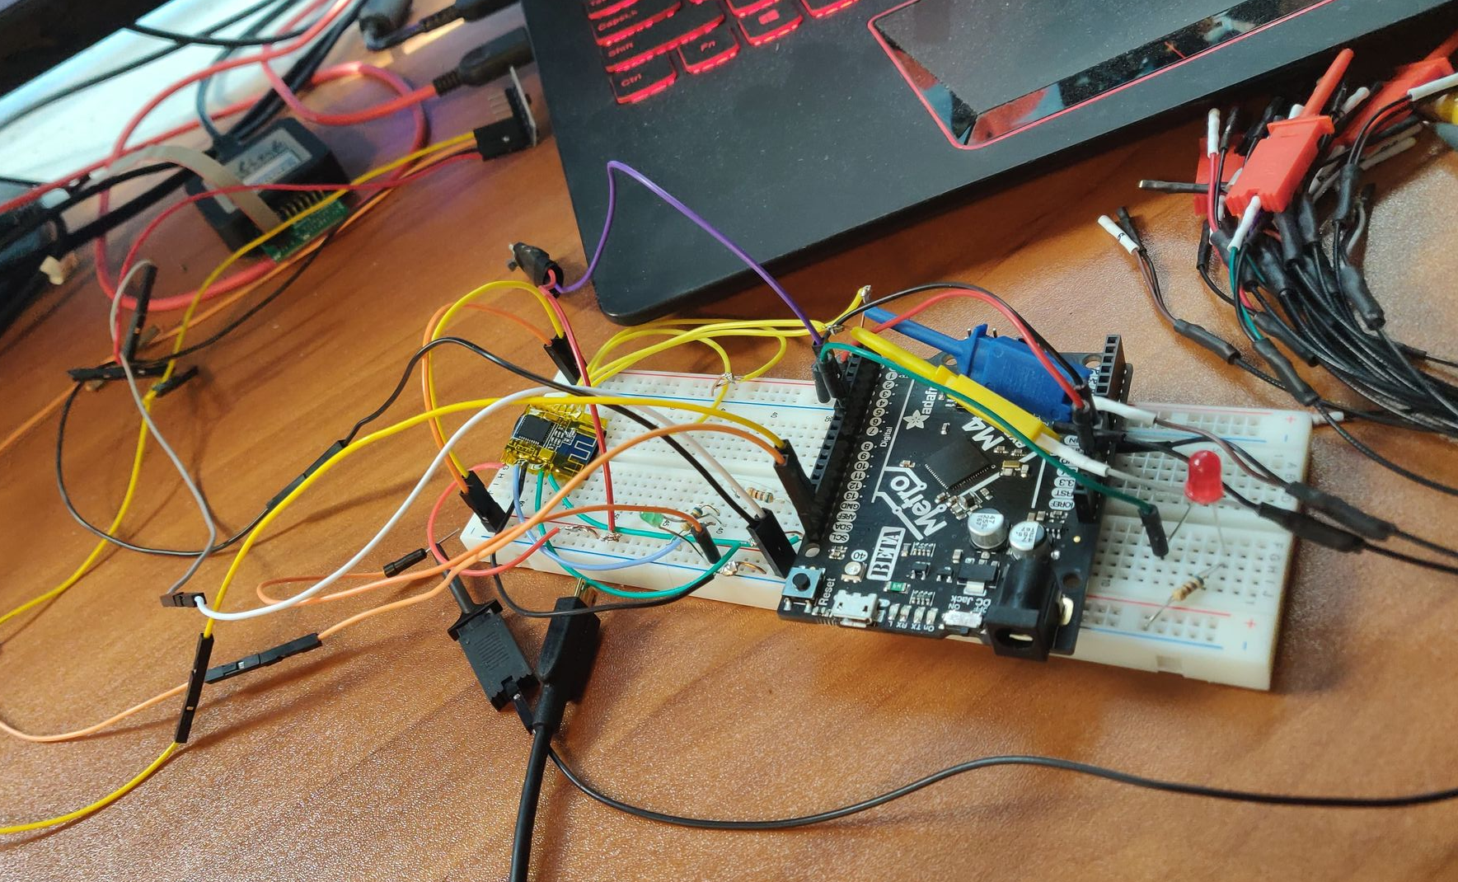
Documentation of Current Prototype
Accelerometer
Button to lower the alarm and reset system
BLE chip
Blinking green light means ready to connect, and staying on shows connected
Red light indicates the buzzer being activated
Notes:
Mike Reads.
This is a picture our current prototype, courtesy of John. The buzzer and covered button are not in yet, so we replaced them with an led and a regular button.
Transition: “Now, we will discuss the overall design.”

Slide 6
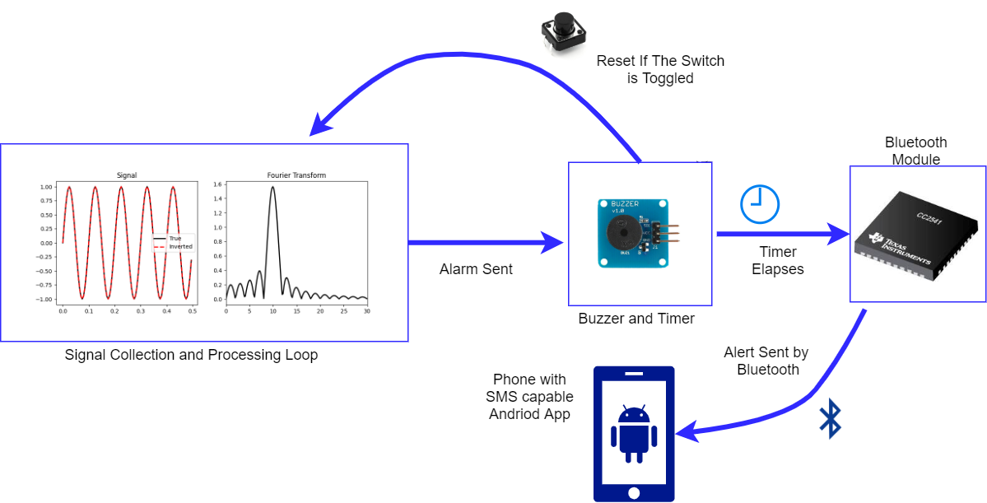
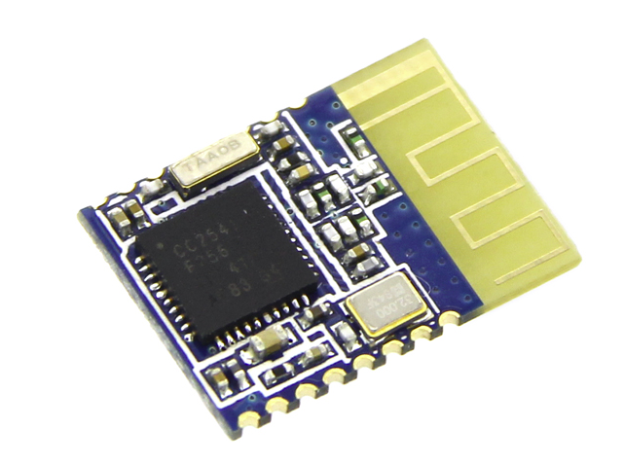
Updated Overall Design
Notes:
John-
1 The signal is taken in processed and the shivering events count increments, until threshold reached
2 The local alarm is set off and 9 seconds of time (to meet previous stated 24 seconds from initial event detected)
3 if the alarm has not been shut off them the bluetooth connects send the data to android phone connected
4 the custom app on the phone sends an sms to preset person to aid them
trans after The sms is sent

Slide 7
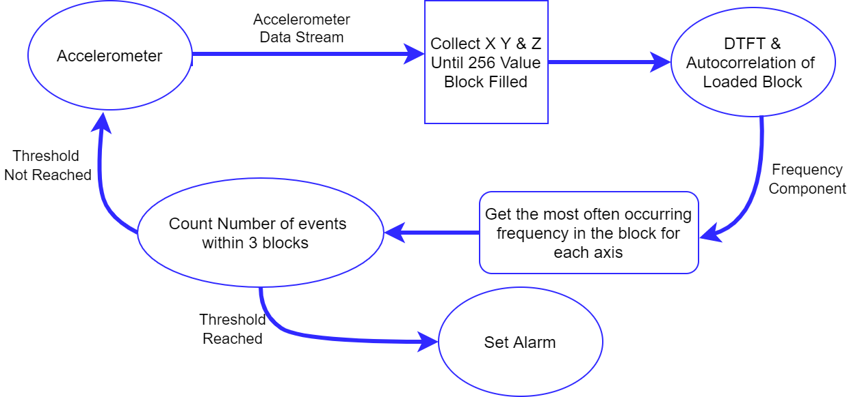
Updated Signal Processing
Collect X Y & Z Until 1024 Value Block FIlled
DTFT on each axis of the loaded box
Notes:
Adam talks
Gathering data takes 4.096 seconds
calculating the data takes 0.78 seconds
total time between outputs 4.79 seconds
data sampled at 1 KHz
transition : emergency detection alarm is raised

Slide 8
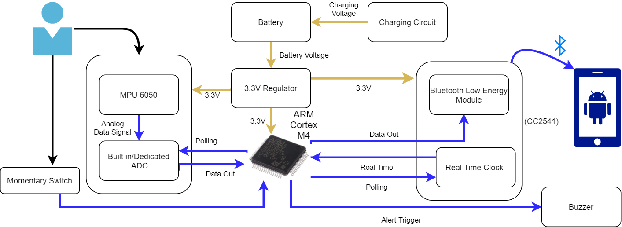
Updated Hardware Design
(HM-11)
Notes:
Connor talks
Just go through components and connections
as for why the m4? mention designed for digital signal processing and is low energy
Go in depth about purpose of momentary switch
Talk a bit about android app how it receive bluetooth alert and send SMS
Transition after “If the alert is not disabled, there is a bluetooth module that communicates with an android app that is responsible for communicating with an emergency contact via sms”

Slide 9
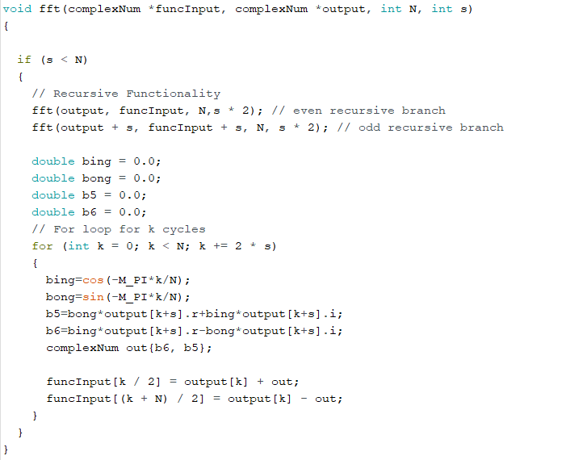
Mike CDR Deliverables
Source code for FreeRTOS converted to C/C++
Executable binary for loading directly
Base C++, software integration with other parts of project
Notes:
Mike
We use Arduino exclusively for our FreeRTOS implementation. Everything else has been converted to C++ code. We have decided to use ATMEL ICEs and John will use a J-link to code the microcontroller instead of loading binaries directly. FreeRTOS, sensing and detection code, and bluetooth have been fully implemented as one codebase.
Transition “And now we will discuss our bluetooth and Android app development.”

Slide 10
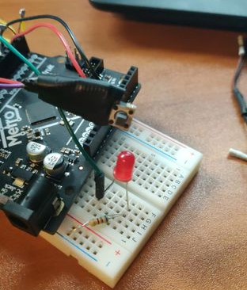
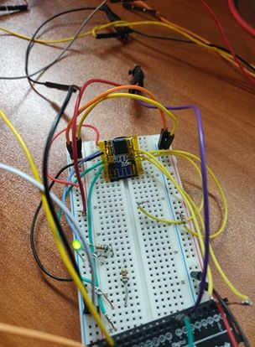
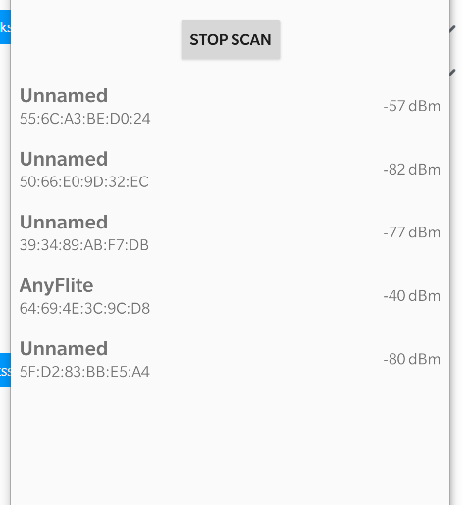
John CDR Deliverables
Bluetooth module integration on embedded system
App integration of bluetooth and Improvement of Overall App
Buzzer functionality (simulated for CDR using standard button and Red LED)
Notes:
John
Transition “ Now we will discuss our circuit and pcb progress”

Slide 11
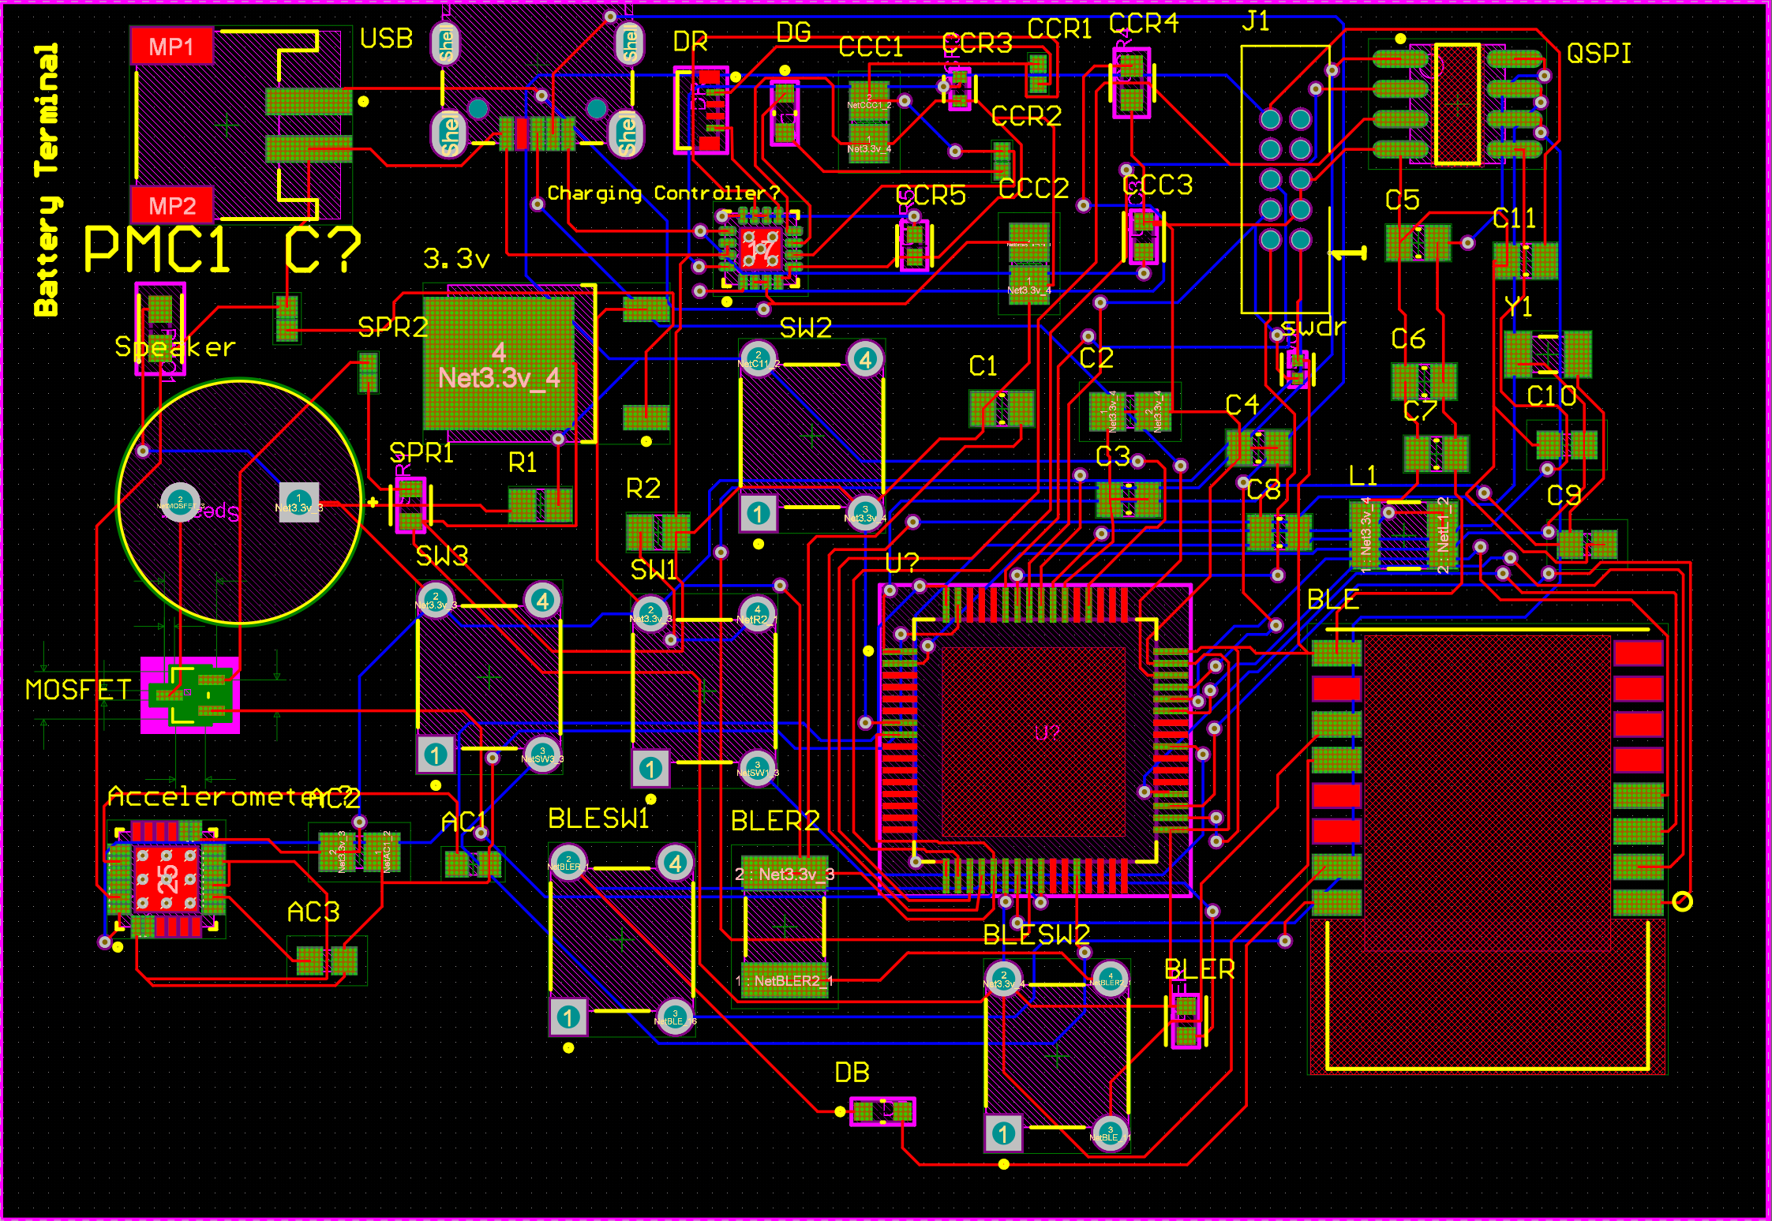
Connor CDR Deliverables
PCB
Finalize design
Sent to print
Schematic
Parts List/ BOM
Find replacements for stock issues
Assist with calendar integration
Notes:
Connor
I have assumed the role of Altium Lead and my main responsibility was to finalize the circuit schematics as well as create the finalized circuit board (Seen above).
Responsible for schematics which will be expanded on in the following slides
Additionally I was responsible for compiling a complete list of parts and finding replacements for parts that have gone out of stock
All but five parts were in stock and the missing components were assorted LED’s, Resistors, crystal, and notably the swd connector
Suitable replacement parts have been ordered and are on their way
Lastly, an additional deliverable that I have been assisting with is the integration of the calendar feature into the Android app and I assisted with gathering shivering data however we have prioritized bluetooth functionality over the calendar at this time

Slide 12
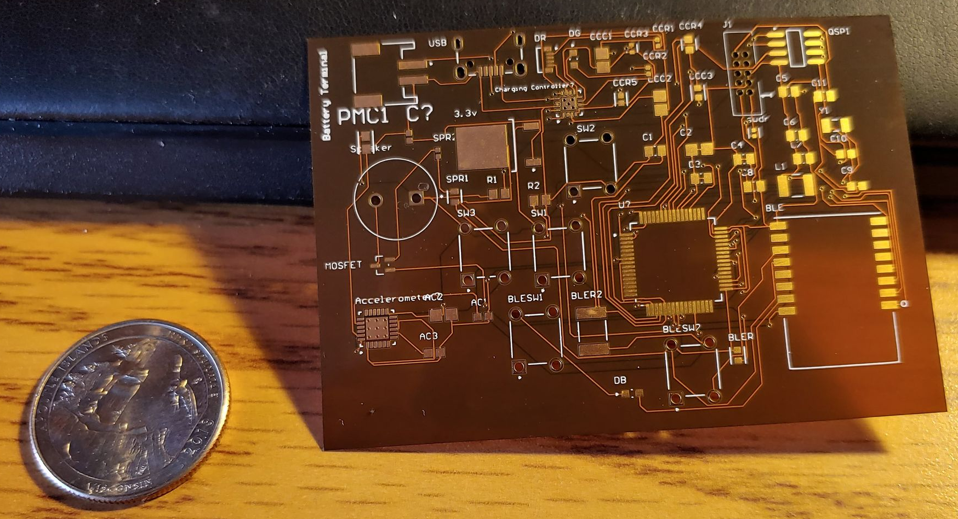
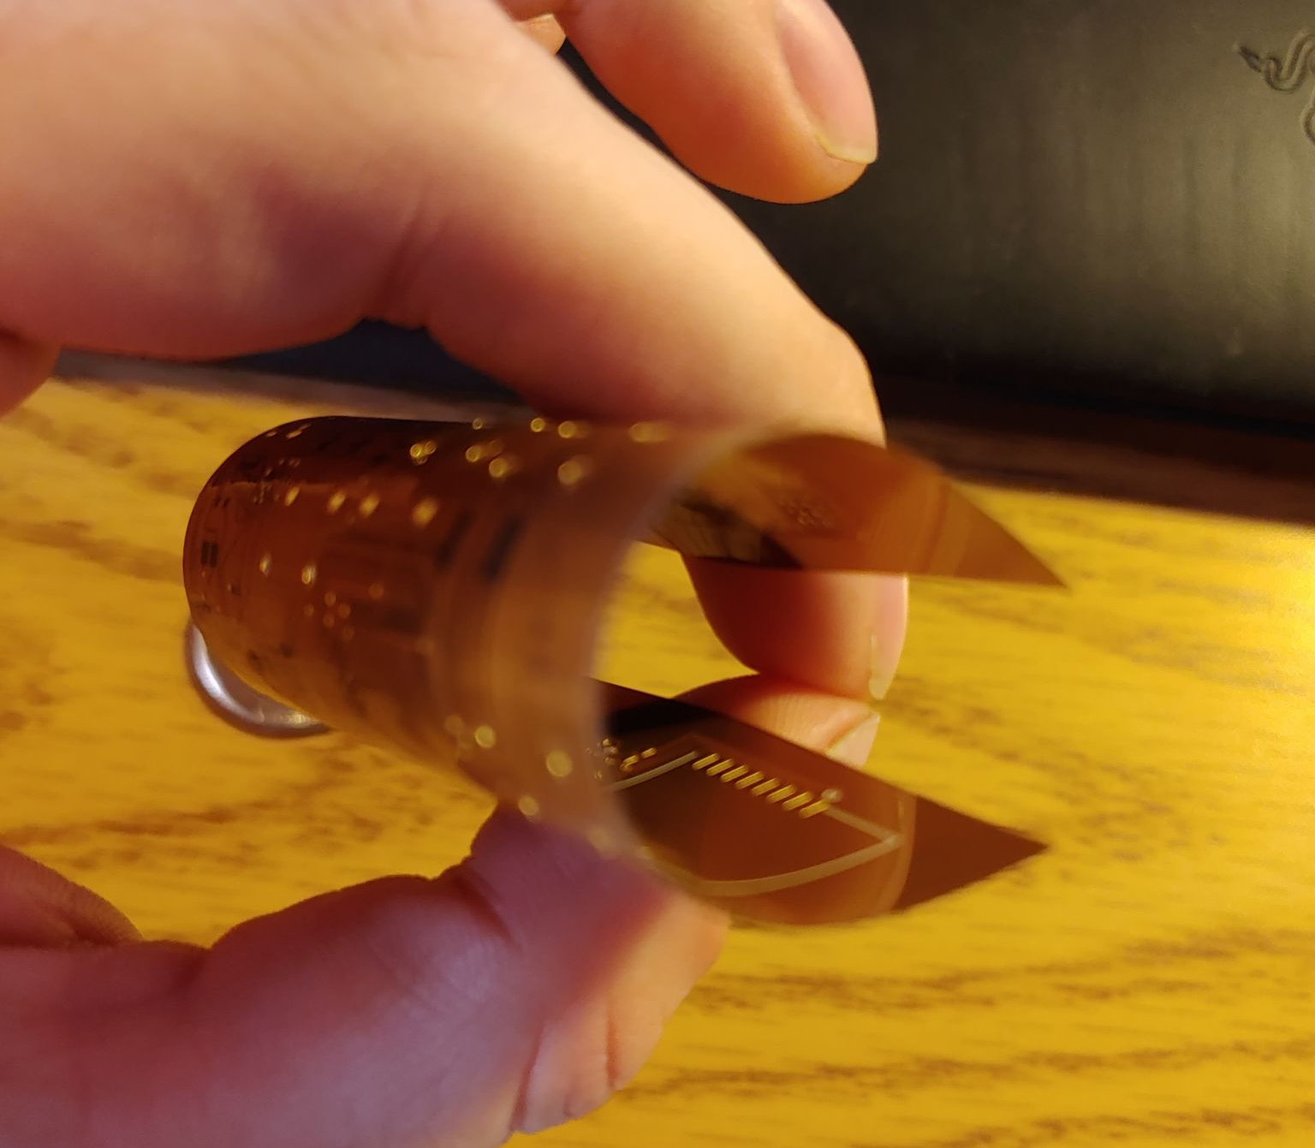
Custom PCB

Slide 13
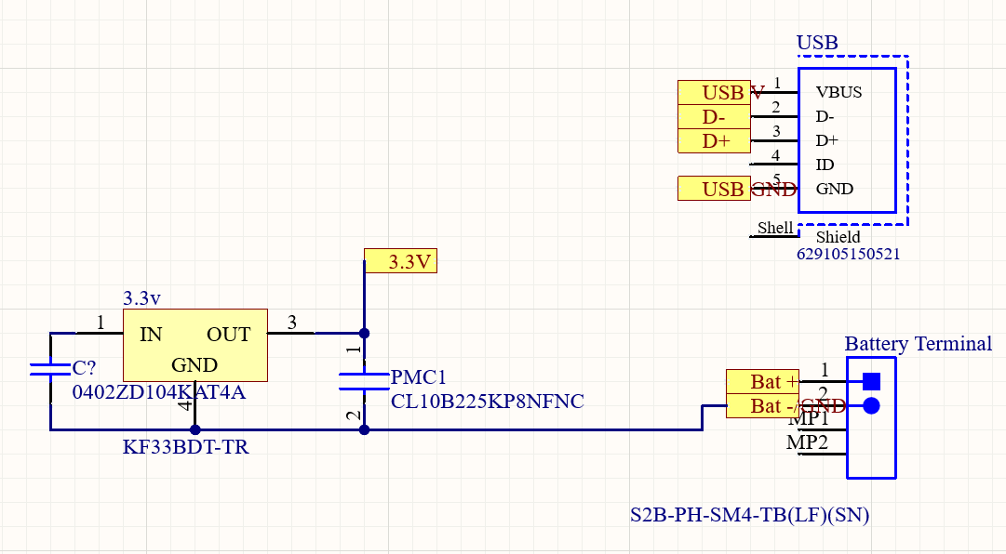
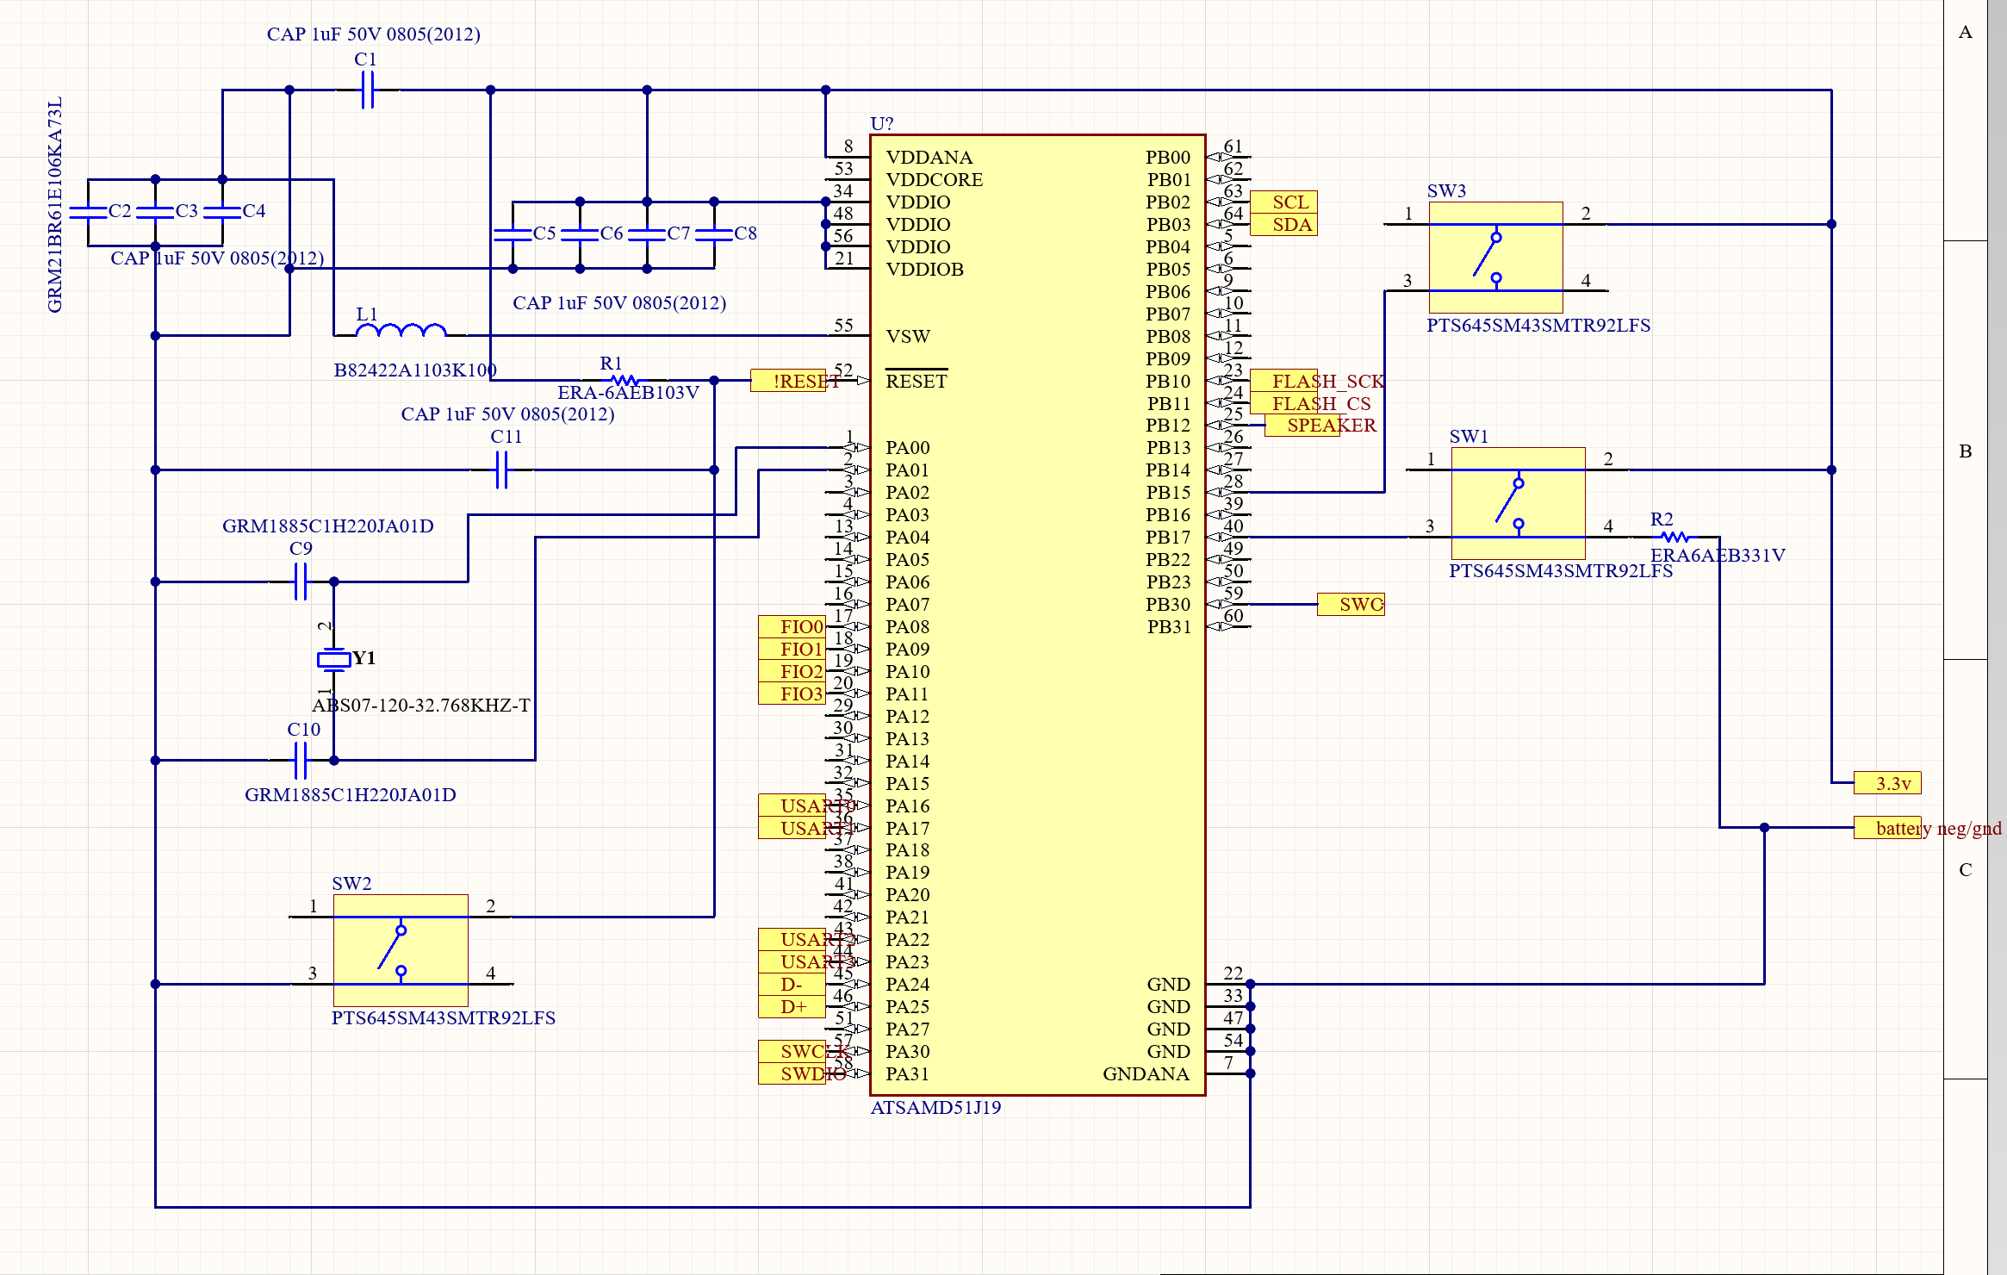
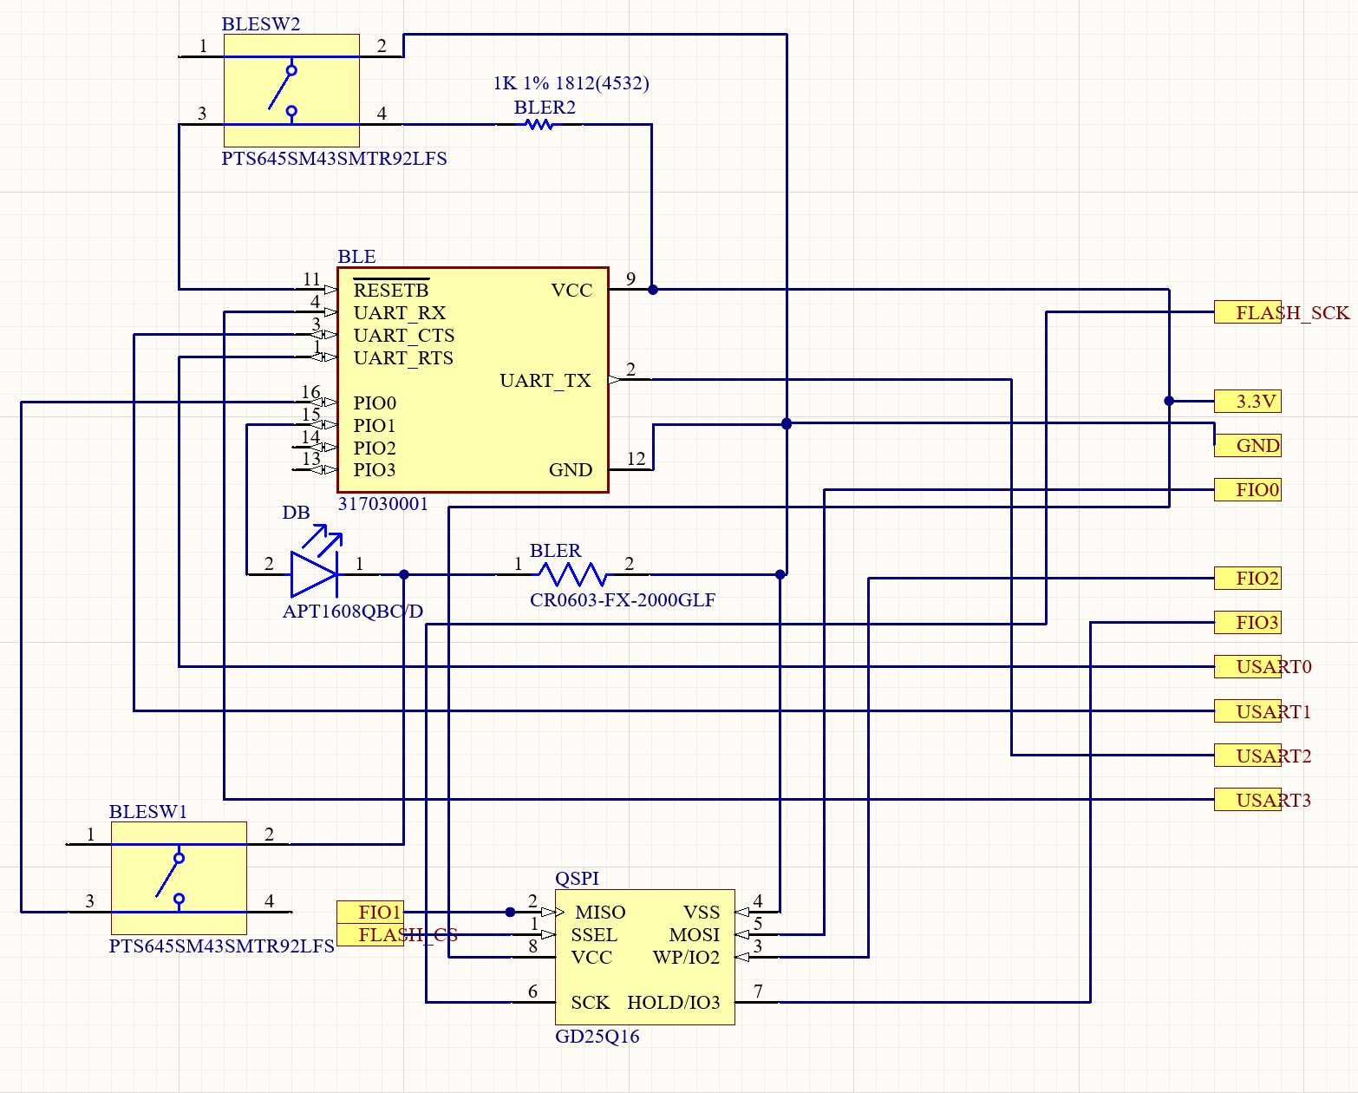
Schematics
Notes:
Shown is M4 microcontroller
Bluetooth/ flash
USB and battery terminal

Slide 14
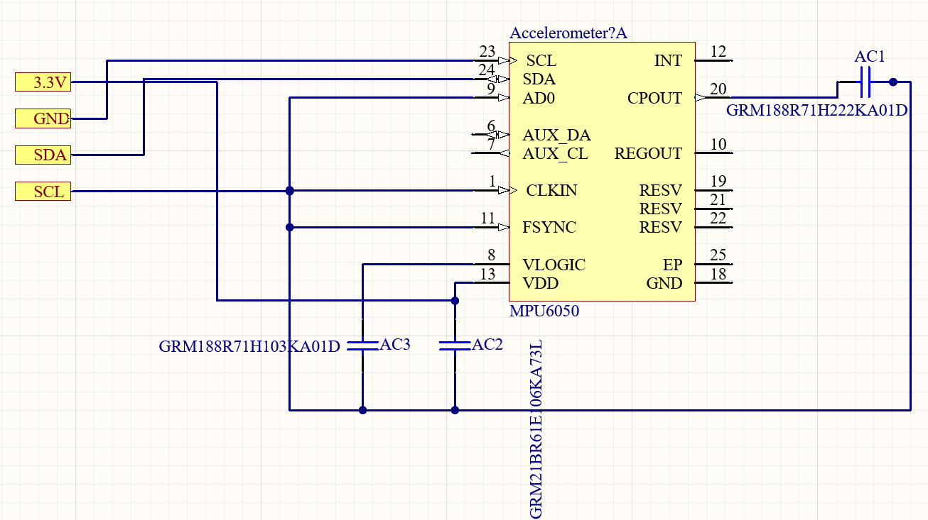
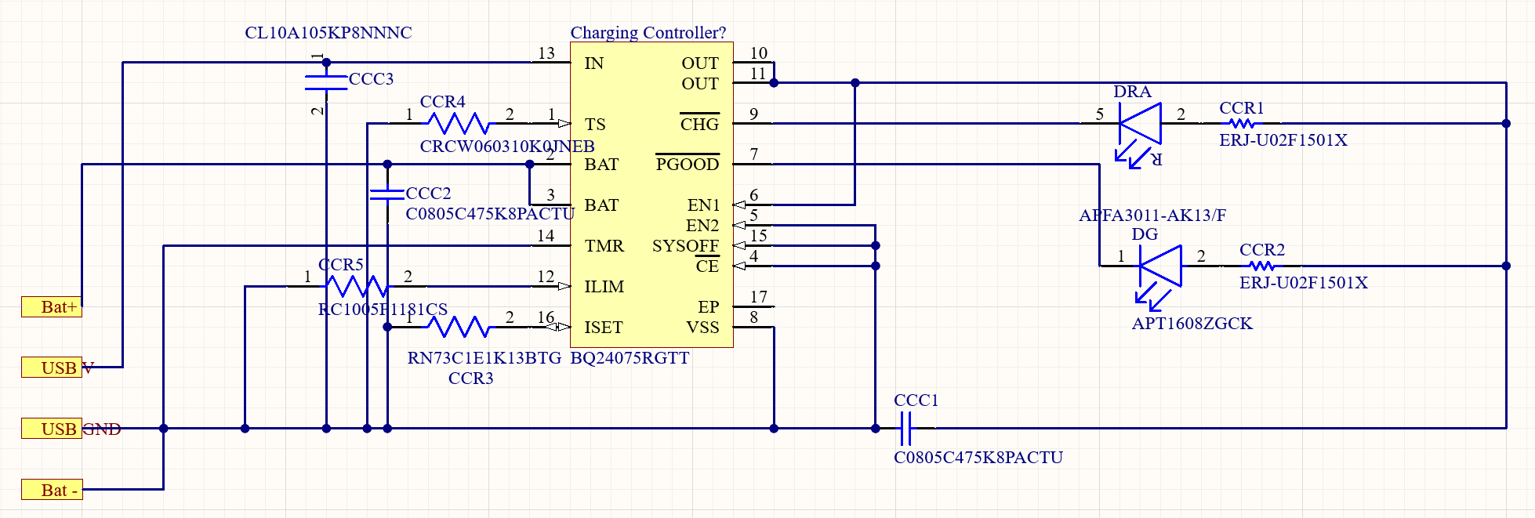
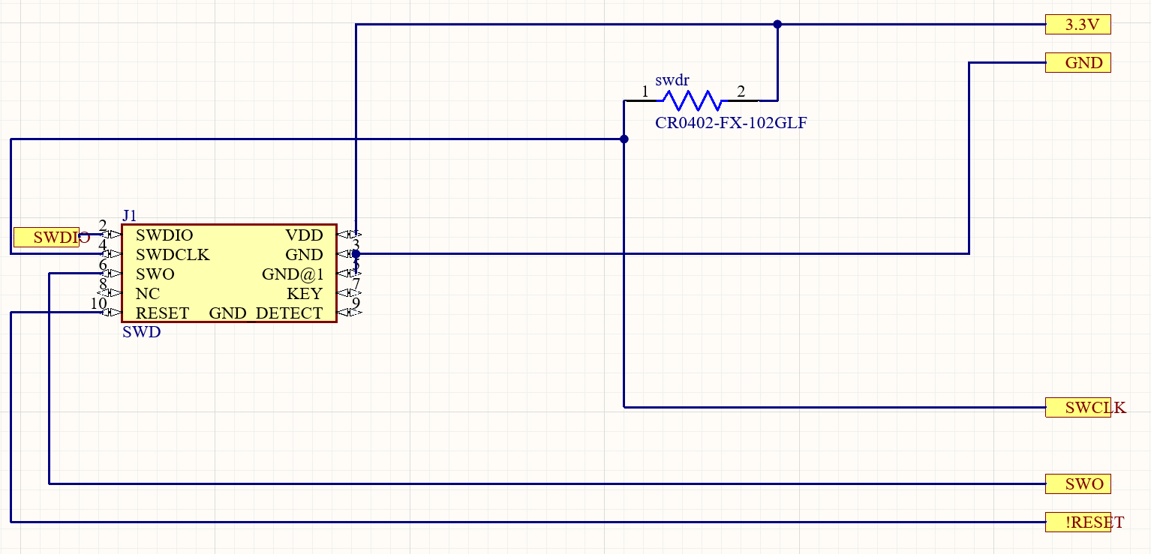
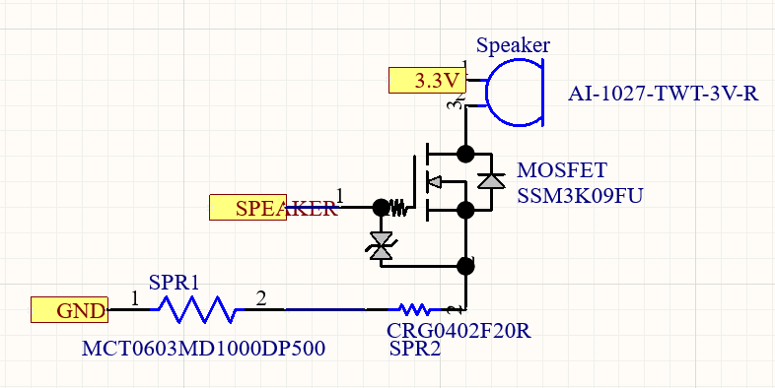
Schematics
Notes:
Accelerometer
SWD connector
Charging controller
Speaker output

Slide 15
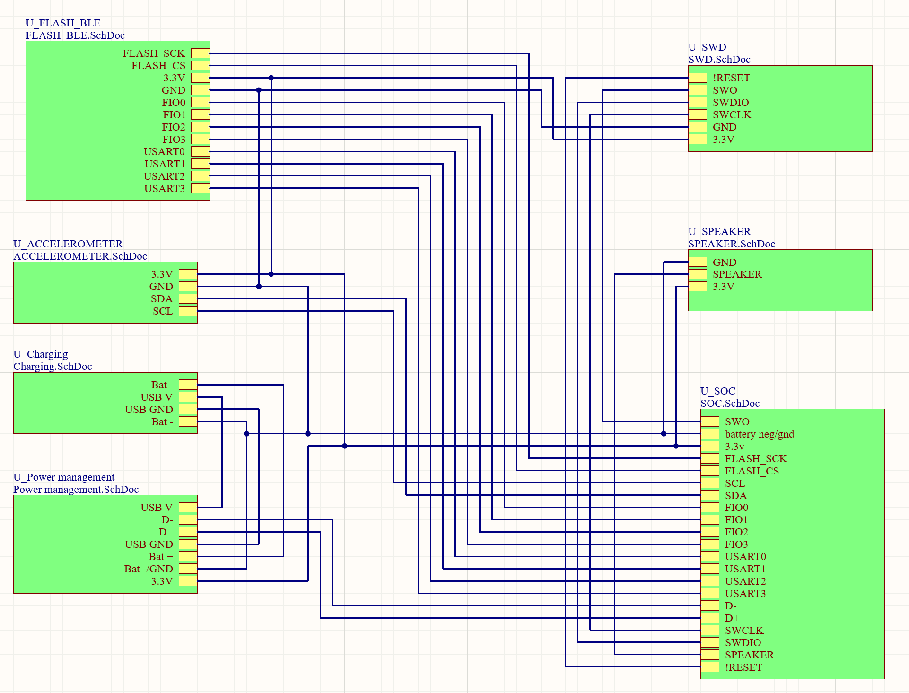
Schematics
Notes:
Finally this schematic shows the interconnection between the individual sheets and their components

Slide 16
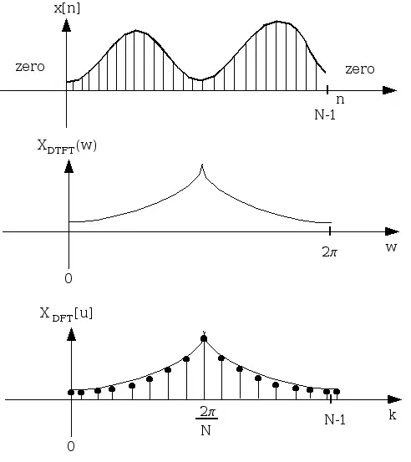
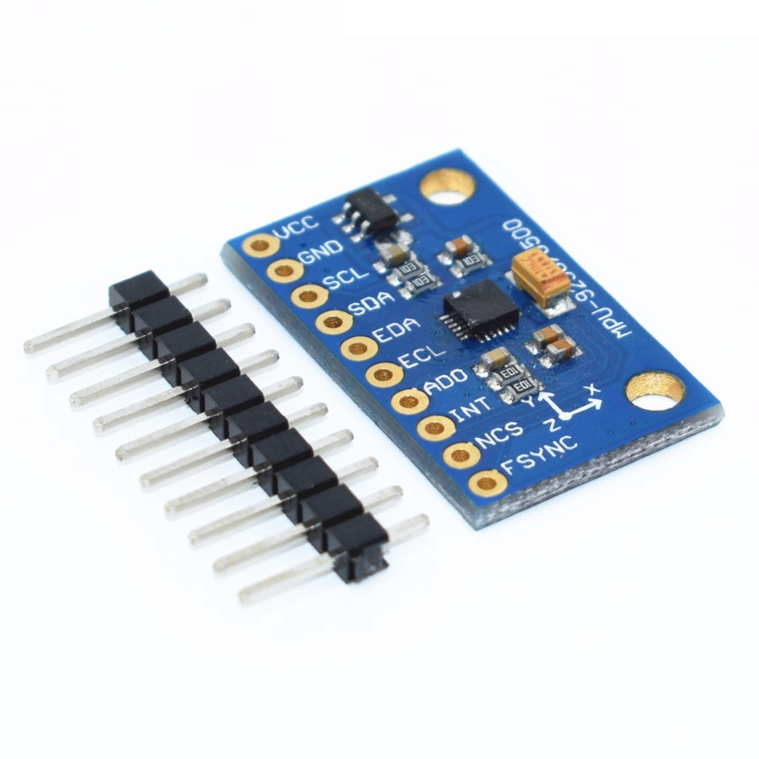
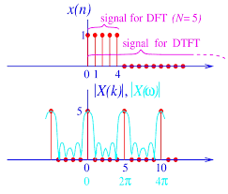
Adam CDR Deliverables
Sensor calibration and integration into final design
Program and FFT conversion from python to C++
Embedded system programming
Notes:
Adam
Transition - I will also be working on the embedded system prototype for the final design, and the calibration needed given the design and weight of the final prototype

Slide 17
FPR Plan
FPR version will:
have calendar functionality
on custom PCB w/ wrist strap
data on power consumption (to meet multi-day spec)
FPR Demo:
consist of video showing shivering and full system response
SMS messaging, add event to calendar
buzzer and reset button demo
Live Demo would consist of a deliberate generation of signals in the target range with full system response
Speaker and tapping
Notes:
Mike Reads.
Transition: “And now John will discuss our plan after CDR”

Slide 18
Project Management - Gantt Chart
Notes:
John
Finally we will state our project estimated cost for next semester into CDR & FPR

Slide 19
Cost Break Down
Part | Number | Price Each | Price
Bluetooth and Prototyping Parts | 4 | $ 14.90 | $ 59.59
Oshpark Flex PCB | 6 | $ 20.82 | $ 124.90
Oshstencils Stencils | 3 | $ 17.17 | $ 51.52
PCB Parts | 5 | $ 42.10 | $ 210.48
Total |  |  | $ 446.49
Notes:
Adam
Transition :” our estimated total is 210 dollars”

Slide 20
Project Management - CDR to FPR
Connor Loughman - Altium Lead, App Dev (Android Calendar Integration), PCB assembly
Adam Maciaszek - Budget Management Lead, Algorithm Tuning, PCB Coding and assembly
Michael Burton - Project Co-Manager (Short-Term), PCB coding
John Murray - PCB assembly, Communication Networking, App Dev (General&SMS), Project Co-Manager (Long-Term)
Notes:
Mike talks
Read the slide
Clear explanation of what is short term( and what is long term management
Short-Term: Scheduling meetings, including team and advisor meetings, and all external communications.
Long-term: Updates the Gantt chart based on estimates from the co-manager that covers short term needs.
Transition: “Now we will demonstrate our current prototype.”

Slide 21
Demo Time
Notes:
Demo order:
Adam
Mike
John

