Slide 1
ECE 671 – Lecture 2
Review of Internet Protocols Link Layer

Slide 2
Structuring networks and protocols
Goal of network:
Provide communication for distributed applications
How to organize networks in such a way that they
Work correctly?
Are scalable to large number of nodes?
Can achieve high performance?
Are interoperable across different technologies and uses?

Slide 3
Example network
How to achieve end-to-end data exchange?

Slide 4
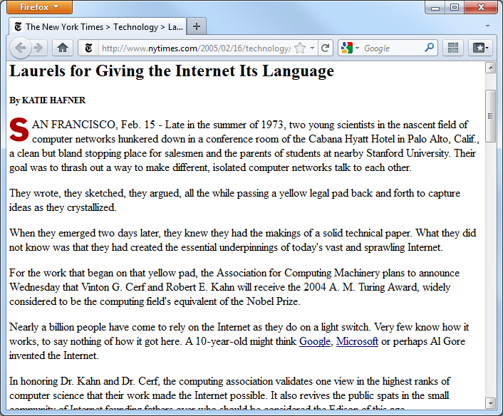
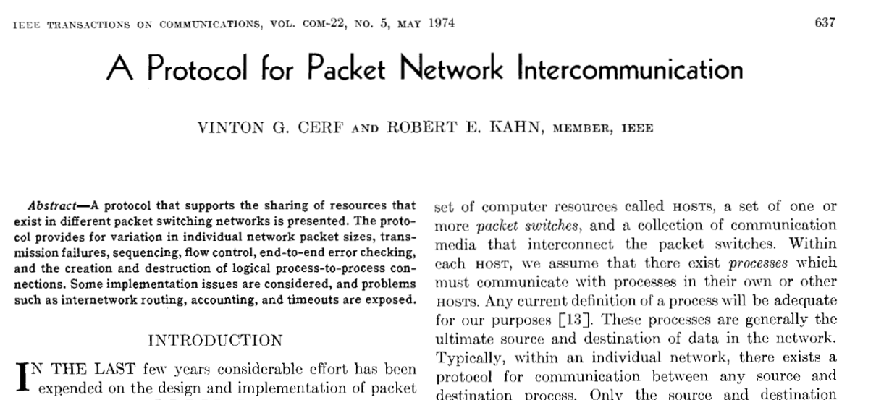
Internet architecture
Designing the structure of the Internet was a difficult problem
Many contributions
One example: TCP/IP

Slide 5
Internet architecture
“Hourglass architecture”
Achieves interoperability
Single, common network layer protocol: Internet Protocol (IP)
All network nodes need to support this protocol
Supports diversity
Different link/physical layer protocols below
Different transport/application layer protocols above

Slide 6
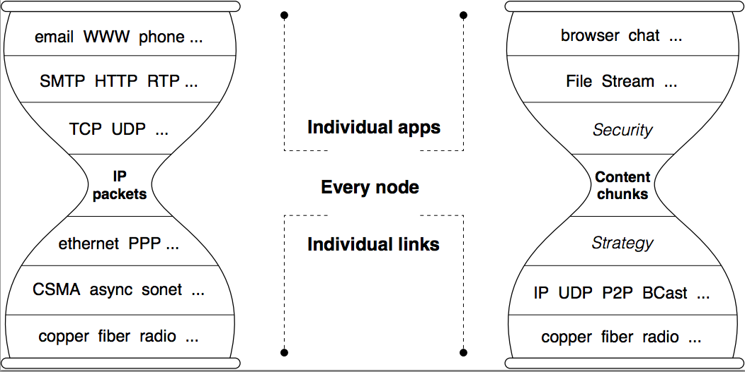
Next Gen. Internet Architecture
Information Centric Networking (ICN):
Move from host-centric to content/information-centric paradigm

Slide 7
Services provided by layers
Each layer in protocol stack provides a “service”
Uses service from lower layers
Benefits of layering
Isolates complexity
Clearly defined interfaces
Protocols implement functionality within layer

Slide 8
Protocols
Protocols define communication between entities
Format and order of messages
Actions taken on transmission and/or receipt of message or other event
Protocols use headers (and trailers) for control information
Naming depends on layer

Slide 9
Network devices
Network devices differ by highest layer processed
Devices can process/modify headers up to that layer
Switches and routers are most common

Slide 10
Review of specific protocols
We will briefly review three protocols
Link layer: Ethernet
Network layer: Internet Protocol (IP)
Transport layer: Transmission Control Protocol (TCP)
For full details
Networking textbooks
RFCs

Slide 11
Link layer
Communication between “neighboring” interfaces
What are the challenges?

Slide 12
Link layer
Point-to-point guided medium is straightforward
One side sends, other side receives (coding, timing, etc. is handled by physical layer)
Duplex operation by duplicating medium
Multiple access case is more interesting
Multiple nodes share guided or unguided medium
Need to consider:
Naming
Medium access protocol
“Strange” cases (e.g., hidden terminal problem)

Slide 13
Medium access principles
How should nodes share a medium?

Slide 14
Medium access principles
How should nodes share a medium?
Do not interrupt ongoing transmissions
When transmitting, stop after a while
Allow for fair sharing among all nodes
Allow efficient use of medium
Do not require central control
Etc.

Slide 15
Side note: delays in networking
What delays are encountered in networks?
What is a typical range of each delay?

Slide 16
Side note: delays in networking
What delays are encountered in networks?
Transmission delay
Propagation delay
Processing delay
Queuing delay
What is a typical range of each delay?
Assumption: 1Gbps, 1250-byte packet, 1000km, 200000km/s
Transmission delay: 10 microseconds
Propagation delay: 5 milliseconds
Processing delay: low microseconds
Queuing delay: transmission delay of queued packets

Slide 17
Signal propagation
At link layer, signal propagation delay matters
Space-time diagram illustrates events
Slope of lines determined by propagation speed
Typically: 2/3 speed of light of light (~200,000 km/s)

Slide 18
ALOHA protocol
Propagation delay may cause collisions on medium
Even if all stations check to see if medium is available
Slotted ALOHA protocol
Discrete time slots
Each node makes random choice to transmit in slot or not
Pure ALOHA
No time slots
Each note makes random choice to transmit at any time

Slide 19
Slotted ALOHA
Assumptions:
all frames same size
time divided into equal size slots (time to transmit 1 frame)
nodes start to transmit only at slot beginning
nodes are synchronized
if 2 or more nodes transmit in slot, all nodes detect collision
Operation:
when node obtains fresh frame, transmits in next slot
if no collision: node can send new frame in next slot
if collision: node retransmits frame in each subsequent slot with prob. p until success

Slide 20
Slotted Aloha
node 1
1
1
1
1
node 2
2
2
2
node 3
3
3
3
C
E
C
S
E
C
E
S
S
Pros:
single active node can continuously transmit at full rate of channel
highly decentralized: only slots in nodes need to be in sync
simple
Cons:
collisions, wasting slots
idle slots
nodes may be able to detect collision in less than time to transmit packet
clock synchronization

Slide 21
Slotted ALOHA Efficiency
efficiency: long-run fraction of successful slots (many nodes, all with many frames to send)
max efficiency: find p* that maximizes Np(1-p)^{N-1}
for many nodes, take limit of Np*(1-p*)^{N-1} as N goes to infinity, gives:
max efficiency = 1/e = .37
suppose: N nodes with many frames to send, each transmits in slot with probability p
prob that given node has success in a slot = p(1-p)^{N-1}
prob that any node has a success = Np(1-p)^{N-1}
at best: channel
used for useful
transmissions 37%
of time!
!

Slide 22
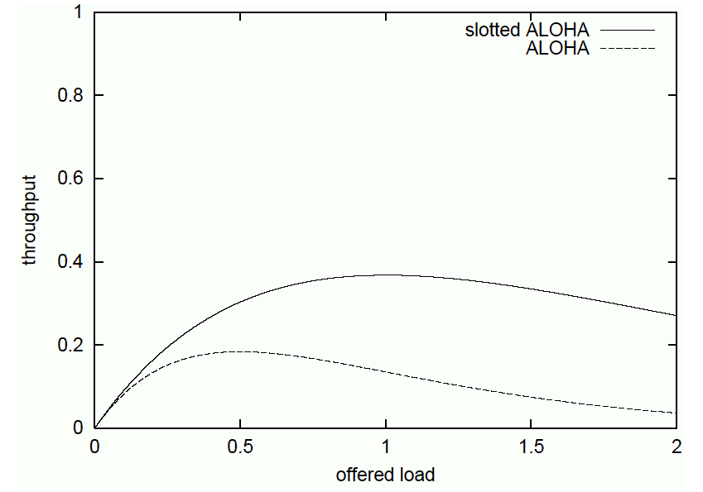
Analysis of ALOHA
Slotted ALOHA analysis
Probability that k frames are generated during interval
Poisson distribution: Pr[k]=G^{k}e^{-G}/k!
G is rate of frame generation (new and retransmission)
Probability of successful transmission
Success if no other frame generated (P₀): S=GP₀=Ge^{-G}
ALOHA analysis
Frame overlaps two slots
Probability that no other frame is generated during two slots:
P₀=e^{-2G}
Success S=GP₀=Ge^{-2G}
Max throughput:
37%@G=1.0 (slotted ALOHA)
18%@G=0.5 (ALOHA)

Slide 23
CSMA/CD protocol
How can we improve ALOHA?
Don’t send when somebody else has already started
Stop when interference is already happening
Why do we need to do that if we don’t start sending when somebody else sends?
Carrier Sensing (CS)
Listen on channel
Only send when nobody else is transmitting
Collision Detection (CD)
Listen to own transmission on channel
If garbled then stop transmitting

Slide 24
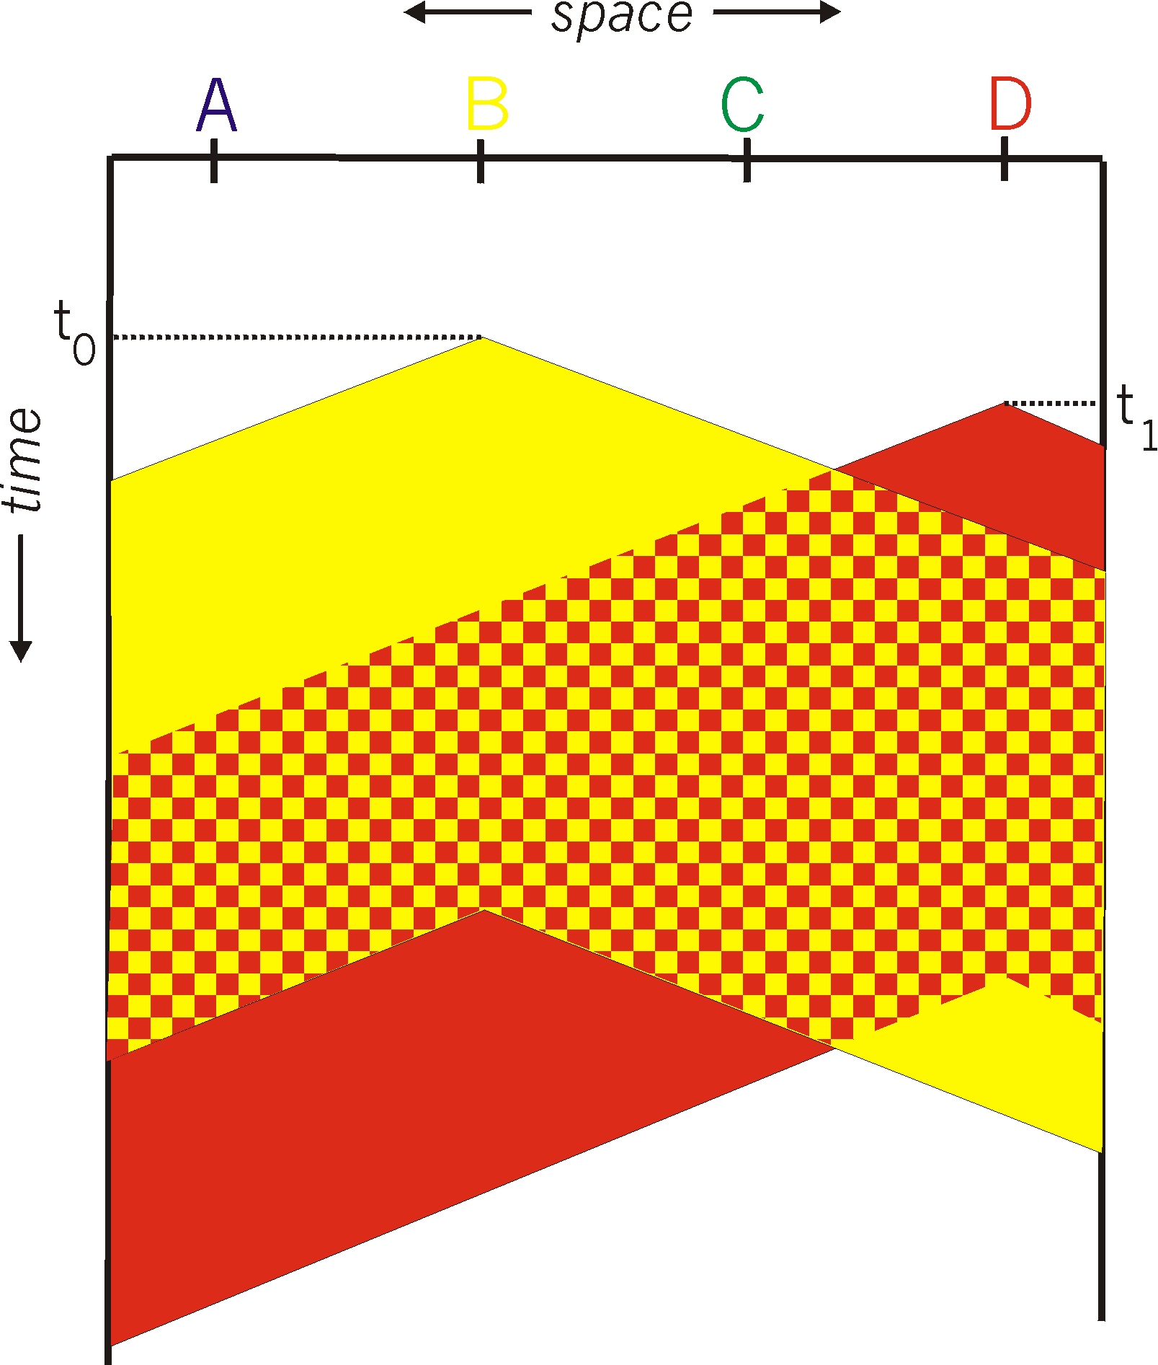
CSMA/CD Collision
spatial layout of nodes
Collisions can still occur: propagation delay means two nodes may not hear each other’s transmission
Collision: entire packet transmission time wasted
distance & propagation delay play role in in determining collision probability

Slide 25
CSMA/CD example
A

Slide 26
Ethernet
IEEE 802.3 protocol
Medium access with CSMA/CD
Truncated exponential backoff
Wait for random number of 512 bit-times
After c collisions: uniform distribution over [0…2^{min{c,10}}-1]
After 16 collisions: transmission aborted
Limitations
Max 2.5km of cable, thus RTT limited to 51.2µs
Corresponds to 64 bytes @ 10Mbps

Slide 27
Ethernet Switch
link-layer device: takes an active role
store, forward Ethernet frames
examine incoming frame’s MAC address, selectively forward frame to one-or-more outgoing links when frame is to be forwarded on segment, uses CSMA/CD to access segment
transparent
hosts are unaware of presence of switches
plug-and-play, self-learning
switches do not need to be configured

Slide 28
Simultaneous Transmissions
A
hosts have dedicated, direct connection to switch
switches buffer packets
Ethernet protocol used on each incoming link, but no collisions; full duplex
each link is its own collision domain
switching: A-to-A’ and B-to-B’ simultaneously, without collisions
C’
B
6
1
2
5
4
3
B’
C
A’
switch with six interfaces
(1,2,3,4,5,6)

Slide 29
Switch Table
A
Q: how does switch know that A’ reachable via interface 4, B’ reachable via interface 5?
A: each switch has a switch table, each entry:
(MAC address of host, interface to reach host, time stamp)
looks like a routing table!
Q: how are entries created, maintained in switch table?
something like a routing protocol?
C’
B
6
1
2
5
4
3
B’
C
A’
switch with six interfaces
(1,2,3,4,5,6)

Slide 30
Self-learning Switch
Source: A
Dest: A’
A
A A’
switch learns which hosts can be reached through which interfaces
when frame received, switch “learns” location of sender: incoming LAN segment
records sender/location pair in switch table
C’
B
6
1
2
5
4
3
B’
C
A’
MAC addr interface TTL
A
1
60
Switch table
(initially empty)

Slide 31
VLANs
Port-based VLAN: switch ports grouped (by switch management software) so that single physical switch ……
Virtual Local
Area Network
1
7
9
15
2
8
10
16
…
…
Switch(es) supporting VLAN capabilities can be configured to define multiple virtual LANS over single physical LAN infrastructure.
Electrical Engineering
(VLAN ports 1-8)
Computer Science
(VLAN ports 9-15)
… operates as multiple virtual switches
1
7
9
15
2
8
10
16
…
…
Electrical Engineering
(VLAN ports 1-8)
Computer Science
(VLAN ports 9-16)

Slide 32
Port-based VLAN
router
traffic isolation: frames to/from ports 1-8 can only reach ports 1-8
can also define VLAN based on MAC addresses of endpoints, rather than switch port
dynamic membership: ports can be dynamically assigned among VLANs
forwarding between VLANS: done via routing (just as with separate switches)
in practice vendors sell combined switches plus routers
1
7
9
15
2
8
10
16
…
…
Electrical Engineering
(VLAN ports 1-8)
Computer Science
(VLAN ports 9-15)

Slide 33
Spanning Multiple Switches
1
7
9
15
1
3
5
7
2
8
10
16
2
4
6
8
…
…
Electrical Engineering
(VLAN ports 1-8)
Computer Science
(VLAN ports 9-15)
Ports 2,3,5 belong to EE VLAN
Ports 4,6,7,8 belong to CS VLAN
trunk port: carries frames between VLANS defined over multiple physical switches
frames forwarded within VLAN between switches can’t be vanilla 802.1 frames (must carry VLAN ID info)
802.1q protocol adds/removed additional header fields for frames forwarded between trunk ports

Slide 34
802.1Q VLAN Frame Format
type
preamble
dest.
address
source
address
data (payload)
CRC
802.1 frame
type
preamble
dest.
address
source
address
data (payload)
CRC
802.1Q frame
2-byte Tag Protocol Identifier
(value: 81-00)
Recomputed
CRC
Tag Control Information (12 bit VLAN ID field,
3 bit priority field like IP TOS)

Slide 35
Related topics
Next: network layer
Combining links to a network
Later: switches and bridges
Organization of layer 2 links into local area networks (LAN)
Algorithms for reaching particular nodes in a LAN

