Slide 1
ECE 671 – Lecture 25
Queueing Models
Slides graciously provided by
Prof. Amr Rizk

Slide 2
Overview
Queueing Models
M|M|1|N Queueing System
M|M|m Queueing System
M|M|m|m Queueing System
M|M| Queueing System

Slide 3
Queueing Systems
Birth-death process
Births correspond to arrivals to the system
Deaths correspond to departures from the system
Size of the population corresponds to the number of customers in the system
Model for circuit as well as packet switching networks.

Slide 4
Kendall’s Notation
The specification of a queueing system comprises
Arrival process
Number of places in the system respectively queue
Scheduling discipline
Number of servers
Service process
Specification of system parameters: Kendall’s notation
arrivals|service|# servers|# places in the system|scheduling

Slide 5
Kendall’s Notation
Arrivals and service can typically be
M: Markov stands for Markov respectively Poisson processes, i.e., exponential inter-arrival times or exponential service times
D: Deterministic
G: General
If not specified infinitely many places in system and fcfs scheduling.

Slide 6
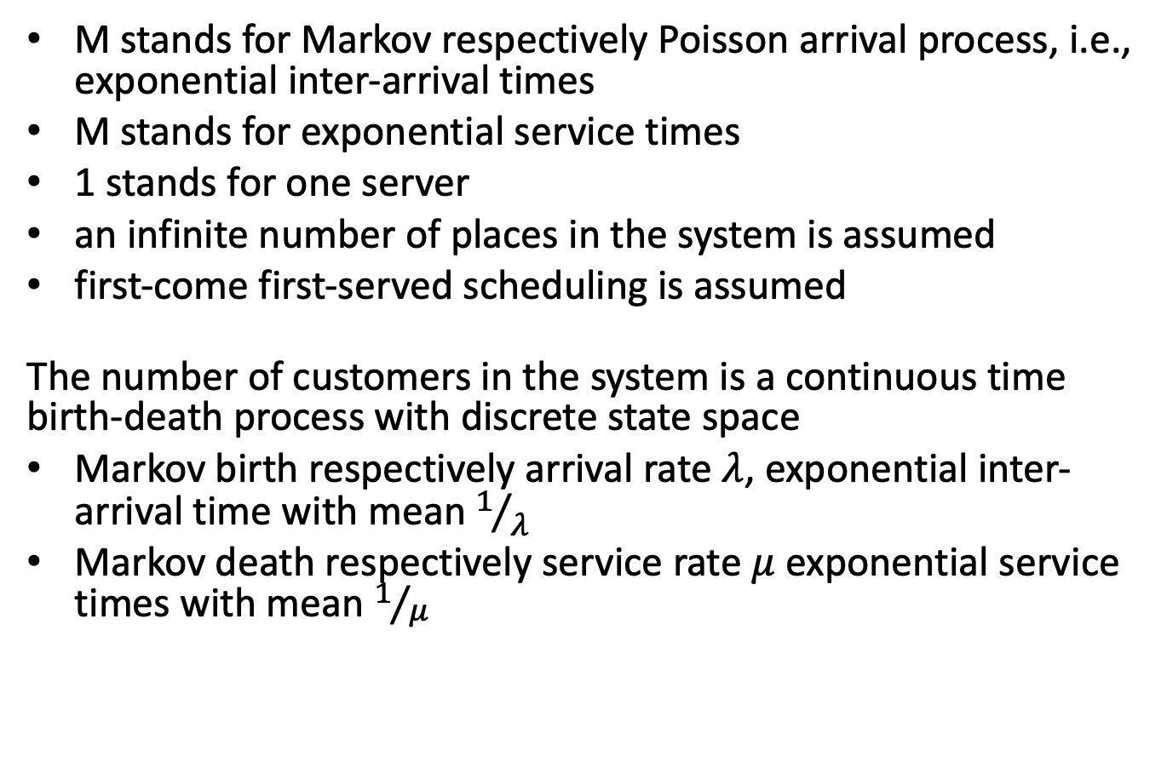
M|M|1 Queueing System
M stands for Markov respectively Poisson arrival process, i.e., exponential inter-arrival times
M stands for exponential service times
1 stands for one server
an infinite number of places in the system is assumed
first-come first-served scheduling is assumed
The number of customers in the system is a continuous time birth-death process with discrete state space
Markov birth respectively arrival rate $λ$, exponential inter-arrival time with mean $1/λ$
Markov death respectively service rate $μ$ exponential service times with mean $1/μ$

Slide 7
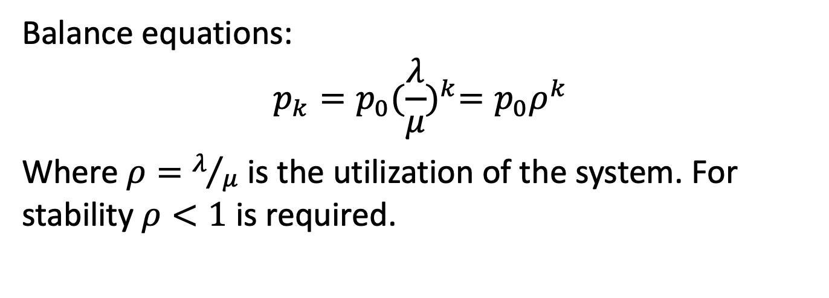
Balance Equations
Arrival and service rates do not depend on the number of customers in the system.
Balance equations:
$$p_{k}=p_{0}{(\frac{λ}{μ})}^{k}=p_{0}ρ^{k}$$
Where $ρ=λ/μ$ is the utilization of the system. For stability $ρ<1$ is required.

Slide 8
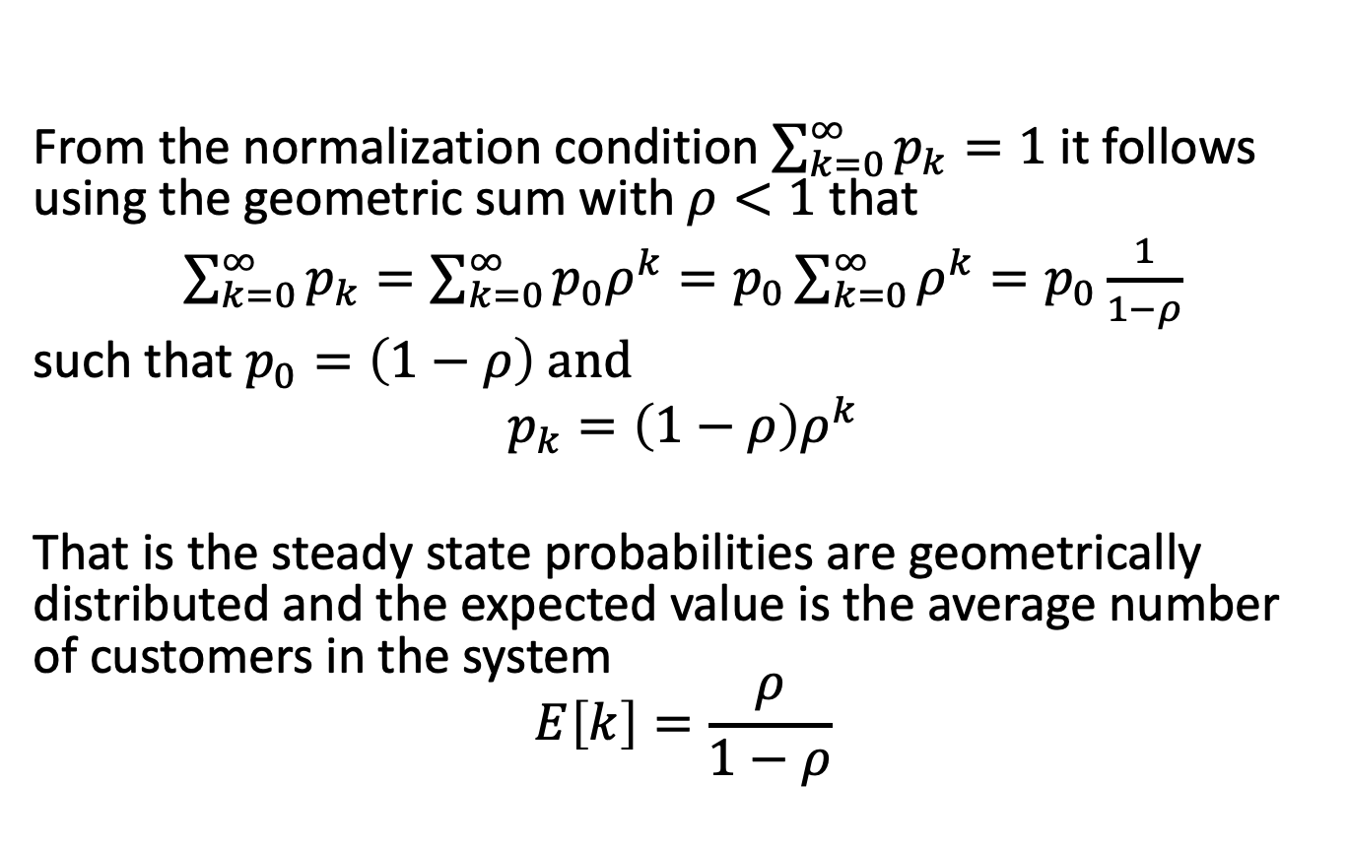
Normalization
From the normalization condition $\sum_{k=0}^{∞}{p_{k}=1}$ it follows using the geometric sum with $ρ<1$ that
$\sum_{k=0}^{∞}{p_{k}=\sum_{k=0}^{∞}{p_{0}ρ^{k}=p_{0}\sum_{k=0}^{∞}{ρ^{k}=p_{0}\frac{1}{1−ρ}}}}$
such that $p_{0}=\left(1−ρ\right) and$
$p_{k}=\left(1−ρ\right)ρ^{k}$
That is the steady state probabilities are geometrically distributed and the expected value is the average number of customers in the system
$$E\left[k\right]=\frac{ρ}{1−ρ}$$

Slide 9
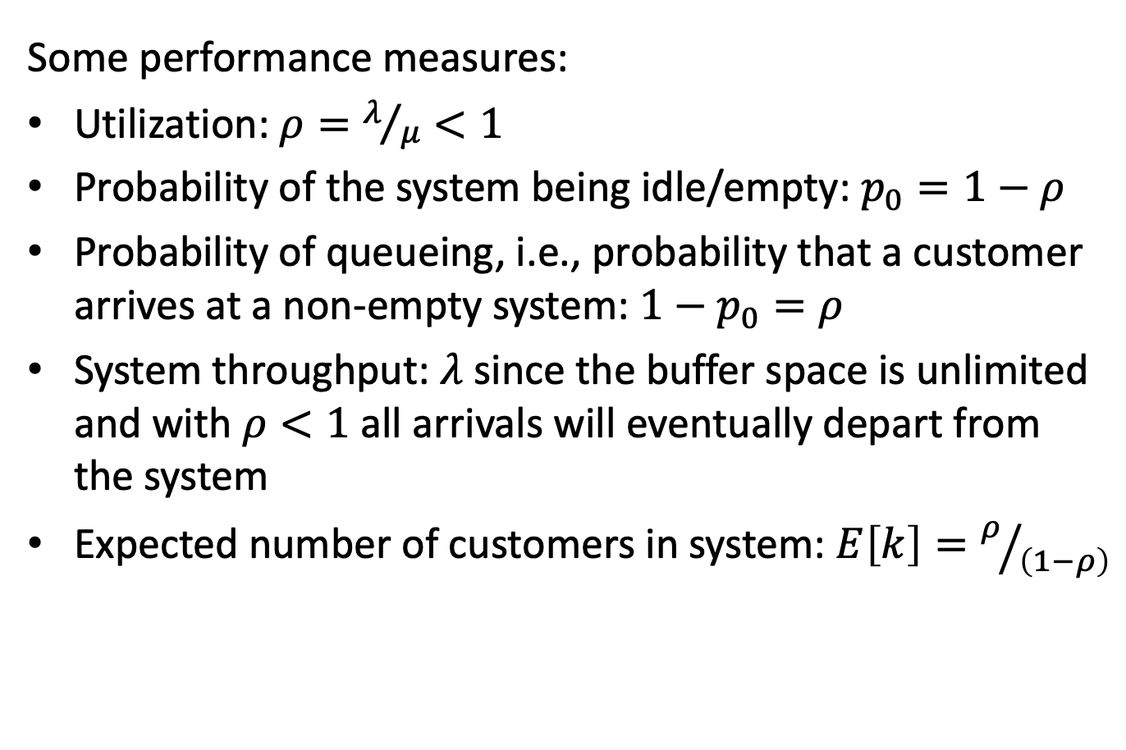
Performance Measures
Some performance measures:
Utilization: $ρ=λ/μ<1$
Probability of the system being idle/empty: $p_{0}=1−ρ$
Probability of queueing, i.e., probability that a customer arrives at a non-empty system: $1−p_{0}=ρ$
System throughput: $λ$ since the buffer space is unlimited and with $ρ<1$ all arrivals will eventually depart from the system
Expected number of customers in system: $E\left[k\right]=ρ/{\left(1−ρ\right)}$

Slide 10
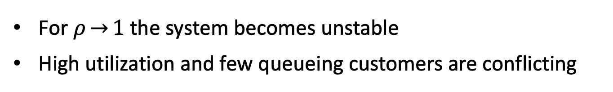
Numerical Example
Expected number of customers in an M| M| 1 queue
For $ρ\overset{→}{}1$ the system becomes unstable
High utilization and few queueing customers are conflicting

Slide 11

Expected System Time
So far we considered only the expected number of customers in the system. There exists a very simple and powerful relation between the number of customers in the system and the system time.
Denote $A\left(t\right)$ and $D(t)$ the cumulative arrivals respective departures of the system.

Slide 12
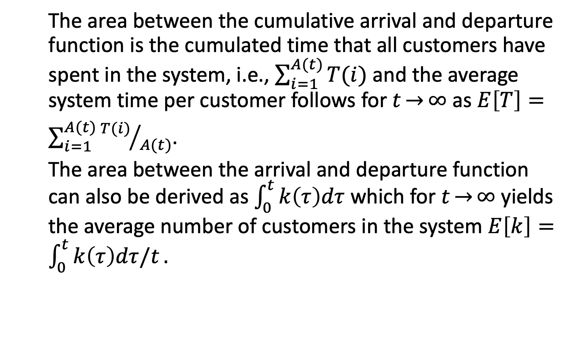
Little’s Law
The area between the cumulative arrival and departure function is the cumulated time that all customers have spent in the system, i.e., $\sum_{i=1}^{A(t)}{T(i)}$ and the average system time per customer follows for $t\overset{→}{}∞$ as $E\left[T\right]=\sum_{i=1}^{A(t)}{{T(i)}/{A(t)}}$.
The area between the arrival and departure function can also be derived as $\int_{0}^{t}{k\left(τ\right)dτ}$ which for $t\overset{→}{}∞$ yields the average number of customers in the system $E\left[k\right]=\int_{0}^{t}{k\left(τ\right)dτ/t}.$

Slide 13
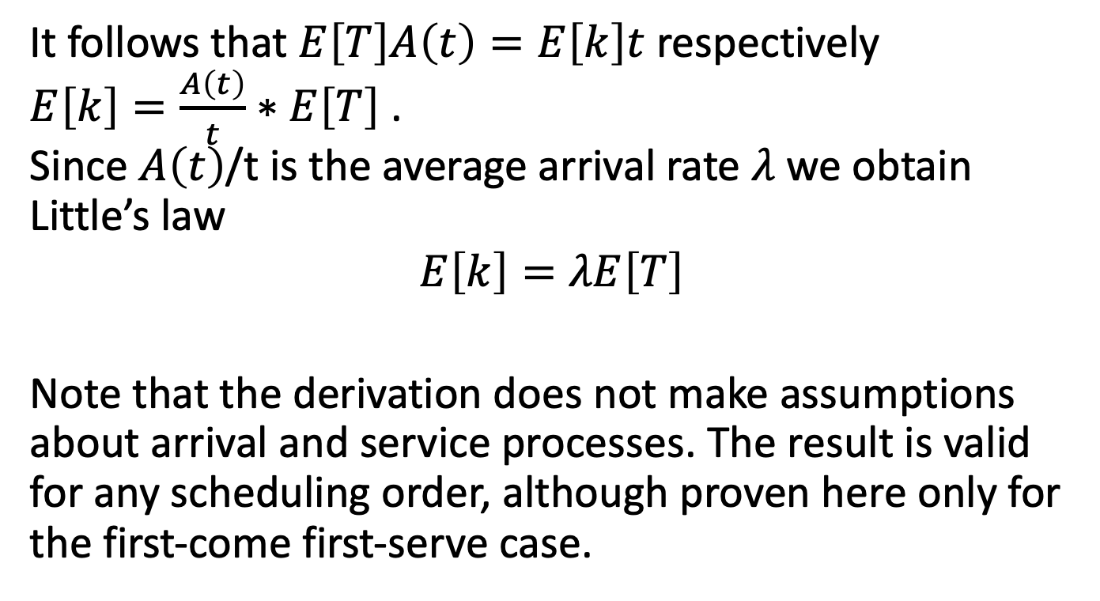
Little’s Law
It follows that $E\left[T\right]A\left(t\right)=E\left[k\right]t$ respectively
$E\left[k\right]=\frac{A\left(t\right)}{t}∗E\left[T\right]$ .
Since $A\left(t\right)$/t is the average arrival rate $λ$ we obtain Little’s law
$$E\left[k\right]=λE\left[T\right]$$
Note that the derivation does not make assumptions about arrival and service processes. The result is valid for any scheduling order, although proven here only for the first-come first-serve case.

Slide 14
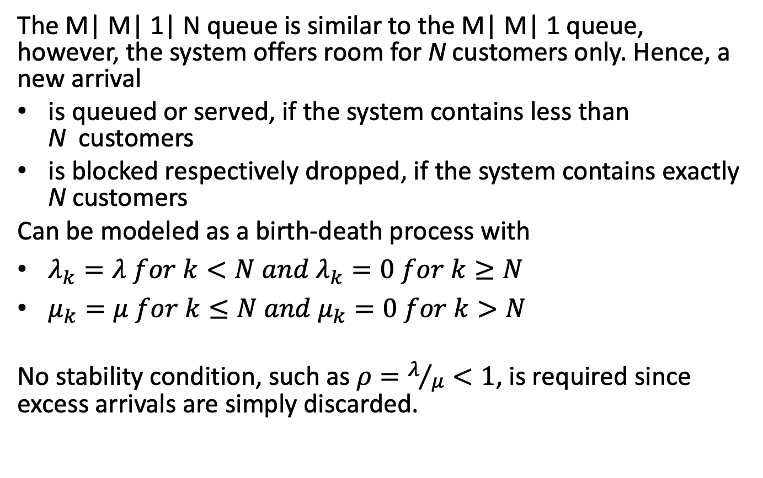
M|N|1|N Queueing System
The M| M| 1| N queue is similar to the M| M| 1 queue, however, the system offers room for N customers only. Hence, a new arrival
is queued or served, if the system contains less than N customers
is blocked respectively dropped, if the system contains exactly N customers
Can be modeled as a birth-death process with
$λ_{k}=λ for k<N and λ_{k}=0 for k≥N$
$μ_{k}=μ for k≤N and μ_{k}=0 for k>N$
No stability condition, such as $ρ=λ/μ<1$, is required since excess arrivals are simply discarded.

Slide 15
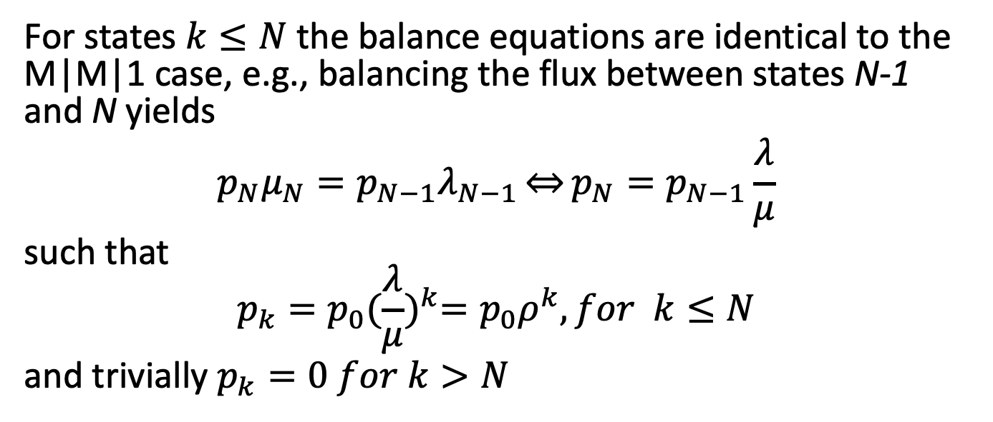
Balance Equations
For states $k≤N$ the balance equations are identical to the M|M|1 case, e.g., balancing the flux between states N-1 and N yields
$$p_{N}μ_{N}=p_{N−1}λ_{N−1}\overset{⇔}{}p_{N}=p_{N−1}\frac{λ}{μ}$$
such that
$$p_{k}=p_{0}{(\frac{λ}{μ})}^{k}=p_{0}ρ^{k}, for k≤N$$
and trivially $p_{k}=0 for k>N$

Slide 16
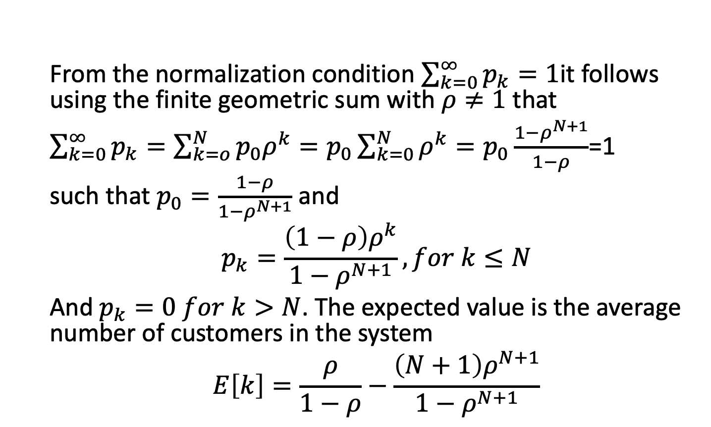
Normalization
From the normalization condition $\sum_{k=0}^{∞}{p_{k}=1}$it follows using the finite geometric sum with $ρ≠1$ that
$\sum_{k=0}^{∞}{p_{k}=\sum_{k=o}^{N}{p_{0}ρ^{k}=p_{0}\sum_{k=0}^{N}{ρ^{k}=p_{0}\frac{1−ρ^{N+1}}{1−ρ}}}}$=1
such that $p_{0}=\frac{1−ρ}{1−ρ^{N+1}}$ and
$$p_{k}=\frac{\left(1−ρ\right)ρ^{k}}{1−ρ^{N+1}}, for k≤N$$
And $p_{k}=0 for k>N$. The expected value is the average number of customers in the system
$$E\left[k\right]=\frac{ρ}{1−ρ}−\frac{\left(N+1\right)ρ^{N+1}}{1−ρ^{N+1}}$$

Slide 17
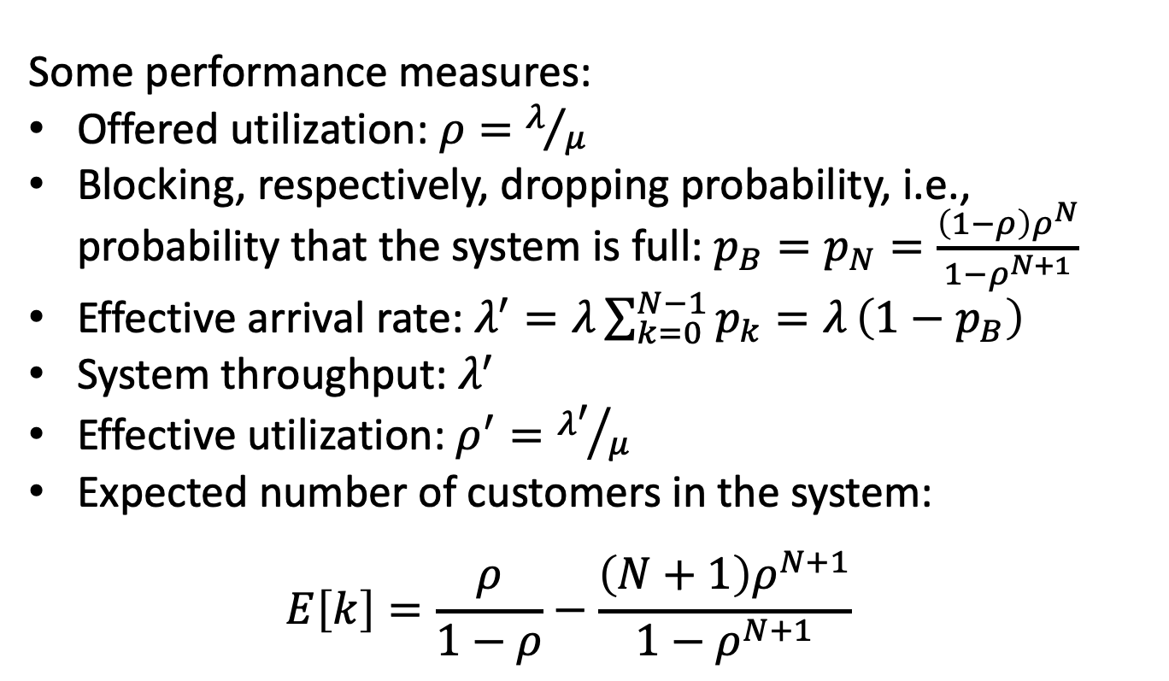
Performance Measures
Some performance measures:
Offered utilization: $ρ=λ/μ$
Blocking, respectively, dropping probability, i.e., probability that the system is full: $p_{B}=p_{N}=\frac{\left(1−ρ\right)ρ^{N}}{1−ρ^{N+1}}$
Effective arrival rate: $λ^{′}=λ\sum_{k=0}^{N−1}{p_{k}=λ}\left(1−p_{B}\right)$
System throughput: $λ^{′}$
Effective utilization: $ρ^{′}={λ^{′}}/μ$
Expected number of customers in the system:
$E\left[k\right]=\frac{ρ}{1−ρ}−\frac{\left(N+1\right)ρ^{N+1}}{1−ρ^{N+1}}$

Slide 18
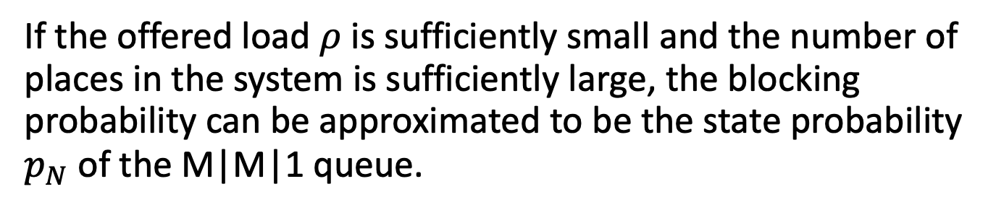
Numerical Example
Blocking probability of an M|M|1|N queue
If the offered load $ρ$ is sufficiently small and the number of places in the system is sufficiently large, the blocking probability can be approximated to be the state probability $p_{N}$ of the M|M|1 queue.

Slide 19
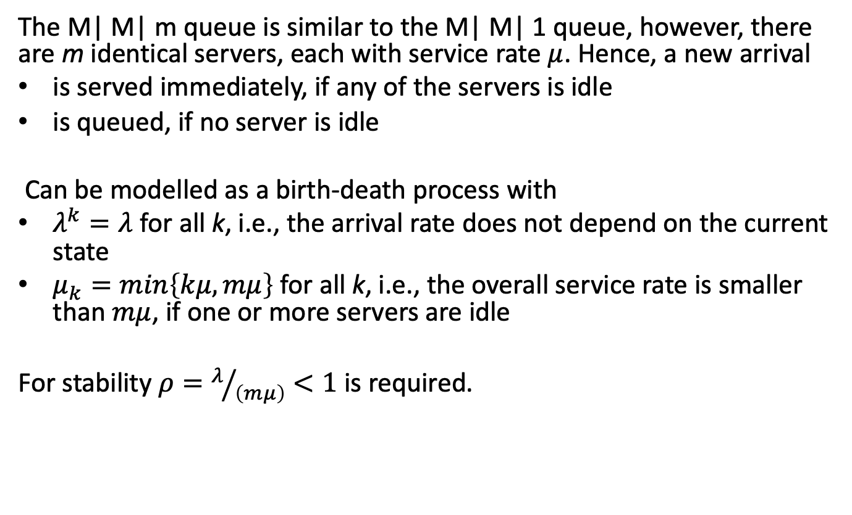
M|M|m Queueing System
The M| M| m queue is similar to the M| M| 1 queue, however, there are m identical servers, each with service rate $μ$. Hence, a new arrival
is served immediately, if any of the servers is idle
is queued, if no server is idle
Can be modelled as a birth-death process with
$λ^{k}=λ$ for all k, i.e., the arrival rate does not depend on the current state
$μ_{k}=min\left\{kμ,mμ\right\}$ for all k, i.e., the overall service rate is smaller than $mμ$, if one or more servers are idle
For stability $ρ=λ/{\left(mμ\right)}<1$ is required.

Slide 20
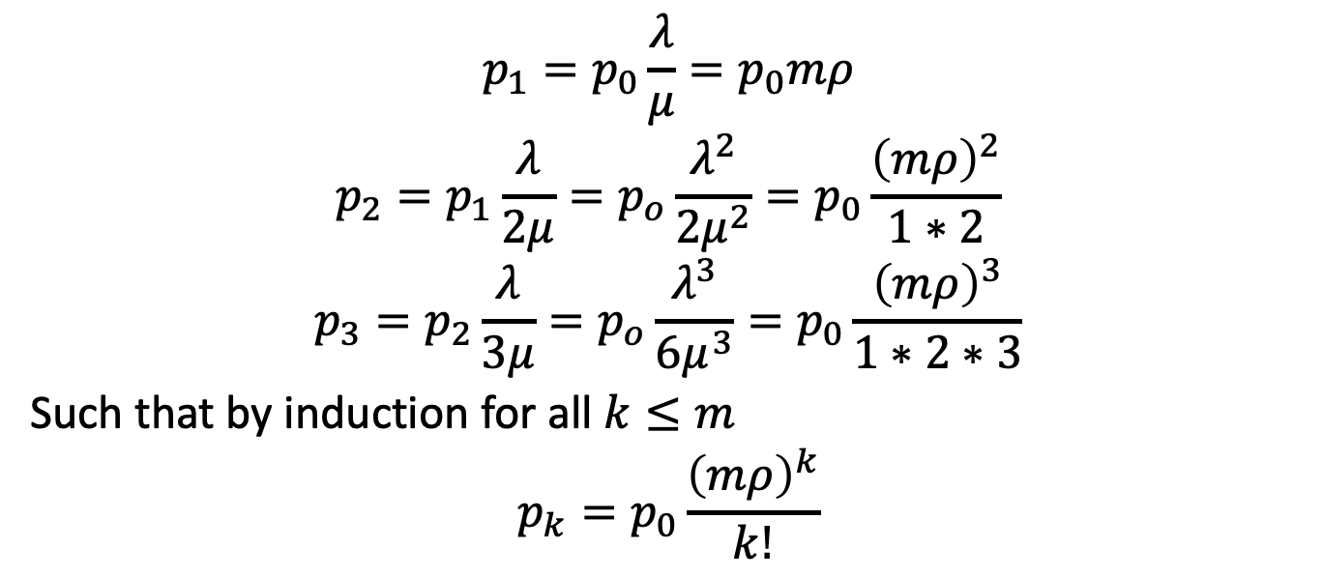
Balance Equation (1/2)
$$p_{1}=p_{0}\frac{λ}{μ}=p_{0}mρ$$
$$p_{2}=p_{1}\frac{λ}{2μ}=p_{o}\frac{λ^{2}}{2μ^{2}}=p_{0}\frac{{\left(mρ\right)}^{2}}{1∗2}$$
$$p_{3}=p_{2}\frac{λ}{3μ}=p_{o}\frac{λ^{3}}{6μ^{3}}=p_{0}\frac{{\left(mρ\right)}^{3}}{1∗2∗3}$$
Such that by induction for all $k≤m$
$$p_{k}=p_{0}\frac{{\left(mρ\right)}^{k}}{k!}$$

Slide 21
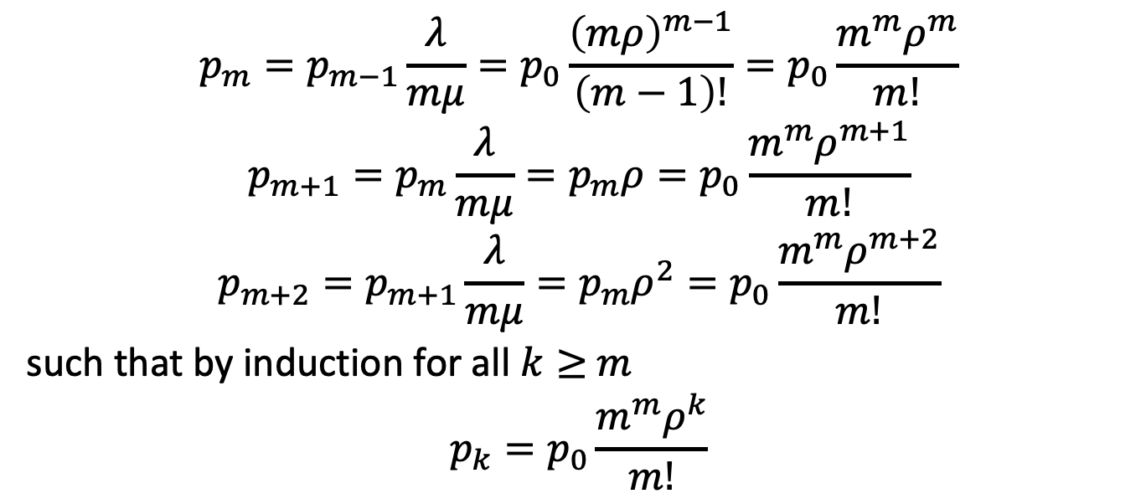
Balance Equation (2/2)
$$p_{m}=p_{m−1}\frac{λ}{mμ}=p_{0}\frac{{\left(mρ\right)}^{m−1}}{\left(m−1\right)!}=p_{0}\frac{m^{m}ρ^{m}}{m!}$$
$$p_{m+1}=p_{m}\frac{λ}{mμ}=p_{m}ρ=p_{0}\frac{m^{m}ρ^{m+1}}{m!}$$
$$p_{m+2}=p_{m+1}\frac{λ}{mμ}=p_{m}ρ^{2}=p_{0}\frac{m^{m}ρ^{m+2}}{m!}$$
such that by induction for all $k≥$ $m$
$$p_{k}=p_{0}\frac{m^{m}ρ^{k}}{m!}$$

Slide 22
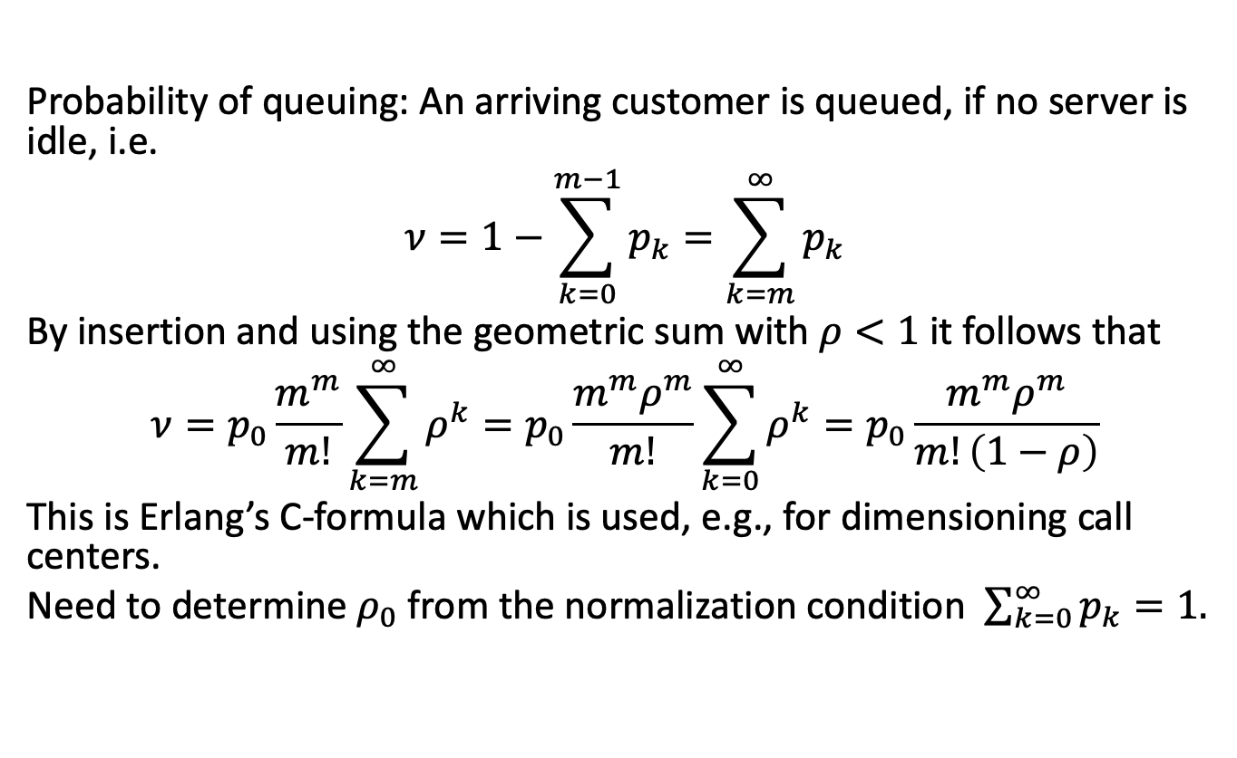
Erlang’s C-formula
Probability of queuing: An arriving customer is queued, if no server is idle, i.e.
$$ν=1−\sum_{k=0}^{m−1}{p_{k}=\sum_{k=m}^{∞}{p_{k}}}$$
By insertion and using the geometric sum with $ρ<1$ it follows that
$$ν=p_{0}\frac{m^{m}}{m!}\sum_{k=m}^{∞}{ρ^{k}=p_{0}}\frac{m^{m}ρ^{m}}{m!}\sum_{k=0}^{∞}{ρ^{k}}=p_{0}\frac{m^{m}ρ^{m}}{m!\left(1−ρ\right)}$$
This is Erlang’s C-formula which is used, e.g., for dimensioning call centers.
Need to determine $ρ_{0}$ from the normalization condition $\sum_{k=0}^{∞}{p_{k}=1.}$

Slide 23

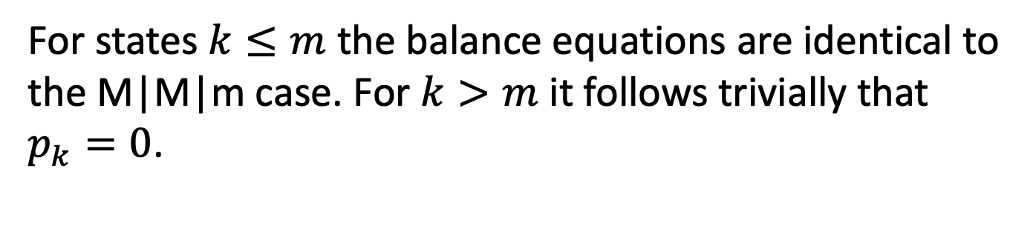
M|M|m|m Queueing System
The M| M| m| m queue is a combination of the M| M| m queue and the M| M| 1| N queue, however, there is no buffer space at all, i.e. the system has m servers which in total offer room for m customers.
For states $k≤m$ the balance equations are identical to the M|M|m case. For $k>m$ it follows trivially that $p_{k}=0$.

Slide 24
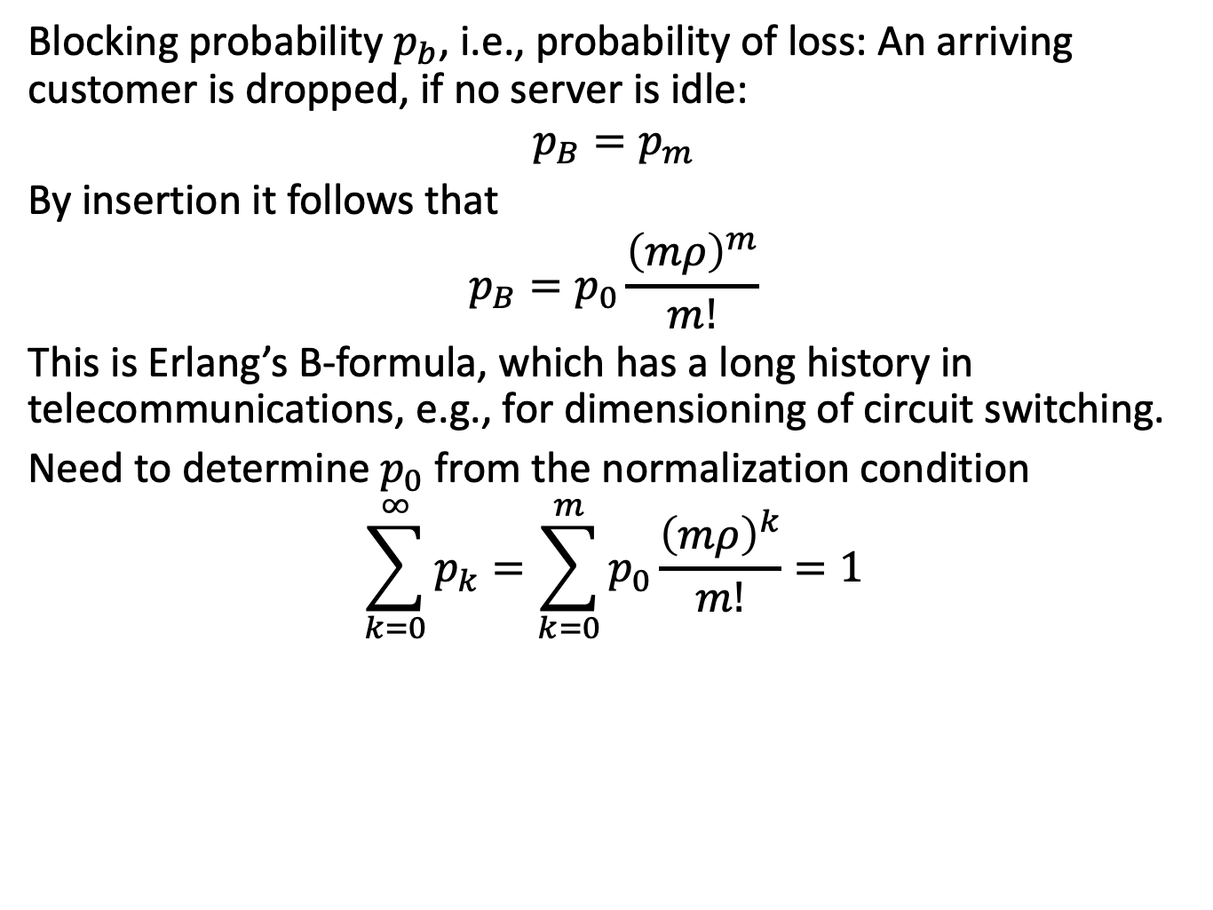
Erlang’s B-formula
Blocking probability $p_{b}$, i.e., probability of loss: An arriving customer is dropped, if no server is idle:
$$p_{B}=p_{m}$$
By insertion it follows that
$$p_{B}=p_{0}\frac{{\left(mρ\right)}^{m}}{m!}$$
This is Erlang’s B-formula, which has a long history in telecommunications, e.g., for dimensioning of circuit switching.
Need to determine $p_{0}$ from the normalization condition
$$\sum_{k=0}^{∞}{p_{k}=\sum_{k=0}^{m}{p_{0}\frac{{\left(mρ\right)}^{k}}{m!}=1}}$$

Slide 25
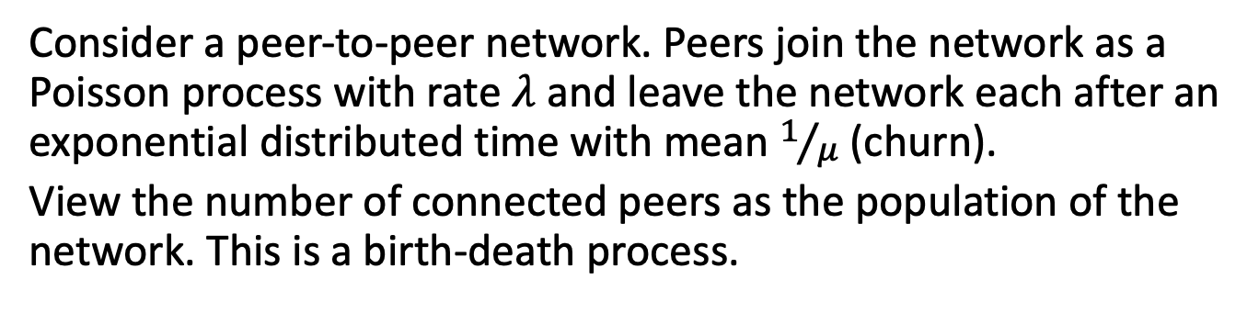
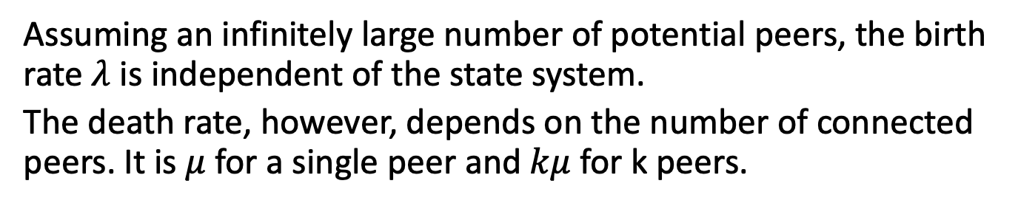
Population of a Peer-to-Peer Network
Consider a peer-to-peer network. Peers join the network as a Poisson process with rate $λ$ and leave the network each after an exponential distributed time with mean $1/μ$ (churn).
View the number of connected peers as the population of the network. This is a birth-death process.
Assuming an infinitely large number of potential peers, the birth rate $λ$ is independent of the state system.
The death rate, however, depends on the number of connected peers. It is $μ$ for a single peer and $kμ$ for k peers.

Slide 26
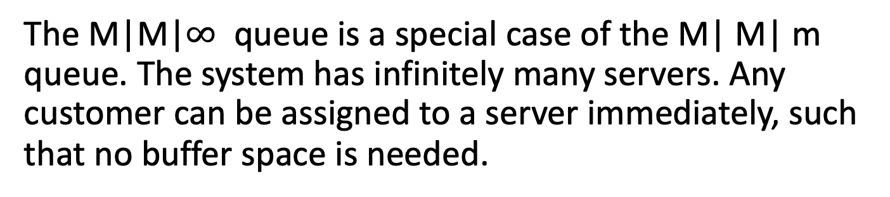

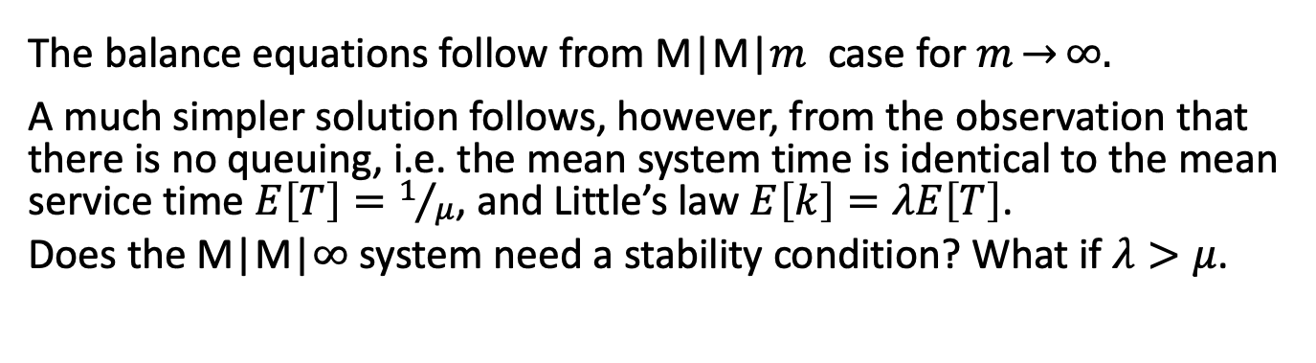
M|M|$∞$ Queueing System
The M|M|$∞$ queue is a special case of the M| M| m queue. The system has infinitely many servers. Any customer can be assigned to a server immediately, such that no buffer space is needed.
The balance equations follow from M|M|$m$ case for $m\overset{→}{}∞.$
A much simpler solution follows, however, from the observation that there is no queuing, i.e. the mean system time is identical to the mean service time $E\left[T\right]=1/μ$, and Little’s law $E\left[k\right]=λE\left[T\right]$.
Does the M|M|$∞$ system need a stability condition? What if $λ>μ$.

Slide 27
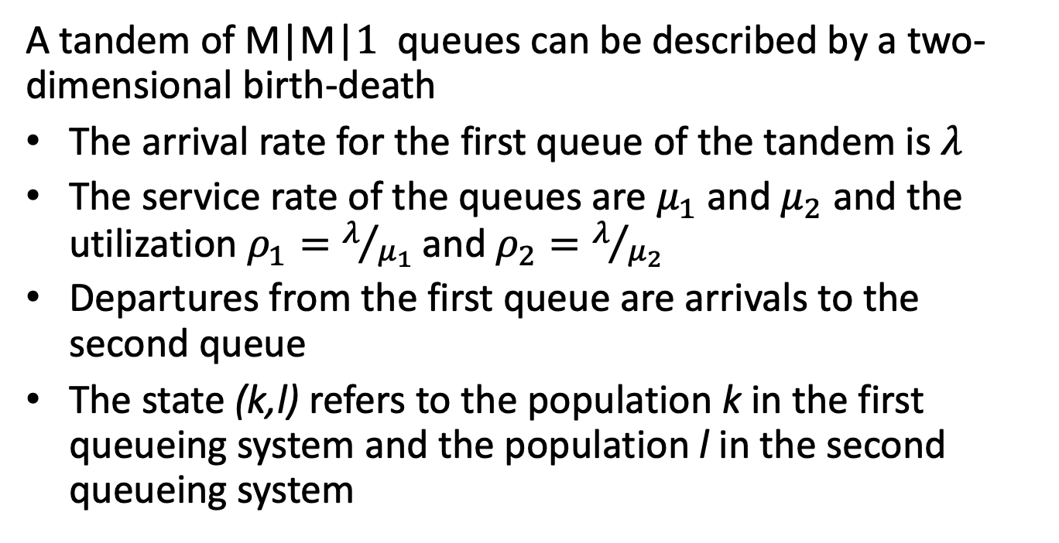
Queueing Networks
A tandem of M|M|$1$ queues can be described by a two-dimensional birth-death
The arrival rate for the first queue of the tandem is $λ$
The service rate of the queues are $μ_{1}$ and $μ_{2}$ and the utilization $ρ_{1}=λ/{μ_{1}}$ and $ρ_{2}=λ/{μ_{2}}$
Departures from the first queue are arrivals to the second queue
The state (k,l) refers to the population k in the first queueing system and the population l in the second queueing system

Slide 28
State Transition Diagram

Slide 29
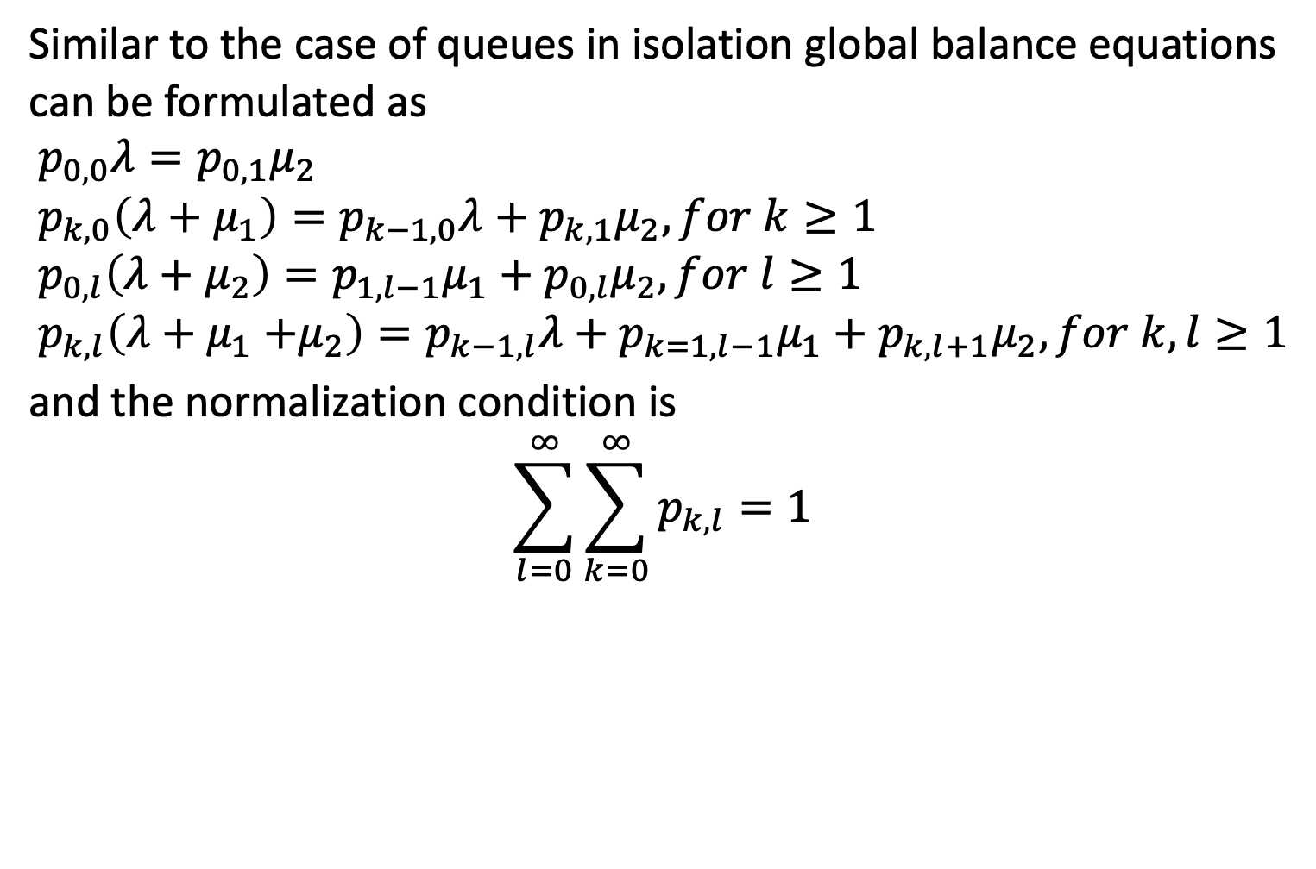
Global Balance Equation
Similar to the case of queues in isolation global balance equations can be formulated as
$$p_{0,0}λ=p_{0,1}μ_{2} \\ p_{k,0}\left(λ+μ_{1}\right)=p_{k−1,0}λ+p_{k,1}μ_{2}, for k≥1 \\ p_{0,l}\left(λ+μ_{2}\right)=p_{1,l−1}μ_{1}+p_{0,l}μ_{2}, for l≥1 \\ p_{k,l}\left(λ+μ_{1}{+μ}_{2}\right)={p_{k−1,l}λ+p}_{k=1,l−1}μ_{1}+p_{k,l+1}μ_{2}, for k,l≥1$$
and the normalization condition is
$$\sum_{l=0}^{∞}{\sum_{k=0}^{∞}{p_{k,l}=1}}$$

Slide 30
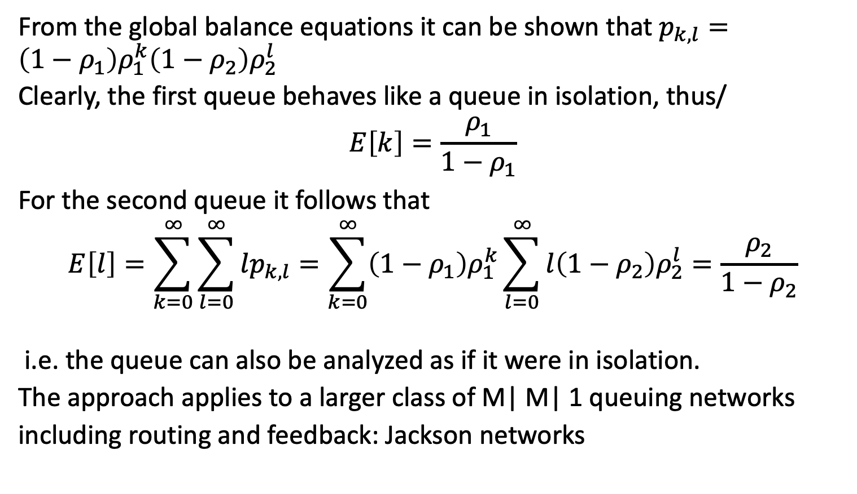
Product Form Solution
From the global balance equations it can be shown that $p_{k,l}=\left(1−ρ_{1}\right)ρ_{1}^{k}\left(1−ρ_{2}\right)ρ_{2}^{l}$
Clearly, the first queue behaves like a queue in isolation, thus/
$$E\left[k\right]=\frac{ρ_{1}}{1−ρ_{1}}$$
For the second queue it follows that
$$E\left[l\right]=\sum_{k=0}^{∞}{\sum_{l=0}^{∞}{lp_{k,l}=\sum_{k=0}^{∞}{\left(1−ρ_{1}\right)ρ_{1}^{k}\sum_{l=0}^{∞}{l\left(1−ρ_{2}\right)ρ_{2}^{l}=\frac{ρ_{2}}{1−ρ_{2}}}}}}$$
i.e. the queue can also be analyzed as if it were in isolation.
The approach applies to a larger class of M| M| 1 queuing networks
including routing and feedback: Jackson networks

