Slide 1
ECE 671 – Lecture 24
Markov Chains
Slides graciously provided by
Prof. Amr Rizk

Slide 2
Overview
Markov Chains
Google’s Pagerank Algorithm
Birth-death Processes

Slide 3
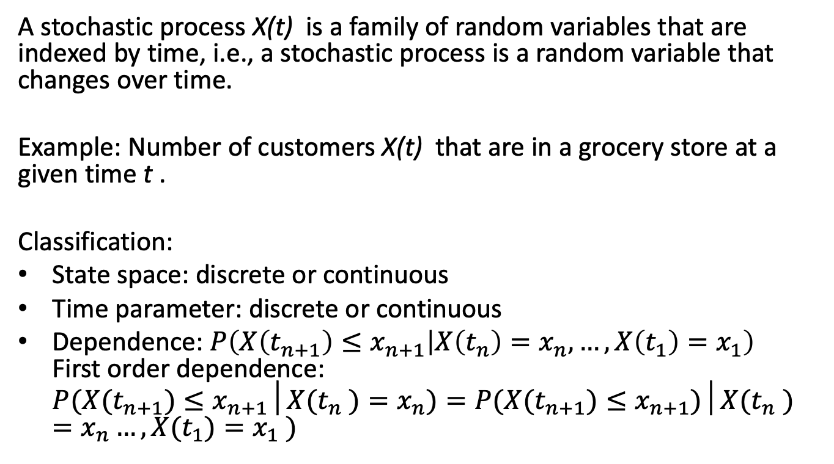
Stochastic Process
A stochastic process X(t) is a family of random variables that are indexed by time, i.e., a stochastic process is a random variable that changes over time.
Example: Number of customers X(t) that are in a grocery store at a given time t .
Classification:
State space: discrete or continuous
Time parameter: discrete or continuous
Dependence: $P\left(X\left(t_{n+1}\right)≤x_{n+1} | X\left(t_{n}\right)=x_{n},…,X\left(t_{1}\right)=x_{1}\right)$
First order dependence:
$P(X(t_{n+1})≤x_{n+1}│X(t_{n} )=x_{n})=P(X(t_{n+1})≤x_{n+1})│X(t_{n} )=x_{n}…,X(t_{1})=x_{1} )$

Slide 4
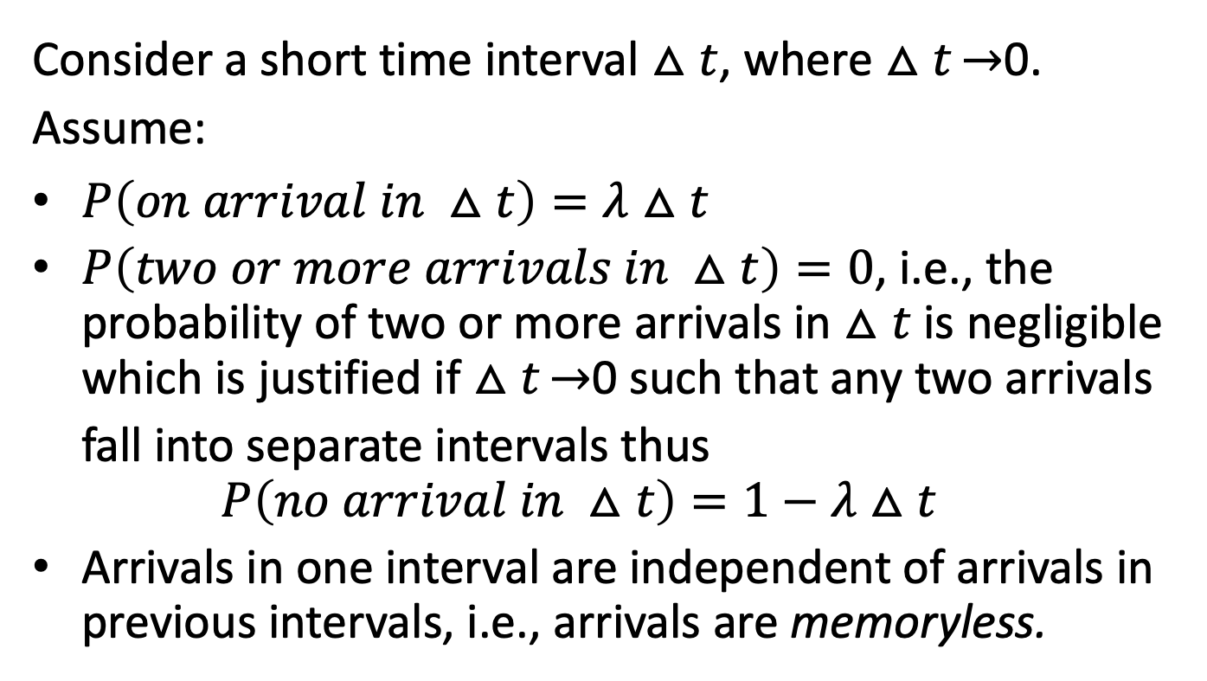
Towards the Poisson Arrival Process
Consider a short time interval $△t$, where $△t\overset{→}{}$0. Assume:
$P\left(on arrival in △t\right)=λ△t$
$P\left(two or more arrivals in △t\right)=0$, i.e., the probability of two or more arrivals in $△t$ is negligible which is justified if $△t\overset{→}{}$0 such that any two arrivals fall into separate intervals thus
$P\left(no arrival in △t\right)=1−λ△t$
Arrivals in one interval are independent of arrivals in previous intervals, i.e., arrivals are memoryless.

Slide 5
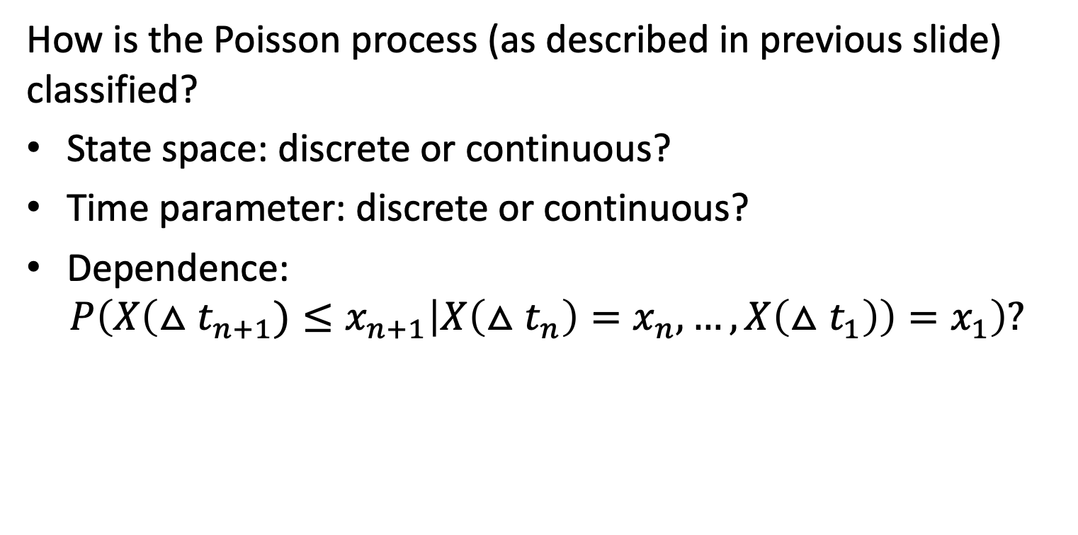
Poisson Arrival Process: Classification
How is the Poisson process (as described in previous slide) classified?
State space: discrete or continuous?
Time parameter: discrete or continuous?
Dependence:
$P\left(X\left(△t_{n+1})≤x_{n+1} | X\left(△t_{n}\right)=x_{n},…,X\left(△t_{1}\right)\right)=x_{1}\right)?$

Slide 6
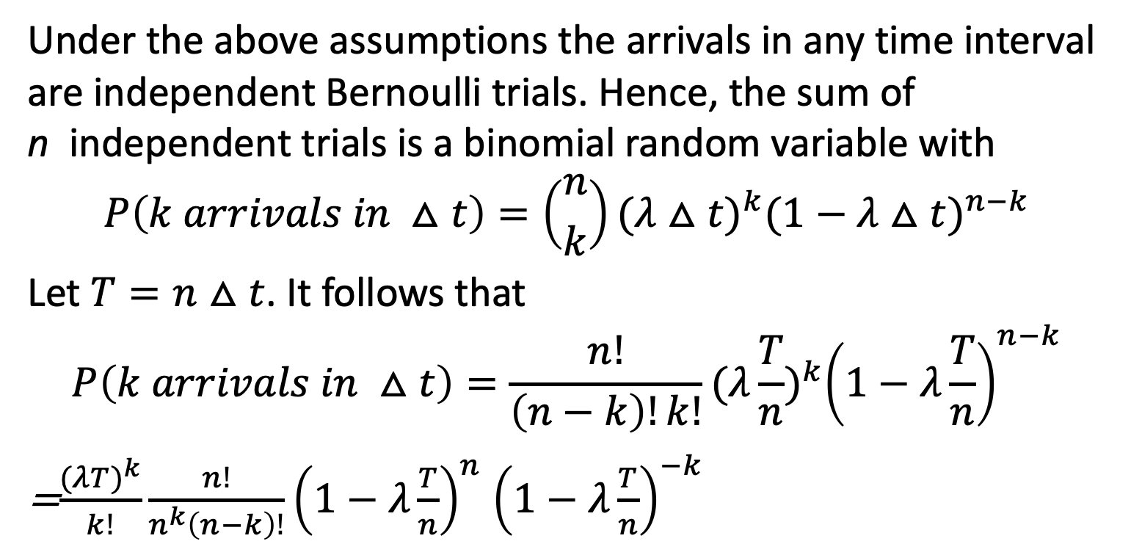
Poisson Arrival Process: Continued
Under the above assumptions the arrivals in any time interval are independent Bernoulli trials. Hence, the sum of n independent trials is a binomial random variable with
$$P\left(k arrivals in △t\right)=\left({n \atop k}\right){(λ△t)}^{k}{(1−λ△t)}^{n−k}$$
Let $T=n$ $△t$. It follows that
$$P\left(k arrivals in △t\right)=\frac{n!}{\left(n−k\right)!k!}{(λ\frac{T}{n})}^{k}{\left(1−λ\frac{T}{n}\right)}^{n−k}$$
=$\frac{{(λT)}^{k}}{k!}\frac{n!}{n^{k}\left(n−k\right)!}{\left(1−λ\frac{T}{n}\right)}^{n}$ ${\left(1−λ\frac{T}{n}\right)}^{−k}$

Slide 7
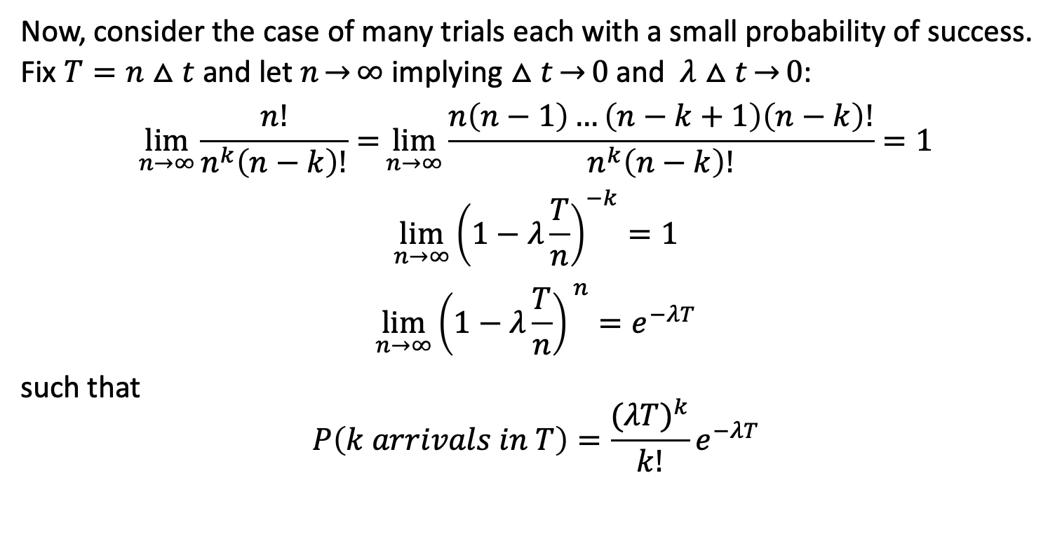
Poisson Arrival Process: Continued
Now, consider the case of many trials each with a small probability of success.
Fix $T=n△t$ and let $n\overset{→}{}∞$ implying $△t\overset{→}{}0$ and $λ△t\overset{→}{}0$:
$$\lim_{n\overset{→}{}∞}{\frac{n!}{n^{k}\left(n−k\right)!}=}\lim_{n\overset{→}{}∞}\frac{n\left(n−1\right)…\left(n−k+1\right)\left(n−k\right)!}{n^{k}\left(n−k\right)!}=1$$
$$\lim_{n\overset{→}{}∞}{\left(1−λ\frac{T}{n}\right)}^{−k}=1$$
$$\lim_{n\overset{→}{}∞}{\left(1−λ\frac{T}{n}\right)}^{ n}=e^{−λT}$$
such that
$$P\left(k arrivals in T\right)=\frac{{(λT)}^{k}}{k!}e^{−λT}$$

Slide 8
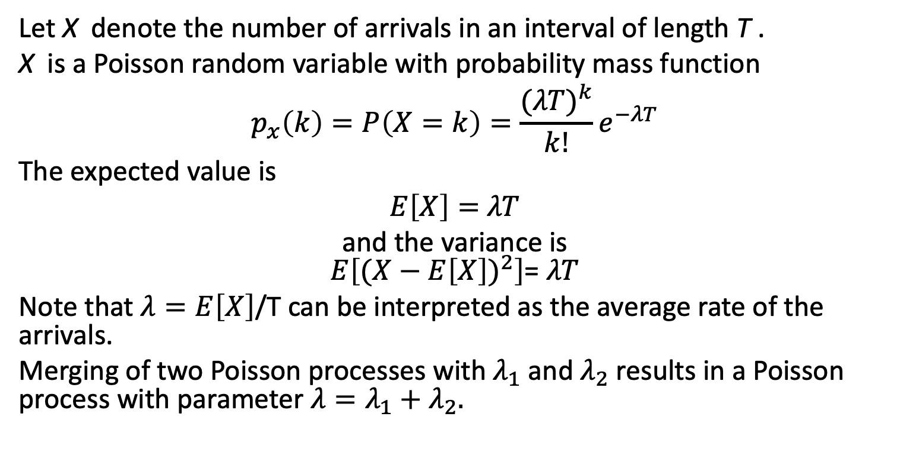
Poisson Arrival Process: Continued
Let X denote the number of arrivals in an interval of length T .
X is a Poisson random variable with probability mass function
$$p_{x}\left(k\right)=P\left(X=k\right)=\frac{{(λT)}^{k}}{k!}e^{−λT}$$
The expected value is
$E\left[X\right]=$ $λT$
and the variance is
$E\left[({X−E\left[X\right])}^{2}\right]$= $λT$
Note that $λ=E\left[X\right]$/T can be interpreted as the average rate of the arrivals.
Merging of two Poisson processes with $λ_{1}$ and $λ_{2}$ results in a Poisson process with parameter $λ=λ_{1}+λ_{2}.$

Slide 9
Poisson mass and distribution function
Poisson random variable with $λ=0.4$ and $T=10.$

Slide 10
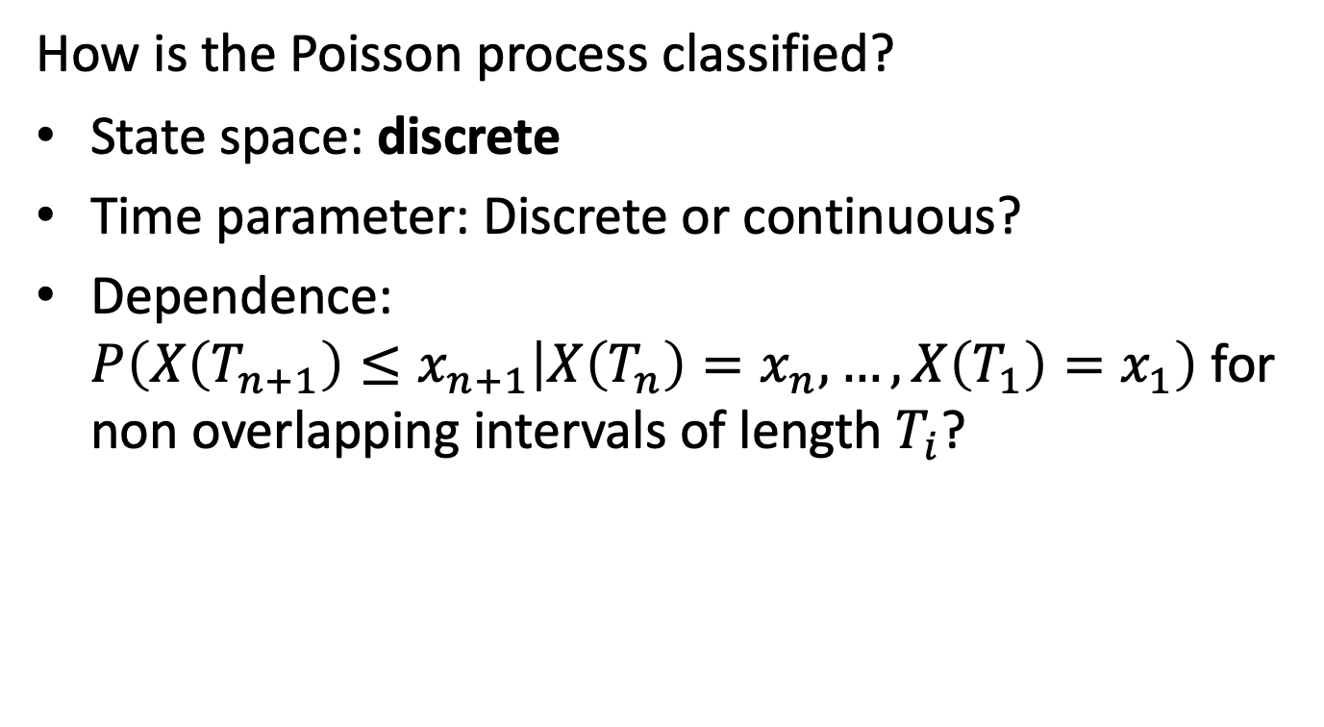
Poisson Arrival Process
How is the Poisson process classified?
State space: discrete
Time parameter: Discrete or continuous?
Dependence: $P\left(X\left(T_{n+1}\right)≤x_{n+1} | X\left(T_{n}\right)=x_{n},…,X\left(T_{1}\right)=x_{1}\right)$ for non overlapping intervals of length $T_{i}$?

Slide 11
Examples
The Poisson distribution has a large number of important applications. Poisson random variables are a good approximation if there are many trials each with a small probability of resulting in a success, e.g.
the number of customers entering a grocery store in a given time interval T
the number of telephone calls that originate from a city in a given time interval T
the number of insured events that occur in a given time interval
the number of earthquakes that occur in a given time interval
…

Slide 12
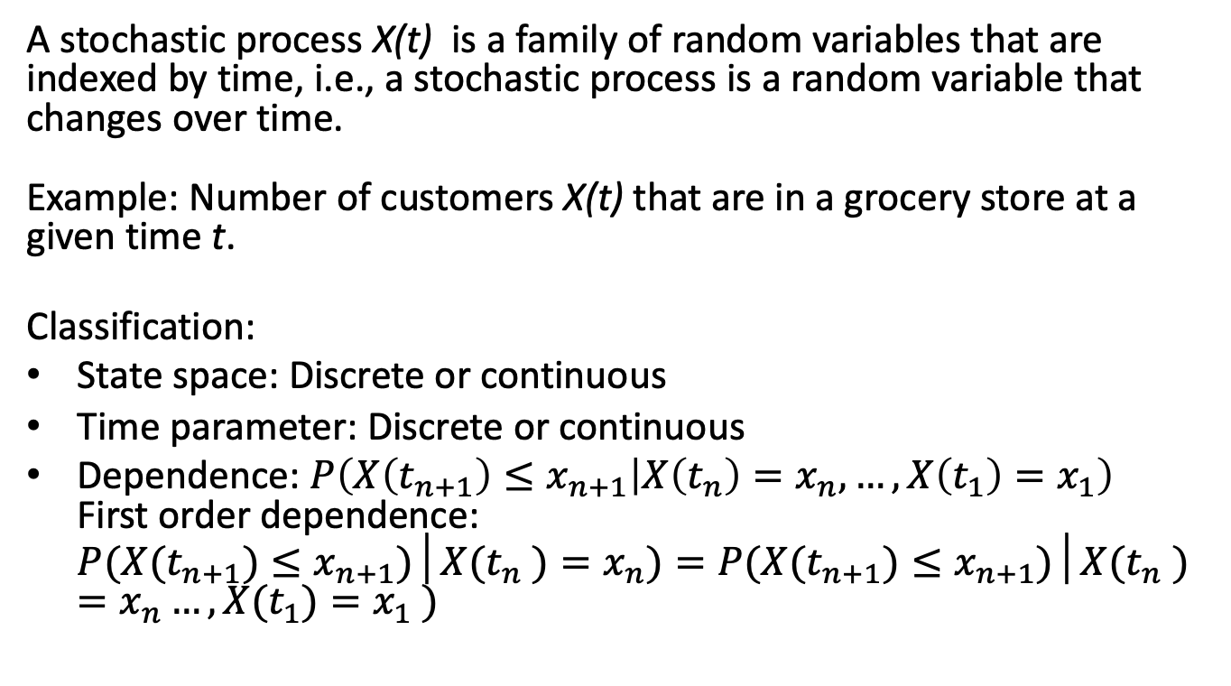
Again - Stochastic Process
A stochastic process X(t) is a family of random variables that are indexed by time, i.e., a stochastic process is a random variable that changes over time.
Example: Number of customers X(t) that are in a grocery store at a given time t.
Classification:
State space: Discrete or continuous
Time parameter: Discrete or continuous
Dependence: $P\left(X\left(t_{n+1}\right)≤x_{n+1} | X\left(t_{n}\right)=x_{n},…,X\left(t_{1}\right)=x_{1}\right)$
First order dependence:
$P(X(t_{n+1})≤x_{n+1})│X(t_{n} )=x_{n})=P(X(t_{n+1})≤x_{n+1})│X(t_{n} )=x_{n}…,X(t_{1})=x_{1} )$

Slide 13
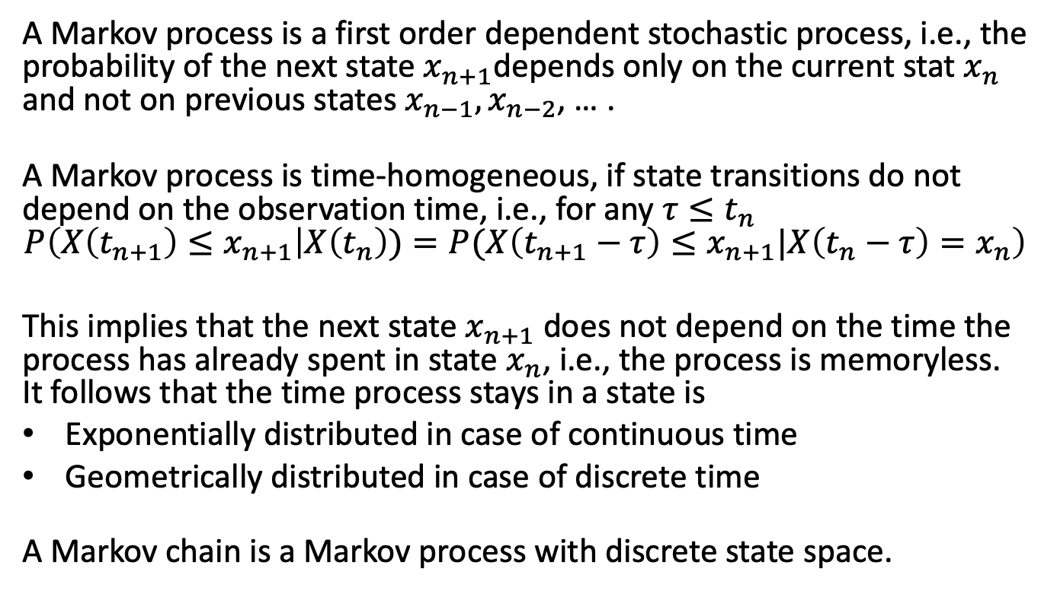
Markov Process
A Markov process is a first order dependent stochastic process, i.e., the probability of the next state $x_{n+1}$depends only on the current stat $x_{n}$ and not on previous states $x_{n−1},x_{n−2}$, … .
A Markov process is time-homogeneous, if state transitions do not depend on the observation time, i.e., for any $τ≤t_{n}$
$$P\left(X\left(t_{n+1}\right)≤x_{n+1} | X\left(t_{n}\right))=P{(X\left(t_{n+1}−τ\right)≤x}_{n+1}|X\left(t_{n}−τ\right)=x_{n}\right)$$
This implies that the next state $x_{n+1}$ does not depend on the time the process has already spent in state $x_{n}$, i.e., the process is memoryless. It follows that the time process stays in a state is
Exponentially distributed in case of continuous time
Geometrically distributed in case of discrete time
A Markov chain is a Markov process with discrete state space.

Slide 14
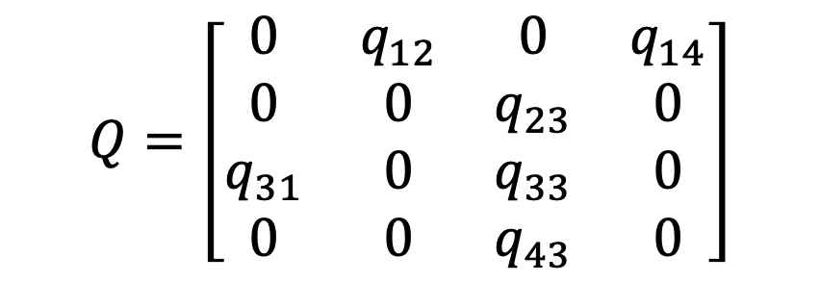
Space Diagram
A discrete time Markov chain:
$$Q=\left[\begin{matrix}0 & q_{12} & 0 & q_{14} \\ 0 & 0 & q_{23} & 0 \\ q_{31} & 0 & q_{33} & 0 \\ 0 & 0 & q_{43} & 0\end{matrix}\right]$$
State space diagram
Transition matrix

Slide 15
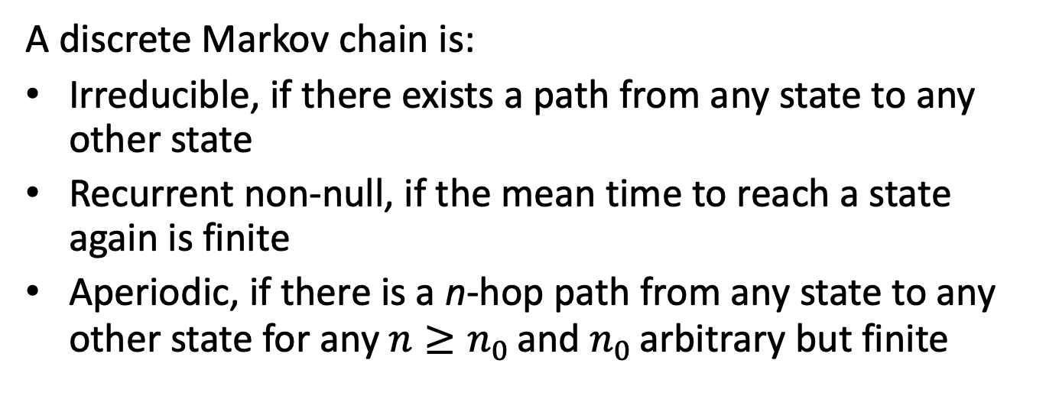
Properties of Markov Chains
A discrete Markov chain is:
Irreducible, if there exists a path from any state to any other state
Recurrent non-null, if the mean time to reach a state again is finite
Aperiodic, if there is a n-hop path from any state to any other state for any $n≥n_{0 }$and $n_{0 }$arbitrary but finite

Slide 16
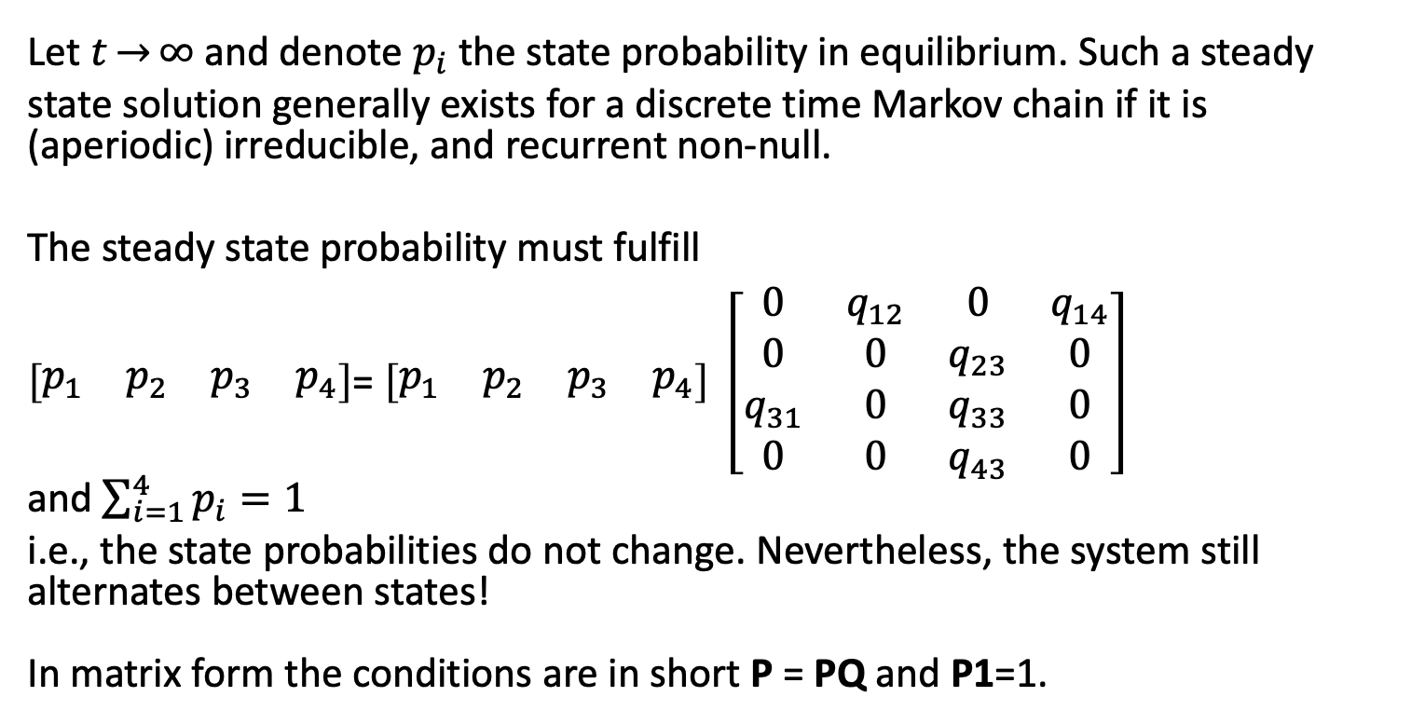
Steady State probabilities
Let $t\overset{→}{}∞$ and denote $p_{i}$ the state probability in equilibrium. Such a steady state solution generally exists for a discrete time Markov chain if it is (aperiodic) irreducible, and recurrent non-null.
The steady state probability must fulfill
$\left[\begin{matrix}p_{1} & p_{2} & p_{3} & p_{4}\end{matrix}\right]$= $\left[\begin{matrix}p_{1} & p_{2} & p_{3} & p_{4}\end{matrix}\right] \left[\begin{matrix}0 & q_{12} & 0 & q_{14} \\ 0 & 0 & q_{23} & 0 \\ q_{31} & 0 & q_{33} & 0 \\ 0 & 0 & q_{43} & 0\end{matrix}\right]$
and $\sum_{i=1}^{4}{p_{i}=1}$
i.e., the state probabilities do not change. Nevertheless, the system still alternates between states!
In matrix form the conditions are in short P = PQ and P1=1.

Slide 17
How to Rank Webpages?
Web queries frequently return huge numbers of potentially relevant webpages. A criterion is required to postprocess results and sort webpages in descending order of significance.
The idea of Pagerank by S. Brin and L. Page is to use the information that is provided by authors through hyperlinks to estimate a ranking of webpages.
Hyperlinks:
That point to a webpage increase the rank of a page
That originate from highly ranked pages weigh higher

Slide 18
Random Surfer Model
The Pagerank algorithm has an intuitive interpretation, the so-called random surfer model.
A person surfs the WWW in a random fashion. Starting from some initial webpage at each time instance the surfer randomly with uniform probability follows one of the hyperlinks on the currently visited webpage.
The Pagerank of a webpage is the probability that the random surfer visits the webpage at a given time instance.
The random surfer model is a first-order dependent random process. It
is a Markov chain with discrete time and discrete state space, where states are webpages (the current state is the currently visited webpage) and transitions are hyperlinks.

Slide 19
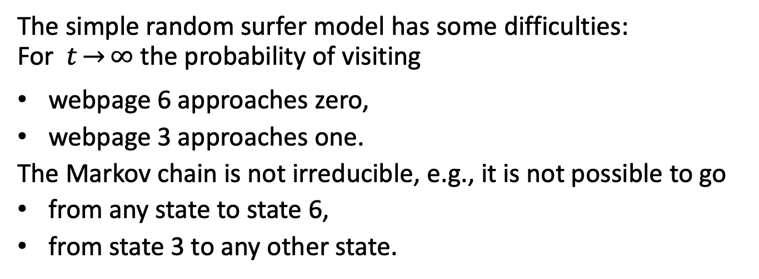
Example WWW Markov Model (1/2)
Markov model of a small WWW with numbered webpages
The simple random surfer model has some difficulties: For $t\overset{→}{}∞$ the probability of visiting
webpage 6 approaches zero,
webpage 3 approaches one.
The Markov chain is not irreducible, e.g., it is not possible to go
from any state to state 6,
from state 3 to any other state.

Slide 20
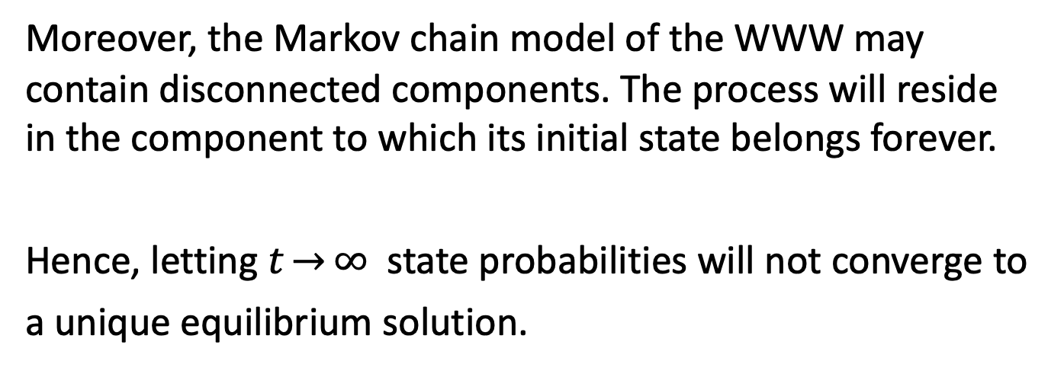
Example WWW Markov Model (2/2)
Markov model of a small WWW with numbered webpages
Moreover, the Markov chain model of the WWW may contain disconnected components. The process will reside in the component to which its initial state belongs forever.
Hence, letting $t\overset{→}{}∞$ state probabilities will not converge to a unique equilibrium solution.

Slide 21
Random Server Model Extension
Consider a WWW consisting of N webpages. At each time instance the surfer makes an additional random decision:
with probability d the surfer randomly follows one of the current webpage’s hyperlinks,
with probability 1−d he randomly selects one of the N webpages with uniform probability,
and if the current webpage does not have any outgoing hyperlinks:
the surfer randomly selects one of the N webpages with uniform probability.

Slide 22
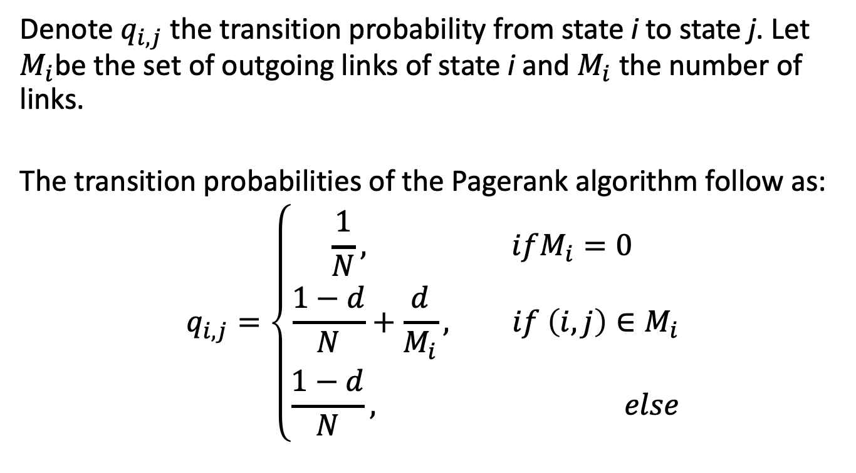
Transition Probabilities (1/2)
Denote $q_{i,j}$ the transition probability from state i to state j. Let $M_{i}$be the set of outgoing links of state i and $M_{i}$ the number of links.
The transition probabilities of the Pagerank algorithm follow as:
$$q_{i,j}=\left\{\begin{aligned}\frac{1}{N}, ifM_{i}=0 \\ \frac{1−d}{N}+\frac{d}{M_{i}}, if \left(i,j\right)∈M_{i} \\ \frac{1−d}{N}, else\end{aligned}\right.$$

Slide 23
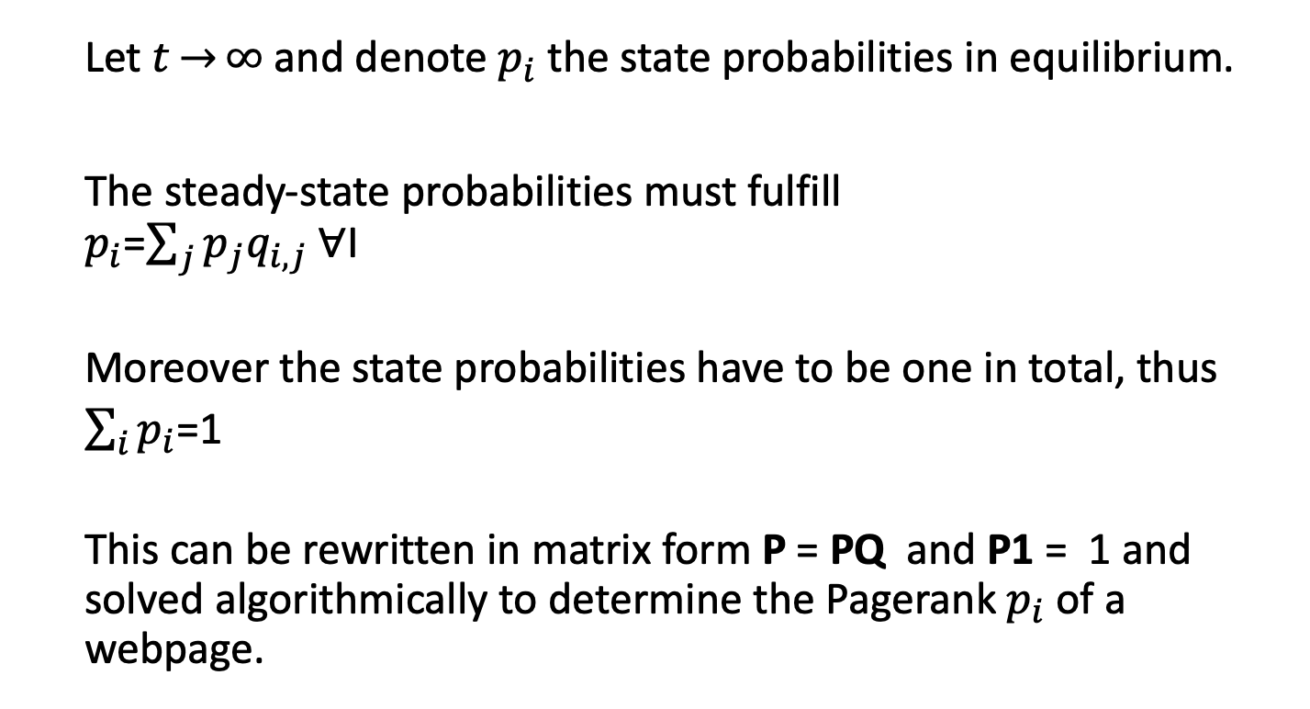
Transition Probabilities (2/2)
Let $t\overset{→}{}∞$ and denote $p_{i}$ the state probabilities in equilibrium.
The steady-state probabilities must fulfill
$p_{i}$=$\sum_{j}{p_{j}q_{i,j} ∀}$I
Moreover the state probabilities have to be one in total, thus
$\sum_{i}{p_{i}}$=1
This can be rewritten in matrix form P = PQ and P1 = 1 and solved algorithmically to determine the Pagerank $p_{i}$of a webpage.

Slide 24
Birth-death Process (1/2)
Birth-death processes are used in biology, e.g., to determine the probability that a population becomes extinct.
A birth-death process is a homogeneous Markov process where state transitions can happen only between neighboring states.
If the state space is the set of integers then if the current state is k the next state can only be state k − 1, k , or k + 1.
The transition from k to
k + 1 is called a birth
k − 1 is called a death
and k is the current size of the population.

Slide 25
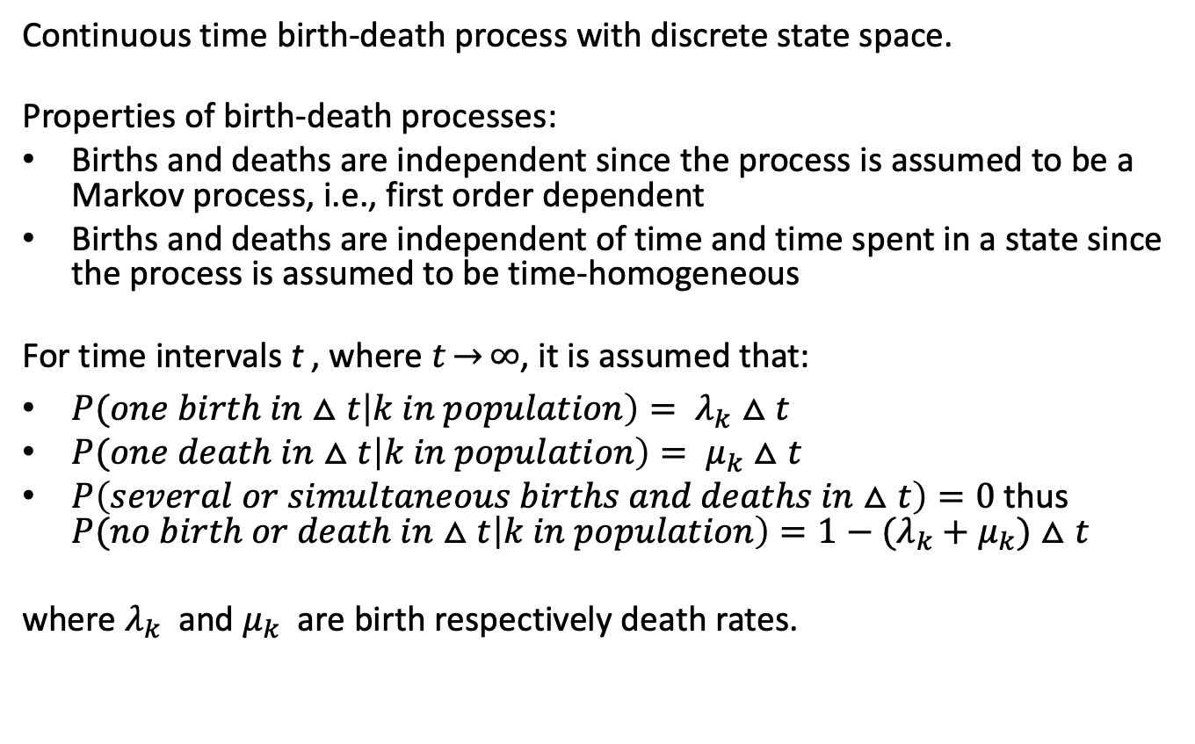
Birth-death Process (2/2)
Continuous time birth-death process with discrete state space.
Properties of birth-death processes:
Births and deaths are independent since the process is assumed to be a Markov process, i.e., first order dependent
Births and deaths are independent of time and time spent in a state since the process is assumed to be time-homogeneous
For time intervals t , where $t\overset{→}{}∞$, it is assumed that:
$P(one birth in$ $△t\left|k in population\right)= λ_{k}△t$
$P(one death in$ $△t\left|k in population\right)= μ_{k}△t$
$P\left(several or simultaneous births and deaths in△t\right)=0$ thus
$P(no birth or death in$ $△t\left|k in population\right)=1−({λ_{k}+μ}_{k})△t$
where $λ_{k}$and $μ_{k}$ are birth respectively death rates.

Slide 26
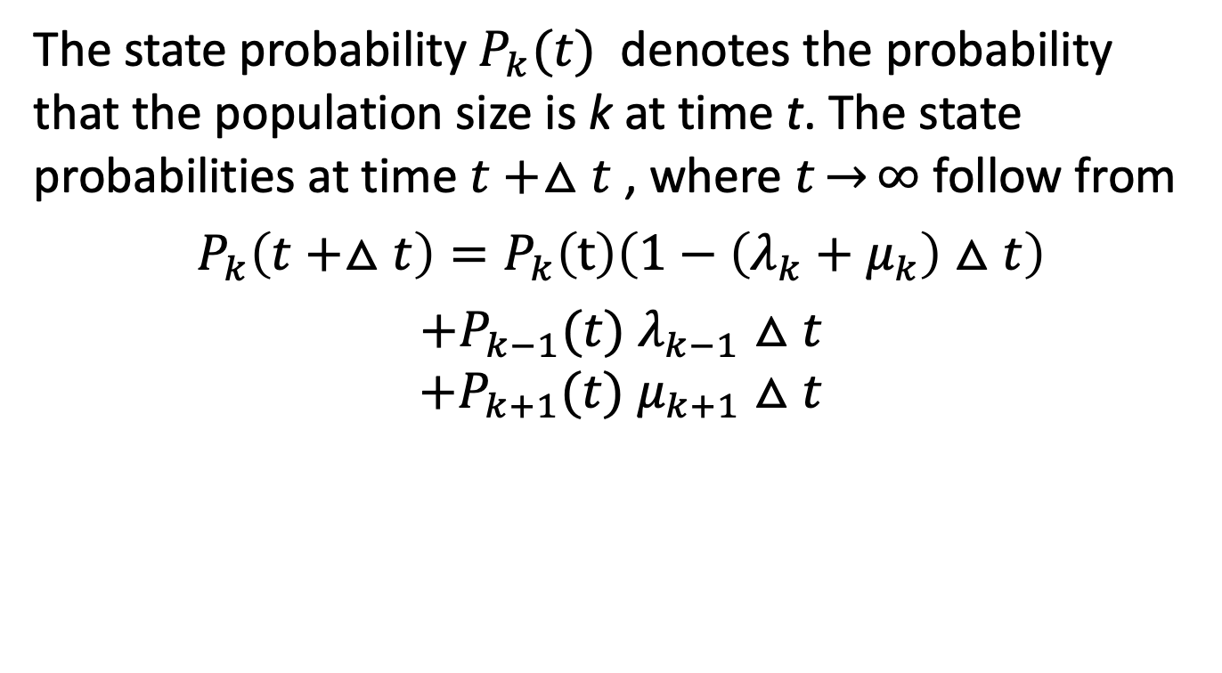
State Probabilities
The state probability $P_{k}(t)$ denotes the probability that the population size is k at time t. The state probabilities at time $t+△t$ , where $t\overset{→}{}∞$ follow from
$$P_{k}\left(t+△t\right)=P_{k}\left(t\right)\left(1−\left({λ_{k}+μ}_{k}\right)△t\right)$$
$+P_{k−1}(t)$ $λ_{k−1}$ $△t$
$${+P}_{k+1}(t) μ_{k+1}△t$$
no birth nor death
one birth
one death

Slide 27
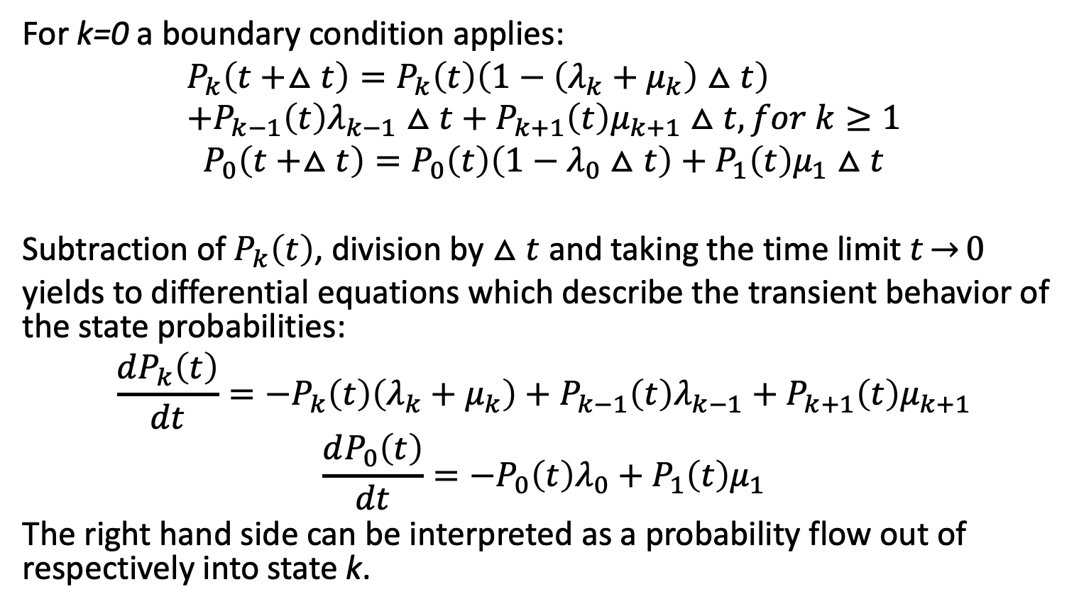
Transient Behavior
For k=0 a boundary condition applies:
$$P_{k}\left(t+△t\right)=P_{k}\left(t\right)\left(1−\left(λ_{k}+μ_{k}\right)△t\right) \\ +P_{k−1}\left(t\right)λ_{k−1}△t+P_{k+1}\left(t\right)μ_{k+1}△t, for k≥1$$
$$P_{0}\left(t+△t\right)=P_{0}\left(t\right)\left(1−λ_{0}△t\right)+P_{1}\left(t\right)μ_{1}△t$$
Subtraction of $P_{k}\left(t\right)$, division by $△t$ and taking the time limit $t\overset{→}{}0$ yields to differential equations which describe the transient behavior of the state probabilities:
$$\frac{dP_{k}\left(t\right)}{dt}=−P_{k}\left(t\right)\left(λ_{k}+μ_{k}\right)+P_{k−1}\left(t\right)λ_{k−1}+P_{k+1}\left(t\right)μ_{k+1}$$
$$\frac{dP_{0}\left(t\right)}{dt}=−P_{0}\left(t\right)λ_{0}+P_{1}\left(t\right)μ_{1}$$
The right hand side can be interpreted as a probability flow out of respectively into state k.

Slide 28
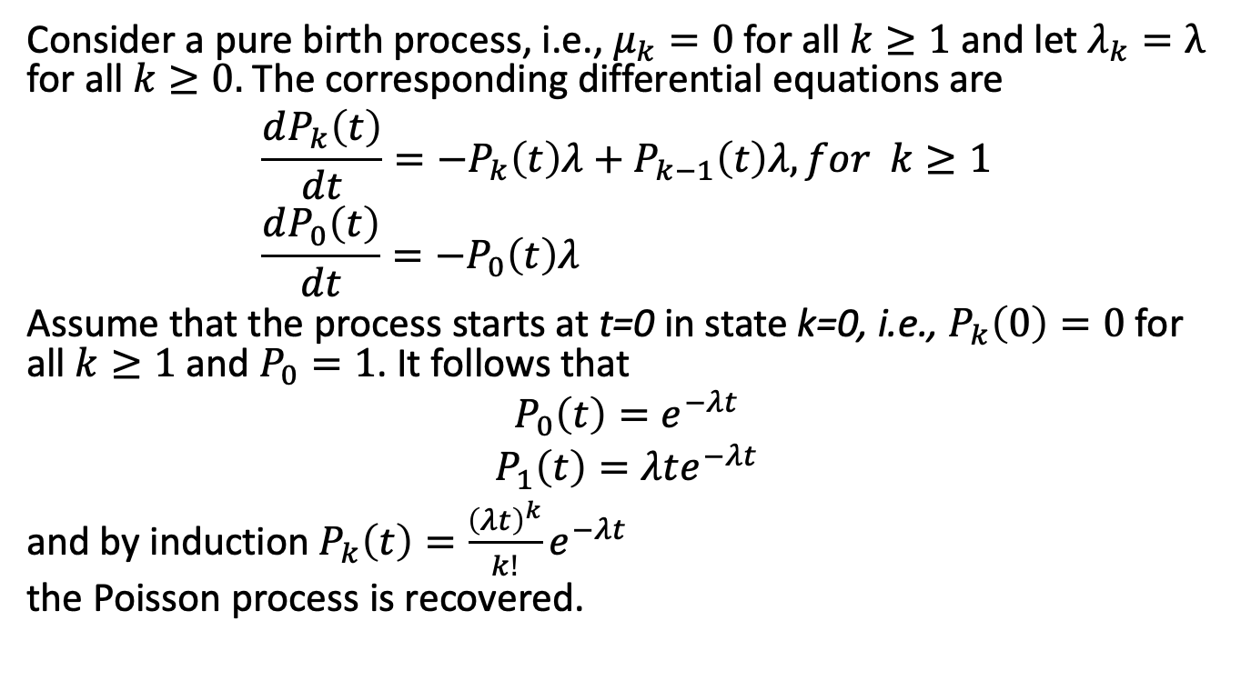
Poisson Process
Consider a pure birth process, i.e., $μ_{k}=0$ for all $k≥1$ and let $λ_{k}=λ$ for all $k≥0.$ The corresponding differential equations are
$$\frac{dP_{k}\left(t\right)}{dt}=−P_{k}\left(t\right)λ+P_{k−1}\left(t\right)λ, for k≥1 \\ \frac{dP_{0}\left(t\right)}{dt}=−P_{0}\left(t\right)λ_{}$$
Assume that the process starts at t=0 in state k=0, i.e., $P_{k}\left(0\right)=0$ for all $k≥1$ and $P_{0}=1$. It follows that
$$P_{0}\left(t\right)=e^{−λt}$$
$$P_{1}\left(t\right)=λte^{−λt}$$
and by induction $P_{k}\left(t\right)=\frac{{\left(λt\right)}^{k}}{k!}e^{−λt}$
the Poisson process is recovered.

Slide 29
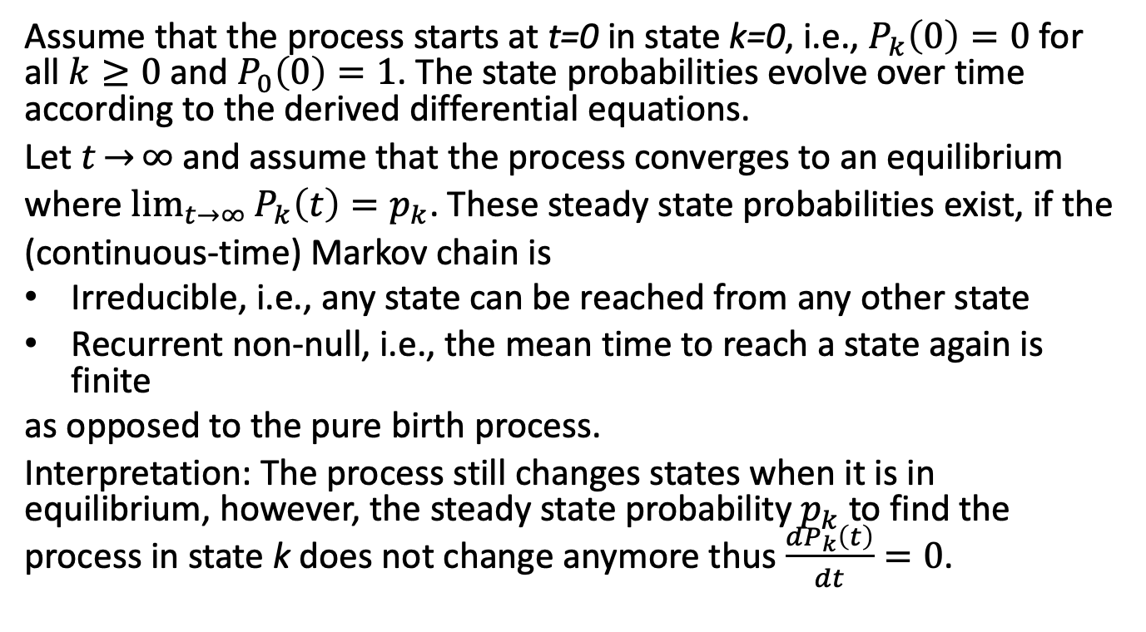
Equilibrium Solution
Assume that the process starts at t=0 in state k=0, i.e., $P_{k}\left(0\right)=0$ for all $k≥0$ and $P_{0}\left(0\right)=1$. The state probabilities evolve over time according to the derived differential equations.
Let $t\overset{→}{}∞$ and assume that the process converges to an equilibrium where $\lim_{t\overset{→}{}∞}{P_{k}\left(t\right)=p_{k}}$. These steady state probabilities exist, if the (continuous-time) Markov chain is
Irreducible, i.e., any state can be reached from any other state
Recurrent non-null, i.e., the mean time to reach a state again is finite
as opposed to the pure birth process.
Interpretation: The process still changes states when it is in equilibrium, however, the steady state probability $p_{k}$ to find the process in state k does not change anymore thus $\frac{dP_{k}\left(t\right)}{dt}=0$.

Slide 30
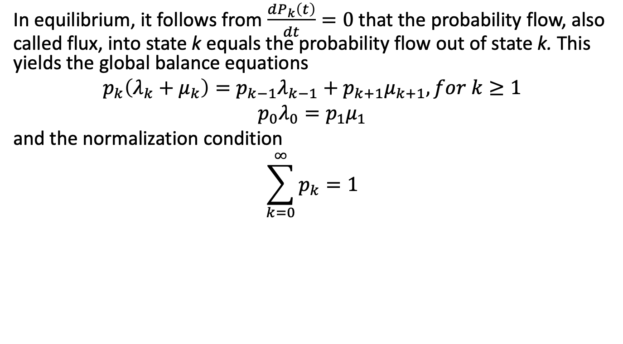
Balance Equations (1/2)
In equilibrium, it follows from $\frac{dP_{k}\left(t\right)}{dt}=0$ that the probability flow, also called flux, into state k equals the probability flow out of state k. This yields the global balance equations
$$p_{k}\left(λ_{k}+μ_{k}\right)=p_{k−1}λ_{k−1}+p_{k+1}μ_{k+1}, for k≥1$$
$$p_{0}λ_{0}=p_{1}μ_{1}$$
and the normalization condition
$$\sum_{k=0}^{∞}{p_{k}=1}$$

Slide 31
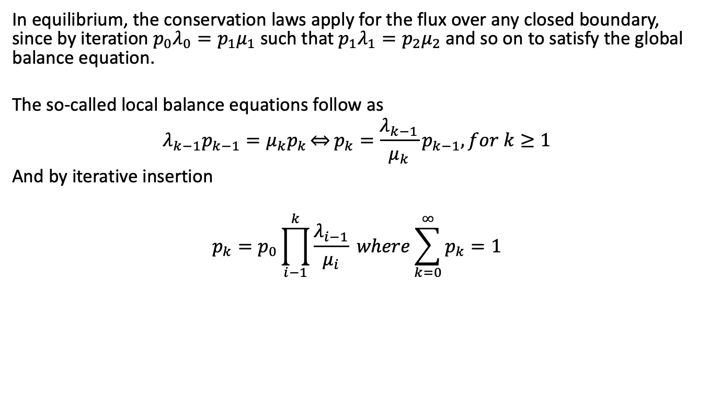
Balance Equations (2/2)
In equilibrium, the conservation laws apply for the flux over any closed boundary, since by iteration $p_{0}λ_{0}=p_{1}μ_{1}$ such that $p_{1}λ_{1}=p_{2}μ_{2}$ and so on to satisfy the global balance equation.
The so-called local balance equations follow as
$$λ_{k−1}p_{k−1}=μ_{k}p_{k}\overset{⇔}{}p_{k}=\frac{λ_{k−1}}{μ_{k}}p_{k−1}, for k≥1$$
And by iterative insertion
$$p_{k}=p_{0}\prod_{i−1}^{k}{\frac{λ_{i−1}}{μ_{i}} where}\sum_{k=0}^{∞}{p_{k}=1}$$

