Slide 1
ECE 671 – Lectures 20 and 21
Network security
Cryptographic Principles

Slide 2
Security in networks
Where do we need … ?
  Confidentiality
  Integrity and non-repudiation
  Authentication
How to achieve … ?
  Confidentiality
  Integrity and non-repudiation
  Authentication

Slide 3
Confidentiality
Encryption of information
How to do encryption?
Kerckhoffs’ principle
  System should remain secure if everything is known
  (except secret key)
  Variation: security should not be based on obfuscation

Slide 4



Language of Cryptography
Alice’s
encryption
key
Bob’s
decryption
key
K
K
A
B
plaintext
encryption
algorithm
ciphertext
decryption
algorithm
plaintext
m plaintext message
K_{A}(m) ciphertext, encrypted with key K_{A}
m = K_{B}(K_{A}(m))

Slide 5
Simple Encryption Scheme
substitution cipher: substituting one thing for another
  monoalphabetic cipher: substitute one letter for another
plaintext: abcdefghijklmnopqrstuvwxyz
ciphertext: mnbvcxzasdfghjklpoiuytrewq
E.g.:
Plaintext: bob. i love you. alice
ciphertext: nkn. s gktc wky. mgsbc
Key: the mapping from the set of 26 letters to the
set of 26 letters

Slide 6
Polyalphabetic Encryption
n monoalphabetic ciphers, M1,M2,…,Mn
Cycling pattern:
  e.g., n=4, M1,M3,M4,M3,M2; M1,M3,M4,M3,M2;
For each new plaintext symbol, use subsequent monoalphabetic pattern in cyclic pattern
  dog: d from M1, o from M3, g from M4
Key: the n ciphers and the cyclic pattern

Slide 7
Breaking Encryption Scheme
Cipher-text only attack: Trudy has ciphertext that she can analyze
Two approaches:
  Search through all keys: must be able to differentiate resulting plaintext from gibberish
  Statistical analysis
Known-plaintext attack: Trudy has some plaintext corresponding to some ciphertext
  e.g., in monoalphabetic cipher, Trudy determines pairings for a,l,i,c,e,b,o,
Chosen-plaintext attack: Trudy can get the ciphertext for some chosen plaintext

Slide 8
Types of Cryptography
Crypto often uses keys:
  Algorithm is known to everyone
  Only “keys” are secret
Public key cryptography
  Involves the use of two keys
Symmetric key cryptography
  Involves the use one key
Hash functions
  Involves the use of no keys
  Nothing secret: How can this be useful?

Slide 9
Symmetric Key
K
K
S
S
plaintext
message, m
encryption
algorithm
ciphertext
decryption
algorithm
plaintext
K (m)
m = K_{S}(K_{S}(m))
S
symmetric key crypto: Bob and Alice share same (symmetric) key: K
e.g., key is knowing substitution pattern in mono alphabetic substitution cipher
Q: how do Bob and Alice agree on key value?
S

Slide 10
Public Key Cryptography
symmetric key crypto
requires sender, receiver know shared secret key
Q: how to agree on key in first place (particularly if never “met”)?
public key cryptography
radically different approach [Diffie-Hellman76, RSA78]
sender, receiver do not share secret key
public encryption key known to all
private decryption key known only to receiver

Slide 11
Public Key Cryptography
+
Bob’s public
key
K
B
-
Bob’s private
key
K
B
plaintext
message, m
encryption
algorithm
ciphertext
decryption
algorithm
plaintext
message
+
K (m)
-
+
B
m = K (K (m))
B
B

Slide 12
PKE Algorithm
Requirements:
.
.
1
+
-
need K ( ) and K ( ) such that
B
B
-
+
K (K (m)) = m
B
B
2
+
given public key K , it should be impossible to compute private key K
B
-
B
RSA: Rivest, Shamir, Adelson algorithm

Slide 13
Detour: Modular Arithmetic
x mod n = remainder of x when divide by n
Facts:
  [(a mod n) + (b mod n)] mod n = (a+b) mod n
  [(a mod n) - (b mod n)] mod n = (a-b) mod n
  [(a mod n) * (b mod n)] mod n = (a*b) mod n
Thus
(a mod n)^{d} mod n = a^{d} mod n
Example: x=14, n=10, d=2:
(x mod n)^{d} mod n = 4² mod 10 = 6
x^{d} = 14² = 196 x^{d} mod 10 = 6

Slide 14
RSA: Getting Ready
A message is a bit pattern.
A bit pattern can be uniquely represented by an integer number.
Thus encrypting a message is equivalent to encrypting a number.
Example:
m= 10010001 . This message is uniquely represented by the decimal number 145.
To encrypt m, we encrypt the corresponding number, which gives a new number (the ciphertext).

Slide 15
RSA: Creating Private/Public Key Pair
1. Choose two large prime numbers p, q.
(e.g., 1024 bits each)
2. Compute n = pq, z = (p-1)(q-1)
3. Choose e (with e<n) that has no common factors
with z. (e, z are “relatively prime”).
4. Choose d such that ed-1 is exactly divisible by z.
(in other words: ed mod z = 1 ).
5. Public key is (n,e). Private key is (n,d).
+
-
K
K
B
B

Slide 16
RSA: Encryption/Decryption
0. Given (n,e) and (n,d) as computed above
1. To encrypt message m (<n), compute
e
c = m mod n
2. To decrypt received bit pattern, c, compute
d
m = c mod n
Magic
happens!
e
d
m = (m mod n)
mod n
c

Slide 17
RSA Example
Bob chooses p=5, q=7. Then n=35, z=24.
e=5 (so e, z relatively prime).
d=29 (so ed-1 exactly divisible by z).
Encrypting 8-bit messages.
m
e
e
bit pattern
m
c = m mod n
encrypt:
0000l000
12
24832
17
d
d
c
c
m = c mod n
decrypt:
17
481968572106750915091411825223071697
12

Slide 18
Why Does RSA Work?
Must show that c^{d} mod n = m
where c = m^{e} mod n
Fact: for any x and y: x^{y} mod n = x^{(y mod z)} mod n
  where n= pq and z = (p-1)(q-1)
Thus,
c^{d} mod n = (m^{e} mod n)^{d} mod n
= m^{ed} mod n
= m^{(ed mod z)} mod n
= m¹ mod n
= m

Slide 19
RSA: Another Important Feature
The following property will be very useful later:
-
+
+
-
K (K (m)) = m
=
K (K (m))
B
B
B
B
use public key first, followed by private key
use private key first, followed by public key
Result is the same!

Slide 20
Why is RSA Secure?
suppose you know Bob’s public key (n,e). How hard is it to determine d?
essentially need to find factors of n without knowing the two factors p and q.
fact: factoring a big number is hard.
Generation RSA Keys
have to find big primes p and q
approach: make good guess then apply testing rules

Slide 21
Digital Signatures
Alice verifies signature and integrity of digitally signed message:
Bob sends digitally signed message:
large
message
m
H: Hash
function
encrypted
msg digest
H(m)
-
K_{B}(H(m))
Bob’s
private
key
digital
signature
(encrypt)
large
message
m
-
Bob’s
public
key
digital
signature
(decrypt)
K
B
+
H: Hash
function
K
encrypted
msg digest
B
+
-
K_{B}(H(m))
H(m)
H(m)
equal
?

Slide 22
Digital Signatures
-
suppose Alice receives msg m, digital signature K_{B}(m)
Alice verifies m signed by Bob by applying Bob’s public key K_{B} to K_{B}(m) then checks K_{B}(K_{B}(m) ) = m.
if K_{B}(K_{B}(m) ) = m, whoever signed m must have used Bob’s private key.
+
-
+
-
-
+
Alice thus verifies that:
  Bob signed m.
  no one else signed m.
  Bob signed m and not m’.
Non-repudiation:
  Alice can take m, and signature K_{B}(m) to court and prove that Bob signed m.
-

Slide 23
Public Key Certification
motivation: Trudy plays pizza prank on Bob
  Trudy creates e-mail order:
  Dear Pizza Store, Please deliver to me four pepperoni pizzas. Thank you, Bob
  Trudy signs order with her private key
  Trudy sends order to Pizza Store
  Trudy sends to Pizza Store her public key, but says it’s Bob’s public key.
  Pizza Store verifies signature; then delivers four pizzas to Bob.
  Bob doesn’t even like Pepperoni

Slide 24
Certification Authorities
Certification authority (CA): binds public key to particular entity, E.
E (person, router) registers its public key with CA.
  E provides “proof of identity” to CA.
  CA creates certificate binding E to its public key.
  certificate containing E’s public key digitally signed by CA – CA says “this is E’s public key”
Bob’s
public
key
digital
signature
(encrypt)
+
K
+
B
K
B
CA
private
key
certificate for Bob’s public key, signed by CA
Bob’s
identifying information
-
K
CA

Slide 25
Certification Authorities
when Alice wants Bob’s public key:
  gets Bob’s certificate (Bob or elsewhere).
  apply CA’s public key to Bob’s certificate, get Bob’s public key
+
digital
signature
(decrypt)
Bob’s
public
key
K
B
+
K
B
CA
public
key
+
K
CA

Slide 26
Certificates Summary
primary standard X.509 (RFC 2459)
certificate contains:
  issuer name
  entity name, address, domain name, etc.
  entity’s public key
  digital signature (signed with issuer’s private key)
Public-Key Infrastructure (PKI)
  certificates, certification authorities
  often considered “heavy”

Slide 27
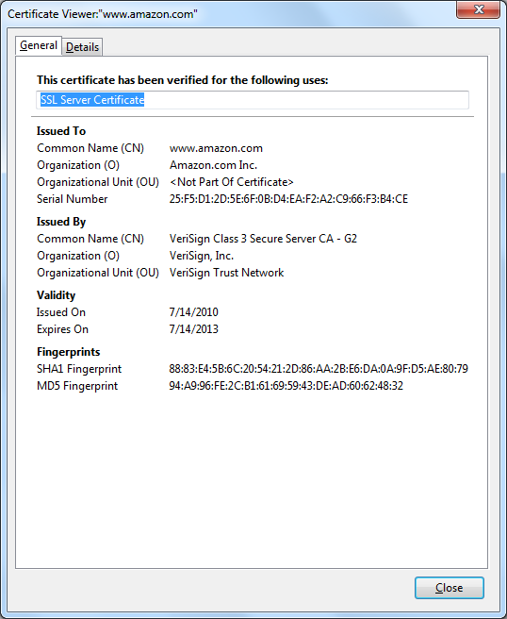
Certificate example
Multiple certificate
authorities
  E.g., VeriSign
Example VeriSign
certificate:

Slide 28
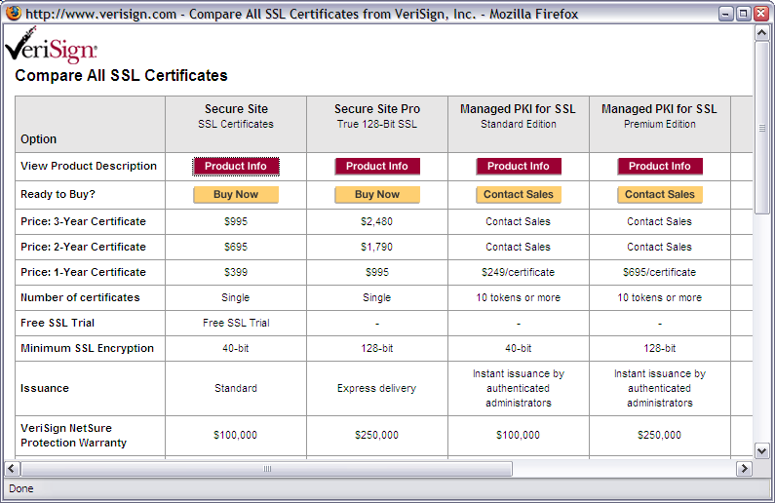
SSL certificates
Certification as a business:

Slide 29

Chain of trust
Chain of trust can go multiple levels
  Root certificates are final step
Private keys need to protected well
Security hardware:
  Tamper-proof
  On-board key generation
  On-board cryptographic engine
  E.g., IBM 4758 Cryptographic
  Coprocessor
Many modern computers have security module

Slide 30
Security in network protocols
Main focus: confidentiality
Protocols provide security at different layers:

Slide 31
Security in network protocols
IPSec provides security between network
TLS / SSL provides security between sockets
  Security between end-systems
  “Lock icon” in browser
  How to establish trust with new end-system?

