Slide 1
ECE 671 – Lecture 19
Network security Network attacks

Slide 2
Security issues in networks
What is security in context of networks?
What are potential attacks?
What can an attacker gain?

Slide 3
Security principles
Confidentiality
Content is hidden
Authentication
Source is verified
Message integrity and non-repudiation
Message is unchanged and undeniable
Availability and access control
Legitimate users should have access
Today: availability; next lecture: “CIA triad”

Slide 4
Attack types
Classification of attacks by target:

Slide 5
End system attacks
End-system intrusion
Exploit software vulnerabilities to gain access
Steal data or control system to launch attacks
Denial of service
Overwhelm system with traffic
Defenses
Firewalls
Intrusion detection systems

Slide 6
Control plane attacks
Mapping
Analysis of target domain (network topology, contact info) Tools: ping, traceroute, port scanners
Hijacking of connections
Eavesdrop on connection state
DoS attack on one side
Spoof towards other side
DNS attacks
DoS attack on root server

Slide 7
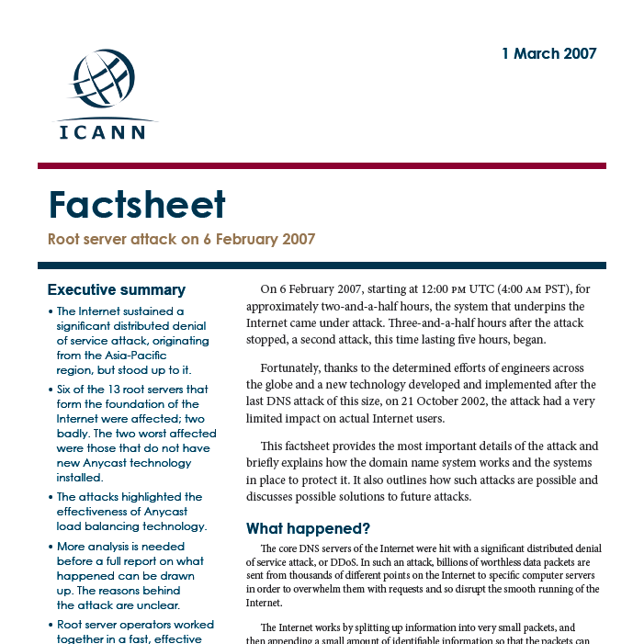
Control plane attacks

Slide 8
Data plane attacks
Packet sniffing
Ethernet interface in promiscuous mode
Spoofing
Forging of IP source address
Actual sender hard to identify
Denial of Service attacks
Use up network or end-system resources

Slide 9
Denial of Service attacks
Denial of service (DoS) attack
SYN flooding
TCP state exhaustion
Smurf attack
ICMP echo request converge on single host
Distributed DoS (DDoS) attacks
Large number of hosts attack single node
Much better scalability of attack
Often based on botnets

Slide 10
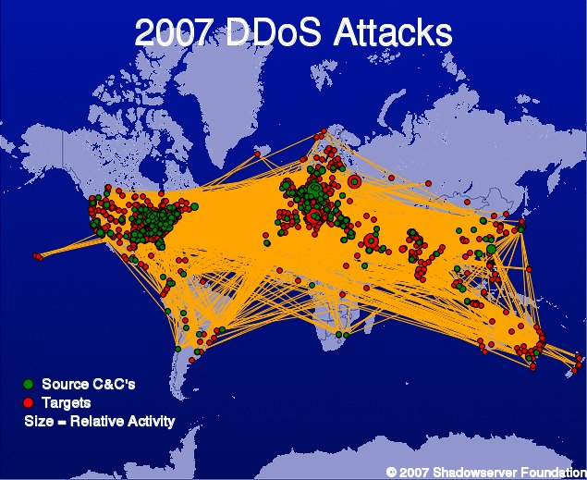
Botnets
Geographic distribution of botnets

Slide 11
DoS attack for economic gain
PC World: Web of Crime August 22, 2005

Slide 12
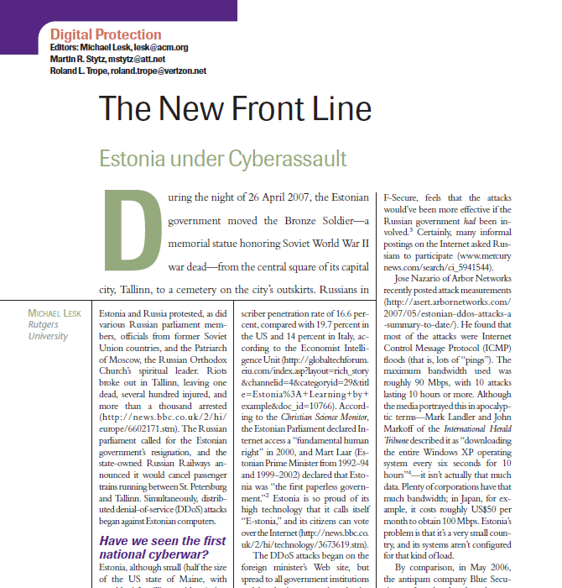
DoS attack as cyber warfare

Slide 14
Ransomware

Slide 15
Network attacks
Internet is based on “on-by-default” principle
Any node can send traffic to any other node
Open approach is good for cooperative environment
Difficult to deal with malicious users
Some network attacks can be solved with crypto
Confidentiality, integrity, authentication in protocols
Availability of resources still an open problem
New network architectures aim to address security at core

