Slide 1
ECE 671 – Lecture 15
MultiPath TCP
Material from http://multipath-tcp.org/

Slide 2
Motivation
Mobile, wireless clients
ECMP
Data Centers

Slide 3
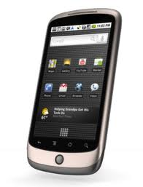
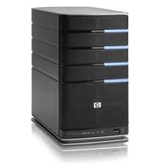
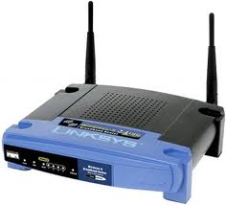
Traditional Wireless
3G celltower
IP 1.2.3.4

Slide 4
Traditional Wireless
3G celltower
IP 1.2.3.4
IP 5.6.7.8

Slide 5
Traditional Wireless
3G celltower
IP 1.2.3.4
IP 5.6.7.8
When IP addresses change TCP connections have to be re-established !

Slide 6
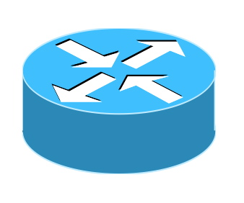
Equal Cost Multipath
Packets from one TCP connection (same 5-tupel) follow same path
Different flows might follow different paths
ECMP implementation
Packet arrival :
Hash(IP_{src}, IP_{dst}, Prot, Port_{src}, Port_{dst}) mod #oif
Notes:
ECMP – Equal Cost Multi-Path Routing

Slide 7
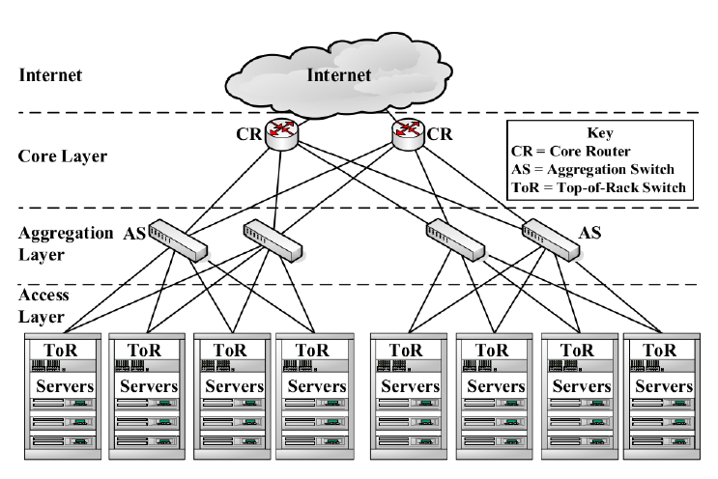
CLOS Data Center Network

Slide 8
Design Objectives
Evolution of TCP
Does not require modification of applications
Works in the current Internet
Works everywhere were regular TCP works!

Slide 9
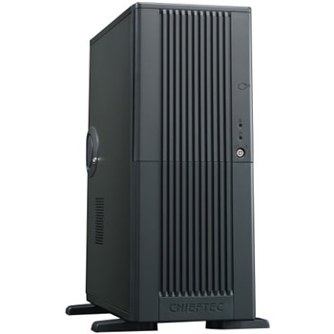
TCP Connection Establishment
Three-way handshake
SYN,seq=1234,Options
SYN+ACK,ack=1235,seq=5678,Options
ACK,seq=1235,ack=5679

Slide 10
Data Transfer
seq=1234,"abcd"
ACK,ack=1238,win=4
seq=1238,"efgh"
ACK,ack=1242,win=0

Slide 11
Connection Release
seq=1234,"abcd"
RST

Slide 12
Connection Release
seq=1234,"abcd"
FIN, seq=1238
ACK,ack=1239
seq=345,"ijkl"
FIN,seq=349
FIN,ack=350

Slide 13
Identification of TCP Connection
Four tuple
IP_{source}
IP_{dest}
Port_{source}
Port_{dest}
All TCP segments contain the four tuple
Ver IHL ToS
Total length
Identification
Flags Frag. Offset
IP
TTL Protocol
Checksum
Source IP address
Destination IP address
Source port
Destination port
Sequence number
Acknowledgment number
TCP
THL Reserved Flags
Window
Checksum
Urgent pointer
Options
Payload

Slide 14
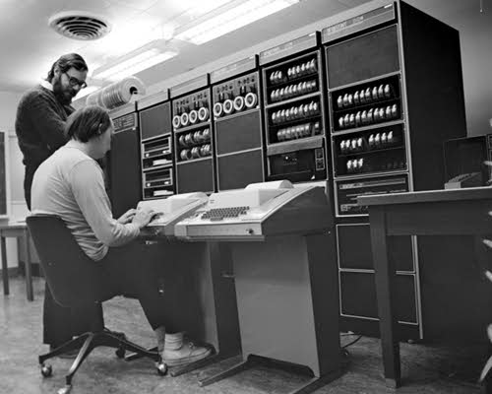
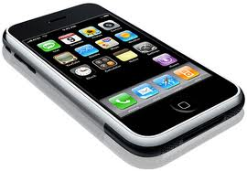
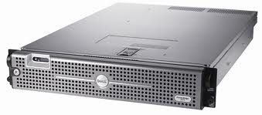
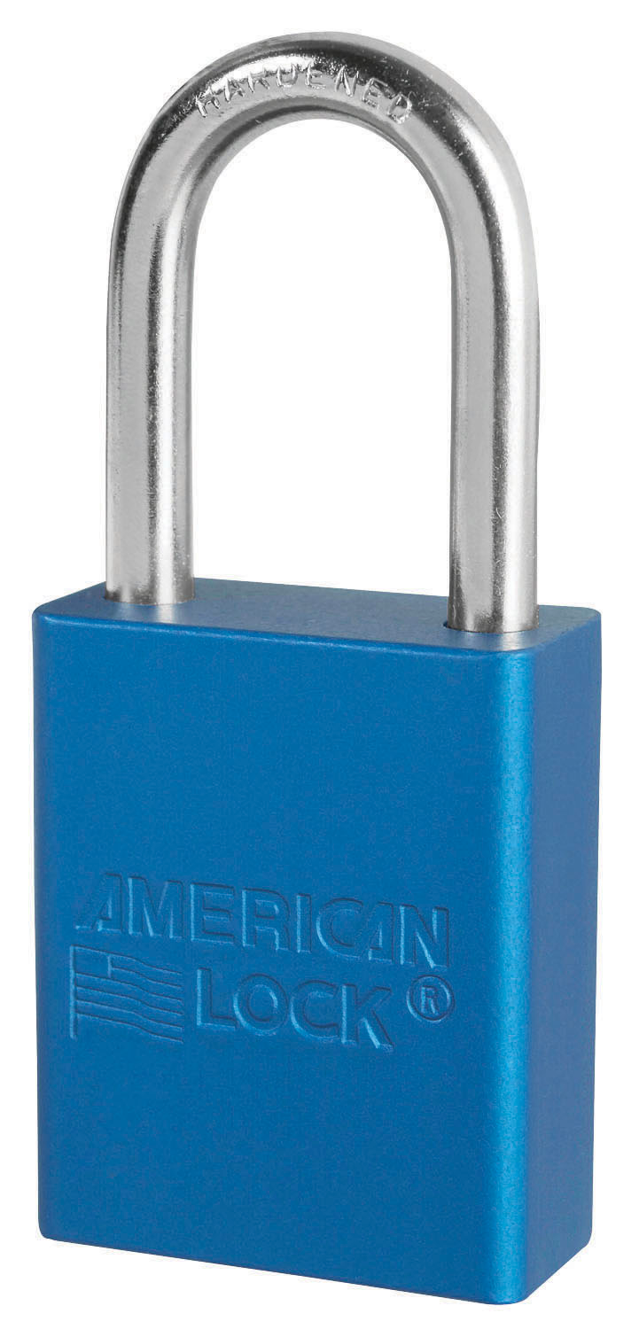
New Bytestream Model
Client
ABCDEF...111232
Server
0988989 ... XYZZ
D
C
B
A
IP:2.3.4.5
IP:6.7.8.9
IP:1.2.3.4
IP:4.5.6.7

Slide 15
MultiPath TCP Protocol
Control Plane
How to manage TCP connection that uses several paths?
Data Plane
How to transport data?
Congestion Control
How to perform congestion control over multiple paths?

Slide 16
MultiPath TCP Protocol
Control Plane
How to manage TCP connection that uses several paths?
Data Plane
How to transport data?
Congestion Control
How to perform congestion control over multiple paths?

Slide 17
A naïve Approach
SYN+ACK+Option
ACK
seq=123, "abc"
seq=126, "def"

Slide 18
Not Working!
SYN+Option
SYN+ACK+Option
ACK
seq=123, "abc"
There is no corresponding TCP connection
seq=126, "def"

Slide 19
Design Decisions
A multipath TCP connection is composed of one or more regular, combined TCP subflows
Host maintains state that glues TCP subflows that compose a TCP multipath connection together
Each TCP subflow is sent over a single path and appears like a regular TCP connection along this path

Slide 20
Multipath TCP Architecture
Application
socket
Application
Multipath TCP
Transport
TCP1
TCP2
TCPn
Network
...
Datalink
Physical
A. Ford, C. Raiciu, M. Handley, S. Barre, and J. Iyengar, “Architectural guidelines for multipath TCP development", RFC6182 2011.

Slide 21
Two Subflow Example
SYN+Option
SYN+ACK+Option
ACK
SYN+OtherOption
SYN+ACK+OtherOption
ACK

Slide 22
How to combine subflows?
SYN+Option
SYN+ACK+Option
ACK
SYN+OtherOption
How to link with
blue subflow ?
SYN+ACK+OtherOption
ACK

Slide 23
How to link subflows?
SYN, Port_{src}=1234,Port_{dst}=80+Option
SYN+ACK[...]
A NAT could change addresses and port numbers
ACK
SYN, Port_{src}=1235,Port_{dst}=80
+Option[link Port_{src}=1234,Port_{dst}=80]

Slide 24
How to link subflows?
SYN, Port_{src}=1234,Port_{dst}=80 +Option[Token=5678]
SYN+ACK+Option[Token=6543]
ACK
MyToken=5678
YourToken=6543
MyToken=6543
YourToken=5678
SYN, Port_{src}=1235,Port_{dst}=80
+Option[Token=6543]

Slide 25
Subflow Agility
Multipath TCP supports
Addition of subflows
Removal of subflows

Slide 26
TCP Subflows
Which subflows can be associated to a Multipath TCP connection ?
At least one of the elements of the four-tuple needs to differ between two subflows
Local IP address
Remote IP address
Local port
Remote port

Slide 27
MultiPath TCP Protocol
Control Plane
How to manage TCP connection that uses several paths?
Data Plane
How to transport data?
Congestion Control
How to perform congestion control over multiple paths?

Slide 28
How to Transfer Data?
seq=123,"a"
ack=124
seq=125,"c"
ack=126
seq=124,"b"
ack=125
seq=126,"d"
ack=127

Slide 29
In today’s Internet
seq=123,"a"
ack=124
seq=125,"c"
ack=126
Gap in sequence numbering space
Some DPI will not allow this !
seq=124,"b"
ack=125

Slide 30
Multipath Data Transfer
Two levels of sequence numbers
ABCDEF
socket
socket
Multipath TCP
Multipath TCP
Data sequence #
TCP1
TCP1 sequence #
TCP1
TCP2
TCP2 sequence #
TCP2

Slide 31
Multipath Data Transfer
Dseq=0,seq=123,"a"
DAck=1,ack=124
DSeq=2, seq=124,"c"
DAck=3, ack=125
DSeq=1, seq=456,"b"
DAck=2,ack=457

Slide 32
How to deal with losses?
Data losses over one TCP subflow
Fast retransmit and timeout as in regular TCP
Dseq=0,seq=123,"a"
DAck=1,ack=124
Dseq=0,seq=123,"a"
DAck=1,ack=124

Slide 33
Subflow failure
Dseq=0,seq=123,"a"
DSeq=1, seq=456,"b"
DSeq=0,ack=457
Dseq=0,seq=457,"a"
DAck=2,ack=458

Slide 34
Retransmission heuristics
Fast retransmit is performed on the same subflow as the original transmission
Upon timeout expiration, reevaluate whether the segment could be retransmitted over another subflow
Upon loss of a subflow, all the unacknowledged data are retransmitted on other subflows

Slide 35
Flow Control
How should the window-based flow control be performed ?
Independent windows on each TCP subflow
A single window that is shared among all TCP subflows

Slide 36
Independent Windows
Dseq=0,seq=123,"a"
DAck=1,ack=124,win=0
DSeq=1, seq=456,"b"
DAck=2,ack=457,win=100
Dseq=2,seq=457,"c"
DAck=3,ack=458,win=100

Slide 37
Independent Windows Problem
Dseq=0,seq=123,"a"
DSeq=1, seq=456,"b"
DAck=2,ack=457,win=0
Impossible to retransmit, window is already full on green subflow

Slide 38
Single window approach
Dseq=0,seq=123,"a"
DAck=1,ack=124,win=10
DSeq=1, seq=456,"b"
DAck=2,ack=457,win=10
Dseq=2,seq=457,"c"
DAck=3,ack=458,win=10

Slide 39
Middle box impact
Dseq=0,seq=123,"a"
DAck=1,ack=124,win=100
DSeq=1, seq=456,"b"
DAck=2,ack=457,win=100
DAck=2,ack=457,win=5

Slide 40
Multipath TCP Windows
Multipath TCP maintains one window per Multipath TCP connection
Window is relative to the last acked data (Data Ack)
Window is shared among all subflows
It's up to the implementation to decide how the window is shared
Window is transmitted inside the window field of the regular TCP header
If middleboxes change window field,
use largest window received at MPTCP-level
use received window over each subflow to cope with the flow control imposed by the middlebox

Slide 41
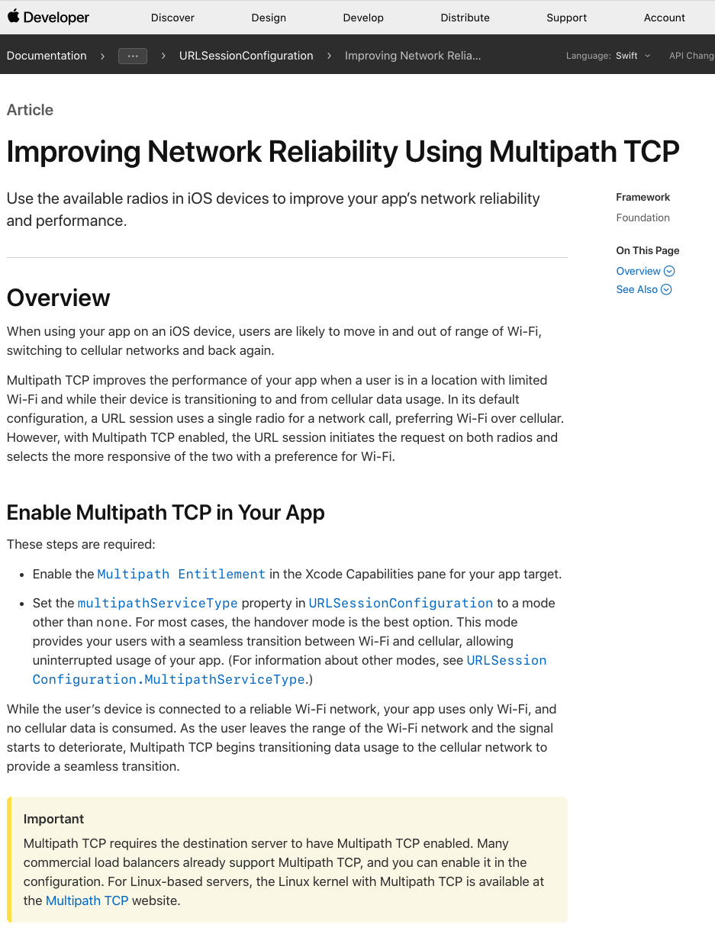
This is not fiction

Slide 42
Comparison with QUIC
HOL blocking
FEC
Middle boxes?

