Slide 1
ECE 671 – Lecture 12
Routers
Prefix lookup

Slide 2
Prefix lookups for packet forwarding
Match of IP destination address
with prefixes specified in FIB
  Longest matching prefix
Typical core router
  Hundreds of thousands of prefixes
  Millions of lookups per second
Efficient data structures and
algorithms essential for lookup

Slide 3
LPF Thoughts
Given N prefixes K_i of up to W bits, find the longest match with input K of W bits.
3 prefix notations: slash, mask, and wildcard. 192.255.255.255 /31 or 1*
N =1M (ISPs) or as small as 5000 (Enterprise). W can be 32 (IPv4), 64 (multicast), 128 (IPv6).
For IPv4, CIDR makes all prefix lengths from 8 to 28 common, density at 16 and 24

Slide 4
Example prefixes
Prefixes used for example data structures
How to find match for an address (e.g., 01001111)?

Slide 5
Binary tree
One bit per level
How to do lookup?

Slide 6
Binary tree
Lookup may require backtracking (or memory):
01001111

Slide 7
Leaf pushing
Disjoint prefix binary tree (01001111)
  All matches in leaf nodes

Slide 8
Path compression
Path-compressed binary tree
  Avoids long branches with
  only one node
  Annotation to determine
  which bit to compare
  Final node needs to be
  checked – otherwise
  backtracking

Slide 9
Tries
Check multiple bits per step

Slide 10
Content Addressable Memory (CAM)
Uses hardware to complete search in a single cycle
O(1)
Fast massively parallel lookup engine
Large power consumption due to large amount of comparison circuitry
Binary (0, 1) and Ternary (0, 1, X) CAMs. Latter most popular due to LPF.

Slide 11
TCAM Example
Line No. | Address (Binary) | Output Port
1 | 101XX | A
2 | 0110X | B
3 | 011XX | C
4 | 10011 | D
Lookup 01101.

Slide 12
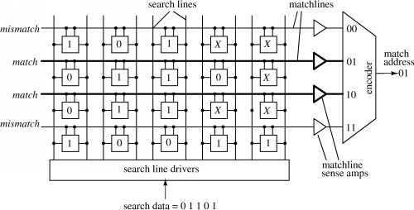
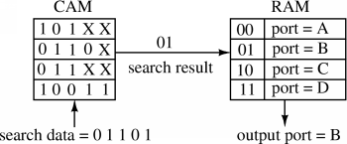
TCAM
https://www.pagiamtzis.com/cam/camintro/

Slide 13
Hardware implementation
Ternary content-addressable memory (TCAM)
  Parallel lookup across all entries
  ‘x’ indicates “don’t care”

Slide 14
Hardware implementation
TCAM operation

Slide 15
Prefix lookup issues
Performance concerns
  Lookups per second
  Memory requirements
  Power requirements
  Ability to handle updates
Lots of research in past years
  Many specialized solutions

Slide 16
Router wrap-up

Slide 17


