Slide 1
ECE 671 – Lecture 8
Network Adapters

Slide 2
Network adapters
Use in network system or end-systems
Implements layer 2 processing

Slide 3
Design challenges
Throughput preservation
Needs to sustain link data rate
Asynchronous operation
Asynchronous packet arrival
Variable packet size
Interface to processor
Avoid negative impact on processing performance

Slide 4
Basic network adapter
How does packet reception and processing work?

Slide 5
How to store a packet in memory?
What data structures are suitable for packet storage?

Slide 6
Packet buffer
Ring buffer:

Slide 7
Packet buffer
mbuf:

Slide 8
Performance estimation
Consider each step:
Task switch: t_{S}
Get address of free memory: t_{MM1}
Set up DMA controller: t_{DMA}
Transfer packet over bus: N/D*t_{B}
Append packet to queue: t_{MM2}
Time to next packet: t_{A}

Slide 9
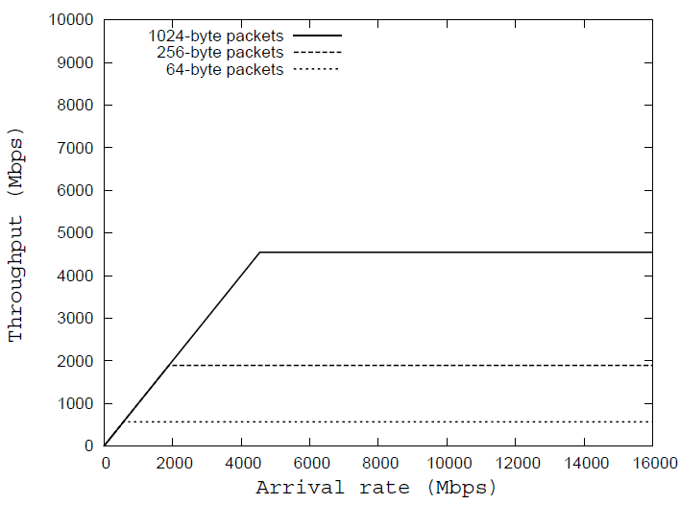
Throughput performance
Simulation of baseline adapter:

Slide 10
Memory management
MMU uses specialized hardware to manage memory
Enqueue/dequeue operations
Free lists
Local memory maintain information about main memory
MMU implements operations faster than software

Slide 11
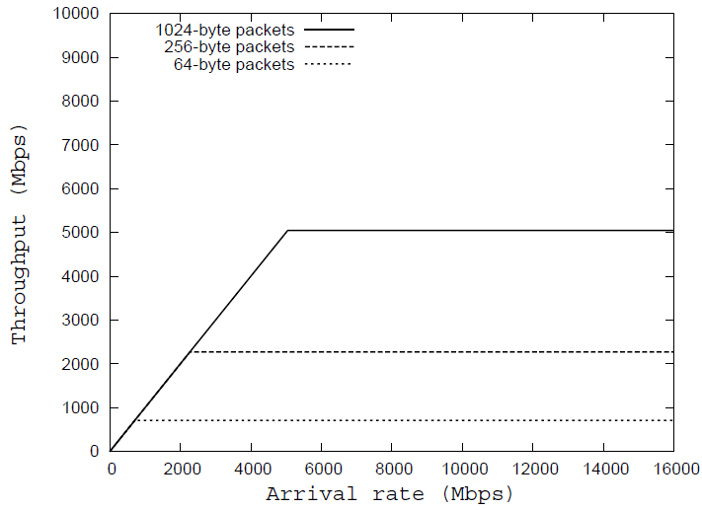
Throughput performance
Simulation of adapter with MMU:

Slide 12
Local memory for processor
Processor is idle during data transfers
Cannot access memory via bus
Local memory for processor for parallel operation
Pipelining of data transfers and processing

Slide 13
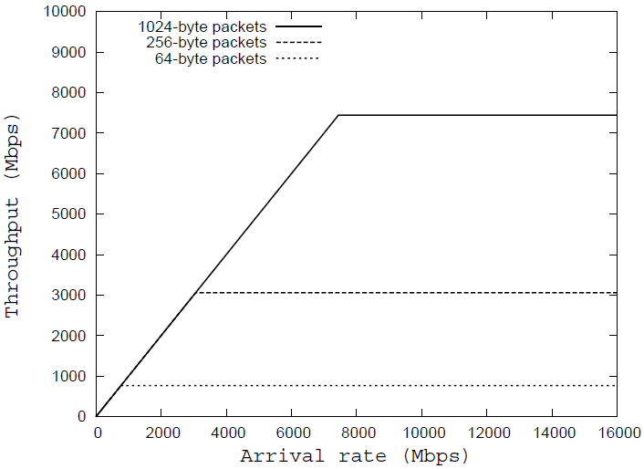
Throughput performance
Simulation of adapter with MMU and local memory:

Slide 14
Comparison
Baseline
MMU
MMU & local memory

Slide 15
Further improvements
Other techniques to improve throughput
Intelligent DMA (no processor setup required)
Multiprocessor configuration (parallel operation possible)
Multiple MMUs

Slide 16
Network adapters and OS
On end-system, protocol stack is implemented in OS
Network adapter implements Layer 2 processing
OS implements Layer 3-5/7 processing
How is asynchronous packet arrival handled?

Slide 17
TCP Segmentation Offload
TCP/IP
Large Segment
NIC
Segmentation & Checksum Offload
MTU-sized Ethernet Frames
17
Reduces load in OS by transferring processing to NIC
Segmentation performed at sending NIC
Re-assembly performed at receiving NIC

Slide 18
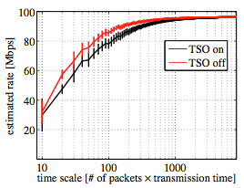
TCP Segmentation Offload
Issues when lot’s of short packets

