Slide 1
ECE 671 – Lecture 7
Interconnects and Switching Fabrics

Slide 2
Network systems
How to interconnect ports of the network system?

Slide 3
Interconnect designs
What are possible designs for an interconnect?
Need to get data from any input to any output

Slide 4
Interconnect designs
Shared bus
Shared memory
Crossbar
Multistage switching fabric
Scalability is important
Assume N ports with C bandwidth each
What is the speed requirement for each component?
In practice: 1xC to 2xC is reasonable, more is not feasibles

Slide 5
Scalability evaluation
Shared bus
Shared memory
Crossbar

Slide 6
Multistage switching fabric
Switching element
Two states: cross-over or straight
Very simple implementation
Switch fabric assembled from multiple switching elements:

Slide 7
Switching fabric topologies
Topologies determine properties
E.g., blocking probability, self-routing property, etc.
Delta network
Omega network

Slide 8
Contention in interconnects
Any traffic pattern should be handled
Focus on “permissible traffic load”
Over “long” term, each port receives and sends C
Short-term variation in traffic can lead to contention
Switching system needs to deal with contention
What are possible solutions

Slide 9
Queuing techniques
Input queuing

Slide 10
Queuing techniques
Output queuing

Slide 11
Queuing techniques
Virtual output queuing

Slide 12
Queuing techniques
Combined input-output queuing

Slide 13
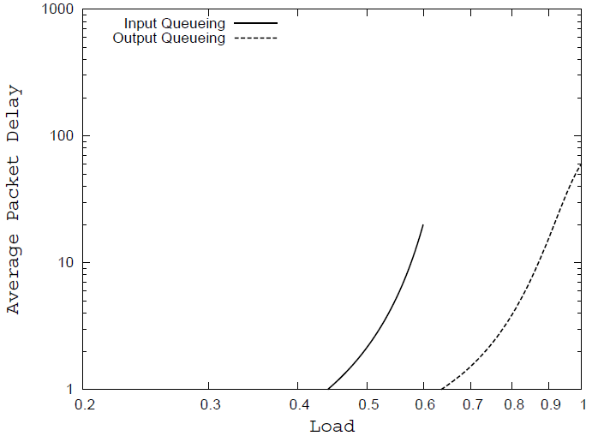
Queuing techniques
Input queuing
Head-of-line blocking
Theoretical throughput limit 58.6%
Output queuing
Requires speedup of N
Virtual output queuing
N² queues
VOQ and CIOQ require scheduling algorithm

Slide 14
Switch scheduling
Model of scheduling problem
Request matrix or bipartite graph
Goal: find match in graph

Slide 15
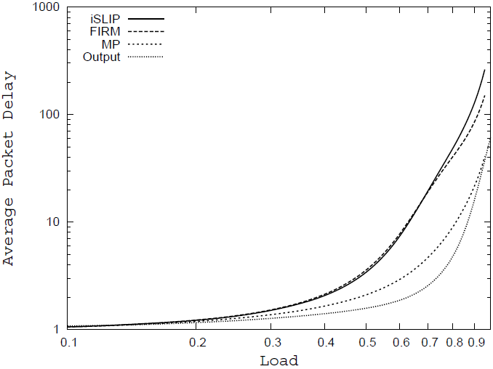
Switch scheduling
Goals for scheduler
High throughput
Low latency
Fairness
Low-cost implementation
Comparison
iSlip, FIRM, MP
Output queuing is optimum

