Slide 1
ECE 671 – Lecture 4
Review of Internet Protocols Transport Layer

Slide 2
Process-to-process communication
We have a network. How to get between programs?

Slide 3
Transport layer functionality
What functions should transport layer implement?

Slide 4
Multiplexing/demultiplexing
Multiple processes operate on one computer
Interface address alone is not sufficient to distinguish
Need to (de)multiplex traffic from different processes
5-tuple used for unique identification of connection
IP source address
IP destination address
Transport layer source port
Transport layer destination port
Transport layer protocol

Slide 5
UDP: bare bones protocol
Ports, length, checksum
Checksum is optional
Notes:
Why checksum?

Slide 6
5-tuple example
5-tuple is reversed for return communication
Destination port is associated with application layer protocol (e.g., 80 for HTTP)
Operating system picks source port randomly

Slide 7
What functionality does TCP provide?

Slide 8
What functionality does TCP provide?
Reliability
Recovery from errors in the network layer
Flow control
Limit transmission rate to not overwhelm receiver
Congestion control
Limit transmission rate to not overwhelm network

Slide 9
Reliable data transfer
How can reliability be achieved?

Slide 10
Reliable data transfer
How can reliability be achieved?
Consider different assumptions for network layer
Case 1: completely reliable network layer
Send segment
Case 2: bit errors in network layer
Add error detection and ACK/NAK
Add sequence number to handle garbled ACK/NAK
Case 3: bit errors and packet loss in network layer
Timer to trigger retransmission
“Stop-and-wait” protocol

Slide 11
Reliable data transfer
Stop-and-wait has low performance
How can we increase throughput?
Sliding window
Allow multiple segments “in-flight”

Slide 12
Sliding window example

Slide 13
TCP header
Port numbers
Sequence number
Position of data
ACK number
Next expected data
Checksum
Flags for connection setup and teardown

Slide 14
TCP CUBIC
Improve scalability of TCP over fast and long-distance networks
Modifies linear window growth function of existing TCP standards into cubic function
More equitable BW allocations among flows with different RTTs
Window growth independent of RTT
Default TCP algorithm in Linux

Slide 15
Standard TCP
BW underutilization in high-speed networks
Cannot fully utilize the huge capacity of high-speed networks!
NS-2 Simulation (100 sec)
Link Capacity = 155Mbps, 622Mbps, 2.5Gbps, 5Gbps, 10Gbps,
Drop-Tail Routers, 0.1BDP Buffer
5 TCP Connections, 100ms RTT, 1000-Byte Packet Size
15
Presentation: "Congestion Control on High-Speed Networks”, Injong Rhee, Lisong Xu

Slide 16
Standard TCP
TCP connection with 1250-Byte packet size and 100ms RTT over a 10Gbps link (no other connections, no buffers at routers)
1.4 hours
1.4 hours
1.4 hours
Packet loss
Packet loss
Packet loss
Packet loss
TCP
cwnd
100,000
10Gbps
50,000
Slow Increase
cwnd = cwnd + 1
Fast Decrease
cwnd = cwnd * 0.5
5Gbps
Slow start
Congestion avoidance
Time (RTT)
16
Presentation: "Congestion Control on High-Speed Networks”, Injong Rhee, Lisong Xu

Slide 17
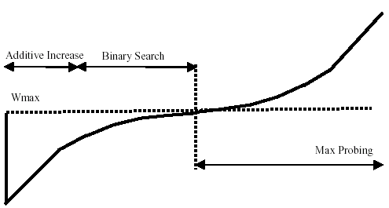
BIC
Scalability
RTT fairness
TCP friendliness
Fairness and convergence
Presentation: "Congestion Control on High-Speed Networks”, Injong Rhee, Lisong Xu

Slide 18
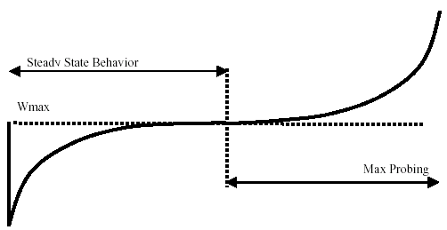


CUBIC - Intro
where C is a scaling factor, t is the elapsed time from the last window reduction, and β is a constant multiplication decrease factor
Presentation: "Congestion Control on High-Speed Networks”, Injong Rhee, Lisong Xu

Slide 19
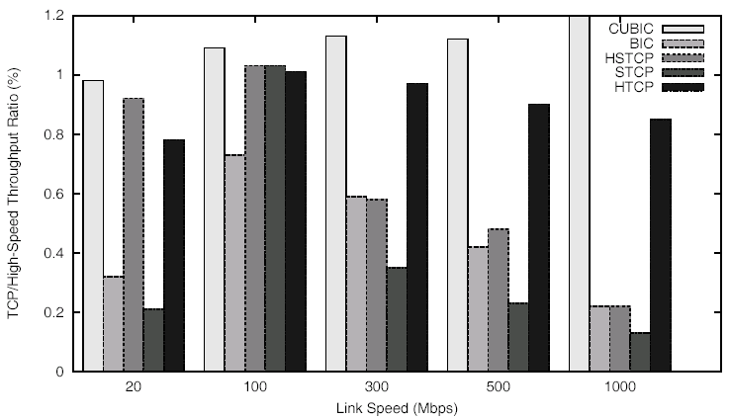
TCP friendliness
NS simulation : RTT 10 ms & 20 Mbps ~ 1 Gbps
Presentation: "Congestion Control on High-Speed Networks”, Injong Rhee, Lisong Xu

Slide 20
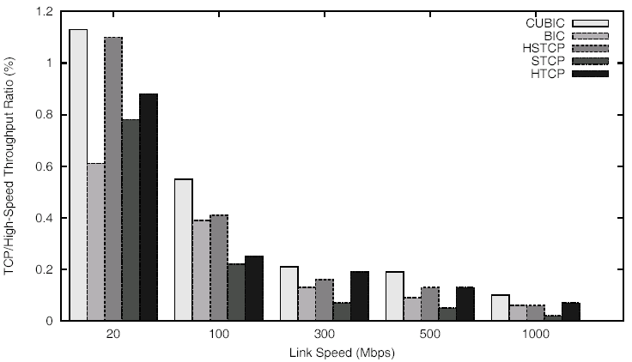
TCP friendliness
NS simulation : RTT 100 ms & 20 Mbps ~ 1 Gbps
Presentation: "Congestion Control on High-Speed Networks”, Injong Rhee, Lisong Xu

Slide 21
TCP friendliness
Dummynet Testbed : RTT 5ms & 800 Mbps, 100% router buffer of the BDP with 80 ~ 200 Mbps background traffic
80 Mbps
Background traffic
200 Mbps
Presentation: "Congestion Control on High-Speed Networks”, Injong Rhee, Lisong Xu

