Slide 1
ECE 671 – Lecture 19
Available Bit Rate Streaming

Slide 2
Video on Demand
VoD: dominate factor of today’s Internet
VoD: 67% of peak hour downstream Internet traffic in US [1]
VoD challenges
Various end user devices
TV, laptop, tablet, cell phone
Variety of access networks
Ethernet, Wifi, Cellular networks
[1] Sandvine. Global Internet phenomena report 2015

Slide 3
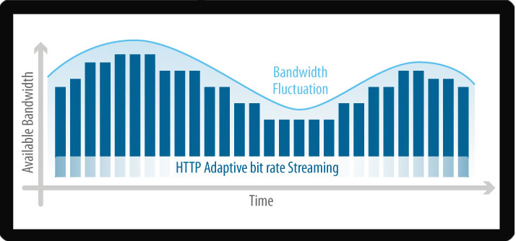
Introduction
Video streaming has moved from fixed bit rate to adaptive bit rate streaming (ABR).
Example, Netflix creates up to 120 different quality versions to support ABR streaming.
http://www.streamingmedia.com/Articles/Editorial/What-Is-.../What-is-Adaptive-Streaming-75195.aspx

Slide 4
Adaptive Streaming Solutions
Microsoft SmoothStream
Apple HTTP Live Streaming (HLS)
Adobe HTTP Dynamic Streaming (HDS)
MPEG – Dynamic Adaptive Streaming over HTTP (DASH)

Slide 5
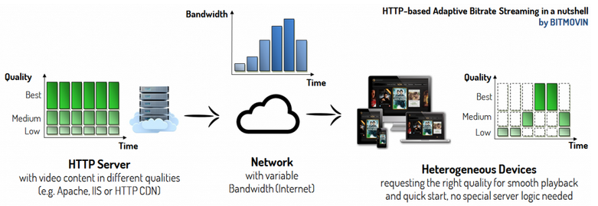
Adaptive Bit Rate (ABR) Streaming
Single video split into segments – 2s, 4s, 10s…
Each segment in different qualities
Based on Advanced Video Codec (AVC)
Client decides next requested quality based on download rate or buffer level
Avoid playback freezing
* Picture source: https://bitmovin.com/bitdash-mpeg-dash-player/

Slide 6
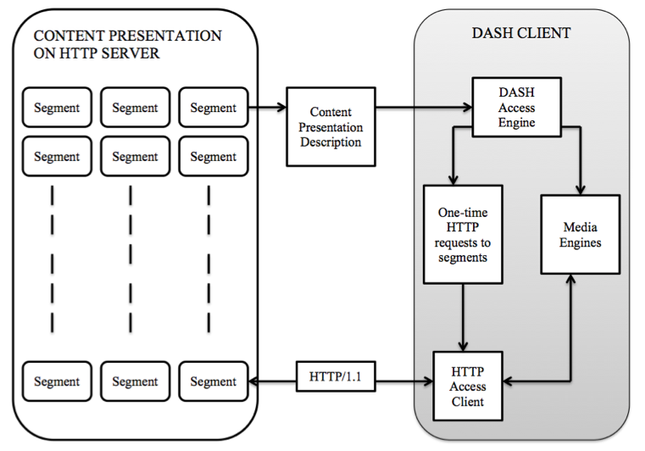
DASH – Playback without Pauses
Split video into segments
Different qualities for each segment
HTTP based
Can be hosted on regular HTTP server
Easy firewall penetration
Client driven segment retrieval
No HTTP server logic needed

Slide 7
Timeliness
Start presenting data (e.g., video playout) at t₁
Consumed bytes (offset)
variable rate
constant rate
Must start retrieving data earlier
Data must arrive before consumption time
Data must be sent before arrival time
Data must be read from disk before sending time
arrive function
data offset
send function
read function
consume function
time

Slide 8
Quality Adaptation Issues
Identify existing issues with current rate estimation approaches
Improve QoE
Prevent re-buffering
Reduce quality changes
Keep average quality as high as possible
No server modifications ➔ work with any web server
Evaluate new approach in testbed and real-world scenario

Slide 9
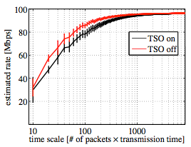
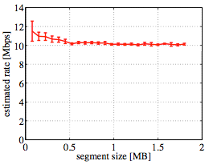
Critical Observation I
DASH in User Space: Inaccurate Rate Estimation
User space rate estimation
Impact of NIC segment offloading
More accurate for longer segments

Slide 10
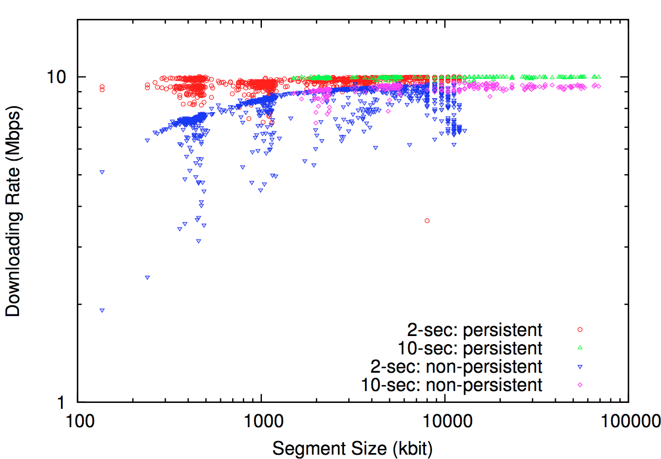
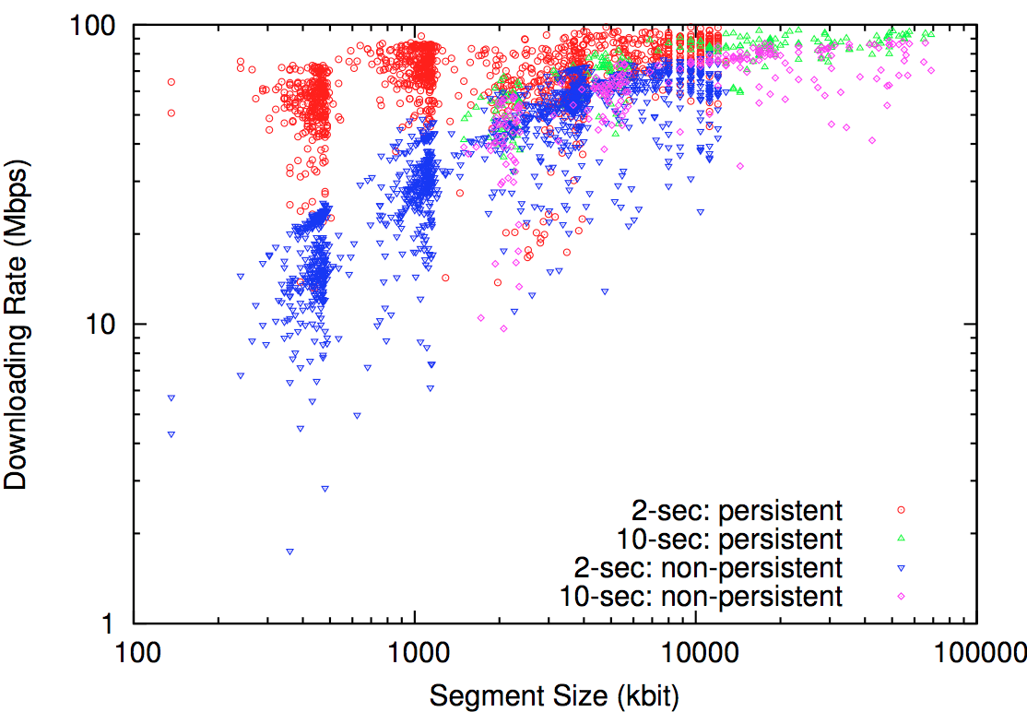
Critical Observation II
Segment Size Impacts Download Rate
Download rate for each segment
With segment length 2s & 10s
With persistent & non-persistent HTTP connection
Higher rate for longer segments (10 seconds)
Higher rate for persistent HTTP connection

Slide 11
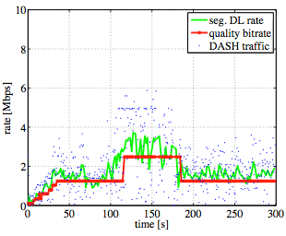
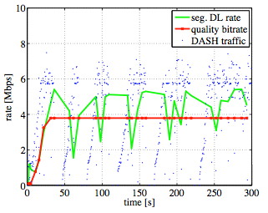
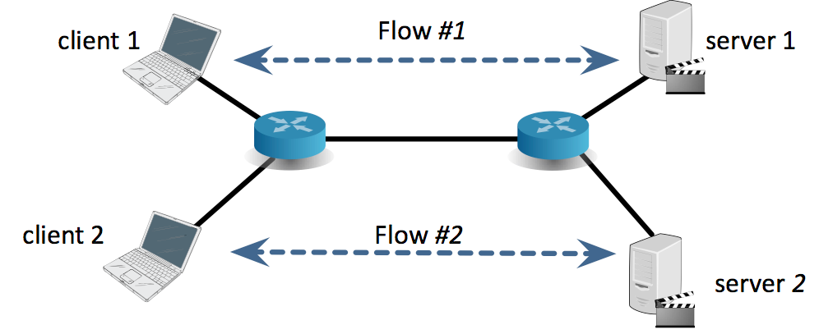
Critical Observation III
DASH is TCP submissive
DASH with competing TCP flow
Butterfly topology
One competing TCP flow
DASH behaves as ON/OFF source on top of TCP
2s segment: 1.5 Mbps
10s segment: 3.8 Mbp
Cross-traffic off
DASH with 2 sec segments
10 Mbps
DASH with 10 sec segments

Slide 12
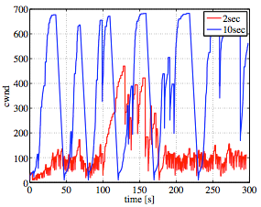
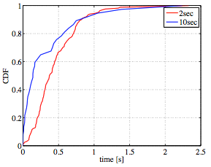
Segment Size Impacts TCP CW
Congestion window size
Much larger cwnd size for longer segments
Inter-GET times
Silence time between two segment requests
Longer segments have shorter inter-GET time
Congestion window comparison
CDF of inter-GET times

