Slide 1
ECE 671 – Lecture 13B
Quick UDP Internet Connections

Slide 2
Currently
Web is built on top of TCP
3-way handshake to start connection
Adds significant delay to each new connection
In case of TLS, even more packets have to be transmitted

Slide 3
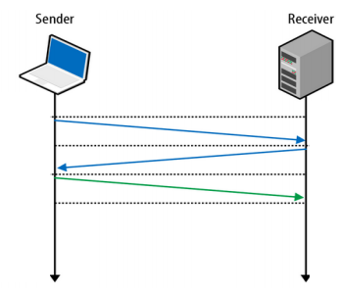
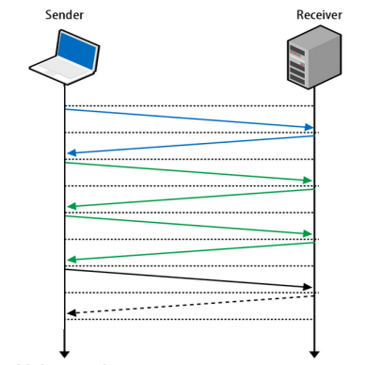
3-Way Handshake
Without TLS
With TLS

Slide 4
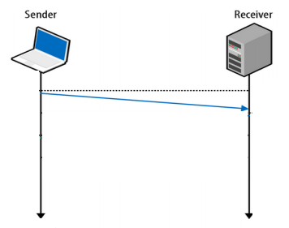
UDP
Fire and forget
Less time spent to validate packets
Downside - no reliability, has to be built on top of UDP

Slide 5
Why QUIC is needed?
Combine speed of UDP protocol with TCP’s reliability
Very hard to make changes to TCP
Faster to implement new protocol on top of UDP
Roll features in TCP if they prove theory

Slide 6
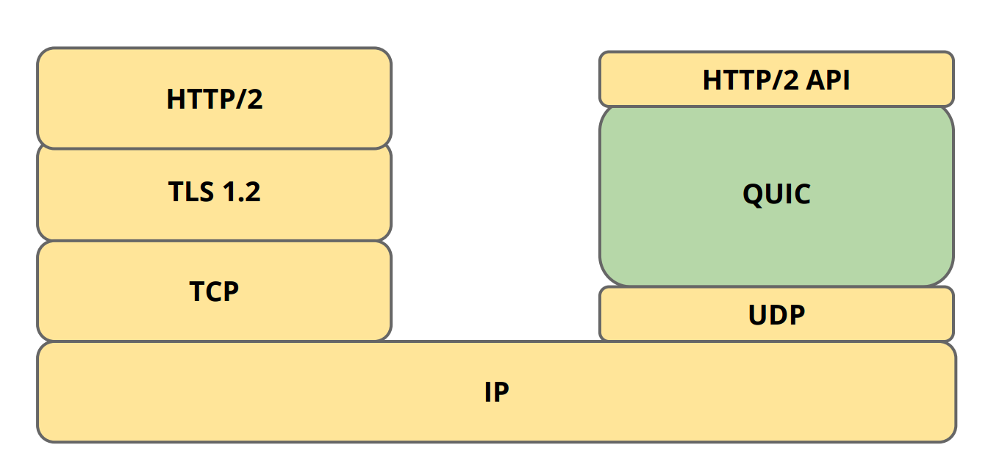
Where does QUIC fit in?
Replaces TLS stack and part of HTTP/2
Implements its own crypto layer and congestion control
Replaces TCP
Multiplexing/connection management is handled in QUIC

Slide 7
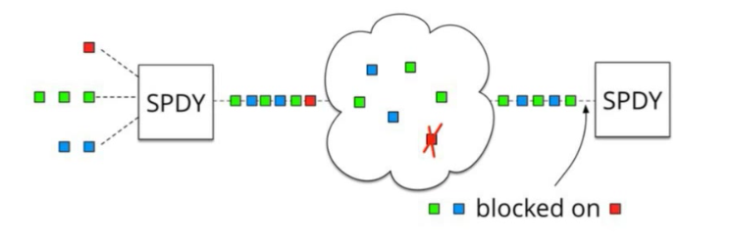
SPDY
SPDY + HTTP/2: One single TCP connection instead of multiple
Downside: Head of line blocking
In TCP, packets need to be processed in correct order

Slide 8
QUIC
UDP does NOT depend on order of arriving packets
Lost packets will only impact an individual resource, e.g., CSS or JS file.
QUIC is combining best parts of HTTP/2 and SPDY:
Multiplexing on top of non-blocking transport protocol

Slide 9
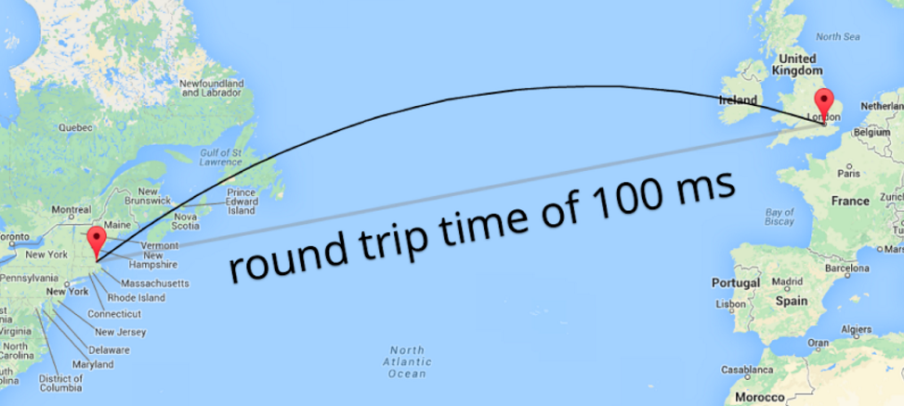
Reducing packets is essential
Especially with wireless device (LTE, 4G, etc) RTTs of 100ms can be experienced (travel distance)
Sending/receiving 4 packets (TCP/TLS) in comparison to 1 QUIC packet can add up to 300ms!

Slide 10
Forward Error Correction (FEC)
Every packet includes enough data of other packets such that missing packets can be reconstructed
RAID 5 on network level
Trade off: more payload vs. less retransmissions
Currently 10% overhead
For every 10 packets sent one can be reconstructed.

Slide 11
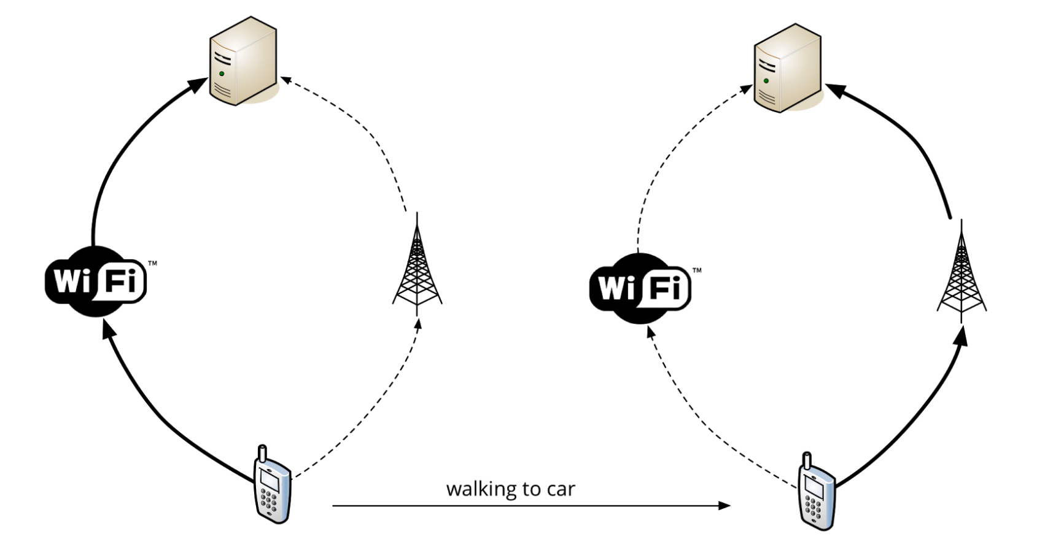
Session resumption & parallel downloads
No longer dependent on source IP of connection
Quadruplets needed in TCP
If any parameter changes, new connection has to be created

Slide 12
QUIC: Connection UUID
Own identifier: Connection UUID
Go from WiFi to LTE and keep UUID
No need to renegotiate connection or TLS
Opens door to use multiple sources to fetch content
Multipath approach supported

Slide 13
QUIC Implementation
Implemented in Chrome and Google servers (google.com, youtube.com)
Run large-scale tests
Observe QUIC usage by opening chrome://net-internals/#quic tab or using wireshark

Slide 14
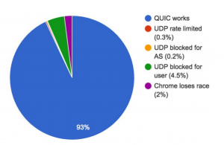
Firewall Issues

Slide 15
QUIC – Server Side
Caddy supports QUIC

Slide 16
Performance benefits
QUIC outshines TCP under poor network conditions, shaving a full second off the Google Search page load time for the slowest 1% of connections.
These benefits are even more apparent for video services like YouTube. Users report 30% fewer rebuffers when watching videos over QUIC.
A QUIC update on Google’s experimental transport (2015)

