Slide 1
Content Delivery Networks
Ramesh Sitaraman University of Massachusetts, Amherst

Slide 2
Current Snap Shot of the Internet
World Internet usage: 3 billion users ()
285 million active domains
U.S. household broadband use : 102 million
U.S. Internet retail sales totaled $335 Billion in 2015

Slide 3
Business Drivers and Growth Areas
What is driving business adoption of the Internet?
Cost reduction
Enhance convenience
Broaden reach to a mass market
Greater personalization of marketing and services
Generate new sources of revenue
Growth areas:
Online commerce
Software downloads (consumer and business)
Distributed enterprise applications
Voice over IP
User-generated content
Electronic gaming
Media and entertainment
Notes:
The Internet is a dominant source for news and information:
Music downloads
Forrester forecasts that there will be plenty of room for growth as the market increases from $201 million in 2004 to $3.2 billion in 2008
5 of Forrester’s top 6 music download sites rely on a distributed delivery to deliver their online music files
Apple announced in October that the iTunes music store downloads topped 150 million songs
Streaming stats
MSNBC served a total of 250,000 streams on election day and over 80,000 simultaneous streams
Video on Demand
Internet VoD will generate more than $169 million in revenue by 2008 (Yankee Group)

Slide 4
RATIONALE FOR CONTENT DELIVERY NETWORKS (OR, WHAT IS WRONG WITH THE INTERNET)

Slide 5

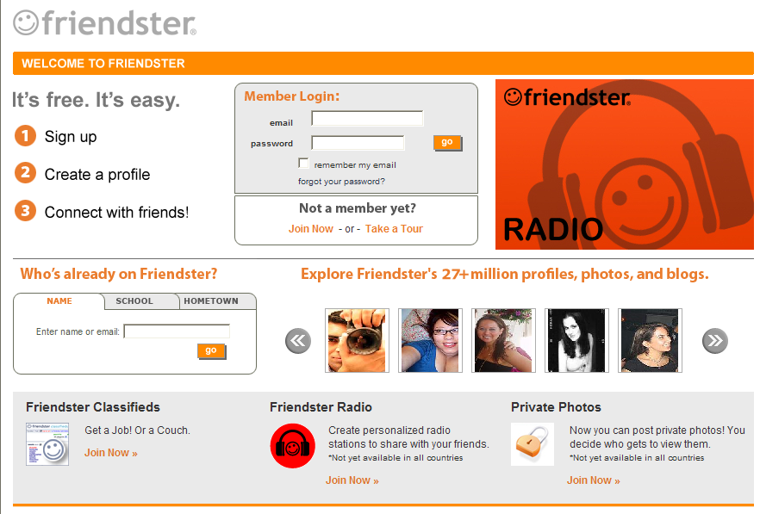


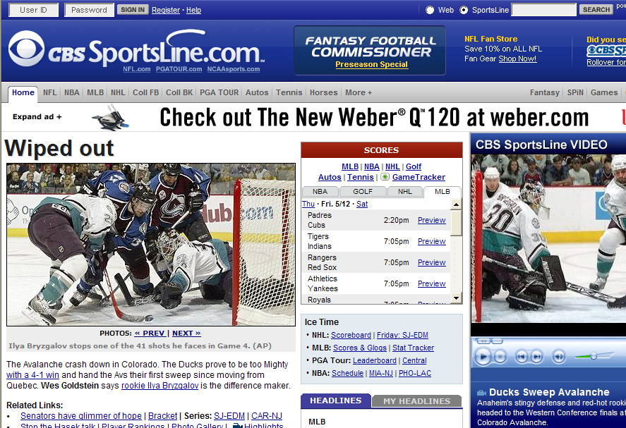
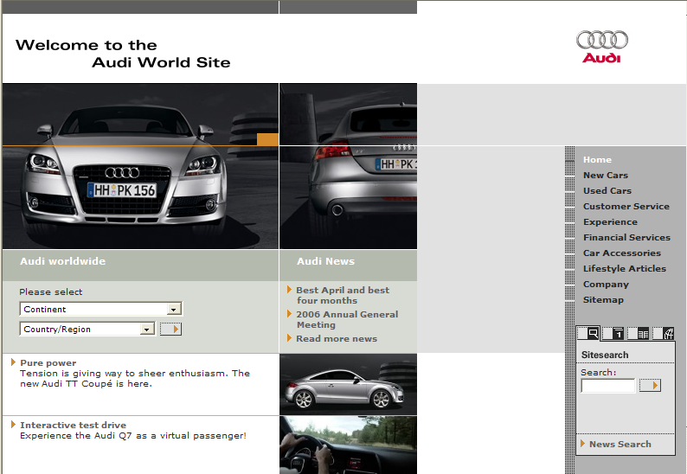

The Web: Simple on the outside…
Web Server
End-Users
Internet

Slide 6


…but problematic on the inside
Web Server
Network
Providers
End-Users
Peering Points
Verizon
X
NAP
X
L3
X
NAP
Cogent
X

Slide 7


The Centralization Bottleneck (First-Mile)
Centralized sites create an inherent bottleneck and target for attackers
Worldwide user population = huge infrastructure problem
Over provisioning raises cost of ownership
Not scalable

Slide 8
The Problems with Peering (Middle-Mile)
Economic considerations limit peering capacity – results in congestion and poor performance.
Routing algorithms (BGP) ignore congestion! BGP is policy-driven not performance-driven.
Data used to determine routes is subject to intentional inaccuracies and human error.
Routing algorithms are subject to accidental loss of routes, filtering, and intentional theft of routes.

Slide 9

The Middle Mile Bottleneck
Web Content
$
$
$
$
$
$
20X
First Mile
20X
Tier 1 ISPs
6X
Middle Mile
6X
Local ISPs
$
$
$
$
$
$
50X
Last Mile
50X
Web Users
Notes:
Internet is a network of networks;
2. You and I buy “last mile” access to the Internet from our local Internet Service Provider
3. Companies like Akamai, Yahoo! and CNN buy “first mile” access from major transit providers… or corporate Internet Service Providers

Slide 10





Need to store and deliver content at edge to avoid the middle mile bottleneck
Tier 1 IPS’s
Tier 1 IPS’s
Tier 1 IPS’s
“The Internet won’t scale for video without CDNs”
Congestion Causes
Slow downloads & applications
Poor video quality
Bottleneck
Edge ISPs
Edge ISPs
Edge ISPs
Edge ISPs
Edge ISPs
Edge ISPs
Edge IPSs
Notes:
Internet is a network of networks;
2. You and I buy “last mile” access to the Internet from our local Internet Service Provider
3. Companies like Akamai, Yahoo! and CNN buy “first mile” access from major transit providers… or corporate Internet Service Providers

Slide 11
Normal traffic flow
Because routing information is not authenticated, an attacker can “steal” traffic destined for someone else.
End User
CW
Sprint
End User
Web Server
192.168.1.15/24
End User
BBN
End User
End User

Slide 12
Hijacked Traffic Flow – “Pharming”
Hacker tells Sprint, “Send me
all traffic for 192.168.1.15/32.”
Hacker
End User
CW
Sprint
End User
Web Server
192.168.1.15/24
End User
BBN
End User
End User

Slide 13
The Internet is Insecure
Internet protocols (BGP, DNS and DHCP) are not authenticated. Easy to steal traffic and identities.
Millions of Americans fell victim with losses in Billions.
Fears of on-line identity theft inhibits e-commerce growth rates by 1-3%.
Denial-of-service attacks.
DDoS with hundreds of Gbps of traffic.
Active botnets with millions of zombies.
Cyber-extortion on the rise.

Slide 14
How Did We Get Into this State?
The Internet was not designed for the way it is used now!
Internet is a best-effort network with no notion of end-to-end performance guarantees.
Internet protocols and software were designed based on an assumption of trust, which dates back to the days of the ARPANet. This assumption no longer holds.

Slide 15
Challenges Impeding Future Growth
Slow downloads and applications
Content and transactions must traverse multiple backbones and long distances
Unreliable
Content and transactions may be blocked by congestion or backbone peering problems
Not scalable
Usage limited by bandwidth and CPU power available at master site
Insecure
Traffic and identities can be easily stolen. Websites can be DoS’ed and cyber-extorted.

Slide 16
HOW CDNs WORK

Slide 17






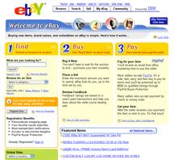
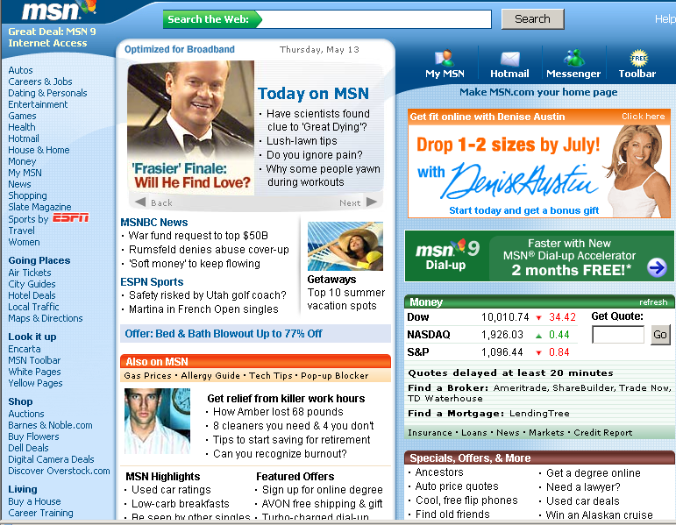
There is a better way … the Content Delivery Network (CDN) Approach.
End-Users
Origin Server
Network
Providers
End-Users
Origin Server
Peering Points
Create a shared platform of servers at the Network Edge
X
MCI
NAP
X
X
L3
X
NAP
AOL

Slide 18

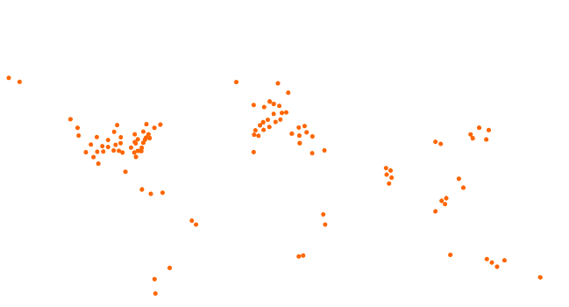
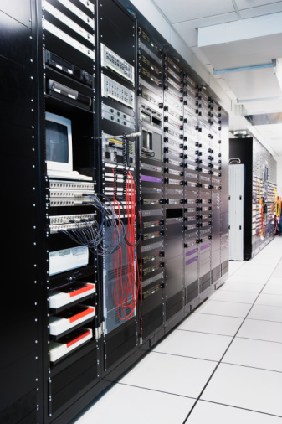




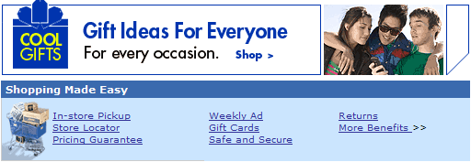


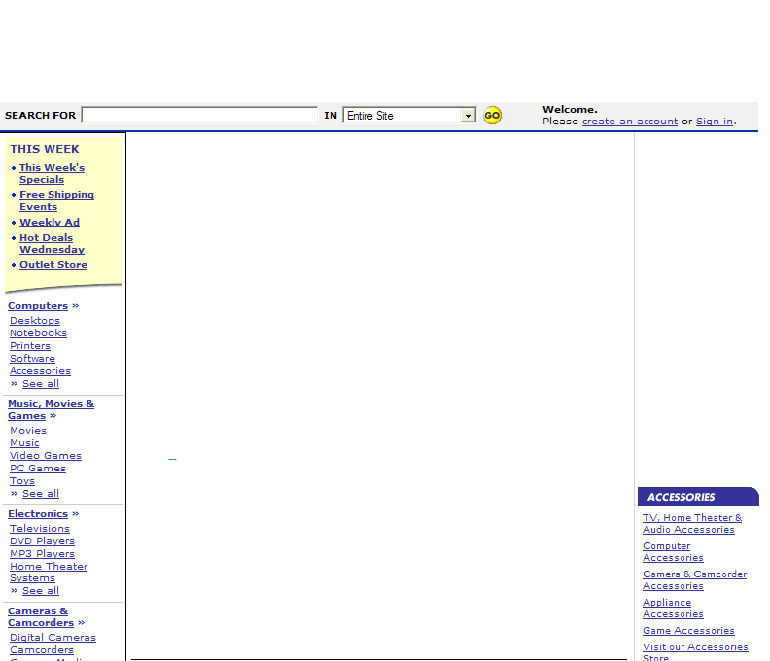
Object Delivery (Classic CDN delivering only embedded content)
Enduser types www.retailer.com into browser
Browser retrieves HTML from retailer’s origin infrastructure
HTML instructs browser to get objects from CDN
Browser retrieves images from optimal CDN EdgeServer
Origin Infrastructure
End User
HTML
Notes:
E-commerce sites began as Object Delivery customers, then moved into being more of a Static and Dynamic Site Delivery’ this is an example of how functionality has evolved from early (a prior generation) of CDN services from the past to today.

Slide 19
Whole Site Delivery (for static sites without dynamic content customized for the user)
Enduser types www.retailer.com into browser
Browser retrieves cached HTML from optimal EdgeServer of CDN
HTML instructs browser to get objects from CDN
Browser retrieves images from optimal EdgeServer of CDN
Origin Infrastructure
End User
HTML
Notes:
Delivering the entire site – Also called Dynamic site delivery

Slide 20
Whole Site Delivery (for Dynamic Sites)
Enduser types www.retailer.com into browser
Browser requests HTML from optimal EdgeServer of CDN
EdgeServer retrieves HTML from origin infrastructure
EdgeServer sends HTML to browser
Browser retrieves images from optimal EdgeServer of CDN
Origin Infrastructure
End User
HTML
HTML

Slide 21
Without CDN: Unreliable connectivity
Origin Infrastructure
End User
x
X

Slide 22
With CDN dynamic content is sent using overlay routing: Route around trouble spots using multiple paths (example, Akamai’s SureRoute)
Origin Infrastructure
End User
HTML
HTML
x
Notes:
End users path w/ out; killed. With, hits close Akamai server, then goes to origin, using same path; full roundtrip. Show same path.
TCP first (going back and forth lots of time) built on that step that goes across the middle. TCP Optimization (fewer round trips) On a single path. Then focus on step 3 from slide 5. that’s the step we’re blowing-up here. It will be a deeper dive.

Slide 23


Without CDN: More round trips to get dynamic or cold objects
Origin Infrastructure
End User
Notes:
What are we calling this? “Dynamic (or Whole Site) Delivery” and then make it consistent across all slides.

Slide 24
With CDN content can be fetched before it is requested: “Just-in-time caching” or Pre-fetching
Enduser types www.retailer.com into browser
Browser requests HTML from optimal CDN’s EdgeServer
Origin Infrastructure
End User

Slide 25
With CDN content can be fetched before it is requested: “Just-in-time caching” or Pre-fetching
Enduser types www.retailer.com into browser
Browser requests HTML from optimal EdgeServer
EdgeServer “gets” HTML from origin infrastructure
Origin Infrastructure
End User
HTML

Slide 26
With CDN content can be fetched before it is requested: “Just-in-time caching” or Pre-fetching
Enduser types www.retailer.com into browser
Browser requests HTML from optimal EdgeServer
EdgeServer “gets” HTML from origin infrastructure
EdgeServer parses HTML and requests uncached images from origin while delivering HTML to browser
Origin Infrastructure
End User
HTML
Notes:
Without AKAM, gets HTML, then objects. With AKAM, it . For ESI and Edge Java; will need slides. Should they be separate? ESI, back to Best Buy; text to use. Slide 34 is ESI, and find an Edge Computing slide. He will say we assemble. ESI “Caching uncachable content”. Then he will blow out the page. Then talk about EdgeComputing in a slide; need to convey that application is at the Edge.

Slide 27
With CDN content can be fetched before it is requested: “Just-in-time caching” or Pre-fetching
Enduser types www.retailer.com into browser
Browser requests HTML from optimal EdgeServer
EdgeServer “gets” HTML from origin infrastructure
EdgeServer parses HTML and requests uncached images from origin while delivering HTML to browser
EdgeServer delivers fetched images to browser
Origin Infrastructure
End User
Notes:
Without AKAM, gets HTML, then objects. With AKAM, it . For ESI and Edge Java; will need slides. Should they be separate? ESI, back to Best Buy; text to use. Slide 34 is ESI, and find an Edge Computing slide. He will say we assemble. ESI “Caching uncachable content”. Then he will blow out the page. Then talk about EdgeComputing in a slide; need to convey that application is at the Edge.

Slide 28
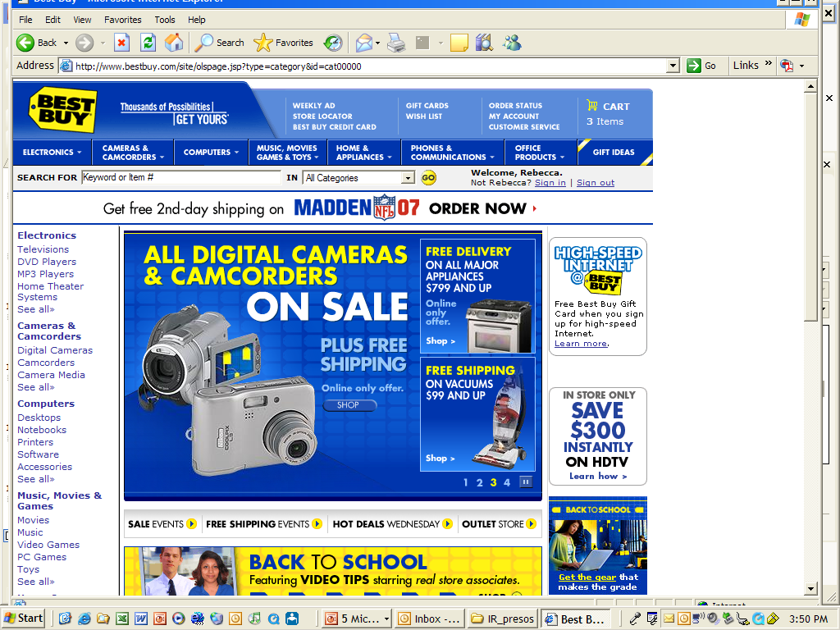
Improving performance further: Constructing dynamic HTML at the edge through EdgeSide Includes (ESI)
All of the retailer’s pages are cacheable for a short period of time. Except for one small piece of data, unique for each end user, and for each hit.
<% if Application(“useESI") = true then %>
<esi:include src="/includes/i_top.asp<%=ESI_querystring()%>" no-store="on" />
<% Else %>
<!--#include virtual="/includes/i_top.asp"-->
<% End If %>

Slide 29
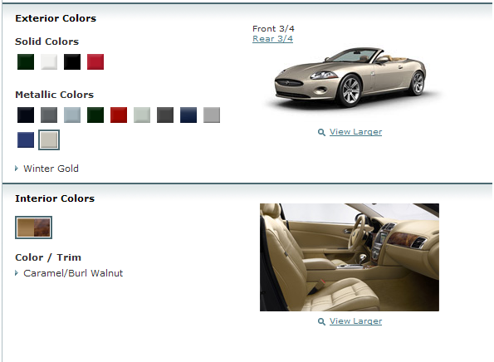
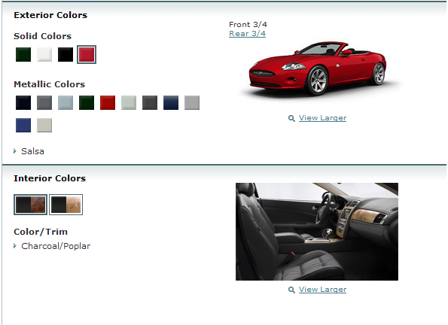
Improving Performance Further: Moving Business logic to the edge (Edge Computing)
Other types of Edge Applications:
Configure Product
Giveaway Contest
Locate Dealer/Store
Complete Survey
User Prioritization
Manage Shopping Cart
Play Game
Register for Entry
Search Site
Calculate Financing
Sweepstakes Contest
Wait for Purchase
Voting Form
Plan a trip
Generate a map
Request information
Process Form
End User
Origin Infrastructure
Notes:
In a centralized world, all of your application logic sits on your Application Servers.
What is Akamai EdgeComputing?
Platform for deploying and running your J2EE Web-based applications
Built on Akamai’s EdgeSuite Platform
Provides a pay-for-use model for application servers usage
Offering functionality:
Tomcat-based offering for Web container functionality
IBM WebSphere-based offering for Enterprise Tier functionality
With EdgeComputing, part of this logic (at least the presentation logic and some parts of your business logic e.g. custom authentication code or result polling, etc) is deployed to Akamai’s Edge servers. These servers are capable of running Java applications.
The request flow for an application using EdgeComputing goes like this (which is very similar to the overall flow for EdgeSuite if you’re familiar with it):
When accessing your web application running on EdgeComputing, the same mechanisms as EdgeSuite apply. The end user does a DNS lookup on the hostname, the optimal Akamai edge server is returned, and the user makes a request for the application.
The end user makes a request for a certain web page that is your web-enabled application.
When the Edge Server receives the request for e.g. /app.jsp, it sees that this is a JSP page and has been configured to handles such requests by running them through the built in application server. So the Edge Server hands off the request for /app.jsp to the application server. This is just like the application server you run at your web site today – it executes your application logic.
While processing the request, your application may need to retrieve some data from your origin servers (e.g. to retrieve a user profile). It can do this using any of a set of standard Java technologies (RMI, SOAP, JDBC) that can be tunneled over standard Web protocols (HTTP/HTTPS). The short of it is – all standard Java technologies here, nothing Akamai specific.
The origin server responds with the requested content, sending it back to the edge server.
The application server gets the data it requested from the origin, finishes processing the request, and sends the page of HTML pack to the end user.

Slide 30
Content Delivery Network Advantages
Fast
Content and Applications are served from locations near to end users
Reliable
No single point of failure
Automatic failover
Scalable
Global capacity on demand
Cost effective
No overprovisioning
No redundant datacenters
Simple to manage
Secure
Traffic harder to steal
Defense in depth protects central infrastructure

Slide 31
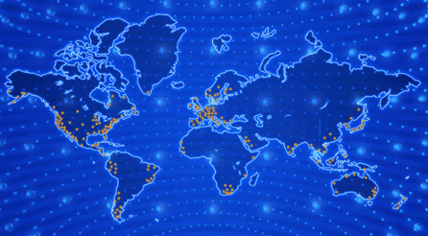
Example: Akamai’s Content Delivery Network
The world’s largest on-demand, distributed computing platform; it delivers all forms of Web content and applications for thousands of customers and tens of thousands domains.
Resulting in Daily Traffic of:
3 Trillion requests per day
30 Tbps of traffic
215,000+ Servers
1500 Networks
120 Countries

Slide 32
CDN SYSTEM ARCHITECTURE

Slide 33
Design Principles
Notice and Quarantine Faults
Zoning for Releases
Fail-Stop & Restart
Distributed Control
Software for Message Reliability
Ensure Significant Redundancy
Philosophy: Assume numerous failures
Assumption: Significant and constantly changing failures

Slide 34
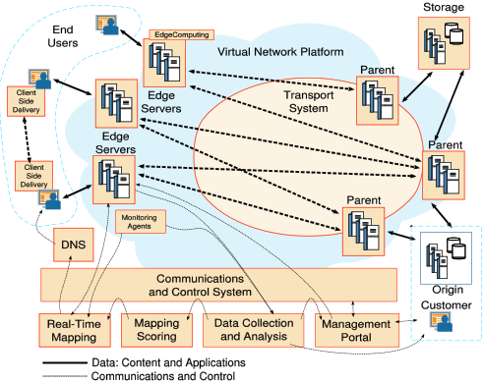
ARCHITECTURAL COMPONENTS

Slide 35
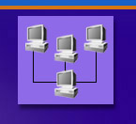



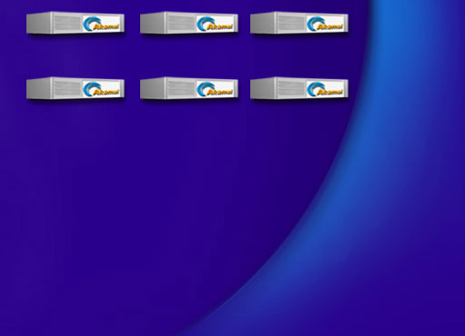


DNS Resolution is Used For Server Selection
4
xyz.com
.com .net
Root (InterNIC)
5
10.10.123.5
xyz.com’s nameserver
akamai.net
a212.g.akamai.net
8
7
9
6
15.15.125.6
ak.xyz.com
select cluster
10
g.akamai.net
20.20.123.55
11
Akamai High-Level DNS Servers
12
a212.g.akamai.net
30.30.123.5
13
Akamai Low-Level DNS Servers
End User
Local Name Server
select servers within cluster
16
1
3
14
2
Browser’s Cache
15
OS
Notes:
Happens in two steps. Select cluster (global load balancing) & select server within cluster (local load balancing). Many of the steps do not happen each time because of TTL.

Slide 36
Mapping System Architecture
Notes:
If we look closer into the dataflow of the mapping system, there are always components that measure the Internet. And of course the CDN will monitor its own deployment, checking servers’ conditions, load, failure etc.. Then measurement like traceroute and pinging are used for topology discovery and scoring, which evaluate the performance of different locations for serving the client.
Another important function is the load balancing system. The global load balancing makes no single data center is overloaded, while trying to send each client to the optimal location. The local load balancing spread the load among servers within a data center.
Eventually the nameserver compoenent will handle over the mapping decision from the load balancing to the client’s LDNS.

Slide 37
Edge Server Architecture
Forward connection management
Metadata
Execution
Overlay
Routing
Cache
Management
Client connection management

Slide 38
CDN CHALLENGES

Slide 39
The Scientific and Technological Challenges (Involves every area of CS Research!)
Mapping and server assignment
Logging, reporting, and billing
Operations
Content freshness and accuracy
Management of live streaming and Webcasting
Distributed applications at the edge
Security
Analytics
Scheduling algorithms balance traffic, minimize storage footprint, and optimize replication
Global load balancing to optimize performance and cost in the face of unknown demands
Distributed protocols that work even with thousands of component failures
Consistent hashing -- technology to store objects/files so as to optimize use of memory/disk footprint

Slide 40
The Scientific and Technological Challenges (Involves every area of CS Research!)
Mapping and server assignment
Logging, reporting, and billing
Operations
Content freshness and accuracy
Management of live streaming and Webcasting
Distributed applications at the edge
Security
Analytics
Very large-scale data aggregation and
distribution algorithms (trillions of
billable items on behalf of 20,000 Web
sites every day)

Slide 41
The Scientific and Technological Challenges (Involves every area of CS Research!)
Mapping and server assignment
Logging, reporting, and billing
Operations
Content freshness and accuracy
Management of live streaming and Webcasting
Distributed applications at the edge
Security
Analytics
Algorithms for the deployment of software to 200,000 distributed servers in a safe and seamless manner
Automated distributed control and alerting system to allow 24x7 operation of network by small NOCC staff

Slide 42
The Scientific and Technological Challenges (Involves every area of CS Research!)
Mapping and server assignment
Logging, reporting, and billing
Operations
Content freshness and accuracy
Management of live streaming and Webcasting
Distributed applications at the edge
Security
Analytics
Authentication technology to
ensure content is correct and
timely

Slide 43
The Scientific and Technological Challenges (Involves every area of CS Research!)
Mapping and server assignment
Logging, reporting, and billing
Operations
Content freshness and accuracy
Management of live streaming and Webcasting
Distributed applications at the edge
Security
Analytics
Distributed algorithms for virtual
multi-casting with error correction
at the edge

Slide 44
The Scientific and Technological Challenges (Involves every area of CS Research!)
Mapping and server assignment
Logging, reporting, and billing
Operations
Content freshness and accuracy
Management of live streaming and Webcasting
Distributed applications at the edge
Security
Analytics
Proactive creation of virtual
application servers close to end
users so as to optimize
performance, balance load, and
minimize cost

Slide 45
The Scientific and Technological Challenges (Involves every area of CS Research!)
Mapping and server assignment
Logging, reporting, and billing
Operations
Content freshness and accuracy
Management of live streaming and Webcasting
Distributed applications at the edge
Security
Analytics
True end-to-end authentication and encryption technologies to safeguard sensitive data
Digital rights management to monetize assets

Slide 46
The Scientific and Technological Challenges (Involves every area of CS Research!)
Mapping and server assignment
Logging, reporting, and billing
Operations
Content freshness and accuracy
Management of live streaming and Webcasting
Distributed applications at the edge
Security
Analytics
Measure, analyze, visualize and present business and performance metrics
Sophisticated agents, cutting-edge large-scale data mining and analysis, complex visualizations, etc

Slide 47
Questions?

