Slide 1

Title Slide
IKU ECU
By: Takuya Seaver, Jack Walter, Xueteng Qian, and Yongjie Yang
October 6, 2019

Slide 2
Background
Most modern vehicles have what is a called an ECU (Electronic Control Unit) which controls almost everything within it. One of these controls is the fuel injection control system. An ECU reads values from multiple sensors, interprets such data using multidimensional performance maps (lookup tables), and adjusts the engine actuators for optimal performance.

Slide 3
Problem Statement
Our goal is to build a control system for the fuel injection process. Using the data from sensors throughout the system, we will be able to modify, tune, and improve the functionality of the fuel injection process.

Slide 4
Requirements/Specifications
Has to support RPM of up to 6000
Support open/closed loop operation
Compatibility with other fuel injectors
Documentation for design and verification
Make additional boards for use
Capability of tuning
GUI application

Slide 5
Block Diagram
Inputs:
ADC: Analog Digital Converter
TPS: Throttle Position Sensor
O2: Oxygen Sensor
IAT: Intake Air Temperature Sensor
ECT: Engine Coolant Temperature Sensor
MAP: Manifold Air Pressure Sensor
CKP: Crankshaft Position Sensor
IgnSw: Ignition Hardware Switch
Outputs:
Fuel Inj: Fuel Injector
Ignition MDS:
USB: Universal Serial Bus

Slide 6
Design and Deliverables
Direct Injection: fuel directly into the combustion chamber
Design an ECU that reads values from sensors and controls the injector
Feed back loop to control the system
A User Interface to interact with the ECU

Slide 7
Alternatives
Existing product: Throttle Body Injection, mainly used in 90s.
Advantage: easy to implement and maintain, reduce carbon accumulation on intake valves
Disadvantage: not as precise as Direct Injection, thus low efficiency

Slide 8
Plan to Implement

Slide 9
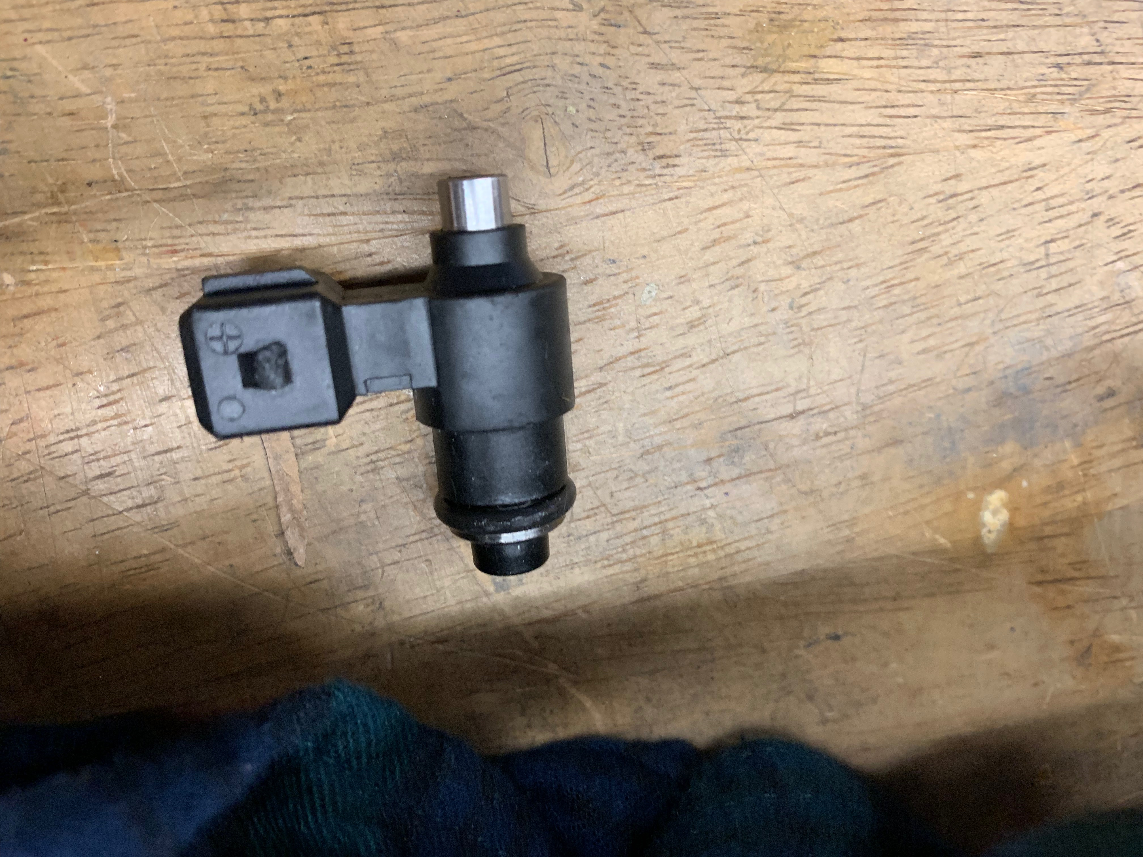
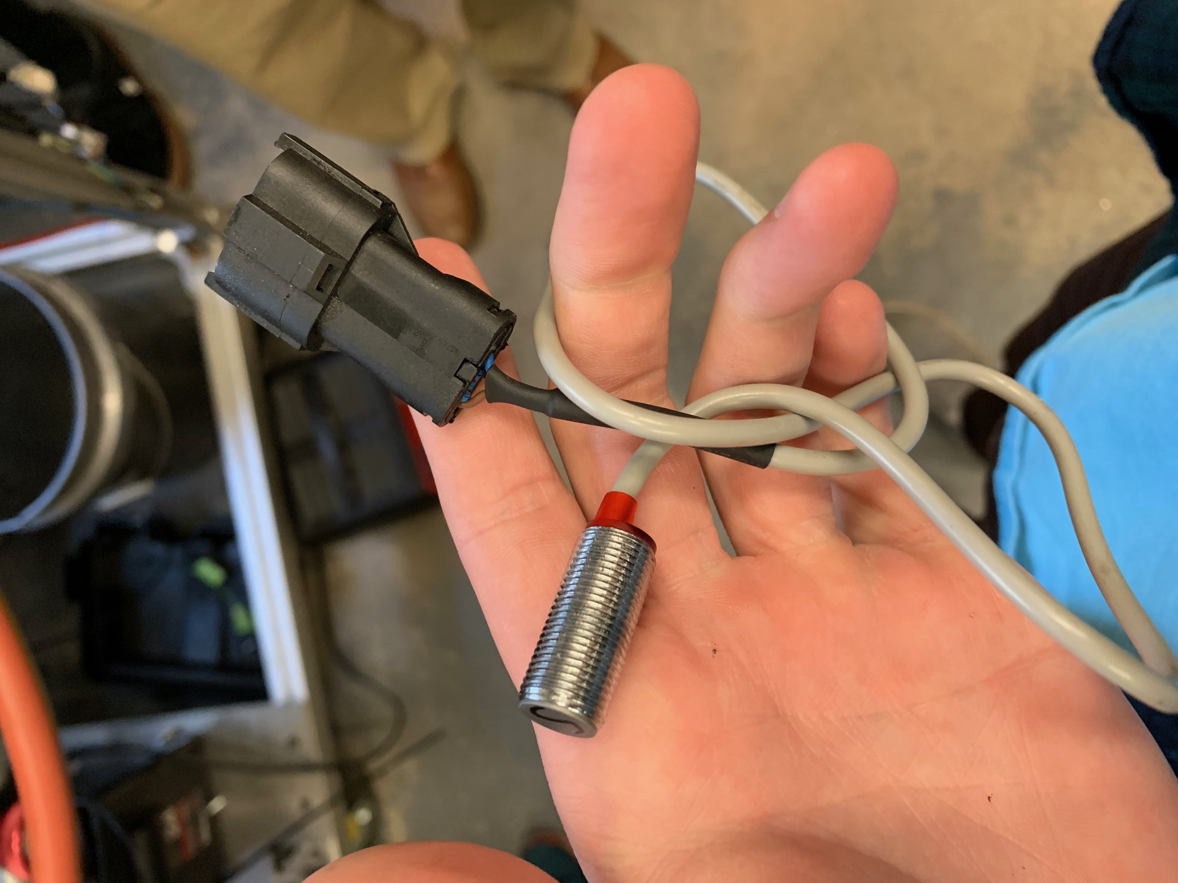
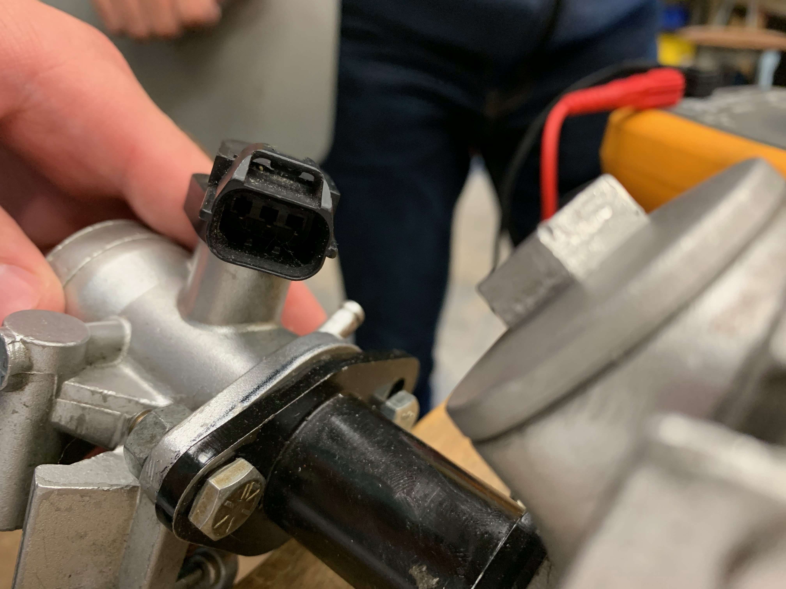
Budget
Most of sensors will be provided by the SMV team, such as O2 sensors and pressure sensors.
Camshaft Sensor x2 = $180
Microcontroller x3 = $10
PCB x5 = $25
Total Estimate = $220

Slide 10
Closing Slide

