Slide 1
IKU ECU
Team 17
Advisor: Professor Xia
MDR Presentation
12/09/2019
Notes:
Highlight your project name. Date.
Template
slide number

Slide 2
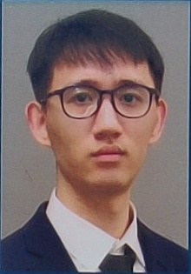
Team 17: IKU ECU
Takuya Seaver
EE
Jack Walter
CSE
Xueteng Qian
CSE
Yongjie Yang
EE

Slide 3
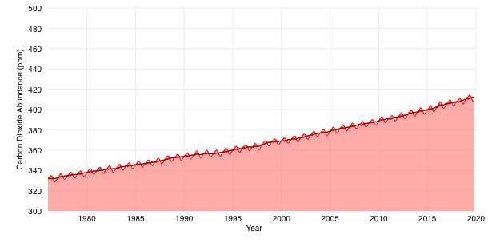
Problem Statement
An Electronic Control Unit, ECU, is the brain of fuel injection in a vehicle.
By optimizing the functionality of an ECU, gas mileage can be improved thus reducing the amount of carbon emissions released into the air.
“Climate Change: Atmospheric Carbon Dioxide: NOAA Climate.gov,” Climate Change: Atmospheric Carbon Dioxide | NOAA Climate.gov, 19-Sep-2019. [Online]. Available: https://www.climate.gov/news-features/understanding-climate/climate-change-atmospheric-carbon-dioxide. [Accessed: 08-Dec-2019].
Notes:
Data especially in the graph format is more appealing.

Slide 4
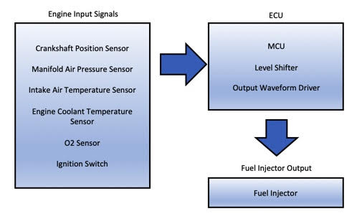
Our Solution

Slide 5
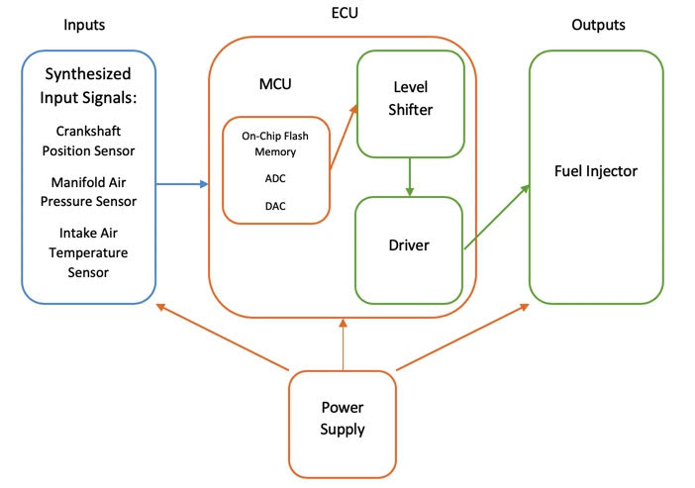
Block Diagram
Notes:
acronym
On-Chip Memory : what type?
Refine the block diagram

Slide 6
Requirements & Specifications
Real-time processing of input data signals for correct fuel injection
Feedback capabilities with O2 sensor for optimization
Support up to 6000 RPM
Ability to inject correct amount of fuel within ~10ms
Ability for user to optimize the system (modify lookup table, equations, etc.)
Calculate fuel map value within 2 rotations of the crankshaft (10ms)
Store input data
Notes:
'Our solution' is missing between slides 3& 4.
Specifics should be after the big picture on the system.
Talk about requirements for each individual module as well.

Slide 7
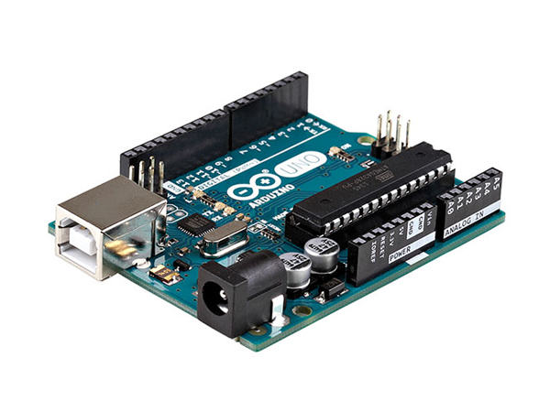
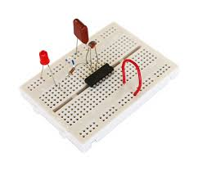
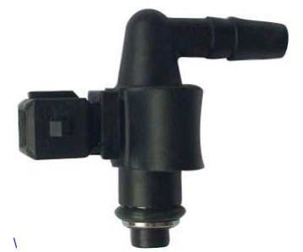
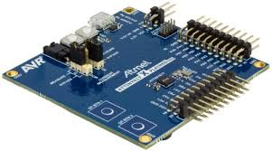
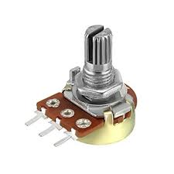
System Topology
Synthesized Signals
(Arduino and Potentiometers)
MCU
(ATtiny 817)
Level Shifter and
Fuel Injector Driver
Fuel Injector
Synthesized Signals: Takuya Seaver and Jack Walter
MCU: Xueteng Qian and Jack Walter
Level Shifter and Fuel Injector Driver: Yongjie Yang and Takuya Seaver
Notes:
This is what we already have, should come later.
Label each components.

Slide 8
MDR Deliverables
Step 1: Correctly synthesize engine sensor signals.
Step 2: Calculate pulse width time based on input data calculations and lookup table values.
Step 3: Inject the correct amount of ”fuel”.
Notes:
Check the consistency with promise.
Numerical

Slide 9
Synthesized Input Signals (TK and Jack)
Arduino program created to mimic the functionality of the crankshaft position sensor.
Potentiometers used to be able to act as the acceleration (to control speed), emulate the MAP sensor signal, and act as a thermistor to simulate our IAT sensor signal.
Communication through ADC input terminals on the microcontroller to be able to modify the input signals and compare with lookup table.
Notes:
Make sure it corresponds to the deliverables.
Put images or plots here.

Slide 10
ECU Software and Lookup Table (Xueteng and Jack)
Measure interval between two rotation from CKP signal to calculate
RPM = 60*100/interval.
Measure intake air pressure and temperature
Use to calculate load of engine
Load = 100*MAP/(IAT)
Use RPM and Load to find output pulse width in the lookup table.
Notes:
Show the results (plots)
Show the process to get RPM, Load

Slide 11
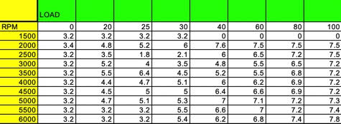
Lookup Table
Notes:
Split the corner to RPM\Load
Slide title

Slide 12
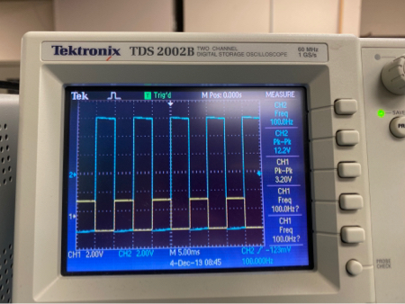
Voltage Level Shifter (Yongjie)
Input:
ECU output signal:
Simulating Input frequency around
6000 rpm (100Hz) ---（1RPM = 1/60Hz）
Simulating Input rectangular wave
(High:3.3V, Low:0V)
Output:
Output rectangular wave
(High:12V, Low:0V)
Same pulse width as input

Slide 13
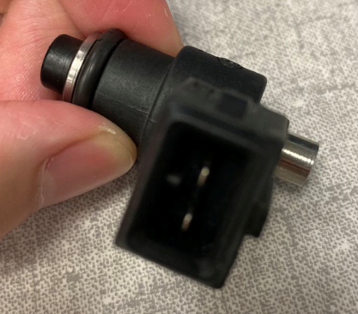
Fuel Injector
The control signal is from ECU, when the voltage of control wire is LOW (0V),the injector will inject fuel, and when the control signal voltage is HIGH (12V), then the injector will be closed and not inject fuel.
Technical Specifications:
Control signal wire pin: Driver wire Power wire pin : Power Supply (12V DC)
Driver current: ~800mA @12V
Coil resistance: 12~14.5ohm

Slide 14
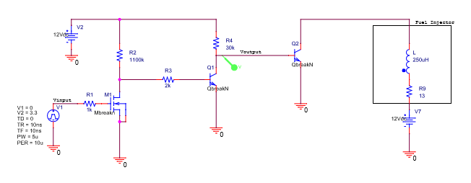
Level Shifter and Driver Schematic and Test
NMOS (2N5486):
High drain voltage 25V
NPN Bipolar Transistor (mpsa05):
High collector voltage 60V
Low noise
NPN Bipolar Transistor (TIP122):
High collector current 5A

Slide 15
Test (Fuel Injector)

Slide 16
How did it turn out?
Step 1: Correctly synthesize engine sensor signals.
Step 2: Calculate pulse width time based on input data calculations and lookup table values.
Step 3: Inject the correct amount of ”fuel”.
Notes:
Check marks

Slide 17
Proposed CDR Deliverables
Integration of real engine components.
Speed of processing of real engine input signals.
Optimization of code and hardware to get closer to a real use case.
Math/Physics for the LUT (e.g., equation, then to analog computing).
Training and Testing of both hardware and software with documentation.
Notes:
Not specific enough
1. Integration ; 2. Speed; 3. Optimization; 4. Math/physics for the LUT (e.g., equation, then to analog computing). 5. Training-->Test

Slide 18
Gantt Chart
Notes:
Consistent with the previous slide.

Slide 19
Questions?

Slide 20
Demo

