Slide 1
Smart Coaster
SDP20
Team 16
PDR
October 11, 2019
Notes:
Tim
Possible military uses?...
Piezo sensor to trigger communication system to reduce power consumption
Resonant frequency?...

Slide 2
Meet the Team
Professor Joshua Yang
Advisor
Jonathan Capozzi
EE
Timothy Shum
EE
Angus Mo
EE
Joshua Howell
CSE
Notes:
Everyone, starting with Tim then in order

Slide 3
Problem Statement
At restaurants, fast and responsive service leads to higher customer satisfaction. Waiters/waitresses often juggle serving several tables at the same time. A customer might finish their drink and have to wait a while for service.
Notes:
Josh

Slide 4
Solution - Smart Coaster
Monitor multiple tables’ drinks with ease
Coasters connect to a single device to easily see what table needs a drink/refill
Faster customer service response
Coasters send a notification to the smart device when a cup is emptied
Intuitive system
Low maintenance coaster with long lasting battery life
Notes:
Josh
Include multiple sizes, not just coaster size: Bowl-sized, plate-sized, etc.

Slide 5
Similar Products
Brio Smart Coaster
New Potato Technologies
Interactive app recommends pubs and restaurants
Includes coaster position tracking
“Drink Guard” notifies if a drink has been tampered with
Notes:
Angus
starts at ~2:30
Lacks the idea of tracking the contents within a cup. Only provides social networking aspect as well as drink awareness.

Slide 6
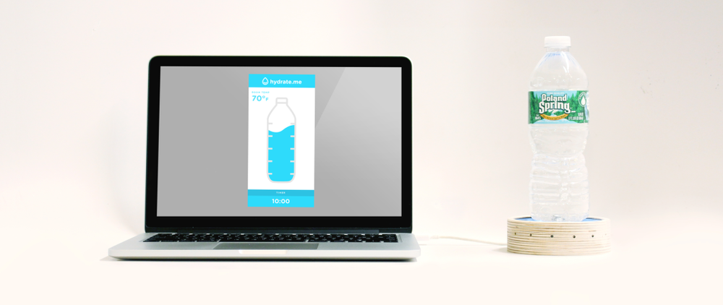
Similar Products
HYDRATE.ME
NYU Design Team
Coaster reminds user periodically to drink water
Notifies the user when to refill water bottle
Widget provides visual representation of water bottle
Notes:
Angus
Lacks wireless communication/power supply. Does not support multiple devices.

Slide 7
Specifications
>95% “empty glass” detection rate
<1% “empty glass” false positives
>12hr battery life
<5hr recharge time
<2cm coaster thickness
Supports multiple coasters
Accurately detects a new/refilled beverage
Accurately determines weight of glass itself
Accounts for ice or other leftovers
Reach Goal: Wireless charging station
Notes:
Jon
starts at ~4:00

Slide 8
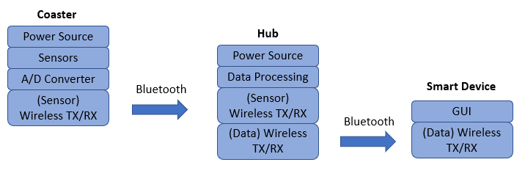
Block Diagram
Notes:
Tim
starts at ~6:00
Edit: 3 coasters, 1 hub, 1 smart device

Slide 9
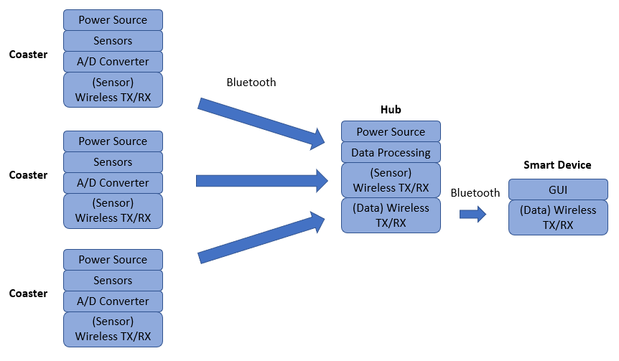
Block Diagram
Notes:
Tim
Edit: 3 coasters, 1 hub, 1 smart device

Slide 10
Block Diagram - Sensing Components
Possible Implementations:
Load Cell
High precision
Bulky - adds thickness
High cost
Force Sensitive Capacitors
Thin/small form factor
Low precision
High cost
Velostat - Variable Resistor
Thin/small form factor
Low precision
Low cost
Notes:
TIM

Slide 11
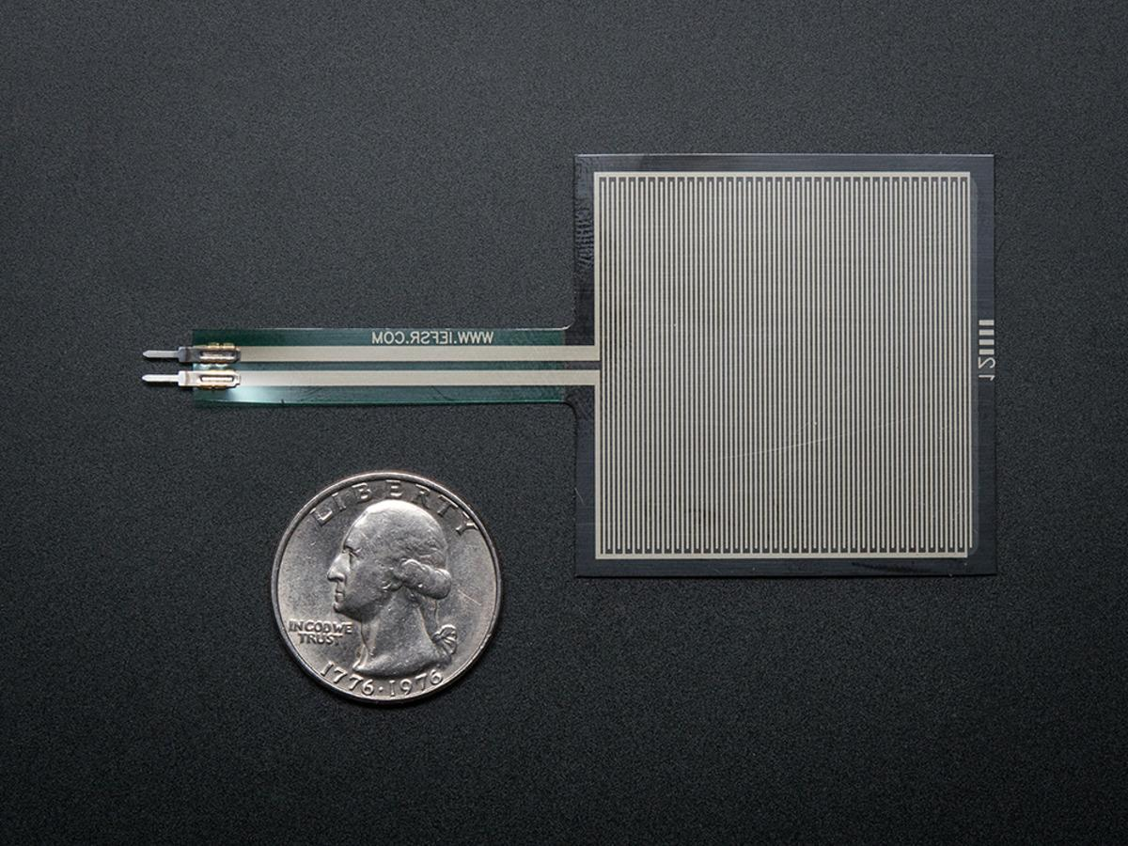
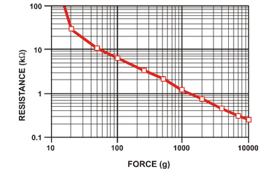
Block Diagram - Sensing Components
Force Sensitive Resistors:
Compact and discrete form factor
Capable of measuring weight within desired weight range (50 - 300 grams)
Figure 1. Plot of resistance vs force for a force sensing resistor. Source: https://learn.adafruit.com/assets/429
Notes:
TIM
starts at ~7:00
Square and round FSRs
d=0.5” https://www.sparkfun.com/products/9376
d=1” https://www.sparkfun.com/products/11207
1.75x1.5” https://www.sparkfun.com/products/9375
1.5x1.5” https://www.adafruit.com/product/1075
d=0.5” https://www.adafruit.com/product/166

Slide 12
Block Diagram - Sensing Components
Figure 1. Plot of resistance vs force for a force sensing resistor. Source: https://learn.adafruit.com/assets/429
Notes:
TIM

Slide 13
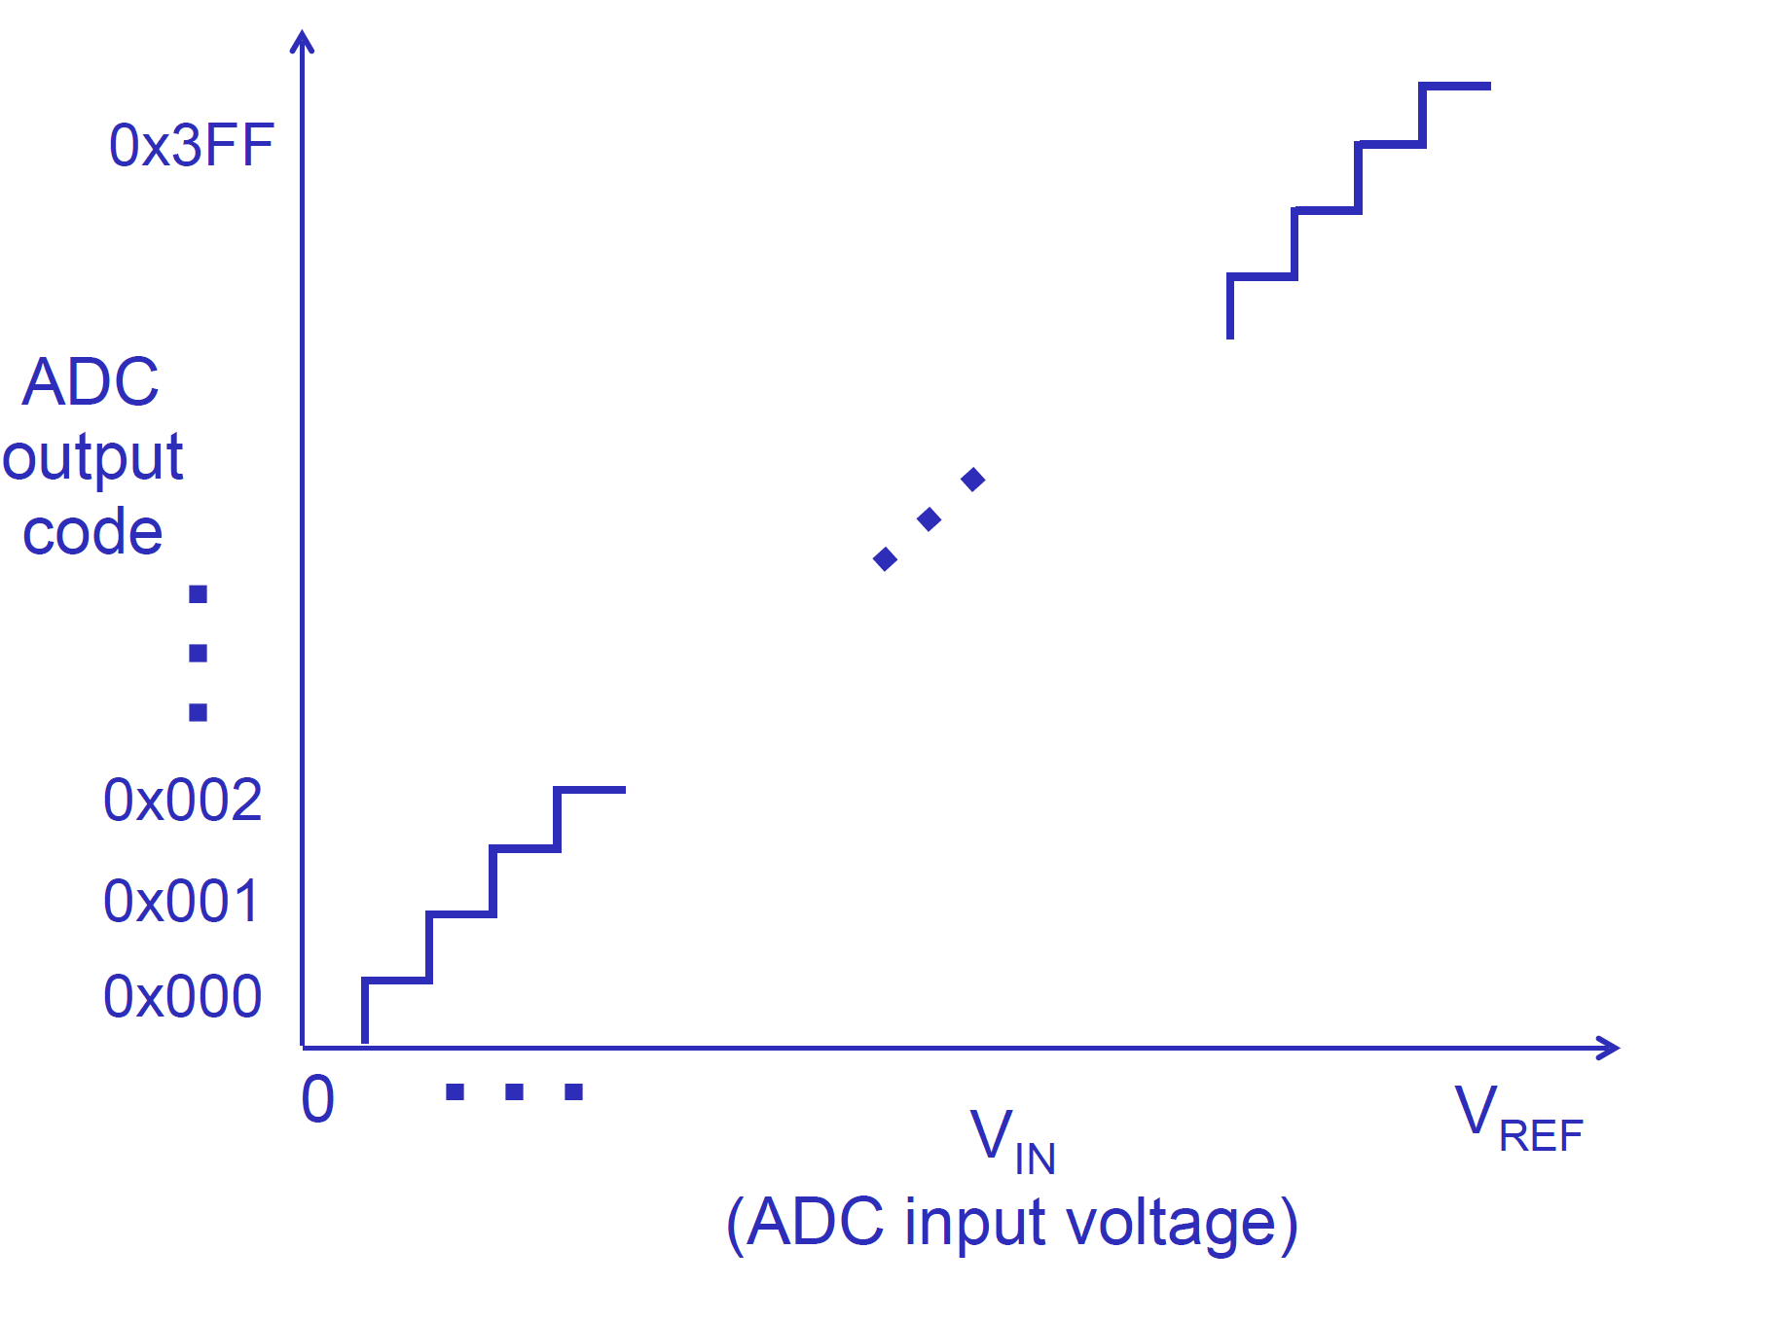
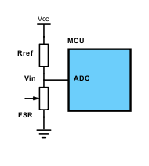
Analog Digital Converter
Needs to translate analog voltage into a force/weight measurement (ADC)
Has enough resolution to detect small changes in weight
Low power consumption
Figure 2. Wiring diagram of the force resistive sensor into the Microcontroller ADC
Figure 3. Expression for evaluating the ADC output value based on the input voltage
Figure 4. Translation of ADC input voltage into output codes
Notes:
Angus
starts at ~8:15

Slide 14
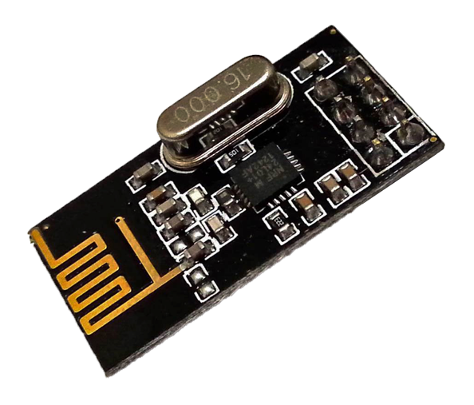
Wireless Communication
Requirements:
Send status notification wirelessly to a central hub
Does not have to be real-time, i.e. report status every few seconds
Low power communication
Working range up to 100m in open space
Nordic Semiconductor's nRF24L01+ is a common 2.4GHz radio transceiver IC for low power/bandwidth scenarios.
1.9V-3.6V
Transmission: ~12mA
Standby: 26µA
Power down: 0.9µA
Notes:
Josh
starts at ~9:10
In practice, open-air ranges may be 80m or less with small payload… Smaller payload may increase range, not sure if true with static payload size.

Slide 15
Block Diagram - Software Requirements
Determine expected empty and full weights
Each range is bounded by the empty weight and max full weight
Relate weight ranges to container types
Standard glass, coffee mug, wine glass, etc.
Detect empty drinks with ice/other leftovers
Log the time when the weight last changed by more than some threshold
Track how long a drink has gone untouched
Notify staff
Alert waiters/waitresses when drink is low/empty
Hub notifies app to send alerts
Notes:
Josh

Slide 16
MDR Deliverables
Arduino-driven coaster and hub prototype
Sensor Accuracy:
Weight error <10 grams
Differentiate between drink levels
Coaster Functionality:
Full, half-full, empty
System Communication:
Hub receives and logs weight sent from coasters
Notes:
Jon
starts at ~13:30

Slide 17
Prototype Cost Analysis
Coaster:
Enclosure: $15
Processing unit: $25
Microcontroller
PCB
Passive Components
Wireless comms: $7
Battery: $5
Force sensors: $25
Coaster Total: $77
Hub:
Enclosure: $15
Processing unit: $25
Microcontroller
PCB
Passive Components
Wireless comms: $7
HUB Total: $47
Notes:
Jon
starts at ~14:30 Maybe coaster and hub on each side. If needed, we can add a section below with any extra expenses and maybe some sort of total cost

Slide 18
Major Tasks
Josh
Wireless implementation
App/UI Development
Tim
Hardware/Sensor implementation
Enclosure Design
Angus
Embedded Software
Data analysis/processing
Jon
PCB
Power budgeting
Notes:
Jon
starts at ~15:45

Slide 19
Questions?
Notes:
~16:30
More functionality!
Add buttons, what type of drink
Power Consumption: specific numbers
Interrupts vs polling
MDR 2 prototypes
Different modes
ADC power hungry: alternatives?

Slide 20
References
FSR Wiring
https://www.electronicdesign.com/analog/signal-conditioning-force-sensing-resistors
Connecting FSR to AVR
https://learn.adafruit.com/force-sensitive-resistor-fsr/using-an-fsr
MCU Wifi
https://circuitdigest.com/microcontroller-projects/esp8266-nodemcu-with-atmega16-avr-microcontroller-to-send-an-email
nRF24L01+ RF Transceiver IC
https://lastminuteengineers.com/nrf24l01-arduino-wireless-communication/
Force Sensing Resistor (FSR)
https://www.adafruit.com/product/1075

