Slide 1
Smart Coaster
SDP20
Team 16
MDR
December 4th, 2019
Notes:
Tim
Possible military uses?...
Piezo sensor to trigger communication system to reduce power consumption
Resonant frequency?...

Slide 2
Meet the Team
Professor Joshua Yang
Advisor
Jonathan Capozzi
EE
Timothy Shum
EE
Angus Mo
EE
Joshua Howell
CSE
Notes:
Everyone, starting with Tim then in order

Slide 3
Problem Statement
At restaurants, fast and responsive service leads to higher customer satisfaction. Waiters/waitresses often juggle serving several tables at the same time. A customer might finish their drink and have to wait a while for service.
Notes:
Josh

Slide 4
Specifications
>95% “empty glass” detection rate
<1% “empty glass” false positives
>12hr battery life
<5hr recharge time
<2cm coaster thickness
Supports multiple coasters
Accurately detects a new/refilled beverage
Accurately determines weight of glass itself
Accounts for ice or other leftovers
Reach Goal: Wireless charging station
Notes:
Jon
starts at ~4:00

Slide 5
Block Diagram - Software Requirements
Determine expected empty and full weights
Each range is bounded by the empty weight and max full weight
Relate weight ranges to container types
Standard glass, coffee mug, wine glass, etc.
Detect empty drinks with ice/other leftovers
Log the time when the weight last changed by more than some threshold
Track how long a drink has gone untouched
Notify staff
Alert waiters/waitresses when drink is low/empty
Hub notifies app to send alerts
Notes:
Josh

Slide 6
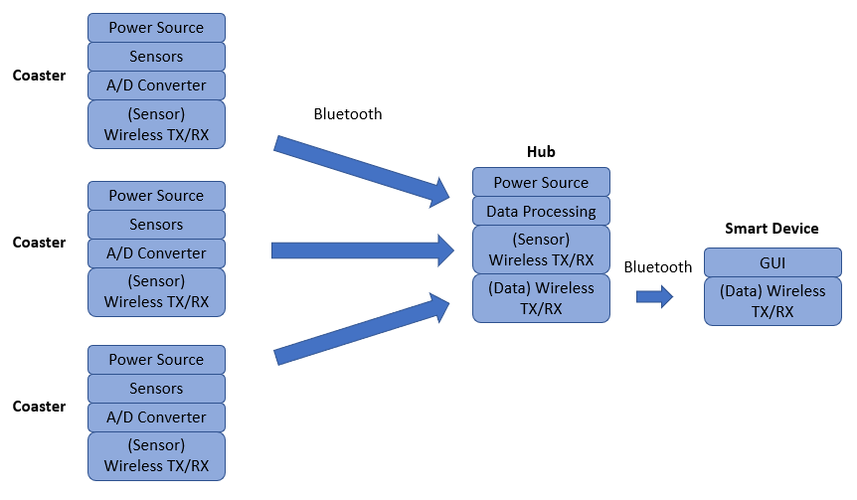
Block Diagram
Notes:
Tim
Edit: 3 coasters, 1 hub, 1 smart device

Slide 7
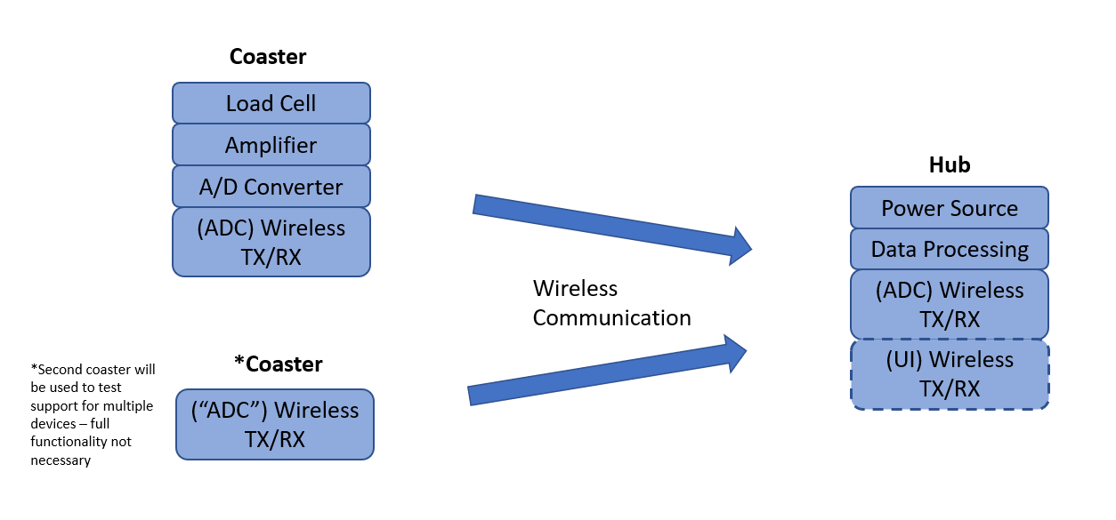
MDR Block Diagram

Slide 8
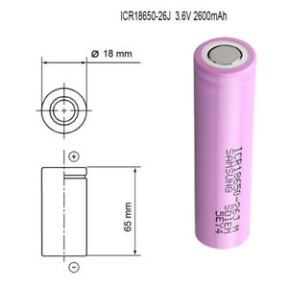
Power Plan
Battery Choice:
Each coaster will have two 3.7V 2600mAH Li-Ion rechargeable batteries in series.
This 7.4V supply voltage will be stepped down to the 5V operating voltage chosen.
If we were to bring down the operating voltage of our Amplifier we could potentially use a series of nickel metal hydride (NiMH) batteries.
Subject to change based on the current needs of future part selection such as the microcontroller.

Slide 9
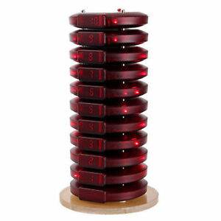
Power Plan
Charging:
Recharge station on the central hub (Regulated power supply using the same wall supply the hub is connected to)
The coasters are rechargeable through the same process as restaurant pagers
Metal Contacts on the screws that hold the enclosure together
The charge travels up through all the coasters that are stacked, charging them all simultaneously
Metal plates make contact with the screws internally to charge the batteries

Slide 10
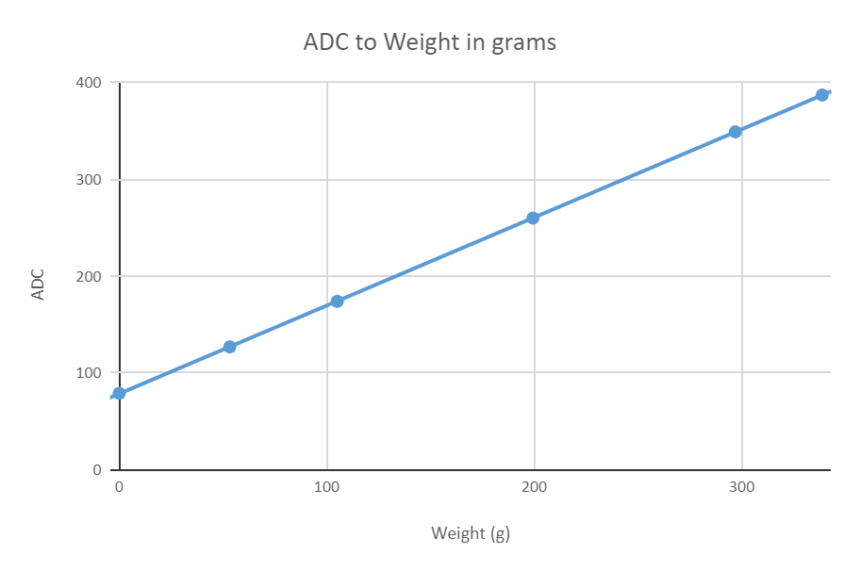
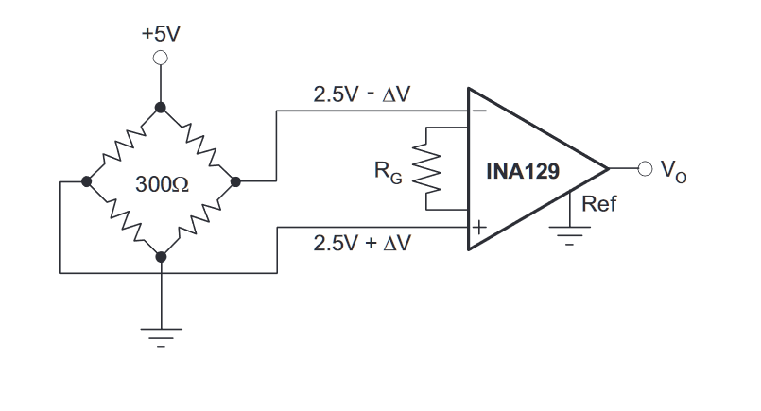
Load Cell
High accuracy
Highly linear
Small output voltage
Needs an amplifier so that we can use the range of our ADC

Slide 11
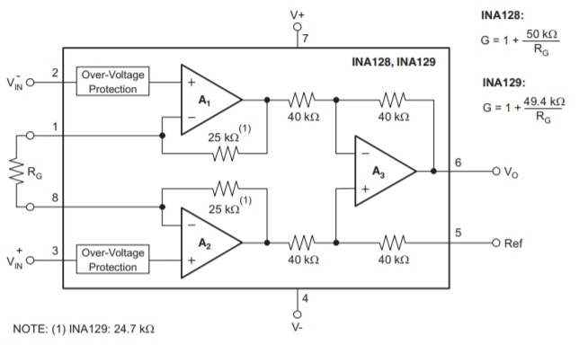
Instrumentation Amplifier
Needed to bring the output voltage range of the load cell to the range of the ADC
~ .4mV-3.7mV from the load cell
Picked a gain resistor to reach for 1000 V/V gain
Operating at a supply voltage of 5V

Slide 12
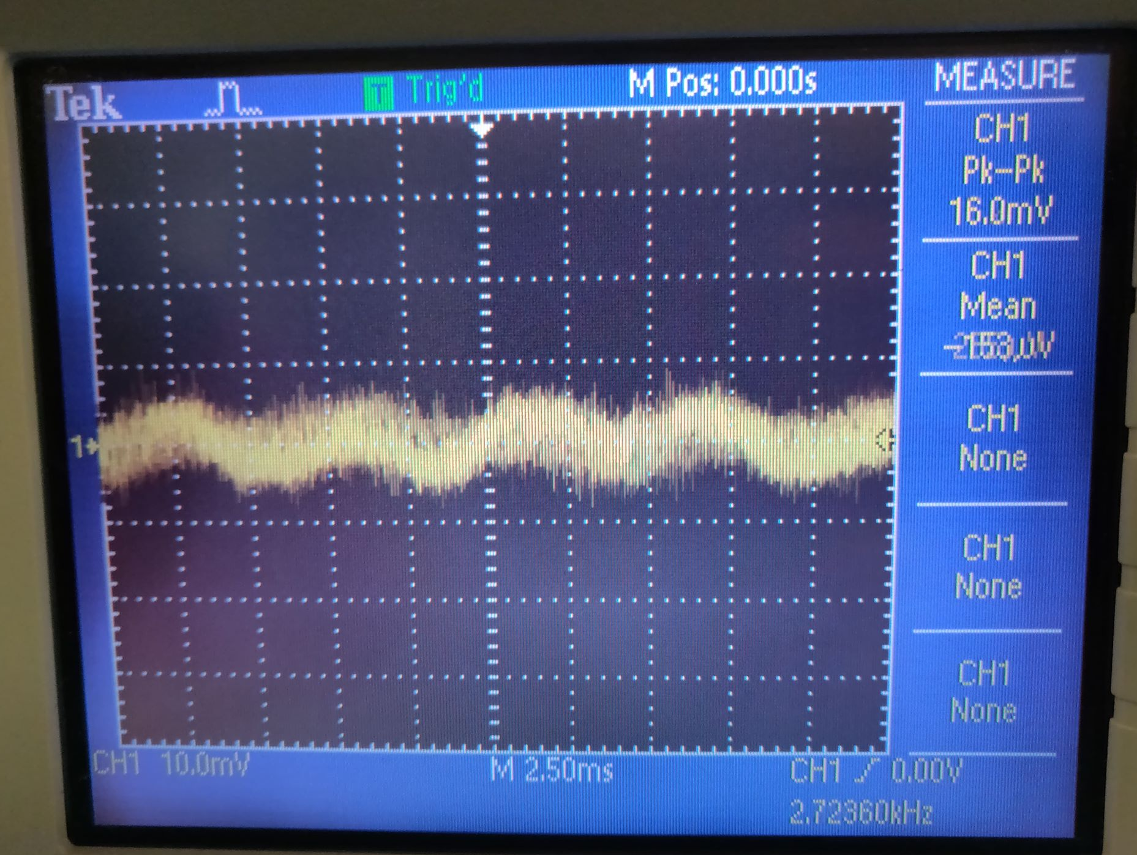
ADC and Measurement Precision
ATMEGA328 ADC maps analog input between 0-5V to a digital range 0-1023
Each ADC value represented roughly by 5mV
Considering noise ~ 7.5mV amplitude, expected +/- 1.5 error in ADC value
Depending on calibration, accuracy of about X grams/ADC value
Notes:
Angus
starts at ~8:15

Slide 13
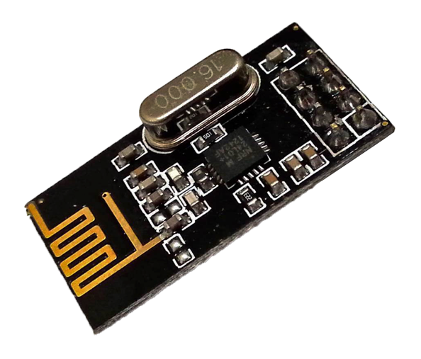
Wireless Communication
Requirements:
Send status notification wirelessly to a central hub
Does not have to be real-time, i.e. report status every few seconds
Low power communication
Working range up to 100m in open space
Nordic Semiconductor's nRF24L01+ is a common 2.4GHz radio transceiver IC for low power/bandwidth scenarios.
1.9V-3.6V
Transmission: ~12mA
Standby: 26µA
Power down: 0.9µA
Notes:
Josh
starts at ~9:10
In practice, open-air ranges may be 80m or less with small payload… Smaller payload may increase range, not sure if true with static payload size.

Slide 14
MDR Deliverables
Arduino-driven coaster and hub prototype
Sensor Accuracy:
Weight error <10 grams
Differentiate between drink levels
Coaster Functionality:
Full, half-full, empty
System Communication:
Hub receives and logs weight sent from coasters
Notes:
Jon
starts at ~13:30

Slide 15
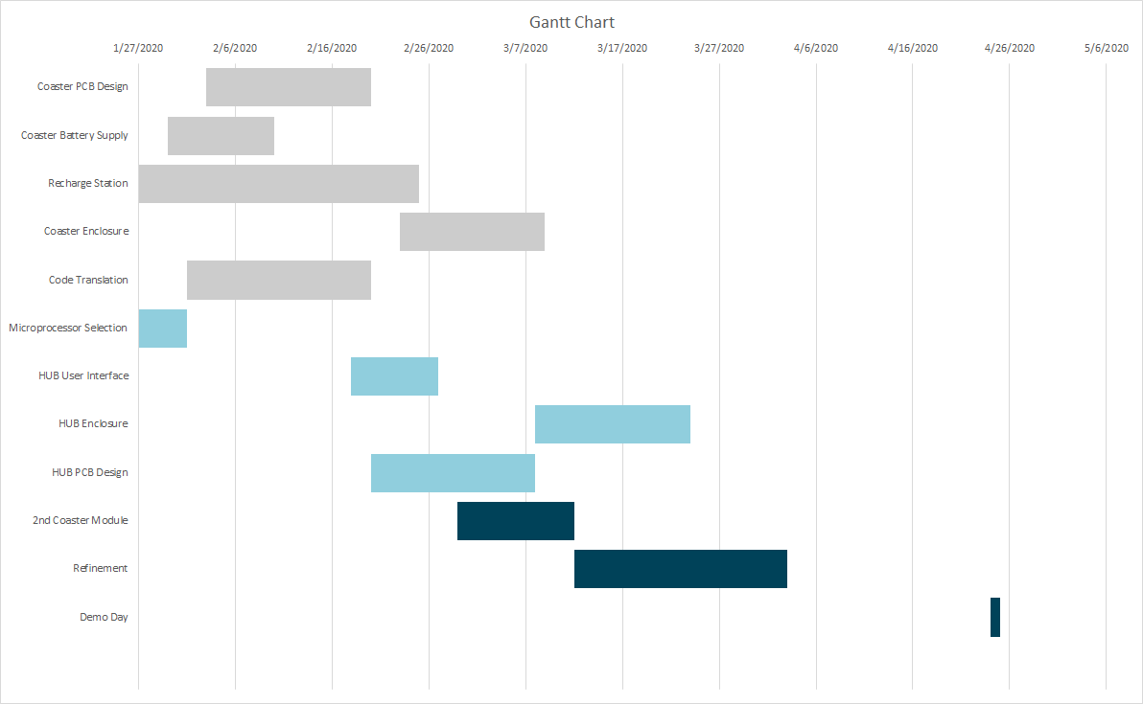
Gantt Chart

Slide 16
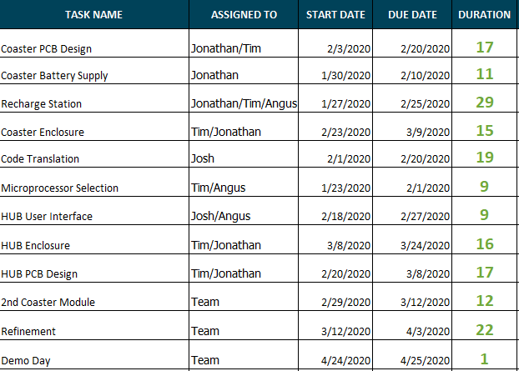
Responsibilities

Slide 17
Demo
Notes:
~16:30
More functionality!
Add buttons, what type of drink
Power Consumption: specific numbers
Interrupts vs polling
MDR 2 prototypes
Different modes
ADC power hungry: alternatives?

Slide 18
References
FSR Wiring
https://www.electronicdesign.com/analog/signal-conditioning-force-sensing-resistors
Connecting FSR to AVR
https://learn.adafruit.com/force-sensitive-resistor-fsr/using-an-fsr
MCU Wifi
https://circuitdigest.com/microcontroller-projects/esp8266-nodemcu-with-atmega16-avr-microcontroller-to-send-an-email
nRF24L01+ RF Transceiver IC
https://lastminuteengineers.com/nrf24l01-arduino-wireless-communication/
Force Sensing Resistor (FSR)
https://www.adafruit.com/product/1075

