Slide 1
Preliminary Design Review
October 10th,2019
Team 9
Clover
Notes:
Problem Statement - Tim (1)
Alternative Solution - Tucker (3)
System Requirements - Tim (2)
Block Diagram, State Diagram - Brandon (2)
Microcontroller, Solar Panel - Omar (2)
Moisture Sensor - Tucker (4)
Wifi RX/TX - Brandon (3)
User Interface - Brandon (4)
Proposed Budget - Omar (3)
MDR Prototype - Tim (3)
Reach Goals - Omar (4)
Significant Hardware Component - Tim (4)
Questions

Slide 2
Clover Team
Tucker Chaisit
EE
Omar Yacteen
EE
Brandon Zeng
CompE
Tim Zhang
EE
Christopher V. Hollot
Advisor

Slide 3
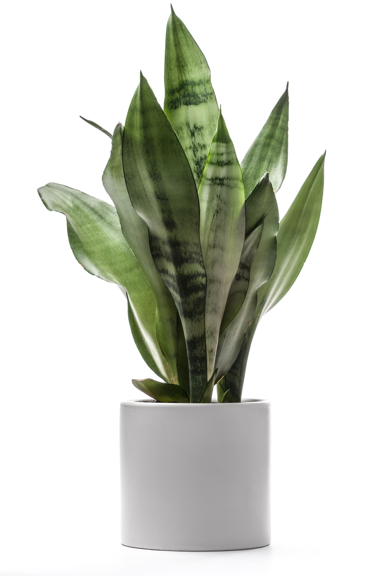
Problem Statement
Plants are positive, welcoming, and healthy in homes
Inexperienced plant owners
Time, money, and resources wasted
Plants are living but hard to understand
Technology enables convenience, improves understanding
Clover monitors light intensity and soil moisture then notifies the owner when the plant needs attention

Slide 4
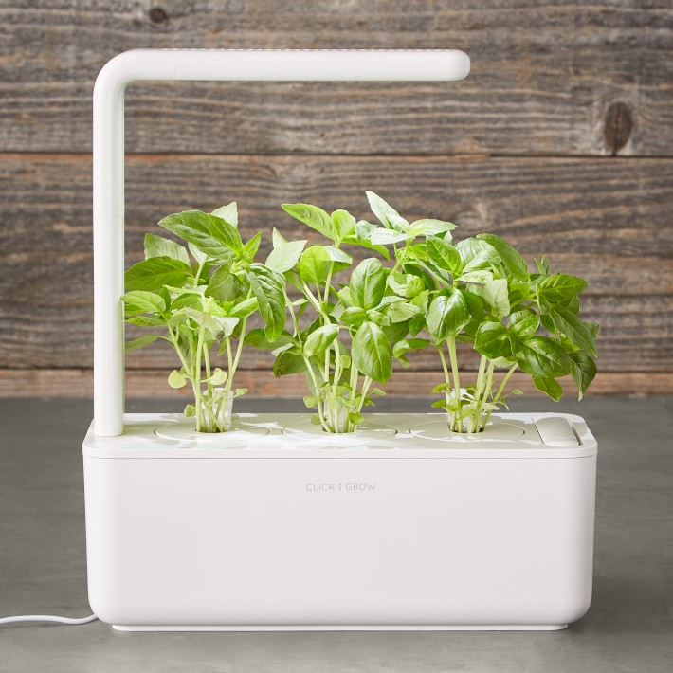
Alternative Solution: Automated Growing Stations
Pros:
Artificial light included
Smart soil
Easy installation & Maintenance
Cons:
Fixed size
Pre-seeded plant capsule
Lack of programmability
Relatively High Cost ($60-$200)
Click and Grow Smart Garden on Amazon ($99)

Slide 5
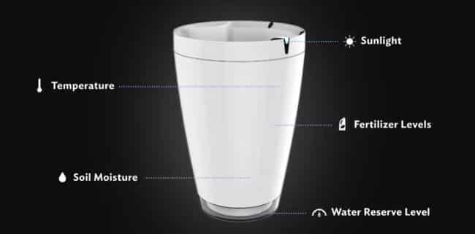
Alternative Solution: Smart Pot
Pros:
Provides housing for the plant
Automatic watering system
Monitoring App
Cons:
Only focus on watering
Prone to hardware failures (based on Amazon reviews)
Fixed Size
Only Bluetooth enabled
Lack of programmability
Parrot Pot on Amazon ($58.95)

Slide 6
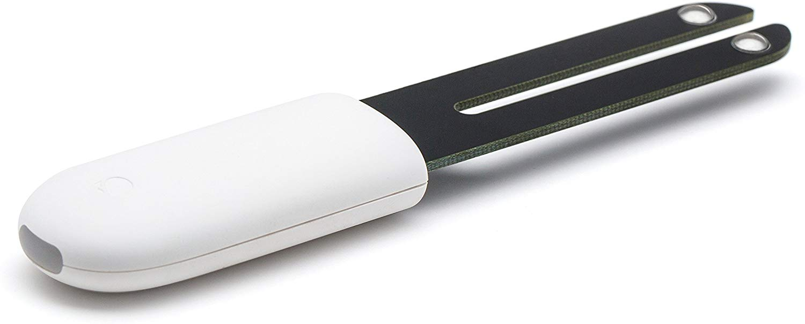
Alternative Solution: Smart Sensor
Pros:
Fits in most plant enclosures (6.8 x 3 x 0.7 in)
Real time analysis
Easy to connect App and set up
Waterproof
Cons:
Resistive measurement
measure conductivity between 2 metal prongs
Do not work in loose soil
Bluetooth only
No notification systems
Lack of programmability
Vistefly Flowers Smart Care Sensor
on Amazon ($25)

Slide 7
System Requirements/Specifications
Compact form factor fits into most plant enclosures.
3 x 2 x 7 in
Portable
Low Power
Onboard battery is charged via solar cell
Product will notify users when the plant requires attention
LED indicators show basic plant status on button press
Communication range up to 40m
IP64 dust and water resistance rating
Programmable Plant Library
Tracks and stores records of active plants
Supports 10 different plant classes (flowering, palm, foliage, etc.)

Slide 8
Solution: Block Diagram
Enclosure
Power Supply
Bluetooth RX/TX
Sensor Module
Controller
BT
Pi
Sensor Package
BT/WiFi Hub
Light
Water
WiFi
Database
Active Plant Library
Plant Growth Parameters
-Brandon
-Omar
-Tucker
-Tim
Smartphone App
User Interface

Slide 9
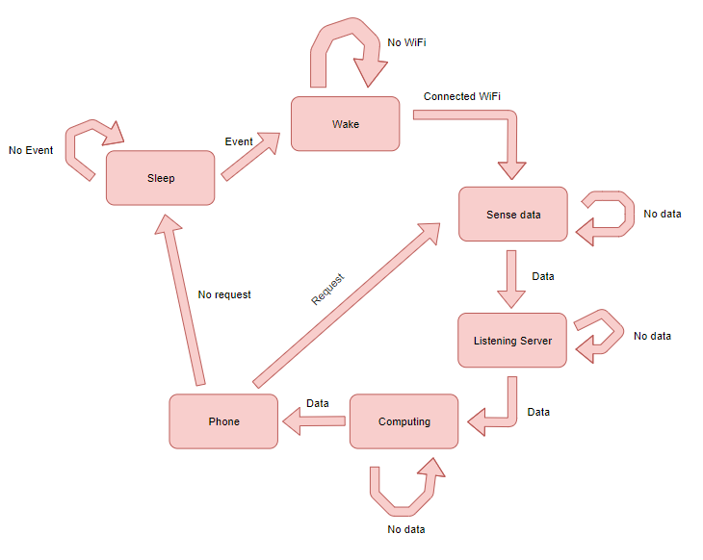
Solution: State Diagram

Slide 10
MDR Prototype
Enclosure
Power Supply
LED Indicators
Sensor Module
Controller
RX/TX
Sensor Package
WiFi
Database/Server
Light
Water
Active Plant Library
Plant Growth Parameters
Internet Link
Smartphone App
User Interface
Notes:
Demonstration of Working Sensor System (Spec 4)
Capable of processing data from connected sensors
Powered by 2,400 mAh AA battery (Spec 2)
Transfer processed data to UI
Demonstration of the User Interface (Spec 3)
Functional Android App
App is able to read and display sensor data
Send notification to user if the plant needs attention

Slide 11
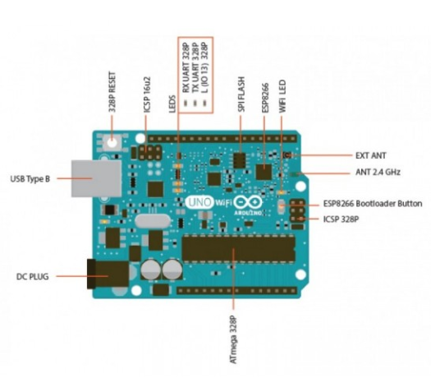
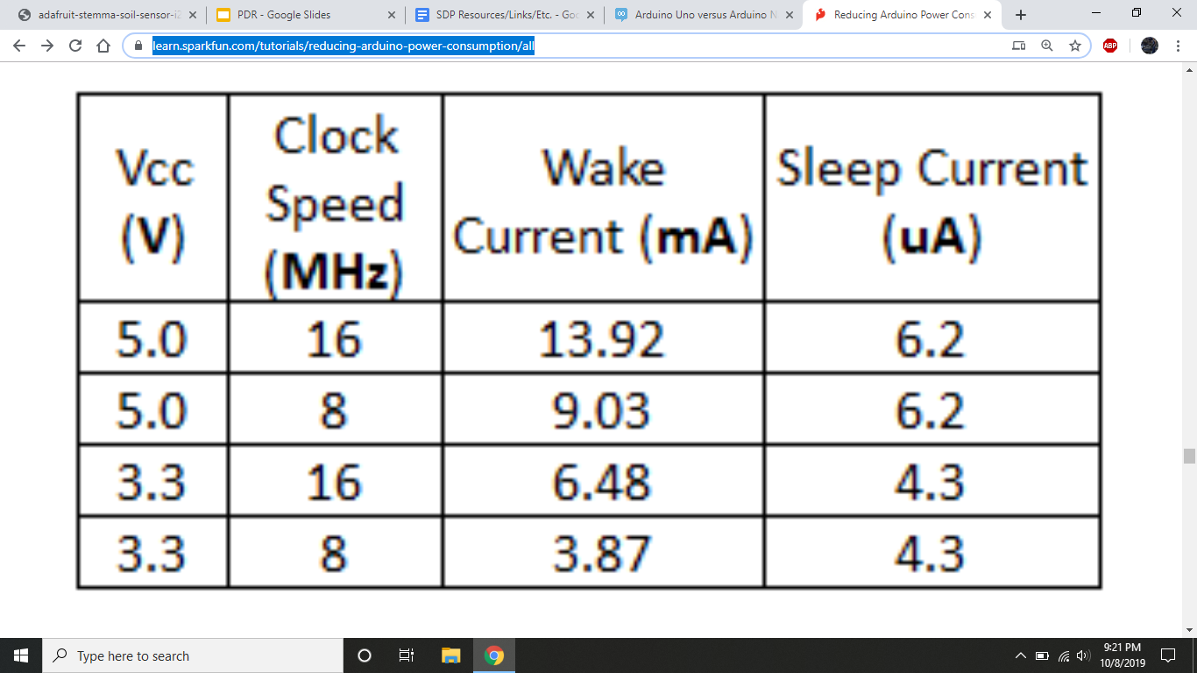
Subsystem: Microcontroller
Arduino UNO
Sensing, Computation, LED Control
Receives info from sensors
Runs instruction set
Transmits data
~45 mW
~0.031 mW

Slide 12
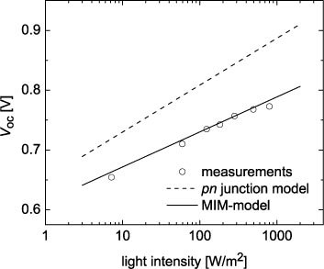
Subsystem: Solar Panel/Light Sensor
AMX3d Micro Solar Cell
Supplies up to 150 mW of power
Excess power used to charge 2,400 mAh backup battery
Read in voltage to determine lighting conditions
₁

Slide 13
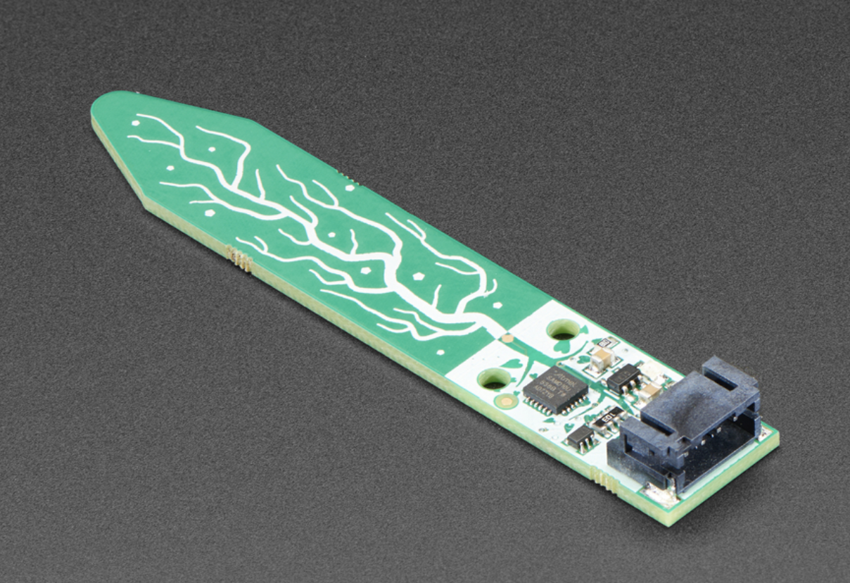
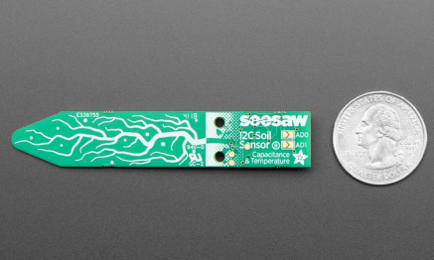
Subsystem: Soil Moisture Sensor
Adafruit STEMMA Soil Sensor
Dimensions: 76.2mm x 14.0mm x 7.0mm
This sensor is a capacitive measurement
Measure the change in dielectric that is form by soil, water is the most important factor
Do not have any exposed metal, no Corrosion
Do not introduce any DC current to the plant
Provide reading ranging from about 200 (very dry) to 2000 (very wet)
Connect a 4-pin JST-PH cable to microcontroller or single board computer to 3-5V power

Slide 14
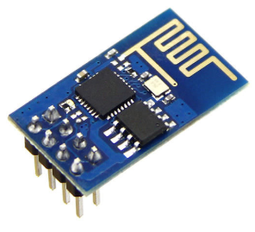
Subsystem: WiFi RX/TX
MQTT- ESP8266 WiFi Module
Small and compact form factor (Spec 1)
Transfers data regarding sensor measurements
Tx 802.11b, 612mW
Capable of receiving data from user
Rx 802.11b, 180mW
Programmable Deep Sleep Mode, 72uW (Spec 2)

Slide 15
Subsystem: User Interface
Display Plant Data
Light Intensity
Soil Moisture level
Notifies user if plant data is outside optimal plant conditioning threshold (Spec 3)
Plant Profiles
Implementation
Android Studio

Slide 16
Proposed Budget
Arduino UNO R3 - $19
ESP8266 WiFi Module - $9
Linear Voltage Regulator LM317 - <$1
Solar Panel - $6
Soil moisture sensor - $7.5
AAA/AA Batteries - $10
Enclosure - ? (~$50)
PCB fabrication - ? (~$100) Total cost ≅ $200

Slide 17
Reach Goals
Additional sensors for temperature & humidity
Wider plant class database
Include 100 most common houseplants

Slide 18
Significant Hardware Component
Power/Control
Sensing
Communication
Notes:
Main circuit board for integrating major subsystems
Interface with RX/TX and sensor modules
Regulate and control power supply
Will replace Arduino after MDR

Slide 19
Questions?

