Slide 1
Mid-year Design Review
December 3rd,2019
Team 9
Clover
Notes:
Problem Statement - Tim (1)
Alternative Solution - Tucker (3)
System Requirements - Tim (2)
Block Diagram, State Diagram - Brandon (2)
Microcontroller, Solar Panel - Omar (2)
Moisture Sensor - Tucker (4)
Wifi RX/TX - Brandon (3)
User Interface - Brandon (4)
Proposed Budget - Omar (3)
MDR Prototype - Tim (3)
Reach Goals - Omar (4)
Significant Hardware Component - Tim (4)
Questions

Slide 2
Clover Team
Tucker Chaisit
EE
Omar Yacteen
EE
Brandon Zeng
CompE
Tim Zhang
EE
Christopher V. Hollot
Advisor

Slide 3
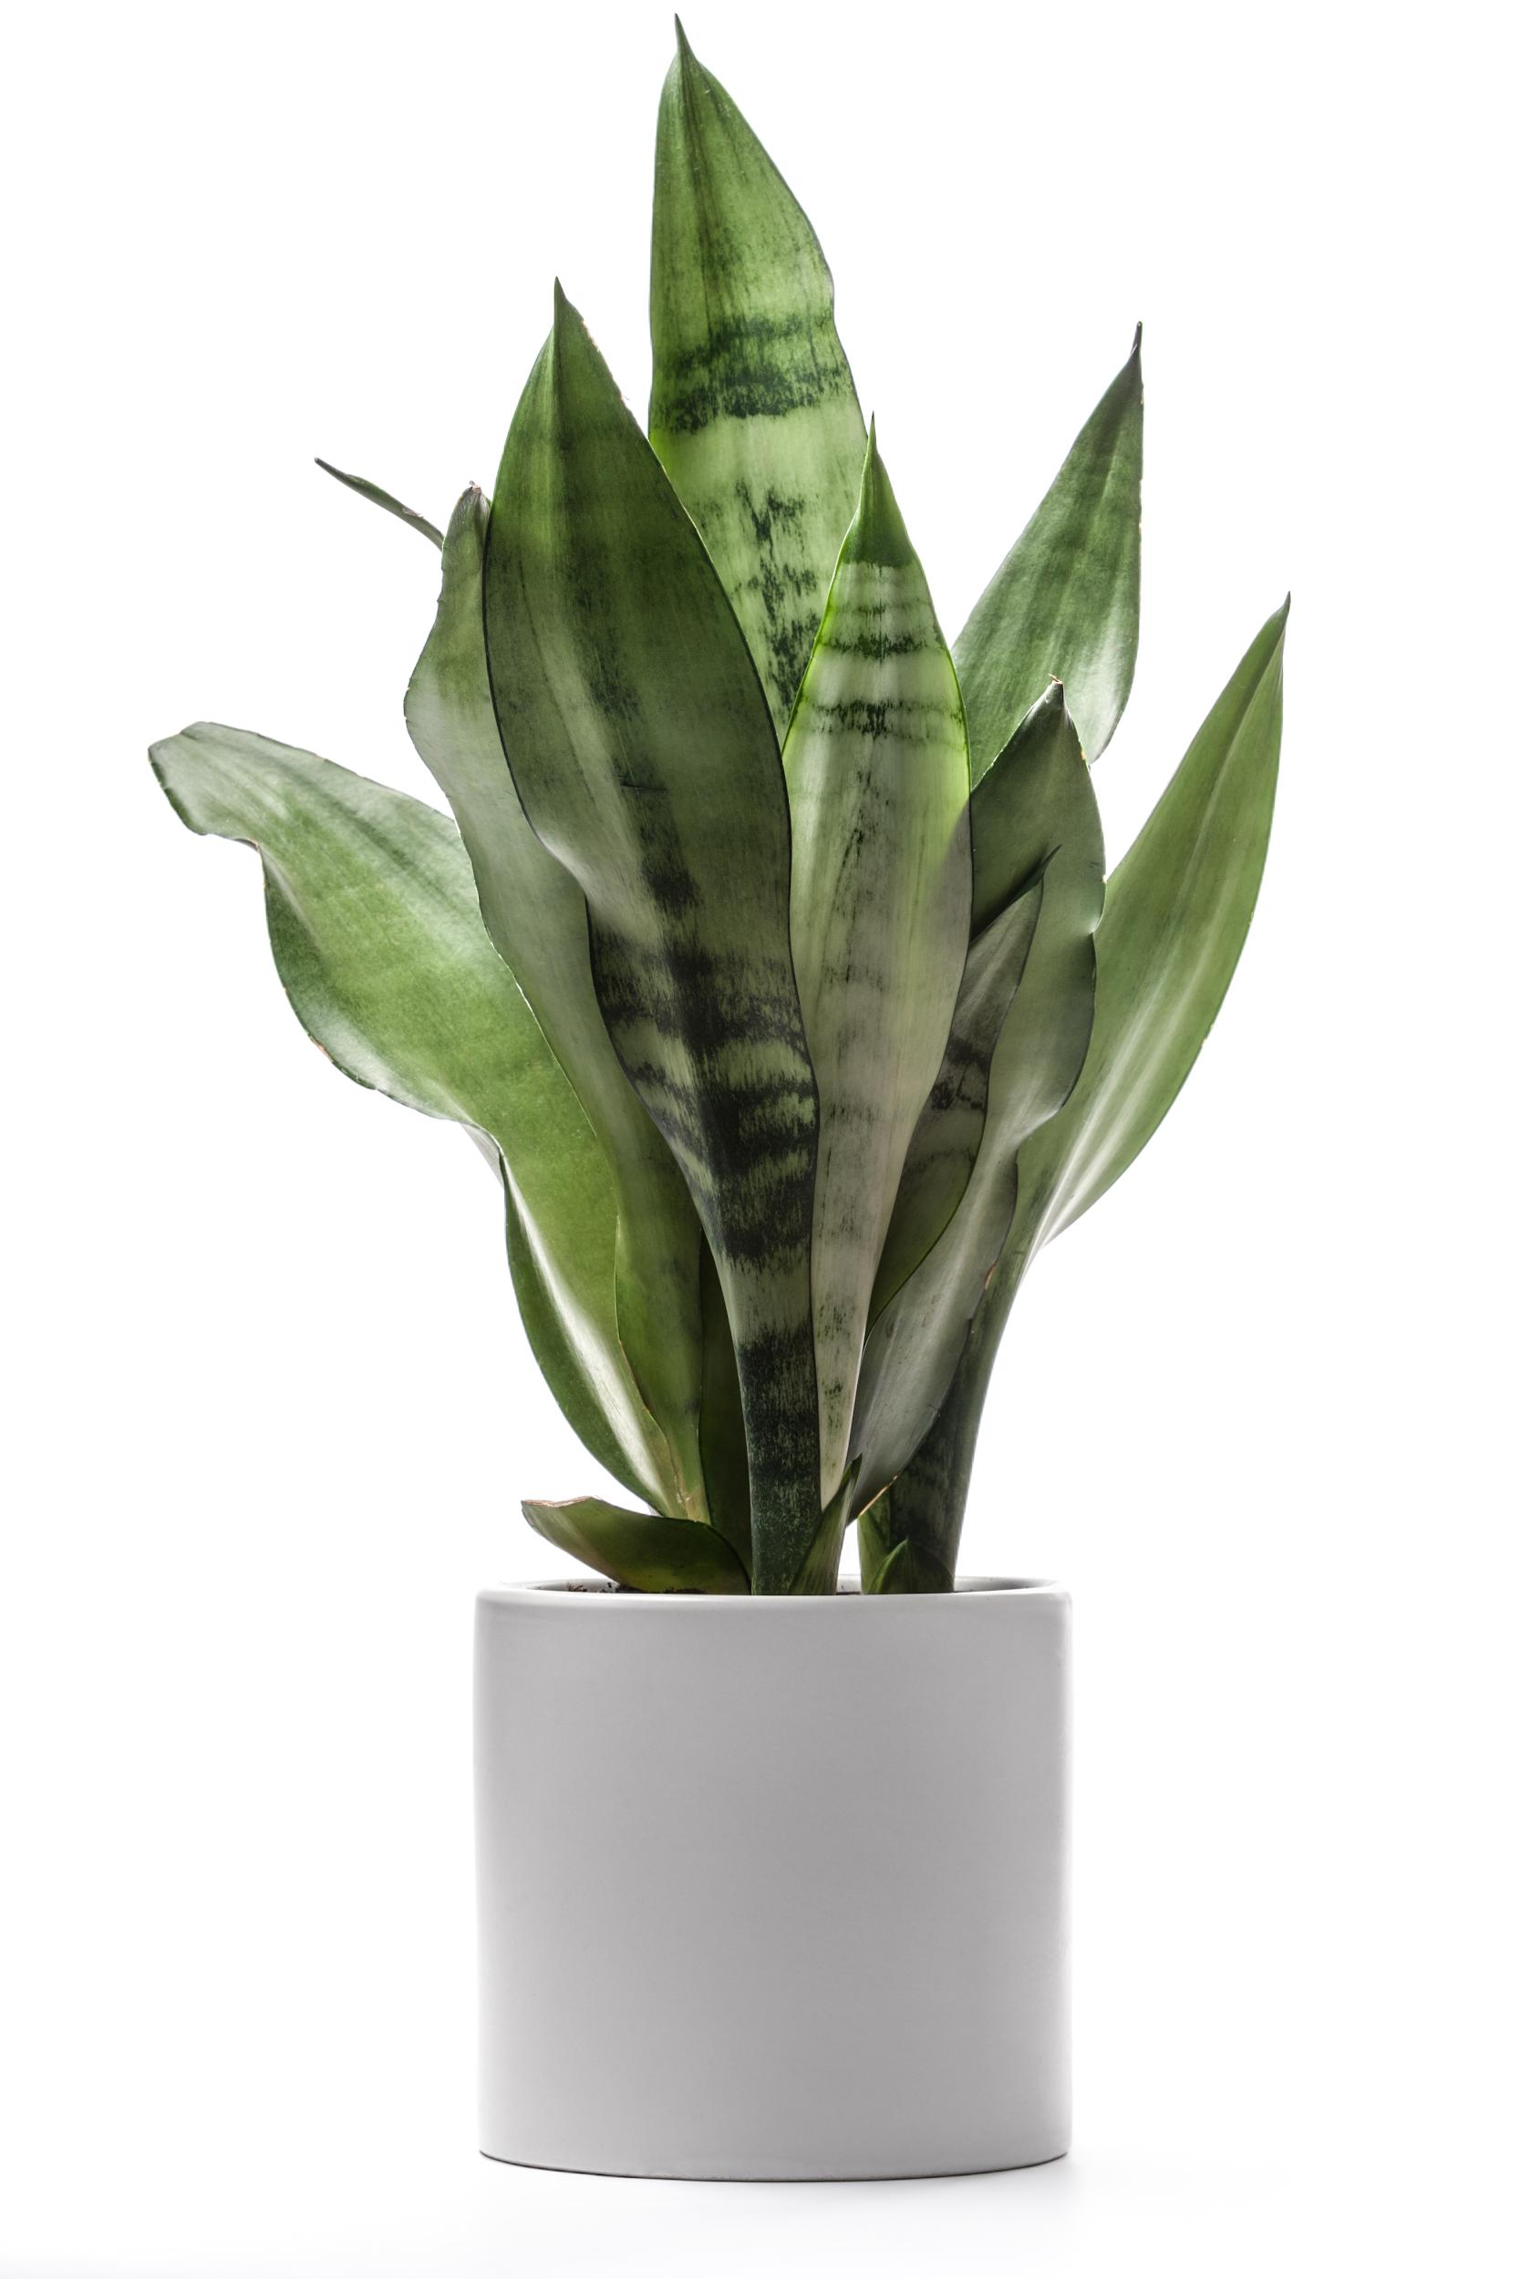
Problem Statement
People like to keep indoor plants (for health, decoration, etc)
People don’t like their plants dying
Time, money, and resources wasted
It can be easy to forget to care for your plants
Plants are living but hard to understand their needs
Technology enables convenience, improves understanding
The Clover IoT sensor is a wireless device that monitors light intensity and soil moisture then notifies the owner when the plant needs attention.
Notes:
Tim (1)

Slide 4
System Requirements/Specifications
Compact form factor fits into most plant enclosures.
3 x 2 x 7 in
Portable
Low Power
Onboard battery is charged via solar cell
Product will notify users when the plant requires attention
Effective Bluetooth transmission range: 40m with 90% success rate
IP64 dust and water resistance rating
Programmable Plant Library
Tracks and stores records of active plants
Supports 10 different plant classes (flowering, palm, foliage, etc.)
Notes:
Tim(2)

Slide 5
Our Previous Solution: Block Diagram
Enclosure
Power Supply
LED Indicators
Sensor Module
Controller
RX/TX
WiFi
Sensor Package
Database/Server
Light
Water
Active Plant Library
Plant Growth Parameters
Internet Link
-Brandon
-Omar
-Tucker
-Tim
Smartphone App
User Interface
Notes:
Brandon(1)

Slide 6
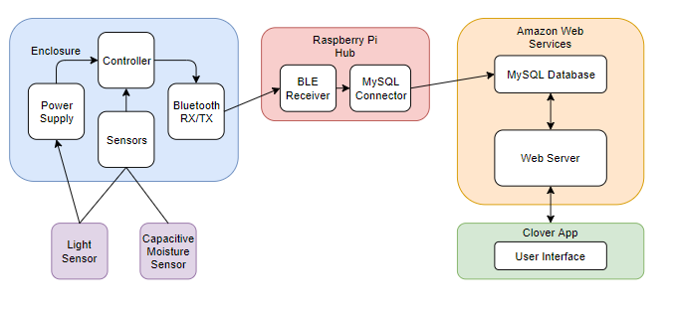
Our Redesigned Solution: Block Diagram
Notes:
Tim(3)

Slide 7
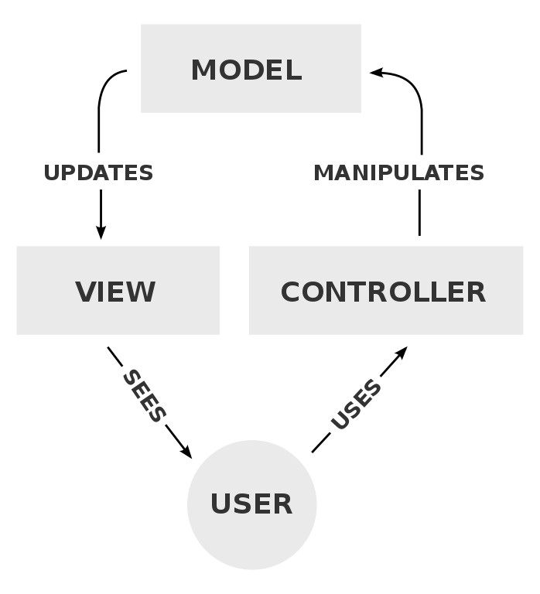
Our Redesigned Solution: Software Flow Diagram
MySQL DB
Android Studio
PHP + Python
Sensor Data
Inform
Interact
Sensing System
Arduino
+
Raspberry Pi
Notes:
Tim(3)

Slide 8
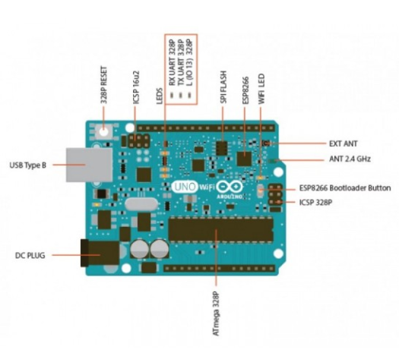
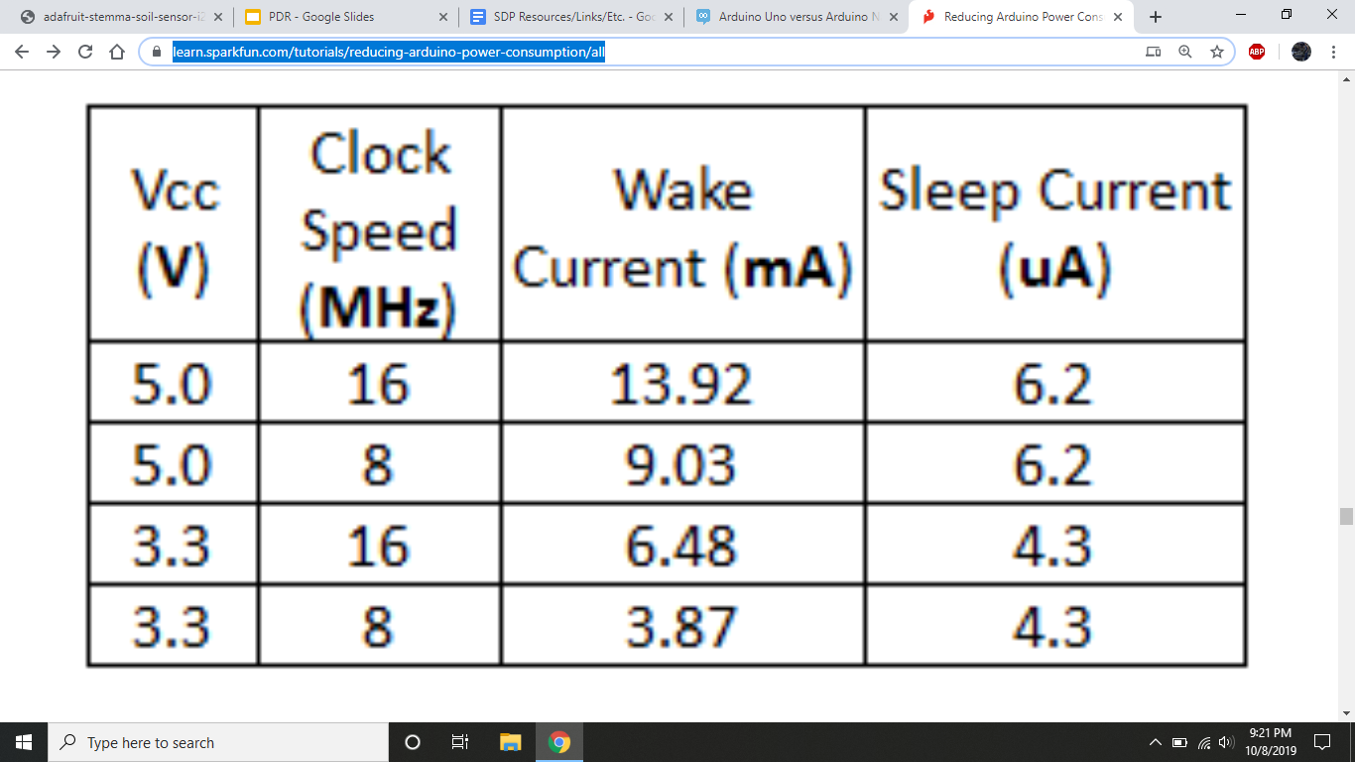
Subsystem: Microcontroller
Arduino UNO
Sensing, Computation, Communication
Receives info from sensors
Runs instruction set
Transmits data
~45 mW
~0.031 mW
Notes:
Omar

Slide 9
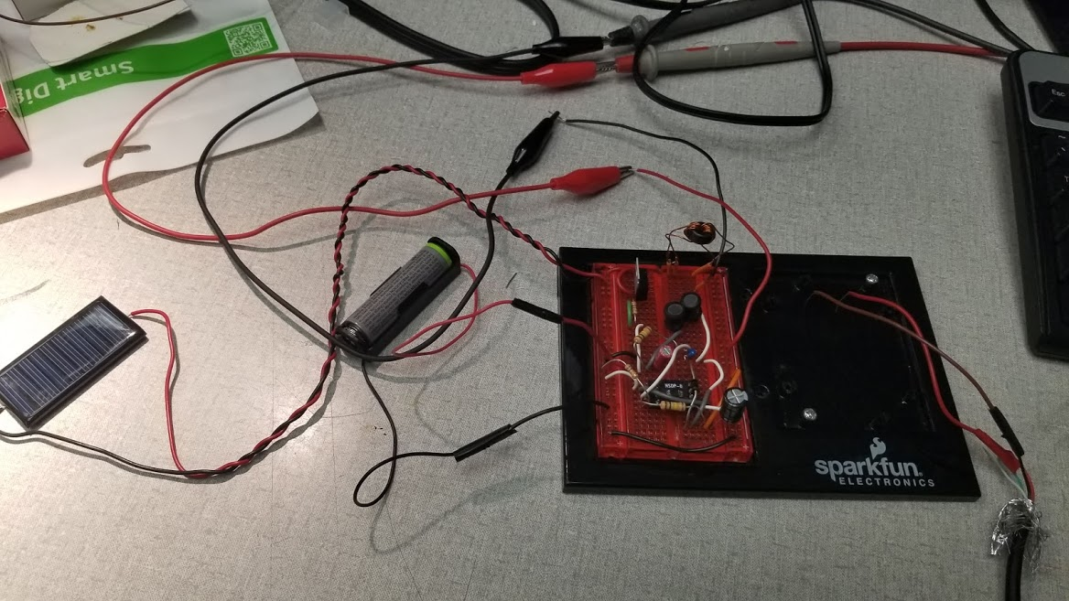
Subsystem: Solar Panel/Light Sensor
Solar Panel for Power, & Sensing
Solar panel recharges the onboard battery.
Arduino also reads in voltage from solar panel to determine light intensity.
Notes:
Omar

Slide 10
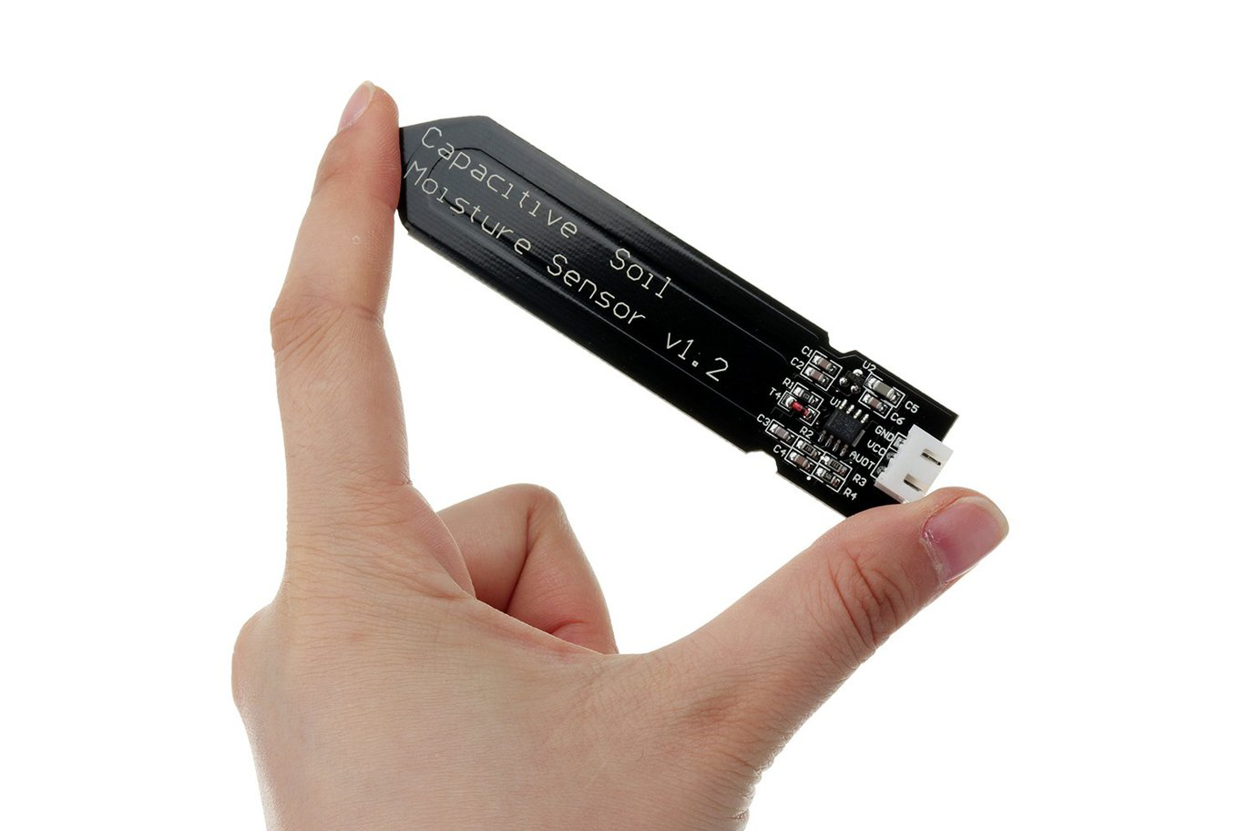
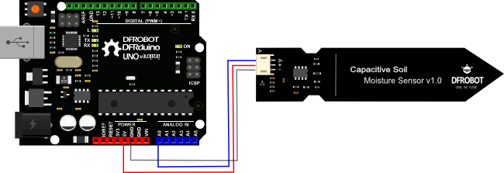
Subsystem: Soil Moisture Sensor
Capacitive Soil Moisture Sensor
Small and compact form factor (Spec 1)
98mm x 23mm
Output analog values
1.2 ~ 2.5V
analogRead() from port 0 on Arduino board
Power
draw about 5mA
Notes:
Tucker

Slide 11
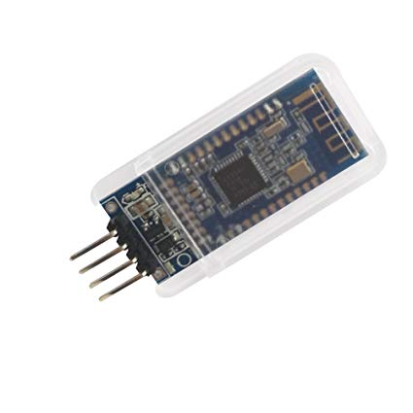
Subsystem: Bluetooth Low Energy (BLE)
DSD Tech HM-10
Small and compact form factor (Spec 1)
27mm x 13mm x 2.2 mm
2.4GHz bandwidth
Bluetooth range: 50 meters
Programmable Sleep Mode (Spec 2)
Power: Active state 8.5mA; Sleep state 50~200uA
Notes:
Brandon(2)

Slide 12
Subsystem: Cross-Device Communications
Arduino to Raspberry Pi
Handles “configuration” services
Pairs the BLE module with it’s MAC address
BluePy library
Raspberry Pi to Server
Uploads “plant data” characteristics
Reads data stored inside BLE Module and inserts it into MySQL database
Notes:
Tim(4)

Slide 13
Subsystem: Amazon Web Services
MySQL Clover Database
Contains two tables
Sensor Measurement Table
Plant Profile List
EC2 Instance (Server)
Backend server that will allow the User Interface to read sensor data from the database.
Contains PHP files that will make queries to and from the MySQL database
The PHP scripts are executed by calling it’s URL file location
Notes:
Brandon(3)

Slide 14
Subsystem: User Interface
Display Most Recent Plant Measurement
Light Intensity
Soil Moisture level
Allow users to add personal plants to database
Plant List
Notification system that will remind users to care for their plant (Spec 3)
Notify user every 15 min
Implementation
Android Studio
Notes:
Brandon(4)

Slide 15
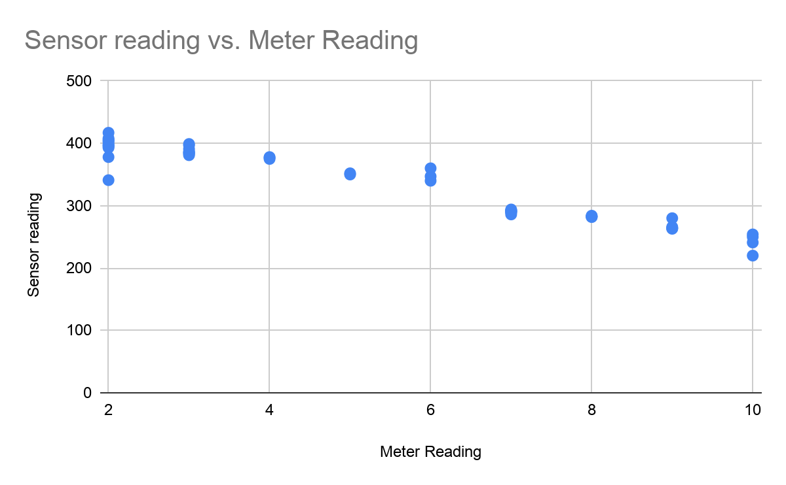
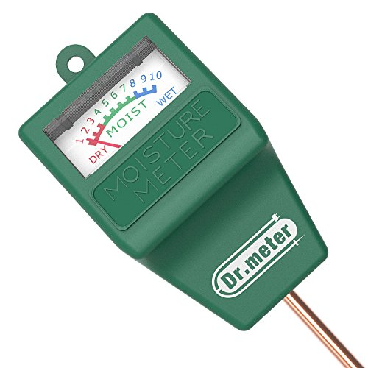
Moisture Sensor Test Results
Soil Meter Reading:
Dry: 0-3
Moist : 4-7
Wet: 8-10
Notes:
Tucker

Slide 16
Proposed MDR Deliverables
Demonstration of Working Sensor System
Capable of processing data from connected sensors
Currently only moisture sensor connected, but data process is implemented
Powered by 2,400 mAh AA battery
Transfer processed data to UI
Demonstration of the User Interface
Functional Android App and Server database
App is able to read and display sensor data
Send notification to user if the plant needs attention
Notes:
Omar

Slide 17
Proposed CDR Deliverables
Integration of custom HW component as primary microcontroller
Develop the structure and an enclosure of the device
Modify Android app and database to accommodate for different users
Notes:
Tucker

Slide 18
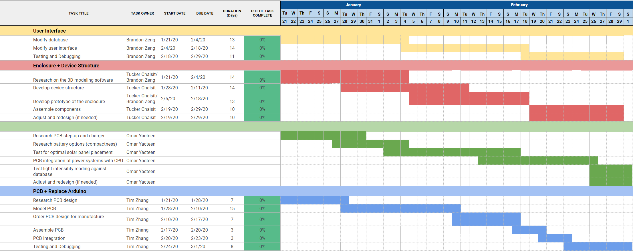
Gantt chart
Notes:
Tucker

Slide 19
o
Demo
Notes:
All

Slide 20
Questions?
Notes:
All

Slide 21
Software Flow Diagram
MySQL DB
Android Studio
PHP + Python
Sensor Data
Inform
Interact
Sensing System
Arduino
+
Raspberry Pi
Notes:
Tim(3)

Slide 22
Solar Panel Battery Charger Curve

Slide 23
Solar Panel Voltage vs Light Intensity

Slide 24
Power Limitations
Goal: Allow Product to run for 48 hrs solely on battery power
Battery can provide ~2.4 Wh [according to duracell datasheet]
2.4 Wh/48 hours = 50 mW
→ Need to keep average power consumption under 50 mW
When in wake mode, only possible running at 8 MHz on Arduino Uno (default is 16 MHz)
Fully integrated product will get rid of unused power pins, LEDs, run at slower clock speeds, sleep longer, and utilize only what is necessary from our prototyping this semester in order to save power

Slide 25
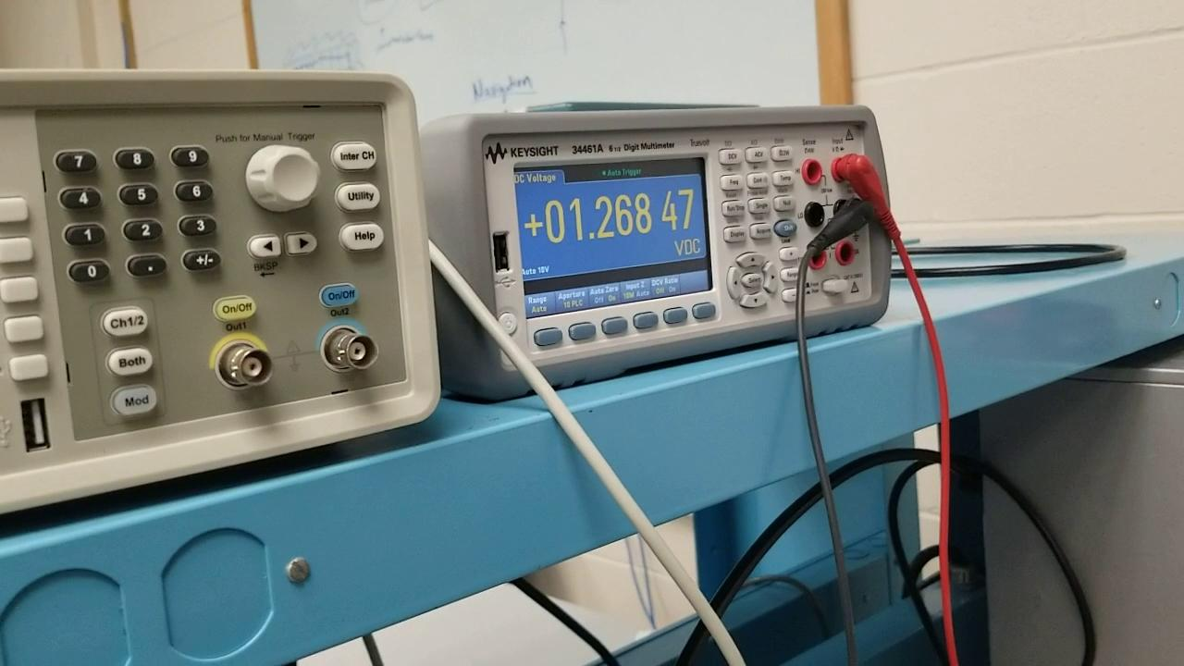
1.2v to 5v Step-up Demo

Slide 26
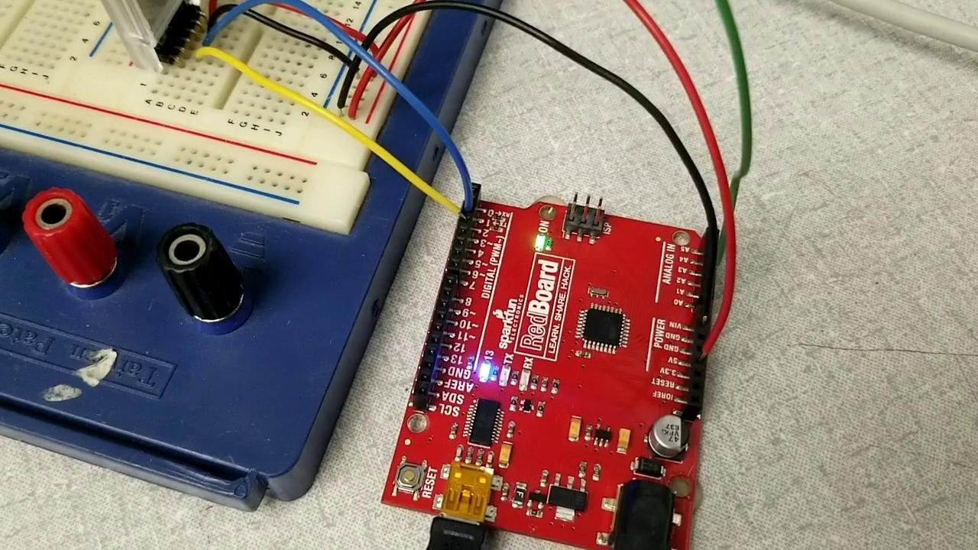
Arduino Uno w/Sensors Battery Power Demo

Slide 27
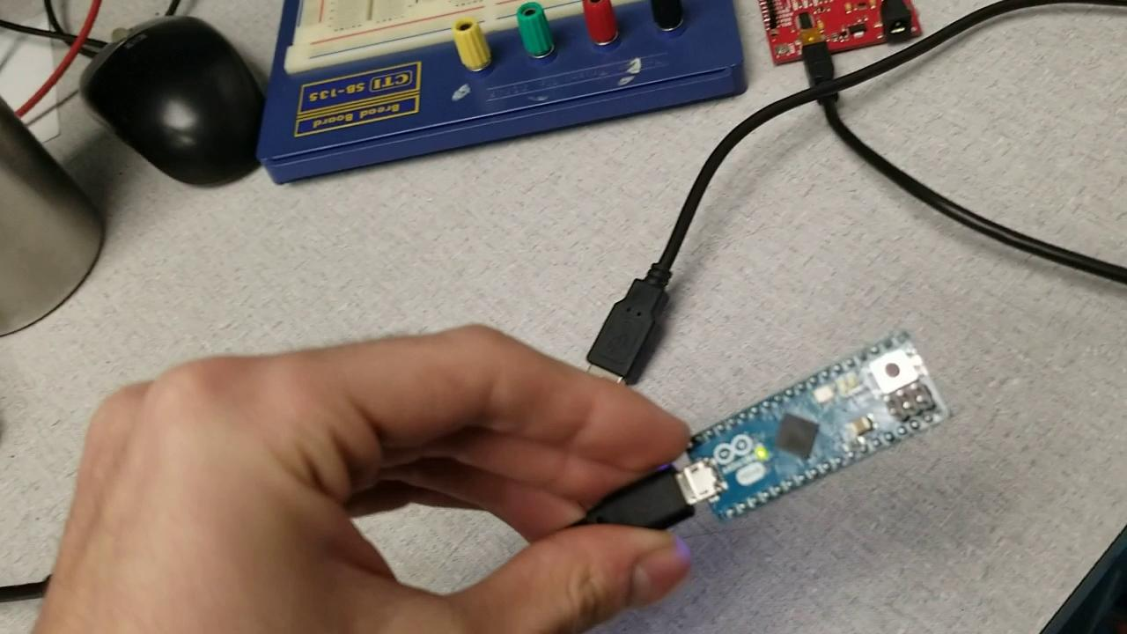
Arduino Micro Battery Power Demo

Slide 28
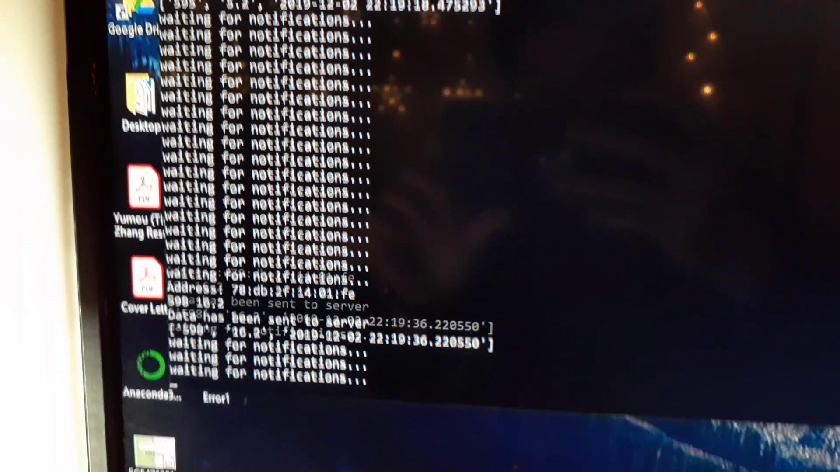
Sensing System Demo Video

Slide 29
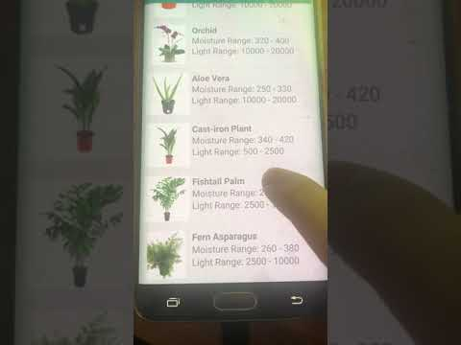
User Interface Demo Video

