Slide 1
Weather Box
Team 3/LH 6
SDP 20
PDR
October 11, 2019

Slide 2
Introduction
Professor Zink
Advisor
Anthony Mendez
CompE
Team Manager
Tina Maurer
EE
Hardware Lead
Stephan Kim
CompE
Christian Norton
CompE
Notes:
Tina pic to be changed

Slide 3
Problem Statement
Commercial weather stations can effectively collect data for a specified area at the macroscale. However, weather conditions in these area can vary greatly at the microscale.
These micro-weather conditions can impact various situations, such as the effective use of a wind farm, the flow of pollutants and waste through an area, and a drone’s ability to fly for emergency services.
Notes:
Christian

Slide 4
System Specifications
Each unit will take measurement at its location and the web server must create a map of at least 150x50 m² based on data from sensor packages
Each sensor package must be mountable and weigh less than one pound
System must measure wind, temperature, barometric pressure, humidity, dust, and air quality
Battery life of combined solar cell and backup battery of at least 24 hours
System must be operable in the range of 20 degrees Fahrenheit to 100 degrees Fahrenheit
Be able to transmit weather measurements wirelessly to a user interface
Each unit must be manufacturable for at most $120
Notes:
Tina

Slide 5
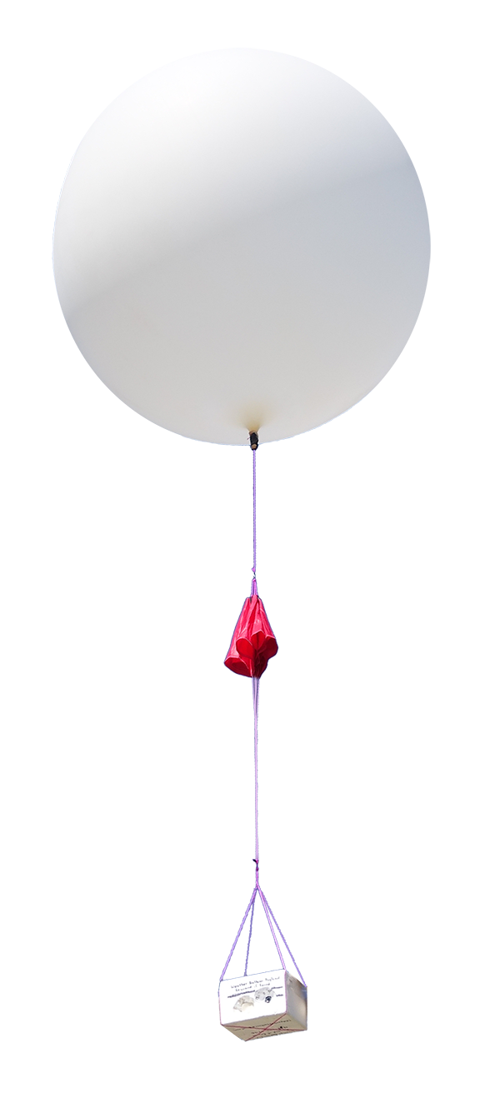
Alternative Design #1:
Weather Balloon Mounted Device
Pros
Easy to deploy
Cons
Only a single vertical map
One time use
Delay between each recording
There is a chance that equipment is never recovered
Limitations on where it can be deployed
Notes:
Christian

Slide 6
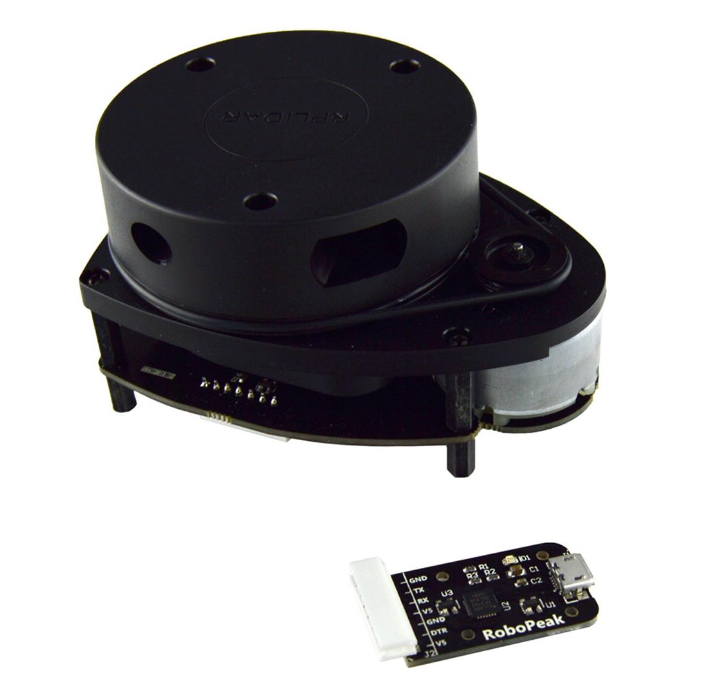
Alternative Design #2:
Lidar Sensor Grid
Pros
Higher resolution
A single device records a 3D map of wind
Better mapping quality
Records data on dust and particles as well
Cons
Out of our budget
Too heavy
Notes:
Christian

Slide 7
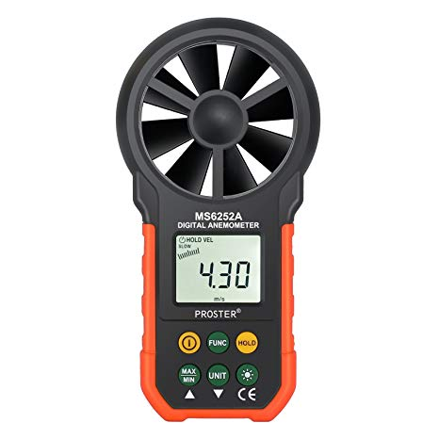
Alternative Design #3:
Hand Sensors
Pros
Easy to carry
Low cost
High accuracy
Cons
Only a single point of measurement
Mapping is difficult, time consuming, and needs to be done manually
Requires people to be on location
Notes:
Christian

Slide 8
Solution
Low cost, Low power, light-weight sensor system that records weather data and sends it to a web server
Web server processes the data and displays it to a website
Users log in to view a map of the sensors to view the following data points:
Temperature
Humidity
Pressure
Wind Speed
Wind Direction
Air Quality
Notes:
Anthony
Low cost, Low Power, Light Weight. Records weather data that is sent to our web server.
Server will process the data and present it on the website
Website will present the following data points:
Temperature
Humidity
Pressure
Wind Speed
Wind Direction
Air Quality

Slide 9
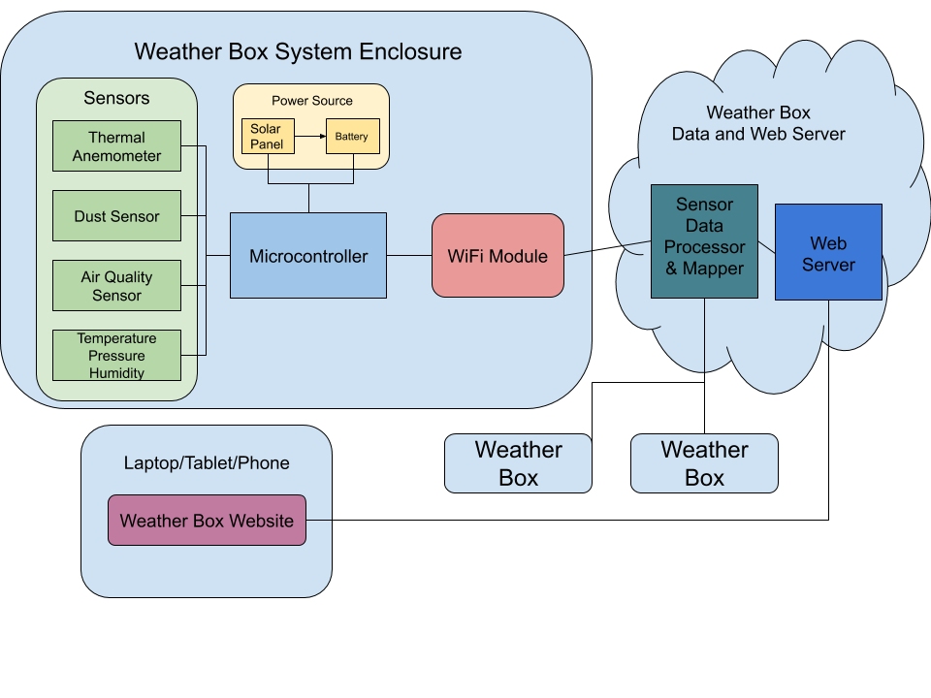
Block Diagram
Notes:
Stephan

Slide 10
Deployment of System
When one of the sensor packages is mounted, its location will be recorded by the installer
The location of the installer’s phone will then be stored on the web application
This eliminates the need for a GPS unit on each sensor module
Notes:
Stephan

Slide 11
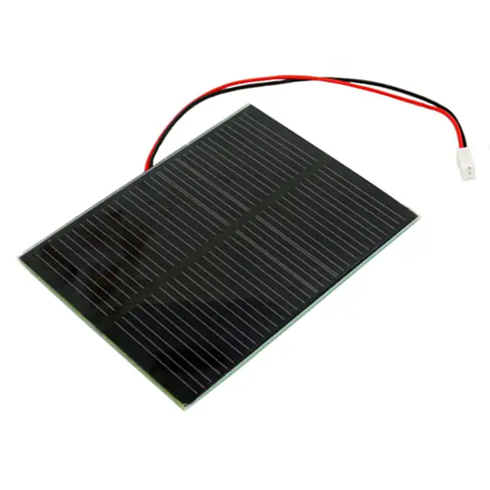
Subsystems - Power Source
Solar cell will act as both a battery charger and power source to power all on board components and sensors
When acting as a battery charger, we will use maximum power point tracking to create a more reliable power source
Based on data from the voltage monitoring, the backup battery will be used as the primary power source should the power source drop below a threshold voltage
Notes:
Tina

Slide 12
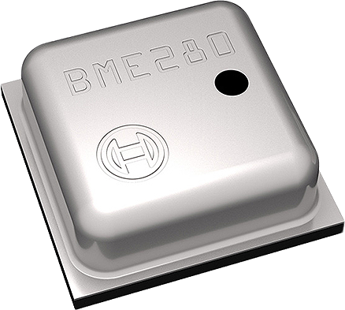
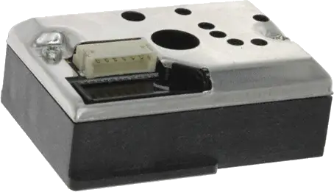
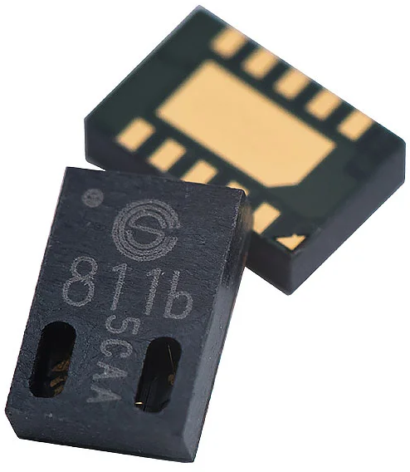
Subsystems - Sensors
Bosch BME280
Temperature, Pressure, Humidity
SHARP GP2Y1010AU0F
Dust Sensor
ams CCS811B-JOPD500
Air Quality Sensor
Modern Device Wind Sensor Rev. P
Thermal Anemometer / Wind Speed
Sensors will record weather measurements at a sample rate of at least 1 measurement per 10 seconds
Notes:
Anthony
Bosch Sensor:
20 uW
Dust Sensor:
150 mW
Air Quality:
Measures co2 and VOC (Volatile Organic Compounds) in the air
200 mW
Wind Sensor:
0 to 150 mph
Hotwire technique: Tracks how much voltage is needed to keep a hotwire at the same temperature.
600 mW
Can’t use a physical wind anemometer because it will be too big, too heavy, and cost too much money.

Slide 13
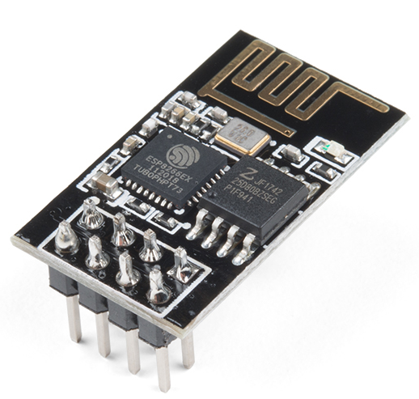
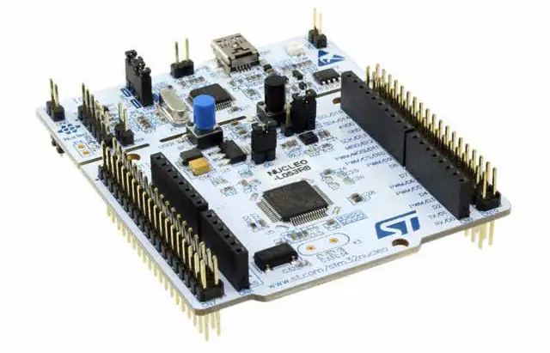
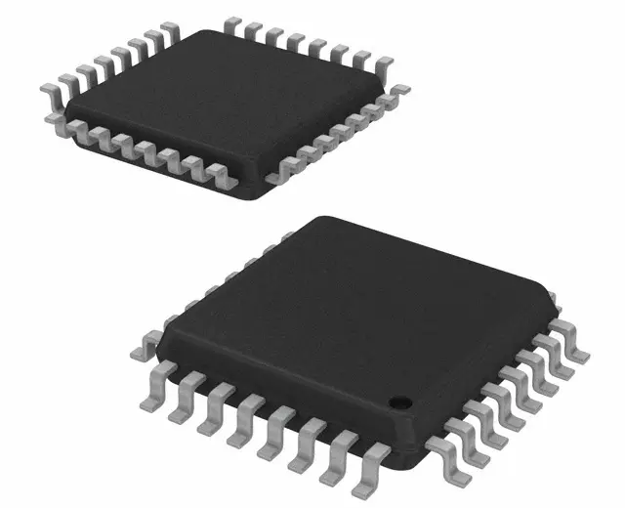
Subsystems - Microcontroller/WiFi Module
Microcontroller will monitor both the solar cell and backup battery in addition to processing weather measurements
The microcontroller will determine when the solar cell passes a low voltage threshold in order to switch to the backup battery
Espressif Systems ESP8266 WiFi module will communicate data to a remote server
Notes:
Tina/Stephan

Slide 14
Subsystems - Web Server/Web Application
The server will receive data from each Weather Box
Process data and display the information to a user logged into the Weather Box website
Microsoft Azure for the web server
Offers discounted and free resources for students
Linux Virtual Machine
Python for the back-end web application
Easy to prototype
Extensive libraries with documentation
Notes:
Anthony
Server takes in data from each Weather Box
Process data and display it on a map to the user
Azure
Discounted and Free student resources
Using a Linux Virtual Machine
Python
Quick to prototype with
Libraries with extensive documentation will make the process of getting website up more efficient

Slide 15
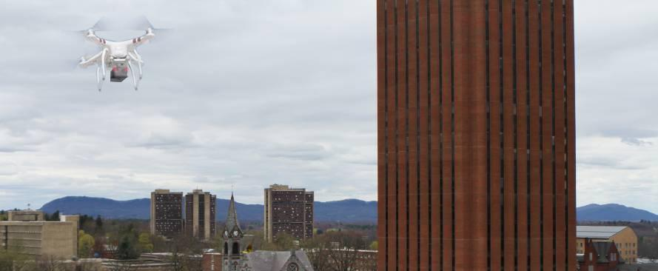
Stretch Goals
Mount a Weather Box to a drone for real time weather conditions at different altitudes
More focus on public safety aspect in terms of helping police decide if conditions are suitable for a drone mission
Notes:
Stephan

Slide 16
Budget
 | Part | Price | Total Prices
Sensing System |  |  | $98
 | Sensors | $49
 | Solar Cell/Backup Battery | $27
 | Custom PCB | $10
 | WiFi Module | $7
 | Microcontroller | $5
Development & Testing |  |  | $152
 | MCU Development Kit (x2) | $24
 | Extra Sets of Components | $98
 | 3D Printed Materials | $30
Total Cost |  |  | $445
 | 3x Sensing Systems | $293
 | Development Components | $152
Notes:
Anthony
Sensing system
$98
About half is for the sensors
Development
Two STM Development Kits
Extra set of components in case anything goes wrong
Dedicating $30 to give our system a 3D Printed Enclosure
Total
3 Sensing systems run us close to $293
Development components will cost us about $152
$445
Leaves about a $55 buffer in our budget

Slide 17
MDR Deliverables
Two sensor packages capable of measuring simulated wind speed, temperature, and barometric pressure (including protoboard for custom sensor PCB)
Basic weather map created by the two sensor packages in a small and simulated test environment
UI able to display raw data from Weather Boxes to remote server terminal
Notes:
Tina

Slide 18
Team Responsibilities
Anthony
Microcontroller Firmware (Sensor Data)
Web Server
Tina
Hardware and PCB Design
Power Systems and Sensors
Stephan
Microcontroller Firmware (WiFi)
Web Server
Christian
Web Server
Web Application
Notes:
Anthony
Handle programming sensors data capture and processing
Assist in programming and setting up the Web Server

