Slide 1
Weather Box
Team 3/LH 6
SDP 20
MDR
December 9, 2019

Slide 2
Introduction
Professor Zink
Advisor
Anthony Mendez
CompE
Team Manager
Tina Maurer
EE
Hardware Lead
Stephan Kim
CompE
Christian Norton
CompE
Notes:
Tina

Slide 3
Problem Statement
Commercial weather stations can effectively collect data for a specified area at the macroscale. However, weather conditions in these area can vary greatly at the microscale.
These micro-weather conditions can impact various situations, such as the effective use of a wind farm, the flow of pollutants and waste through an area, and a drone’s ability to fly for emergency services.
Notes:
Tina

Slide 4
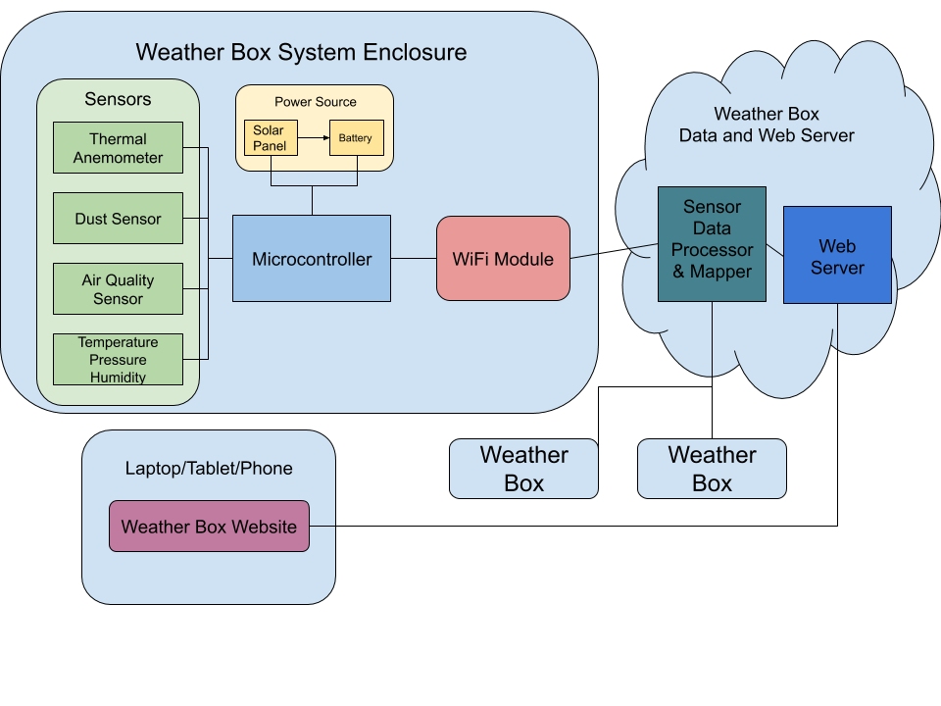
Our Previous Solution
Notes:
Stephan

Slide 5
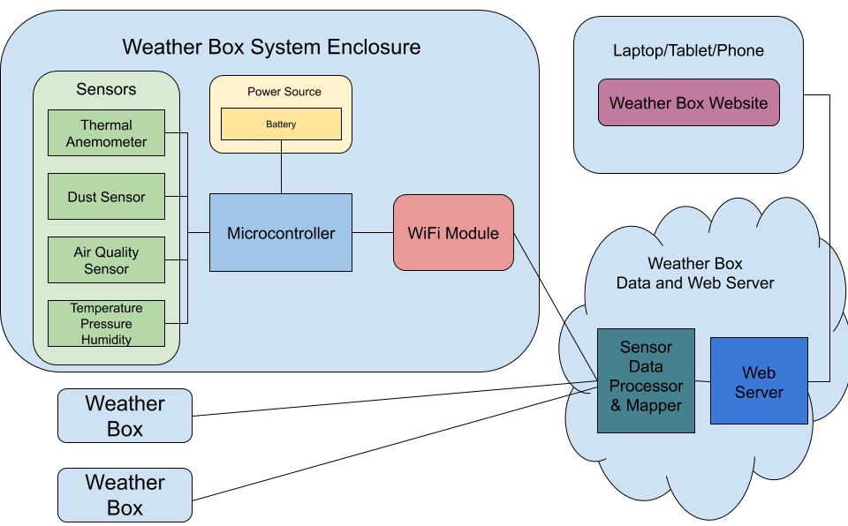
Our Modified Solution
Notes:
Stephan

Slide 6
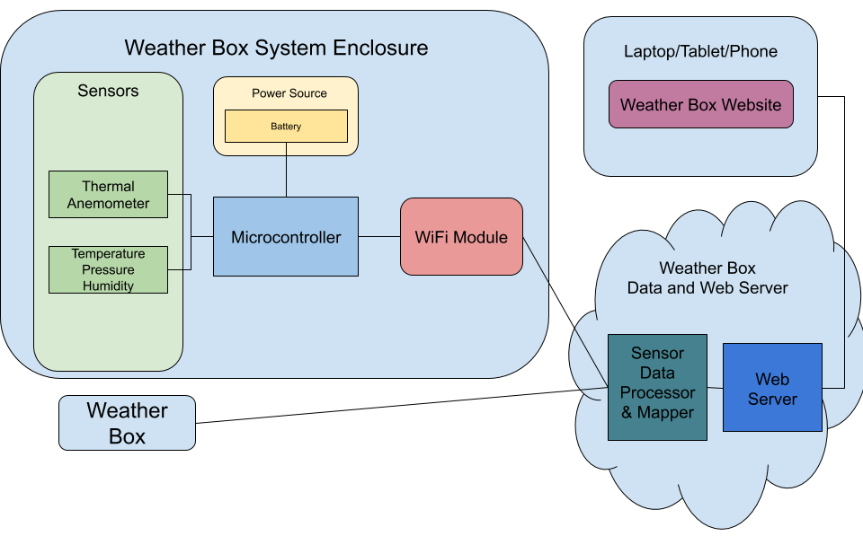
MDR Prototype
Notes:
Stephan

Slide 7
System Specifications
Each sensor package will take measurement at its location and the web server must create a map of at least 75x50 m² based on data from sensor packages
Each sensor package must be mountable and weighs less than one pound
Each sensor package must measure wind, temperature, barometric pressure, humidity, dust, and air quality with 95% confidence
Each sensor package must have a battery life of at least 24 hours
Sensor package must be operable in the range of 20 degrees Fahrenheit to 100 degrees Fahrenheit
Each sensor package should be able to transmit sensor data to a web server via WiFi
Each sensor package must be manufacturable for at most $120
Notes:
Tina

Slide 8
MDR Deliverables
Two fixed point development sensor boards that measure temperature, air pressure, humidity, and wind speed
Temperature between 30°F - 80°F with 95% confidence
Air pressure between 1.00atm - 0.96atm with 95% confidence
Humidity between 0% - 100% with 95% confidence
Wind speed between 0mph - 50mph with 95% confidence
The sensor package will be powered by a battery
Map displaying the location and data points of each sensor package
Notes:
Tina

Slide 9
MDR Team Responsibilities
Tina
Hardware Lead
Power systems
Anthony
Firmware - Bosch BME280, WiFi
Web Server
Stephan
Firmware - Anemometer, ADC, WiFi
Christian
Web Server
Website
Notes:
Anthony
Tina is the hardware lead. She built the power systems and made all major hardware decisions
I programmed the Bosch sensor, helped program the wifi module, and the web server
Stephan programmed the wifi module, anemometer and ADC
Christian programmed the website

Slide 10
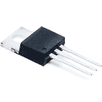
Hardware/Power Design: Tina
Each sensor package is powered by a +12V battery stack of AA batteries
LDO regulators steps down the stack voltage to create a +5V rail and a +3.3V rail
These create all necessary reliable supply voltage for the sensors
0.1uF filter caps are placed from each power line to ground to protect our electronics from any transients
Notes:
Tina

Slide 11
Power Consumption: Tina
One of our specifications state that a sensor package must have a battery life of at least 24 hours
Power supply consists of 8 stacked Panasonic AA Alkaline batteries
Battery capacity = 3125mAh
Sensor package total current is approximately 110mA
Battery life = (3125mAh)/(110mA) = 28.4 hours
With the current design, we will successfully meet the battery life specification
Notes:
Tina

Slide 12
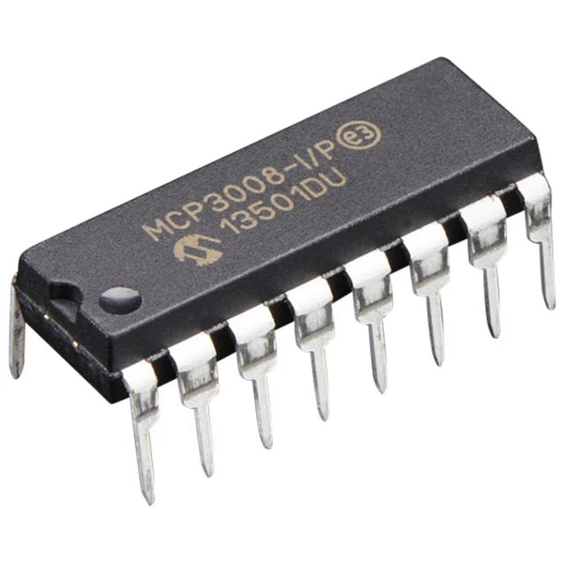
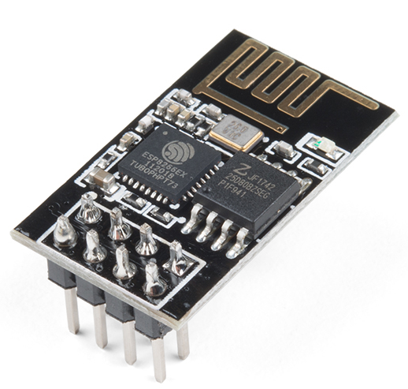
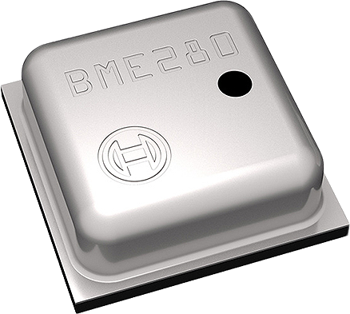
Firmware: Stephan, Anthony
MCP3008 ADC 10-bit
Programmed using ST’s own HAL API in C
Utilized SPI protocol for communication
Will consider using internal ADC on STM32
ESP8266 WiFi Module
Utilized UART protocol for serial communication
Programmed using HAL API with AT commands
Bosch BME280 - Temperature, Pressure, Humidity
Used Bosch C drivers
Utilized I2C protocol for communication
Notes:
Stephan

Slide 13
Web Server Back-end: Anthony, Christian
Microsoft Azure for hosting
ANSI/ISO SQL database for weather data storage
Back-end runs on Python
Receives JSON weather data from sensor packages, then saves the data into the database
Handles retrieving weather data from the sensor packages, then sends the data in JSON to the client
Notes:
Anthony
Setup a Microsoft Azure Student account
Created a python web application along with a SQL database
Current capabilities of the python webserver:
Sends client the weather map page
Receives weather data from each MCU through a HTTP Post link
Loads the data from JSON, and stores it in the database
Send weather data to the client through a HTTP Get link
Loads the data from the database, formats it into JSON
Send systems data to the client through a HTTP get link

Slide 14
Web Server Front-end: Christian
Google Maps Javascript API
Seamlessly add Google Maps to the website
Allows us to create markers with information windows
Retrieves weather data every 10 seconds, parses JSON, and updates information windows
Retrieves systems data every 60 seconds, parses JSON, and updates markers
Styled using Bootstrap Framework
Notes:
Anthony
Setup Google Cloud Account
Implemented Google Maps API to the website
Create markers based on the amount of systems we have registered
Each marker has an information window with data displaying information about each system

Slide 15
MDR Results
Built two fixed point development sensor packages that measure temperature, air pressure, humidity, and wind speed
Sensor packages are powered by a battery stack
Sensor packages send their data to a web server at a rate of 1 sample every 10 seconds
Web server displays map with location and data points of each sensor package
Can be viewed at weatherbox.azurewebsites.net
Notes:
Anthony
Built two sensor packages that measure temperature, air pressure, and humidity, and wind speed
Each sensor package is powered by a battery stack
Sensor packages take a measurement every 10 seconds then transmits the data over wifi
The web server displays the map with location and data points of each systems

Slide 16
MDR Results
Notes:
Tina

Slide 17
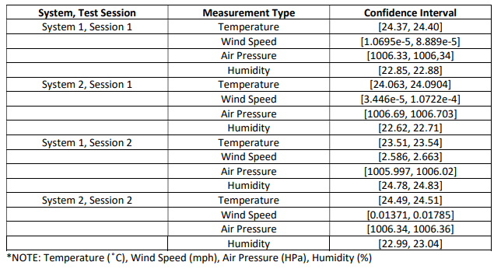
Confidence Intervals
Notes:
Stephan

Slide 18
CDR Deliverables
A first revision custom PCB containing the sensor suite and power circuitry
Firmware written and tested for remaining sensors
ams CCS811B-JOPD500 Air Quality Sensor
SHARP GP2Y1010AU0F Dust Sensor
Preliminary interpolation algorithm implemented on the map
Prototype physical enclosure for the sensor package
Notes:
Anthony
Preliminary PCB containing our sensor suite and power circuitry
Firmware written and tested for the remaining sensors
Preliminary weather interpolation algorithm on the map
Prototype physical enclosure

Slide 19
Gantt Chart
Notes:
Stephan

Slide 20
Notes:
Questions?

Slide 21
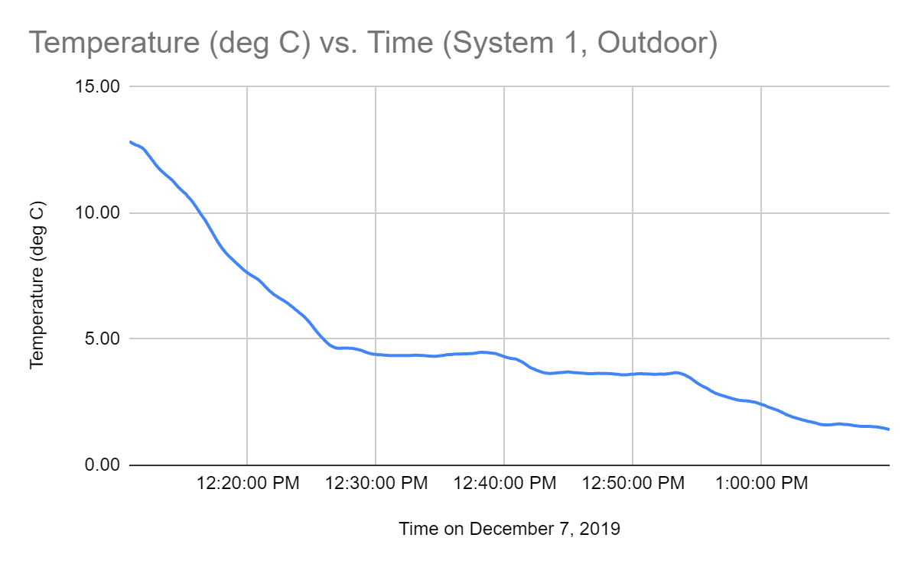
Supplementary Slide - Outdoor Testing
Notes:
Anthony
PCB with sensor suite
Firmware written and tested for the remaining sensors
Preliminary weather interpolation algorithm on the map

Slide 22
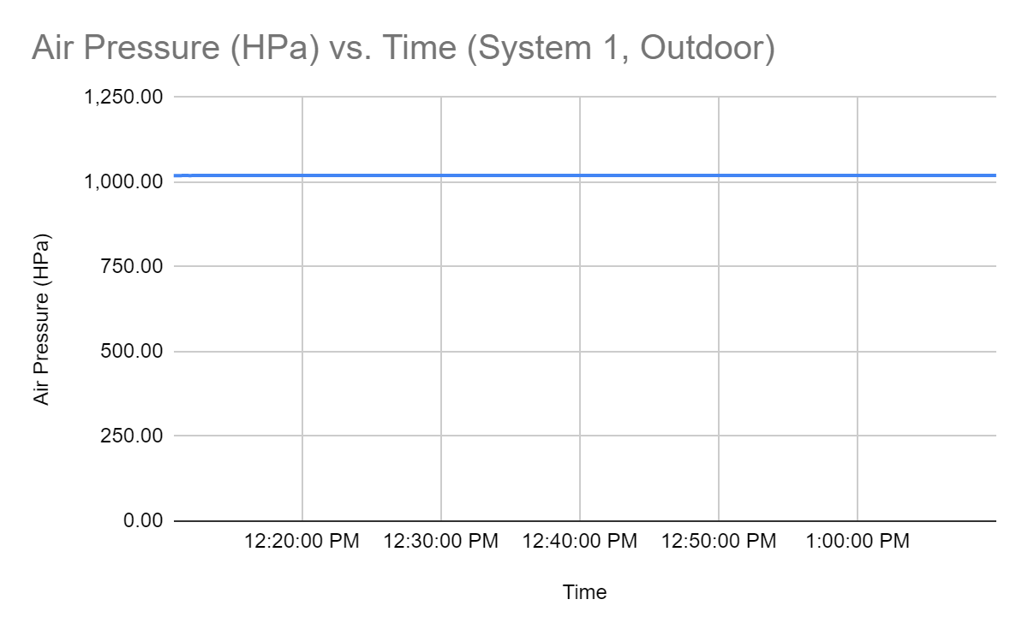
Supplementary Slide - Outdoor Testing

Slide 23
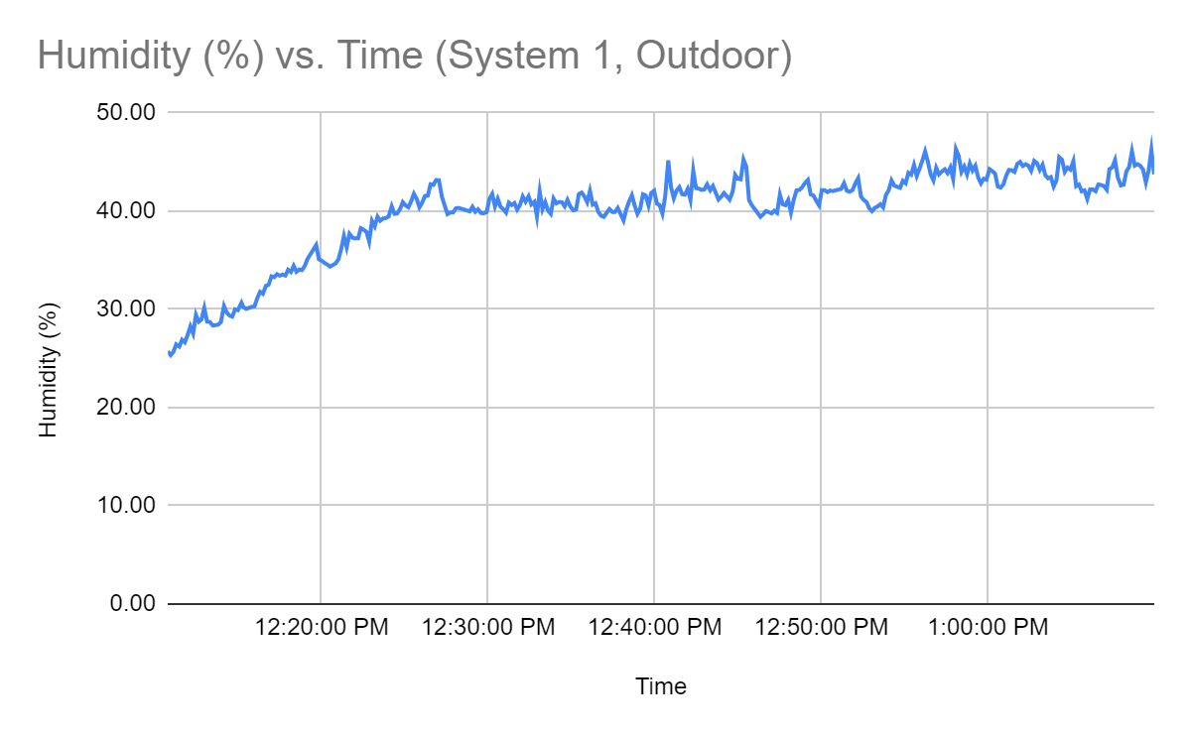
Supplementary Slide - Outdoor Testing

Slide 24
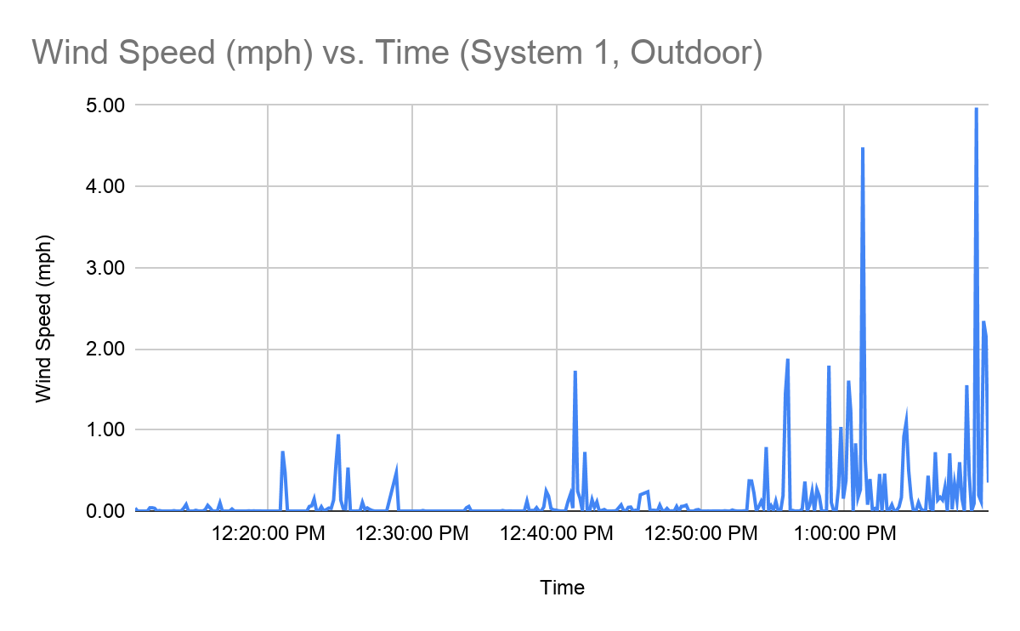
Supplementary Slide - Outdoor Testing

Slide 25
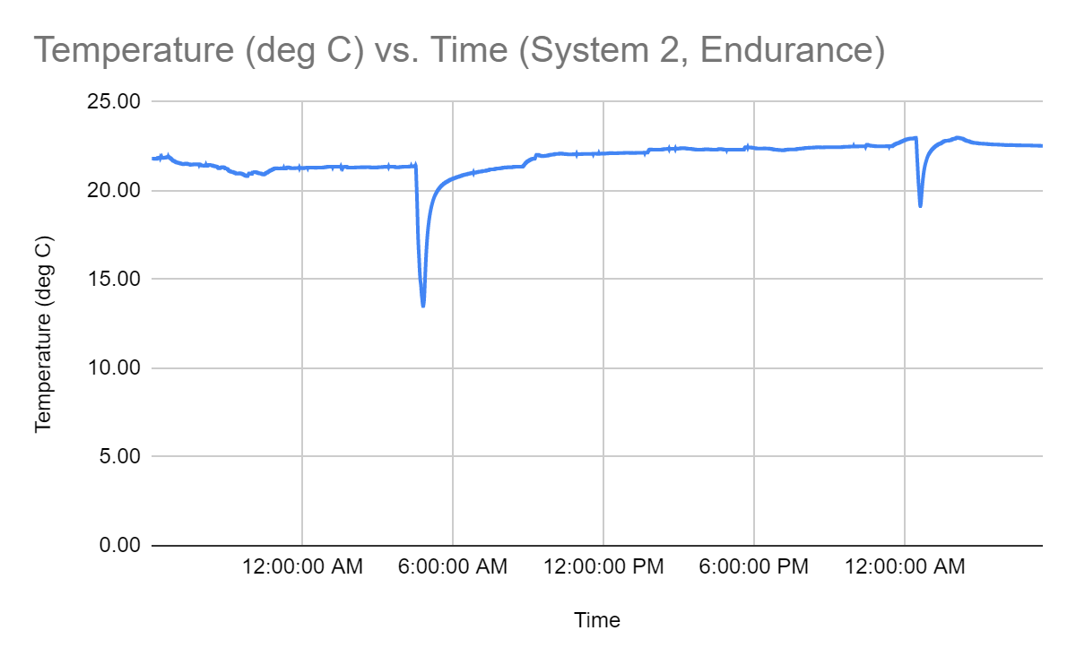
Supplementary Slide - Endurance Testing

