Slide 1
Weather Box
Team 3/LH 6
SDP 20
CDR
March 9, 2020

Slide 2
Introduction
Professor Zink
Advisor
Anthony Mendez
CompE
Software Lead
Tina Maurer
EE
Hardware Lead
Stephan Kim
CompE
Christian Norton
CompE
Notes:
Introduce Ourselves

Slide 3
Problem Statement
Commercial weather stations can effectively collect data for a specified area at the macroscale. However, weather conditions in these area can vary greatly at the microscale.
These micro-weather conditions can impact various situations, such as the effective use of a wind farm, the flow of pollutants and waste through an area, and a drone’s ability to fly for emergency services.
Notes:
Christian

Slide 4
System Specifications
Each sensor package will take measurement at its location and the web server must create a map of at least 75x50 m² based on data from sensor packages
Each sensor package must be mountable and weighs less than one pound
Each sensor package must measure wind, temperature, barometric pressure, humidity, dust, and air quality with 95% confidence
Each sensor package must have a battery life of at least 24 hours
Sensor package must be operable in the range of 20 degrees Fahrenheit to 100 degrees Fahrenheit
Each sensor package should be able to transmit sensor data to a web server via WiFi
Each sensor package must be manufacturable for at most $120
Notes:
Tina

Slide 5
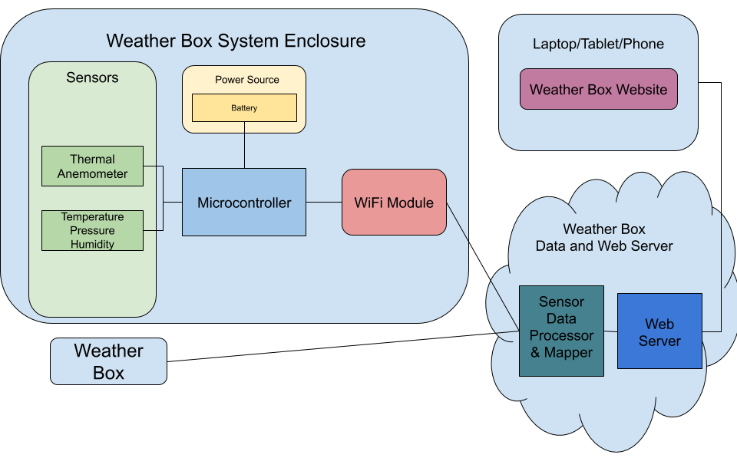
Our MDR Solution
Notes:
Stephan

Slide 6
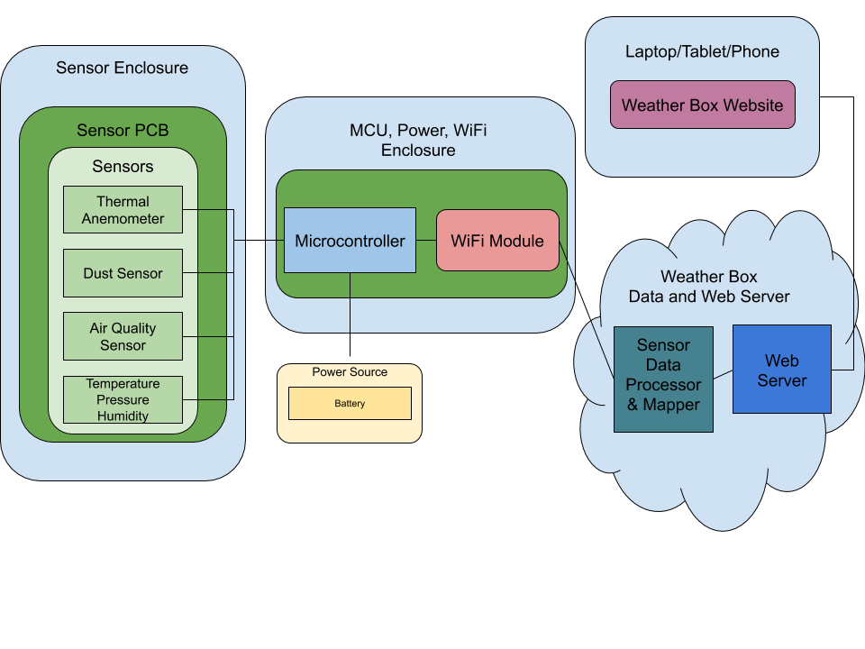
Our CDR Solution
Notes:
Stephan

Slide 7
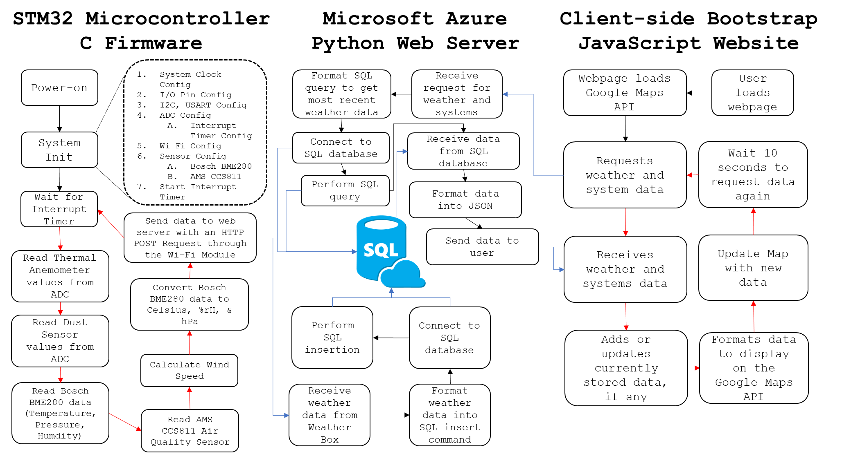
CDR Prototype - Software
Notes:
Anthony
Three major components to the software
Firmware
Handles reading sensor data, and sending to the web server
Web Server
Handles receiving data from the Weather Boxes, storing the data, and sending to the client websites
Website
Handles requesting data from the web server and handles placing data onto the map.

Slide 8
CDR Deliverables
A first revision custom PCB containing the sensor suite and power circuitry
Firmware written and tested for remaining sensors
ams CCS811B-JOPD500 Air Quality Sensor
SHARP GP2Y1010AU0F Dust Sensor
Preliminary interpolation algorithm implemented on the map
Prototype physical enclosure for the sensor package
Notes:
Anthony
Promised:
First revision of a custom PCB with sensors and power circuitry
Firmware written and tested for the Air Quality and Dust Sensor
Preliminary interpolation algorithm on the map
Preliminary physical enclosure

Slide 9
CDR Team Responsibilities
Tina
Hardware Lead
PCB, Enclosure
Anthony
Software Lead
Firmware - Air Quality Sensor
Website/Server - Google Sign-In, Systems Management
Stephan
Firmware - Dust Sensor, WiFi
Christian
Website - UI Overhaul, Interpolation
Notes:
Our Responsibilities
Anthony
Oversaw and managed communications between firmware, server, and client side.
Programmed the Air Quality Sensor
Implemented Google Sign In and Systems Management

Slide 10
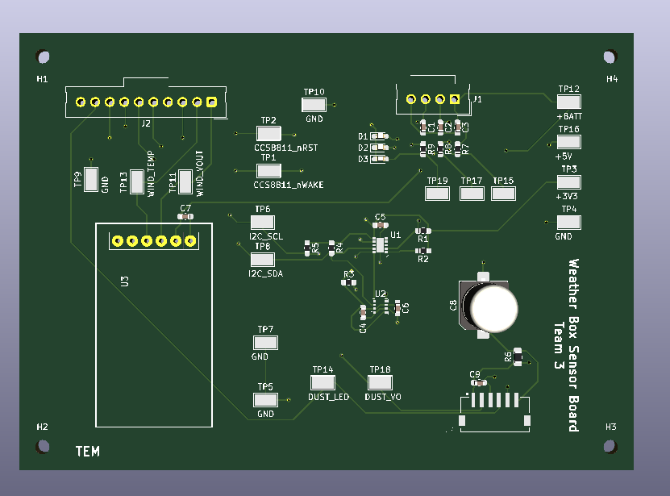
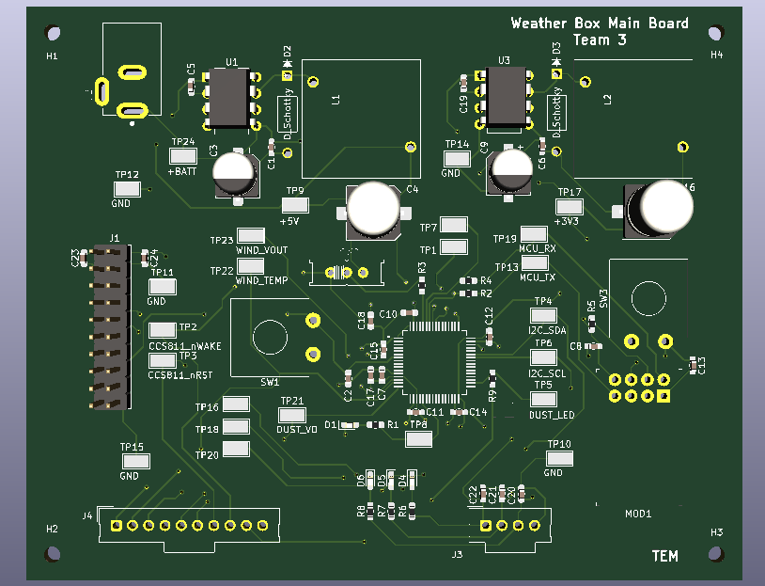
PCB Design: Tina
Created schematic and completed layout for printed circuit board using KiCAD software
Main and sensor board are both four layers with a ground plane on the second layer
Power circuit has been adjusted from LDO regulators to switching regulators for power rails
Boards were hand soldered and tested against prototype measurements
Notes:
Tina

Slide 11
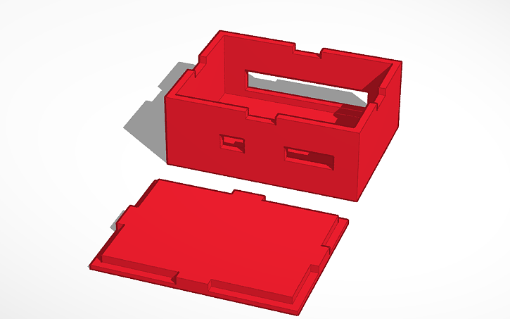
System Enclosures: Tina
Designed robust housings for each board using TinkerCAD, then 3D-printed with PLA filament
The interlocking joints between the lid and box create a seal for each enclosure
Along with cable openings, a small window was created in the sensor housing to allow the sensors to be exposed to weather conditions
Notes:
Tina

Slide 12
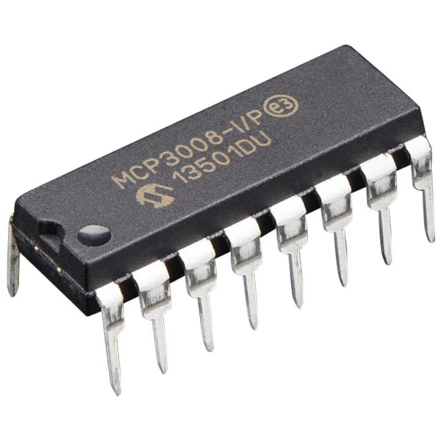
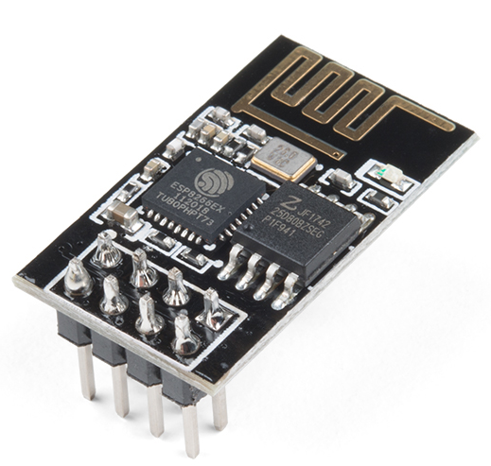
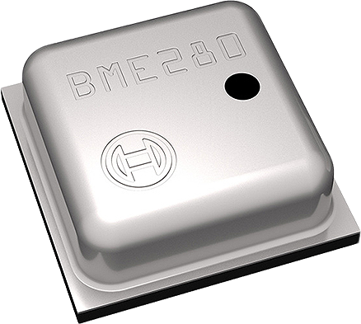
Firmware: Stephan, Anthony
MCP3008 10-bit ADC
Removed in favor of STM32’s built-in ADC
STM32 Internal ADC
12-bit, simplified circuit by removal of other ADC
Programmed using STM’s HAL API in C
Sharp GP2Y1010AUF Dust Sensor
Analog Dust Sensor
Utilizes GPIO for LED and ADC for output reading
Notes:
Stephan

Slide 13
Firmware: Stephan, Anthony
ESP8266 WiFi Module
Wrote C driver in order to interface between STM32
and ESP8266
C drivers send AT commands through STM32
and UART serial protocol to program our module
ams CCS811 Air Quality Sensor
Wrote C library to handle sensor operations
Library mimicked Bosch driver format
Utilizes I2C communication protocol
Notes:
Stephan
Anthony
Wrote a C library to handle sensor operations
Library mimicked format of the Bosch sensor, changed functions to reflect AQ sensor operations
I2C to request and retrieve data

Slide 14
Google Sign-In API: Anthony
Needed to ensure Integrity and Availability
UMass utilizes Google Mail
Easy to implement
Created Public Client ID in Google Cloud
Once signed in, JavaScript function is called
Sends user token to server
Server checks if user is an admin
If so, server assigns the client a session variable “admin”
Notes:
Anthony
Needed an Authentication API to let us and only us edit the systems database on the website
UMass uses Google Mail
Google provides a Sign-In API that’s easy to use
The setup and adding to our website was easy
Client signs in with Google, website receives a token, sent to our web server, and checks if the user is an admin.

Slide 15
Systems Management: Anthony
Once authenticated, admin can:
Add a system to the database
Remove a system from the database
Edit a system’s location
Website does front-end and back-end data validation
Operations only proceed if session variable “admin” exists and is set to “true”
Notes:
Anthony
If user is an admin, they can manipulate the systems database without writing SQL queries
Adding, removing, and editing systems
Website and Server does data validation
If user is not an admin but still tries to send changes to web server, web server will reject those changes

Slide 16
Interpolation: Christian
Current implementation uses a linear interpolation
Calculate an average latitude, longitude, and weight for every combination of two points
Populate the heatmap with these points
The function can be called repeatedly to generate a more flushed out heatmap
Next implementation will use Inverse Distance Weighting
Allows for calculation of points outside of the bounds of systems
Notes:
Christian

Slide 17
UI Overhaul: Christian
Improved dynamic transition between desktop and mobile layout
Column scaling is done under a set of defined CSS classes
Classes can be applied to any section allowing for easier separation
Enlarged buttons for better use on mobile layout
Improved colors for better readability
Reserved space for system management
Notes:
Christian

Slide 18
CDR Result
A first revision custom PCB containing the sensor suite and power circuitry
Designed, laid out, and tested PCB set
Firmware written and tested sensors
ams CCS811B-JOPD500 Air Quality Sensor
SHARP GP2Y1010AU0F Dust Sensor
Preliminary interpolation algorithm implemented on the map
Designed and printed prototype enclosure for the PCB set
Notes:
Tina

Slide 19
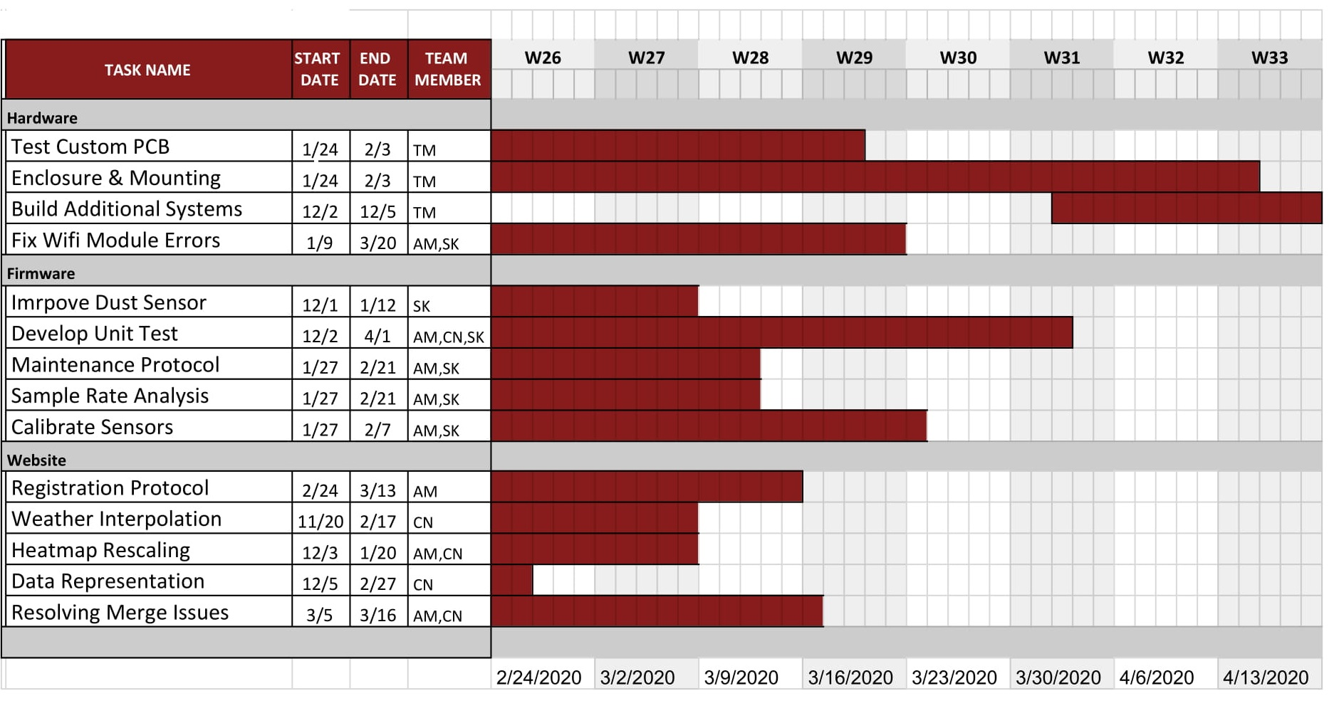
Gantt Chart
Notes:
Christian

Slide 20
Notes:
Questions?

Slide 21
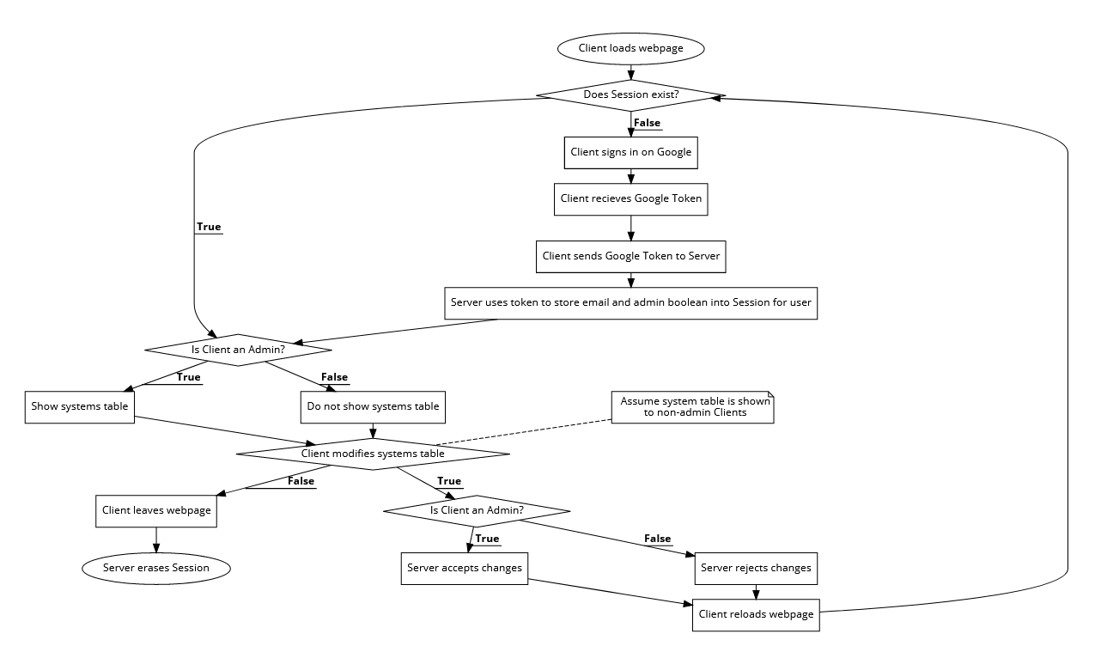
Systems Management Diagram: Anthony
Notes:
Anthony

Slide 22
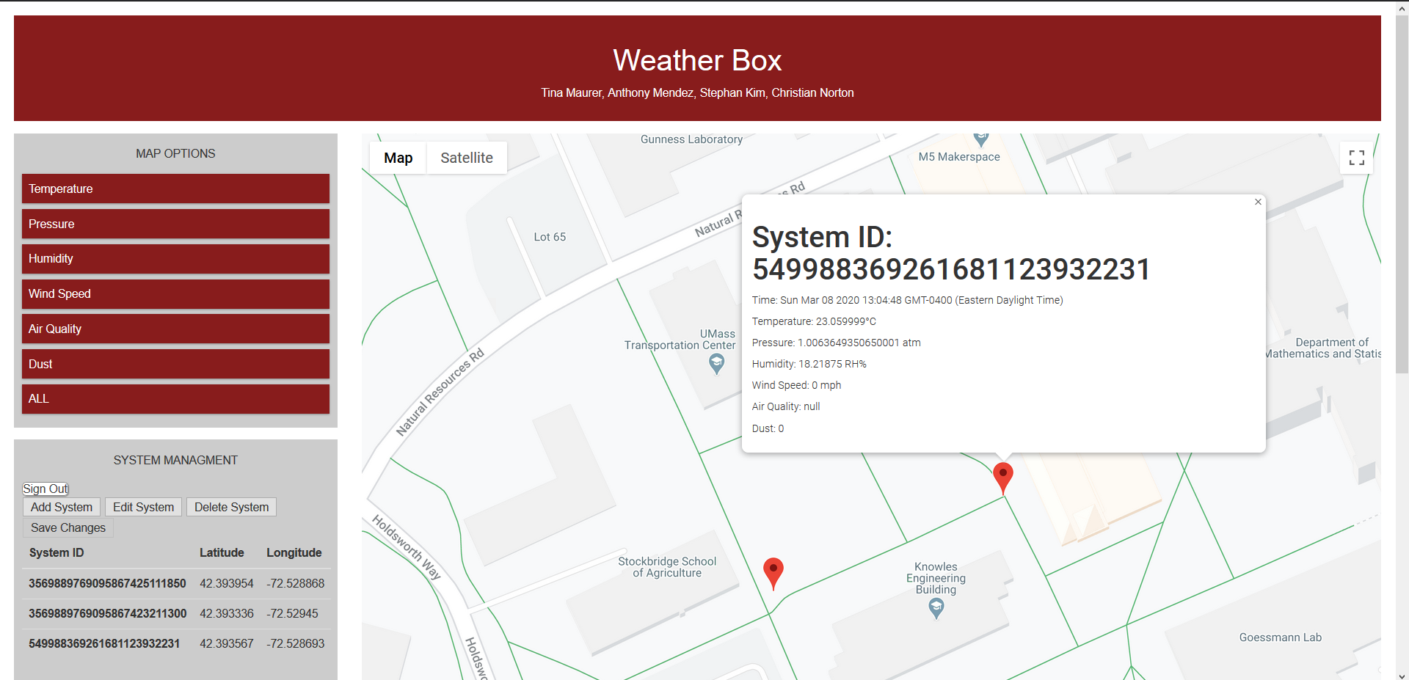
Website

