Slide 1
PDR PRESENTATION

Slide 2
Team Members: Lighthouse #19
Electrical Engineering:
Cormac Kennedy
Richard Brown
Computer Engineering:
Ibrahim Tahoun
Titus Rwantare

Slide 3
Problem Statement
At one point, we’ve all felt the gut-wrenching fear and frustration of losing a valuable personal item. Americans spend almost three days every year on average searching for lost valuables¹, such as wallets and keys. To solve this problem, technologies like the Tile tracker have been developed to clip onto valuables and track their location. However, while tracking location allows you to find your item after its already lost, it does not prevent you from leaving your item behind in the first place. Existing solutions lack a preemptive warning system to prevent you from losing your valuables. Introducing... Radius.
1. prnewswire.com

Slide 4
Why is RADIUS?
Existing tracking devices suck.

Slide 5
What is RADIUS?
The RADIUS Bluetooth Tracking System consists of:
1.) The RADIUS Android Application
Receives notifications from RADIUS device when phone is perceived to be out of allowable range by device
Provides functionality for sending a ping to the RADIUS Bluetooth tracker
Allows user to configure the operation mode of device (close / far proximity)
2.) The RADIUS Bluetooth Tracking Device
Sends notifications to the RADIUS Android application when the phone is considered to be out of range of the device
Contains a push button for sending pings to the RADIUS Android Application
Utilizes an acoustic piezo buzzer for projecting a noise when ping’d

Slide 6
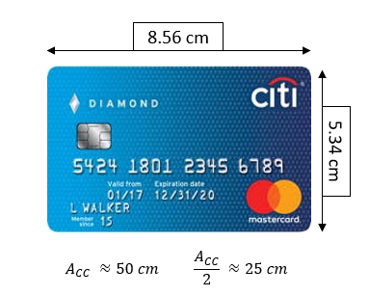
Requirements/Specifications: Tracking Board
Performance
Sizing
Two Modes of Operation
 | M1: High Importance | M2: Low Importance
Radius (m) | 5 | 10
Alert delay (s) | 10 | 30
Battery life target (months) | 1 | 3
Board Dimensions
Area (cm²) | 25
Height (cm) | 0.5

Slide 7
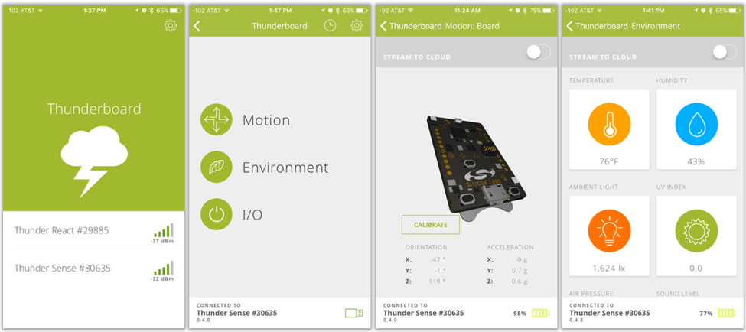
Requirements/Specifications: Phone Application
Phone application will be able to...
Ping the Tracking Board to produce an audible noise
Ring the phone when a ping is received from the Tracking Board push button
Display Current connectivity rating on your phone
Note:
Source code is available for application development with the Thunderboard Sense 2
Notes:
Work in progress

Slide 8
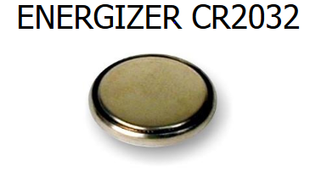
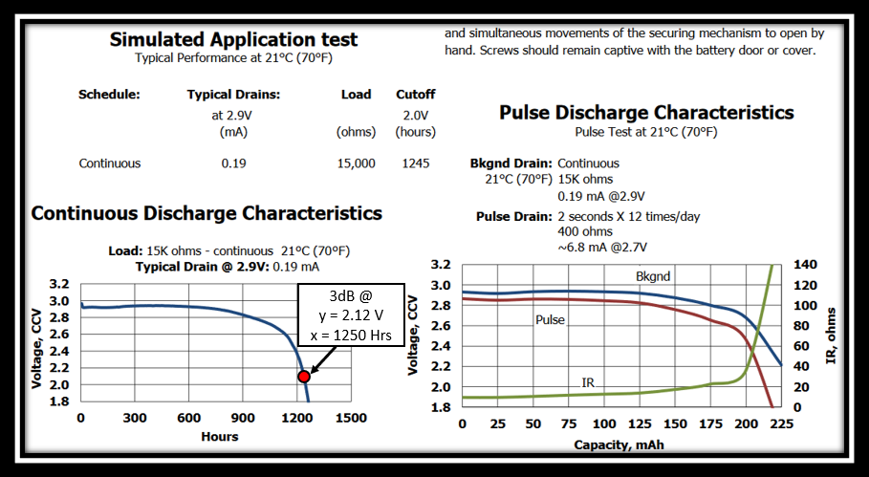
Power Spec: Power Supply
Note:
EFR32MG12 Radio SoC supports supply voltages above the nominal 3V rating and below the 3dB point in this graph at 2.12V.

Slide 9
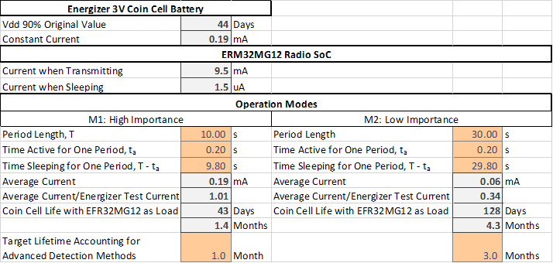
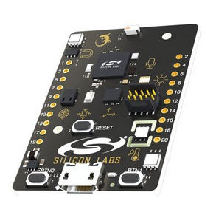
Power Spec: Load and conclusion
Notes:
Work in progress

Slide 10
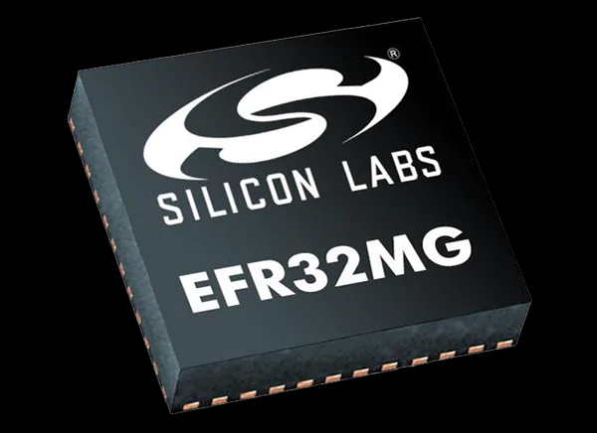
Hardware Component
Will utilize the EFR32 Radio Board IC
Requires an antenna matching network
External RF crystal
Power supply network (Decoupling capacitors, Internal DC-DC Converter)
2.4Ghz Ceramic IC antenna
Coin Cell Battery
Piezo Buzzer
Push button for sending ping to phone

Slide 11
EFR32 Features
Same processor/IC that will be used in the MDR prototype
Seamless transferability of code from MDR prototype to PCB
Supports Bluetooth 5 Protocol
Internal DC-DC converter which allows for maximum power efficiency
Includes Deep Sleep low energy consumption mode and radio wake up functionality
Support for internet security
True Random Number Generator
Hardware Cryptographic Acceleration

Slide 12
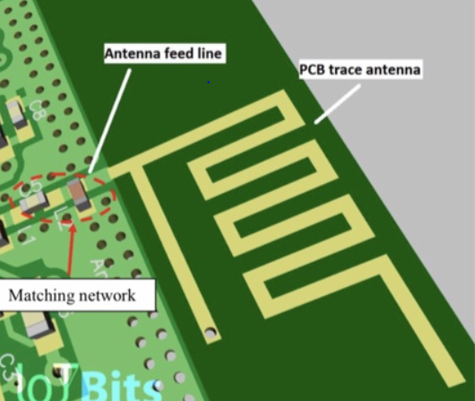
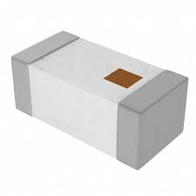
Why a 2.4Ghz Ceramic IC Antenna?
Small size; cuts down cost of PCB
Not as sensitive as PCB trace antennas when it comes to environmental noise
More flexible; changes in layout are easily accommodated
Many configurations readily available
Vs.

Slide 13
Proposed tracking methods
Connection Status
Alert on connection drop
RSSI
Set a threshold signal strength
Advanced Methods
Kalman filter to estimate relative velocity/displacement
Alert on poor signal
Estimate distances (alert on radius)
^{Also handles false positives}
Accelerometers to generate directional information about displacement
MDR
CDR
Notes:
Aim to have a prototype alert system based on RSSI by MDR
Project has a sufficiently challenging progression curve

Slide 14
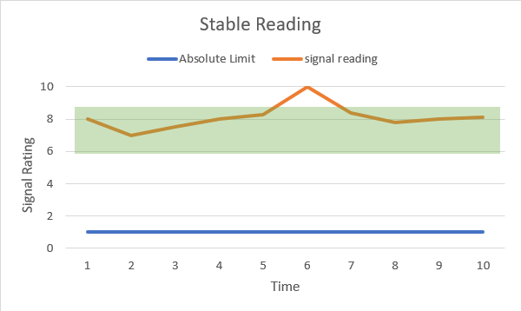
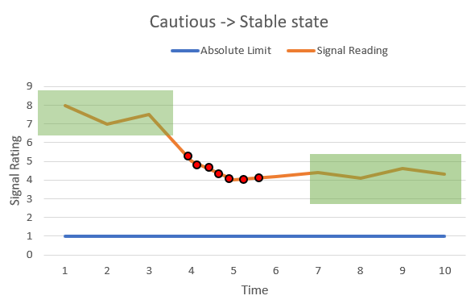
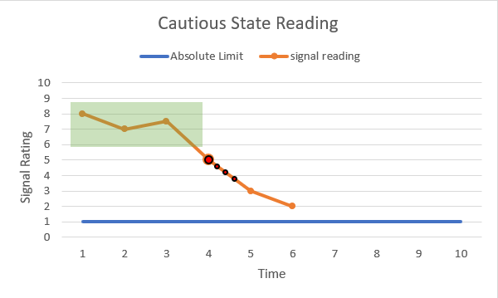
State based data collection
Indicators:
Error margins
current state
RSSI reading
Trendline slope
Sampling rate

Slide 15
Why Bluetooth Low Energy?
All smartphones have Bluetooth
Low cost of modules, radio boards, and chipsets
Low power consumption
Easy access to development references, documentation, etc.
Bluetooth chipsets are easily used with on-board IC antennas

Slide 16
Bluetooth Low Energy Alternatives
UWB - Ultra-wideband
RF
IR - Line of Sight
802.11 - Interference and power
GPS - Outdoors only - high power
ZigBee - requires mesh network, multiple points of use

Slide 17
Block Diagram

Slide 18
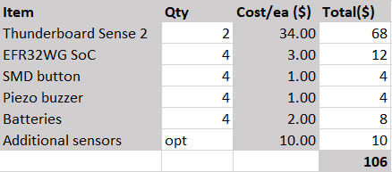
Budgeting
TOTAL estimated: ~$100 for full development
Product can be released for $25.00

Slide 19
Thank You
Questions?

Slide 20
Sources
https://www.prnewswire.com/news-releases/lost-and-found-the-average-american-spends-25-days-each-year-looking-for-lost-items-collectively-costing-us-households-27-billion-annually-in-replacement-costs-300449305.html

