Slide 2
Team Members: Lighthouse #19
Electrical Engineering:
Cormac Kennedy
Richard Brown
Computer Engineering:
Ibrahim Tahoun
Titus Rwantare

Slide 3
Problem Statement
We’ve all felt the gut-wrenching fear and frustration of losing valuable personal items. Consisting of a Bluetooth tag and phone app, Radius is a tracking system that alerts you before you've left your items behind, accomplishing what existing solutions currently do, and more!
By keeping track of your belongings when you're not, Radius helps keep what's important to you close by.
Never lose again with Radius.

Slide 4
What is RADIUS?
The RADIUS Bluetooth Tracking System consists of:
1.) The RADIUS Android Application
Receives notifications from RADIUS device when phone is perceived to be out of allowable range by device
Provides functionality for sending a ping to the RADIUS Bluetooth tracker
Allows user to configure the operation mode of device (close / far proximity)
2.) The RADIUS Bluetooth Tracking Device
Sends notifications to the RADIUS Android application when the phone is considered to be out of range of the device
Contains a push button for sending pings to the RADIUS Android Application
Utilizes an acoustic piezo buzzer for projecting a noise when ping’d

Slide 5
Block Diagram
Tracking Tag
Android Application
EFR32MG
Radio SoC
TX/RX IC Antenna
Communicate signal strength and infrared sensor status
Data Management & Algorithms
Ring phone on button press
Ring phone
Ring Piezo Buzzer if app icon pressed
Ring buzzer if icon pressed
Light detection
Piezo Buzzer
Ambient Light Sensor
Push Button
Mode Selection
Button to Ring Thunderboard
Item Lost Alerts
3V Coin Cell
Titus Rwantare
Cormac Kennedy
Ibrahim Tahoun
Richard Brown

Slide 6
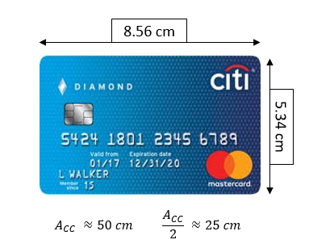
Project Specifications
Specifications | Tracking Tag
I/O | Will make noise when button on phone is pushed
I/O | Will make noise when paired devices exceed allowable range
Power | Battery life of 1-3 months utilizing 3V Coin Cell battery
Size | Area of 25 cm²
Size | Thickness of 5 mm
$$A ≈50 {cm}^{2} \frac{A}{2} ≈25 {cm}^{2}$$
Specifications | Phone Application / Android Device
I/O | Will ring when button on tag is pushed
I/O | Will ring when paired devices exceed allowable range
Performance | Capable of running high and low priority modes

Slide 7
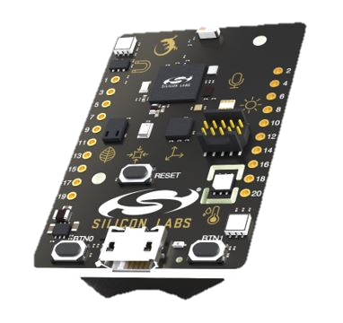
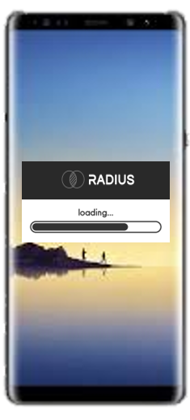
Integral Based Trend Tracking
-70 dBm ~ 4 – 5 meters
-56 dBm ~ 1.5 – 3 meters

Slide 8
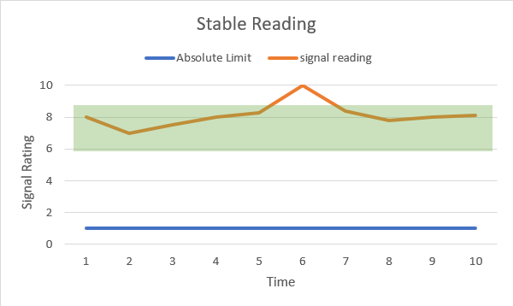
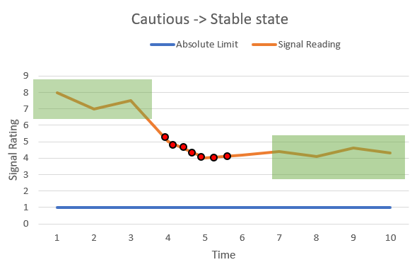
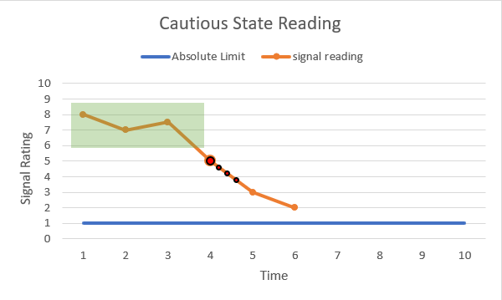
Derivative Based Trend Tracking
Indicators:
Error margins
current state
RSSI reading
Trendline slope
Sampling rate

Slide 9
2019 – 2020 Schedule
Titus Rwantare
Cormac Kennedy
Ibrahim Tahoun
Richard Brown

Slide 10
Budgeting
Item Description | Unit Price | Qty | Total Price
Thunderboard Sense 2 | 36.00 | 1 | 36.00
EFR32MG12 | 8.52 | 5 | 42.60
Push button | 0.90 | 4 | 3.60
Piezo Buzzer | 0.93 | 4 | 3.72
Infrared Sensor | 3.13 | 4 | 12.52
CR2025 Battery | 0.33 | 25 | 8.25
PCB Orders | - | - | 75.00
 |  |  | $ 181.69

Slide 11
Project Specifications: MDR
As proposed at bench-side on November 19, 2019:
Phone application will be able to:
Detect when a user has left an item outside of their “radius.” This will be done by displaying “GOOD” or “BAD” indicator on our app.
Buzz the phone if a dramatic change in signal strength has occurred. This indicates that the user is moving away from their object but does not constitute a lost item.
Buzz and Ring the phone if a connection is completely dropped. This constitutes a lost item.
Notes:
Work in progress

Slide 12
Thank You
Questions?

Slide 13
Sources
https://www.prnewswire.com/news-releases/lost-and-found-the-average-american-spends-25-days-each-year-looking-for-lost-items-collectively-costing-us-households-27-billion-annually-in-replacement-costs-300449305.html

Slide 14
MDR Room Measurements
Distance (in meters) | µ | σ | σ² | µ - 2σ | µ + 2σ
1 | -48.8 | 3.8 | 14.3 | -56.4 | -41.3
2 | -57.2 | 6.9 | 48.1 | -71.0 | -43.3
3 | -60.2 | 1.2 | 1.5 | -62.7 | -57.8
4 | -62.0 | 1.1 | 1.2 | -64.2 | -59.8
Sensitivity increased in current prototype to ensure full functionality in MDR room.

