Slide 1
Team BB
Preliminary Design Review
__________
Senior Design Project
__________
Fall 2018

Slide 2
BB (Battery Box)
Advisor
Shira Epstein
Team
Ebenezer Adams - CSE - Software Engineer, Battery Safety Officer
Kaden Chen - EE - Hardware Engineer, PCB Designer
Jayme Gordon - EE - Energy Engineer, Team Manager

Slide 3
Presentation overview
BB
Problem Statement
Effect of Problem
Project Specifications
Block Diagram
Design Alternatives
The Science behind Charging
Our Solution
Proposed MDR Deliverables

Slide 4
THE PROBLEM: Battery Life
Students face the problem of battery life on devices not lasting a full day with an on-the-go lifestyle
Battery life has not increased enough to meet the growing energy needs
Electronic devices with energy needs include mobile phones, tablets and laptops
Notes:
https://www.dailymail.co.uk/sciencetech/article-3607598/Do-low-battery-anxiety-90-panic-losing-power-phones.html
https://myweego.com/2015/02/02/dead-phones-statistics-on-the-everyday-hassle/

Slide 5
How significant is the problem?
Device screen time has increased
Device use include calls, texts, web browsing, email
Devices have high energy demand from these uses
Energy density of batteries not increasing fast enough
On-the-go lifestyle has led to less downtime to charge
Staying in one place waiting for charge is not convenient
A reasonable person’s phone dies once a day
Need for a convenient system to charge on-the-go
Notes:
Change average to reasonble
And exponential to quick

Slide 6
Requirements Analysis: Customer habit
Customers have reasonable expectation to continuously use device
Customers place device on charger more than once a day
Dependence on mobile devices is increasing
Customer have functional needs that depend on devices
Notes:
Hide it

Slide 7
Context: Effects on Individuals
Individuals affected by non-continuous, non-reliable device availability
Example: Phone Dies
Cannot track the bus
Cannot check food menu
Cannot check store hours
Cannot check phone communications (email, calls)
Lack of emergency dialing

Slide 8
Context: Effects on Culture
Cultural expectation that users maintain online connection at all times
Devices enable users to maintain daily schedules, check to do lists, GPS navigation, etc.
Devices enable instant communication
Notes:
Doubled points fix this

Slide 9
Requirement Analysis: Specifications
Battery box with individual lockers for each battery
Locker doors will open via electronic locks and output fully charged batteries
Card reader to login users
Online web portal for users to view battery inventories and reserve batteries
Cooling fan system to maintain temperature due to heat product from charging
External laptop-sized battery will provide 50000mAh and around 24 hours for average use, i.e. web browsing (Based on 2018 15” Macbook Pro)
External mobile-sized batteries will provide 10000mAh and around 48 hours for average use, i.e. web browsing (Based on 2017 iPhone 8)
Notes:
Get rid of the second bullet point
Mobile be small letter
Note average use(normal web browsing)
Card reader instead
At stations battery inventories
“As feedback”
At fan to spec

Slide 10
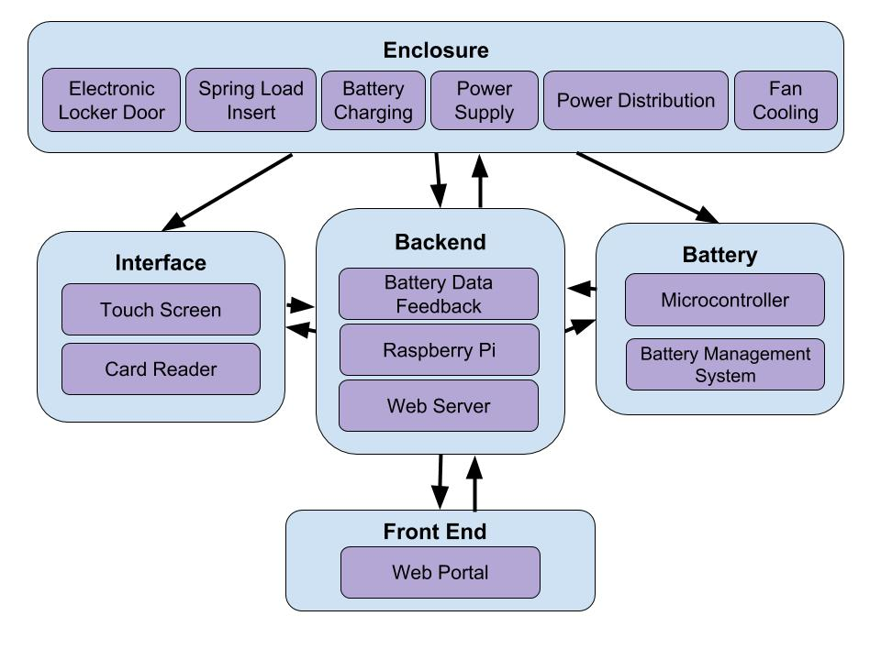
Our Solution: Block Diagram
Notes:
Battery rfid not but microcontroller
Remove web server

Slide 11
Design Alternatives
Fastcharge:
Fast charge tries to solve the problem by shortening the charging time of devices. However, there are still some problems. Customer need to carry their own fast charge device with them all days, and some fast charge products need to be near a power outlet while using, which is hard to find in some places. Some phones don’t support fast charge technology.
Notes:
Shortening
Is to are
Near power outlet

Slide 12
Design Alternatives
User-owned portable batteries (including charging cases):
Individual batteries need to be charged
Not convenient for users to have discharged internal and external batteries
Notes:
Including chargeable phone case
User owned

Slide 13
BATTERY Charging System
Requirements:
Proprietary charging port for batteries
Power supply regulation
Internal temperature control for Battery Box
Implementation:
Battery Management system to control voltage and current
Raspberry Pi to monitor power being drawn by charging system
Notes:
Charge system
Go right after the B.D
Make internal temp control
Be able to charge multiple batteries
Manage

Slide 14
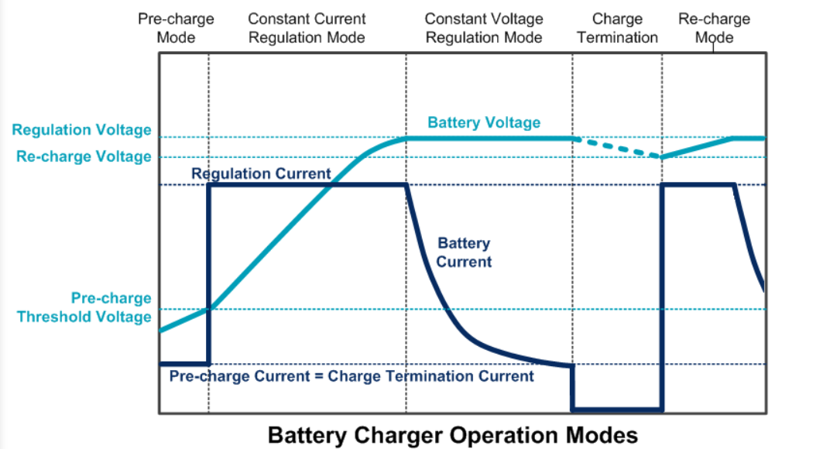
CHarge Function
Most batteries should be charged at 0.5°C
First stage is constant current of 0.5°C until max 4.2-5V
2nd stage is the charger maintains a voltage and current that slows as resistance increases. 3%-10% of nominal current means fully charged
Notes:
http://static.richtek.com/assets/AppNote/AN025_EN/AN025_EN.jsp
https://www.instructables.com/id/Li-ion-battery-charging/
Why 0.5 C
Don’t want bake but charge

Slide 15
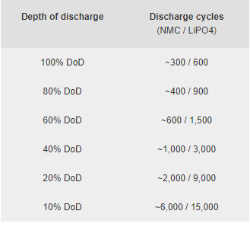
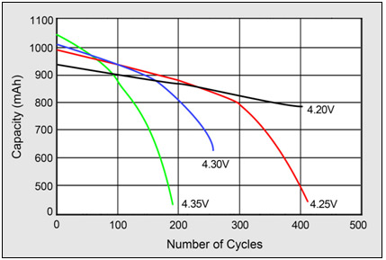
Charging lifetime cycles
Most 18650 cells have about 300 to 500 cycles - a common cheap battery option. More premium batteries can go up to 40,000 cycles (Tesla)
Notes:
https://batterybro.com/blogs/18650-wholesale-battery-reviews/18852515-when-to-recycle-18650-batteries-and-how-to-start-a-collection-center-in-your-vape-shop
Most 18650 cells are rated for between 300 and 500 cycles. That means your cell can charge up to 4.2 volts, and discharge down to 2.5 - 2.8 volts, a maximum of 300 to 500 times without too much much loss in performance. When an 18650 cell nears the end of its life, the performance loss is sudden and fast.

Slide 16
Charging Requirement
Capacity:
Mobile phone: 10,000mAh Laptop: 50,000mAh
Charging Period:
Mobile phone: 8 hours Laptop: 4 hours
Lifespan (Cycles)：
2 Years or 300 cycles
Notes:
The specs dont even match between slides
cycles

Slide 17
Battery voltage
Battery current
Mobile phone:
5V-4.2V
Maximum Voltage: 5V
Boost convert from 4.2V to 5V
Laptop (MacBook Pro):
15V-11V
Maximum voltage: 15V
Mobile phone:
Discharging current: 200mA
Charging current: 2A
Laptop(Macbook pro): 0.5A
Charging current: 2A
Notes:
Boost converter
Look in to laptop specific

Slide 18
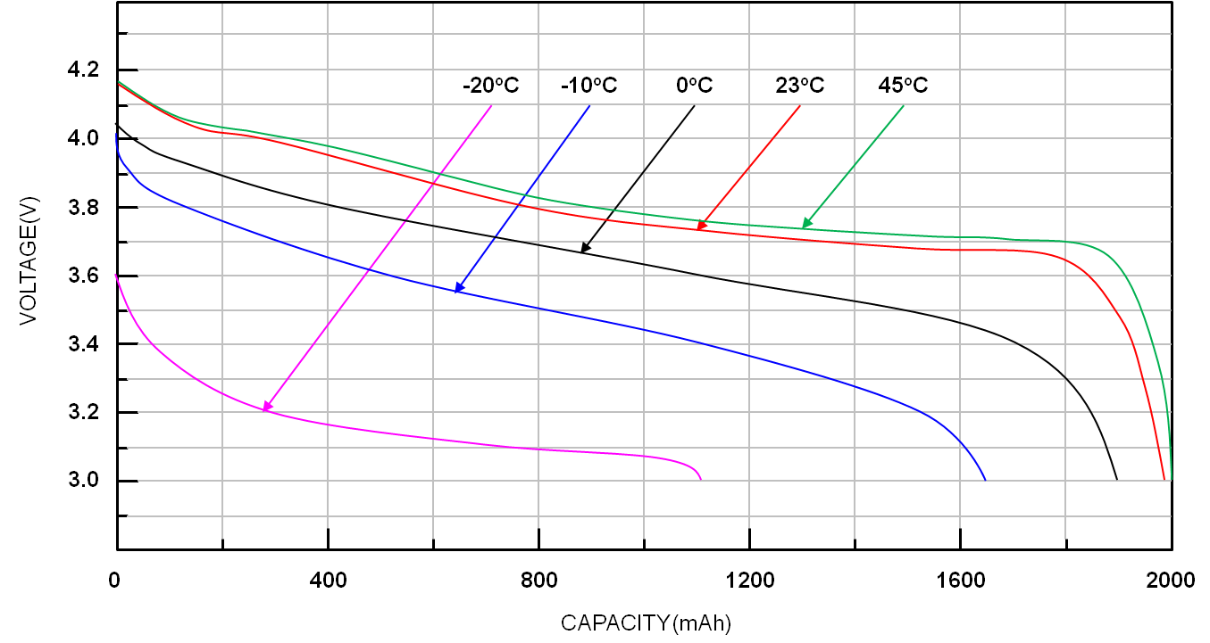
Effects of temperature
The performance of our battery will depend on temperature conditions.
Therefore, we will have:
-Nominal voltage from 5V to 3.8V
-Range of temperature operation conditions from -10℃ (14°F) to 30℃ (86°F)
Notes:
https://www.richtek.com/Design%20Support/Technical%20Document/AN024?sc_lang=en
Send link to shira
Minimum voltage explanaition
Convert the unit

Slide 19
THe BB Solution
Keep battery dispensing stations in buildings (room temperature)
Use of lithium ion batteries than lead-acid because their temperature effects can be reversed by warming up
Notes:
Lead acid heavy and less energy dene

Slide 20
User Interface and Communication
Requirements:
Ask user for identification
Show user’s history
Provide user choice between two battery capacities
Communicate with the backend to open locker door
Notes:
User history

Slide 21
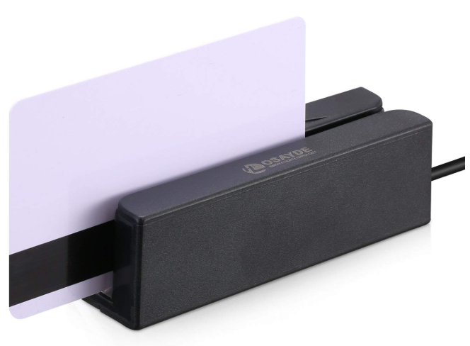
Card Reader for Interface
Magnetic Card Reader

Slide 22
Battery Data Feedback
Need to create data pathway from battery when it is being charged
Necessary to learn battery’s performance
Collect usage data from battery while charging for analysis

Slide 23
FRONT END - Web Portal
HTML/CSS/Javascript Web Portal
Provide user portal to access backend data including:
Battery charge level
Battery size inventory
Provides access over internet

Slide 24
BACKEND - RASPBERRY PI
On the Raspberry Pi, we communicate with our web server to store data and retrieve old data
Web Server contains information about Battery information accessed through the Web Portal on users end
Battery information is also accessible through the Interface
Notes:
Raspberry Pi would only comm with it

Slide 25
Preliminary Weight Analysis
Mobile Device Battery will weigh 0.25 kg Providing 4 charges on iPhone 8
Laptop Battery will weigh 1 kg (2 lbs) Providing 2 charges on MacBook Pro

Slide 26
Proposed MDR Deliverables
Demonstration of Battery Charging
DC power supply charging lithium based battery (Kaden)
Charging circuit (Kaden)
Demonstration of Base Station/UI Interaction
UI able to send user interactions to backend (Jayme)
Card Reader for Interface communicating to backend (Jayme)
UI able to receive from backend and display results (Ebenezer)
Backend Raspberry Pi and web server (Ebenezer)
Notes:
Demonstrate the critical functionality of the project

Slide 27
Thank You
Questions?

