Slide 1
Team BB
Midway Design Review
__________
Senior Design Project
__________
Fall 2018

Slide 2
BB (Battery Box)
Advisor
Shira Epstein
Team
Ebenezer Adams & Kaden Chen
(Two man band)

Slide 3
THE PROBLEM: Battery Life
Students face the problem of battery life on devices not lasting a full day with an on-the-go lifestyle
Battery life has not increased enough to meet the growing energy needs
Electronic devices with energy needs include mobile phones, tablets and laptops
Notes:
https://www.dailymail.co.uk/sciencetech/article-3607598/Do-low-battery-anxiety-90-panic-losing-power-phones.html
https://myweego.com/2015/02/02/dead-phones-statistics-on-the-everyday-hassle/

Slide 4
Requirement Analysis: Specifications
Battery box with individual lockers for each battery
Locker doors will open via electronic locks and output fully charged batteries
Card reader to login users
Online web portal for users to view battery inventories and reserve batteries
Cooling fan system to maintain temperature due to heat product from charging
External laptop-sized battery will provide 50000mAh and around 24 hours for average use, i.e. web browsing (Based on 2018 15” Macbook Pro)
External mobile-sized batteries will provide 10000mAh and around 48 hours for average use, i.e. web browsing (Based on 2017 iPhone 8)
Notes:
Get rid of the second bullet point
Mobile be small letter
Note average use(normal web browsing)
Card reader instead
At stations battery inventories
“As feedback”
At fan to spec

Slide 5
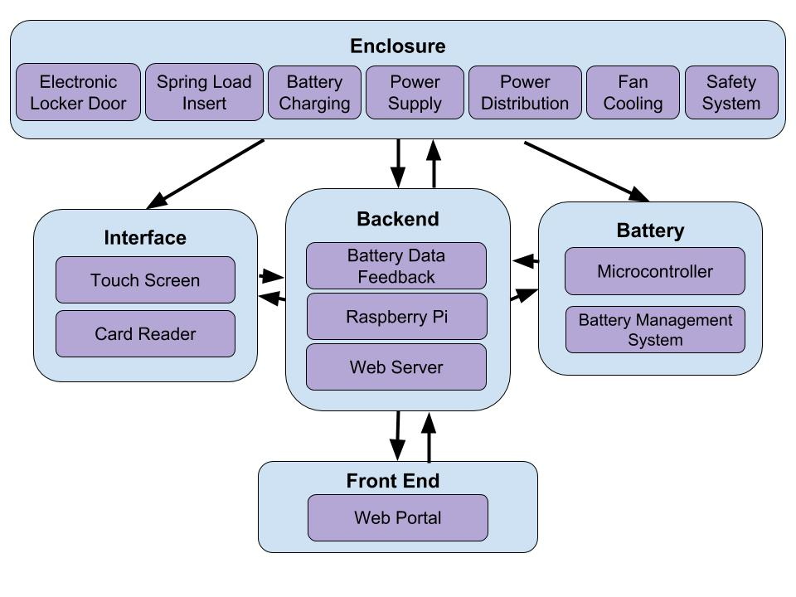
Block Diagram
Notes:
Battery rfid not but microcontroller
Remove web server

Slide 6
BATTERY Charging System
Requirements:
Proprietary charging port for batteries
Power supply regulation
Internal temperature control for Battery Box
Implementation:
Raspberry Pi to monitor power being drawn by charging system
Notes:
Charge system
Go right after the B.D
Make internal temp control
Be able to charge multiple batteries
Manage

Slide 7
Battery Box System
User Interface:
User will use a touchscreen and a ID reader to login and check out.
Locker:
System will be able output fully charged battery/ store returned batteries
Web portal:
User will be able to check a availability for batteries on website.

Slide 8
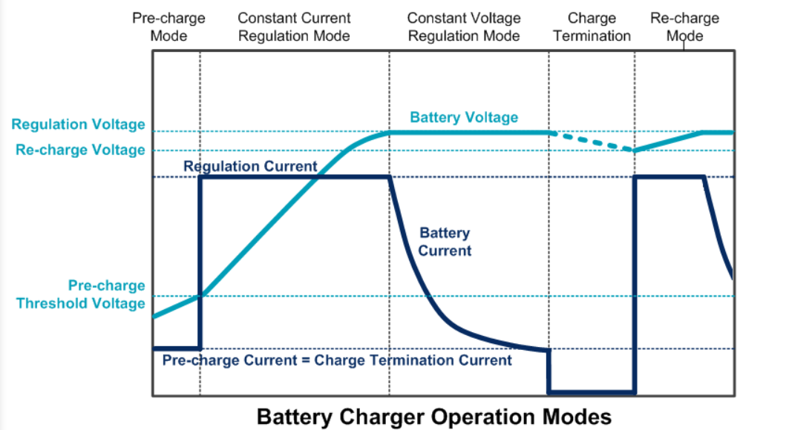
CHarger Formula
Chargers will be able to cut the voltage off after battery is fully charged and be able to restart charging after battery voltage drops 2.5% below floating voltage.
Notes:
A number in the suffix for C such as C10 rating means the battery current capacity divided by 10 times is the right discharge time. On the other hand, a number in the prefix for C such as 10C rating means the battery current capacity multiplied by 10times is the right discharge time.

Slide 9
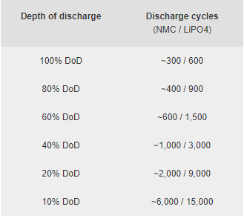
Charging lifetime cycles
Our Battery:
About 75% DoD
Mobile: 3.75 hours of discharge @2A (Fully discharged after 5 hours)
Laptop: 8 hours @4.5A 19V (fully discharged after 11 hours.)
Notes:
https://batterybro.com/blogs/18650-wholesale-battery-reviews/18852515-when-to-recycle-18650-batteries-and-how-to-start-a-collection-center-in-your-vape-shop
Most 18650 cells are rated for between 300 and 500 cycles. That means your cell can charge up to 4.2 volts, and discharge down to 2.5 - 2.8 volts, a maximum of 300 to 500 times without too much much loss in performance. When an 18650 cell nears the end of its life, the performance loss is sudden and fast.

Slide 10
Charging Requirement
Capacity:
Mobile phone: 10,000mAh Laptop: 50,000mAh
Charging Period:
Mobile phone: 3.75 hours Laptop: 8 hours
Lifespan (Cycles)：
Around 2 Years (600-1200 discharge cycles)
Notes:
The specs dont even match between slides
cycles

Slide 11
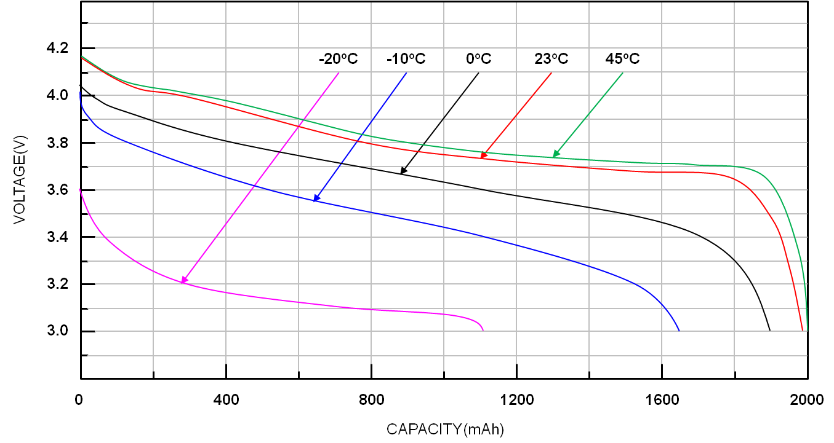
Effects of temperature
The performance of our battery will depend on temperature conditions.
Therefore, we will have:
-Range of temperature operation conditions from -10℃ (14°F) to 30℃ (86°F)
Notes:
https://www.richtek.com/Design%20Support/Technical%20Document/AN024?sc_lang=en
Send link to shira
Minimum voltage explanaition
Convert the unit

Slide 12
THe BB Solution
Keep battery dispensing stations in buildings (room temperature)
Use of lithium ion batteries than lead-acid because their temperature effects can be reversed by warming up
Notes:
Lead acid heavy and less energy dene

Slide 13
User Interface and Communication
Requirements:
Ask user for identification
Show user’s history
Provide user choice between two battery capacities
Communicate with the backend to open locker door
Notes:
User history

Slide 14
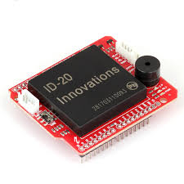
Card Reader for Interface
ID-20 RFID Reader

Slide 15
Battery Data Feedback
Need to create data pathway from battery when it is being charged
Necessary to learn battery’s performance
Collect usage data from battery while charging for analysis

Slide 16
FRONT END - Web Portal
HTML/CSS/Javascript Web Portal
Provide user portal to access backend data including:
Battery size inventory
Reservation
Provides access over internet

Slide 17
BACKEND - RASPBERRY PI
On the Raspberry Pi, we communicate with our web server to store data and retrieve old data
Web Server contains information about Battery information accessed through the Web Portal on users end
Battery information is also accessible through the Interface
Notes:
Raspberry Pi would only comm with it

Slide 18
Preliminary Weight Analysis
Mobile Device Battery will weigh 0.25 kg Providing 4 charges on iPhone 8
Laptop Battery will weigh 1 kg (2 lbs) Providing 2 charges on MacBook Pro

Slide 19
MDR Deliverables
Demonstration of Battery Charging
DC power supply charging lithium based battery (Kaden)
Charging circuit (Kaden)
Demonstration of Base Station/UI Interaction
UI able to send user interactions to backend (Ebenezer)
Card Reader for Interface communicating to backend (Kaden)
UI able to receive from backend and display results (Ebenezer)
Backend Raspberry Pi and web server (Ebenezer)
Notes:
Demonstrate the critical functionality of the project

Slide 20
MDR Deliverables
Demonstration of Battery Charging
DC power supply charging lithium based battery (Kaden)
Charging circuit (Kaden)
Demonstration of Base Station/UI Interaction
UI able to send user interactions to backend (Ebenezer)
Card Reader for Interface communicating to backend (Kaden)
UI able to receive from backend and display results (Ebenezer)
Backend Raspberry Pi and web server (Ebenezer)
Notes:
Demonstrate the critical functionality of the project

Slide 21
Li-Ion Battery & CHarging System (Kaden)
Battery:
5,000 mAh (For testing and experiment. Will have a 10,000mAh one for CDR)
Can be charged / can used to charge another battery

Slide 22
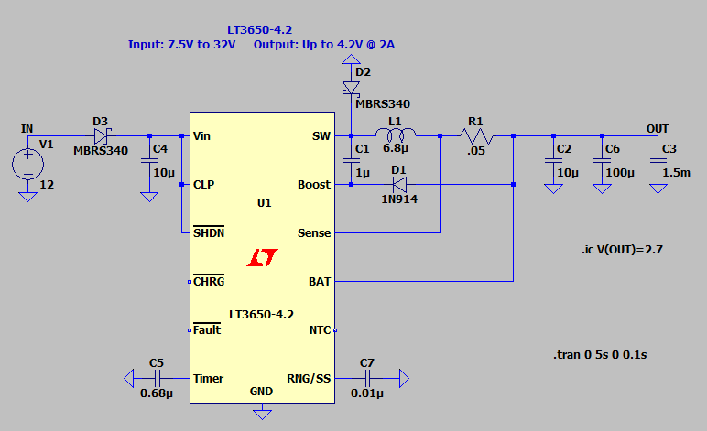
Li-Ion Battery & CHarging System (Kaden)
Charger circuit:
Designed to operate at 7.5V-32V
Input voltage (From an AC adapter)
Cut off after 3 hours of charging
Reboot after voltage of battery drops 2.5% below float voltage

Slide 23
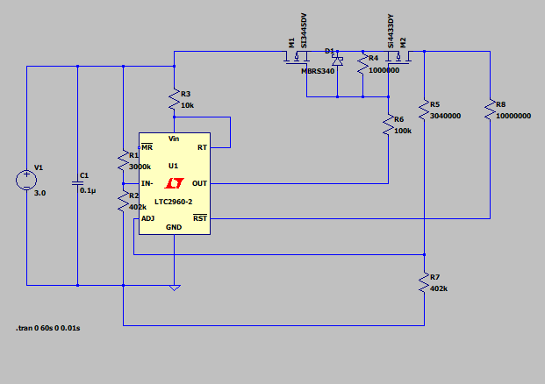
Li-Ion Battery & CHarging System (Kaden)
Voltage Management Circuit (Not in the MDR delivery)
Designed to protect the battery from deep discharging.

Slide 24
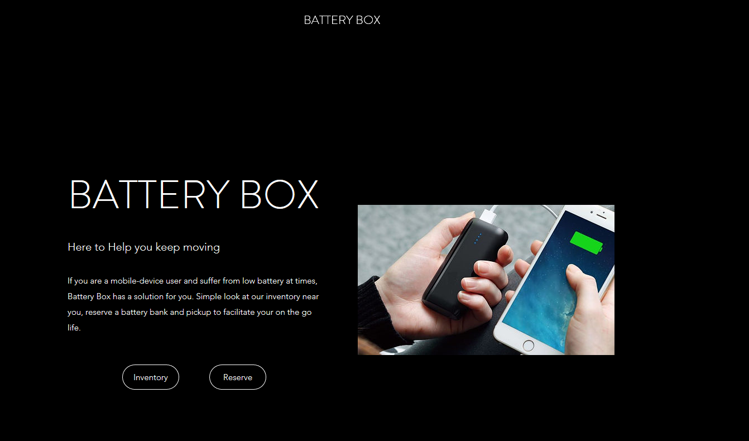
UI & Web Portal (ebenezer)

Slide 25
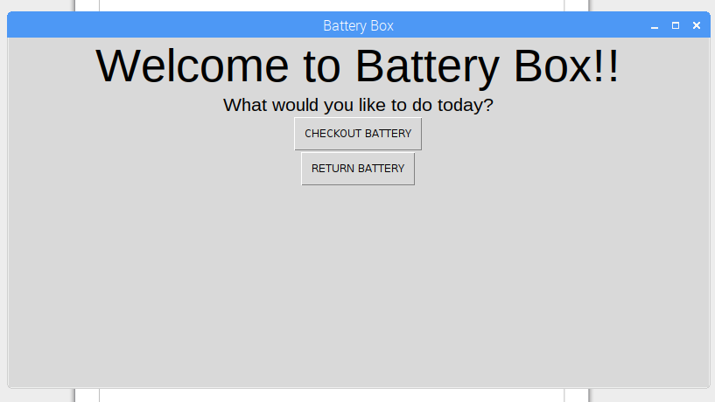
UI & Web Portal (ebenezer)

Slide 26
CDR Deliverable-
Currently
 | Progress | Project Impact
Charging | 40% | 10%
Website | 50% | 10%
UI | 60% | 10%
Battery | 0% | 20%
Building Box | 0% | 45%

Slide 27
CDR Deliverable
Kaden: Battery 0% to 80%
-3d printed cases
-full onboard Battery Management system (BMS)
Ebenezer:Website 50%-99%
-Full user database containing a lot more than email
-User history viewing
-Timing for reservation
Together: Building the Box->0%- 40%-50%
-Putting the outside together
-Few wirings -Locking mechanisms

Slide 28
Gantt Chart

Slide 29
Thank You
Questions?

