Slide 1
Preliminary Design Review
Tablo
Game Projection System
Team 24
October 18, 2018

Slide 2
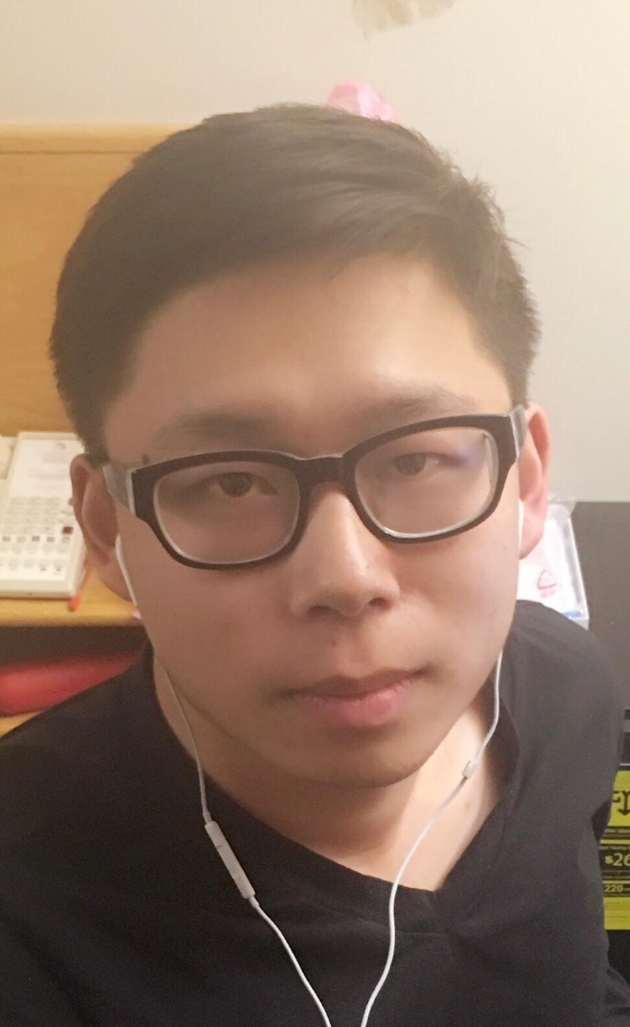
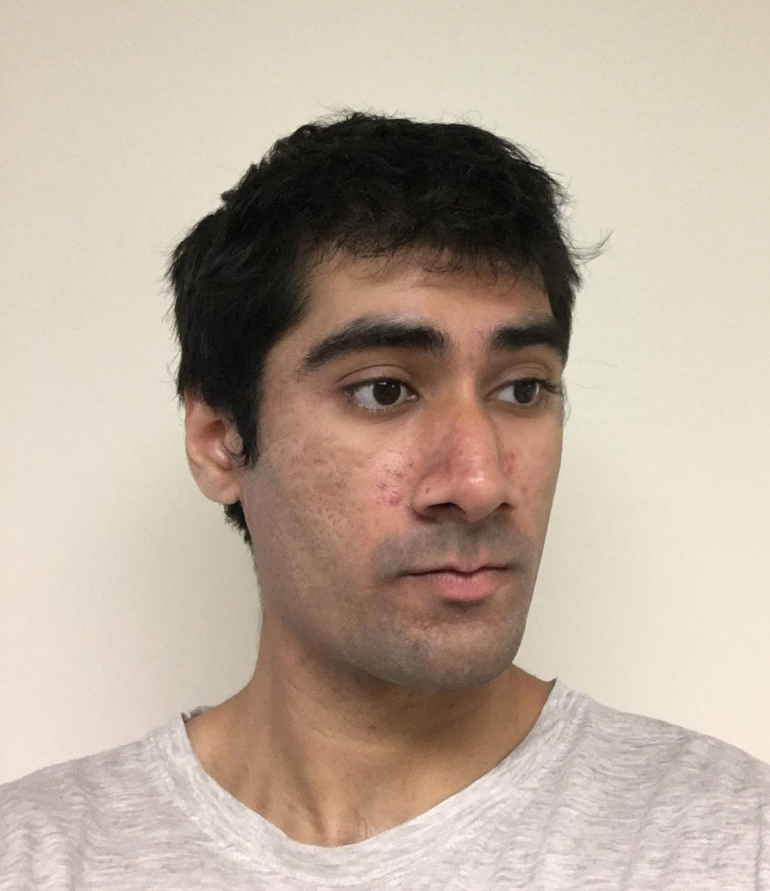
Bowen Yu, CSE
Patrick Green,CSE
Joo Young Park,CSE
Pervesh Jaswal,EE

Slide 3
Problem Statement
-People spend a lot of money on table games which can take up a great deal of space in one’s home.
-Tables serve only one purpose, pool table can only be used for pool game
-Very difficult to move full size tables
Notes:
Joo Young

Slide 4
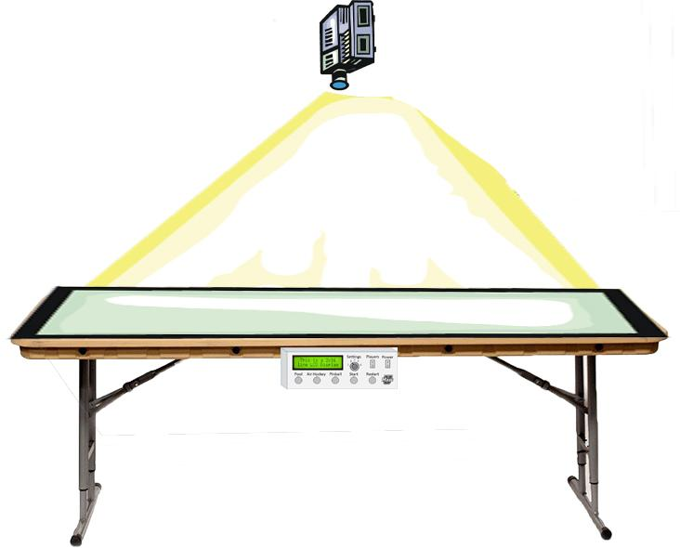
Our Solution
2D User-interactive Projection Gaming System
Allows users to play a virtual table games on any table using a motion tracked sensor
Trajectory shown in the virtual projection.
Players can utilize additional features comparing to classic game.
Notes:
Pervesh

Slide 5
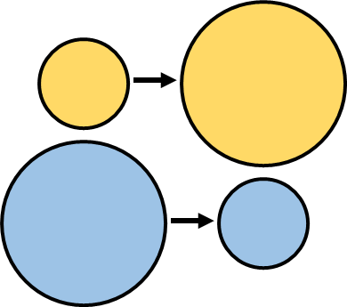
Improvements
The digital system gives us an opportunity to implement many things that are not possible on a traditional table game, such as:
Automated moving objects
Resized objects
Adjustable scoring
Can even go online
Notes:
Pervesh

Slide 6
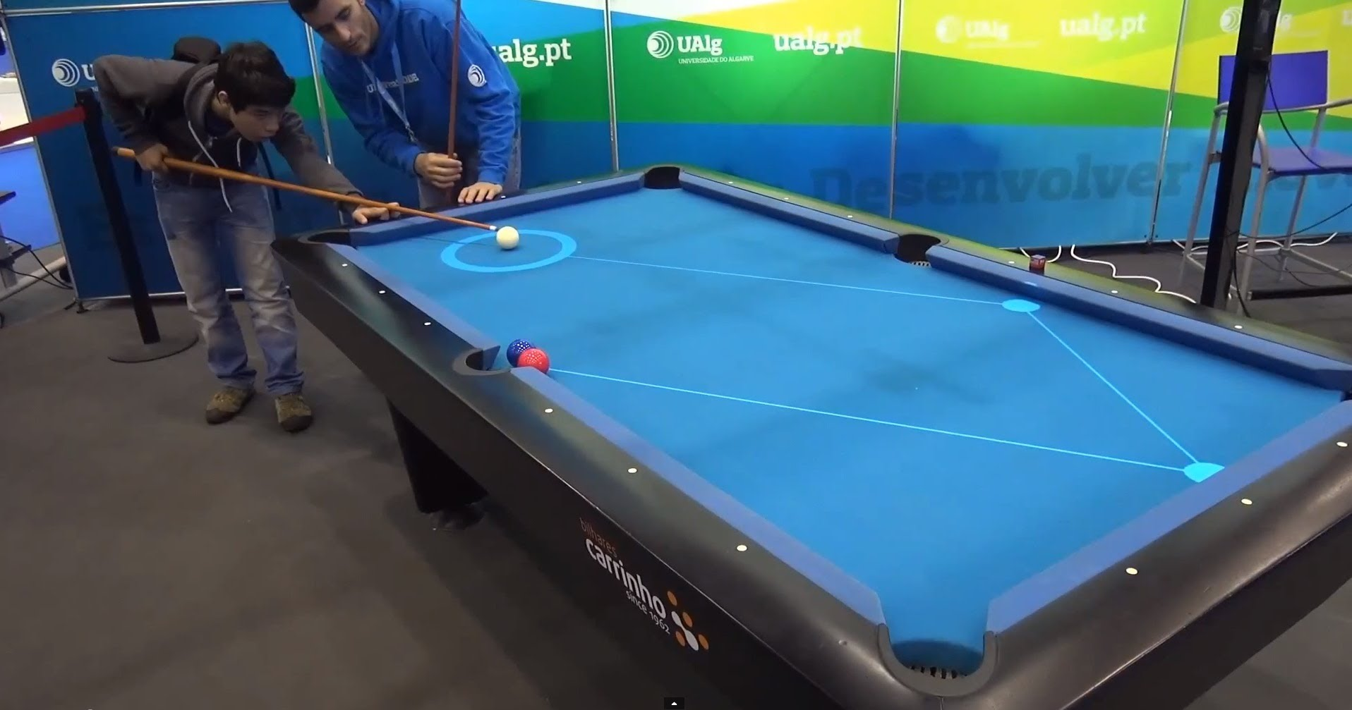
Design Alternatives (Existing Products)
Pool Game Trajectory Displayer
Randomized Virtual 2-D Projected Balls on Ground for Children
Notes:
Patrick

Slide 7
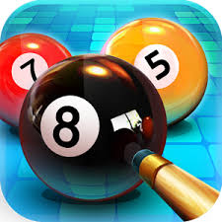
General Interest
8 Ball Pool
15 million reviews between Google Play Store and Apple App Store
Industry standard is to assume roughly 5% of downloaders leave a review, which translates to approximately 300 million downloads
Air Hockey Gold
More than 11 million downloads on the Apple App Store
Pinball
Millions of downloads between multiple pinball apps
Notes:
Patrick

Slide 8
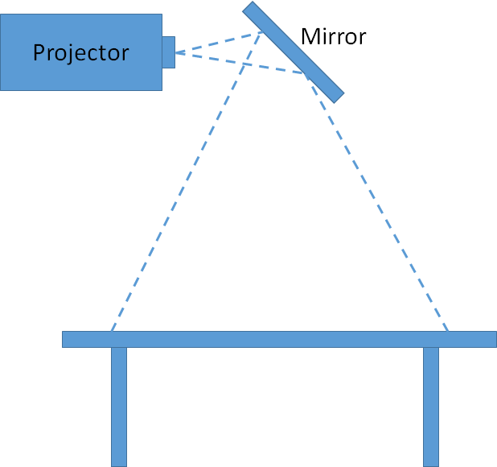
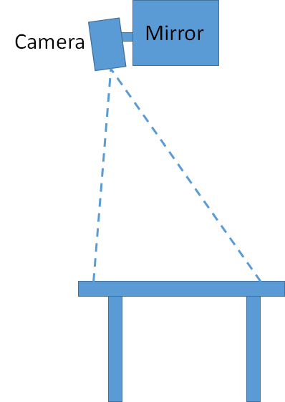
Logistics
Simulation running on laptop projected onto table
Projector mounted above table and reflected off first surface mirror
Camera mounted next to projector senses controllers
Wireless controllers used on table surface to interact
Cardstock on table to aid in projector visibility
Front
Side
Notes:
Patrick

Slide 9
System Specification
System must be able to sense player’s controller in real time
Mechanics of game must imitate real life / original style
Projection display must keep up with interactions of players(important!)
Notes:
Jooyoung

Slide 10
Input and Output
Input:
Dynamic data of sensors
Output:
Processed data from Laptop -> Live projection
Notes:
Jooyoung

Slide 11
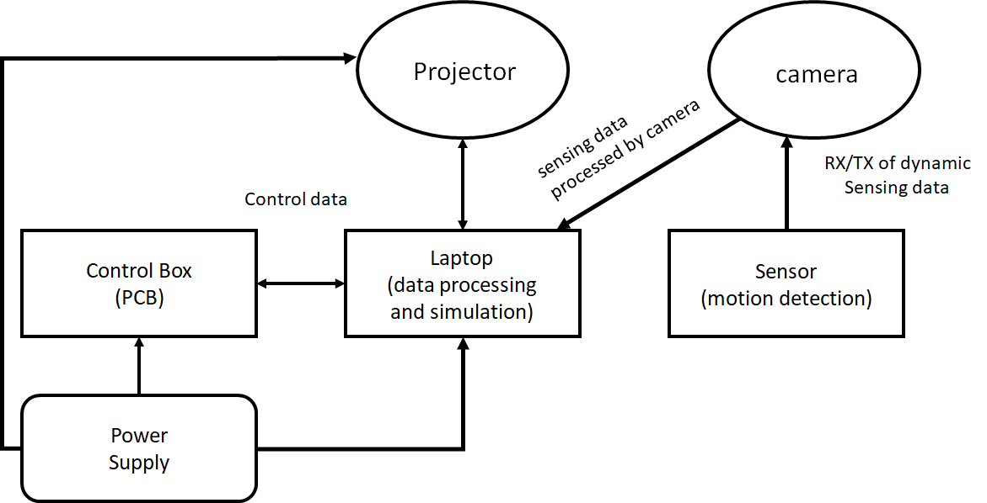
System Block Diagram
Sensing data
Captured by Camera
Notes:
Bowen

Slide 12
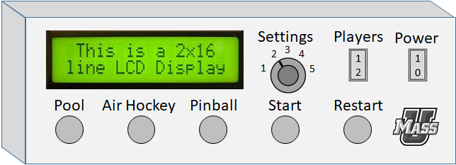
PCB
LCD display
DPST or DPDT switch for Power
Toggle switch for Players
Push buttons for games and Start/Restart
Rotary switch for Settings
Example of general control box on side of table
Notes:
Pervesh

Slide 13
Subsystem: Microcontroller
Communicates with laptop to control game mode
Takes inputs from control box
Notes:
Pervesh

Slide 14
Anticipated Problems
When broken up, individual components not that complicated
Anticipate problems with the individual components communicating with each other
Interfacing (among computer to camera)
Delay
Notes:
Joo Young

Slide 15
System Delay
Significant impact on user experience!
Three kinds:
1. Algorithm and data analysis delay
- depends on algorithm we use
- depends on the speed of the processor(laptop)
2. Data transmission delay(expected to be neglected)
3. Data transformation delay between difference system.
Notes:
Bowen

Slide 16
System Delay
3. Data transformation delay between difference systems.
Between camera and laptop: laptop need to interpret bit stream from camera extract sensing data.
Between laptop and projector: resolution adjustment
Imagine you were watching a movie using projector. Lagging will always be the problem.
No Network delay if game was offline.
Expected: 100ms
Notes:
Bowen

Slide 17
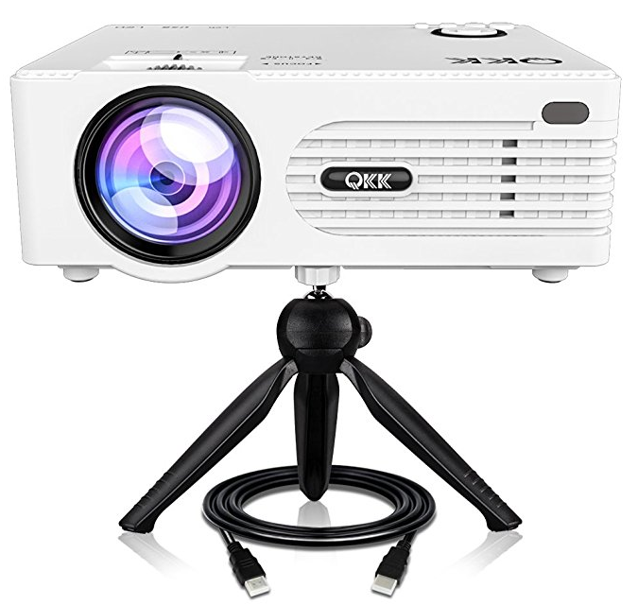
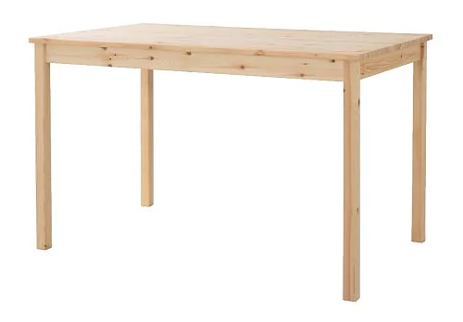
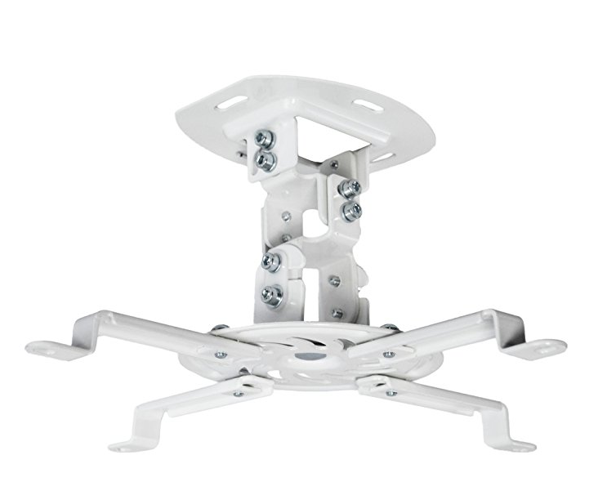
Products: Estimated Budget
Projector $100
Projector mount $30
PCBs $50
Table/ projector stand $100
Mirror $50
Total: $330
Notes:
Patrick

Slide 18
MDR Goals
Functional projection system on regular table
One functional sensor input
Displaying a moving object
Reset function on PCB
Detect collision between sensor location and simulation objects
Notes:
Patrick

Slide 19
Breakdown of activities for each student
PCB - Pervesh
Electrical Engineer with most experience in circuits
Camera Detection - Joo Young and Bowen
Experience in camera detection from ECE 354 Lab II
Simulation - Patrick
Experience in game programming and creation
Notes:
Pervesh

Slide 20
Final Goals
Two functional sensor inputs
Multiple games
Multiple options per game
Controller app for commercial aim
Notes:
Bowen

