Slide 1
Midway Design Review
Tablo
Game Projection System
Team 24
December 11th, 2018

Slide 2
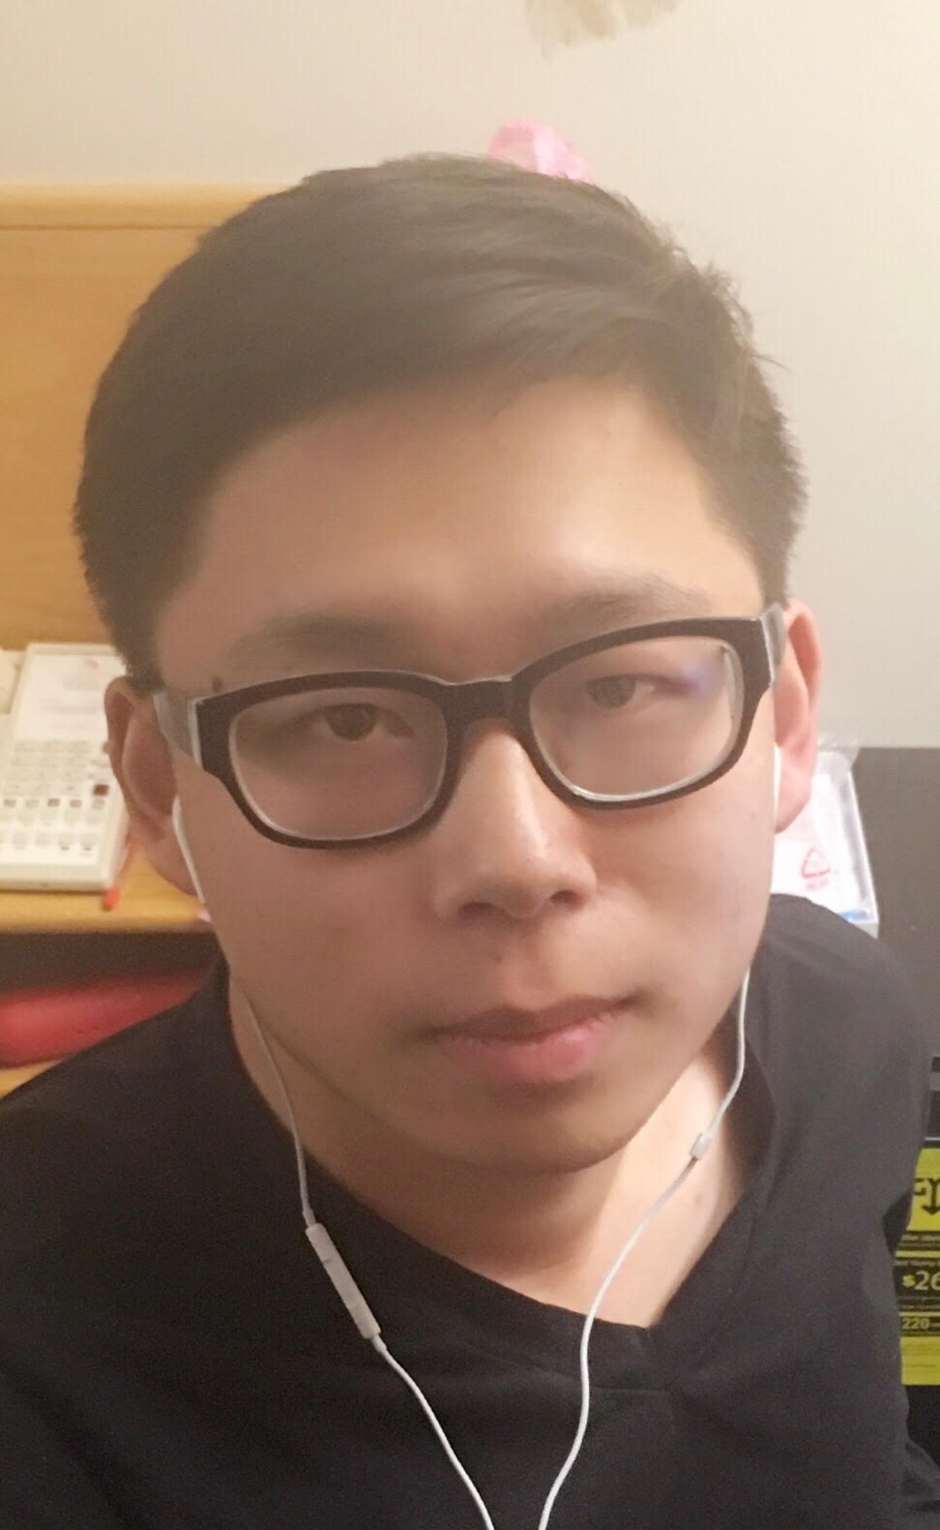
Bowen Yu, CSE
Patrick Green,CSE
Joo Young Park,CSE
Pervesh Jaswal,EE

Slide 3
Problem Statement
-People spend a lot of money on table games/board games which can take up a great deal of space in one’s home.
-Need to buy different kinds of board game in order to play them all
-Tables serve only one purpose, pool table can only be used for pool game
-Very difficult to move full size tables
Notes:
pervesh

Slide 4
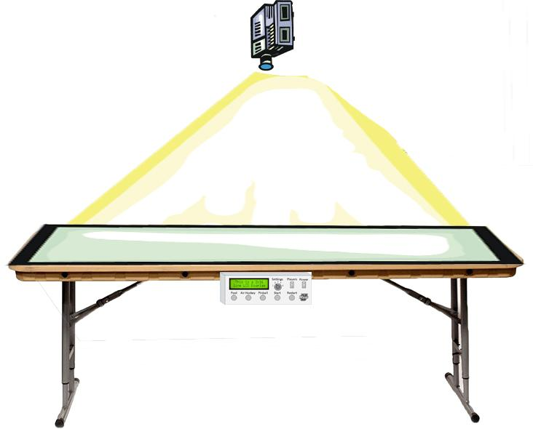
Our Solution
2D User-interactive Projection Gaming System
Allows users to play a virtual table/board games on any table using a motion tracked sensor
Interact with the controller that the users holds.
Players can utilize additional features comparing to classic game.
Notes:
Pervesh

Slide 5
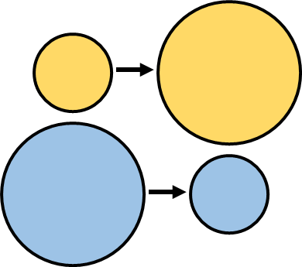
Improvements
The digital system gives us an opportunity to implement many things that are not possible on a traditional table game, such as:
Automated moving objects
Different games in one table
Resized objects
Adjustable scoring
Can even go online
Notes:
Pervesh

Slide 6
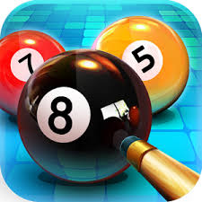
General Interest
8 Ball Pool
15 million reviews between Google Play Store and Apple App Store
Industry standard is to assume roughly 5% of downloaders leave a review, which translates to approximately 300 million downloads
Air Hockey Gold
More than 11 million downloads on the Apple App Store
Pinball
Millions of downloads between multiple pinball apps
Notes:
Patrick

Slide 7
Shift of Motivations
-Table games proved a little ambitious
-Issues with delay and sensing in real time(especially when you move fast)
-Board games are more feasible and practical
-No need to worry about losing pieces
-Able to play more variety of games in one system
-Can have virtual statistic trackers and number generators
-Can have sound or video effect to make the game more exciting
-Other applications, such as education or art
Notes:
Patrick

Slide 8
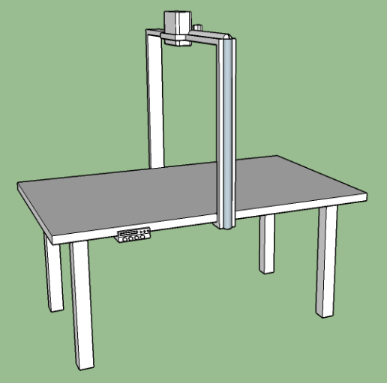
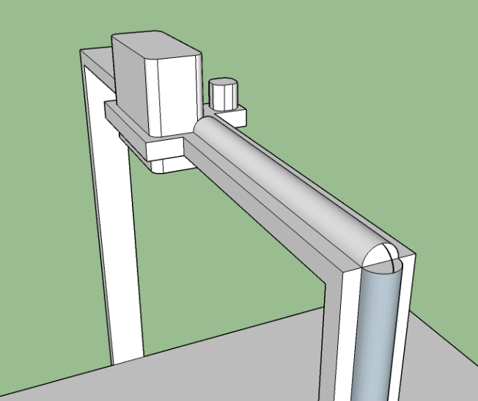
Logistics
Simulation running on laptop projected onto table
Projector mounted above table
Camera mounted next to projector senses controllers
Controllers used on table surface to interact
Notes:
Patrick

Slide 9
Presentation Table
Projector
Camera
Control Box
Wire Bundle
Notes:
Patrick

Slide 10
System Specification
System must be able to sense player’s controller in real time
Also have space for 4-player games
Mechanics of game must imitate real life / original style
Simulated game must follow all rules of original game
Projection display must keep up with interactions of players
Delay must be under 100 ms
Circuit Board Consumes no more than 650 mW
Notes:
Jooyoung

Slide 11
Input and Output
Input:
Dynamic coordinates of controller that is being tracked
Output:
Processed data from Laptop -> Live projection
Notes:
Jooyoung

Slide 12
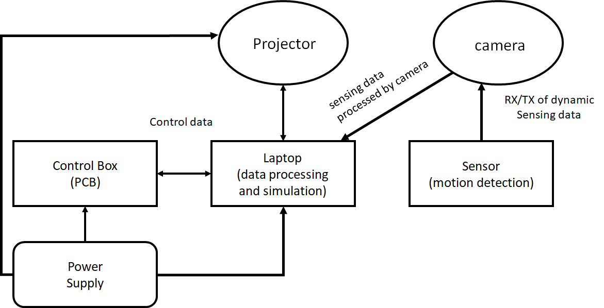
System Block Diagram
controller
Captured by Camera
Controller captured by Camera
HDMI
Notes:
Jooyoung

Slide 13
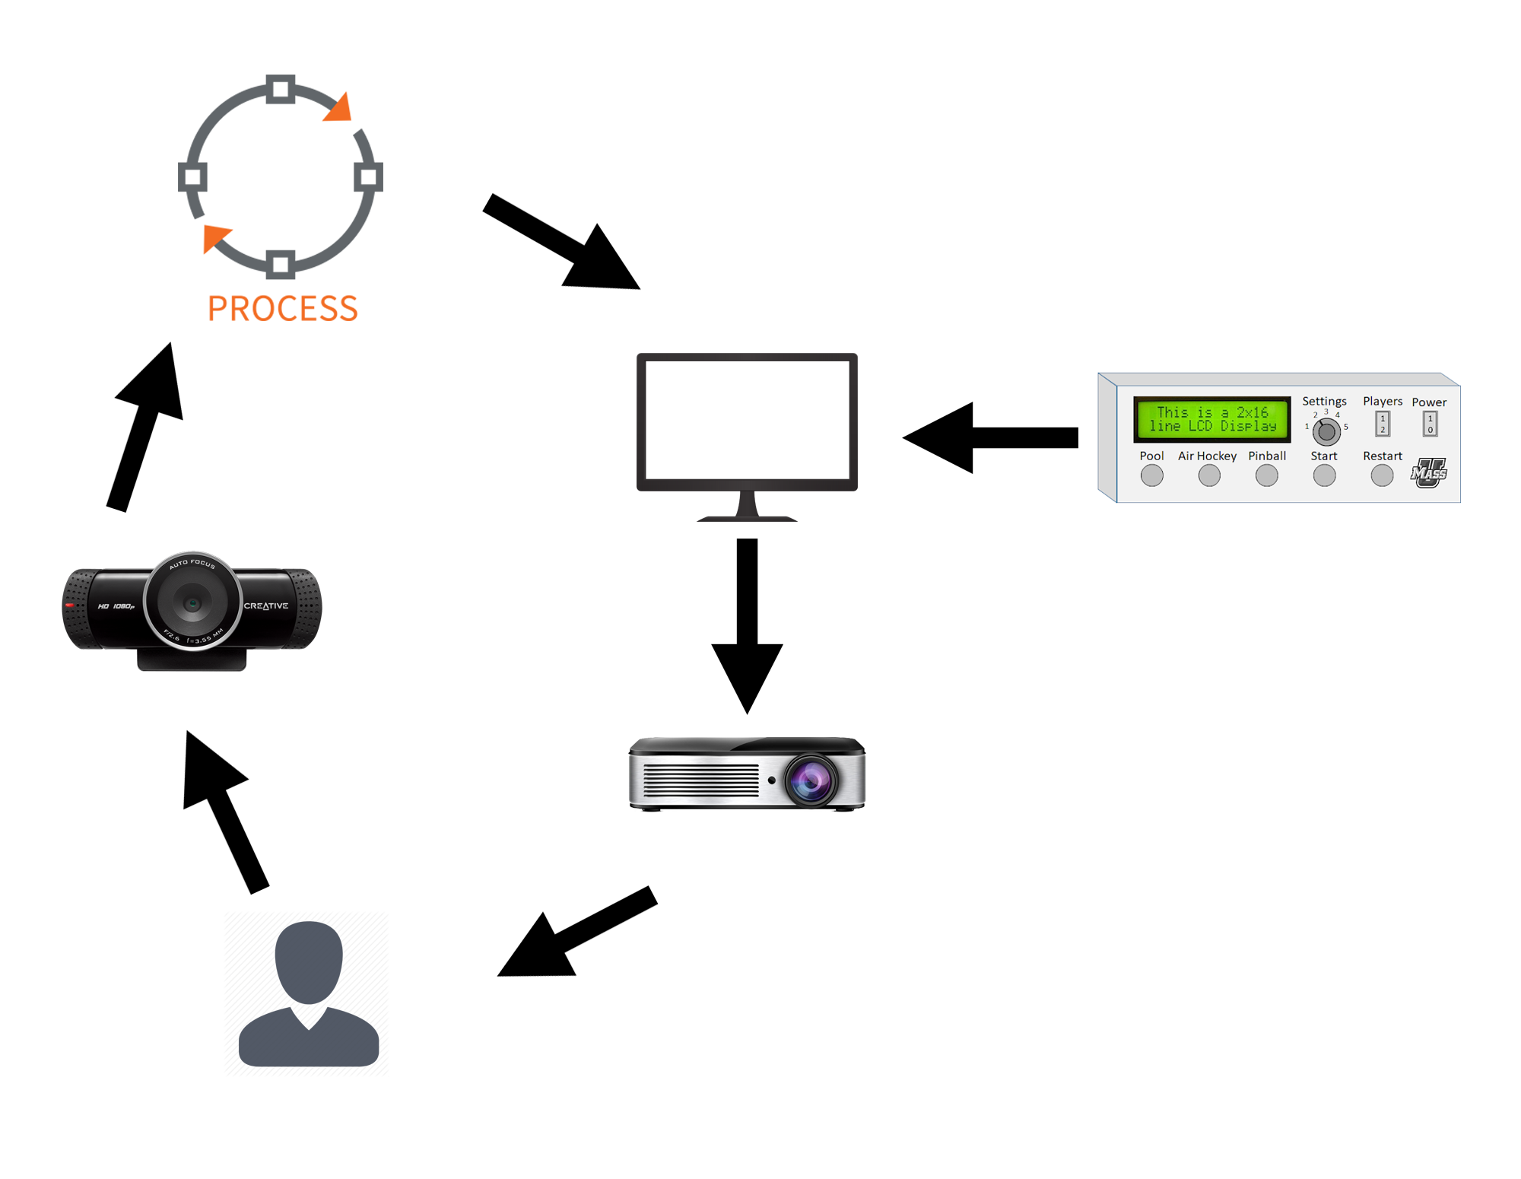
Logistics of communication Diagram
Game
Simulation
Captured movement of controller
Bits stream info
Control Box
Camera
Controller
Table surface
Projection
User
Notes:
Jooyoung

Slide 14
Proposed MDR Deliverables
Functional projection system
-Connect projector from laptop
One functional sensor input
-Implement camera as a sensor to sense targeted object
Detect collision between controller location and simulation objects
-Get coordinates of tracked object and export to simulator
-Import coordinates and use it to simulate
Displaying a moving object
-Project objects that are reacted from simulation.
PCB control commands outlined and set up
Notes:
Patrick

Slide 15
Breakdown of activities for each student
PCB - Pervesh
Using PCB board, designed the control box that controls main function of the system.
Camera Detection
Bowen coded a program that detects and tracks a certain colored object using a camera.
JooYoung coded to get x, y coordinates of tracked object constantly, and made
them to be saved in text file at certain location.
Simulation - Patrick
Made various simulations that interacts with user using saved coordinates file.
Notes:
Bowen

Slide 16
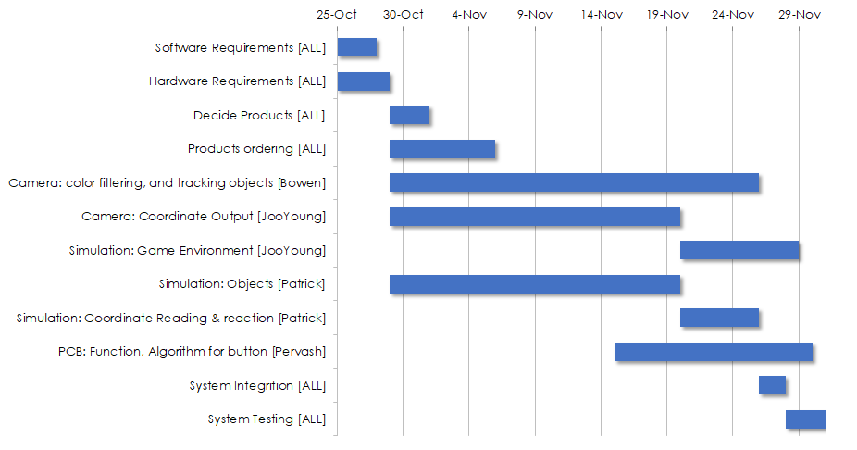
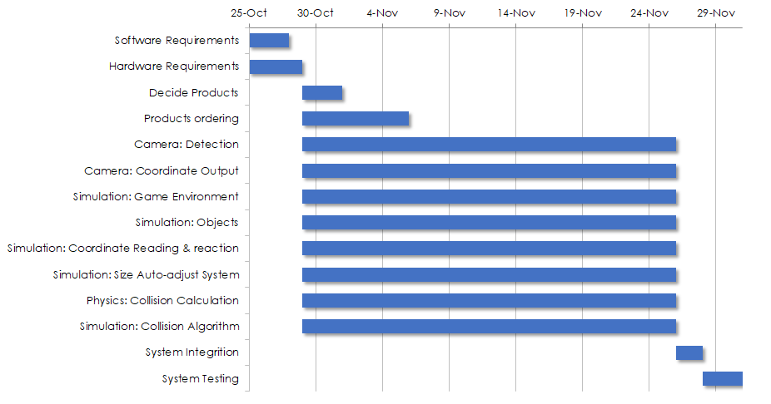
Project Scheduled for MDR

Slide 17
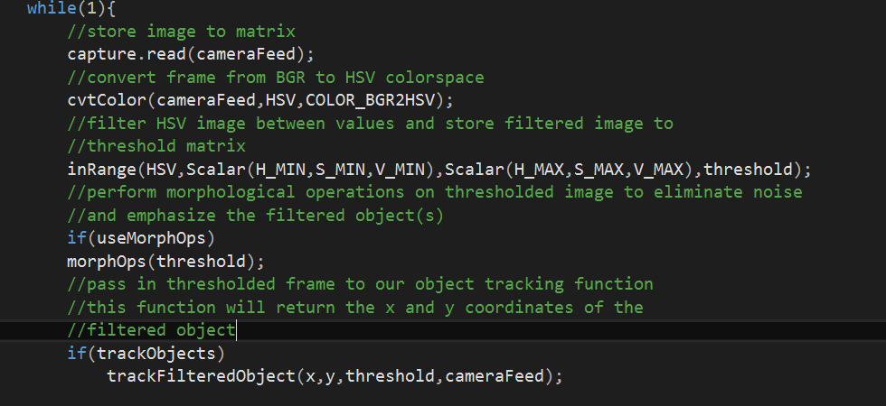
Color Filtering
1.stores frames into a matrix
2.change each frame from RGB to HSV scale
3. Adjusting HSV trackbar to filter out specific color
- Will demo how the video looks after filtering
Notes:
Bowen

Slide 18
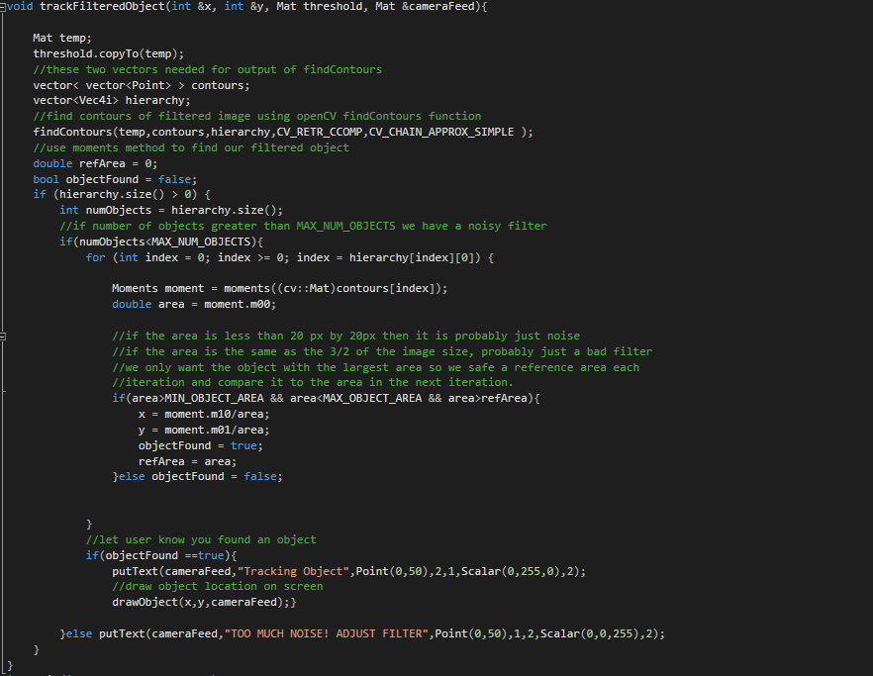
Tracking Object
Using findcontour() to find the edge
Once we have the edge we can use moments method to get the centroid coordinate
https://docs.opencv.org/2.4/modules/imgproc/doc/structural_analysis_and_shape_descriptors.html?highlight=moments#moments
Notes:
Bowen

Slide 19
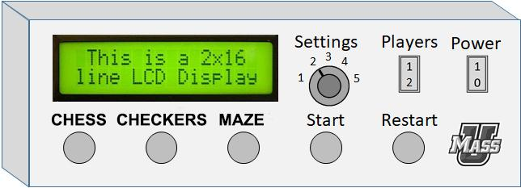
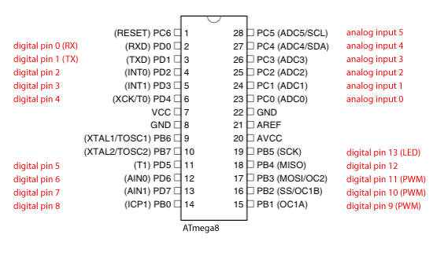
PCB
Allows for easier user interface
Analog switch to adjust display surface area
Logistical buttons for resetting games
Example of general control box on side of table
Notes:
Pervesh

Slide 20
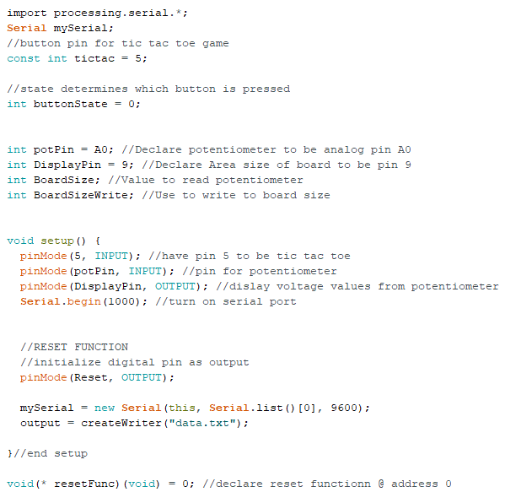
Arduino code part 1/2
Instantiate Reset function
Instantiates functions each button shall carry out
Use of potentiometer for analog input to resize table display
Notes:
pervesh

Slide 21
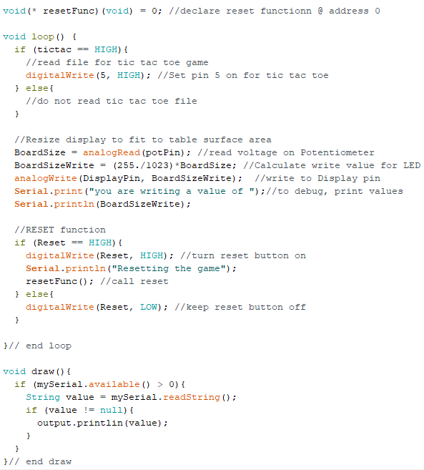
Arduino Code part 2/2
-Reads in voltage values to activate buttons to execute respective functions
Notes:
pervesh

Slide 22
Anticipated Problems
When broken up, individual components not that complicated
Anticipate problems with the individual components communicating with each other
Interfacing (among computer to camera)
Delay
Notes:
Bowen

Slide 23
Encountered problems
Sensing
sensing and tracking a target object depends on environment
Delay
Neglectable when moving at slow speed, huge when move faster
Communications with PCB to Laptop
No compatible output text file
Notes:
Bowen Yu

Slide 24
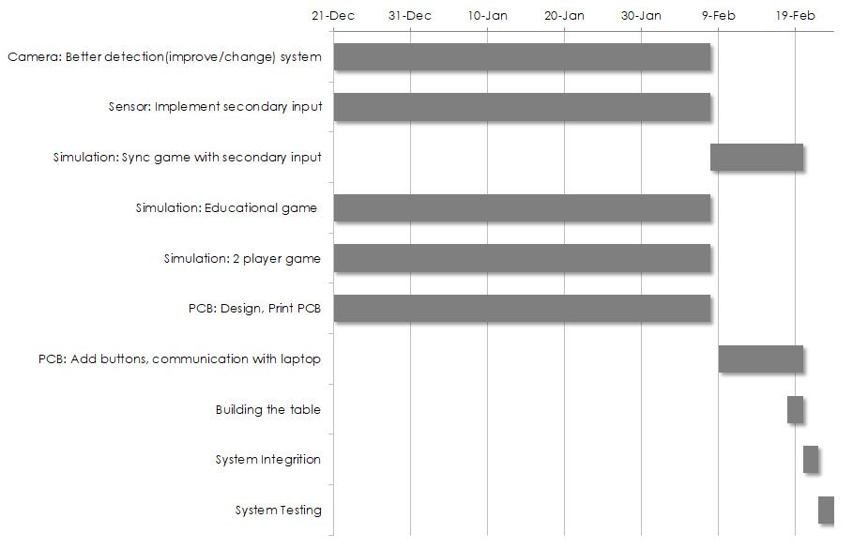
Project Scheduled for CDR

Slide 25
CDR Deliverables
Functional projection system on regular table
Two functional sensor inputs
Displaying a moving object
Detect collision between sensor location and simulation objects
Reaction from two functional sensor inputs and simulation objects.
PCB communication with simulation
Notes:
JooYoung

Slide 26
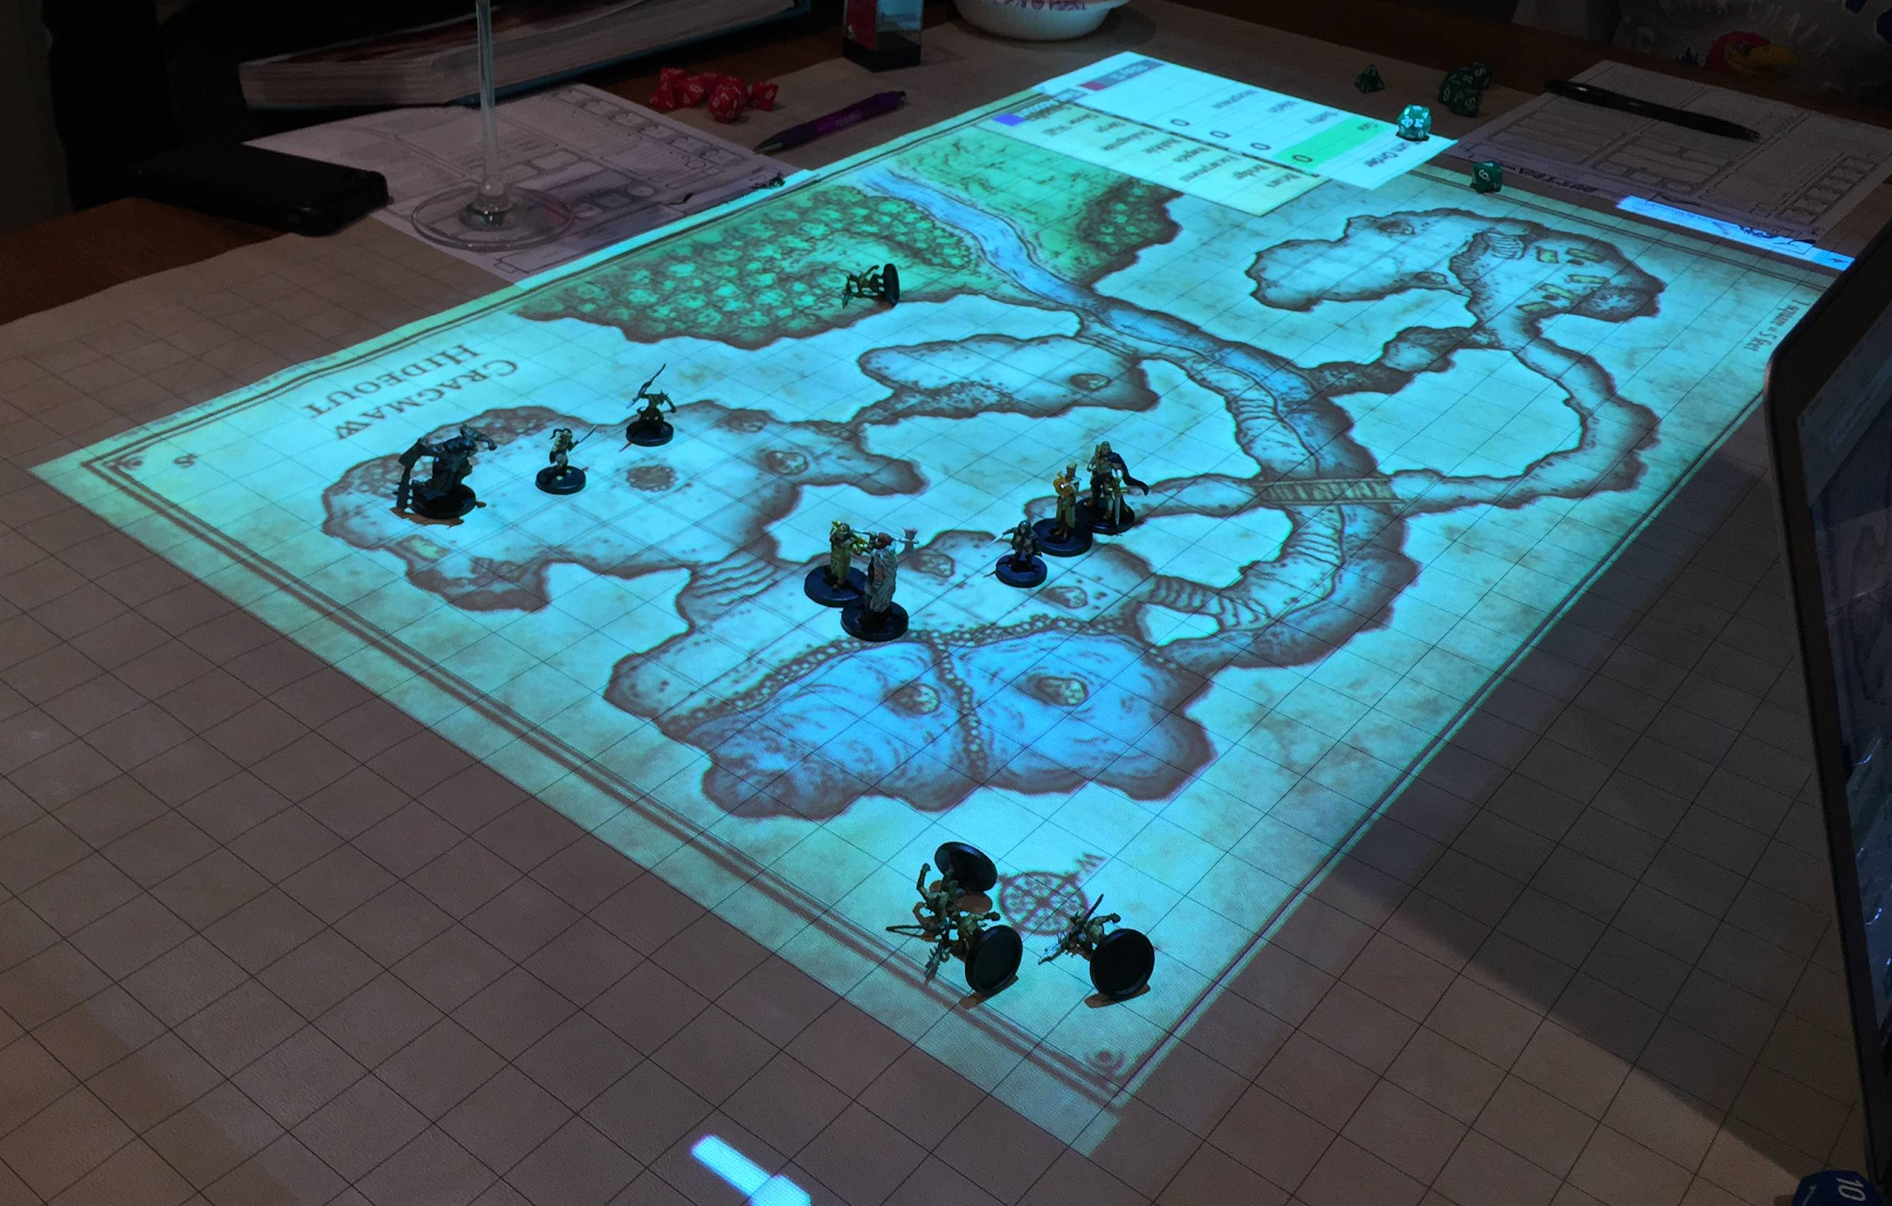
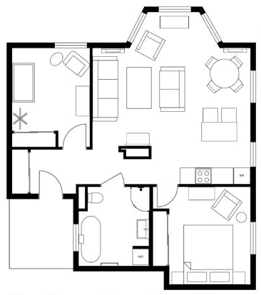
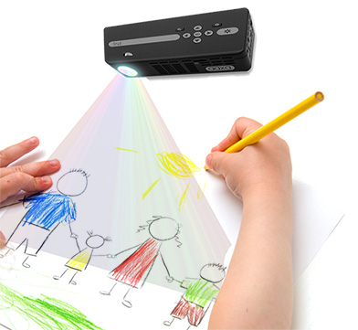
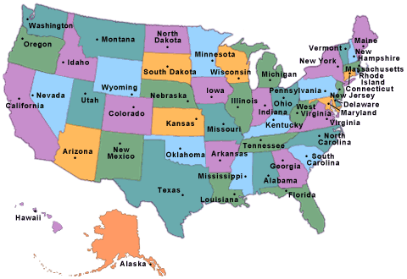
Opportunities other than games
Educational
Art
Planning
Pen and Paper Games
Notes:
Patrick

Slide 27
Future Improvement Ideas
Hand detection
Multiplayer
Secondary input method
Notes:
JooYoung

Slide 28
Final Goals
Two functional sensor inputs
Multiple games
Multiple options per game
Notes:
Bowen

