Slide 1
SandWish
Automated Tabletop Sandwich Maker
Team 21:
Jack Hennessey, Wei Huang, Zach Scipioni, Anson Haniwalt
Date: 12/7/2018
Notes:
Jack

Slide 2
Problem Statement
Custom sandwich production is a laborious task
Custom sandwich orders are potentially difficult to juggle for human servers at catered events
With variable sandwich demand comes unutilized human labor
App allows digital queueing eliminating lines and congestion for food
Notes:
Jack

Slide 3
System Specifications
Autonomous sandwich assembly
Sanitary
User specified ingredients
Interface through a mobile application
3’ x 4’ footprint
Notes:
Zach

Slide 4
System Specifications Cont’d
Sandwich assembly will take max 5 minutes
Bread, meat, cheese, and mayonnaise available
Enough ingredients for 6 sandwiches
Can hold 3 sandwiches in reserve
User can only retrieve their sandwich
Completed sandwich has no ingredient between bread sticking out further than 1”
Notes:
Zach

Slide 5
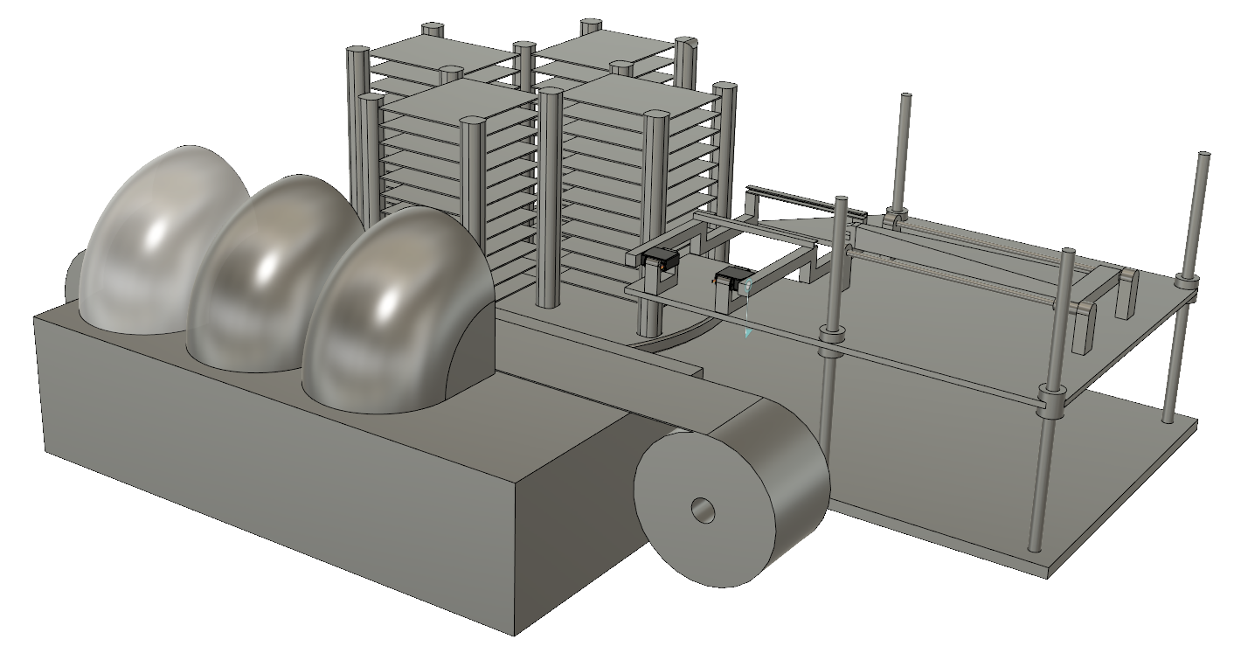
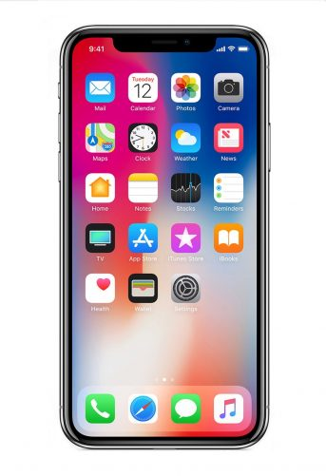
Complete SandWish
2. Storage System
Ingredient Trays
Lazy Susan
3. Arm and Flipper
Locking Doors
1. App
Height Adjustment
5. Electronic Control & Coordination
6. Power Supply
4. Dispenser System
Wax paper conveyor belt
Notes:
Zach

Slide 6
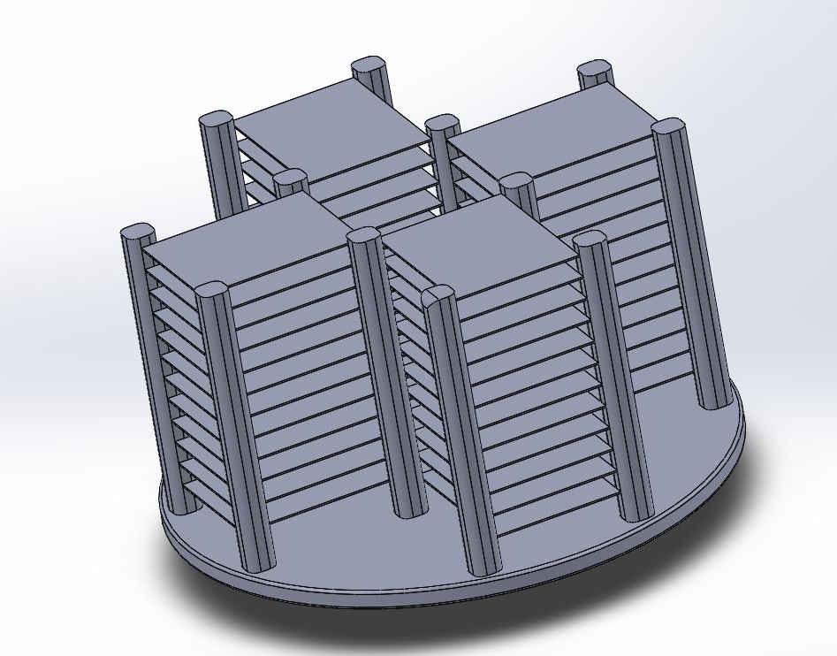
Subsystem 2: Ingredient Storage
Lazy Susan
Rotates to allow arm easy access to different ingredients
Enough ingredients for 6 sandwiches
Stepper motor to rotate
Limit switches for calibration
Lazy susan
Ingredient trays
Notes:
Zach

Slide 7
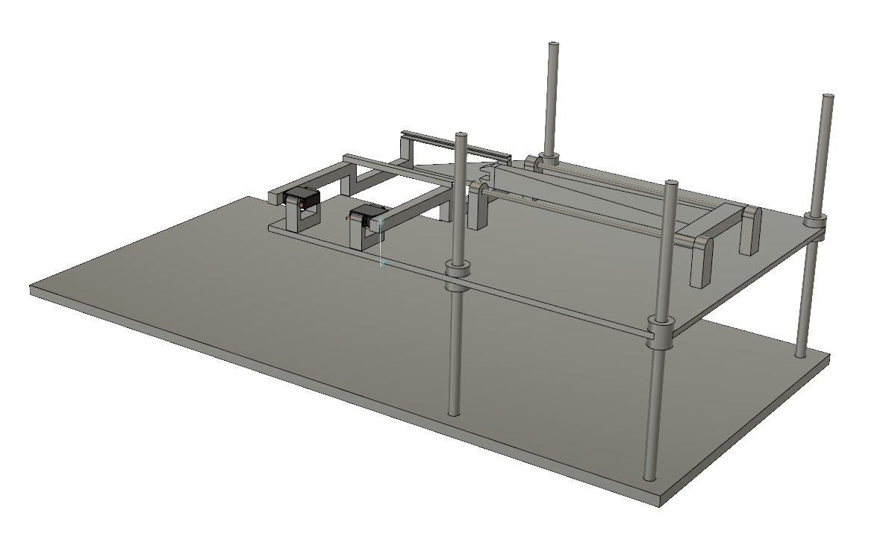
Subsystem 3: Arm and Flipper
Flipper
Arm
Arm
Extends to grab and extract material trays
Flipper
Flips material onto sandwich building zone
Height adjustment
Entire assembly will index up and down to grab trays
Height adjustment
Notes:
Anson

Slide 8
Subsystem 5: Electronic Control & Coordination
The Arduino Uno microcontroller coordinates the motors (Arduino Uno for MDR)
The mobile application communicates back and forth with the boards through local WiFi
“Levels of warning” control the sandwich queue
Notes:
Wei

Slide 9
Subsystem 6: Power Supply
powered by wall outlet
AC/DC converter power supply
3.3V, 5V, servo voltage (5V), and 8-16V stepper motors.
Notes:
Wei

Slide 10
Block Diagram
Enclosure
Power Supply
Acrylic Casing
Sandwich Assembly
2. Instructions
2. Instructions
Dispenser System
Height Adjustment
Conveyor Belt
Microcontroller
Arm and Flipper
ESP8266 WiFi Module
Locking Doors
Ingredient Storage
ATmega328P
Bluetooth
1. WiFi
1. Connect to local WiFi and send ingredients requested. Process updates communicated back.
SandWish App
2. Microcontroller controls motors to correctly move and coordinate with physical parts.
Notes:
Jack

Slide 11
MDR Deliverables
Storage Subsystem (Zach/Anson)
Arm and Flipper Subsystem (Anson/Zach)
Motor movement, power, and calibration (Jack/Wei)
Able to rotate to present ingredient to Arm and Flipper that was instructed
Able to hold and present bread, meat, and cheese
Able to ascend and descend to level of ingredient
Able to extend grabber and grab tray of ingredient and pull and release into flipper
Able to flip ingredient onto a plate without ingredient touching machine
Able to put tray back into its original slot in storage
Notes:
Jack

Slide 12
MDR Deliverables Cont’d
Process of Storage subsystem rotating and Arm and Flipper grabbing and flipping repeated for bread, cheese, meat, and then bread
Complete sandwich will have no ingredients hanging outside of sandwich more than 1”
No Dispenser system or Mobile App
Arduino Uno instead of ATmega328P
Use computer to send signals to Arduino Uno instead of App

Slide 13
Team Member Roles
Wei: Power systems and Electronic Control & Coordination
Anson: Arm and Flipper mechanism
Jack: Electronic Control & Coordination and Application
Zach: Storage and Dispenser mechanism

Slide 14
MDR: What We Delivered
Complete Mechanical storage and arm and flipper subsystems
Working electromechanical arm and flipper
Working height position platform
Storage electromechanical component functional but not integrated
Modified design to eliminate need to replace trays in storage

Slide 15
CDR Deliverables
Completed PCB including ATmega328P
Full mechanical system including conveyor belt and doors
Motors and sensors construct and deliver sandwich
WiFi module and application set up
Data transmitted from application triggers specified sandwich to be constructed
Sandwich is delivered to correct door and app is updated
Notes:
Anson

Slide 16
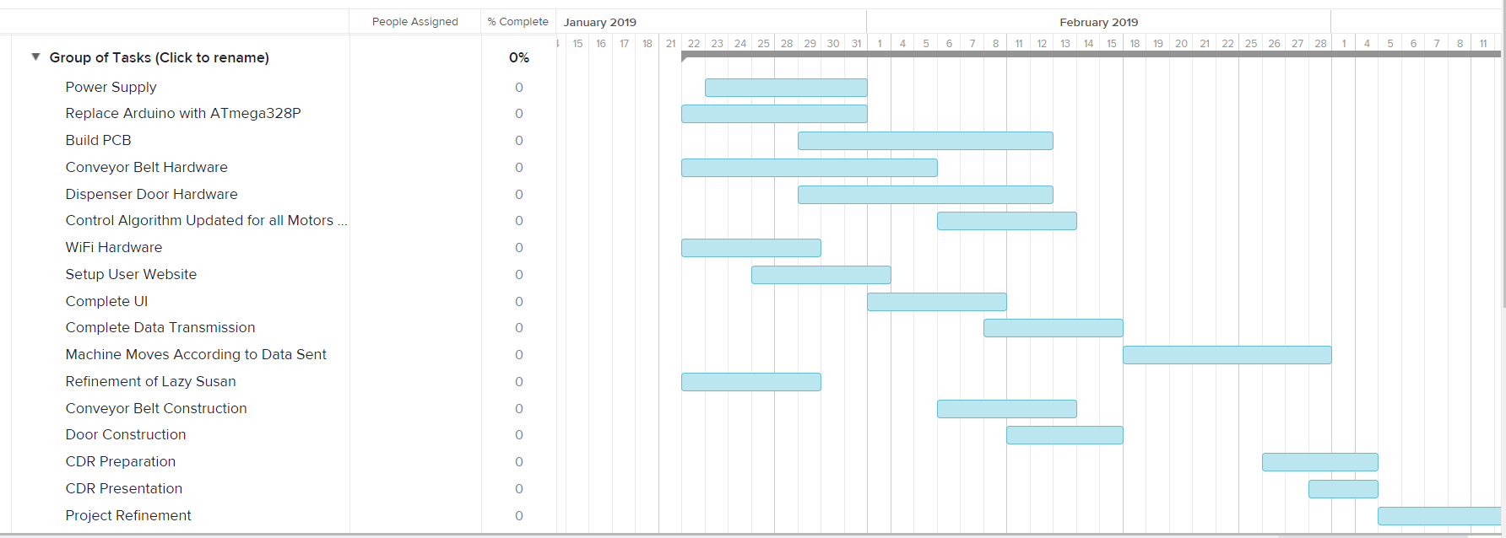
Gantt Chart
Wei
Wei /Jack
Wei
Anson
Zach
Wei
Jack
Jack/wei
Jack/wei/Anson
Jack/Wei
wei/jack
Zach
Anson
Anson
All
All
All

Slide 17
DEMO

Slide 18
Questions?
2. Storage System
Ingredient Trays
Lazy Susan
3. Arm and Flipper
Locking Doors
1. App
Height Adjustment
5. Electronic Control & Coordination
6. Power Supply
4. Dispenser System
Wax paper conveyor belt

