Slide 1
SandWish
Automated Tabletop Sandwich Maker
Team 21:
Jack Hennessey, Wei Huang, Zach Scipioni, Anson Haniwalt
Date: 10/17/2018
Notes:
Jack

Slide 2
Problem Statement
Custom sandwich production is a laborious task
Custom sandwich orders are potentially difficult to juggle for human servers at catered events
With variable sandwich demand comes unutilized human labor
App allows digital queueing eliminating lines and congestion for food
Notes:
Jack

Slide 3
System Specifications
Autonomous sandwich assembly
Sanitary
User specified ingredients
Interface through a mobile application
3’ x 4’ footprint
Notes:
Zach

Slide 4
System Specifications Cont’d
Sandwich assembly will take max 5 minutes
Bread, meat, cheese, and mayonnaise available
Enough ingredients for 6 sandwiches
Can hold 3 sandwiches in reserve
User can only retrieve their sandwich
Completed sandwich has no ingredient between bread sticking out further than 1”
Notes:
Zach

Slide 5
Food Sanitation
Food does not contact the machine directly
Trays are dishwashable and wax paper is disposable
Fresh ingredients can be stored for 2 hours
Will use realistic fake food for testing
Notes:
Anson

Slide 6
Inputs and Outputs
Inputs:
User’s number and sandwich order
Ingredients
Wax paper
Outputs:
A custom sandwich for user
Notes:
Wei

Slide 7
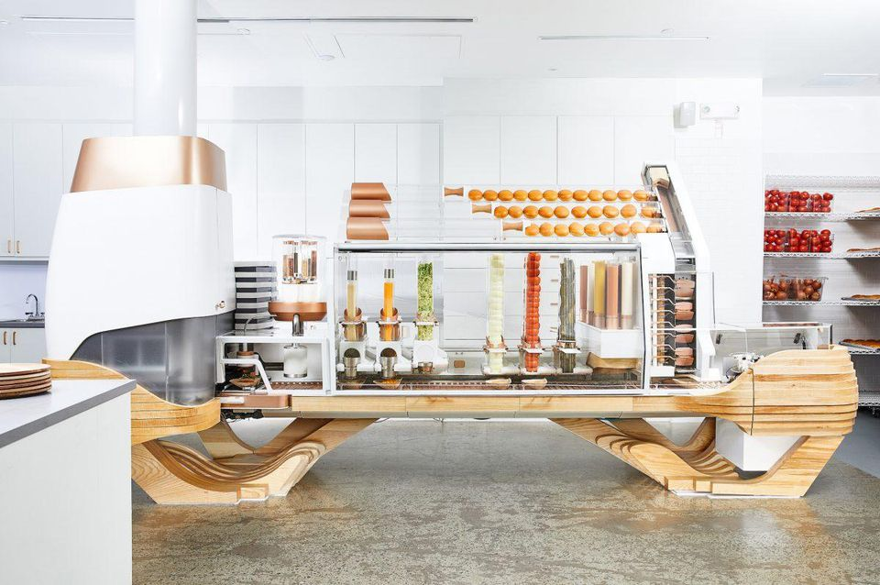
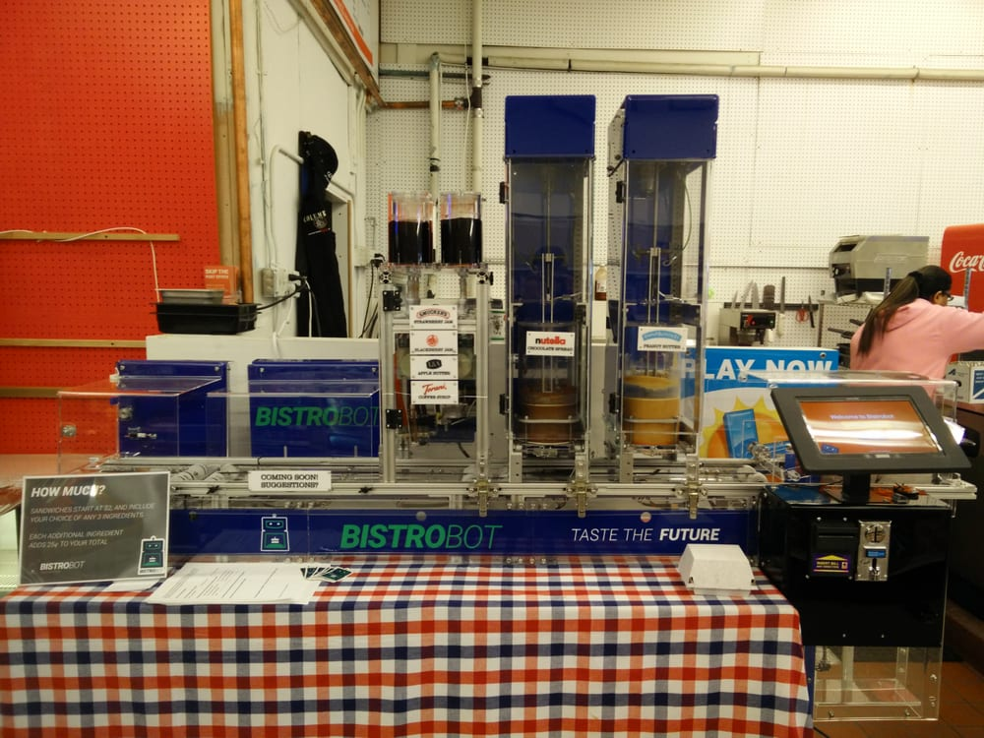
Design Alternatives
Creator by Movement Machines:
Industrial Scale
Very expensive
Bistrobot by Bistrobot:
Only bread and viscous ingredients
Linear design
Less space efficient
Notes:
Zach

Slide 8
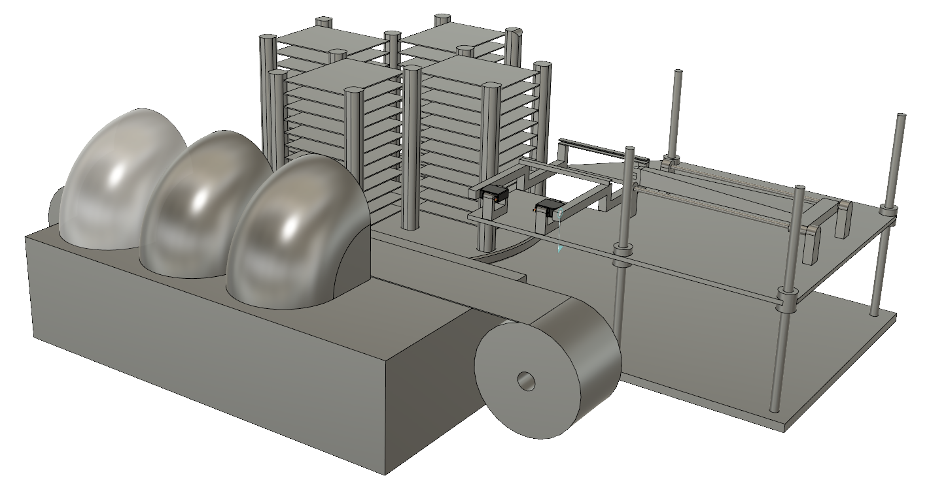
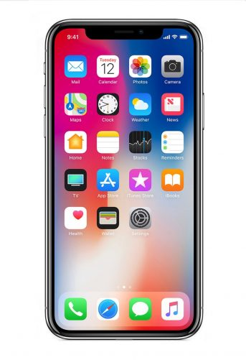
Complete SandWish
2. Storage System
Ingredient Trays
Lazy Susan
3. Arm and Flipper
Locking Doors
1. App
Height Adjustment
5. Electronic Control & Coordination
6. Power Supply
4. Dispenser System
Wax paper conveyor belt
Notes:
Zach

Slide 9
Subsystem 1: Mobile Application
App will handle ingredient customization
Will be aware of available ingredients
Communicate this information with the user
Will communicate ordering and pickup with user
Notes:
Anson

Slide 10
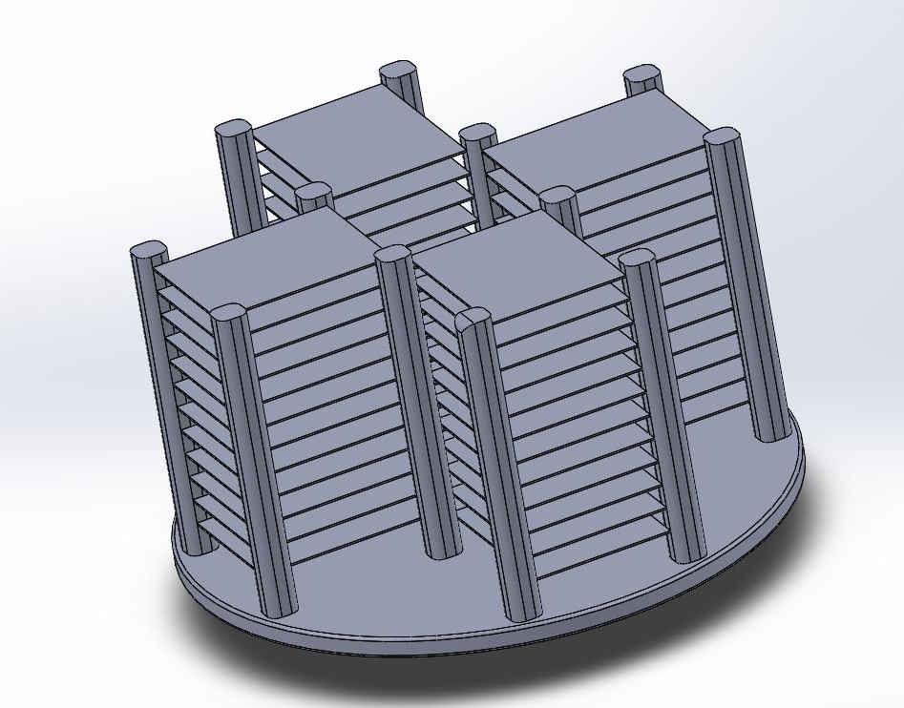
Subsystem 2: Ingredient Storage
Lazy Susan
Rotates to allow arm easy access to different ingredients
Enough ingredients for 6 sandwiches
Stepper motor to rotate
Limit switches for calibration
Lazy susan
Ingredient trays
Notes:
Zach

Slide 11
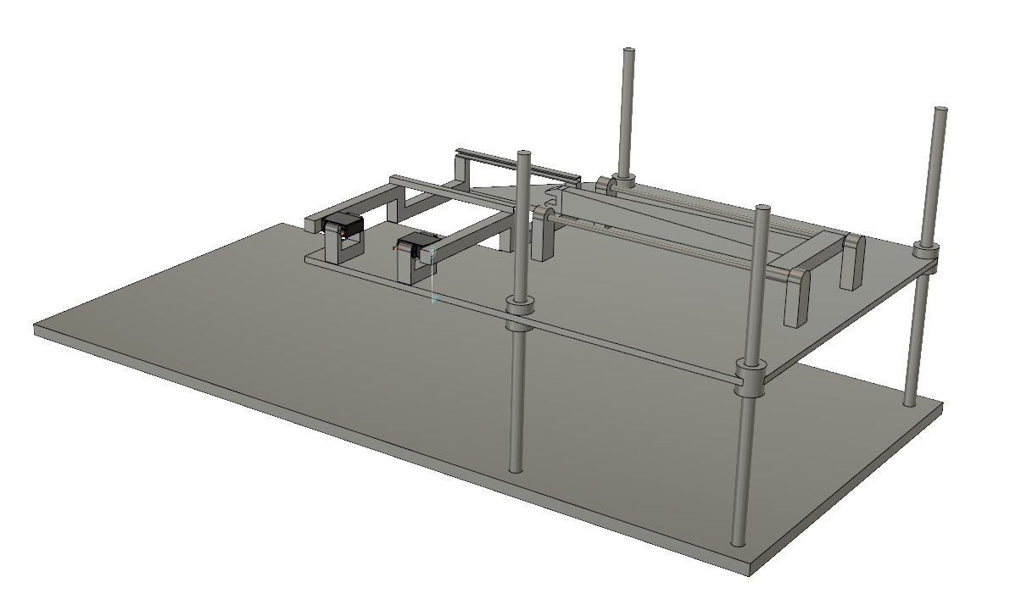
Subsystem 3: Arm and Flipper
Flipper
Arm
Arm
Extends to grab and extract material trays
Flipper
Flips material onto sandwich building zone
Height adjustment
Entire assembly will index up and down to grab trays
Height adjustment
Notes:
Anson

Slide 12
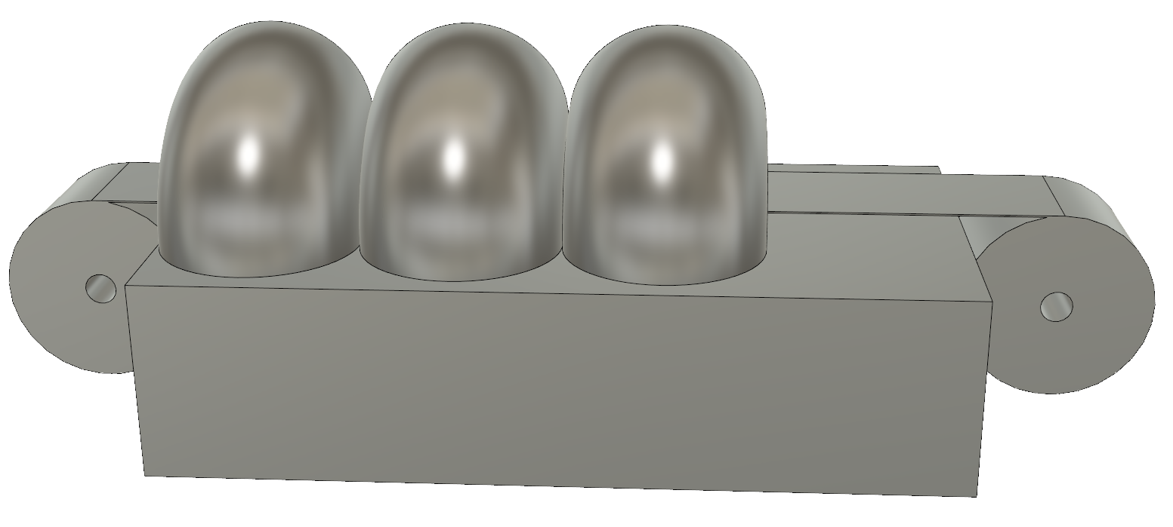
Subsystem 4: Sandwich Dispenser
Locking doors
Wax paper conveyor belt
Wax Paper Conveyor Belt
Room for 3 sandwiches in reserve
Locking doors ensure user can only retrieve their sandwich
Wax paper adds 0.4¢ to each sandwich
Notes:
Zach

Slide 13
Subsystem 5: Electronic Control & Coordination
The ATmega328P microcontroller will coordinate the motors and sensors (Arduino Uno for MDR)
The mobile application communicates back and forth with the boards through local WiFi
“Levels of warning” control the sandwich queue
Notes:
Wei

Slide 14
Subsystem 6: Power Supply
powered by wall outlet
AC/DC converter and voltage step down circuit on PCB along with Microcontroller
3.3V, 5V, servo voltage (5-12V), and 24V available on board
Notes:
Wei

Slide 15
Block Diagram
Enclosure
Power Supply
Acrylic Casing
Sandwich Assembly
2. Instructions
2. Instructions
Dispenser System
Height Adjustment
Conveyor Belt
Microcontroller
Arm and Flipper
ESP8266 WiFi Module
Locking Doors
Ingredient Storage
ATmega328P
Bluetooth
1. WiFi
1. Connect to local WiFi and send ingredients requested. Process updates communicated back.
SandWich App
2. Microcontroller controls motors to correctly move and coordinate with physical parts.
Notes:
Jack

Slide 16
SandWish State Machine
No
Is there room to make the sandwich?
Yes
Are the intended ingredients available?
Yes
Is a sandwich currently being made?
Determine next ingredient
Is it a condiment?
No
Yes
No
Yes
No
Yes
No
Index to ingredient and extract
Enqueue sandwich
Wait
Is a sandwich waiting in queue?
Scrap sandwich, notify user
Make sandwich
Start at any time: Application sends request, loop will be checking constantly allowing for concurrent processes when possible
No
Return used tray to its original position in rack
Type of request
Index sandwiches, notify user
Is a pick-up door open?
Was last ingredient a condiment?
Yes
No
Pickup sandwich
Yes
Yes
No
Yes
Wait for all doors to close
Can index sandwich to pick-up zone?
Sandwich complete?
Yes
Index to condiment, move ingredient into position, and dispense condiment onto ingredient
Open corresponding sandwich door for a period of time, then close
No
Is a sandwich waiting to be indexed to pick-up zone?
No
Flip ingredient onto the sandwich construction zone
Wait
Notes:
Anson

Slide 17
PCB
ATmega328P
Pulse width modulator on board generating square wave for 2 of the stepper motors.
Switching voltage regulators to efficiently control voltage input into the various motors.
ESP8266 WiFi module, breakout board, and serial transceiver

Slide 18
Team Member Roles
Wei: Power systems and Electronic Control & Coordination for Arm and Flipper
Anson: Arm and Flipper mechanism
Jack: Electronic Control & Coordination for Storage and Dispenser and Mobile App
Zach: Storage and Dispenser mechanism

Slide 19
Estimated Bill of Materials
Storage Lazy Susan: $65
Lazy Susan ($40)
Stepper ($15)
Frame ($30)
Ingredient Trays: $45
Wax Paper: $10
Arm and Flipper: $105
2 Servos ($20)
2 Steppers ($30)
Guiding Rails ($25)
Total: $505
Sandwich Dispenser: $55
Stepper Motor ($15)
Frame ($20)
2 Servos ($20)
ATmega328: $5
Power: $30
Fake Food: $40
Acrylic Enclosure: $150
Notes:
Jack

Slide 20
MDR Deliverables
Storage Subsystem (Jack & Zach)
Will rotate to present ingredient to Arm and Flipper that was instructed
Will hold and present bread, meat, and cheese
Arm and Flipper Subsystem (Wei & Anson)
Will ascend and descend to level of ingredient
Will extend grabber and grab tray of ingredient and pull and release into flipper
Will flip ingredient onto a plate without ingredient touching machine
Will put tray back into its original slot in storage
Notes:
Jack

Slide 21
MDR Deliverables Cont’d
Process of Storage subsystem rotating and Arm and Flipper grabbing and flipping repeated for bread, cheese, meat, and then bread
Complete sandwich will have no ingredients hanging outside of sandwich more than 1”
No Dispenser system or Mobile App
Arduino Uno instead of ATmega328P
Use computer to send signals to Arduino Uno instead of App

Slide 22
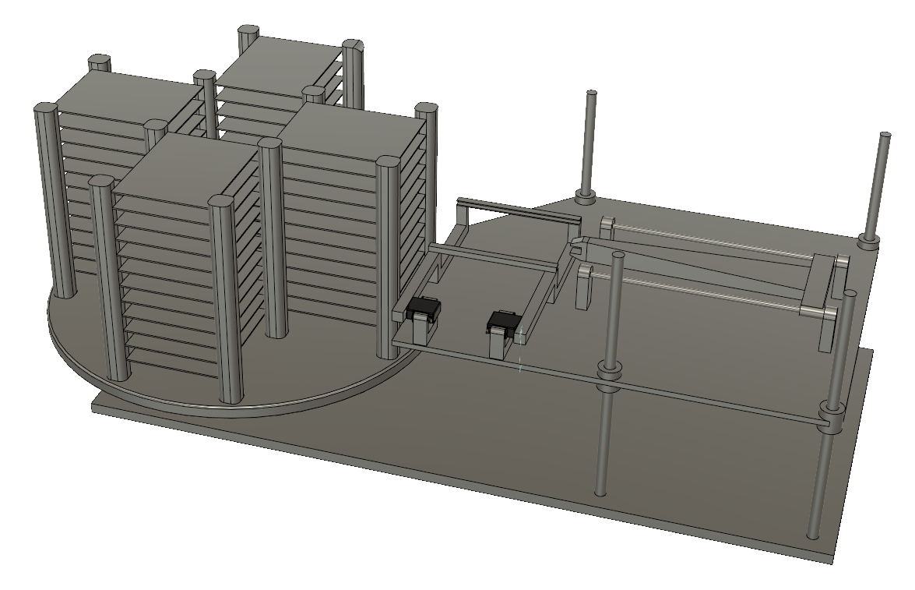
MDR Deliverable Diagram
1. Storage System
2. Arm and Flipper
5. Electronic Control & Coordination

Slide 23
MDR Deliverable Diagram Cont’d
Sandwich Assembly
Ingredient Storage
Microcontroller
Instructions
Arm and Flipper
ATmega328P
Height Adjustment
Bluetooth

Slide 24
FPR Deliverables
Mobile Application
Functional mechanical, electrical, and control system
Storage system
Arm and flipper
Dispensing system
Electronic Control & Coordination system
Power system
Sandwiches consisting of cheese meat or mayonnaise between two pieces of bread
Notes:
Anson

Slide 25
Questions?
2. Storage System
Ingredient Trays
Lazy Susan
3. Arm and Flipper
Locking Doors
1. App
Height Adjustment
5. Electronic Control & Coordination
6. Power Supply
4. Dispenser System
Wax paper conveyor belt

Slide 26
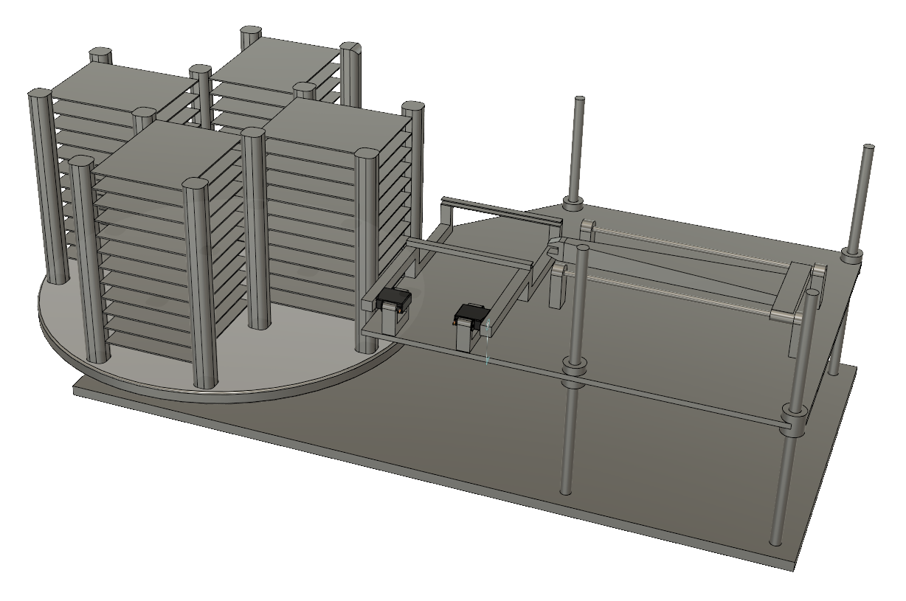
Ingredient Trays
Flipper
Arm
Storage System
Height Adjustment

