Slide 1
SandWish
Automated Tabletop Sandwich Maker
Team 21:
Jack Hennessey, Wei Huang, Zach Scipioni, Anson Haniwalt
Date: 4/18/2019
Notes:
Jack

Slide 2
Problem Statement
Custom sandwich production is a laborious task
Custom sandwich orders are potentially difficult to juggle for human servers at catered events
With variable sandwich demand comes unutilized human labor
App allows digital queueing eliminating lines and congestion for food
Notes:
Jack

Slide 3
System Specifications
Autonomous sandwich assembly
Sanitary
User specified ingredients
Interface through a mobile application
3’ x 4’ footprint
Notes:
Zach

Slide 4
System Specifications Cont’d
Sandwich assembly will take max 5 minutes
Bread, meat, and cheese available
Enough ingredients for 7 sandwiches
Completed sandwich has no ingredient between bread sticking out further than 1”
Notes:
Zach

Slide 5
FPR Deliverables
Completed PCB
Wifi Module and App
Motors and sensors construct and deliver sandwich
Sandwich is ordered on the app and built by the robot
Notes:
Zach

Slide 6
Raspberry pi and Website
Website hosted on Raspberry Pi 3 using Apache
Setup through LAMP server
Utilize PHP scripts to send bytes to ATmega328

Slide 7
Block Diagram
Enclosure
Power Supply
Acrylic Casing
Sandwich Assembly
2. Instructions
2. Instructions
Dispenser System
Height Adjustment
Conveyor Belt
Microcontroller
Arm and Flipper
Ingredient Storage
ATmega328P
Locking Doors
Bluetooth
1. Serial Communication
1. Connect to local WiFi and send ingredients requested. Process updates communicated back.
Raspberry Pi
Hosts Server and Database
2. Microcontroller controls motors to correctly move and coordinate with physical parts.
Notes:
Jack

Slide 8
DEMO

Slide 9
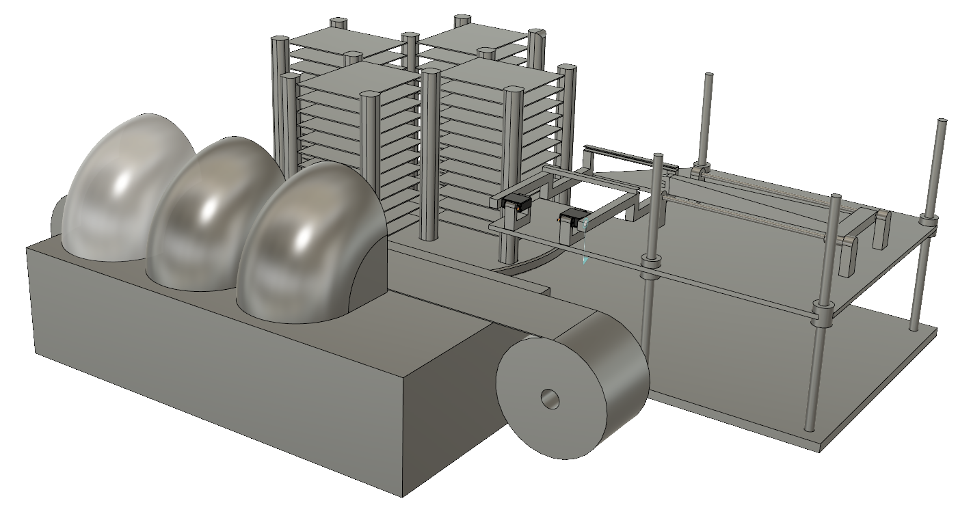
Questions?
2. Storage System
Ingredient Trays
Lazy Susan
3. Arm and Flipper
Locking Doors
1. App
Height Adjustment
5. Electronic Control & Coordination
6. Power Supply
4. Dispenser System
Wax paper conveyor belt

