Slide 1
SandWish
Automated Tabletop Sandwich Maker
Team 21:
Jack Hennessey, Wei Huang, Zach Scipioni, Anson Haniwalt
Date: 3/8/2019
Notes:
Jack

Slide 2
Problem Statement
Custom sandwich production is a laborious task
Custom sandwich orders are potentially difficult to juggle for human servers at catered events
With variable sandwich demand comes unutilized human labor
App allows digital queueing eliminating lines and congestion for food
Notes:
Jack

Slide 3
System Specifications
Autonomous sandwich assembly
Sanitary
User specified ingredients
Interface through a mobile application
3’ x 4’ footprint
Notes:
Zach

Slide 4
System Specifications Cont’d
Sandwich assembly will take max 5 minutes
Bread, meat, cheese, and mayonnaise available
Enough ingredients for 6 sandwiches
Can hold 3 sandwiches in reserve
User can only retrieve their sandwich
Completed sandwich has no ingredient between bread sticking out further than 1”
Notes:
Zach

Slide 5
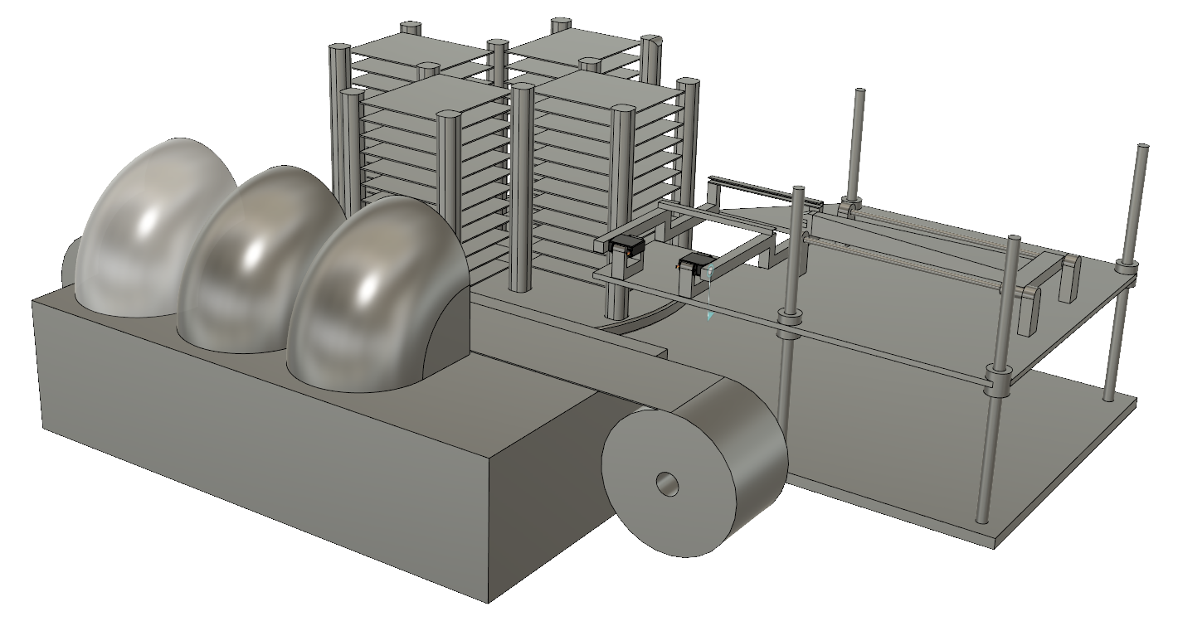
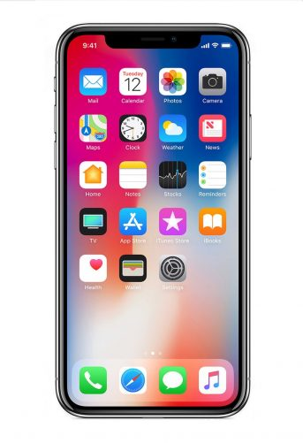
Complete SandWish
2. Storage System
Ingredient Trays
Lazy Susan
3. Arm and Flipper
Locking Doors
1. App
Height Adjustment
5. Electronic Control & Coordination
6. Power Supply
4. Dispenser System
Wax paper conveyor belt
Notes:
Zach

Slide 6
Subsystem 1: Web Application and Wifi Module
ESP8266 wifi module used as access point and web server
Website communicates through the ESP8266 to the ATmega328 different bit streams for different sandwiches
ATmega keeps track on the registers empty ingredient slots, and communicates to website
Orders come into queues still when empty but machine is stopped
Notes:
Jack

Slide 7
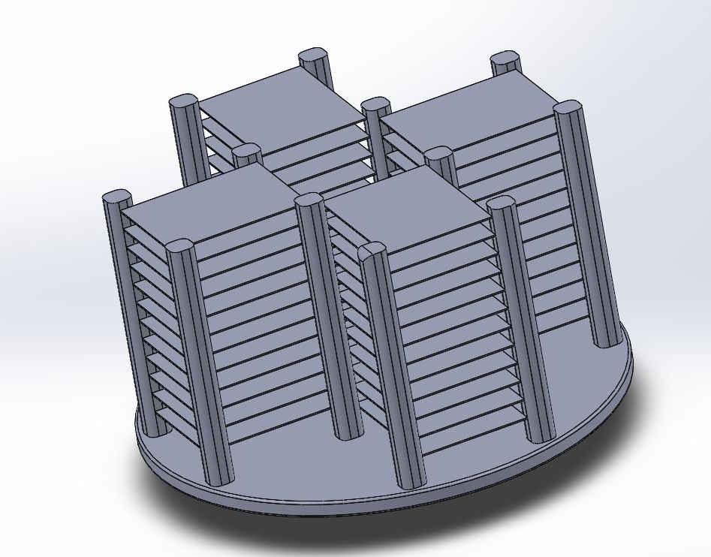
Subsystem 2: Ingredient Storage
Lazy Susan
Rotates to allow arm easy access to different ingredients
Enough ingredients for 6 sandwiches
Cont. Servo motor to rotate
Limit switches for calibration
Lazy susan
Ingredient trays
Notes:
Zach

Slide 8
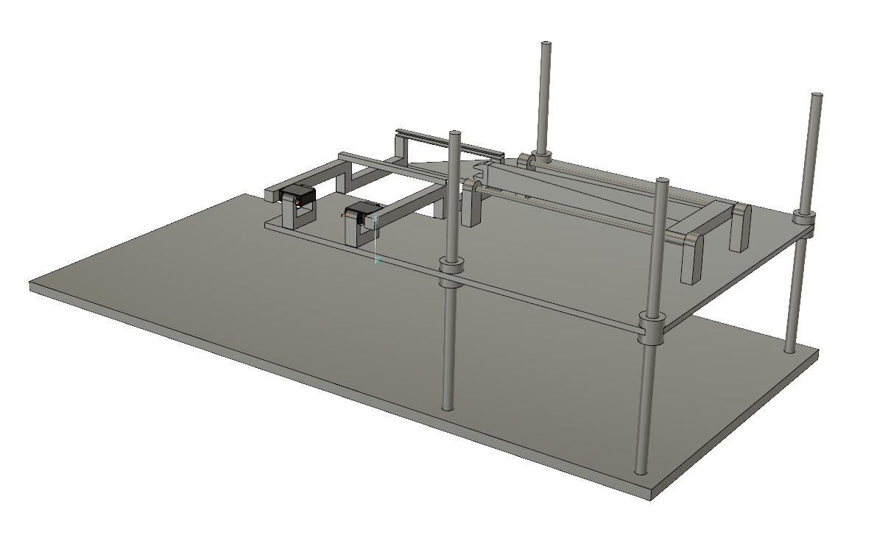
Subsystem 3: Arm and Flipper
Flipper
Arm
Arm
Extends to grab and extract material trays
Flipper
Flips material onto sandwich building zone
Height adjustment
Entire assembly will index up and down to grab trays
Height adjustment
Notes:
Anson

Slide 9
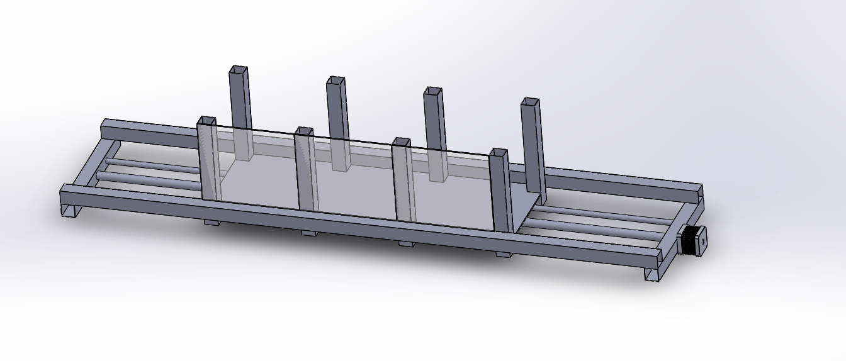
Subsystem 4: The Dispenser
Moving locker assembly
Indexes between three different sandwich lockers
Sandwich lockers
Solenoid doors capable of locking and unlocking
Notes:
Anson

Slide 10
Subsystem 5: Electronic Control & Coordination
The Atmega 328 microcontroller coordinates the motors and sensor
Internal chip variable keeping track of ingredients count on each hopper storage
Notes:
Wei

Slide 11
Subsystem 6: Power Supply
Powered by wall outlet AC/12VDC converter power supply. 12V power supply for stepper motors driver.
5V from breadboard drives 3 servo voltage, 1 continuous servo and atmega328 chip.
Notes:
Wei

Slide 12
Block Diagram
Enclosure
Power Supply
Acrylic Casing
Sandwich Assembly
2. Instructions
2. Instructions
Dispenser System
Height Adjustment
Conveyor Belt
Microcontroller
Arm and Flipper
ESP8266 WiFi Module
Locking Doors
Ingredient Storage
ATmega328P
Bluetooth
1. WiFi
1. Connect to local WiFi and send ingredients requested. Process updates communicated back.
SandWish Web
2. Microcontroller controls motors to correctly move and coordinate with physical parts.
Notes:
Jack

Slide 13
Team Member Roles
Wei: Power systems and Electronic Control & Coordination. PCB board for microcontroller
Anson: Arm and Flipper mechanism
Jack: Web page development and WIFI Application
Zach: Storage and Dispenser mechanism
Notes:
Zach

Slide 14
CDR Deliverables
PCB including ATmega328P
Full mechanical system including conveyor belt and doors
Motors and sensors construct and deliver sandwich
WiFi module and application set up
Data transmitted from application triggers specified sandwich to be constructed
Sandwich is delivered to correct door and app is updated
Notes:
Zach

Slide 15
CDR: What We Delivered
Board is built from components
Mostly functional concerning control and sensing
Additional mechanical components added to increase stability
Mechanical vibrations removed
Notes:
Zach

Slide 16
FPR Deliverables
Completed PCB
Wifi Module and App
Dispenser System?
Motors and sensors construct and deliver sandwich
Sandwich is ordered on the app and built by the robot
Notes:
Zach

Slide 17
DEMO

Slide 18
Questions?
2. Storage System
Ingredient Trays
Lazy Susan
3. Arm and Flipper
Locking Doors
1. App
Height Adjustment
5. Electronic Control & Coordination
6. Power Supply
4. Dispenser System
Wax paper conveyor belt

