Slide 1
Preliminary Design Review
Team 16
October 22, 2018
Notes:
1
1
1
K: Hi, thank you all for coming today. We are team 16, and we are here to present our SDP idea, Mapper.
K: My name is Kelvin Nguyen, and I am a mechanical engineer. M: My name is Marcus Le, and I am an electrical engineer. D: My name is Derek Sun, and I am a computer systems engineer. B: My name is Bryan Martel, and I am also a computer systems engineer.

Slide 2
Mapper
Kelvin Nguyen
ME
Marcus Le
EE
Bryan Martel
CSE
Derek Sun CSE
Notes:
2
2
2
K: To start off with some statistics. Since 2010 there have been over 40 major building collapses causing nearly 2000 casualties. There have also been numerous cave related incidents, some of which have been fatal.

Slide 3
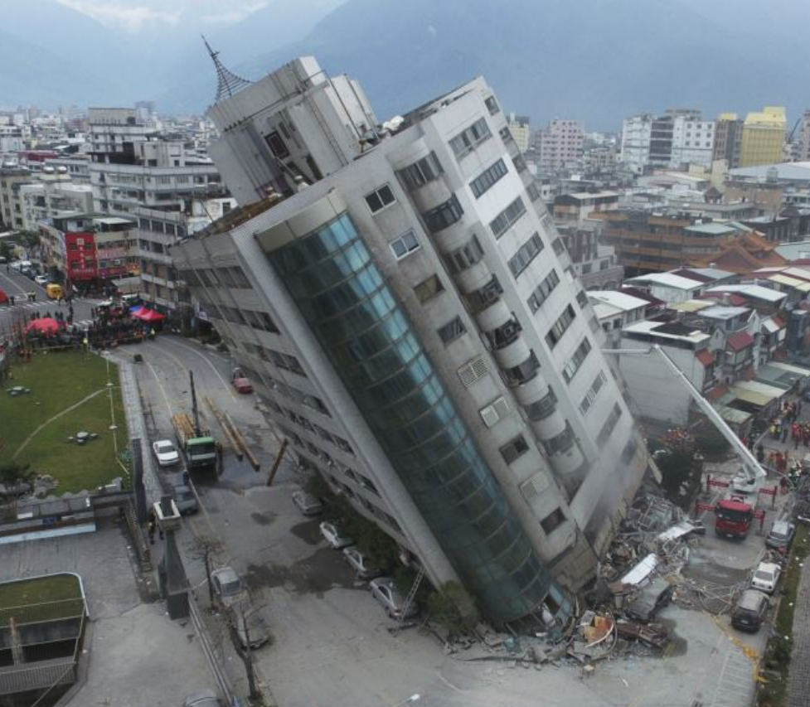
Background and Motivation
44 significant building collapses since 2010
1975 casualties
3459 injuries
40-50 cave related incidents per year
~10% of incidents are fatal
https://en.wikipedia.org/wiki/List_of_structural_failures_and_collapses
https://www.outsideonline.com/1903801/exploring-caving-accidents-deaths-and-rescues-united-states
Notes:
3
3
3
K: Rescue teams face many challenges when traversing unknown environments. This can be dangerous for both the rescuer and the rescuee. So fully understanding the situation is crucial in preventing unnecessary risks in any unknown environment.

Slide 4
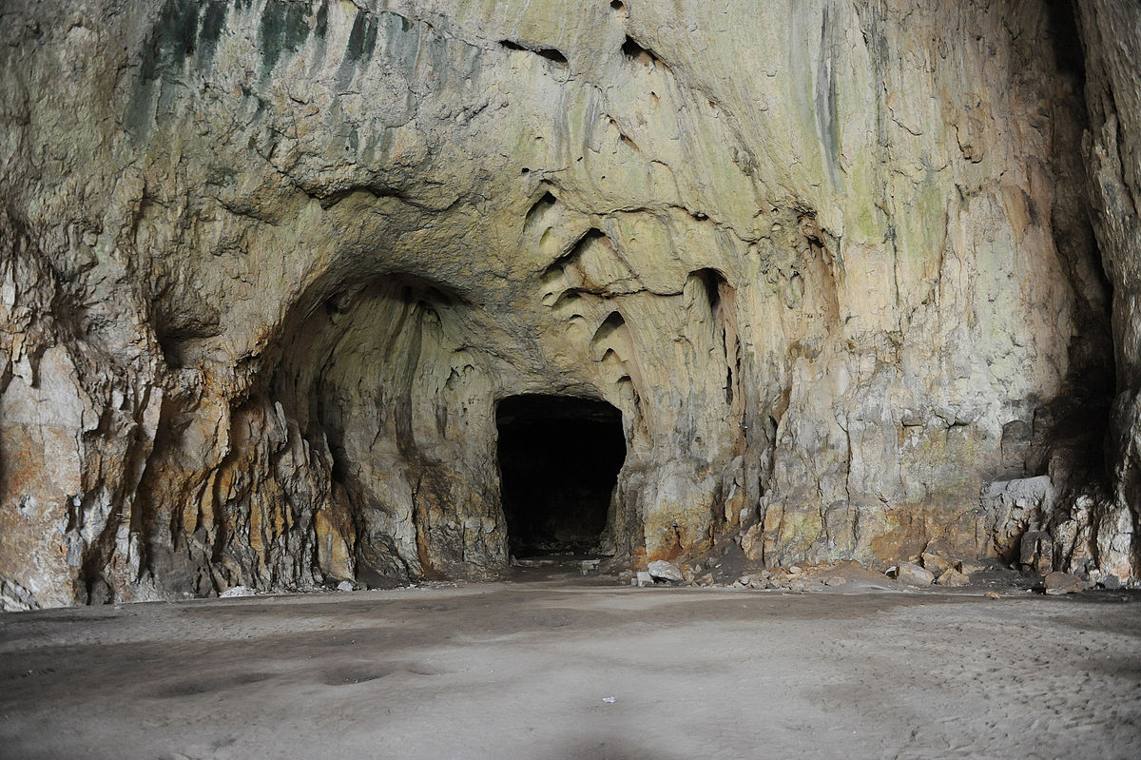
Background and Motivation
Safety and knowledge are very important aspects of rescue missions
Not fully understanding the environment and situation can lead to unnecessary risks and dangers
Examples
Cave rescue
Trapped or lost explorers
Urban search and rescue
Collapsed buildings
Notes:
4
4
4
M: The goal of our project is to reduce possible risks or dangers associated with the unknown. Being able to identify the best method of approach will help improve the navigation efficiency of rescue teams.

Slide 5
Goal
Reduce possible risks or dangers that are associated with traversing through unknown environments
Enable easier navigation through the field and aid in figuring out the best method of approach
Improve efficiency of rescue teams in unknown environments
Notes:
5
5
5
M: Our proposed solution is to create a roomba-based robot that utilizes LIDAR sensors and SLAM algorithms to navigate the environment and provide a 3D map of the area.

Slide 6
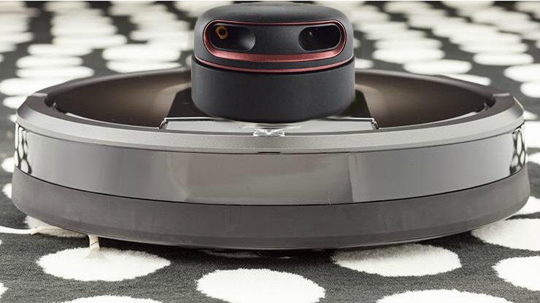
Method of Resolution
A robot that utilizes LIDAR sensors to remotely navigate around the surrounding environment and produce a 3D layout of an indoor area
Notes:
6
6
6
D: Onto the specifications of our project. Our robot will travel at a speed of up to 3mph, with an effective mapping range of 15 feet. The robot will weigh approximately 12 pounds and last about an hour in terms of battery life. The LIDAR sensors will have an elevation range of between 1 to 6 feet. The robot will also be durable enough to withstand minor collisions and reliably continue operations.

Slide 7
Requirements Analysis: Specifications
Speed of up to 3mph
Effective detection range of 15ft
Approximately 12 pounds
Approximately 1 hour of battery life
Elevation 1-6 feet
Durable
Notes:
7
7
7
D: Other projects and products that have been created to fulfill similar purposes include the Google Cartographer and the UCSD mapping robot. The Google Cartographer is a standalone, backpack-mounted LIDAR mapping system made to reliably map out the interiors of buildings. The UCSD two-wheeled, mapping robot utilizes infrared and RGB cameras and high maneuverability to assist firefighter rescue missions.

Slide 8
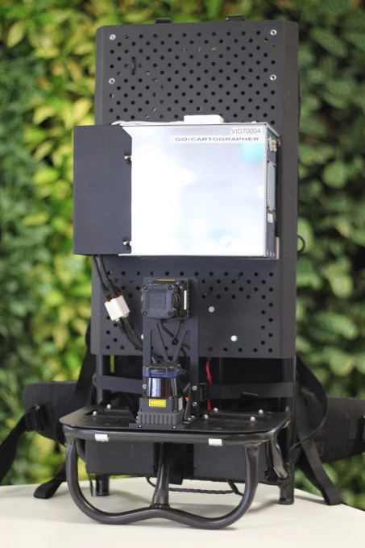
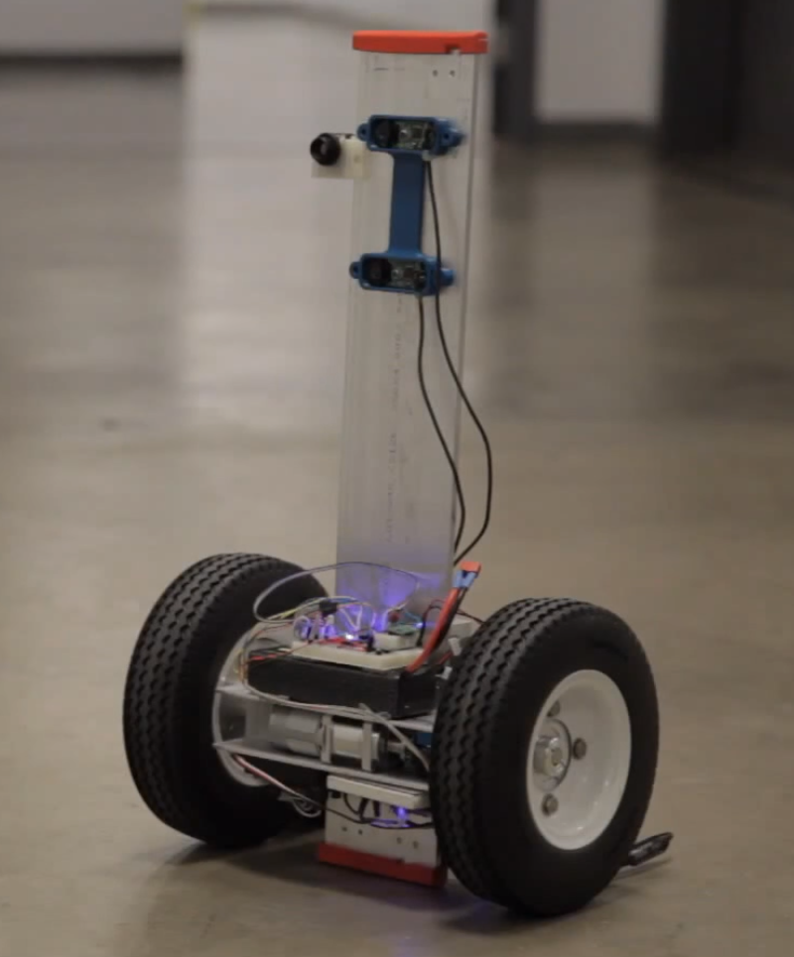
Design Alternatives
Google Cartographer
Backpack mounted
LIDAR mapping
Inertial measurement unit
UCSD 3D RGB Mapping Robot
Infrared and RGB camera
Two-wheeled
Able to climb stairs
Notes:
8
8
8
D: For our project, we decided on LIDAR sensors instead of RGB cameras for obtaining measurements and data points for several reasons. For mapping purposes, LIDAR sensors have higher precision and range than RGB cameras. LIDAR sensor mapping does not require light, whereas RGB camera mapping does. Another reason is that using LIDAR sensors for mapping is generally less computationally intensive than the RGB camera alternative. LIDAR sensors generate point clouds, and RGB cameras generate 2D images. While 2D images are easier for our brains to interpret, point clouds are easier for computers to interpret and use to build 3D representations. RGB cameras also require movement to estimate distance, adding to the localization computational complexity.

Slide 9
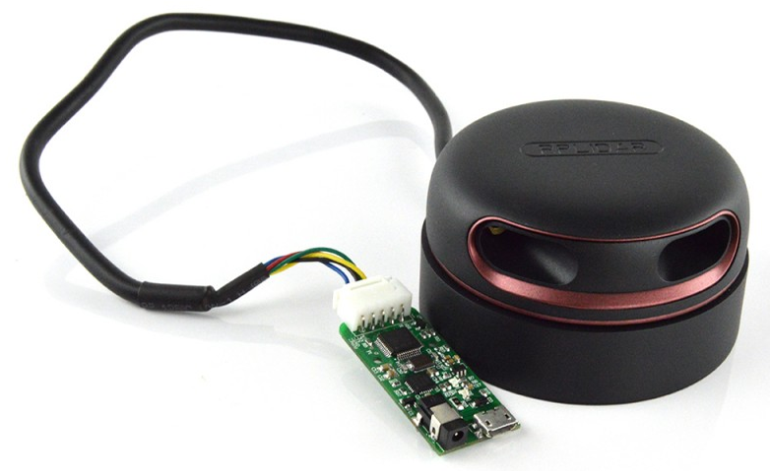
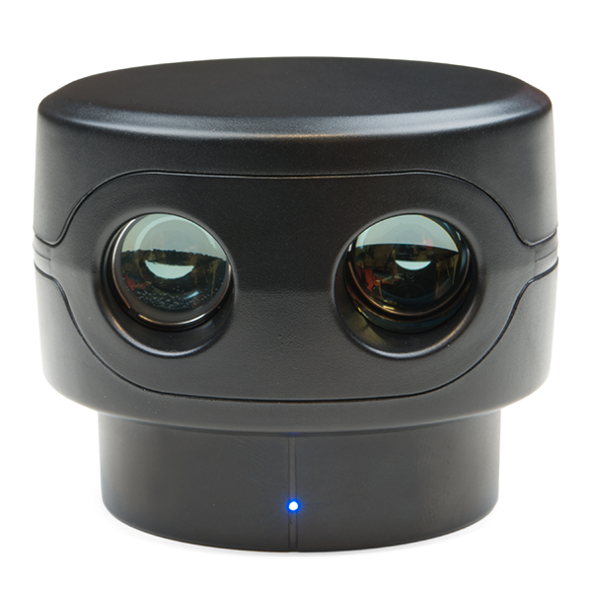
Design Alternatives
Why we chose LIDAR instead of RGB camera for measurements
Higher precision
Higher range
Does not require light
Less computationally intensive
RGB camera requires movement to estimate distance, increases computational complexity for localization
Notes:
9
9
9
B: Our planned design utilizes a modified roomba mounted with a 360 degree lidar sensor, inertial measurement unit, and camera in order to feed information to an external computer for processing. From that external computer we will control the robots movements and be able to view the live video feed mounted on the front of the device. as well as a map generated by the data collected from the lidar and IMU. Not pictured here is the lidar mount which is responsible for elevating the sensor between its ranges of 1 - 6 feet.

Slide 10
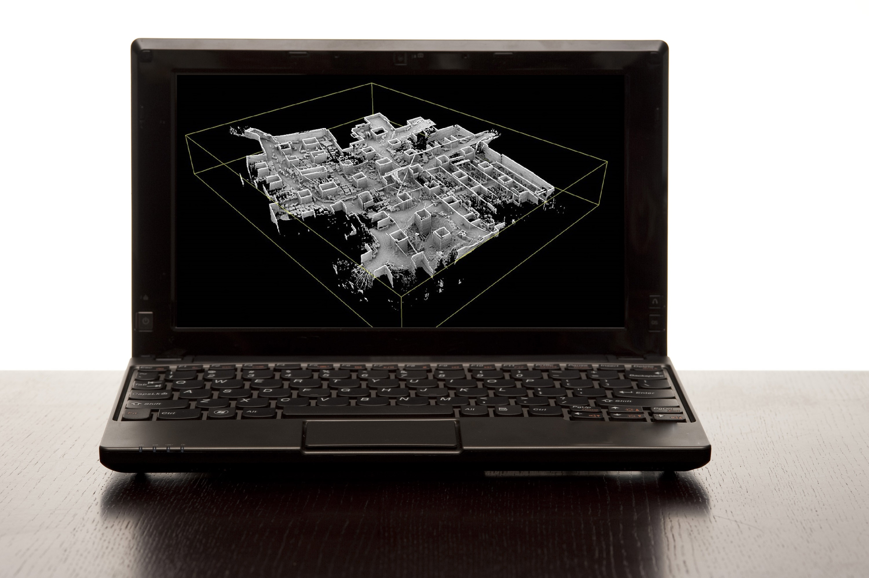
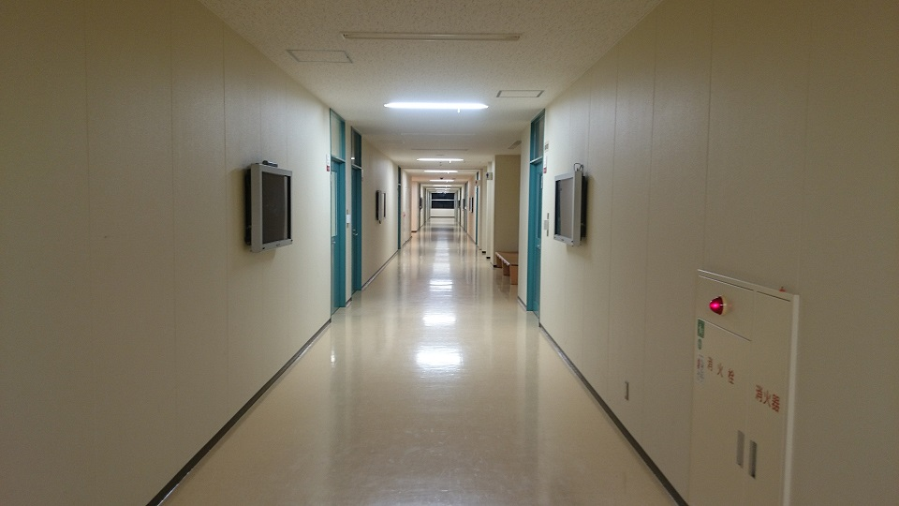
Our Design
Notes:
10
10
10
B: Within our system we have our three sensor inputs providing data, the fourth is our user navigation control which will come from the connected external computer. Our two outputs will be a live video feed in order to assist the user with navigating the robot, and the map.

Slide 11
Requirements Analysis: Inputs and Outputs
Input
LIDAR sensor data
Inertial measurement unit data
Camera data
User navigation control
Output
Live video feed
Map data
Notes:
11
11
11
M:
Our design consists of two main blocks. In the first block, we have Mapper, which includes the robot and the LIDAR system, as well as the power supply and camera. In the other block, the External PC consists of the application and the slam algorithm. Mapper begins with powering on the entire system, this allows the PCB to communicate with the external PC through wifi. The application then gives user input controls to the PCB which then in turn, navigates the robot. This allows for LIDAR measurements to be taken, and this information, along with the IMU corrections and camera feedback, is then relayed back to the PCB and sent to the external PC for the SLAM algorithm. The output of this SLAM algorithm is then displayed through the application as the output.
D: First, we are going to talk about the two sensors in our LIDAR system: the LIDAR sensor and the inertial measurement unit.

Slide 12
Block Diagram
Mapper
Power Supply
Camera
Powers
Powers
Robot
Feedback
PCB
LIDAR System
Wi-Fi module
Inertial Measurement Unit
Microcontroller
Sensor readings
Controls
LIDAR Mount
Navigation
Hydraulics
LIDAR Sensor
Motors
Wheels
Input
directions
External PC
Wi-Fi communication
Application
SLAM Algorithm
Mapping data
Display
Controller
Layout view
Notes:
D: These LIDAR sensors work by firing out rapid pulses of laser light and measuring the time it takes each pulse to bounce back. These sensors are commonly used in police speed guns and 2D or 3D mapping technology. These two images are taken from the documentation of the RPLIDAR A2. In this image, you will see that the data output from our specific 360 degree rotating LIDAR sensor will be a coordinate of distance in millimeters and heading angle in degrees. This second image portrays the coordinate system used in the RPLIDAR scanning. The LIDAR sensor will be used in our project to generate point clouds of the area, which will then be used in creating the final, outputted 3D map.

Slide 13
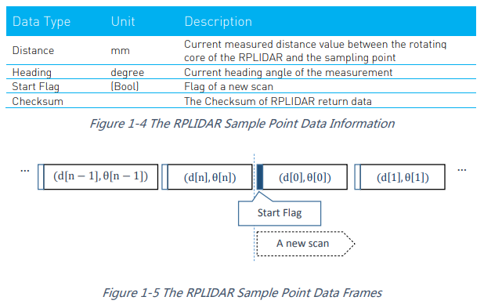
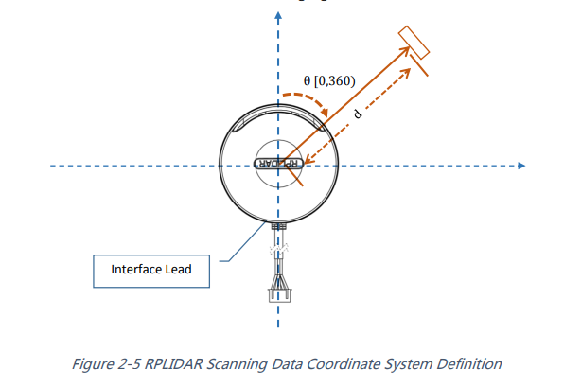
LIDAR Sensors
Rapid pulses of laser light sent out
Measure time each pulse takes to bounce back
Commonly used for police speed guns and mapping
Data is output as a coordinate of distance and heading
Will be used in our project to generate point cloud of area
Notes:
13
13
13
D: The inertial measurement unit that we are planning to use will have 9 degrees of freedom from three 3-axis sensors: the accelerometer, the gyroscope, and the magnetometer. So why do we need to use an IMU with a LIDAR sensor? Using an IMU with our LIDAR sensor will allow us to understand the system’s precise orientation and accurately obtain the position of the data being collected.

Slide 14
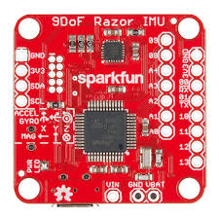
Inertial Measurement Unit
Utilizes three 3-axis sensors
Accelerometer
Gyroscope
Magnetometer
Why use an IMU with a LIDAR sensor?
Must understand orientation in order to understand position of data
Notes:
14
14
14
K: A major component of this project is the robot itself.

Slide 15
Block Diagram
Mapper
Power Supply
Camera
Powers
Powers
Robot
Feedback
PCB
LIDAR System
Wi-Fi module
Inertial Measurement Unit
Microcontroller
Sensor readings
Controls
LIDAR Mount
Navigation
Hydraulics
LIDAR Sensor
Motors
Wheels
Input
directions
External PC
Wi-Fi communication
Application
SLAM Algorithm
Mapping data
Display
Controller
Layout view
Notes:
K: In order to accurately map and traverse the unknown area the Roomba must be able to: First, house and maneuver the sensor and onboard camera to capture as much detail of the environment as possible. We plan to elevate the sensor by producing a platform that mimics a scissor lift. To properly utilize the sensor, the Roomba will be modified with our own custom-made PCB to communicate and control all actions onboard the Roomba. In addition to that, the robot must small enough to traverse a multitude of environments where larger robots cannot traverse, at the same time, being durable and stable enough to not fail while in use.

Slide 16
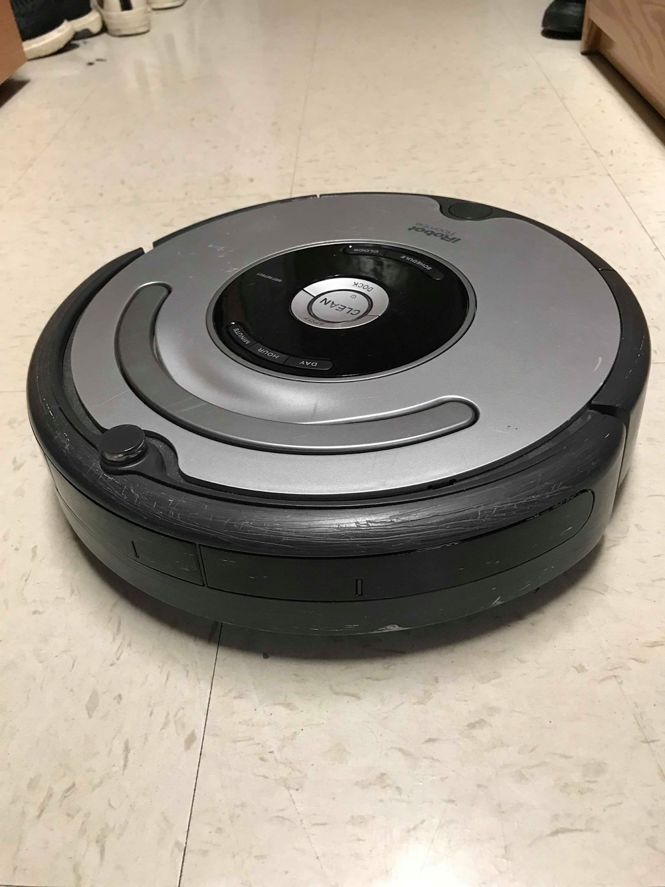
Robot
Requirements
House camera and sensor
Maneuver LIDAR sensor
Integrate our PCB with the components of the Roomba
Modifiable
Portable
Robust
Stable
Notes:
16
16
16
M:
The next component we’re going to take a look at is the Printed Circuit Board.

Slide 17
Block Diagram
Mapper
Power Supply
Camera
Powers
Powers
Robot
Feedback
PCB
LIDAR System
Wi-Fi module
Inertial Measurement Unit
Microcontroller
Sensor readings
Controls
LIDAR Mount
Navigation
Hydraulics
LIDAR Sensor
Motors
Wheels
Input
directions
External PC
Wi-Fi communication
Application
SLAM Algorithm
Mapping data
Display
Controller
Layout view
Notes:
M:
As said earlier, our custom-made PCB is going to replace the Roomba’s internal circuit board. Our board is going to be responsible for power the system and allowing for communication between the robot and the external PC. There will also be a microprocessing chip on the board which will control the robot’s actions, relay sensor data to the external PC, and allow for roomba navigation though controls that the user inputs.

Slide 18
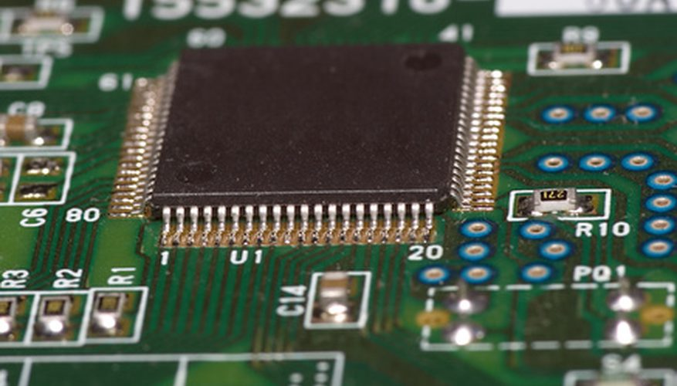
Printed Circuit Board
Replaces the default board inside the Roomba
Provides power to the motors
Houses Wi-Fi module used for communication with external PC
Microprocessor receives sensor outputs and relays the data to external PC
Receives inputs from the
controller and navigates the
Roomba accordingly
Notes:
18
18
18
B: The final piece of the block diagram to discuss is the external computer. Which consists of the application front-end and the SLAM algorithm as the backbone.

Slide 19
Block Diagram
Mapper
Power Supply
Camera
Powers
Powers
Robot
Feedback
PCB
LIDAR System
Wi-Fi module
Inertial Measurement Unit
Microcontroller
Sensor readings
Controls
LIDAR Mount
Navigation
Hydraulics
LIDAR Sensor
Motors
Wheels
Input
directions
External PC
Wi-Fi communication
Application
SLAM Algorithm
Mapping data
Display
Controller
Layout view
Notes:
B: The external computer will be in constant communication with the robot, sending navigation controls input by the user, and processing the stream of data that it receives through our SLAM algorithm. The processed point cloud will be sent to our application front-end where users will be able to see the LIDAR generated map as well as the live video feed in order to better pilot the robot.

Slide 20
External PC
Requirements
Communicate with robot through Wi-Fi
Transmit navigation instructions to robot
Process data collected by the robot and run SLAM algorithm
Display live video feed
Display map model generated from LIDAR point cloud
Notes:
20
20
20
B: This leads us into SLAM, which stands for Simultaneous Localization and Mapping. SLAM algorithms rely on three major techniques, Landmarking, Relocalization, and Loop Closure. Landmarking is the process of recognising distinct points within environment and using them in order to accurately stitch together measurements taken from different locations. When the robot moves within its environment, it uses an IMU and wheel movement to estimate how far it travels and in what direction. This is prone to error which will compound over time producing a warped map. Relocalization finds the correct position of the robot by triangulating itself within the map based upon the points flagged as landmarks. The last major technique is loop closure, which is the process of detecting previously visited locations and connecting the locations together, which also helps to prevent the map from warping. The figure shows a generalized overview of one implementation of the SLAM process using LIDAR. For our project we plan on adapting the google cartographer’s open-source library and modifying it to accept the LIDAR sensor and IMU we will be using in our robot.

Slide 21
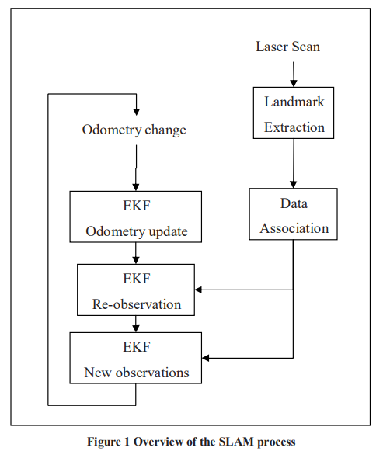
Simultaneous Localization and Mapping (SLAM)
Essential techniques
Landmarking
Identifies distinct points to relate the same object from different locations
Re-localization
Corrects the robot’s positioning using updated map points
Loop closure
Detects previously visited locations
How this applies to Mapper
Plan on adapting open-source Google Cartographer library and tailoring it for our needs
Notes:
21
21
21
K: The estimated total cost for our project is expected to be $500 from the online sources we found. Most of the budget will be invested into the LIDAR sensor with the rest going into components such as the camera and housing. The Roomba is provided by M5 and the PC will be owned so we do not need to invest our budget into those parts.

Slide 22
Budget
360˚ LIDAR sensor $300
Pistons/Housing $120
IMU $30
Camera $20
Wi-Fi module $20
Power supply $10
Roomba (from M5) $0
External PC (owned) $0
________________________
Total: $500
Notes:
22
22
22
K: We have distributed project responsibilities and roles for each team member. My responsibilities for this project include modification of the Roomba, elevating the LIDAR sensor, and ensuring correct connectivity between the Roomba components and our PCB.
M: My responsibilities for this project include the programming of the robot, powering each component of the system, and ensuring correct connectivity between our PCB and the external PC. D: As for me and Bryan, as CSEs, our responsibilities over the course of this project will include the implementation of LIDAR SLAM and the development of our PC application.

Slide 23
Responsibilities
Kelvin (ME)
Robot modification
LIDAR sensor elevation
Connectivity between motors and PCB
Marcus (EE)
Programming of robot
Powering the system
Connectivity between PCB and external PC
Derek (CSE) & Bryan (CSE)
LIDAR SLAM implementation
Application development
Notes:
23
23
23
M:
Throughout the entire brainstorming process and the planning of this project, there have been many challenges we plan on encountering. Shown in front of you is a list of those challenges from most difficult to least difficult. The most prominent and most challenging, we feel, is the SLAM algorithm. This one is likely to take the most amount of time and cause the most difficulty. Other challenges include localization estimates, connecting the whole system together, and application development. Early problems such as Roomba modification and LIDAR sensor stability we plan on solving early on.

Slide 24
Roadblocks/Challenges
SLAM algorithm
Robot localization estimates
System Connectivity
Application development
Modification of Roomba
Stabilization of LIDAR sensor
Notes:
24
24
24
M:
By MDR, we plan on presenting a fully functioning 2D LIDAR mapping from a stationary position. This include, image stitching, communication between Mapper and the PC, and early Application development. We want to be able to place the LIDAR sensor down at two different positions, take measurements from each position, and display the 2D map on the external PC. To achieve this, we’ll have Kelvin work to remodel our the Roomba and supplying power to the system. I myself will program the microcontroller and work to develop the application. Bryan and Derek will jump head first into the SLAM programming and work together to create a layout from the LIDAR point cloud.

Slide 25
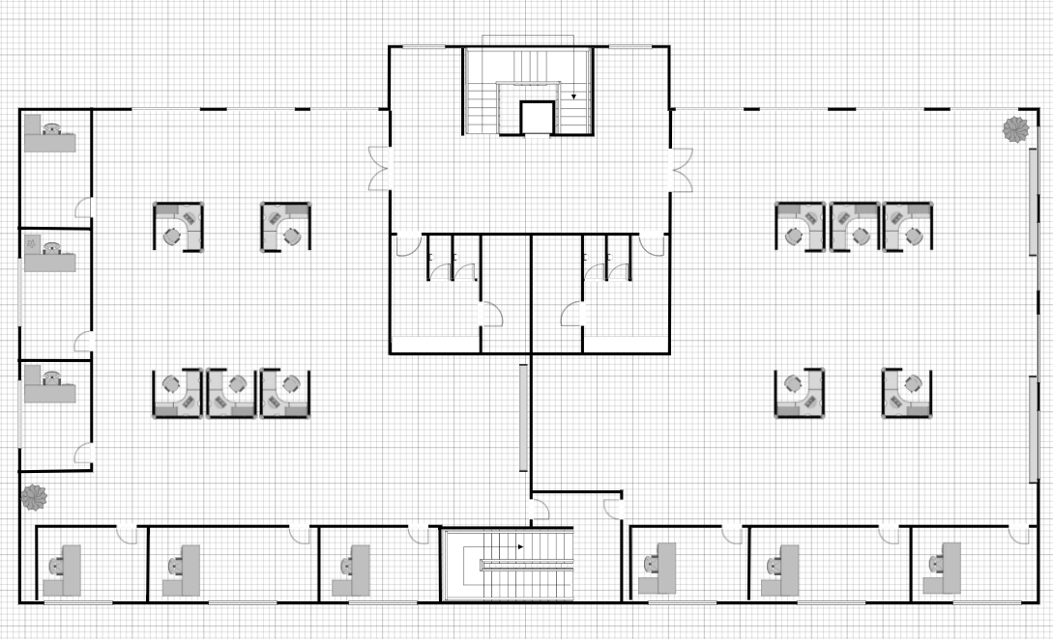
What we plan to bring to MDR
Functioning LIDAR
2D mapping
Stationary or manually moved sensor to map the layout of a floor
Responsibilities
Kelvin (ME)
Remodeling the Roomba and supply power to LIDAR sensors
Marcus (EE)
Program microcontroller and early stage application development
Derek (CSE) & Bryan (CSE)
SLAM programming to create a map from LIDAR point cloud
Notes:
25
25
25
K:
By FPR, we aim to demonstrate that Mapper will be able to produce a clear and accurate map of any given room. This map will be made in real time with the position of the robot also being tracked. However, for the Demo day we will not be able to demonstrate this in real time so we will provide a video to show Mapper in use. Thank you all for your time. That concludes our presentation of Mapper. We will now move onto the Q and A session.

Slide 26
What we plan to bring to FPR and Demo Day
FPR
Live demonstration of Mapper capabilities
Demo Day
Mapper on display
Video that shows Mapper fabricating 3D model of a room
Perspective of robot
Current map that is being created
Tracker that shows where the robot is relative to the room
Notes:
26
26
26

Slide 27
Questions?
Notes:
27
27
27

