Slide 1
Midway Design Review
Team 16
December 6, 2018
Notes:
1
1
1

Slide 2
Mapper
Kelvin Nguyen
ME
Marcus Le
EE
Bryan Martel
CSE
Derek Sun CSE
Notes:
2
2
2

Slide 3
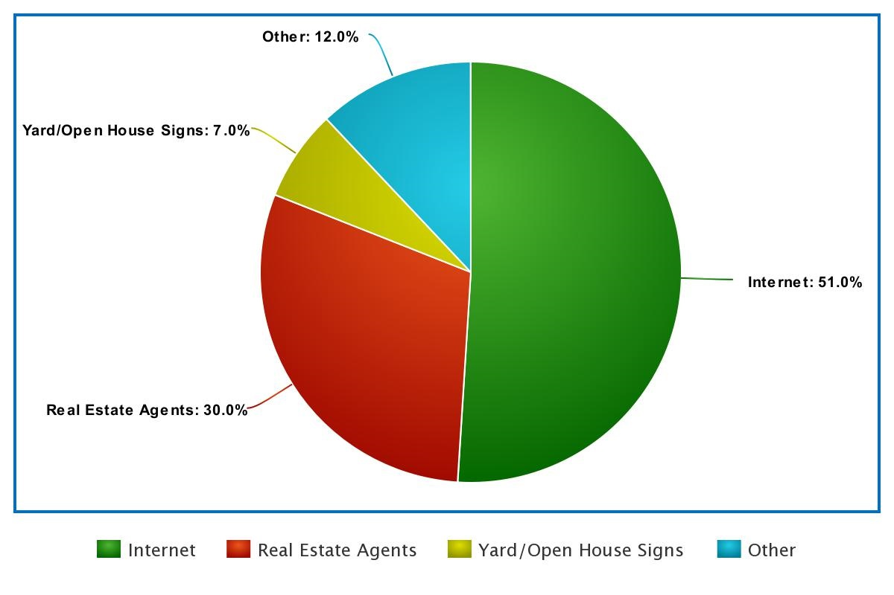
Background and Motivation
In 2017, homeowners found their new houses through:
Internet - 51%
Real Estate Agents - 30%
Yard/Open House signs - 7%
Other - 12%
https://www.nar.realtor/research-and-statistics/quick-real-estate-statistics
Notes:
3
3
3

Slide 4
Background and Motivation
Over 1/3 of all homebuyers are below the age of 36
This age group tends to be more technologically savvy
This leads to the idea that less and less people are going out in active search of houses, instead resorting to the internet to complete their search
https://www.nar.realtor/sites/default/files/reports/2017/2017-real-estate-in-a-digital-age-03-10-2017.pdf
Notes:
4
4
4

Slide 5
Goal
Provide homeowners or real estate agents with the ability to post an updated model of the interior of their house
Potential integration with virtual reality tours
Similar to an open house
Cater toward the younger, more technologically adept generation that will inevitably dominate the future real estate market
Notes:
5
5
5

Slide 6
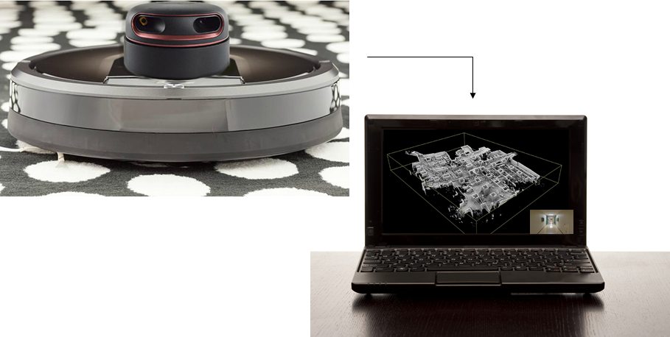
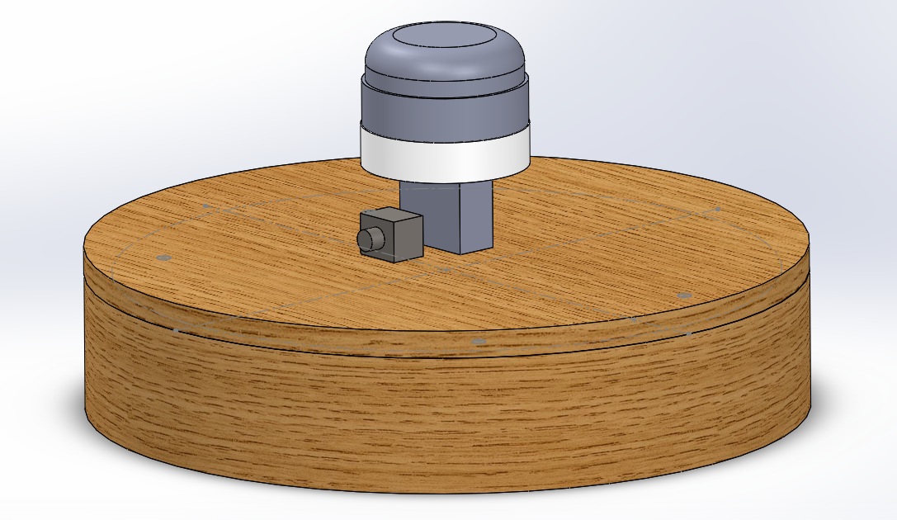
Method of Resolution
A robot that utilizes LIDAR sensors to remotely navigate around the surrounding environment and produce a 3D layout of an indoor area
A camera mounted on the robot will allow for live video feed to assist in user navigation
Notes:
6
6
6

Slide 7
Requirements Analysis: Specifications
Speed of up to 3mph
Effective detection range of 15ft
Approximately 8 pounds
Approximately 2 hours of battery life
Durable enough to withstand minor collisions
Notes:
7
7
7

Slide 8
Requirements Analysis: Inputs and Outputs
Input
LIDAR sensor data
Inertial measurement unit data
Camera data
User navigation control
Output
Live video feed
Map data
Notes:
8
8
8

Slide 9
Block Diagram
Mapper
Power Supply
Powers
Camera
Powers
Robot
Video feed
PCB
LIDAR System
Powers
Microcontroller
Wi-Fi module
Servos
IMU
Sensor readings
Controls
Navigation
LIDAR Sensor
Motors
Wheels
Input
directions
External Laptop
Wi-Fi communication
Application
SLAM Algorithm
Mapping data
Display
Controller
Layout view
Layout view

Slide 10
Proposed MDR Deliverables and Responsibilities
Functioning LIDAR sensor and IMU
2D SLAM with manually moved sensor
Simulated data input for wheel movement
Live data from LIDAR and IMU
Robot
Build housing for LIDAR sensor and prepare for it to be mounted
Arduino/PCB able to send navigation instructions to Roomba motors
Basic lift
Scissor-lift structure for elevation of sensor
Responsibilities
Kelvin (ME)
Remodeling the Roomba and supply power to LIDAR sensors
Marcus (EE)
Program microcontroller and early stage application development
Derek (CSE) & Bryan (CSE)
SLAM programming to create a map from LIDAR point cloud
Notes:
10
10
10

Slide 11
Design Changes
Roomba → Custom robot
Build our own robot with a custom chassis, instead of using Roomba as our robot
Roomba chassis does not have enough room to implement the LIDAR sensor and IMU setup we had envisioned
Basic lift → Pan and tilt
Pan and tilt, instead of using a basic lift for elevation
Decided that pan and tilt would be the better alternative for implementing 3D SLAM
Eliminates stability problems that occurred in lift
Simplifies the wiring of the components
Notes:
11
11
11

Slide 12
Actual MDR Deliverables and Responsibilities
Functioning LIDAR sensor and IMU
2D SLAM with manually moved sensor
Simulated data input for wheel movement
Live data from LIDAR and IMU
Robot
Build housing for LIDAR sensor and prepare for it to be mounted
Arduino/PCB able to send navigation instructions to Roomba motors
Basic lift
Scissor-lift structure for elevation of sensor
Responsibilities
Kelvin (ME)
Robot chassis and LIDAR mount design/production
Marcus (EE)
Roomba motor integration with Arduino controller
Derek (CSE) & Bryan (CSE)
SLAM programming to create a map from LIDAR point cloud
Notes:
12
12
12

Slide 13
Block Diagram
Mapper
Power Supply
Powers
Camera
Powers
Robot
Video feed
PCB
LIDAR System
Powers
Microcontroller
Wi-Fi module
Servos
IMU
Sensor readings
Controls
Navigation
LIDAR Sensor
Motors
Wheels
Input
directions
External Laptop
Wi-Fi communication
Application
SLAM Algorithm
Mapping data
Display
Controller
Layout view
Layout view

Slide 14
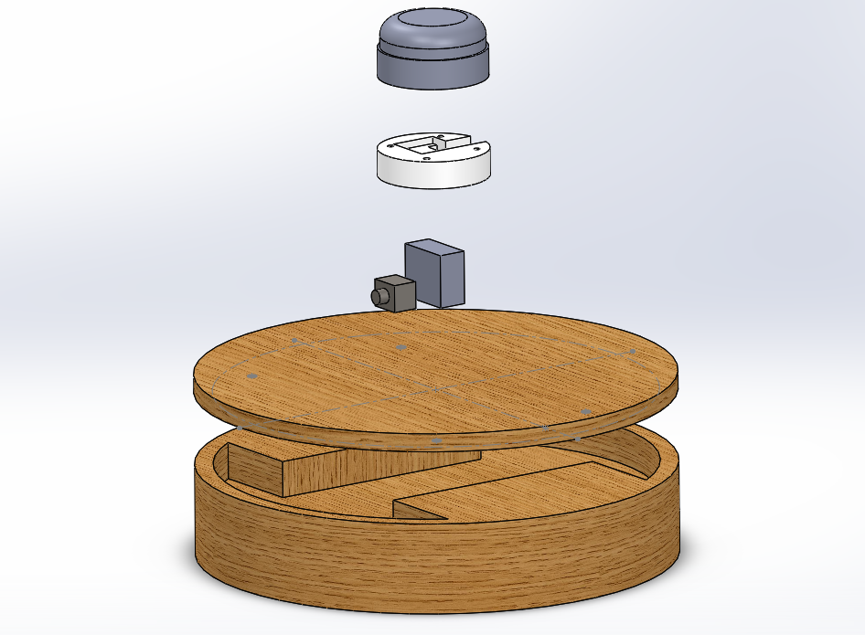
Our Product
LIDAR sensor
Mount
Servos
Camera
Lid
Chassis
Notes:
14
14
14

Slide 15
Our Product
Notes:
15
15
15

Slide 16
Block Diagram
Mapper
Power Supply
Powers
Camera
Powers
Robot
Video feed
PCB
LIDAR System
Powers
Microcontroller
Wi-Fi module
Servos
IMU
Sensor readings
Controls
Navigation
LIDAR Sensor
Motors
Wheels
Input
directions
External Laptop
Wi-Fi communication
Application
SLAM Algorithm
Mapping data
Display
Controller
Layout view
Layout view

Slide 17
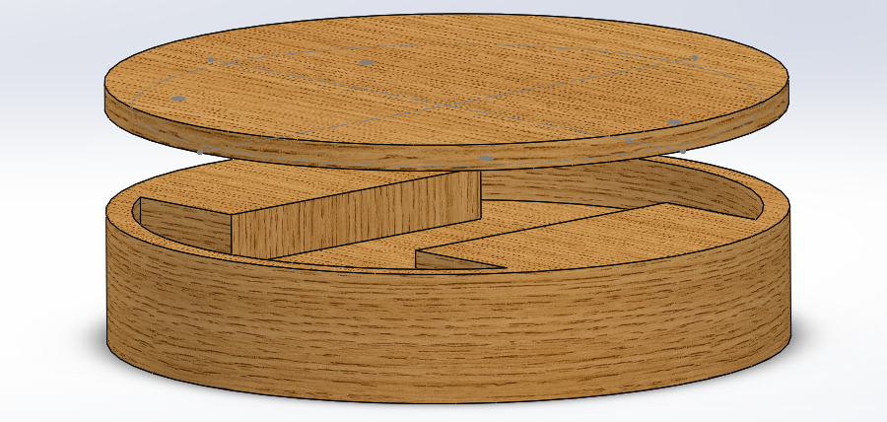
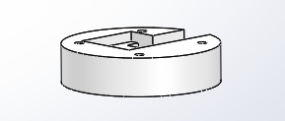
MDR Deliverable (Robot)
Two main components
Chassis
Will be cut out from wood, since wood is lightweight and easy to shape.
LIDAR mount
Will be 3D printed, since the dimensions are fairly small and high precision is required.
Notes:
17
17
17

Slide 18
Block Diagram
Mapper
Power Supply
Powers
Camera
Powers
Robot
Video feed
PCB
LIDAR System
Powers
Microcontroller
Wi-Fi module
Servos
IMU
Sensor readings
Controls
Navigation
LIDAR Sensor
Motors
Wheels
Input
directions
External Laptop
Wi-Fi communication
Application
SLAM Algorithm
Mapping data
Display
Controller
Layout view
Layout view

Slide 19
MDR Deliverable (Motor)
We decided to use the Roomba’s motors in our custom robot
There are two motors that control each wheel
Used an Arduino to code the wheel controls
Motors wired to H bridge that can control both wheels independently
Notes:
19
19
19

Slide 20
MDR Deliverable (Motor)
How the wheel works:
Two terminals across the motor,
If terminal A goes to high, (9-18V), and terminal B goes low, (0V), the wheel moves forward,
If A goes low, and B goes high, the wheel moves backwards
We can control motor speed via:
High voltage across the two terminals
A PWM signal that enables A and B to go high or low (H bridge)
Notes:
20
20
20

Slide 21
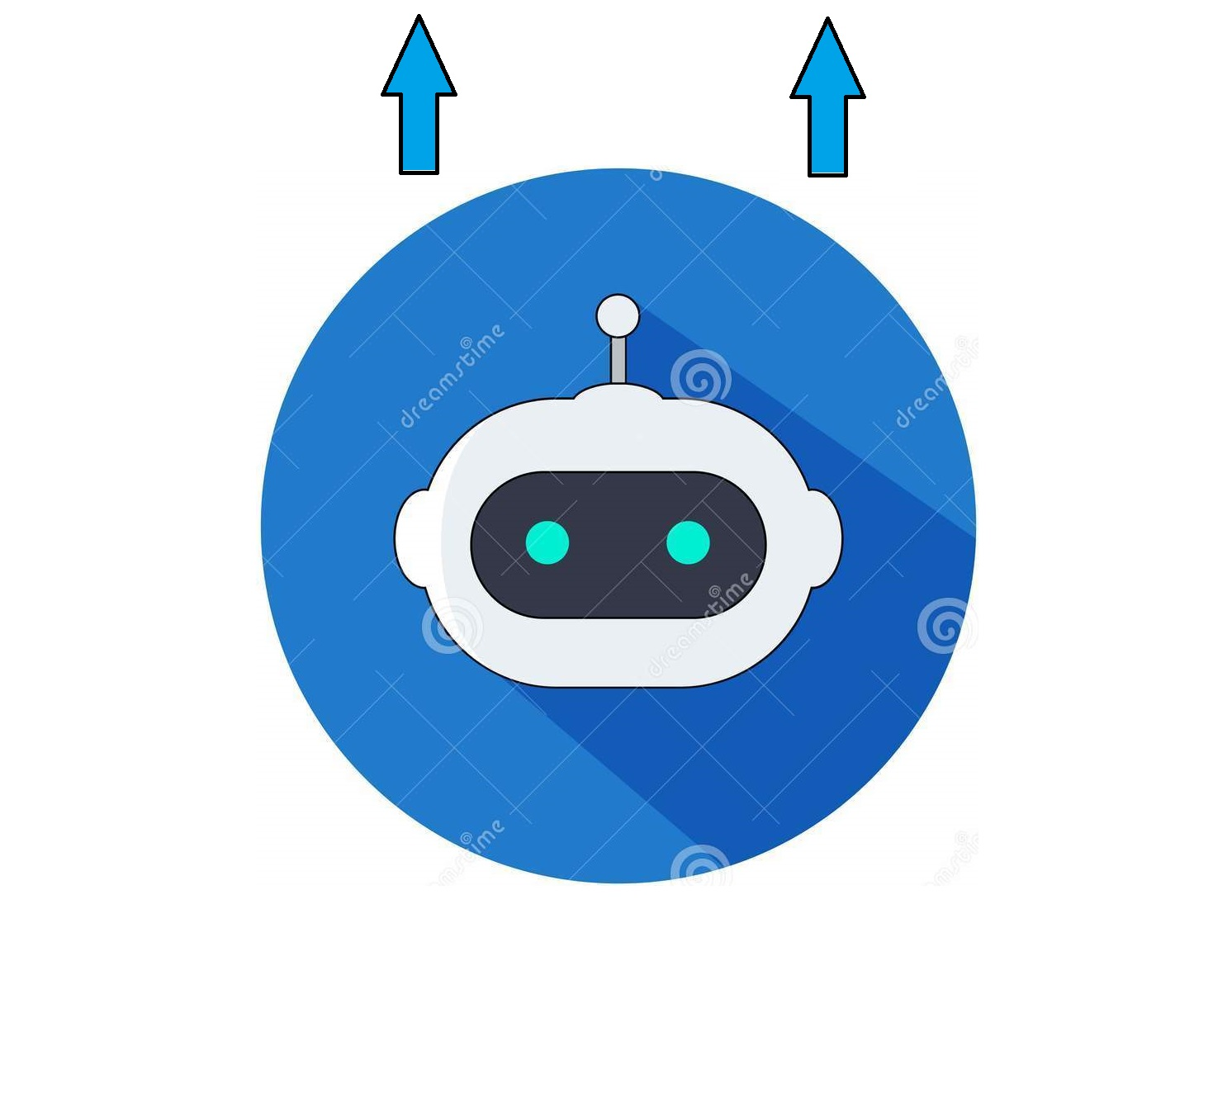
MDR Deliverable (Motor)
We’ll focus on 3 major robot motor movements:
Forward/Backwards:
Both wheels receive the same PWM signal
Terminals of both wheels are the same
Rotate in place:
Both wheels receive the same PWM signal
Terminals of both wheels are opposite each other
One wheel moves forward, the other backwards
Curve left or right:
Terminals of both wheels are the same
Each motor receives a different PWM signal
Notes:
21
21
21

Slide 22
Block Diagram
Mapper
Power Supply
Powers
Camera
Powers
Robot
Video feed
PCB
LIDAR System
Powers
Microcontroller
Wi-Fi module
Servos
IMU
Sensor readings
Controls
Navigation
LIDAR Sensor
Motors
Wheels
Input
directions
External Laptop
Wi-Fi communication
Application
SLAM Algorithm
Mapping data
Display
Controller
Layout view
Layout view

Slide 23
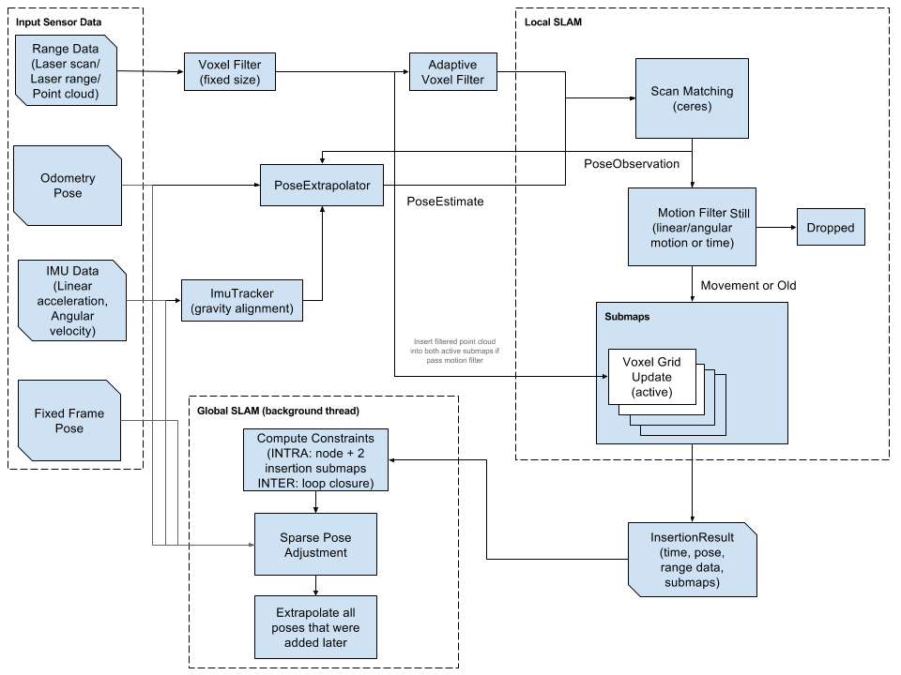
MDR Deliverable (2D SLAM)
Google Cartographer Algorithm Overview
Notes:
23
23
23

Slide 24
MDR Deliverable (2D SLAM)
RPLIDAR A2 → rplidar ROS package
read RPLIDAR raw scan result using RPLIDAR's SDK
convert to ROS /scan messages
record /scan messages to a rosbag
ROS /scan messages → Google Cartographer node
node processes data with Cartographer SLAM algorithm
scans combined to generate local submaps
local submaps merged to global map
Notes:
24
24
24

Slide 25
MDR Deliverable (2D SLAM)
SparkFun 9DoF Razor IMU → razor_imu_9dof ROS package
read IMU sensor data
convert to ROS /imu messages
record /imu messages to a rosbag
Output (displayed in ROS rviz)
Pointcloud
Local and global map
IMU orientation
not yet integrated into Cartographer SLAM algorithm
Notes:
25
25
25

Slide 26
MDR Deliverable (2D SLAM)
Open Source
Cartographer libraries
ROS packages/nodes
RPLIDAR A2 SDK
Our contributions
LIDAR ROS integration
IMU calibration and ROS integration
LIDAR and IMU compatibility with ROS Cartographer package
ROS configurations
Notes:
26
26
26

Slide 27
Demo
Notes:
27
27
27

Slide 28
What we plan to bring to CDR
CDR Deliverables
3D SLAM
Simultaneous LIDAR and IMU data input
Pan & tilt calibration and integration
Functional robot
Mount motors to our custom robot
Integrate custom PCB
Wi-Fi connectivity between robot and PC
Responsibilities
Kelvin (ME)
Ensure functional robot and mount SLAM components
Marcus (EE)
Create PCB, ensure functional robot, and Wi-Fi data transfer
Derek (CSE) & Bryan (CSE)
Programming 2D SLAM → 3D SLAM and Wi-Fi data transfer
Notes:
28
28
28

Slide 29
Challenges
2D SLAM → 3D SLAM
2D SLAM requires just the LIDAR sensor
3D SLAM requires LIDAR, IMU, and pan & tilt servos
Integration of all components to SLAM algorithm will greatly increase overall complexity
Wi-Fi connectivity between robot and PC
Transfer of camera data, SLAM sensor data, and user navigation controls
Integration of all components
Notes:
29
29
29

Slide 30
What we plan to bring to FPR and Demo Day
FPR
Live demonstration of Mapper capabilities
Demo Day
Mapper on display
Video that shows Mapper fabricating 3D model of a room
Perspective of robot
Current map that is being created
Tracker that shows where the robot is relative to the room
Notes:
30
30
30

Slide 31
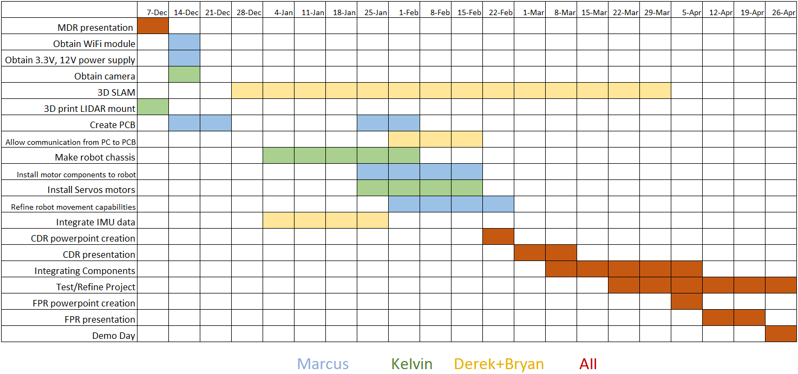
Schedule
Notes:
31
31
31

Slide 32
Questions?
Notes:
32
32
32

