Slide 1
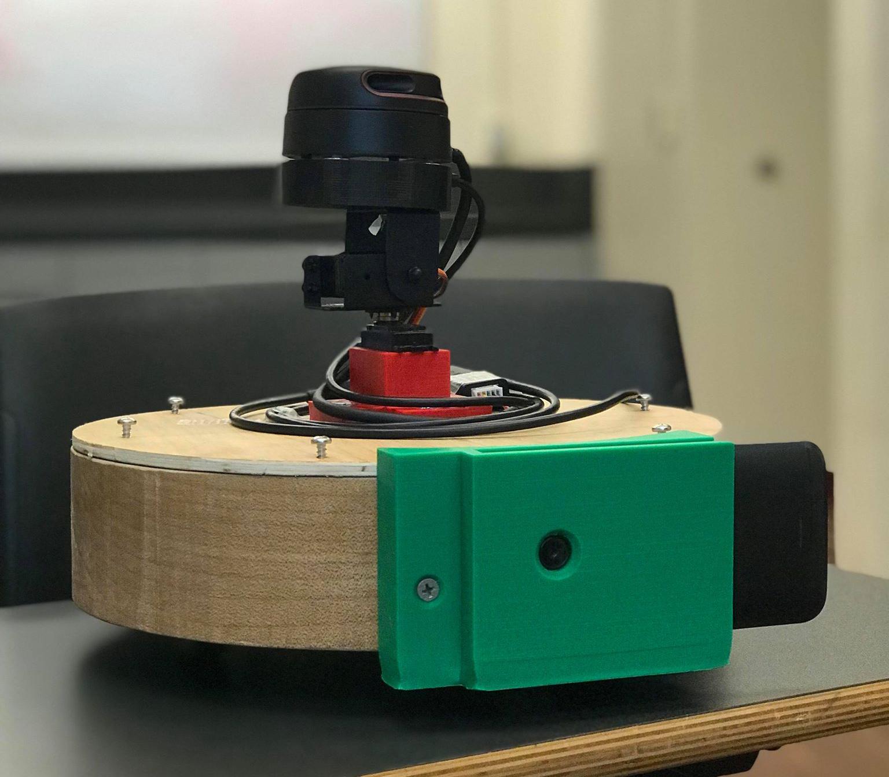
Final Product Review
Team 16
April 17, 2019
Notes:
‹#›
‹#›
‹#›

Slide 2
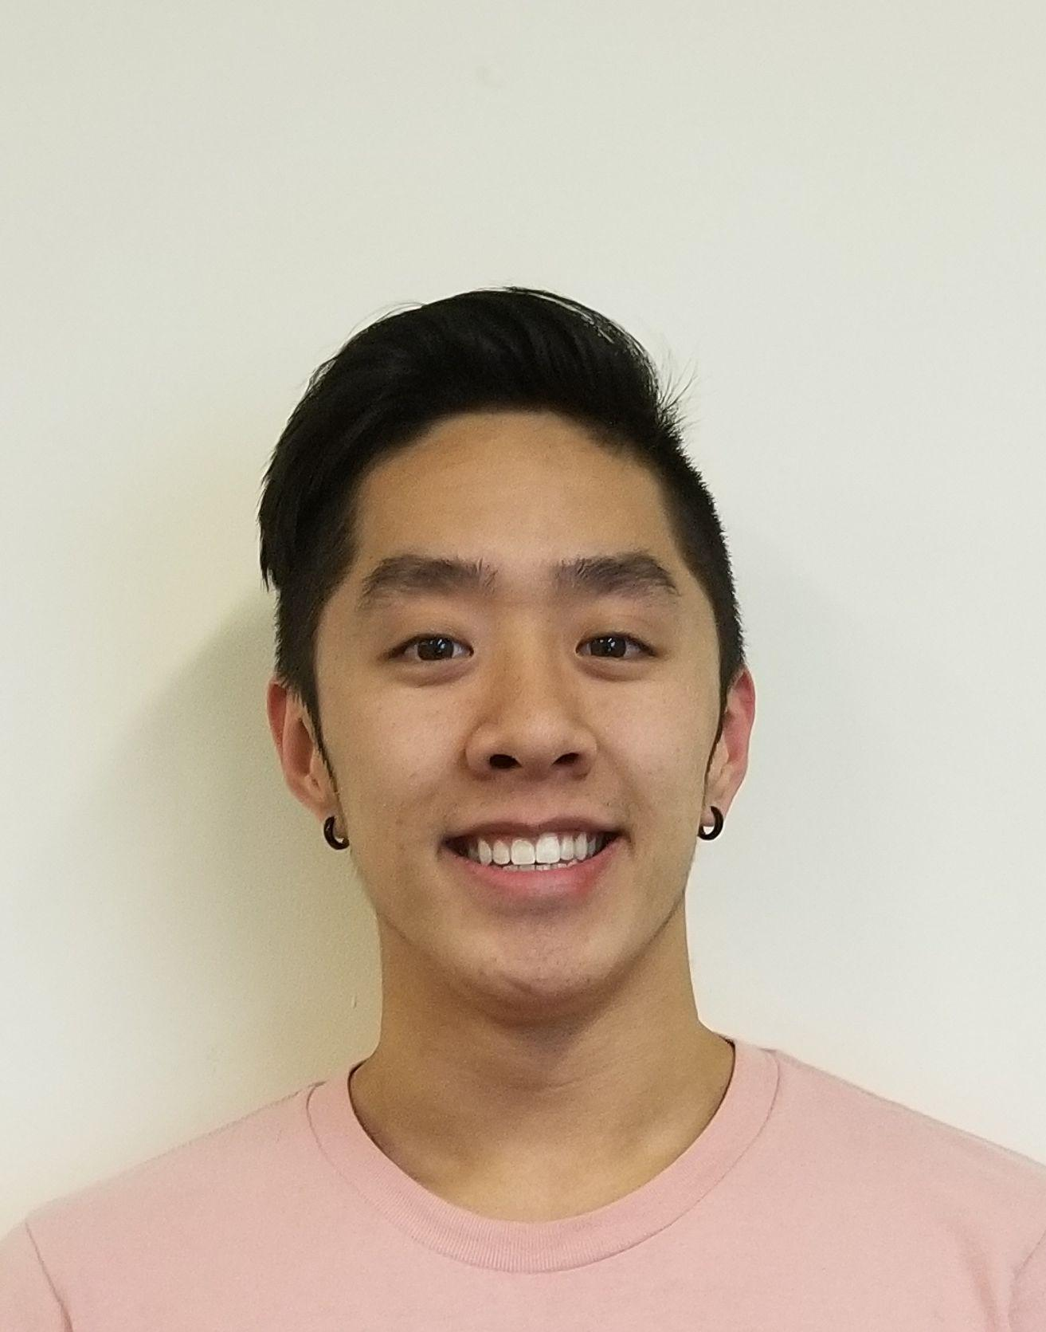
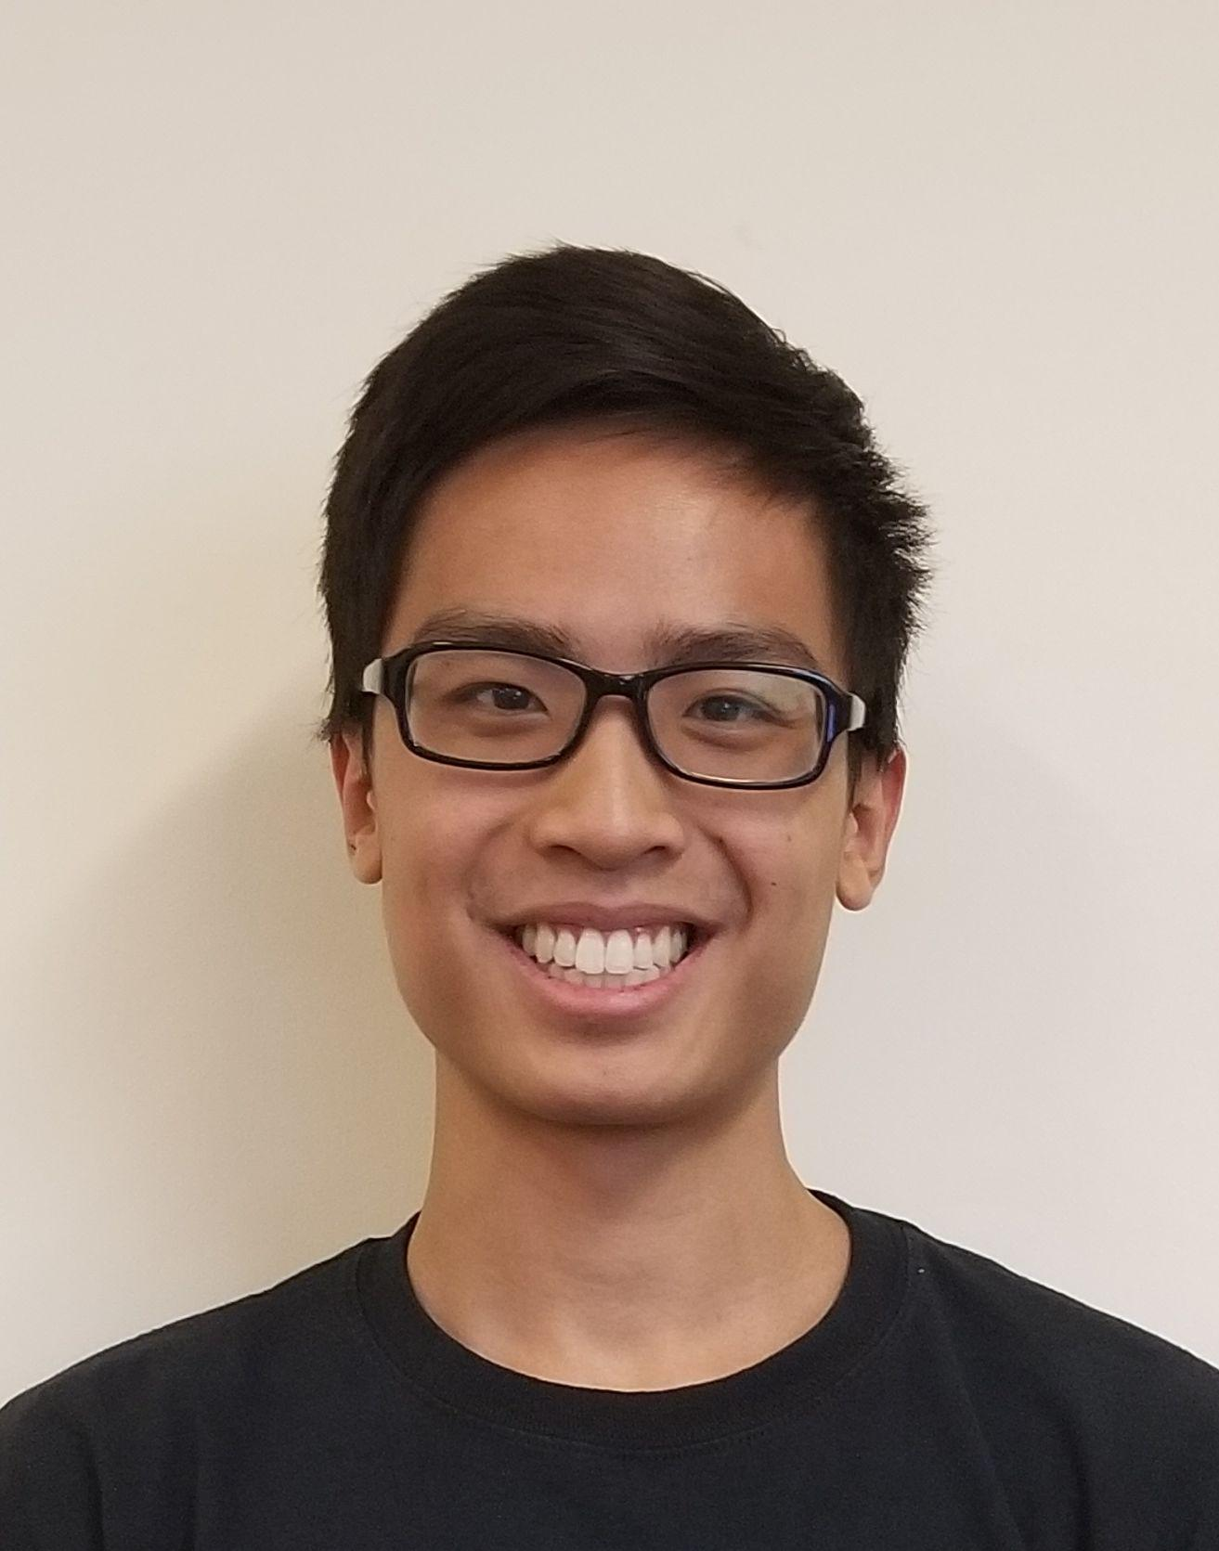
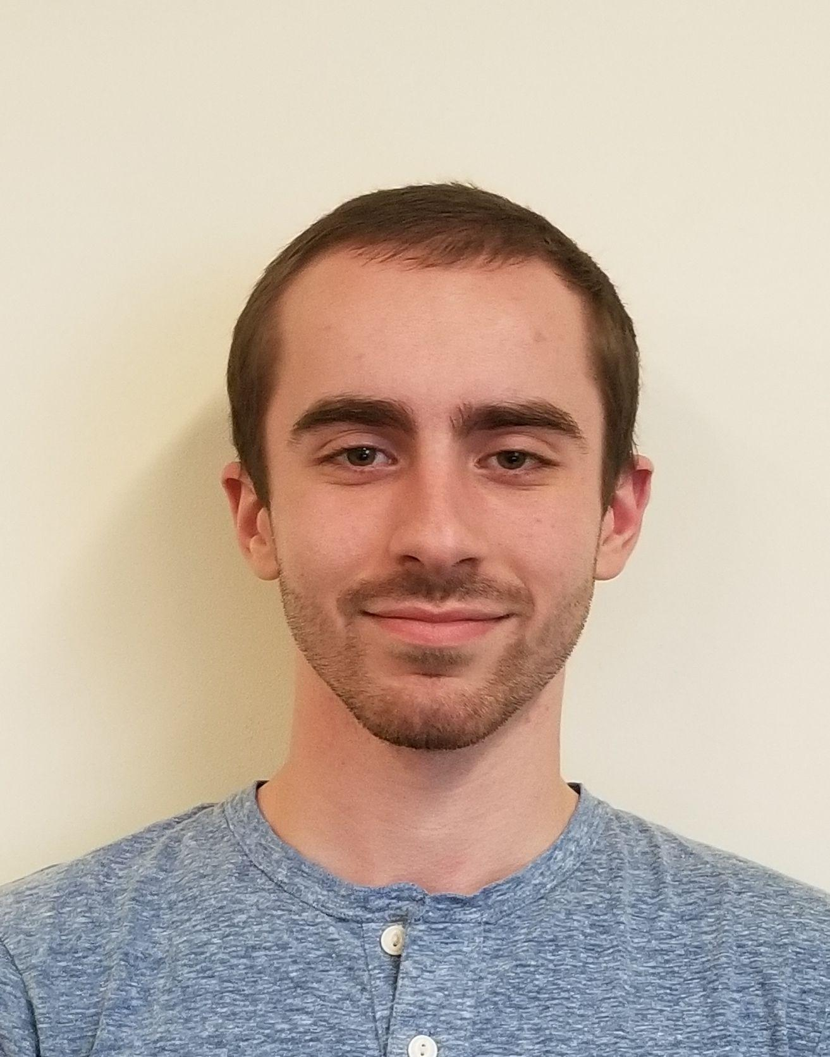
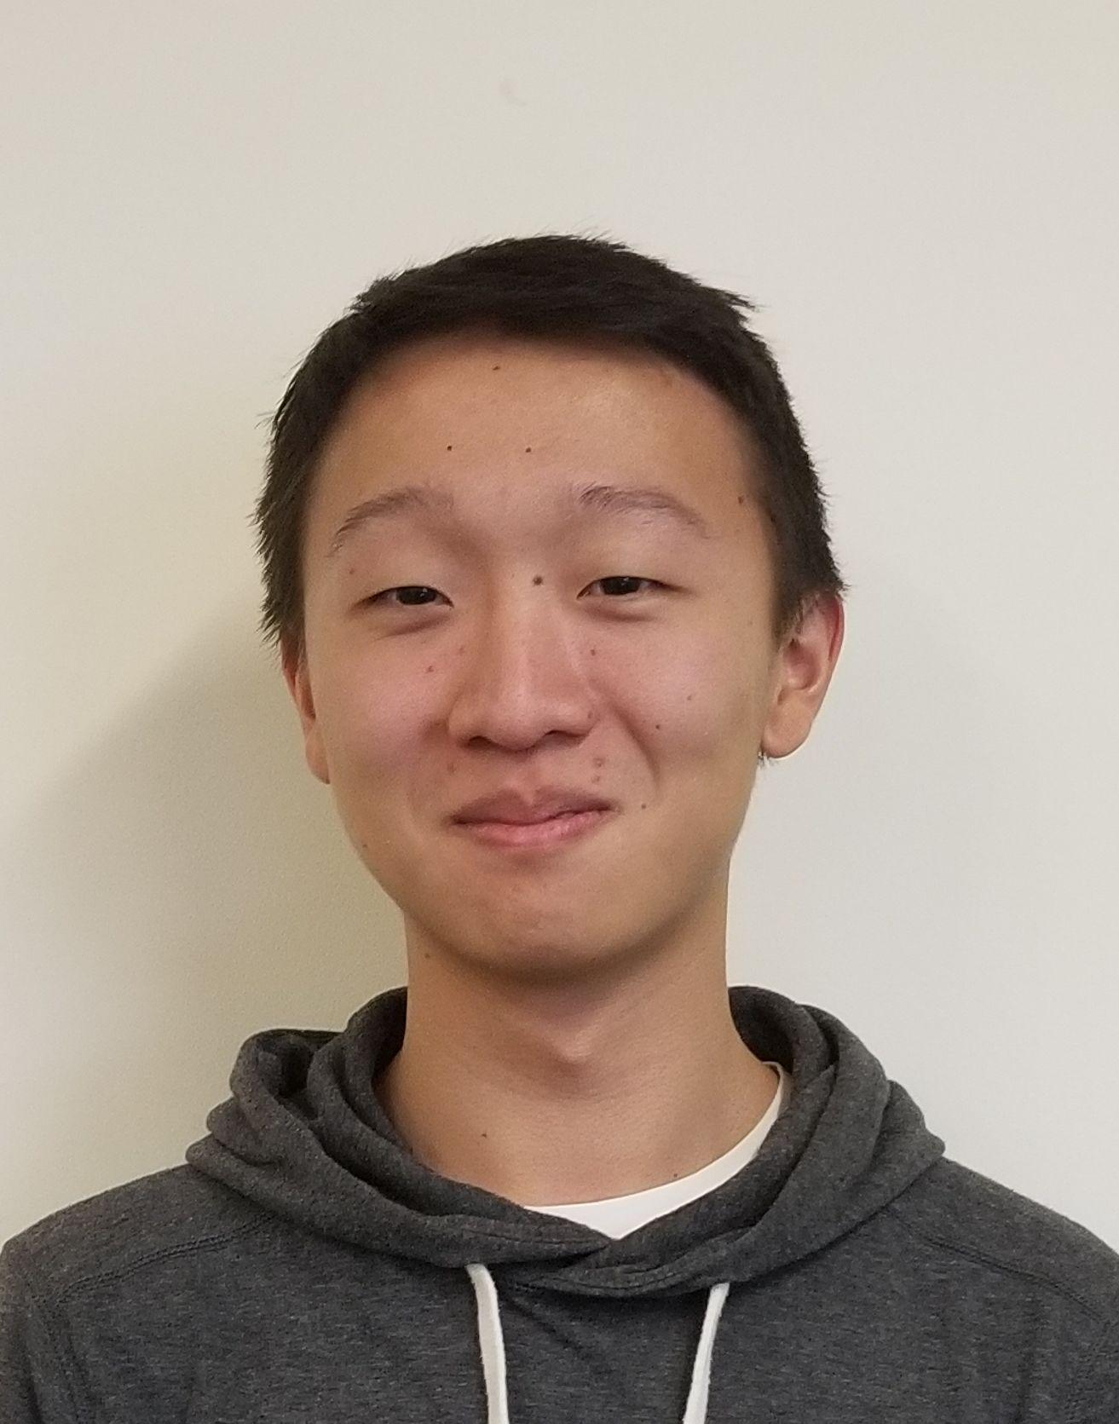
Mapper
Kelvin Nguyen
ME
Marcus Le
EE
Bryan Martel
CSE
Derek Sun CSE
Notes:
‹#›
‹#›
‹#›

Slide 3
Goal
Provide homeowners or real estate agents with the ability to post an updated model of the interior of their house
Potential integration with virtual reality tours
Similar to an open house
Cater toward the younger, more technologically adept generation that will inevitably dominate the future real estate market
Notes:
‹#›
‹#›
‹#›

Slide 4
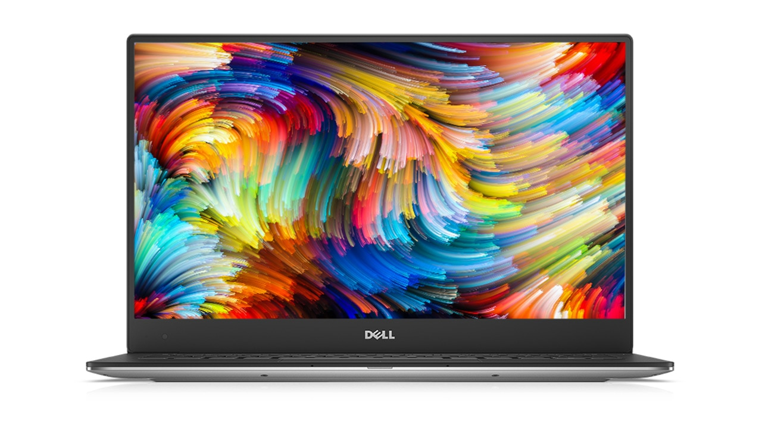
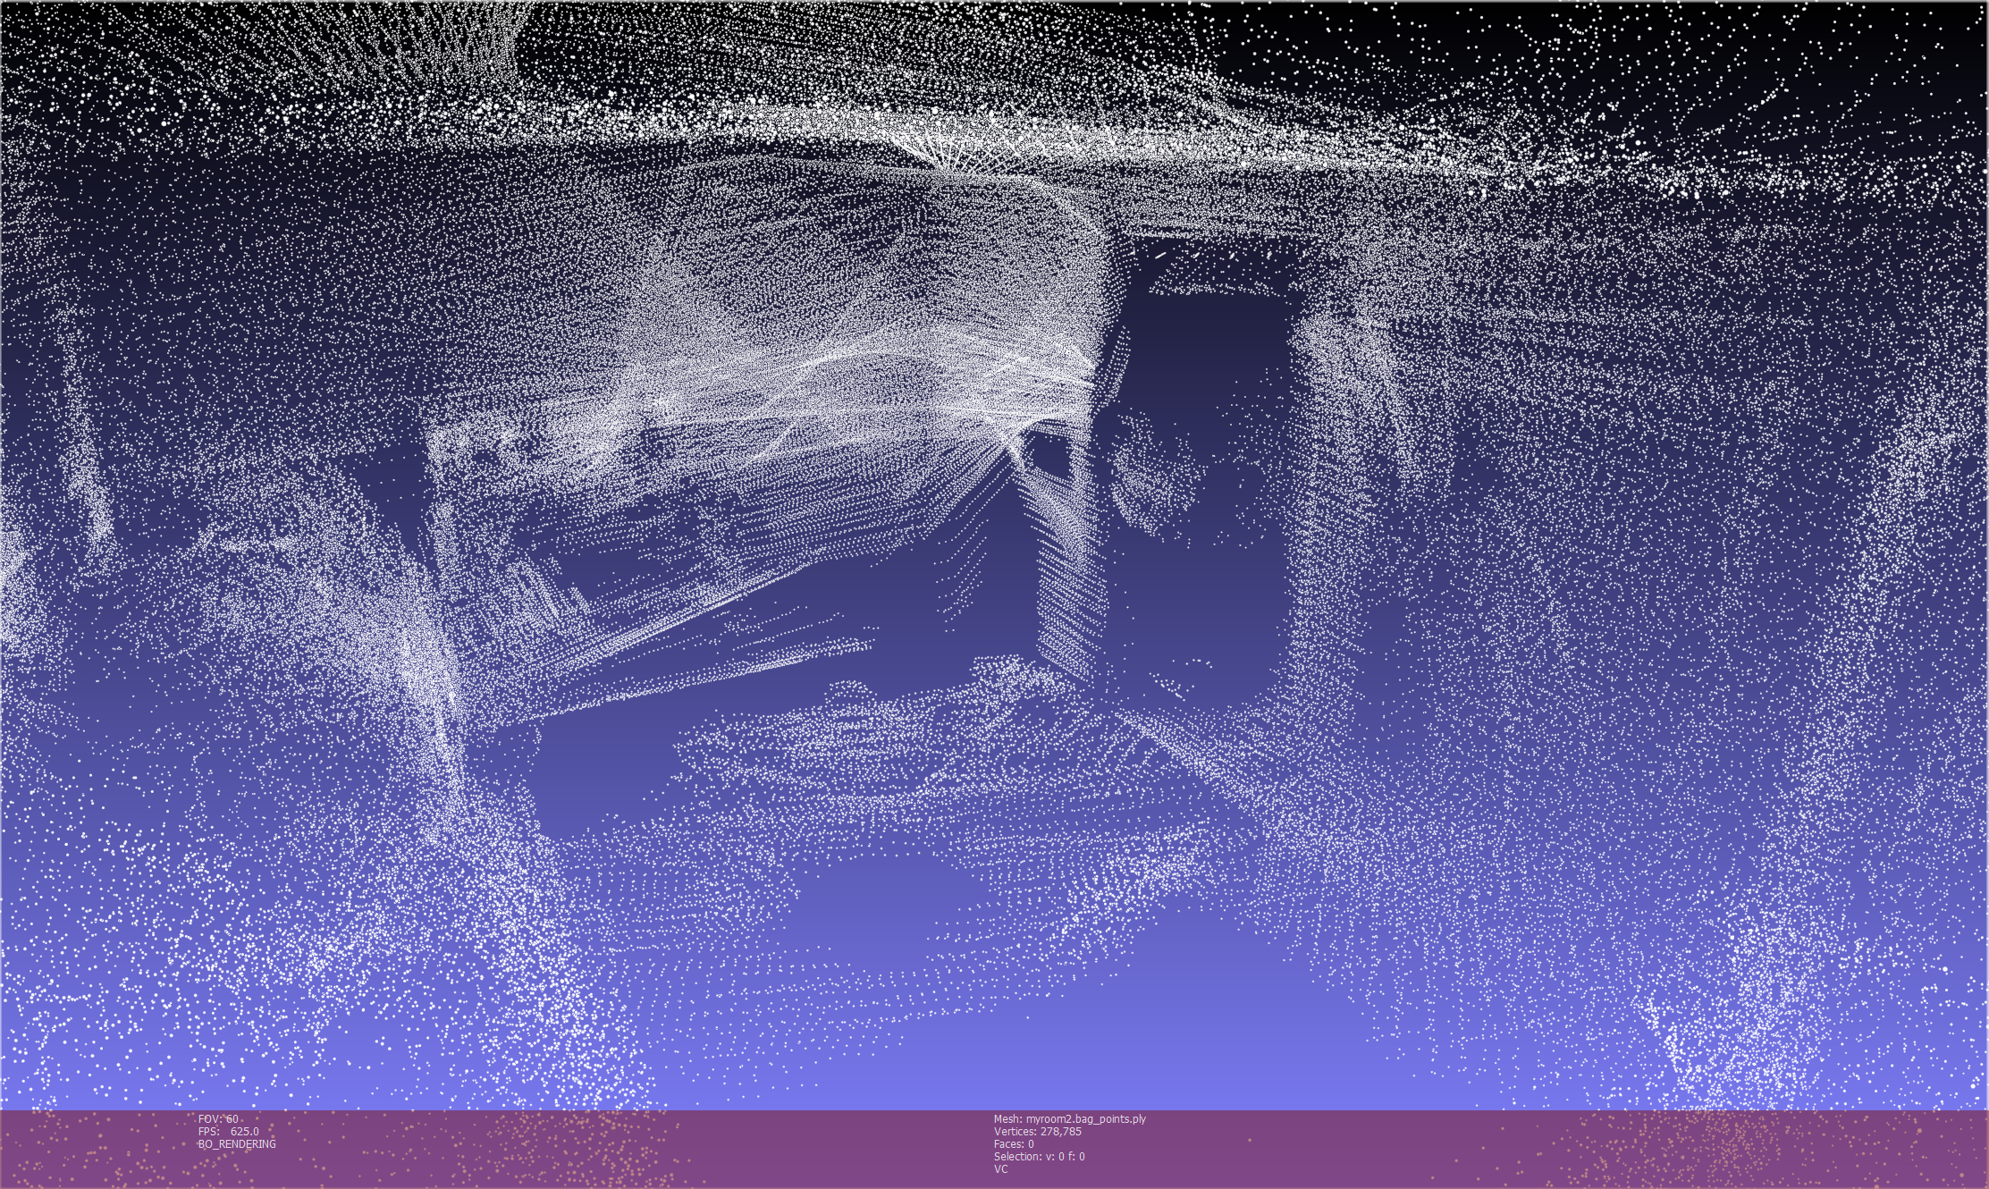
Method of Resolution
A robot that utilizes LIDAR sensors to remotely navigate around the surrounding environment and produce a 3D layout of an indoor area
A camera mounted on the robot will allow for live video feed to assist in user navigation
Notes:
‹#›
‹#›
‹#›

Slide 5
Requirements Analysis: Specifications
Speed of up to 3mph
Effective detection range of 15ft
Approximately 12 pounds
Approximately 2 hours of battery life
Durable enough to withstand minor collisions
Notes:
‹#›
‹#›
‹#›

Slide 6
Requirements Analysis: Inputs and Outputs
Input
LIDAR sensor data
Inertial measurement unit data
Camera data
User navigation control
Output
Live video feed
Map data
Notes:
‹#›
‹#›
‹#›

Slide 7
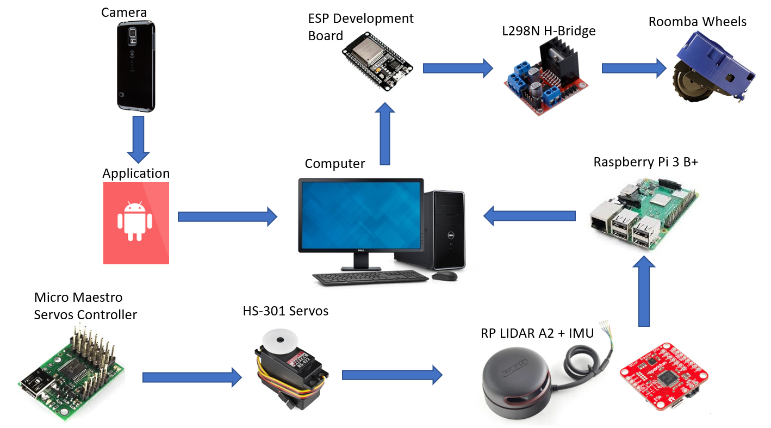
System Overview
Notes:
‹#›
‹#›
‹#›

Slide 8
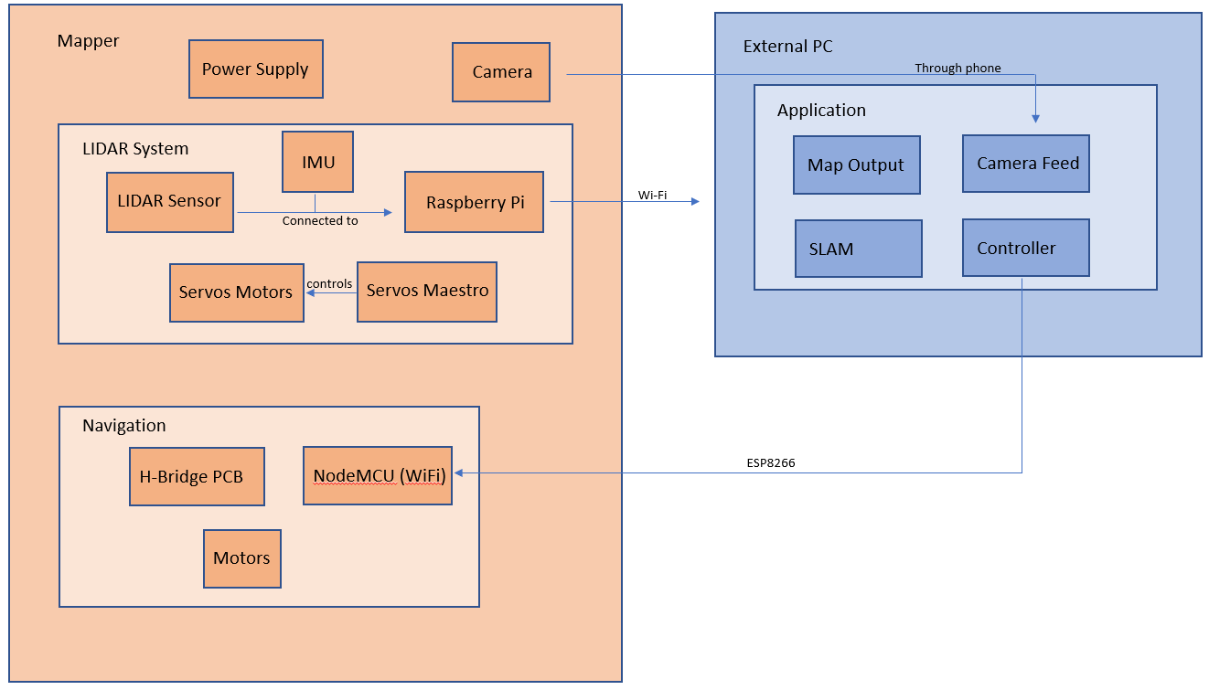
Block Diagram

Slide 9
Proposed FPR Deliverables
Mapper completed
Wireless maneuverability of robot
User controls sent through Wi-Fi to Mapper
LIDAR and IMU sensor data relayed back to PC
Camera feed sent back to PC
3D SLAM
2D map generated and viewable in Rviz
Point cloud viewable in Meshlab
Mesh generated from point cloud
Component integration
Functional PCB integrated into Mapper
All hardware and circuitry fits neatly in Mapper
Notes:
‹#›
‹#›
‹#›

Slide 10
Actual FPR Deliverables
Mapper completed
Wireless maneuverability of robot
User controls sent through Wi-Fi to Mapper
LIDAR and IMU sensor data relayed back to PC
Camera feed sent back to PC
3D SLAM
2D map generated and viewable in Rviz
Point cloud viewable in Meshlab
Mesh generated from point cloud
Component integration
Functional PCB integrated into Mapper
All hardware and circuitry fits neatly in Mapper
Notes:
‹#›
‹#›
‹#›

Slide 11
FPR Responsibilities
Kelvin (ME)
Optimize pan & tilt system, finalize robot chassis, design phone mount, mount all components
Marcus (EE)
Create PCB, Wi-Fi robot control, integrate all components
Derek (CSE)
3D SLAM, Wi-Fi data transfer, Wi-Fi video feed, PC application
Bryan (CSE)
3D SLAM, Wi-Fi robot control, PC application
Notes:
‹#›
‹#›
‹#›

Slide 12
FPR Deliverable (Wireless Maneuverability)
User controls sent through Wi-Fi to Mapper
NodeMCU reads UDP messages sent from PC application
PC application → NodeMCU → motors
LIDAR and IMU sensor data relayed back to PC
Raspberry Pi 3 B+ running Ubuntu Server 18.04 with ROS
ROS master (PC) launches nodes on remote machine (RPi)
Raspberry Pi publishes ROS /scan and /imu to master
Raspberry Pi 3 B+ → PC → SLAM
Camera feed sent back to PC
Phone’s Android application sends captured frames to PC application
Phone → Android application → PC application
Notes:
‹#›
‹#›
‹#›

Slide 13
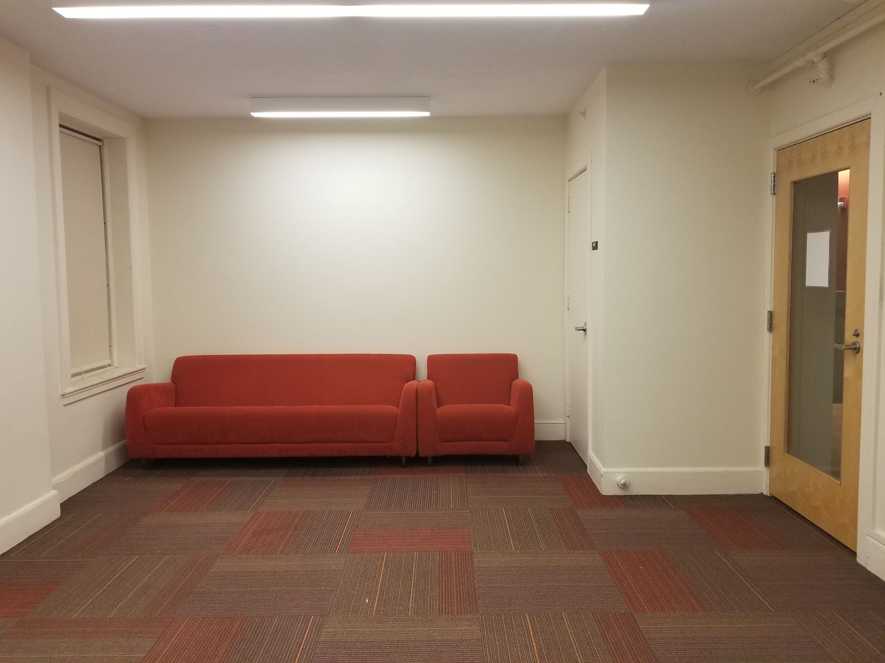
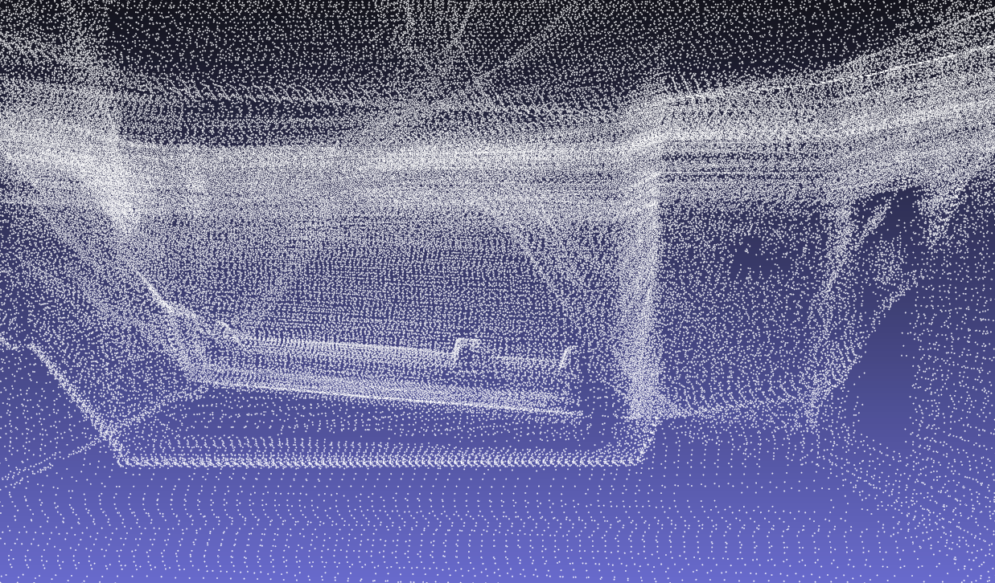
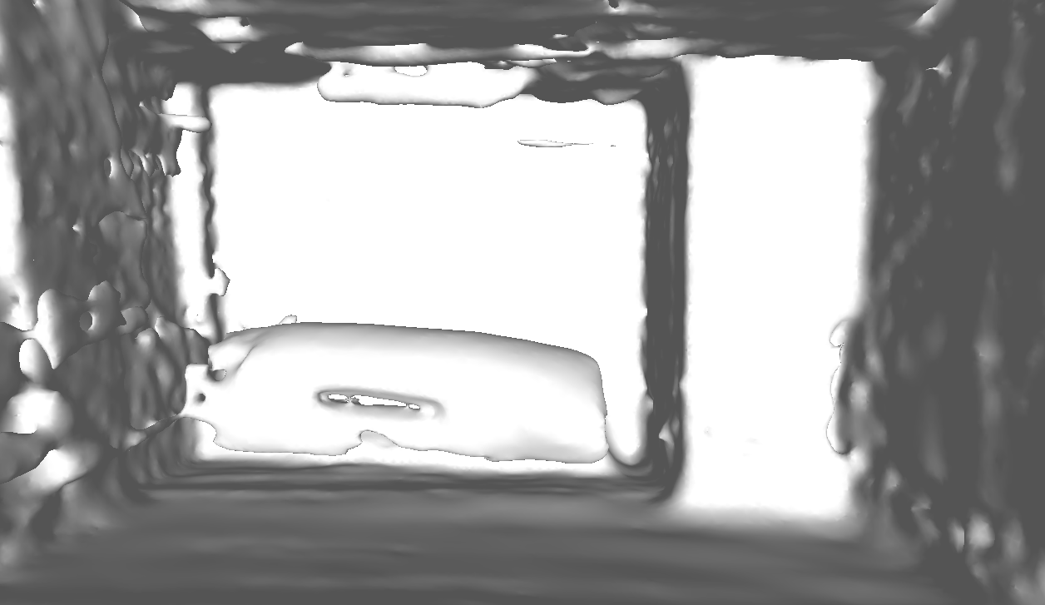
FPR Deliverable (3D SLAM)
Rviz
Generated 2D map
Robot trajectory/path
Meshlab
Generated point cloud
Reconstructed mesh
Notes:
‹#›
‹#›
‹#›

Slide 14
FPR Deliverable (Component Integration)
Functional PCB integrated into Mapper
H-bridge PCB created using Altium Designer
Connects to the NodeMCU to send signals to the wheel motors
Connecting subsystems
LIDAR Sensor and IMU data is sent through the Pi to the laptop
Laptop able to send controls over to the NodeMCU
Camera feedback displayed on the laptop
All hardware and circuitry fits neatly in Mapper
Top: LIDAR Sensor, Servos, IMU
Inside: H-bridge, NodeMCU, Maestro servos controller, batteries
Under: Raspberry Pi, batteries
Notes:
‹#›
‹#›
‹#›

Slide 15
What we plan to bring to Demo Day
Completed Mapper on display
Video that shows Mapper fabricating 3D model of a room
Controller for the robot
Video feedback
Current map that is being created
Marker that shows where the robot is relative to the room
3D output mesh layout
Notes:
‹#›
‹#›
‹#›

Slide 16
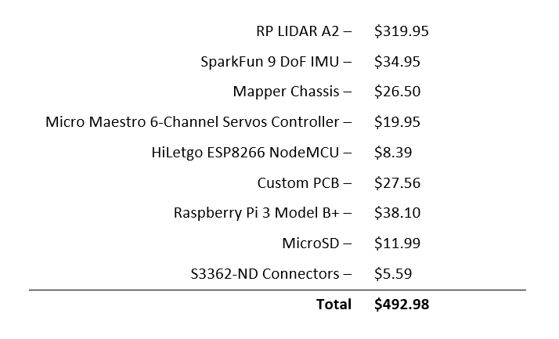
Costs
Notes:
‹#›
‹#›
‹#›

Slide 17
Demo
Notes:
‹#›
‹#›
‹#›

Slide 18
Questions?
Notes:
‹#›
‹#›
‹#›

