Slide 1
Comprehensive Design Review
Team 16
February 25, 2019
Notes:
1
1
1

Slide 2
Mapper
Kelvin Nguyen
ME
Marcus Le
EE
Bryan Martel
CSE
Derek Sun CSE
Notes:
2
2
2

Slide 3
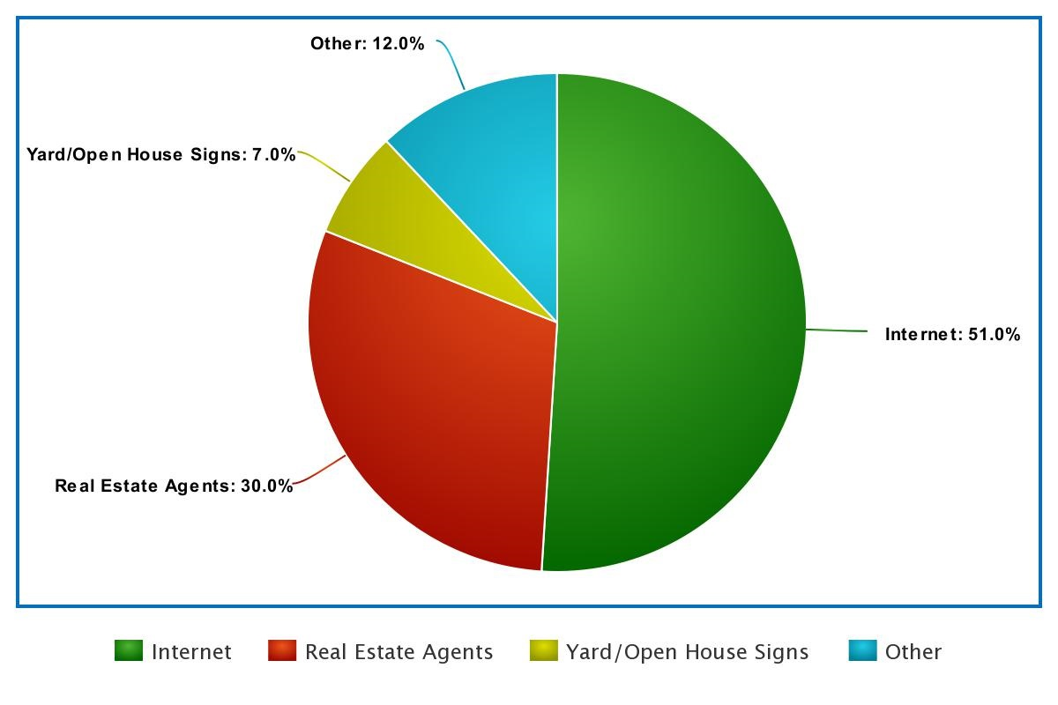
Background and Motivation
In 2017, homeowners found their new houses through:
Internet - 51%
Real Estate Agents - 30%
Yard/Open House signs - 7%
Other - 12%
https://www.nar.realtor/research-and-statistics/quick-real-estate-statistics
Notes:
3
3
3

Slide 4
Goal
Provide homeowners or real estate agents with the ability to post an updated model of the interior of their house
Potential integration with virtual reality tours
Similar to an open house
Cater toward the younger, more technologically adept generation that will inevitably dominate the future real estate market
Notes:
4
4
4

Slide 5
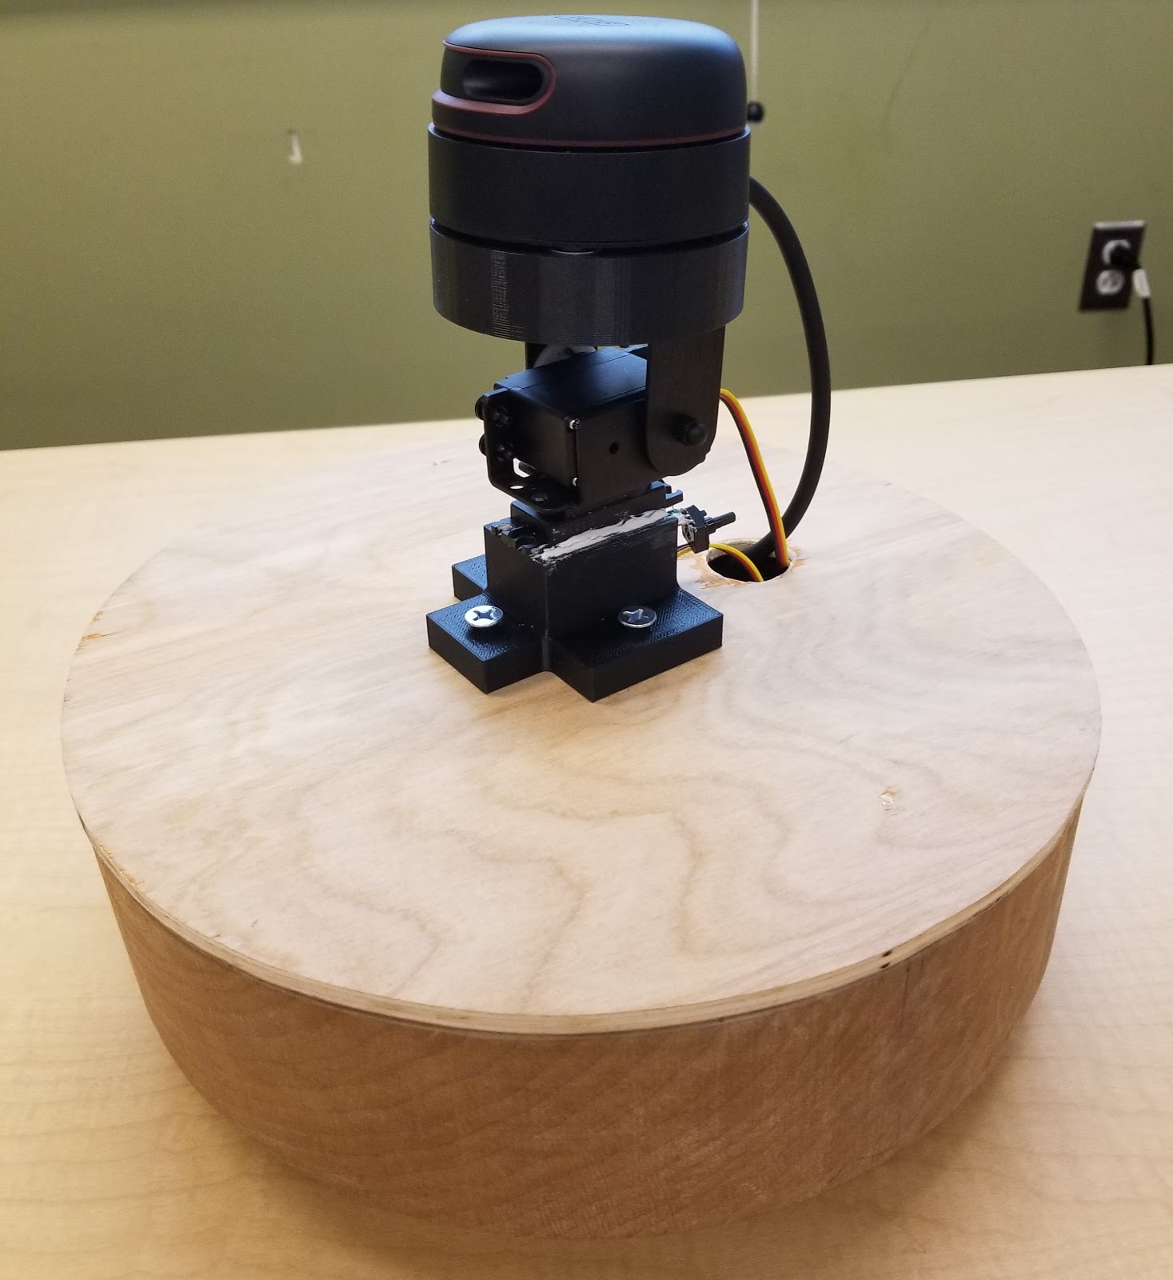
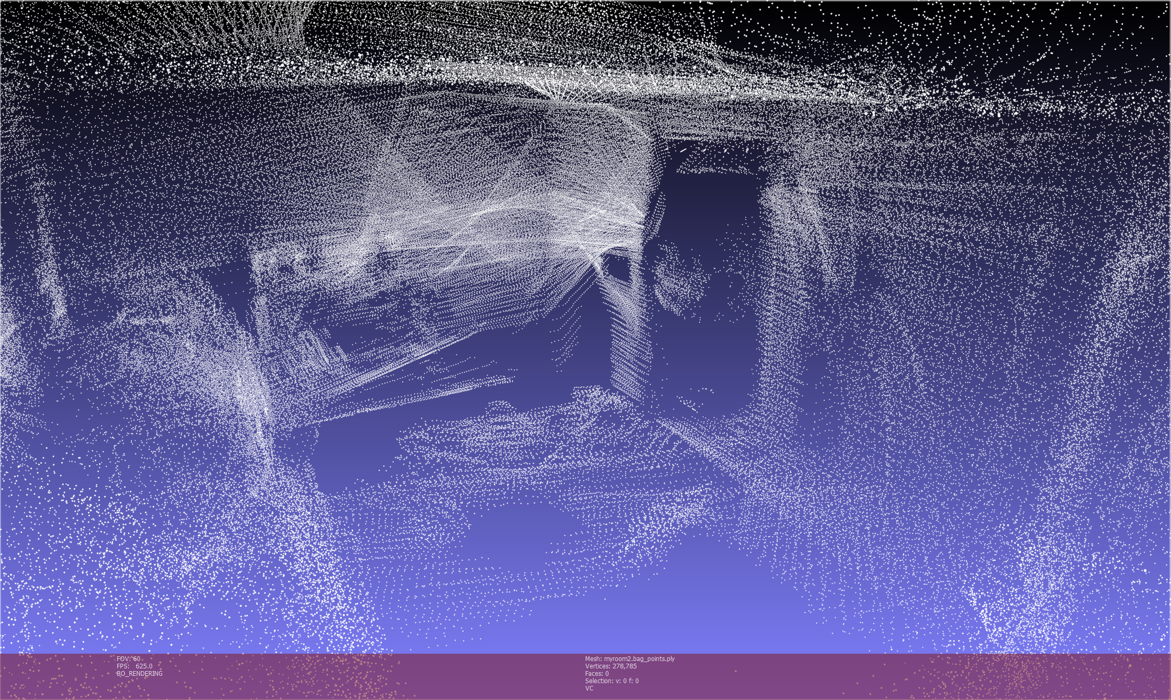
Method of Resolution
A robot that utilizes LIDAR sensors to remotely navigate around the surrounding environment and produce a 3D layout of an indoor area
A camera mounted on the robot will allow for live video feed to assist in user navigation
Notes:
5
5
5

Slide 6
Requirements Analysis: Specifications
Speed of up to 3mph
Effective detection range of 15ft
Approximately 12 pounds
Approximately 2 hours of battery life
Durable enough to withstand minor collisions
Notes:
6
6
6

Slide 7
Requirements Analysis: Inputs and Outputs
Input
LIDAR sensor data
Inertial measurement unit data
Camera data
User navigation control
Output
Live video feed
Map data
Notes:
7
7
7

Slide 8
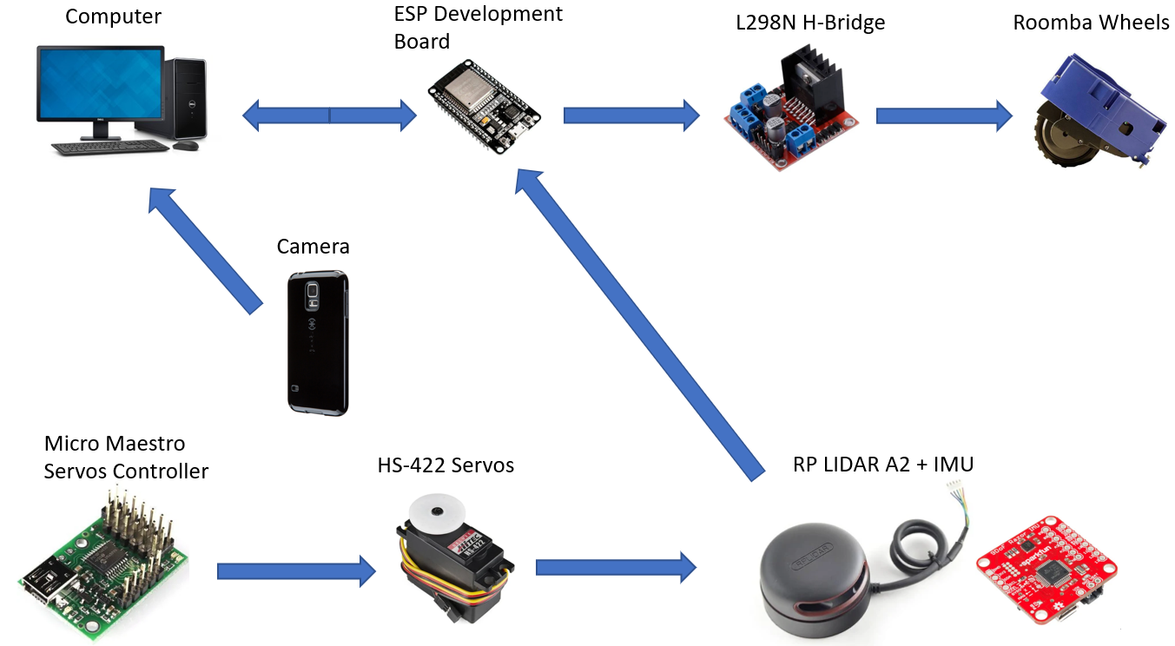
System Overview
Notes:
8
8
8

Slide 9
Block Diagram
Mapper
Power Supply
Powers
Camera
Powers
Internals
Powers
ESP8266 Dev Board
LIDAR System
Wi-Fi module
Microcontroller
Servos
Maestro Controller
IMU
Sensor readings
Controls
Navigation
LIDAR Sensor
Controls
PCB
Motors
Controls
Direction input
Video feed
External Laptop
SLAM Algorithm
Communication Application
Video feed
Display
Layout view
Sensor data
Sensor data
Layout view
Video feed

Slide 10
Proposed CDR Deliverables and Responsibilities
3D SLAM
Simultaneous LIDAR and IMU data input
Pan & tilt calibration and integration
Functional robot
Mount motors to our custom robot
Integrate custom PCB
Wi-Fi connectivity between robot and PC
Able to send navigation input to robot through Wi-Fi
Responsibilities
Kelvin (ME)
Ensure functional robot, mount SLAM components, pan & tilt system
Marcus (EE)
Create PCB, ensure functional robot, pan & tilt system, Wi-Fi data transfer
Derek (CSE) & Bryan (CSE)
Programming 2D SLAM → 3D SLAM, Wi-Fi data transfer
Notes:
10
10
10

Slide 11
Design Changes
Custom Arduino PCB → H-Bridge PCB
Originally, Arduino PCB would handle Wi-Fi signals from the ESP8266 and send signals to the H-bridge accordingly
It turns out that the ESP8266 has a development board that can do this exact thing
Eliminates the need for an Arduino
Creates a more compact design by reducing redundant and unnecessary hardware
Will now use a custom PCB as an H-Bridge to control signals sent to motor
Notes:
11
11
11

Slide 12
Actual CDR Deliverables and Responsibilities
3D SLAM
Simultaneous LIDAR and IMU data input
Pan & tilt calibration and integration
Functional robot
Mount motors to our custom robot
Integrate custom PCB
Wi-Fi connectivity between robot and PC
Able to send navigation input to robot through Wi-Fi
Responsibilities
Kelvin (ME)
Ensure functional robot, mount SLAM components, pan & tilt system
Marcus (EE)
Create PCB, ensure functional robot, pan & tilt system, Wi-Fi data transfer
Derek (CSE) & Bryan (CSE)
Programming 2D SLAM → 3D SLAM, Wi-Fi data transfer
Notes:
12
12
12

Slide 13
Block Diagram
Mapper
Power Supply
Powers
Camera
Powers
Internals
Powers
ESP8266 Dev Board
LIDAR System
Wi-Fi module
Microcontroller
Servos
Maestro Controller
IMU
Sensor readings
Controls
Navigation
LIDAR Sensor
Controls
PCB
Motors
Controls
Direction input
Video feed
External Laptop
SLAM Algorithm
Communication Application
Video feed
Display
Layout view
Sensor data
Sensor data
Layout view
Video feed

Slide 14
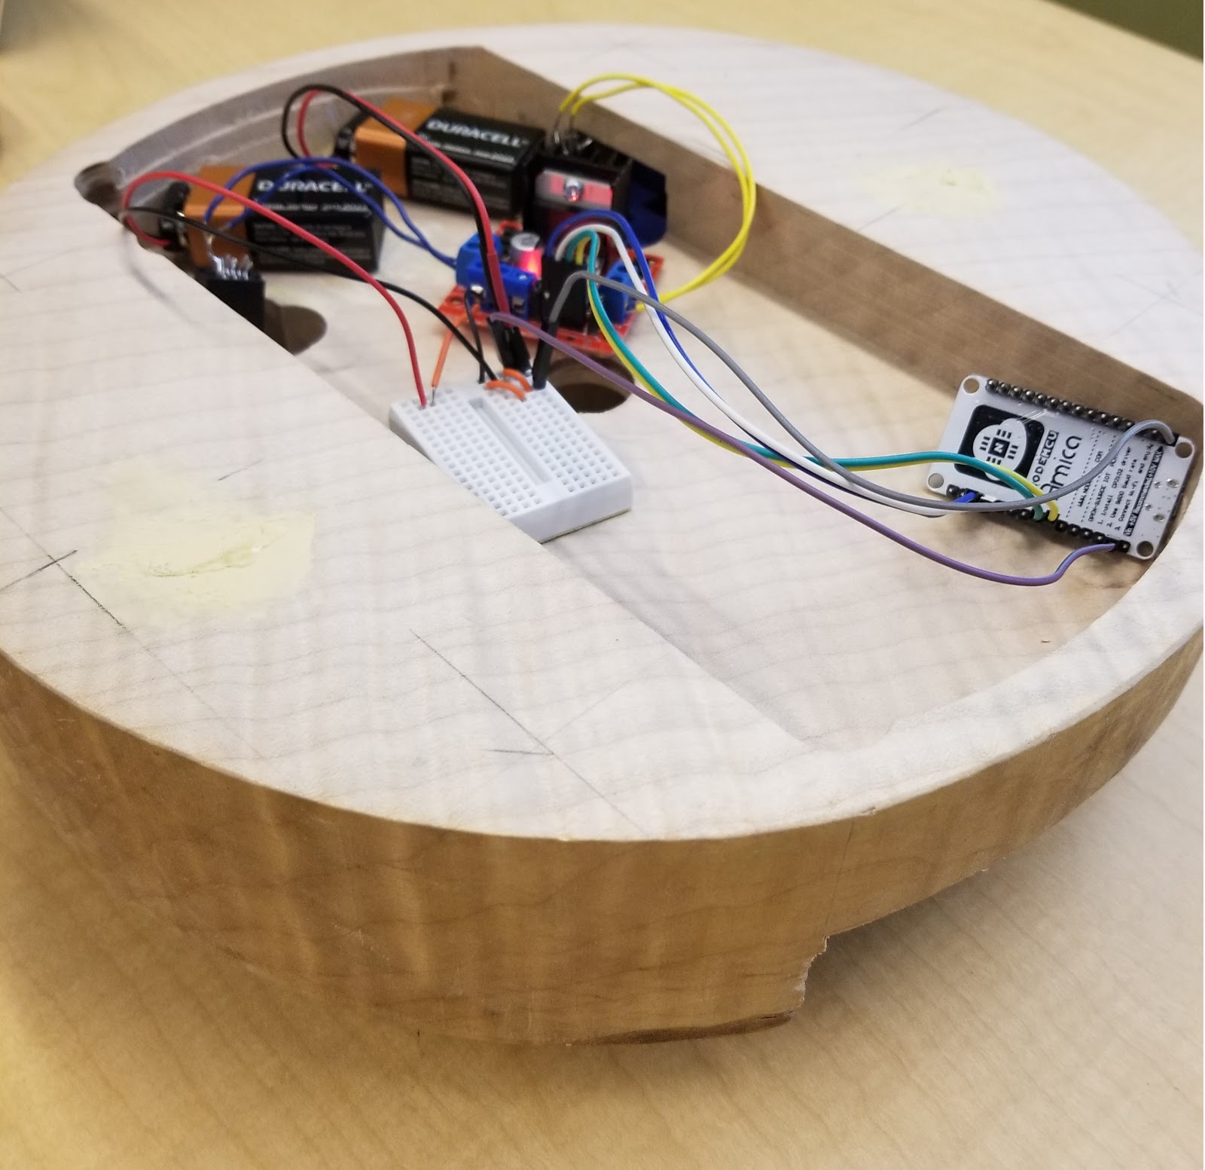
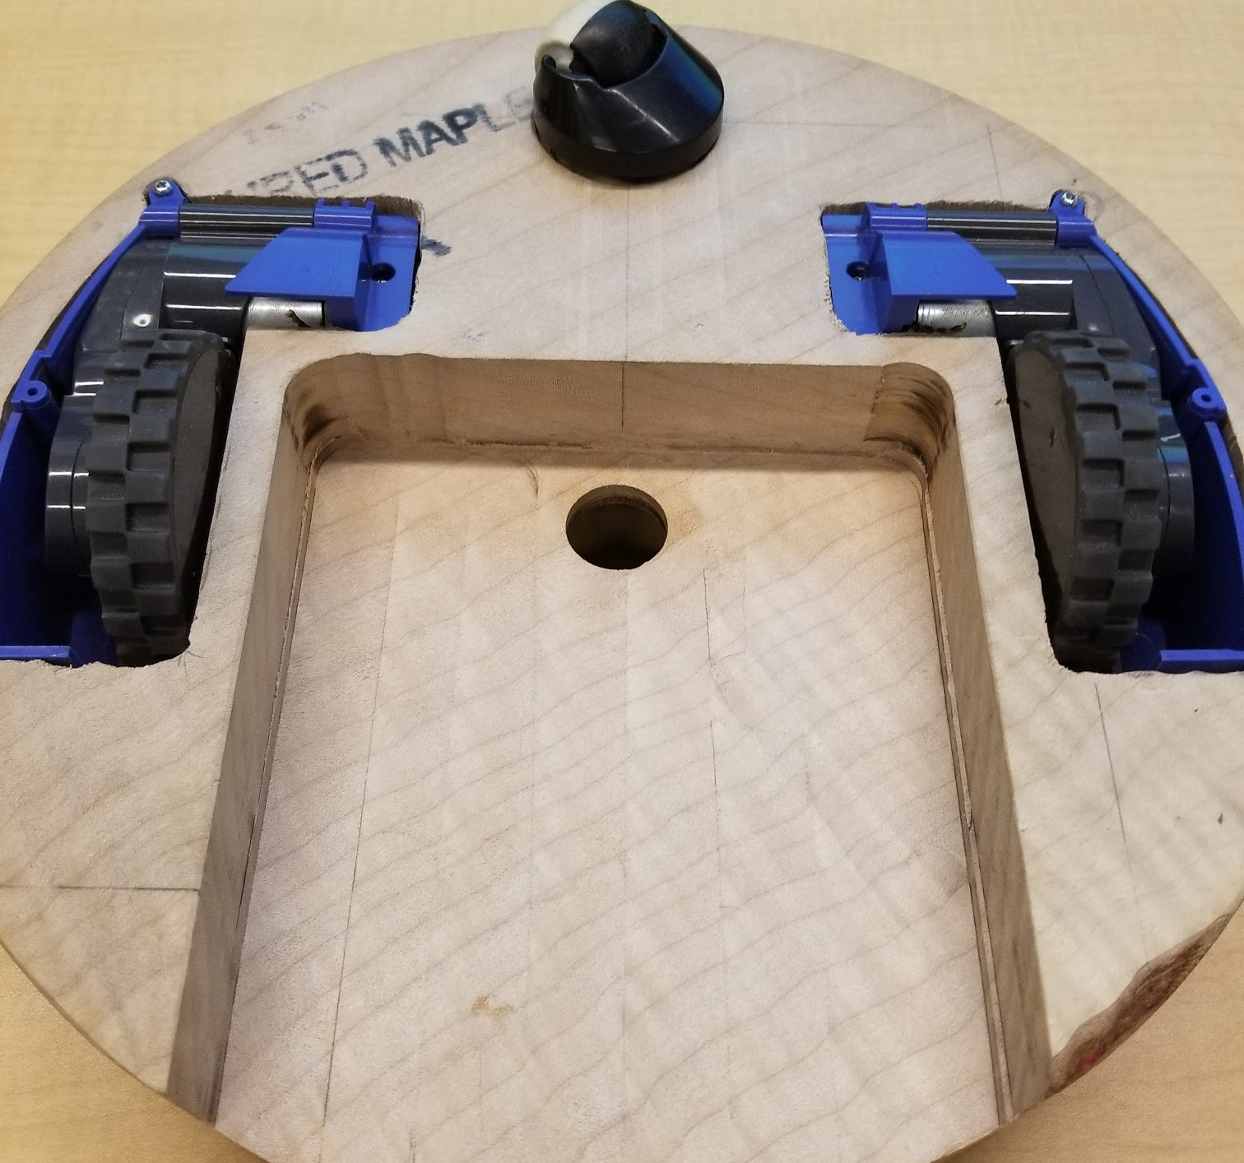
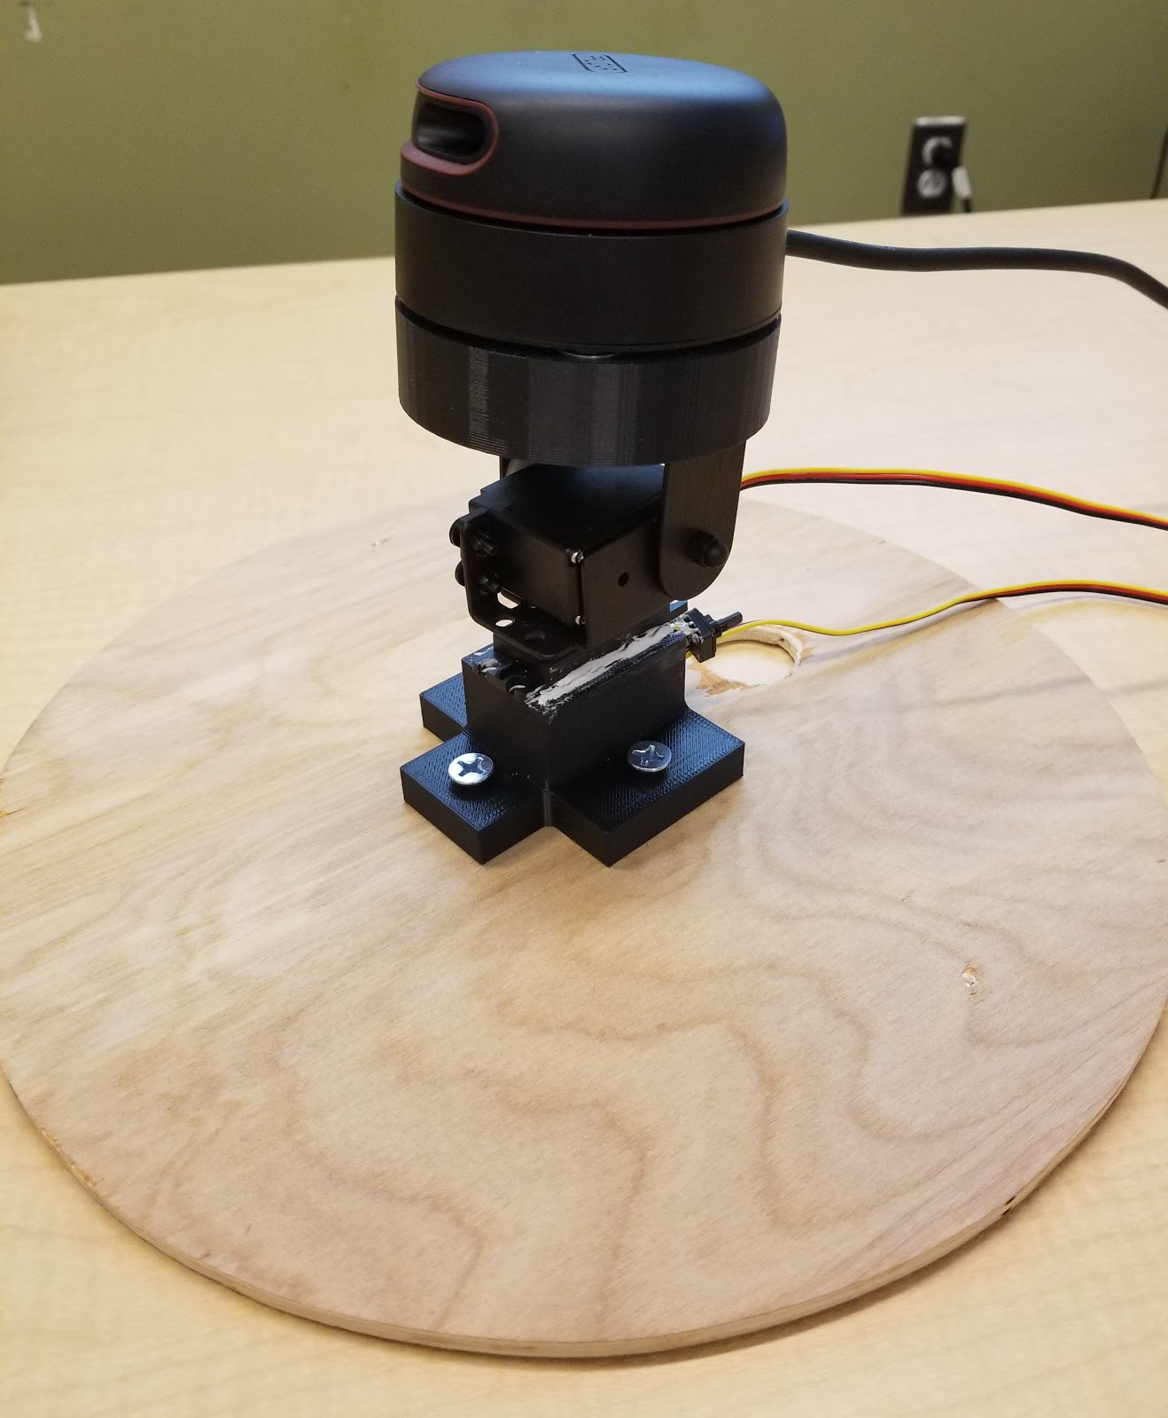
CDR Deliverable (Robot)
Chassis
Contains motors, circuit and battery to navigate Mapper
3D mounts
Servos mount custom-made to house servos motor
LIDAR mount custom-made to house IMU and LIDAR
Lid
Servos system with 3D mounts installed on top
Holds LIDAR in place
Notes:
14
14
14

Slide 15
Block Diagram
Mapper
Power Supply
Powers
Camera
Powers
Internals
Powers
ESP8266 Dev Board
LIDAR System
Wi-Fi module
Microcontroller
Servos
Maestro Controller
IMU
Sensor readings
Controls
Navigation
LIDAR Sensor
Controls
PCB
Motors
Controls
Direction input
Video feed
External Laptop
SLAM Algorithm
Communication Application
Video feed
Display
Layout view
Sensor data
Sensor data
Layout view
Video feed

Slide 16
CDR Deliverable (Wi-Fi Connectivity)
Configure a network
ESP chip, auto connects to the network on startup
Computer connects to the same network
PC Application can then communicate through the network to ESP8266
Able to send robot movement controls through PC application to ESP8266
Accepts WASD keyboard input
W = Forwards
A = Rotate left
S = Backwards
D = Rotate right
Notes:
16
16
16

Slide 17
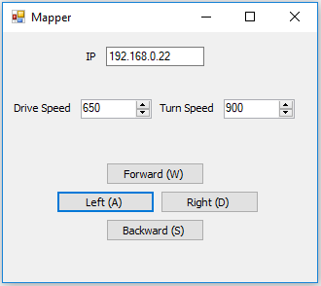
CDR Deliverable (Wi-Fi Connectivity)
On startup the ESP8266 searches for the network pre configured within the RC_Mapper file and establishes a connection
PC client sends UDP messages to the IP defined in the UI through port 4320
Robot movement speeds can be changed using the drive and turn speed parameters
Notes:
17
17
17

Slide 18
CDR Deliverable (Wi-Fi Connectivity)
Wi-Fi connectivity between robot and PC
Able to send navigation input to robot through Wi-Fi
Next steps:
Send LIDAR and IMU data through ESP8266 development board to PC
Transition from Arduino libraries to C
Notes:
18
18
18

Slide 19
Block Diagram
Mapper
Power Supply
Powers
Camera
Powers
Internals
Powers
ESP8266 Dev Board
LIDAR System
Wi-Fi module
Microcontroller
Servos
Maestro Controller
IMU
Sensor readings
Controls
Navigation
LIDAR Sensor
Controls
PCB
Motors
Controls
Direction input
Video feed
External Laptop
SLAM Algorithm
Communication Application
Video feed
Display
Layout view
Sensor data
Sensor data
Layout view
Video feed

Slide 20
CDR Deliverable (3D SLAM)
RPLIDAR A2 → rplidar ROS package
read RPLIDAR raw scan result using RPLIDAR's SDK
convert to ROS /scan messages
record /scan messages to a rosbag
SparkFun 9DoF Razor IMU → razor_imu_9dof ROS package
read IMU sensor data
convert to ROS /imu messages
record /imu messages to a rosbag
Notes:
20
20
20

Slide 21
CDR Deliverable (3D SLAM)
ROS /scan and /imu messages → Google Cartographer node
node processes data with Cartographer SLAM algorithm
scan matching and IMU data to generate local submaps
local submaps merged to global map
2D SLAM while gathering points in all directions for 3D map
Output
Rviz
Live point cloud
Local and global map
Meshlab
Full point cloud
Generated mesh
Notes:
21
21
21

Slide 22
CDR Deliverable (3D SLAM)
Open Source
Cartographer libraries
ROS packages/nodes
RPLIDAR A2 SDK
Our contributions
LIDAR ROS integration
IMU calibration and ROS integration
LIDAR and IMU compatibility with ROS Cartographer package
ROS configurations
Notes:
22
22
22

Slide 23
Demo
Notes:
23
23
23

Slide 24
What we plan to bring to FPR
Mapper completed
Wireless maneuverability of robot
User controls sent through Wi-Fi to Mapper
LIDAR and IMU sensor data relayed back to PC
Camera feed sent back to PC
3D SLAM
2D map generated and viewable in Rviz
Point cloud viewable in Meshlab
Mesh generated from point cloud
Component integration
Functional PCB integrated into Mapper
All hardware and circuitry fits neatly in Mapper
Notes:
24
24
24

Slide 25
What we plan to bring to Demo Day
Completed Mapper on display
Video that shows Mapper fabricating 3D model of a room
Perspective of robot
Current map that is being created
Marker that shows where the robot is relative to the room
Notes:
25
25
25

Slide 26
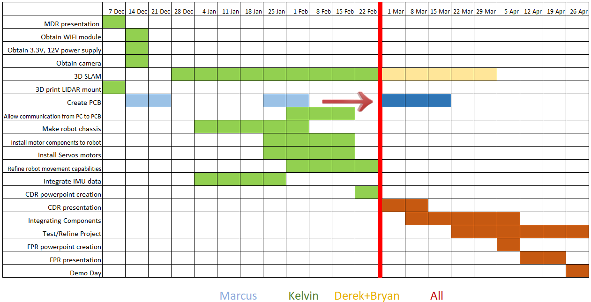
Schedule
Notes:
26
26
26

Slide 27
Questions?
Notes:
27
27
27

